Slide 1
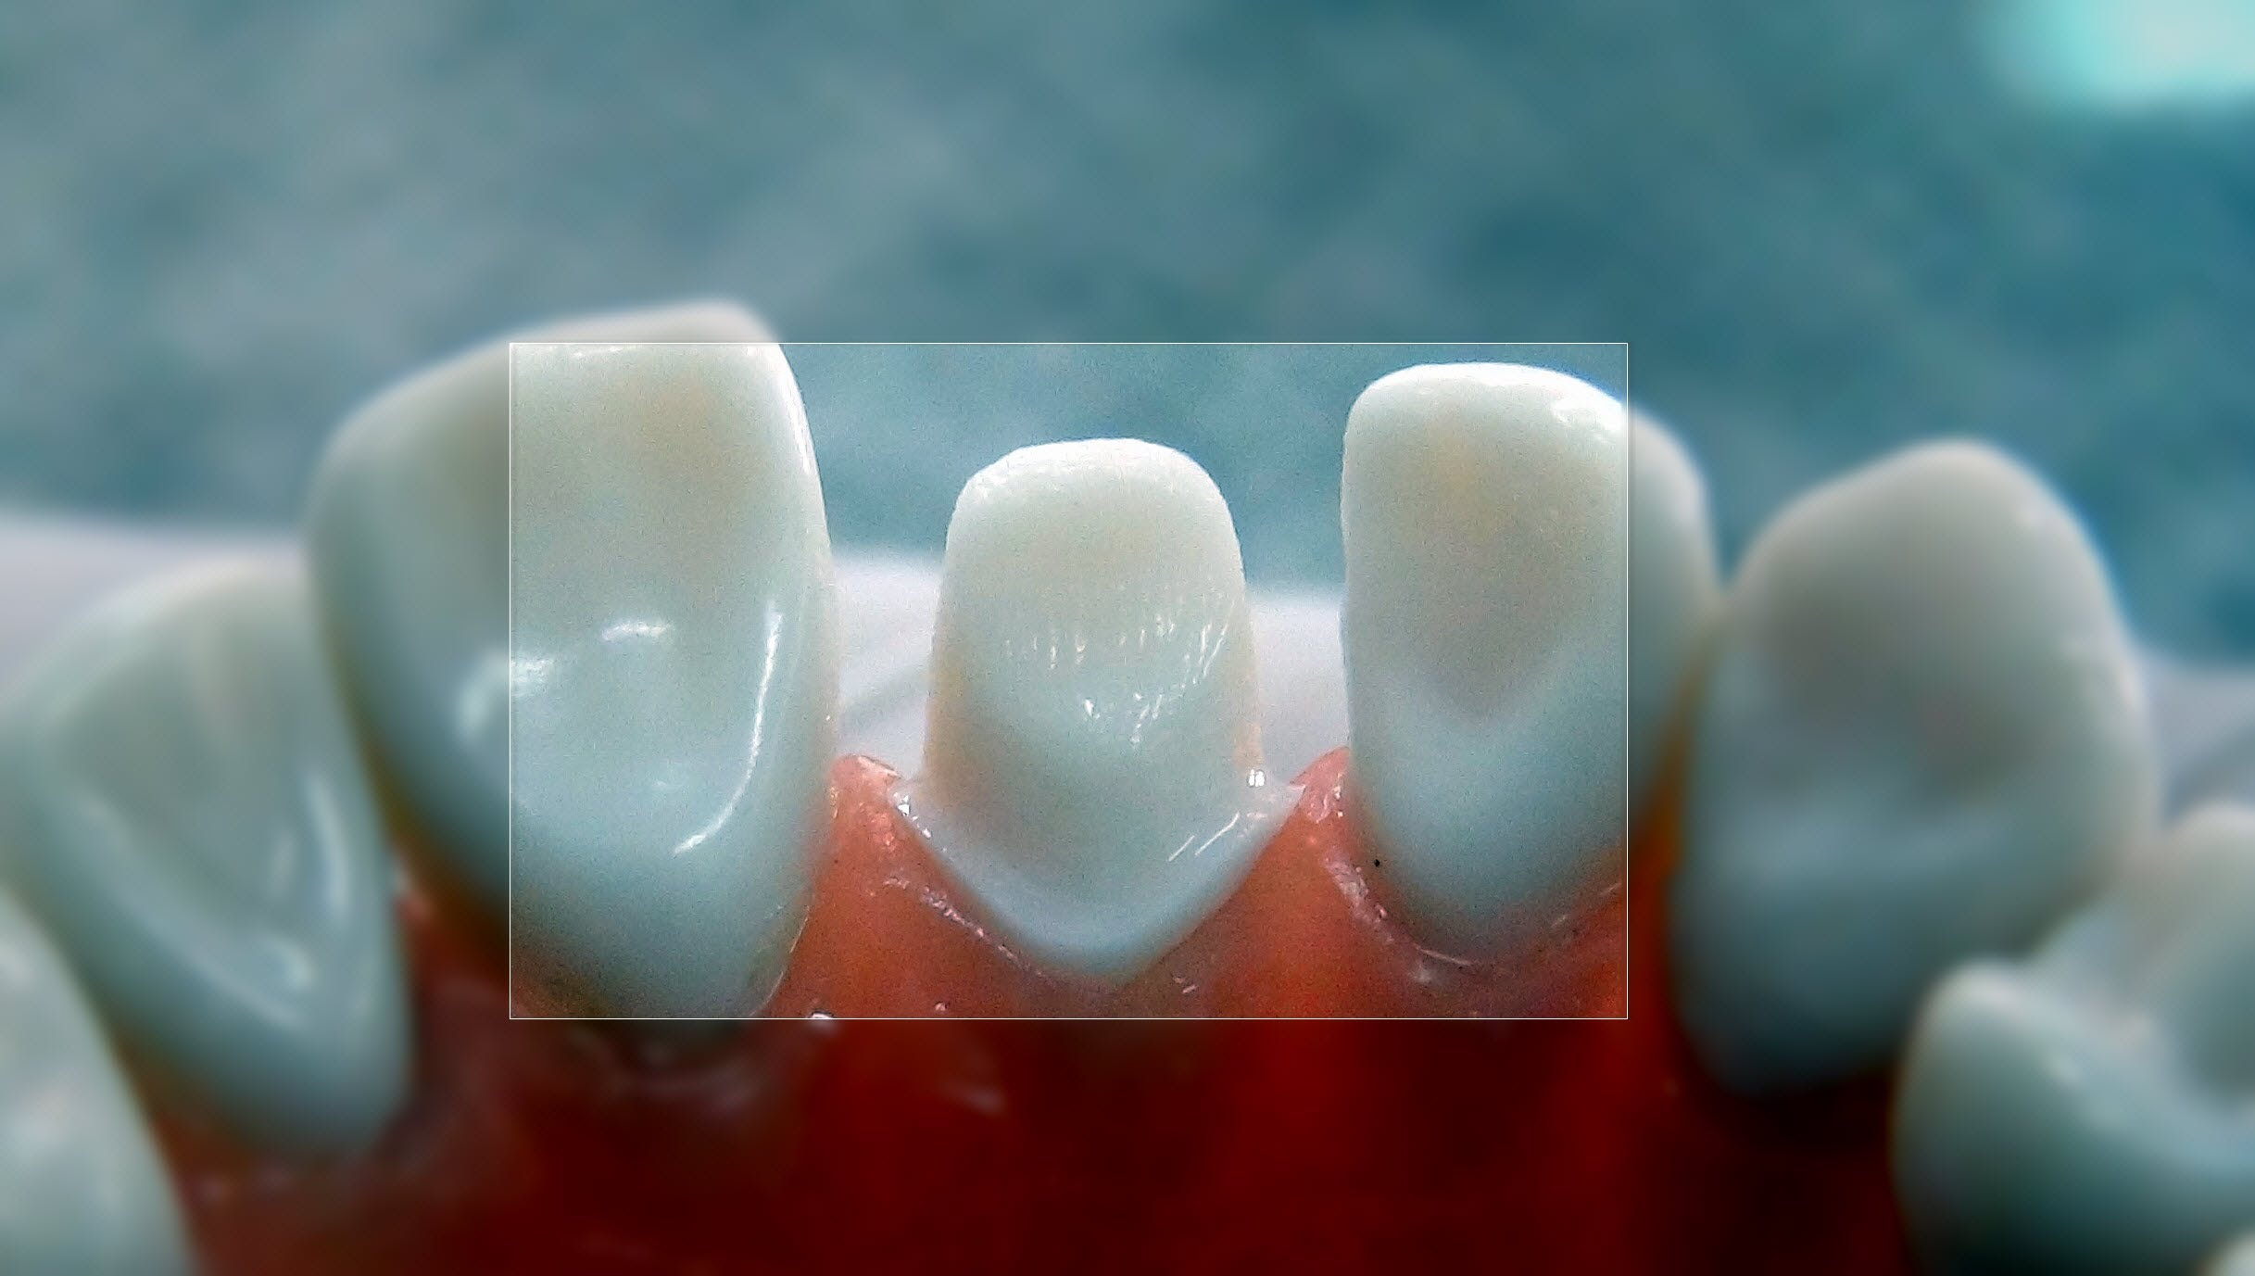

Mechanical Principles of Tooth Preparation - Retention form

Slide 2
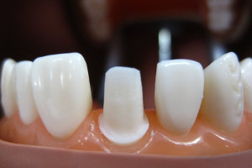
Principles of Tooth Preparation
Biologic Consideration
Mechanical Consideration
Esthetic Consideration

Slide 3

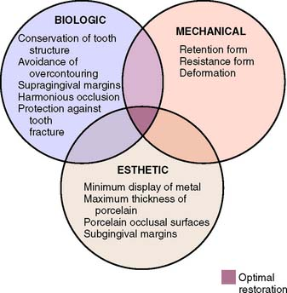
Principles of Tooth Preparation

Slide 4
Learning Objectives:
Definition of retention form
Factors affecting Retention form

Slide 5


Mechanical Consideration
Effects integrity and durability of the restoration
Providing retention form
Providing resistance form
Preventing deformation of the restoration

Slide 6
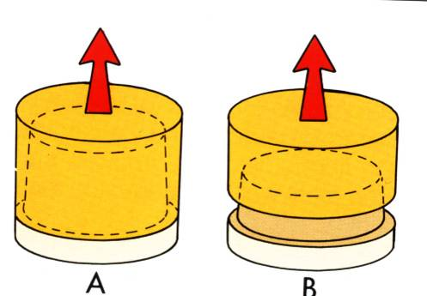
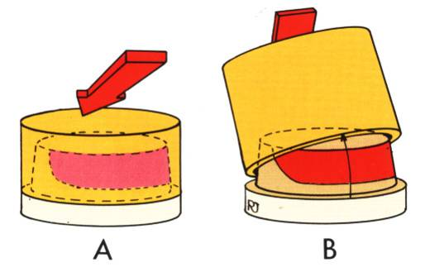
Retention & Resistance form
Retention prevents removal of the restoration along the path of insertion or long axis of the tooth preparation.
Resistance prevents dislodgment of the restoration by forces directed in an apical or oblique direction and prevents any movement of the restoration under occlusal forces.
Notes:
Resistance-Prevents rotation of casting about a fixed point

Slide 7
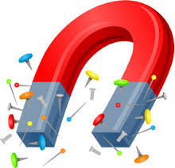

What is retention ???
The quality of a preparation that prevents the restoration from becoming dislodged by such forces parallel to the path of withdrawal is known as retention.

Slide 8
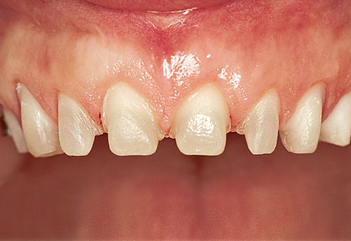
Retention Form
  Dislodging forces
  Geometry of the tooth preparation
  Roughness of the fitting surface of the restoration
  Materials being cemented
  Luting agent being used

Slide 9
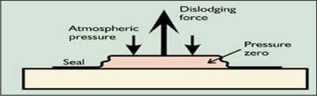
Magnitude of the dislodging forces
Forces that tend to remove a cemented restoration along its path of withdrawal
FPD subject to dislodging forces-
  Flossing under the connectors
  Sticky food

Slide 10
  Geometry of the tooth preparation
Restrained movement (eg. Nut and bolt )
Sliding pair – two cylindrical surfaces constrained to slide along one another

Slide 11
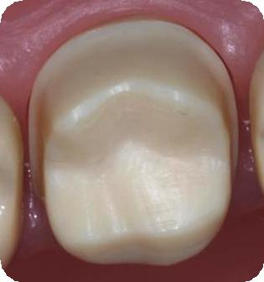
Geometry of the tooth preparation
Taper / Total Occlusal Convergence (TOC)
Substitution of internal features
Path of insertion
Freedom of displacement
Length and Surface area
Stress concentration
Type of preparation

Slide 12
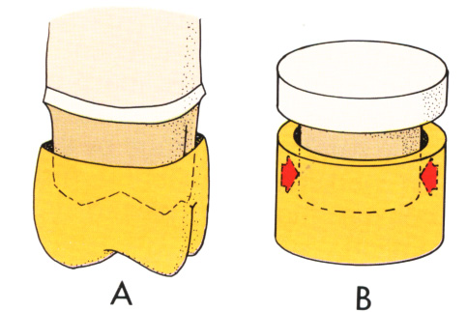
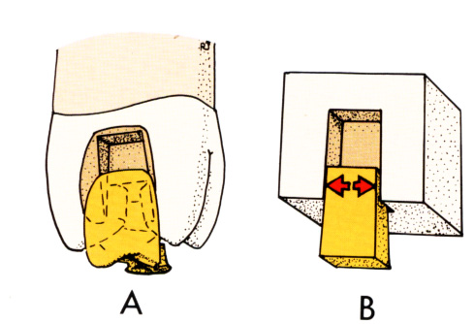
  Taper
Inclination - relationship of one wall of
a preparation to the long axis of that preparation
Tapered diamond bur: 2-3° inclination
Opposing surfaces with 3° inclination= 6° taper
External walls (converge)
Internal walls (diverge)

Slide 13

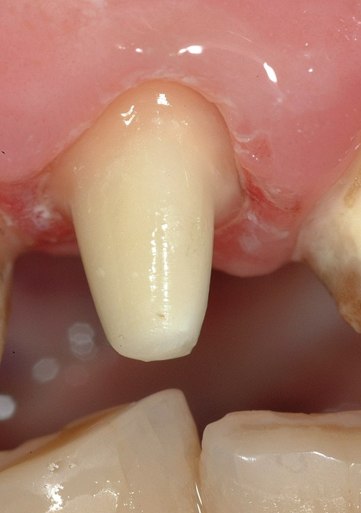
Taper
Less taper more retention
More taper less retention

Slide 14
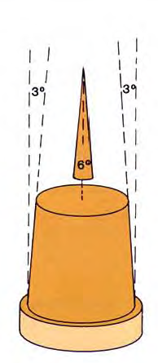
Parallel walls – maximum retention
Taper
  visualize preparation walls
  prevent undercuts
  permit more nearly complete seating of restorations during cementation
Ideal taper: 6°

Slide 15
Title | source | Materials and Method | result | conclusion | Level of Evidence
The taper of clinical preparations for fixed prosthodontics | J Prosth Dent August 1988 Vol 60 No 2 Pg no 148-151 | A total of 88 working dies including full-coverage preparations by eight general practice residents (GPRs) and 120 dies by two prosthodontists (specializing in fixed prosthodontics) were included. The dies were sorted into maxillary and mandibular groups and further divided into anterior, premolar, and molar categories. It was noted whether the preparations were for single crowns or fixed partial denture retainers. | The mean convergence angles of the two groups of investigators’ preparations show no statistically significant difference (19.6 degrees and 20.1 degrees; p > .37) | The ideal convergence angle of 4 to 10 degrees is seldom achieved in clinical practice. 2. Mean convergence angles for mandibular preparations were greater than mean maxillary convergence angles. 3. Premolar convergence angles tended to be smaller than anterior convergence angles. Both were smaller than molar convergence angles. | Level 2

Slide 16
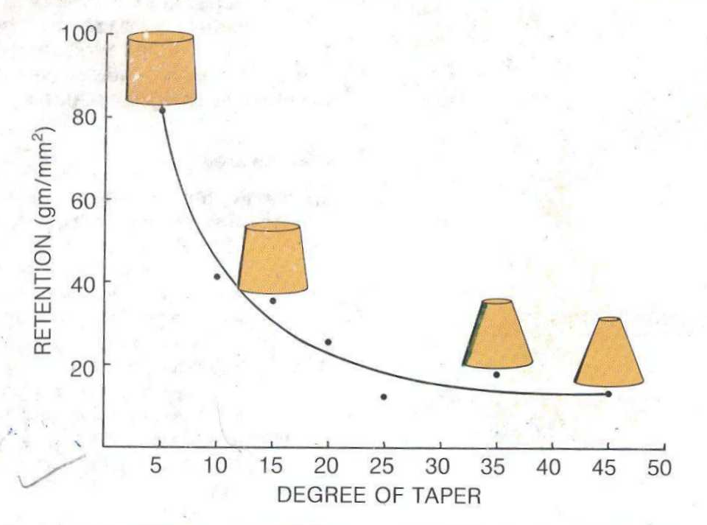
RETENTION DECREASES WITH
INCREASE IN TAPER
Jorgenson KD. The relationship between retention and convergence angle in cemented veneer crowns. Acta Odontol Scand 1955 Feb;59(2):94-8.

Slide 17
TAPER
Parallel walls were advocated for inlay restorations
3 to 5 degrees
6 degrees
10 to 14 degrees
Conzett; Dent Cosmos 1910
Dykema
Shillingberg; Wilson, J Prosthod 1994
Tylman
Contd….

Slide 18
Surface area
More the surface area covered more the retention
Long axial walls are more retentive than short walls
Provided the restoration has a limited path of withdrawal, its retention is dependent on the length of this path or more precisely on the surface area in sliding contact.
Crowns with long axial walls are more retentive than those with short axial walls.

Slide 19
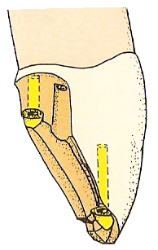
Features such as grooves & boxes that are placed in the preparation increase the surface area thereby increasing retention
GROOVES & PIN HOLES FOR RETENTION
Contd….

Slide 20
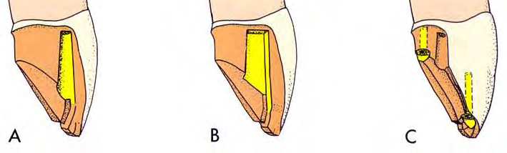
  Substitution of internal features
Basic unit of retention-opposing walls with minimal taper
Opposing walls not available for use-
  Destroyed previously (severe attrition)
  Partial veneer restorations
  Greater than desirable inclination
    Groove Box Pinhole

Slide 21
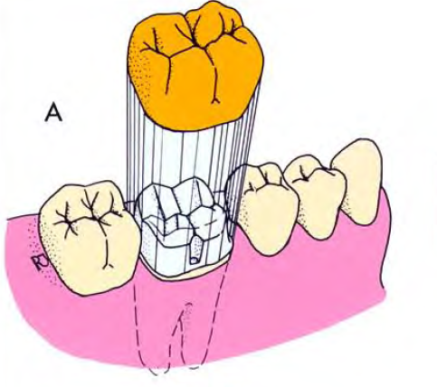
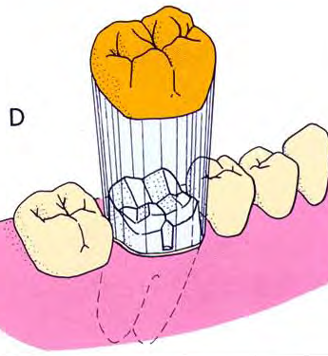
  Path of insertion
Imaginary line along which the restoration will be placed onto and removed from the preparation
Paths of all FPD abutments must parallel each other
Notes:
Determined before the preparation.
Tipped tooth- perpen to the occlusal plane

Slide 22
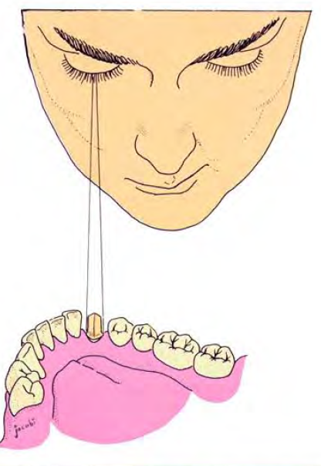
Visual survey - ensures preparation is neither having undercut or over tapered
Center of the occlusal surface of the preparation is viewed with one eye from a distance of 30 cm (12”)
Binocular vision avoided- undercut preparation can appear to have an acceptable taper

Slide 23
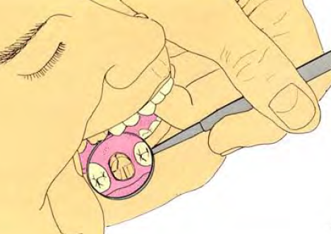
In patient’s mouth – mouth mirror is held at an angle approximately ½ inch above the preparation
Image viewed with one eye

Slide 24
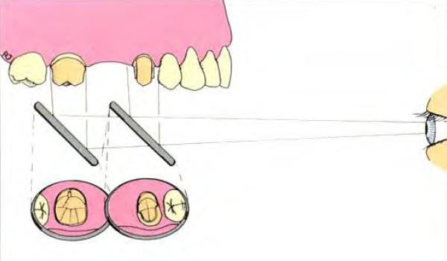
FPD abutments– common path of insertion
Firm finger rest established – mirror maneuvered until one preparation is centered– mirror moved by pivoting on the finger rest without change in angulation till the 2nd preparation is centered

Slide 25
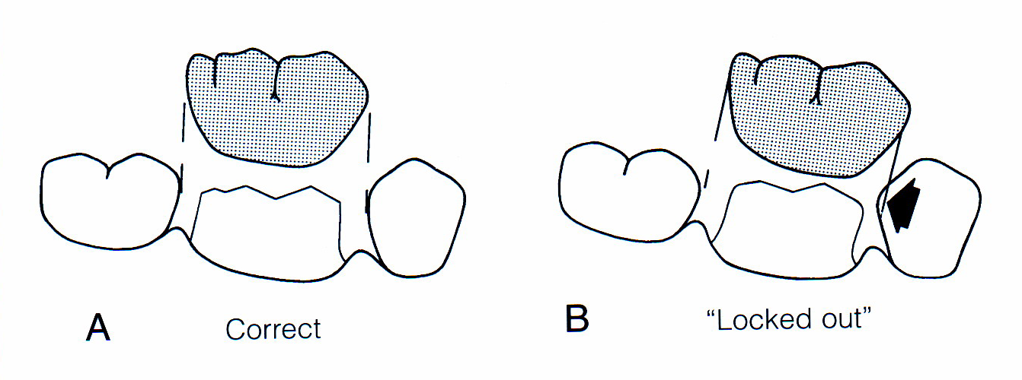
Path of insertion considered in 2 dimensions- mesiodistally and faciolingually.
Mesiodistal inclination - parallel to contact areas of adjacent teeth

Slide 26
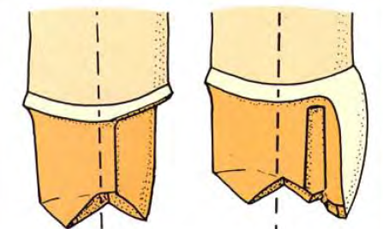
Faciolingual orientation - affects esthetics of metal ceramic and partial veneer crowns
Facially inclined path of insertion
prominent facio-occlusal line angle
overcontouring or opaque show-through
For full veneer crowns
  parallel to long axis of the tooth

Slide 27
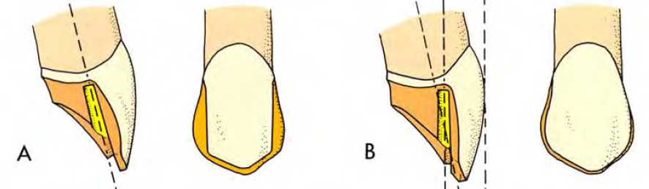
Posterior ¾ crown
  parallel to long axis of the tooth
Anterior ¾ crown
  parallel to incisal ½ of the labial surface

Slide 28
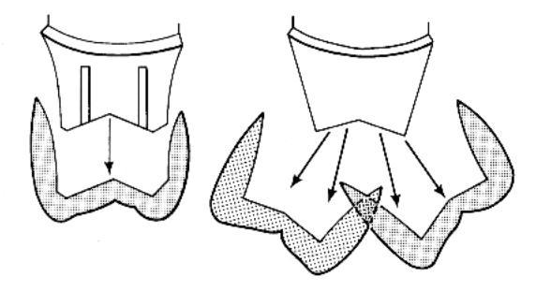
  Freedom of displacement
Numbers of paths along which a restoration can be removed from the tooth preparation
Only one path – maximum retention

Slide 29
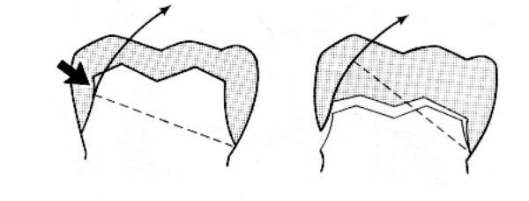
Length and Surface area
Longer preparation – more surface area – more retentive
Length must be great enough to interfere with the arc of the casting pivoting about a point on margin on opposite side of restoration
Short preparations – inclination critical

Slide 30
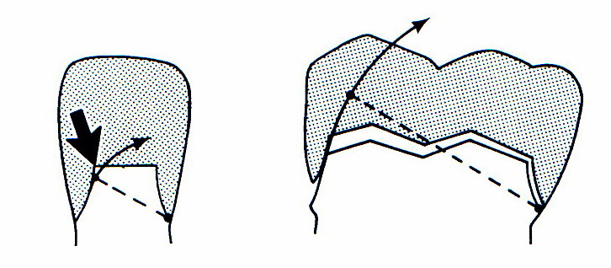
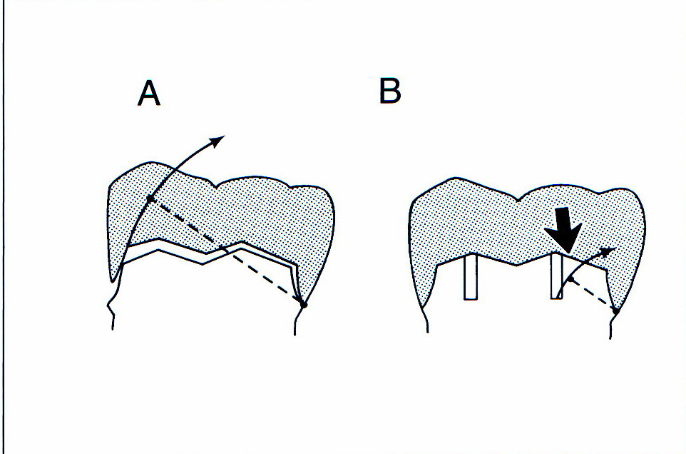
Smaller tooth - short rotation radius
Grooves in the axial walls- reduce the rotation radius

Slide 31
Stress concentrations
Retentive failure occurs - cohesive failure in cement
Stress concentration- around the junction of axial and occlusal surfaces
Rounding the internal line angles

Slide 32
Title | source | Materials and Method | result | conclusion | Level of Evidence
Effect of preparation convergence on retention of multiple unit restorations - An in vitro study | Contemporary Clinical Dentistry. 2015;6(3):409-413. doi:10.4103/0976-237X.161904. | Nickel-chromium alloy single crowns as well as three, six and nine multiple unit fixed partial dentures (FPDs) were casted for standardized milled dies that simulate canine, premolar and molar teeth machined with two different degrees of convergence, 12 (n = 55) and 20 (n = 55). The dies were threaded on rectangular metal platforms with the help of retainer shaft in the proper position to model either single or multiple preparations. The casted crowns and FPDs were cemented and retention tested by securing the units in an Instron universal testing machine. The tabulated values were analyzed statistically using Mann–Whitney test. | Single and multiple units with 12° CA needed greater force to dislodge compared to 20°, but this difference was not statistically significant for single units of premolar (P > 0.05). Irrespective of the angle, there was a simultaneous statistically significant increase in retention as the number of units increased in FPDs, except for the difference between 3 and 6 units in 20° group (P > 0.05). | This study highlights the importance of emphasizing on CA, during canine and molar preparation for single units as well as preparation of canines for 6 units FPDs. | Level 5

Slide 33
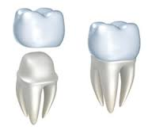
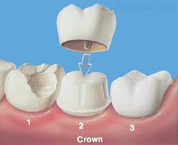
  Type of preparation
Complete crown> partial coverage crowns
Adding groove/ boxes increases retention

Slide 34
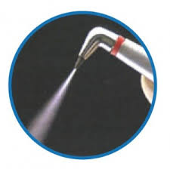
Roughness of the surfaces being cemented
When the internal surface of a restoration is very smooth, retentive failure occurs not through the cement but rather at the cement restoration interface.
Air abrading has been shown to increase the retention of the castings by 64%.

Slide 35

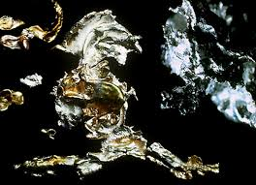
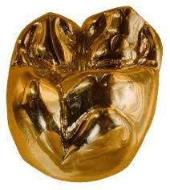
Material being cemented
More retentive the alloy, the more adhesion there will be with the luting agents. Therefore the base metal alloys i.e. nickel, cobalt and chromium are more retentive and better retained than less reactive high gold content metals.

Slide 36

Type of the luting agent
Cement is effective only if the restoration has a single path of withdrawal.
In general adhesive resin cement are the most retentive cement.
Adhesive resin → GIC → Zinc phosphate or poly carboxylate → ZnOE

Slide 37
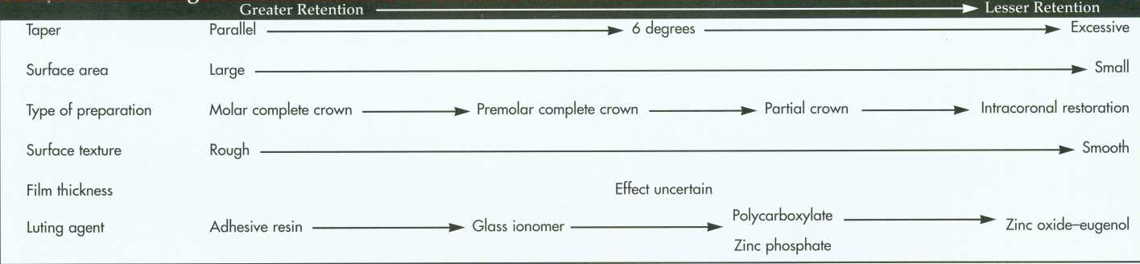
  Factors influencing retention of cemented restorations

Slide 38
Title | JOURNAL & author | Material and method | Result ad conclusion | Level of evidence
Effect of Preparation Taper, Height and Marginal Design Under Varying Occlusal Loading Conditions on Cement Lute Stress: A Three Dimensional Finite Element Analysis | Siddhi Tripathi et al, J Indian Prosthodont Soc (December 2014) | A 3-D FE model of an upper second premolar and molar was developed from CT scan of human skull using software programmes (MIMICS, Hypermesh and ANSYS). 10 and 30 taper, 3 and 5 mm preparation height and shoulder and chamfer finish lines were used. Type 1 Glass ionomer cement with 24 lm lute width was taken and the model was loaded under 100 N horizontal point load, vertical point load distributed axial load. The maximum shear stress and Von Mises stress within the cement lute were recorded. The maximum shear stresses ranged from 1.70 to 3.93 MPa (horizontal point loading), 0.66 to 3.04 MPa (vertical point loading), 0.38 to 0.87 MPa (distributed loading). The maximum Von Mises stresses ranged from 3.39 to 10.62 MPa (horizontal point loading), 1.93 to 8.58 MPa (vertical point loading) and 1.49 to 3.57 MPa (distributed loading). The combination of 10 taper and 5 mm height had the lowest stress field while the combination of 30 taper and 5 mm height had the highest stress field. | Distributed axial loading shows least stress, better stress homogenization and gives a favorable prognosis for the fixed prostheses. Smaller preparation taper of 10 is biomechanically more acceptable than a 30 taper. It is desirable to decrease taper as height increases. The chamfer margin design is associated with greater local cement stresses toward the margins that could place the cement at greater risk for microfracture and failure. | 3a

Slide 39
Title | JOURNAL & author | Material and method | Result | conclusion | Level of evidence
Marginal Fit of Metal‐Ceramic Copings: Effect of Luting Cements and Tooth Preparation Design | Journal of Prosthodontics 28 (2019) | Schematic dies and their respective copings were cast in NiCr alloy. The dies exhibited the following finish line/convergence angle combinations: sloping shoulder/6°, sloping shoulder/20°, shoulder/6°, shoulder/20°. Marginal fit was evaluated under a stereomicroscope, before and after cementation. Copings were air-abraded with 50 μm Al2 O3 particles and cemented with Cimento de Zinco, RelyX U100, or Panavia F cements (n = 10/group). Data were square-root transformed and analyzed by 3-way factorial random effect model and Tukey’s post hoc test (α = 0.05). | Statistical analysis showed significance for the interactions finish line and convergence angle (p < 0.05), convergence angle and time (p < 0.001), and luting cement and time (p < 0.001). Sloping shoulder/20° provided the highest marginal discrepancy when compared to the other finish line/convergence angle combinations, which were statistically similar among each other. For both convergence angles and for all luting cements, the marginal discrepancy was significantly higher after cementation. Before and after cementation, 6° provided better marginal fit than 20°. After cementation, Panavia F provided higher marginal discrepancy than Cimento de Zinco. | Lower convergence angle combined with shoulder and a lowconsistency luting cement is preferable to cement metal copings. | 3a

Slide 40


