Slide 1
Burkitt’s lymphoma
- Dr. Shreedevi B. Patel

Slide 2
Clinical History
a patient presented with abdominal pain and palpable abdominal mass.

Slide 3
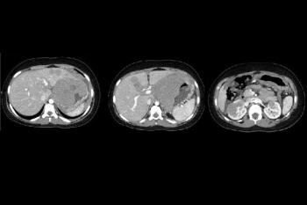
Imaging Findings
Contrast enhanced CT (arterial phase) shows the abdominal mass. It demonstrates multiple hypoattenuating areas in the liver and kidneys.

Slide 4
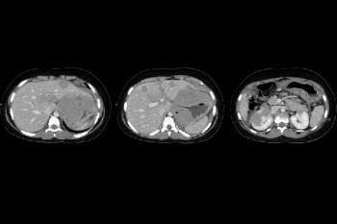
Venous phase of contrast enhanced CT demonstrates lymph node, liver and kidney involvement

Slide 5
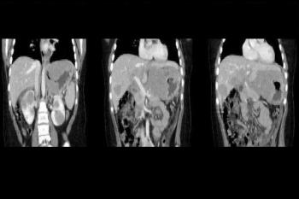
Coronal reconstructions demonstrate an extensive soft tissue mass involving mesenteric and retroperitoneal regions and the involvement of liver and kidneys.

Slide 6
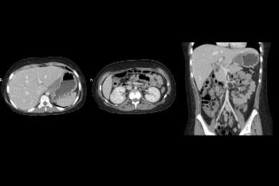
After chemotherapy, CT shows clearly the volumetric reduction of lymph node mass and the disappearance of extra-nodal deposits.

Slide 7
Discussion
Burkitt lymphoma is a Non-Hodgkin lymphoma of B-cell origin and is classified as a poorly
differentiated lymphocytic lymphoma. This tumour predominantly affects children and has one of
the highest cell proliferation rates of any human cancer (doubling time 24-48 h). Burkitt lymphoma
(BL) can be classified in three forms which differ in geographic distribution and Epstein-Barr virus
(EBV) association: endemic, sporadic and HIV associated

Slide 8
THANK YOU

