Slide 1
BLOOD PRESSURE
DR.MAHAVISINGH H.RAJPUT
(M.B.B.S., M.D. Physiology)
Professor
Department of Physiology
S.B.K.S. M.I. & R.C.
Sumandeep Vidyapeeth

Slide 2
Arterial Blood Pressure
Arterial pressure is defined as lateral pressure exerted by contained column of blood on wall of arteries.
The pressure is exerted when blood flow through the arteries.
Expressed in four terms :
  Systolic blood pressure (SBP)
  Diastolic blood pressure (DBP)
  Pulse pressure (PP)
  Mean arterial pressure (MAP)

Slide 3
Terminology
Systolic Blood Pressure (SBP) : is the Maximum Pressure exerted during ventricular systole. It ranges from 100 to 140 mmHg. (Average :120 mmHg). It represents the cardiac output
Diastolic Blood Pressure (DBP) : is the Minimum Pressure during ventricular diastole. It ranges from 60 to 90 mmHg (Average:80 mmHg). It represents the Peripheral Vascular Resistance (PVR).
Pulse Pressure (PP) : is the difference between Systolic and Diastolic Pressure. (PP = SBP - DBP). It ranges from 30 to 50 mmHg Average : 40 mmHg. It represents perfusion.
Mean Arterial Pressure (MAP) : is the average pressure present through out the cardiac cycle.
(MAP = DBP + 1/3 PP) Average 95 mmHg
Note : All cardiovascular reflexes are sensitive to MAP

Slide 4
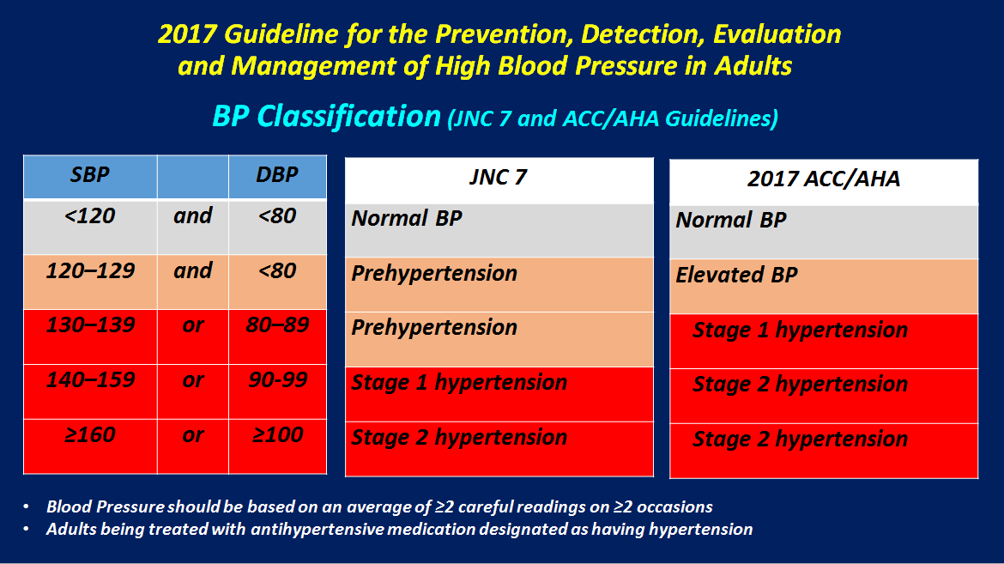

Slide 5
Variation
Blood Pressure is altered in physiological and pathological conditions.
SBP : Easily & Quickly Variable ,in wide range
DBP : Not variable easily & quickly , in narrow range.
Homeostasis : Negative Feedback Mechanism
With in range
  Physiological Variation
  Pathological Variation (Applied Physiology)

Slide 6
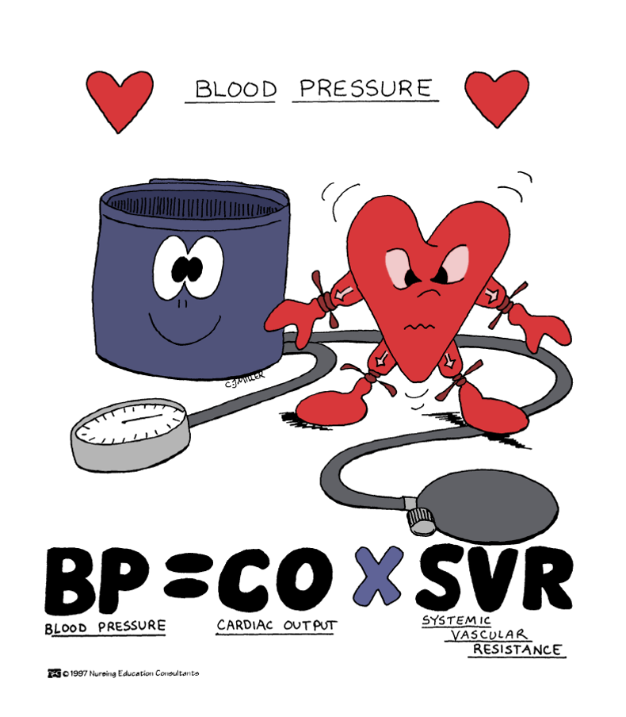

Slide 7
How do our body handle the changes occurring in blood pressure ?
  Orthostatic hypotension
Why Carotid Sinus massage is given in Ventricular tachycardia ?
  Karate neck chop
  Syncope while shaving (SAS)
What prevents us from getting Hypertension or Hypotension?
What is essential hypertension ?
Why Ramipril or Enalapril or Captroril advised in HTN and CHF ?

Slide 8
Learning Objectives
At the end of this lecture you must be able to understand
  Homeostatic mechanism for Blood pressure regulation
  Regulation of blood pressure
    Neural control
    Renal control
  Pathophysiology of HTN & Hypotension

Slide 9
Lecture 4.2 Regulation of Blood Pressure ^{Q}
&
Heart Rate

Slide 10
Regulation of Blood Pressure
Blood pressure is maintained in normal range constantly (MAP ≈ 95 mmHg).
It is subjected to variation during normal physiological condition such as exercise, emotion etc..
Altered blood pressure is quickly brought back to normal by perfectly tuned regulatory system.
Homeostasis by→ Negative Feedback Mechanism
Local Regulation (Autoregulation), when it fails →Systemic Regulation (if it fails then ….)

Slide 11


Homeostasis
Rise above
normal value
Corrective Mechanism
Negative feedback
NEGATIVE FEEDBACK MECHANISM
Normal Value
Normal Value
Negative feedback
Fall below
normal value
Corrective Mechanism

Slide 12
Regulation of Blood Pressure ^{Q}
Short-term or Rapid blood pressure control mechanism : Neural Mechanism
Intermediate-term blood pressure control mechanism : Fluid Shift Mechanism
Long-term blood pressure control mechanism : Renal Mechanism

Slide 13
Altered Blood Pressure
Short term Regulation
Intermediate Term Regulation
Long Term Regulation
Starts: With in Seconds
Starts : With in Minutes
Starts: With in Hours

Slide 14
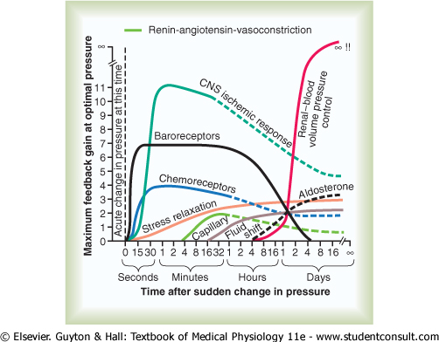

Slide 15
Short Term Regulation ^{Q} : Nervous or Neural Mechanism ^{Q}
Rapid Blood pressure control mechanism
Sino-aortic Mechanism ^{Q}
Activated in Seconds (Fastest mechanism)
Works for few minutes to few hours
Useful in preventing acute decrease or increase in blood pressure

Slide 16
Short Term Regulation ^{Q} : Nervous or Neural Mechanism ^{Q}
Three Mechanism
  Baroreceptor Mechanism (Baroreflex)
  Chemoreceptor Mechanism (Chemoreflex)
  Vaso Motor Center Mechanism (Medullary Ischemic Reflex)

Slide 17
Neural Control Mechanism
Medullary Cardiovascular Control Centers
  Sympathetic Center (VMC)
  Parasympathetic Center
  Relay Center
Autonomic Nervous System supplying Heart & Blood vessels
  Sympathetic supply
  Parasympathetic supply
Afferent impulses from higher centers

Slide 18
Medullary Cardiovascular Control Centers
Medullary Sympathetic Center (VMC)
  Pressure area - RVLM
  Depressor area - CVLM
Medullary Parasympathetic Center
  Nucleus Ambiguus (Cardiac Vagal Center)
Medullary Relay Center
  Nucleus Tractus Solitarius

Slide 19
Sensor
Centre
Effectors Organ

Slide 20
Carotid
Medullary Centers
Heart & Blood Vessels

Slide 21
Vasomotor Center
Medullary Sympathetic Centre
Primary regulatory centre
Consist of group of neurons located reticular substance at floor of fourth Ventricle
Constituted by following different areas
  Pressor area (RVLM)
  Depressor area (CVLM)

Slide 22
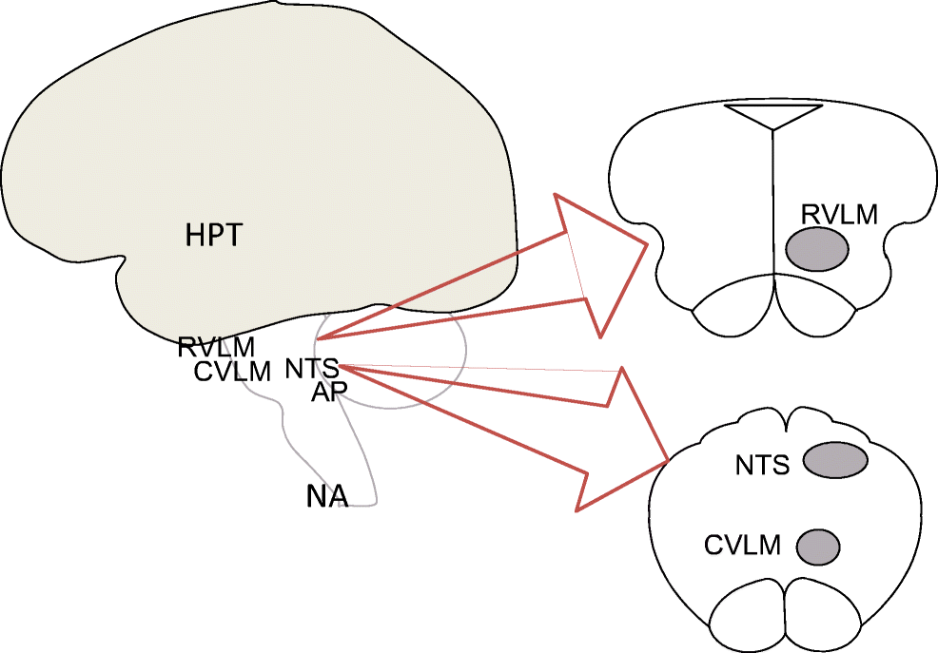

Slide 23
Pressor Area
Rostral Ventrolateral Medulla
Glutaminergic neurons
Excitatory in nature (Cardioacceleratory Centres)
Terminate on thoracolumbar spinal sympathetic neurons
Responsible for continuous Sympathetic tone (1 impulse per second -Vasoconstriction)
Stimulation of Pressor area
  Heart
  Blood Vessels

Slide 24
Medulla Oblongata
RVLM
+
Spinal Cord
IML
Heart
Blood Vessels
Target Organs
+
+

Slide 25
Depressor Area
Caudal Ventrolateral Medulla
GABAergic neurons
Inhibitory in nature
Terminates on RVLM (Pressor area)
Decreases sympathetic activity by feedforward inhibition
Stimulation of Depressor area
  Heart
  Blood Vessels

Slide 26
-
Medulla Oblongata
CVLM
RVLM
+
Spinal Cord
IML
Heart
Blood Vessels
Target Organs
-
-

Slide 27
Medullary Parasympathetic Center
Cardiac Vagal Centre
Earlier also known as Cardiac Inhibitory Centre (CIC)
Now called Nucleus Ambiguus
Laterally in medullary reticular formation
Not tonically active
Afferents from NTS
Efferents forms branches of IX & X CN

Slide 28
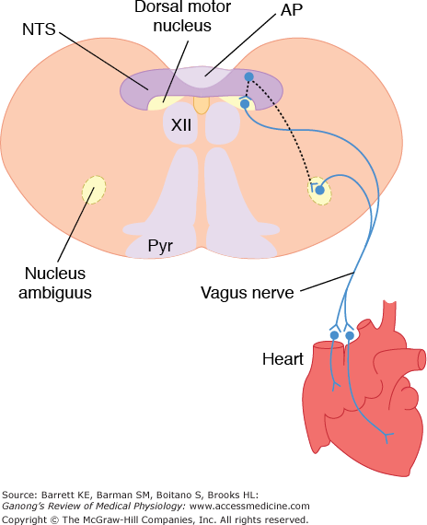

Slide 29
Medullary Relay Center
Nucleus Tractus Solitarius
Afferents from Baroreceptors & Chemoreceptors via IX and X C.N.
Release excitatory Glutamate NTs
Efferent to Cardio- acceleratory Center (CAC) or Cardio-inhibitory Center (CIC)
Control Sympathetic and Parasympathetic output

Slide 30
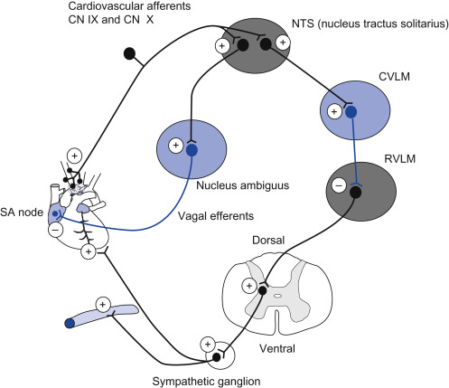

Slide 31
Anatomy
Baroreceptors : (Baro=Pressure) senses Pressure changes :
  Carotid Sinus
  Aortic arch sinus
Chemoreceptor : (Chemo=Chemical) senses Chemical changes:
  Carotid body
  Aortic body

Slide 32
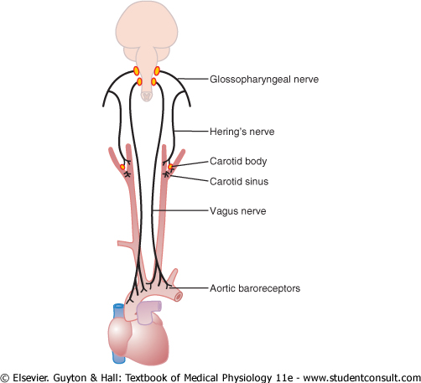

Slide 33
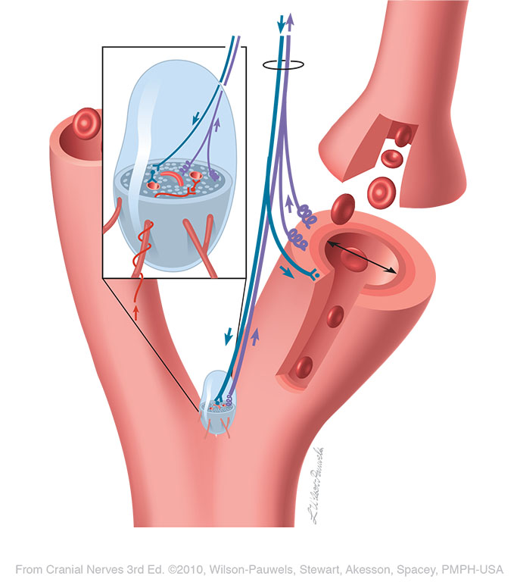
CS
CB

Slide 34
Pathway
Impulse are carried through the baroreceptors
Glossopharyngeal Nerve & Vagus Nerve (Buffer Nerves)
Nucleus of Tractus Solitarius
CVLM & Nucleus Ambiguus

Slide 35
Baroreceptors
Baroreceptors are sensor organ which detects the Pressure changes in Blood Vessels.
Regulates the BP by altering CO and SVR (PR).
Response would be opposite, if BP Falls.

Slide 36
Medullary Cardiac Control Center
Sensory Areas (NTS)
Vasoconstrictor Areas (Cardio-Pressor Area)
Vasodilator Areas (Cardio-Inhibition area)

Slide 37
Effector Organs
Heart
  Autonomic blood supply
    Sympathetic supply
    Parasympathetic supply
Blood Vessels
  Autonomic blood supply
    Sympathetic supply
    Parasympathetic supply

Slide 38
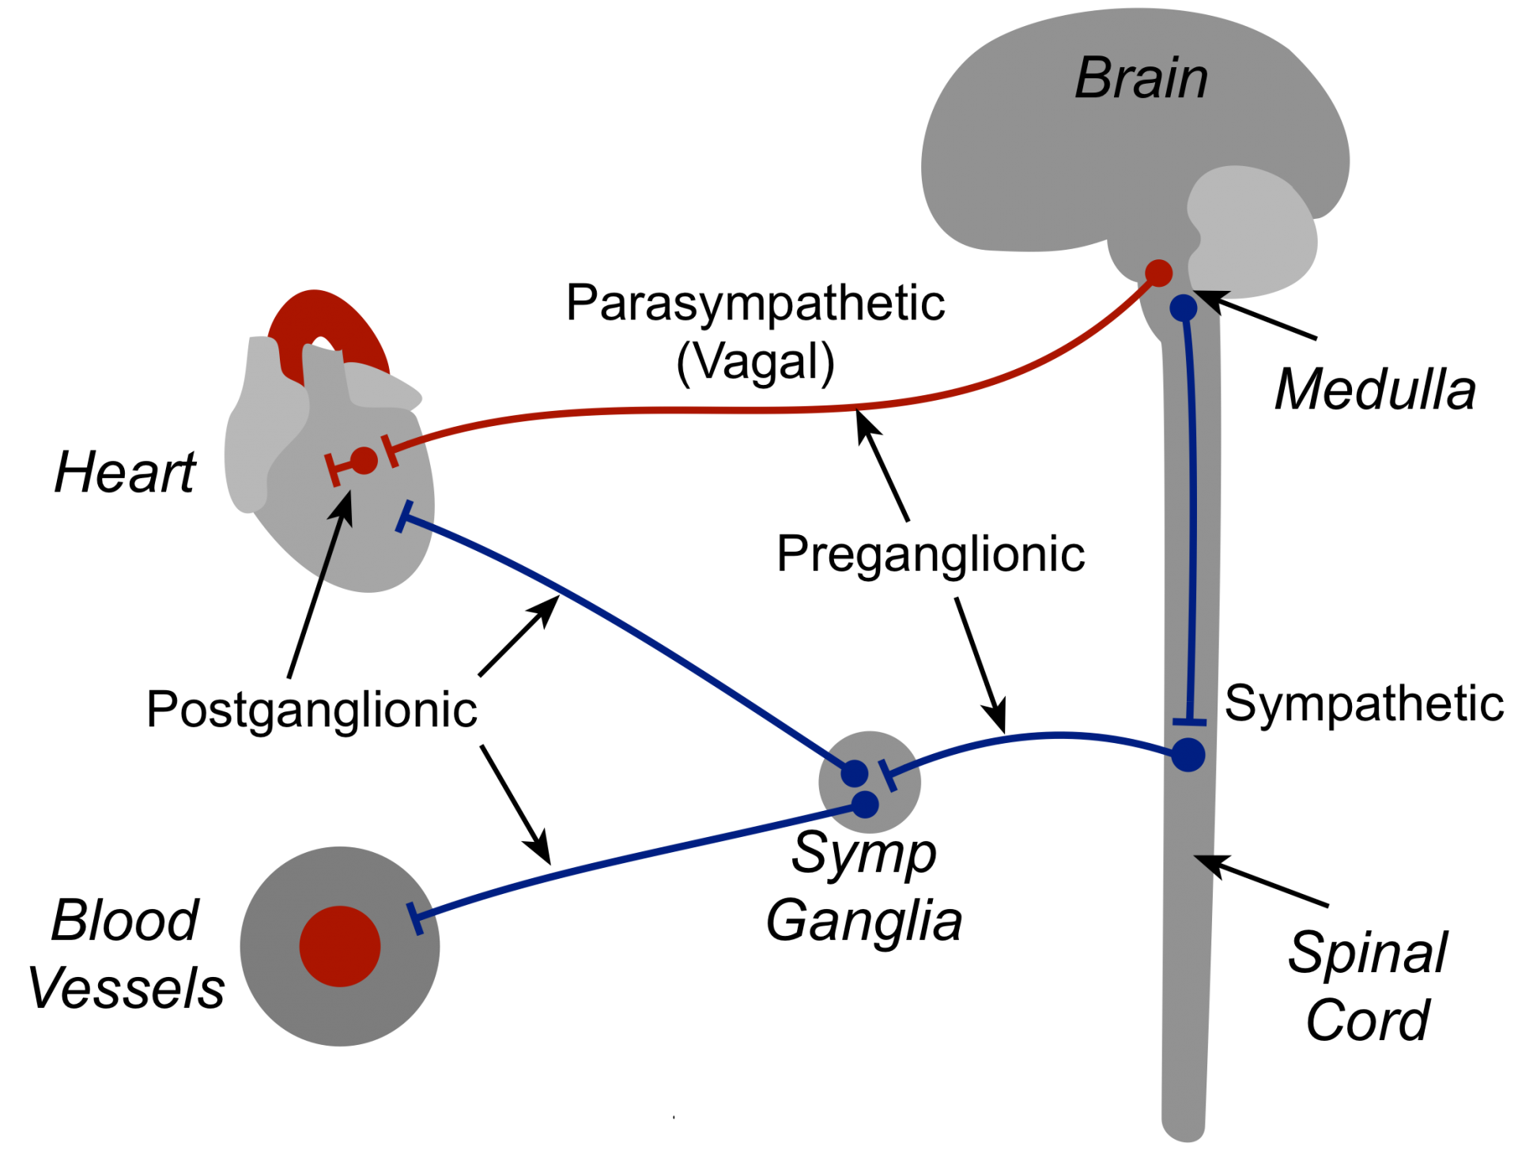

Slide 39
Baroreceptor Mechanism
1
↑ in Arterial Blood Pressure
2
Stimulation of Baroreceptors → NTS
3
Inhibition of VMC & Stimulation of Vagal N.
4
↓ HR & ↓ PR (Vasodilatation)
5
↓ Arterial Blood Pressure

Slide 40
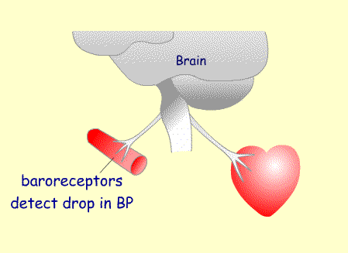
A fall in BP triggers an increase in cardiac output

Slide 41
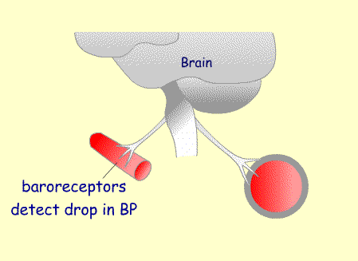
A fall in BP triggers vasoconstriction

Slide 42
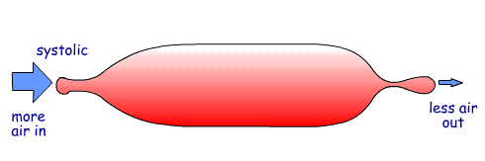
Put another way
If your balloon was losing pressure, there are two actions you can take…
1. put more puff into the balloon (Increase CO)
2. let less air out of the balloon by pinching the end (Increase SVR)

Slide 43
Chemoreceptor Reflex
Chemosensitive cells respond to
  Decreased PO₂
  Increased PCO₂
  Decreased pH
Located
  Carotid Body at bifurcation of common carotid artery → IX CN
  Aortic Body at arch of aorta → X CN

Slide 45
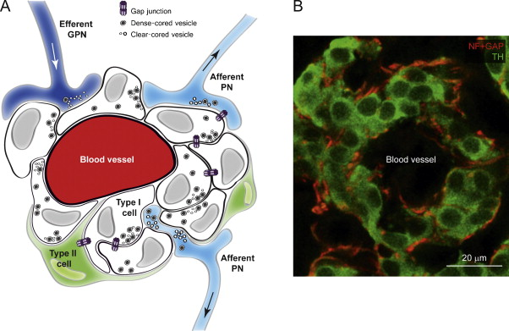
Carotid Body

Slide 46
Chemoreceptor Mechanism
1
2
3
4
5
6
Reduced blood flow to Chemoreceptors
Hypoxia & Hypercapnia at Chemoreceptors
Stimulation of Chemoreceptors → NTS
Stimulation of VMC & Inhibition of Vagal N.
↑ HR & ↑ PR (Vasoconstriction)
↓ Arterial Blood Pressure
7
↑ Arterial Blood Pressure

Slide 47
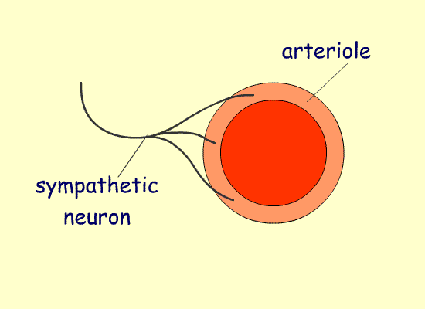
Vasoconstriction

Slide 48
Vasomotor Centre Mechanism
1
2
3
4
5
Ischemia of VMC
Stimulation of VMC
↑ Discharges from VMC
↑ HR & ↑ PR (Vasoconstriction)
↑ Arterial Blood Pressure
Most powerful Response
CNS Ischemic Response

Slide 49
CUSHING’S REFLEX
An Increase in intracranial Pressure decreases blood flow to VMC.
Hypoxia & Hypercapnia at the VMC increase the discharge from it → this enhances BP.
Increased BP overcomes raised intracranial pressure.
Thus, blood flow to the intracranial structure is restored.
Increase in systemic BP reduces the heart rate acting through baroreceptor. (Marey’s Law)

Slide 50
Intermediate Term Regulation
Stress Relaxation : ↑ BP → increase stress → initial vasoconstriction → vasodilatation
Reverse stress relaxation mechanism :↓ BP → decrease stress → vasoconstriction
Fluid Shift Mechanism : increase in hydrostatic pressure
Renin Angiotensin System(RAS): JGA

Slide 51
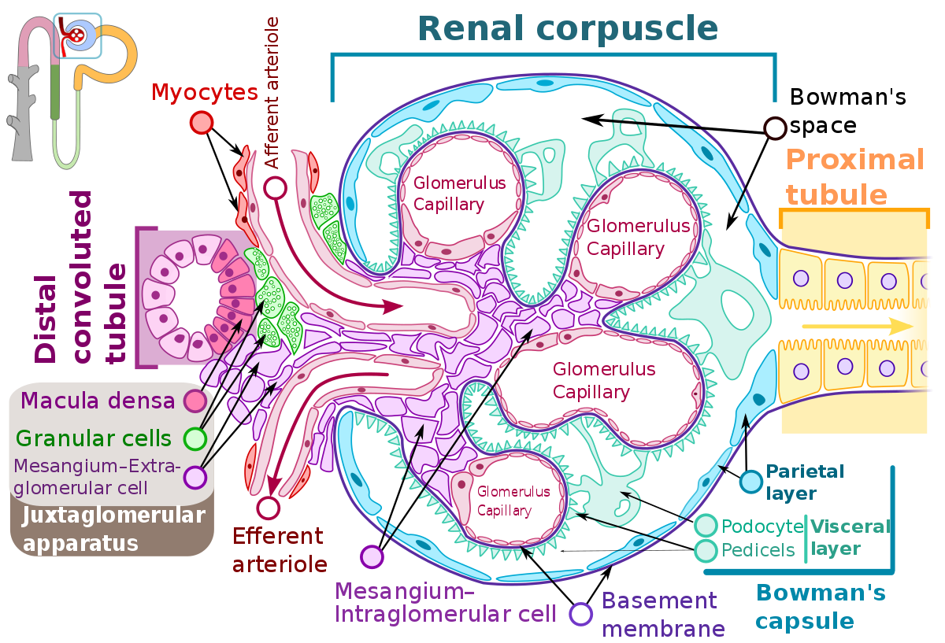

Slide 52
Intermediate regulation of BP (RAS)
1
2
3
4
5
6
7
↓ Arterial BP
↓ Blood Flow to Kidney
Release of Renin from Kidney
Renin acts on Angiotensinogen
Angiotensin I (in Liver)
Angiotensin II (in Lung)
Vasoconstriction (↑ PR)

Slide 53
Renin
Angiotensionogen
ACE
Angiotensin - I
Angiotensin-II
ADH Aldosterone

Slide 54
Long term Regulation of BP (RAAAS)
1
3
4
5
2
Angiotensin II stimulates Aldosterone+ ADH Secretion
↑ Sodium Absorption
↑ Water Retention
↑ Blood Volume
↑ Venous Return
6
↑ Cardiac Output
7
↑ Blood Pressure

Slide 55
SITES OF PRODUCTION
Renin - J.G Cells of
Kidney
Angiotensinogen - Liver Cells
ACE - Lungs
Aldosterone - Adrenal glands
ADH - Hyothalamus
Post . Pituitary

Slide 56
Long Term Regulation
Renal Body Fluid System of Arterial Blood Pressure Control
Renal Body Fluid feedback mechanism
Similar to capillary fluid shift mechanism
Pressure Natriuresis
Pressure Diuresis

Slide 57
Modes of operation of Renal-body fluid feedback
When blood pressure is high
  Pressure diuresis and natriuresis
  Increased amount of secretion of Na⁺ and water
  ECF volume and blood volume decrease
  Blood pressure returns to normal
When blood pressure is low
  Opposite effect

Slide 58
REGULATION OF ARTERIAL
BLOOD PRESSURE
Regulation of Blood Pressure
Nervous
Mechanism
Renal Mechanism
Hormonal
Mechanism
Local
Mechanism
By Vasomotor Center and Impulses from Periphery
By Regulation of ECF Volume and renin – angiotensin mechanism
By Vasocons-
-trictor and Vasodilator Hormones
By Local Vasocons-
-trictors and Vasodilators

Slide 59
Chemical Mechanism
Adrenaline
Noradrenaline
Thyroxine
Aldosterone
Vasopressin (ADH)
Angiotensin
Serotonin
Bradykinins
Prostaglandins
Histamine
Acetylcholine
ANP
BNP
CNP

Slide 60
Local Regulation
Local vasoconstrictor :
  Endothelins (ET)
Local Vasodilator :
  Metabolic Theory
  Endothelial Theory

Slide 61
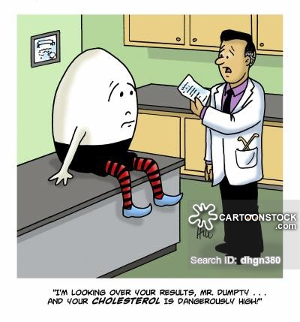
Applied Physiology
How’s the PRESSURE??
HIGH SIR!!!
Hypertension
  Primary Hypertension
  Secondary Hypertension
Hypotension
  Primary Hypotension
  Secondary Hypotension

Slide 62
Hypertension
Hypertension is defined as persistent high blood pressure. (JNC VII)
Systolic BP ≥ 140 mmHg or and
Diastolic BP ≥ 90 mmHg
Only Systolic Pressure increase then its called “Isolated Systolic Hypertension” (ISH)

Slide 63
What Does Your Blood Pressure Reading Mean?
Normal
Less than 120
Less than 80
Pre-hypertension
120-139
80-89
High Blood Pressure – Stage 1
140-159
90 – 99
High Blood Pressure – Stage 2
160 or higher
100 or higher
http://familydoctor.org/online/famdocen/home/common/heartdisease/treatment/128.html
http://www.nhlbi.nih.gov/health/dci/Diseases/Hbp/HBP_WhatIs.html
Notes:
Normal blood pressure is 120/80 or lower. High blood pressure is 140/90 or higher.
If your blood pressure is between 120/80 and 140/90, you have something called “pre-hypertension” (you are in the beginning stages and at risk of high blood pressure).
Only your doctor can tell you whether you have high blood pressure. Most doctors will check your blood pressure several times on different days before deciding that you have high blood pressure.
If you have high blood pressure or pre-hypertension, you need to check your blood pressure regularly and keep in touch with your family doctor.
As you can see – there are 2 stages of hypertension or high blood pressure.
If you have diabetes or chronic kidney disease – there is an exception to these numbers. You are considered to have high blood pressure when your blood pressure reads 130/80.

Slide 65
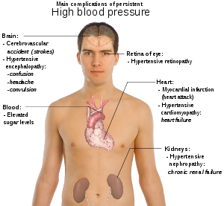

Slide 66
Diseases Attributable to Hypertension
Coronary heart disease
Stroke
Heart failure
Cerebral hemorrhage
Myocardial infarction
Left ventricular
hypertrophy
Hypertension
Chronic kidney failure
Aortic aneurysm
Hypertensive
encephalopathy
Retinopathy
All
Vascular
Peripheral vascular disease
Adapted from: Arch Intern Med 1996; 156:1926-1935.
Notes:
Slide 5
Studies show that a multitude of diseases are attributable to hypertension.
They include:
• Heart failure
• Coronary heart disease
• Myocardial infarction
• Left ventricular hypertrophy and failure
• Aortic aneurysm
• Peripheral vascular disease
• Retinopathy
• Hypertensive encephalopathy
• Chronic kidney failure
• Cerebral hemorrhage
• Stroke
With so many diseases linked to hypertension, prompt and effective treatments have the potential to reduce many complications.
Dustan HP, et al. Arch Intern Med 1996; 156:1926-1935.

Slide 67
Hypotension
Refers to persistent low blood pressure.
SBP < 100 mmHg
DBP < 60 mmHg
Types
  Primary
  Secondary
  Orthostatic hypotension

Slide 68
Venous Pressure
Venous pressure is the pressure exerted by the contained blood in the veins.
Central Venous pressure (CVP)
Peripheral Venous Pressure (PVP)
CVP < PVP

Slide 69
Measurement of Venous Pressure
Direct Method (invasive catheter)
Indirect Method (Ranger’s Method)

Slide 70
Factors Regulating Venous Pressure
Vis a tergo : from behind
Vis a fronte : from front
Vis a Latre : from lateral
Volume
PR
Posture

Slide 71
Capillary Pressure
Capillary Pressure is the pressure exerted by the blood contained in capillary.
Capillary Hydrostatic Pressure
30 mm Hg → 15 mmHg
Measurement
  Direct
  Indirect
Regulation : Precapillary Sphincter
Capillary Oncotic Pressure

Slide 72
Summary
Regulation
  Short Term
  Intermediate Term
  Long Term
Carotid Sinus
Carotid Body
VMC
Hypertension
Hypotension

Slide 73
Reference
Textbooks of….
Indu Khurana
Guyton
Vijaya Joshi
D.Venkatesh
K.Sembulingam
WWW…

Slide 74
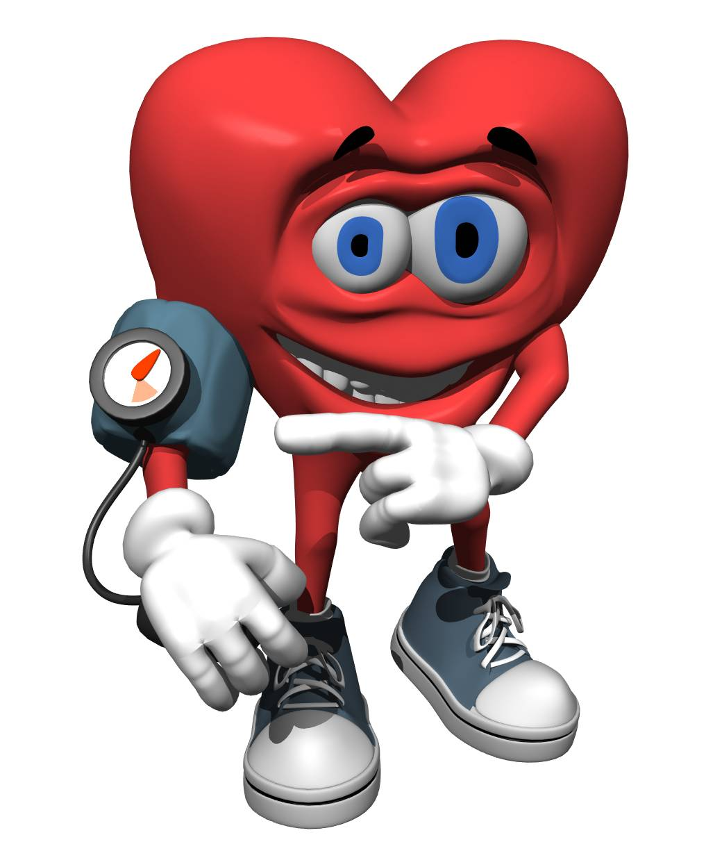
Thanks
CCES
Lecture 4.2 Blood Pressure Regulation @CVS

Slide 75
Continuous Cumulative Evaluation System
Qus.1 : All the followings are examples of Short-term regulation except
Baroreflex
Renin – Angiotensin System
Chemoreceptor mechanism
Medullary Ischemic Reflex

Slide 76
Continuous Cumulative Evaluation System
Qus.2 : Cranial Nerve ____ is also called Buffer Nerve
VI
VII
VIII
IX

Slide 77
Continuous Cumulative Evaluation System
Qus.3 : Baroreceptors are located in…..
Carotid Body
Carotid Sinus
Aortic arch sinus
Both Carotid & Aortic arch sinus

Slide 78
Continuous Cumulative Evaluation System
Qus.4 : Name of the hormone or chemical substance which decrease blood pressure
Acetylcholine
Aldosterone
Noradrenaline
Vasopressin

Slide 79
Continuous Cumulative Evaluation System
Qus 5 : Most of the conversion of
Angiotensin I into Angiotensin II takes place
in _______
Kidney
Liver
Lungs
RBCs

Slide 80
Thanks
Next Lecture : Cardiac Output

