Slide 1
Deep venous thrombosis: an unusual aetiology
- Dr. Anil Ratwa

Slide 2
Clinical History
A 36-year-old caucasian female patient, previously healthy, was admitted due to pain, swelling and redness of left leg. Venous Doppler ultrasound showed extensive deep venous thrombosis (DVT).
In order to investigate possible causes of DVT, blood tests and abdominal and pelvic Computed Tomography (CT) were preformed.

Slide 3
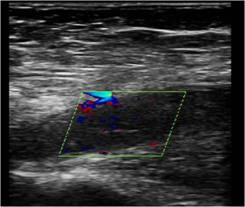
Imaging Findings
Left CFV - Dilated CFV, filled by thrombus. Complete absence of flow with colour Doppler.

Slide 4
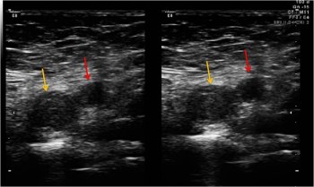
Left CFV (yellow arrow) and CFArtery (red arrow). The right image was obtained with soft tissue compression, showing thrombosed non-compressible CFV.

Slide 5
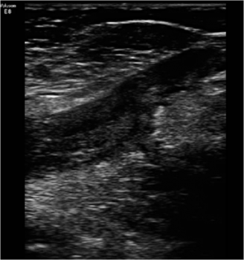
Heterogeneous echogenic thrombotic filling of left saphenous femoral junction.

Slide 6
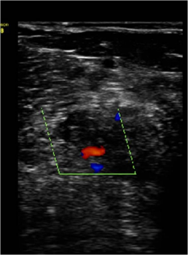
Complete absence of flow on left popliteal vein.

Slide 7
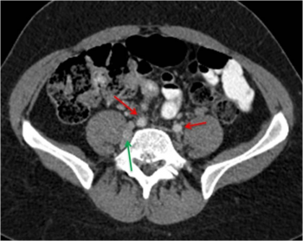
CT-Common iliac arteries (red arrows) and no common iliac veins. On the left ectatic lumbar veins (green arrow).

Slide 8
Discussion
Deep venous thrombosis has a long list of causes which include as one of the less frequently found congenital anomalies of the IVC [1].
These unusual entities cause venous stasis - one of the three factors proposed by Rodolph Virchow as needed to develop thrombosis [1, 2].
An advanced knowledge of the complex development of the inferior vena cava is required to understand the several congenital anomalies that can be found [3]. This vein is the result of the complex development of three pairs of longitudinal venous primitive channels between the 6th and 8th embryonic week: the posterior cardinal, the subcardinal and the supracardinal [2, 4, 5]
In the end we have a right aortic venous channel composed of four segments: intra hepatic, prerenal, renal and infrarenal - this last segment is derived from complex anastomosis between several segments of the posterior and supracardinal veins.

Slide 9
Patients with this diagnosis may suffer venous insufficiency or present like in this case with DVT.
DVT usually presents as progressive leg swelling, redness and pain, signs and symptoms whose extension correlates with the location of the occluded veins. A palpable vein cord may be present if there is associated superficial vein involvement.
Doppler ultrasound can be useful if we have a relatively slim and gasless patient. Always followed by Angiographic CT.

Slide 10
Final Diagnosis
Absence of infrarenal IVC

Slide 11
Differential Diagnosis
Left IVC,
Complete absence of IVC

Slide 12
THANK YOU

