Slide 1
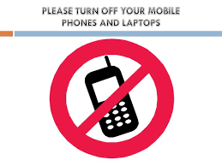
During Online Class !!

Slide 2


Slide 3
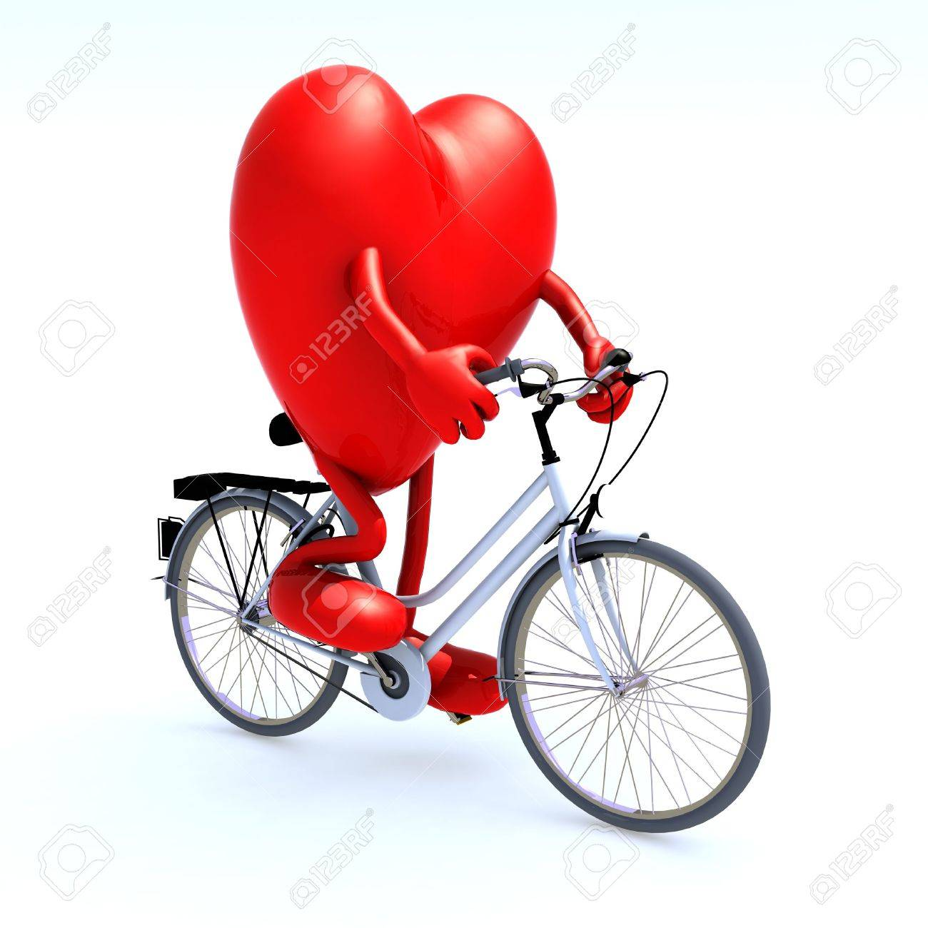

Slide 4
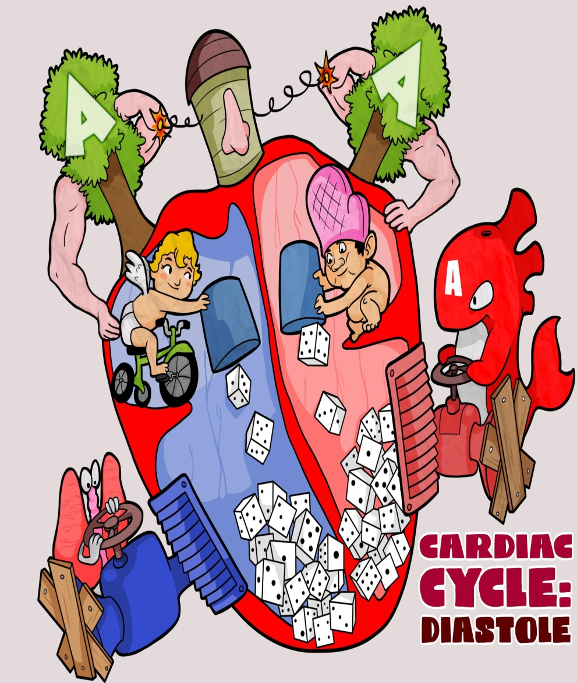
Cardiac
Cycle
Cardiovascular System
Lecture : Cardiac Cycle

Slide 5
V.V.V. Important Question***
Long Question
Define Cardiac Cycle. Describe various events and phases occurring in Cardiac Cycle. Discuss pressure & volume changes during cardiac cycle………..(5 Marks)
Short notes
Phases of cardiac cycle………………………………….(3 Marks)
Events occurring during Cardiac Cycle…………(3 Marks)
Pressure changes during Cardiac cycle………....(3 Marks)
Viva / One Liner Question
Define Cardiac Cycle
Relation of Heart sounds with CC phases
Relation of ECG with CC phases
Notes:
Frequently asked questions : Many MCQs can be asked from Cardiac Cycle in competitive examination

Slide 6
CBME
System : Cardiovascular System
Competency : PY 5.3 Discuss the events occurring during Cardiac Cycle
Method : Online Interactive Lecture
Duration : 2 Hours
Specific Learning Objectives : At the end of this lecture student must be able to;
Define Cardiac Cycle
Enumerate the different events occurring during CC
Describe different phases of cardiac cycle
Discuss the relationship of Heart sound, Pressure changes and volume changes with different phases.

Slide 7
Overview
Definition
Introduction
Electrical Vs Mechanical Events
Atrial Vs Ventricular Cycle
Phases of Cardiac cycle

Slide 8
Cardiac Cycle
Cardiac = Heart
Cycle = Repetitive Events
Cardiac Cycle

Slide 9
Cardiac Cycle
“The series of coordinated cardiac events (Electrical then Mechanical) that occur from beginning of one heart beat to the beginning of the next, are called the CARDIAC CYCLE”
In simple words, things happening between two consecutive heart beats
Cardiac cycle includes both electrical as well as mechanical events. Electrical events precede and initiate the corresponding mechanical events.
Notes:
In short, all the things happening between two consecutive beats

Slide 10
Cardiac Cycle
Electrical Events (Action potential)
  Depolarization
  Repolarization
Mechanical Events (Systole & Diastole)
  Pressure and Volume changes
  Valvular events (Heart Sounds)
Electrical Events
Calcium
Mechanical Events
Notes:
Electrical events precedes mechanical events, again calcium is the coupler between two events

Slide 11
Cardiac Cycle
Initiated by spontaneous generation of Action Potential in SA node. (Electrical Event)
Atria act as PRIMER PUMPS for ventricles & Ventricles provide MAJOR SOURCE OF POWER for moving the blood through the vascular system. (Mechanical Event)
In general, Mechanical events are described as proper cardiac cycle events.

Slide 12
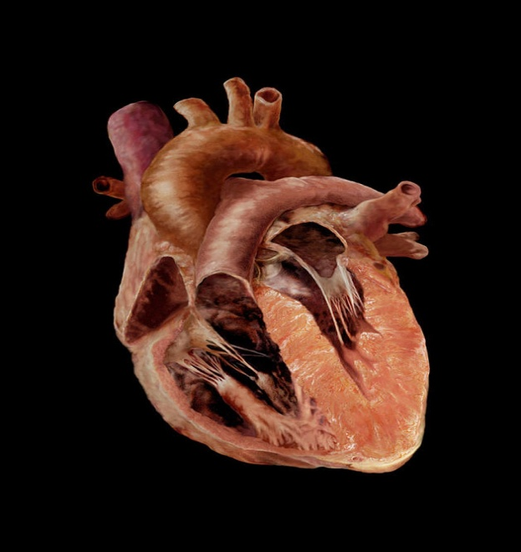
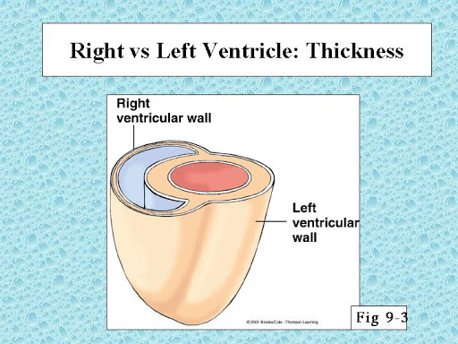
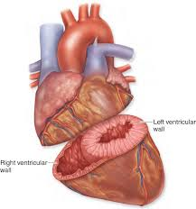
Basic Concepts: Anatomy of Heart

Slide 13
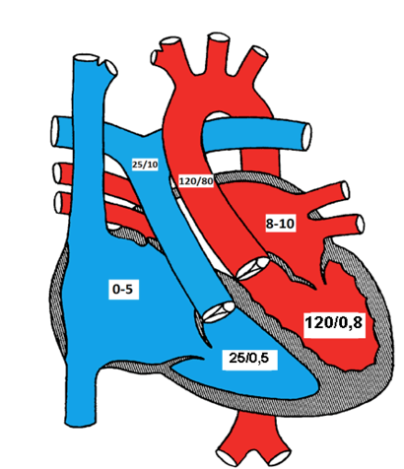

Slide 14
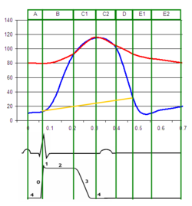
Pressure changes at different places
--- Aortic Pressure
--- Lt. Ventricular Pressure
---Rt. Ventricular Pressure

Slide 15
Properties of Heart
Electrical Properties
Auto-Rhythmicity
Conductivity
Mechanical Properties
Contractility
Excitability
Basic Concepts: Properties of Heart

Slide 16
Basic Concepts: Properties of Heart
Automaticity – Rhythmicity
  Automaticity
  Rhythmicity
Conductivity
  AV Nodal delay
Excitability
  Summation of Subliminal stimuli
  Long Absolute Refractory period
Contractibility
  All or none phenomenon
  Staircase phenomenon
  Effect of Load (Pre -After)
    Frank Starling’s Law

Slide 17
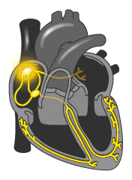
Cardiac Cycle
Electrical → Mechanical
Autorhythmicity
Conductivity
Excitability
Contractibility
Electrical
Mechanical

Slide 18
Cardiac Cycle
Each cardiac cycle starts with generation of impulse from SA node (Autorhythmcity) , spreading of impulse to each corner of heart (Conductivity), excitation of myocardial cell (Excitability).
Which, in turn leads to release of Calcium ions from sarcoplasmic reticulum and ECF in to sarcoplasm → increase in concentration of Ca⁺⁺ → Excitation Contraction Coupling → shortening of sarcomere (Contractility)
Electrical events cannot be seen but can be recorded in the form of ECG.

Slide 19
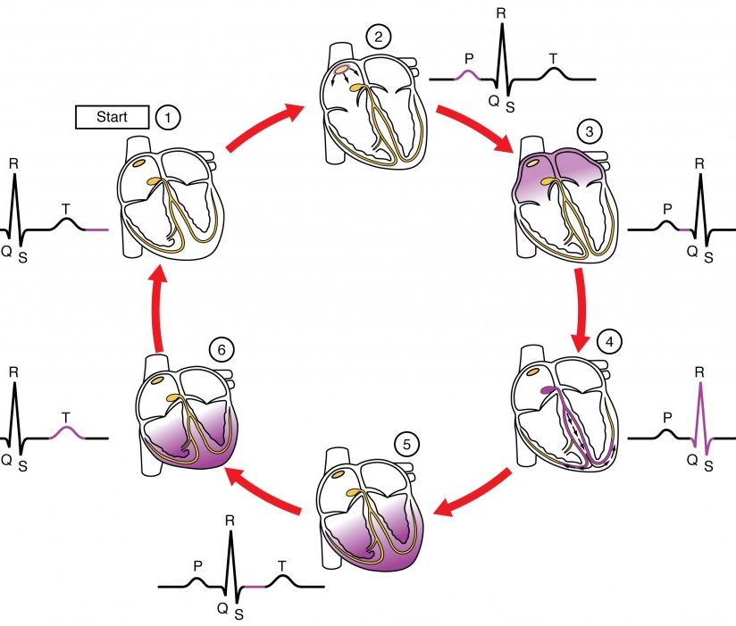
Electrical Event of the
Cardiac Cycle
Depolarization
Repolarization

Slide 20
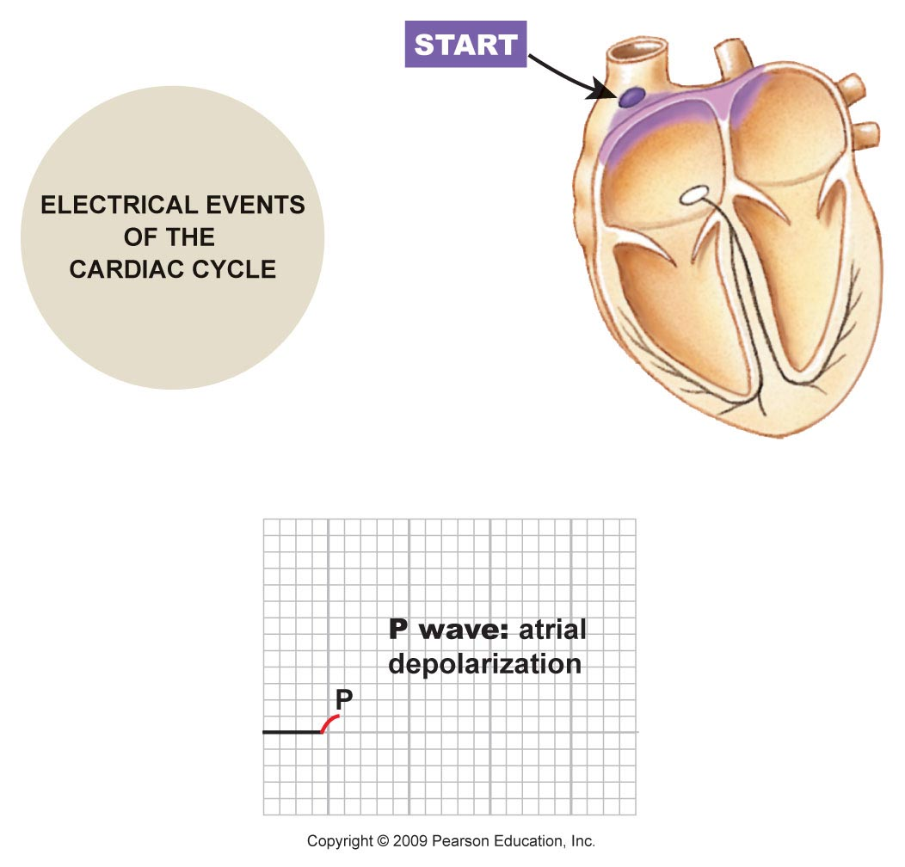
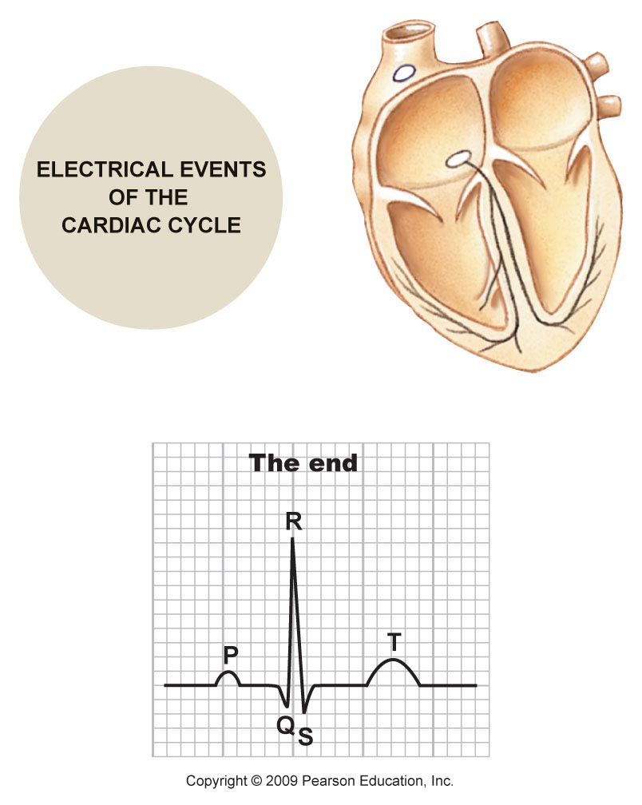
Notes:
Because of its location, SA Node depolarizes the atria first which is recorded as P-wave

Slide 21
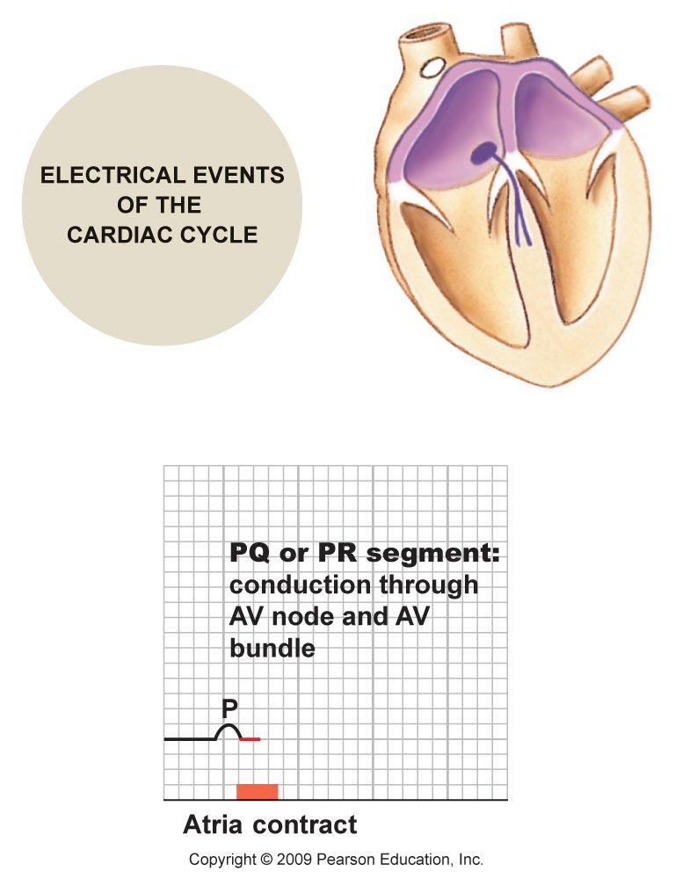
Notes:
PR segment represents delay between atrial and ventricular depolarization (0.12 to 0.2 sec)

Slide 22
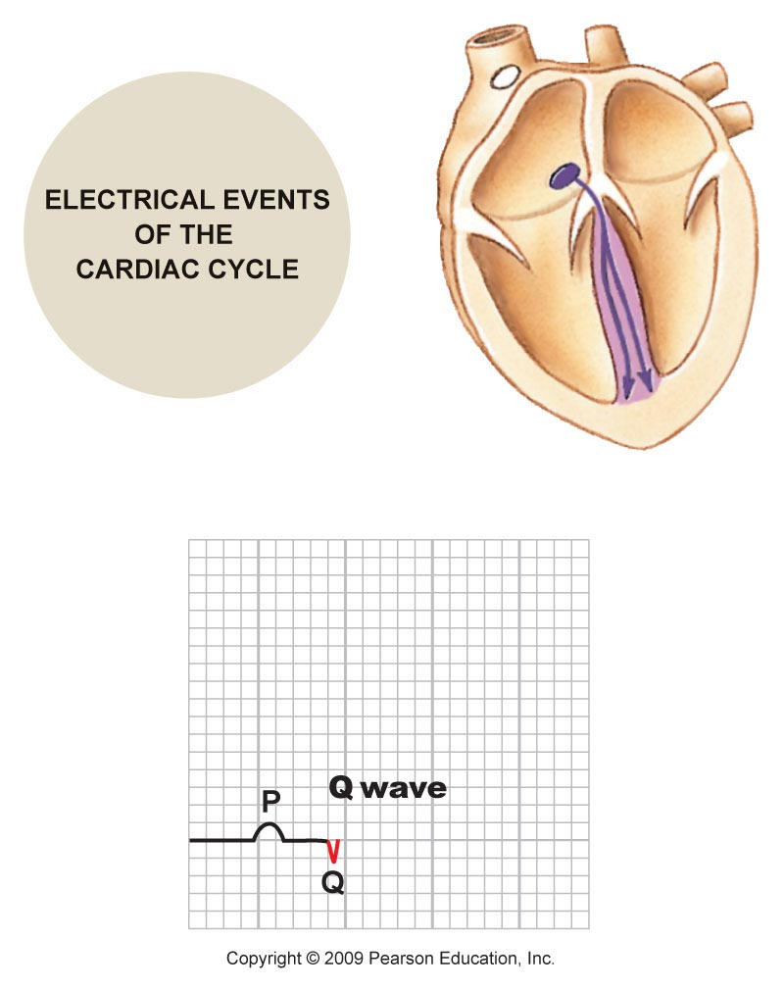
Notes:
Q wave represents depolarization of inter-ventricular septum (wave of depolarization travels from left to right – away from positive electrode) therefore Q-wave negative.

Slide 24
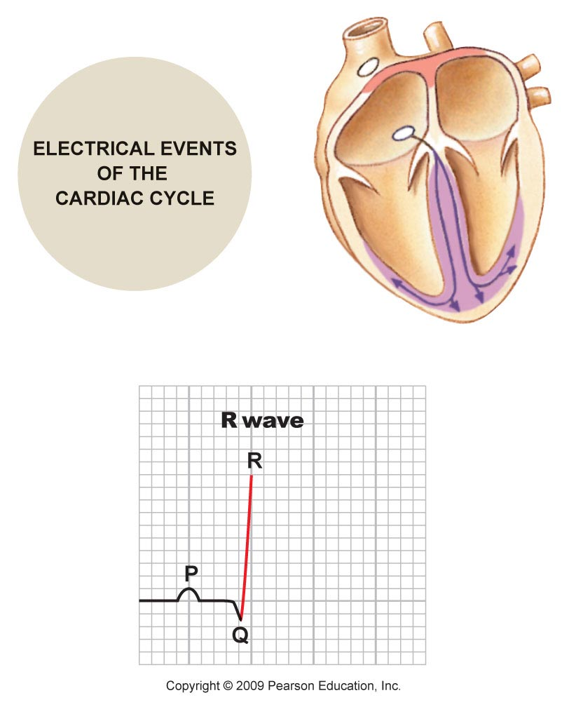
Notes:
R wave represents wave depolarization travelling across thickness of muscle (apex part first (endocardium to epicardium)

Slide 25
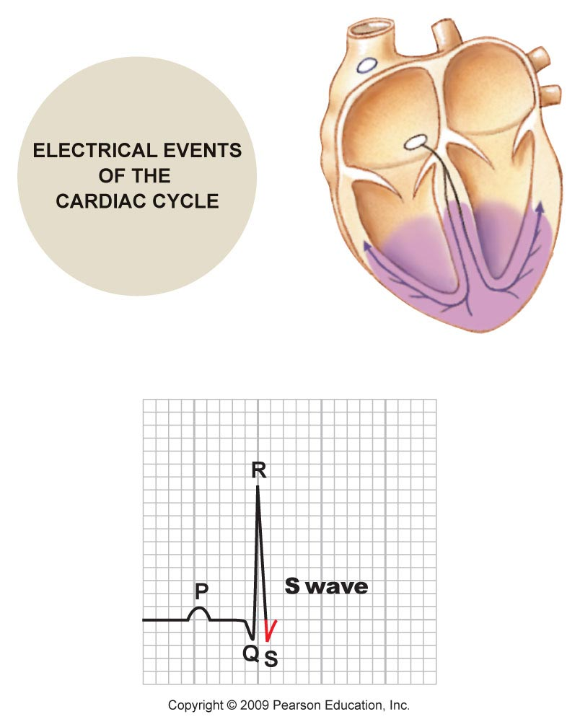
Notes:
S Wave represents depolarization of purkinje fibers (bottom of heart) – wave depolarization travels opposite direction (down to upward)

Slide 26
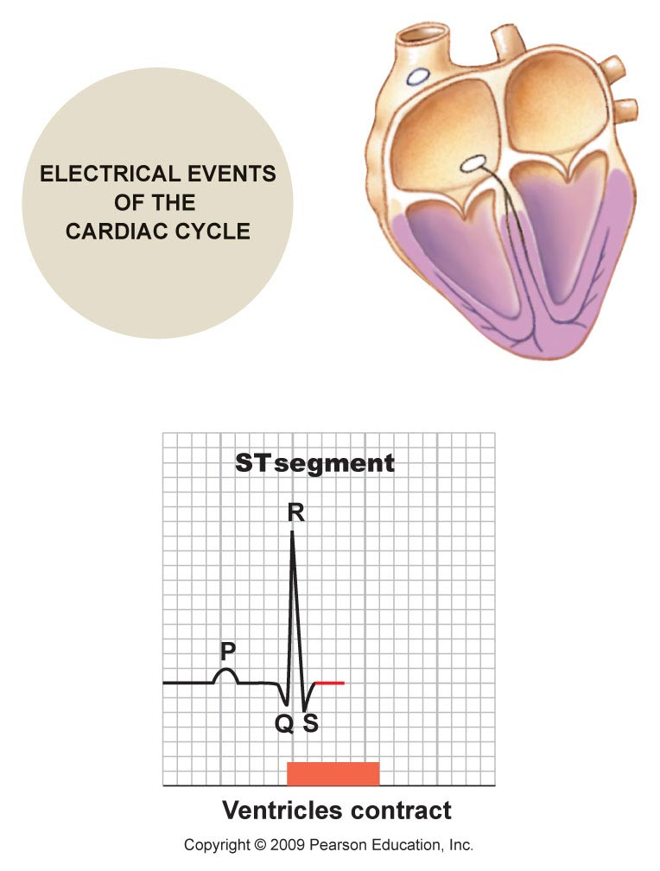
Notes:
J-Point – significance (Isoelectric point)
ST Segment

Slide 27
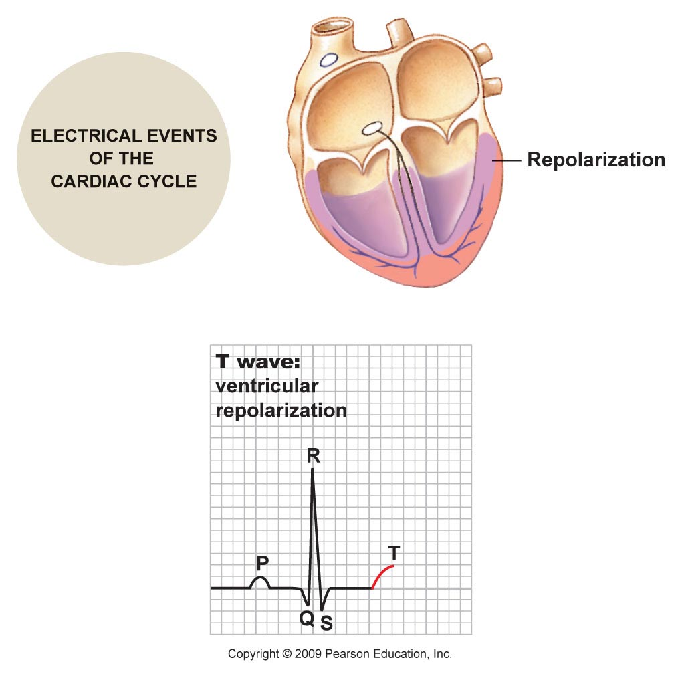
Notes:
T wave – wave of repolarization in vetricle

Slide 28
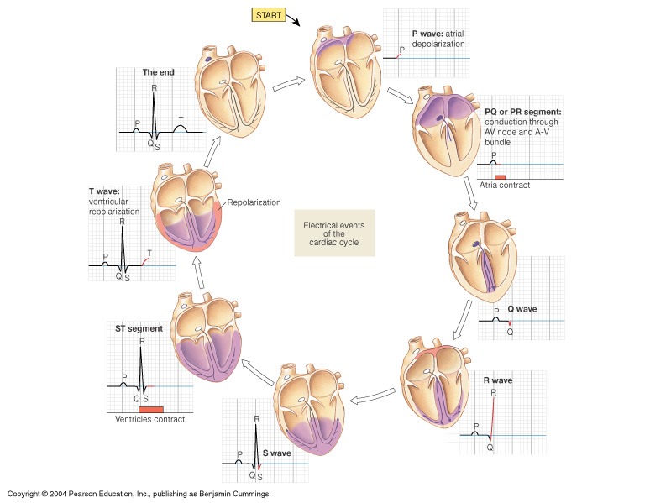
Electrical events of the
cardiac cycle
Notes:
P Wave – Atrial Depolarization, QRS Complex – Ventricular Depolarization, T Wave – Ventricular Repolarization, U Wave – delayed repolarization of Purkinje Fibers

Slide 29
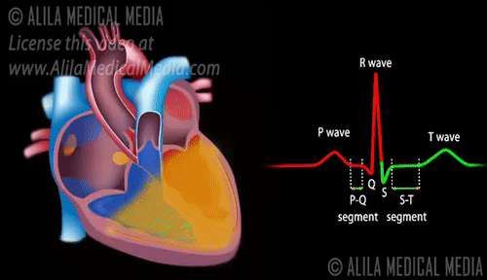

Slide 30

Mechanical Event of the
Cardiac Cycle
Systole
Diastole

Slide 31
Circulation of Blood Around the Body
The cardiac cycle comprises 2 circulations since the right and left sides of the heart function separately as 2 pumps:
Pulmonary Circulation: Rt side receives deO₂ from the body and pumps to the lungs.
Systemic Circulation: Lt side receives O₂ blood from the lungs and pumps to the body.
Can you name vessels involved in this process??
Notes:
Lesser Circulation Vs Greater Circulation

Slide 32
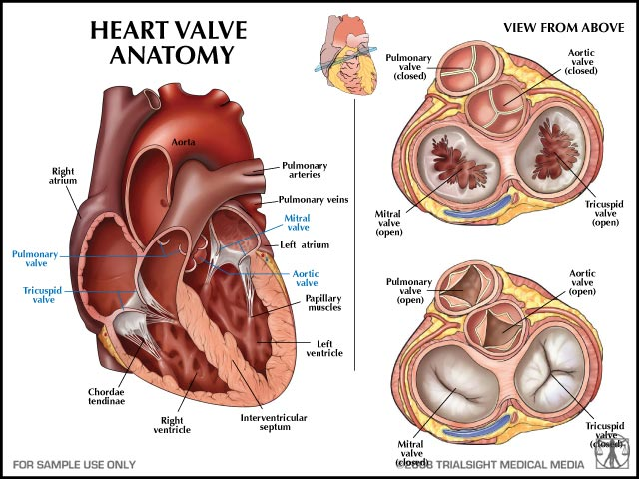
Opening and Closure of Valves
Notes:
AV valves Vs SL Valves

Slide 33
The Cardiac Cycle : MECHANICAL EVENTS
Heart at rest
  Blood flows from large veins into atria
  Passive flow from atria into ventricles
Atria contract (R & L) simultaneously
  Blood forced into ventricles : Pressure drops in atrium
Ventricles contract (R & L) simultaneously
  Pressure Rises in Ventricle
  Atrioventricular valves close → “lubb” sound
  Blood forced into large arteries : Pressure Rises in vessels
Ventricles relax
  Pressure Drops in Ventricle
  Semilunar valves close → “dub” sound
  Filling of Ventricle
Heart at rest

Slide 34
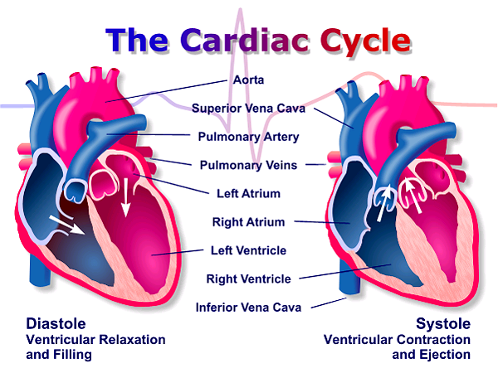
The Cardiac Cycle
The heart muscle contracts rhythmically with a period of relaxation between each beat. Not all parts contract at the same time.
There is an orderly sequence of contractions that begins in the atria and pass to the ventricles.
Boston Scientific : Heart & Blood Vessel Basics

Slide 35
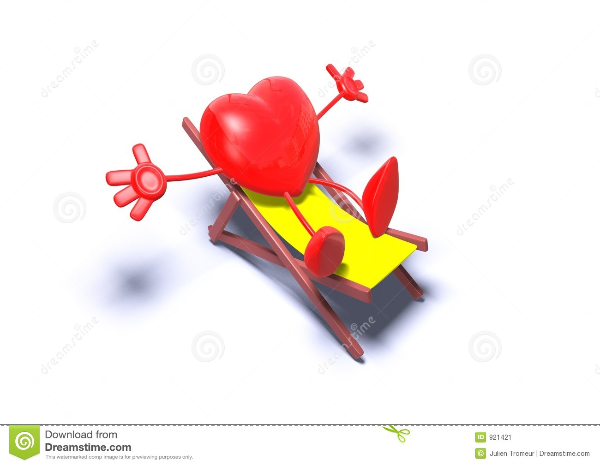
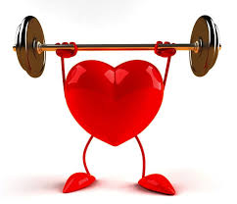
Mechanical Event
Heart @ Rest
Heart @ Work
Diastole
Systole

Slide 36
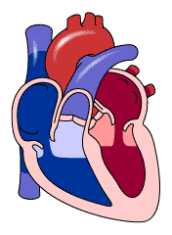
Introduction
CARDIAC CYCLE – Mechanical Event
- A period of relaxation - Diastole , during which
heart fills with blood. : RECEIVE blood
- A period of contraction - Systole , during which
heart empty blood : PUMP blood

Slide 37
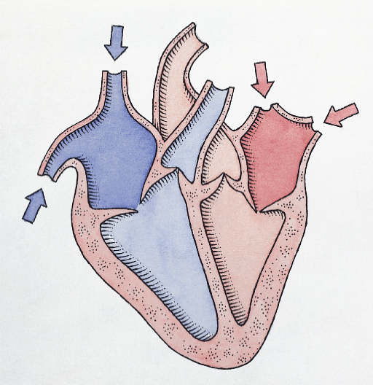
Diastole
Relaxation Time!!!
Muscles of both atria and ventricles relax to receive blood from veins (venacava/pulmonary) then it flow through the atria into the ventricles until heart is filled.
What stops back flow of blood????

Slide 38
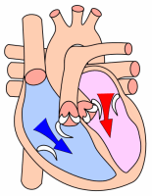
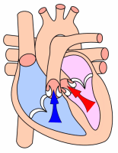
SYstole
Contraction Time!!!
Atrial Systole:
Atria contract and eject blood into ventricles.
Ventricular Systole: Ventricles contract and eject blood into arteries.
At the same time the atria relax and the cycle starts again!

Slide 39
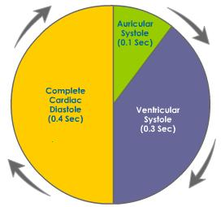
The cardiac cycle
* Atrial systole,
* Ventricular systole, then
* Diastole of the whole heart
Atrial and ventricular systoles never occur at the same time, but their diastoles can occur at the same time during the diastole of the whole heart.

Slide 40
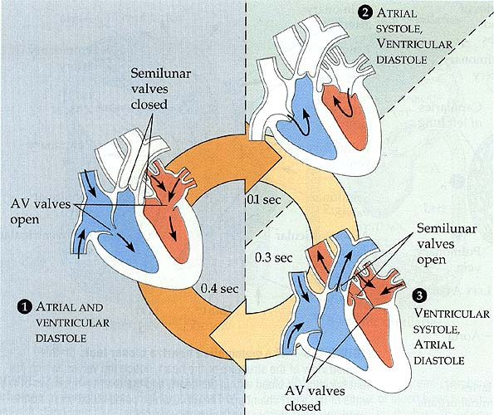

Slide 41
The cardiac cycle – Events
Atrial systole
Ventricular systole
  Isometric (isovolumetric) contraction phase
  Rapid ejection phase
  Reduced (Slow) ejection phase
Diastole of the whole heart
  Protodiastole
  Isometric (isovolumetric) relaxation phase
  First Rapid filling phase
  Slow filling phase
  Last Rapid Filling Phase = * Atrial systole:

Slide 42
How to calculate the duration of cardiac cycle ?
Formula :
Duration of Cardiac Cycle in sec = 60 / HR
So if HR is 60 / minute then Cardiac cycle = ____ sec ??
So if HR is 100 / minute then Cardiac cycle = ____ sec??
Normally HR is around 72/min then cardiac cycle:0.8 sec

Slide 43
The cardiac cycle
In the normal heart, cardiac activity is repeated in a regular cyclical manner.
The two atria contract at the same time, then they relax while the two ventricles simultaneously contract.

Slide 44
The cardiac cycle
With a resting heart rate of 75 beats/min, the duration of each cardiac cycle is 0.8 second.
For the atria , Cycle consist of 0.1 second in systole and 0.7 Second in diastole
For the ventricles, the cycle consists of 0.3 second in systole and 0.5 second in diastole.

Slide 45
Mechanical Events (0.8)
Atrial Events
(0.8)
Atrial
Systole (0.1)
Atrial Diastole (0.7)
Ventricular Events (0.8)
Ventricular Systole (0.3)
Ventricular Diastole (0.5)
3 Phases
5 Phases

Slide 46
PHASES : Mechanical Events at 75 Pulse / Min
Atrial Events (0.8 Sec)
Atrial Systole | 0.1 Sec
Atrial Diastole | 0.7 Sec
Ventricular Events (0.8 Sec)
Ventricular Systole Isovolumetric Contraction Phase Rapid Ejection Period Reduced Ejection Period | 0.3 Sec 0.05 sec 0.10 sec 0.15 sec
Ventricular Diastole Protodiastolic phase Isovolumetric Relaxation Phase First Rapid Filling phase Slow Filling Phase or Diastasis Last Rapid Filling Phase | 0.5 Sec 0.04 sec 0.06 sec 0.10 sec 0.20 sec 0.10 sec

Slide 47
Events occurring during Cardiac Cycle – step by step
Atrial Systole
Isovolumentric (Isometric) contraction phase
Rapid Ejection phase
Reduced Ejection phase
Protodiastole
Isovolumentric (Isometric) relaxation phase
First rapid filling phase
Slow filling phase (diastasis)
Last rapid filling phase

Slide 48
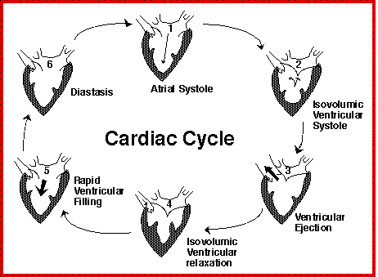

Slide 49
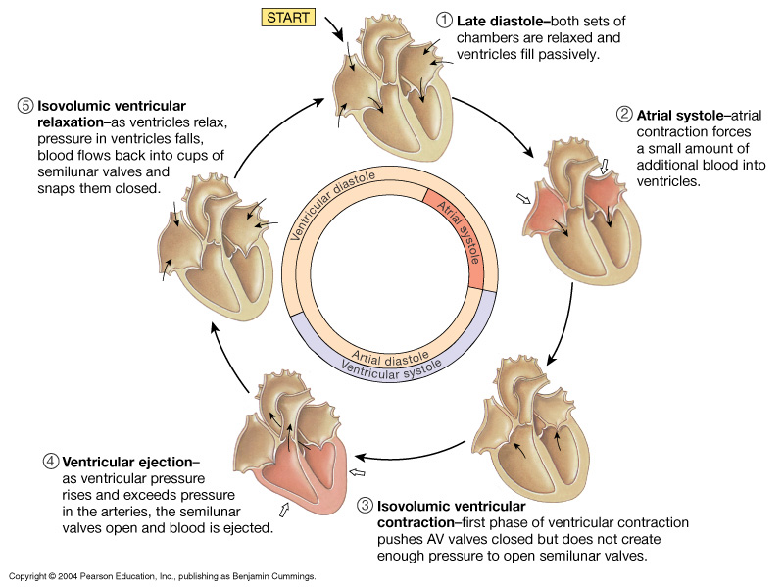
Cardiac Cycle : Mechanical events

Slide 50
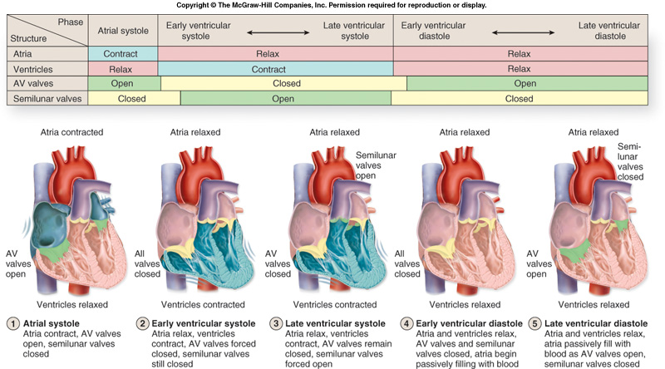

Slide 51
Summary of Cardiac Cycle
  When heart sounds appear ?
  When heart valves open ?
  When volume changes in chambers ?
  When pressure changes in chambers ?
  Effect of Exercise on Cardiac Cycle?
Make it Easy
  Cycle Diagram

Slide 52
0.8
0
0.7
0.1
Cardiac Cycle
0.6
0.2
0.3
0.5
0.4

Slide 53
Cardiac Cycles : Event Recording
Electrocardiogram (ECG)
Phonocardiogram (PCG)*
Cardiac Catheterization
Jugular Venous Pulse (JVP)
Cardiac Ventriculography
Echocardiography
Notes:
Simultaneous recording of above mentioned procedures gives complete picture of cardiac cycle with changes occurring in pressure and volumes during different phases

Slide 54
THE COMPLETE PICTURE

Slide 55
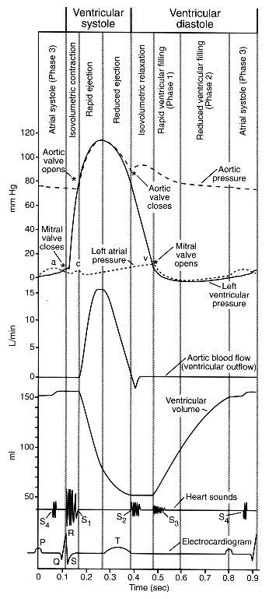
CARDIAC CYCLE
Reduced Ejection
Rapid Ventricular
Filling
Rapid Ejection
Atrial Systole
Isovolumic Relax.
Reduced Ventricular
Filling
Isovolumic contract.
Atrial Systole
Aortic
opens
Aortic
closes
Mitral
opens
Mitral
Closes
S₁
S₂
Notes:
The coordinated contraction-relaxation of the atria and ventricles of the heart make up the complete cardiac cycle seen above in graphic detail. Coming from the top of the graph you can see that basically this is a compound graph formed by several individual graphs in which the x axis is always time. The vertical lines separate time intervals. At the very bottom of the graph heart sounds and the electrocardiogram are illustrated in coordination with all the other events of the cycle. This cycle is based on events happening in the left heart. The upper 3 curves show the changes in atrial, ventricular and aortic pressures during the cycle. The lower curve shows the changes in ventricular volume and the middle curve shows the changes in aortic blood flow. In your book (page69) you will also find the venous pulse curve. This curve closely follows the same changes as the left atrial pressure curve shown here. It is of paramount importance that you come to class prepared to discuss the cardiac cycle.

Slide 56
QUICK QUIZ
How to find out that you know the valvular event Cardiac Cycle.
150
LEFT
VENTRICULAR
VOLUME (ML)
Atrial
systole
Mitral
closes
Aortic
opens
Aortic
closes
Mitral
opens
50
TIME (SEC)

Slide 57
Valves during Cardiac Cycle
 | Without pressure (relaxed) | With pressure (contraction)
A-V valves | open | closed
semilunar valves | closed | open

Slide 58
Summary: Cardiac Cycle
One heartbeat = one cardiac cycle
  Atria contract and relax
  Ventricles contract and relax
Right atrium contracts
  Tricuspid valve opens
  Blood fills right ventricle
Right ventricle contracts
  Tricuspid valve closes
  Pulmonary semilunar valve opens
  Blood flows into pulmonary artery
Left atrium contracts
  Bicuspid valve opens
  Blood fills left ventricle
Left ventricle contracts
  Bicuspid valve closes
  Aortic semilunar valve opens
  Blood pushed into aorta

Slide 59
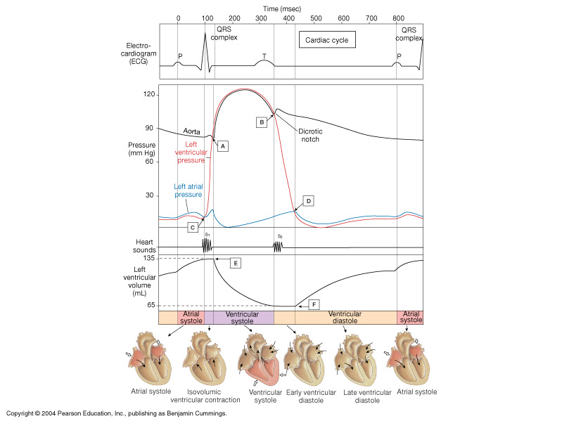
Summary of Heart Beat:
Electrical, Pressure and Chamber Volumes

Slide 60
Applied Physiology: Cardiac Cycle
Influenced by
  Exercise
  Parasympathetic nerves
  Sympathetic nerves
  Cardiac control center
  Body temperature
  Potassium ions
  Calcium ions

Slide 61
You Can Refer to
Textbooks of….
Indu Khurana
Guyton
Vijaya Joshi
D.Venkatesh
K.Sembulingam
WWW… for Images / Animation

Slide 62

Thanks
Your work is to discover your world and then with all your heart give yourself to it.
~ Buddha
CCES : Lecture 2 Cardiac Cycle

Slide 63
Continuous Cumulative Evaluation System
Question 1
At the heart rate of 75/min, Normal Duration of Cardiac Cycle = ______ sec
0.08
0.6
0.8
8

Slide 64
Continuous Cumulative Evaluation System
Question 1
At the heart rate of 75/Min, Normal Duration of Cardiac Cycle = ______ sec
0.08
0.6
0.8
8

Slide 65
Continuous Cumulative Evaluation System
Question 2
First heart sound is heard during which phase ?
Isovolumetric Relaxation phase
Last Rapid filling Phase
First Rapid filling Phase
Isovolumetric Contraction Phase

Slide 66
Continuous Cumulative Evaluation System
Question 3
Heart sound recoded as graph known as;
Electrocardiogram
Phonocardiogram
Sphygmogram
Electroencephalogram

Slide 67
Continuous Cumulative Evaluation System
Question 4
Following is not an event in the ventricular systole
Diastasis
Isovolumetric contraction phase
Rapid Ejection phase
Reduced Ejection Phase

Slide 68
Continuous Cumulative Evaluation System
Question 5
In cardiac cycle, during which phase AV valves and semilunar valves remain closed ?
Atrial systole
Isovolumetric relaxation phase
Rapid ejection phase
First rapid filling phase

