Slide 1
Double aortic arch
- Dr. Chandra Raychaudhari

Slide 2
Clinical History
A 29-year-old man was brought to the emergency department after a car accident. He was
previously healthy and asymptomatic.

Slide 3
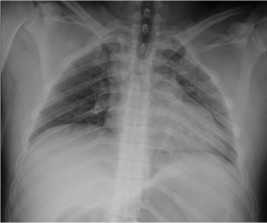
Imaging Findings
A mediastinal abnormality is seen in this chest radiograph performed in the emergency department

Slide 4
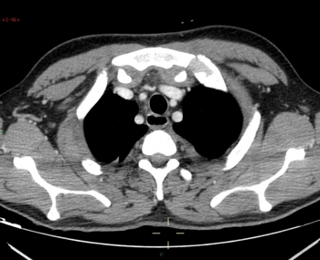
The right and left subclavian and carotid arteries appear symmetrical in the upper mediastinum.

Slide 5
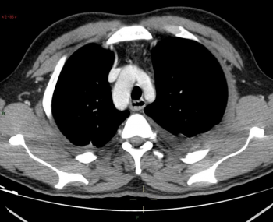
The right arch is larger, extends more cephalad and is more posterior than the left arch.

Slide 6
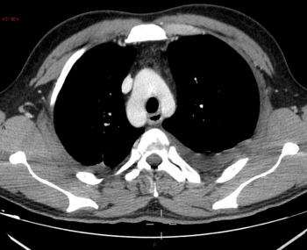
The ascending aorta is seen to divide into right and left arches, the right arch being larger, higher and more posterior than the left arch.

Slide 7
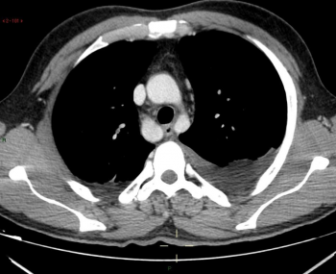
The ascending aorta is seen to divide into right and left arches.

Slide 8
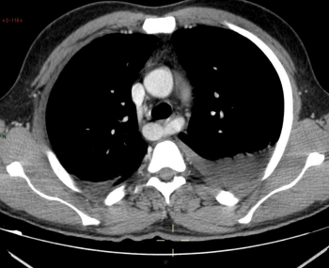
In this case, the left arch is joining the right arch to form the descending aorta, which is not the most common appearance

Slide 9
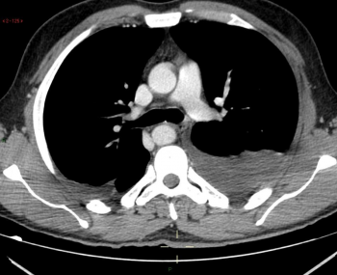
The descending aorta courses slightly on the right side of the midline, which is not the most usual appearance.

Slide 10
Discussion
Congenital anomalies of the aortic arch are rare, with its frequency varying between 0.5 to 3.0%.
They result from abnormal or incomplete regression of embryonic branchial arches. According to
Edward's hypothesis, there are two aortic arches and two ductus arteriosus in the embryonic period,
and the normal anatomy results from the regression of the dorsal segment of the right arch.
Interruption of this system in different locations explains the various aortic arch anomalies.
Congenital anomalies of the aortic arch are in most cases incidental findings in asymptomatic
patients. However, symptoms may present when a vascular ring occurs and compresses the trachea
or oesophagus. Congenital anomalies of the aortic arch may also be associated with congenital heart
disease

Slide 11
In double aortic arch, the ascending aorta divides into two arches. The right arch is usually larger,
extends more cephalad and is more posterior than the left arch. The left arch has a course similar to
that of the normal left aortic arch, and the right arch has a course behind the oesophagus and joins
the left arch. The descending aorta is usually on the left side. The subclavian and carotid arteries
arise from their respective arches.

Slide 12
Double aortic arch is the most common cause of complete vascular ring, with the majority of
patients presenting with symptoms resulting from compression of adjacent structures in the first
months of life (stridor, recurrent respiratory infections or dysphagia). [2, 3] Occasionally, it is an
incidental finding in asymptomatic adults

Slide 13
Differential Diagnosis
Right aortic arch,
Other congenital anomalies of the aortic arch

