Slide 1
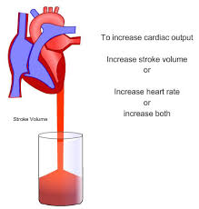
Dr. Mahavirsingh H. Rajput professor
Department of Physiology
Smt.B.K.Shah medical institute & Research Centre
Sumandeep vidyapeeth
Lecture 5 Cardiac Output

Slide 2
WHY ???
Why patients with transplanted heart can also increase the cardiac output in mild exercise?
Why the ejection of blood remain same by right and left ventricles ?
Why ejection fraction is measured during 2D-Echocardiography ?
Why NTG or Nitroprusside is given in chest pain or Hypertensive crisis ?

Slide 3
Objectives
After this lecture you will be able to understand ;
  Which Cardiac vocabulary commonly used, in regarding to cardiac function ?
  Determinants and regulation of Cardiac output
  How is it measured in human and animal
  Applied Aspect

Slide 4
FAQs : Frequently Asked Questions
Long Questions :
Cardiac Output
Short Questions :
Factors affecting Cardiac output
Regulation of Cardiac output
Viva Questions :
  Define Stroke volume, Minute volume, Cardiac output, Cardiac Index, Ejection fraction. Give normal values & range.
  Frank starling’s Law
  Examples of preload & afterload for heart

Slide 5
Overview
Definition & Normal Values
Calculation of different parameters
Variation in cardiac output
Factor affecting cardiac output
Regulation of cardiac output
Measurement of cardiac output

Slide 6
Reading
Klabunde, Cardiovascular Physiology Concepts
  Chapter 4 (Cardiac Function)

Slide 7
Cardiac Output
Basic Concepts
  Cardiac output = (Blood) Output of heart
  Continuous blood output is required for blood flow to organs
  Heart - Non sucking intermittent outflow pump
  Indicator of pumping ability of heart
  75 % of the blood to vital organs
  25 % of the blood to Sk. M. & Skin

Slide 8
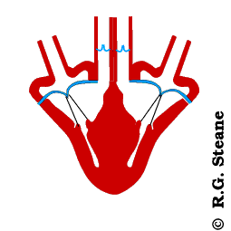
Cardiac Output
Introduction
  CARDIAC OUTPUT (CO) : refers to the amount of blood ejected by each ventricle per minute.
  Left ventricle → Aorta
  Right Ventricle → Pulmonary trunk
  Normal Value : 4-6 Liter/Minute
  (Average : 5 L/min)

Slide 9
Cardiac Output
Definition & Normal Values
  Cardiac output is expressed in three ways;
    Stroke Volume (SV)
    Minute Volume (MV)
    Cardiac Index (CI)
  Note : in routine clinical practice cardiac output refers to minute volume.
  (CO = MV)

Slide 10
Cardiac Output
Stroke Volume (SV) : refers to the amount of blood pumped by each ventricle per stroke or beat.
Normal Value : 60-80 mL
(Average : 70 mL)
SV = EDV – ESV
End diastolic volume : 120 mL
End systolic volume : 50 mL

Slide 11
Cardiac Volumes at different phases
End- diastolic volume : at the end of diastole (filling phase) → Maximum volume (120 ml)
End – systolic volume : at the end of systole (ejection phase) → Minimum volume (50 ml)

Slide 12
End-Diastolic Volume – End-Systolic Volume = Stroke Volume
End-Diastolic Volume
End-Systolic Volume

Slide 13
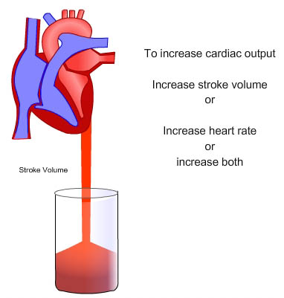

Slide 14
Cardiac Output
Minute Volume (MV) : refers to the amount of blood pumped out by each ventricle in one minute.
Product of Heart rate & Stroke volume.
So, MV = HR X SV
Normal Values : 4- 6 Liter/min
Average : 5 L /min
MV = CO

Slide 15
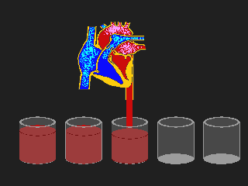

Slide 16
Cardiac Output
Cardiac index (CI) : refers to the minute volume expressed in relation to square meter of body surface area.
Defined as amount of blood pumped out by ventricle/ minute/square meter of body surface area.
CI = CO/BSA (CO = 5 L/min , BSA = 1.56 m²)
Normal Values : 3.2 Liter/min/m²

Slide 17
Cardiac Output
Ejection Fraction (EF) : refers to the fraction of blood (EDV) that is ejected out by each ventricle.
EF = SV/EDV = EDV – ESV / EDV
(SV = 70 ml, EDV = 120 ml)
EF = 70/120 = 0.58 = 58 %
Expressed as percentage %
Normal Value = 55 -65 %

Slide 18
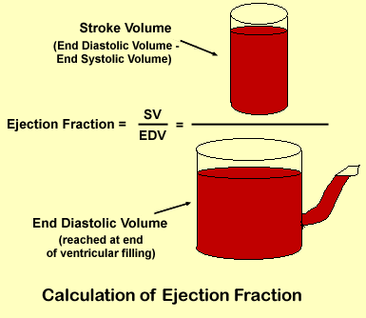

Slide 19
Cardiac Output
Cardiac Reserve : refers to the maximum amount of blood that can be pumped out by the heart above normal value.
Plays important role in increasing the cardiac output during condition like EXERCISE. It is essential to withstand the stress of exercise.
Usually expressed in percentage.

Slide 20
Cardiac Output
Cardiac Reserve :
SUBJECT | CARDIAC RESERVE
Normal Young Healthy Adult Male | 400 -500 %
Normal Young Healthy Adult Female | 300 – 400 %
Old Age | 200 – 300 %
Trained Athletes | 600 – 700 %

Slide 21
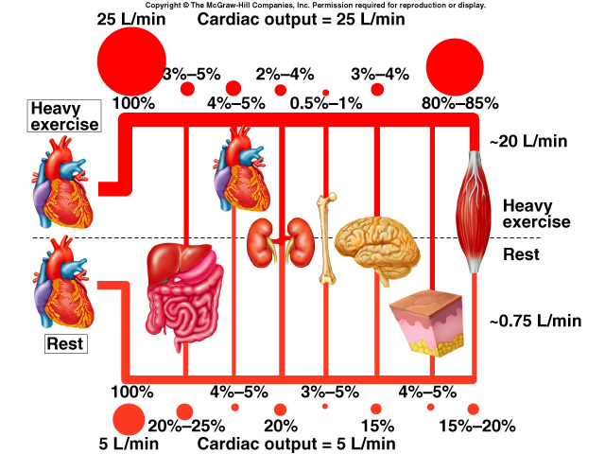

Slide 22
Variation in Cardiac Output
PHYSIOLOGICAL VARIATION
Age
Sex
Build
Diurnal variation
Environmental temperature
Emotional condition
After meals
Exercise
High altitude
Posture
Pregnancy
Sleep
PATHOLOGICAL VARIATION
Increase in Cardiac Output
  Fever
  Anemia
  Hyperthyroidism
Decrease in Cardiac Output
  Hypothyroidism
  Shock
  Hemorrhage
  Heart block
  Cardiac failure

Slide 23
Cardiac Output
Distribution of Cardiac Output
Organ | Blood supply/min | Percentage % of Cardiac output
Liver | 1500 ml /min | 30 %
Kidneys | 1300 ml/min | 26 %
Skeletal Muscles | 900 ml/min | 18 %
Brain | 800 ml/min | 16 %
Skin, Bone, GIT | 300 ml/min | 6 %
Heart | 200 ml/min | 4 %
Total | 5000 ml/min | 100 %

Slide 24
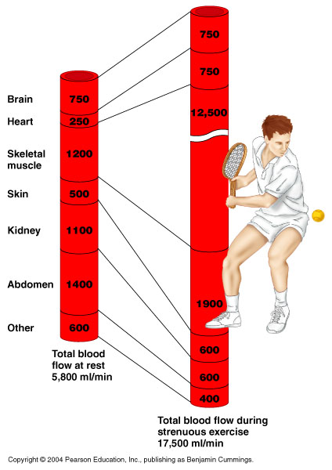


Slide 25
Calculate :
Exercise 1 :
If EDV 100 mL , ESV = 70 mL & HR = 80 min, BSA = 1.2 m²
then,
    SV = ?? --→ 30 ml
    CO = ?? --→ 2.4 L /min
    EF = ?? --→ 30 %
    CI = ?? --→ 2 L /min/m²
GOOD JOB!!!!!

Slide 26
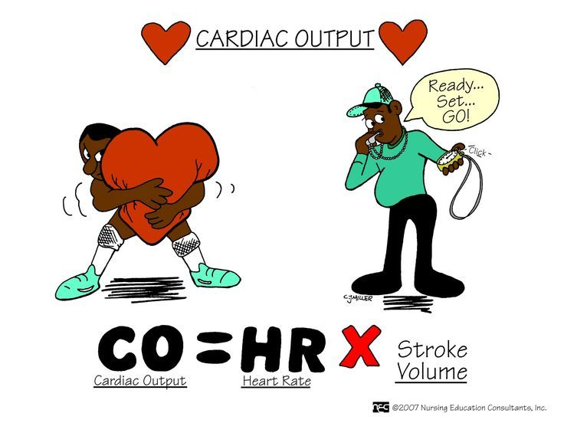

Slide 27
Factors affecting CO
Cardiac Output is product of Heart Rate & Stroke Volume
CO = HR X SV
Whereas SV is dependent on Preload, Force of Contraction and After load
So, CO = HR X (Preload & FOC)
After load

Slide 29
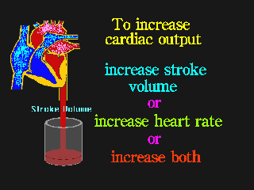
Cardiac Output
Factors Maintaining Cardiac Output
  Venous Return (Preload)
  Force of Contraction
  Heart Rate
  Peripheral Resistance (After-load)

Slide 30
Determinants of Cardiac Output
HEART RATE
PRELOAD
Cardiac
Output
CONTRACTILITY
AFTERLOAD

Slide 31
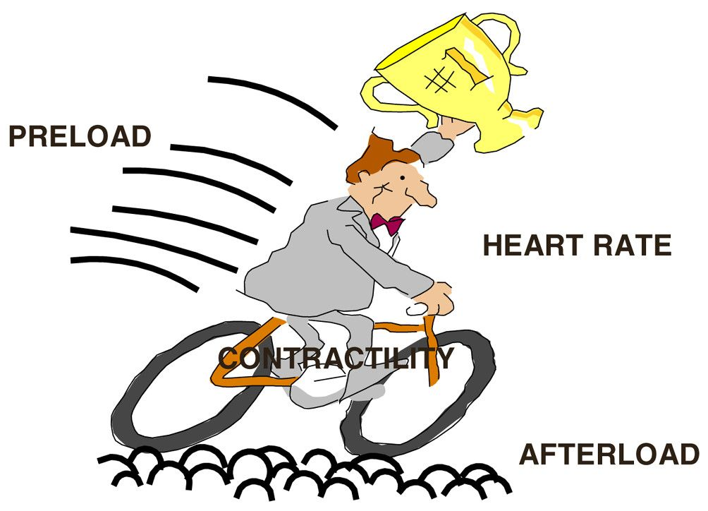

Slide 32
Cardiac Output
Factors Maintaining Cardiac Output
  Venous Return : refers to amount of blood, which is returned to the heart from different parts of the body.
  Directly proportional to cardiac output.
  (CO α VR) provided the other factors constant
  Venous return in turns depend upon six factors;
    Respiratory Pump
    Muscle Pump
    Gravity
    Cardiac Pump
    Venous Pressure
    Sympathetic tone

Slide 33
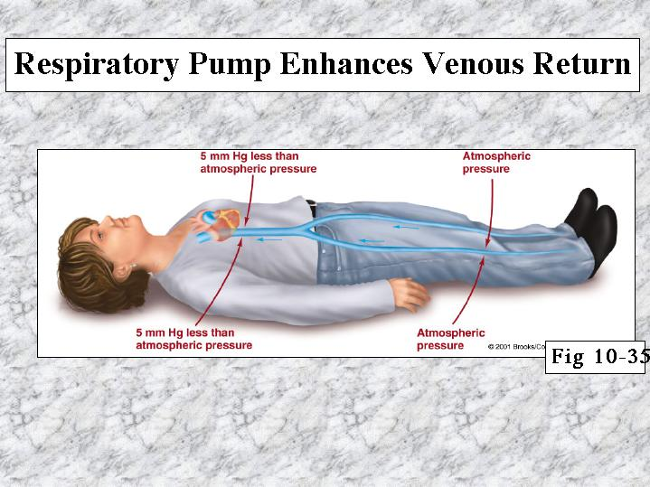
Respiratory Pump

Slide 34
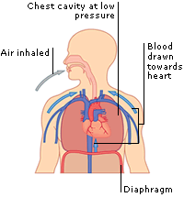
Respiratory Pump: Mechanics
ABDOMINOTHORACIC PUMP
During Inspiration
  Intra-thoracic Pressure : - ve
  Intra-abdominal Pressure : + ve

Slide 35
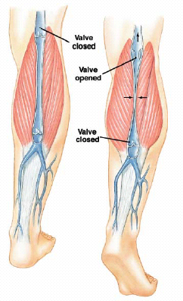
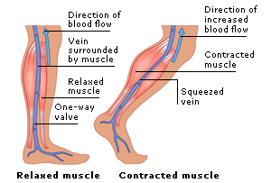
Muscular Activity and Venous Valves

Slide 36
Effects of Gravity on the
Venous System and Cardiac Output
Gravity
  Venous pooling may significantly reduce CO

Slide 37
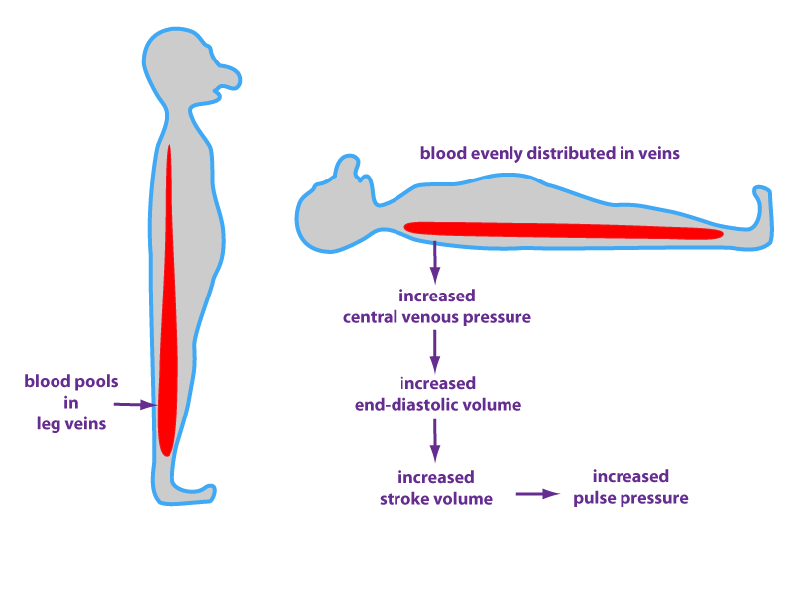

Slide 38
Cardiac Output
Factors Maintaining Cardiac Output
  Force of Contraction : depends on diastolic period and ventricular filling.
  (CO α FOC )
  Frank Starling’s Law : “With in physiological limit, The force of contraction is directly proportional to initial length of muscle fiber before onset of contraction.”
  Preload
  Afterload

Slide 39
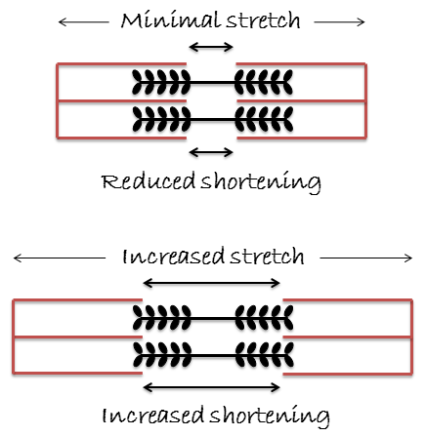
Frank-Starling Relationship

Slide 40
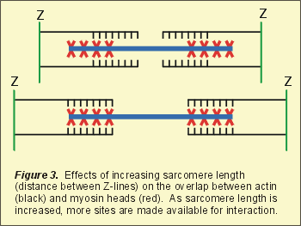
Frank-Starling Relationship

Slide 41
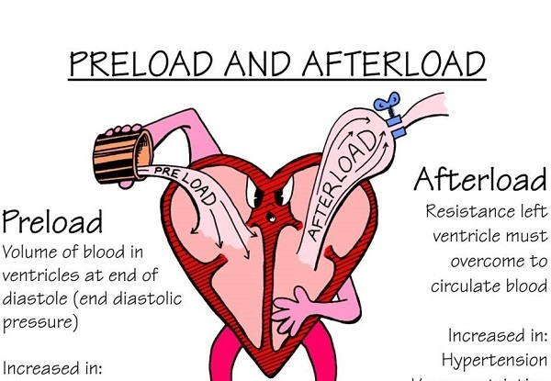

Slide 42
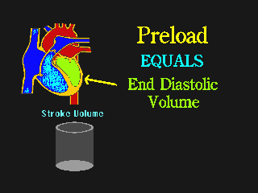
PRELOAD

Slide 43
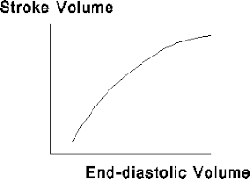

Slide 44
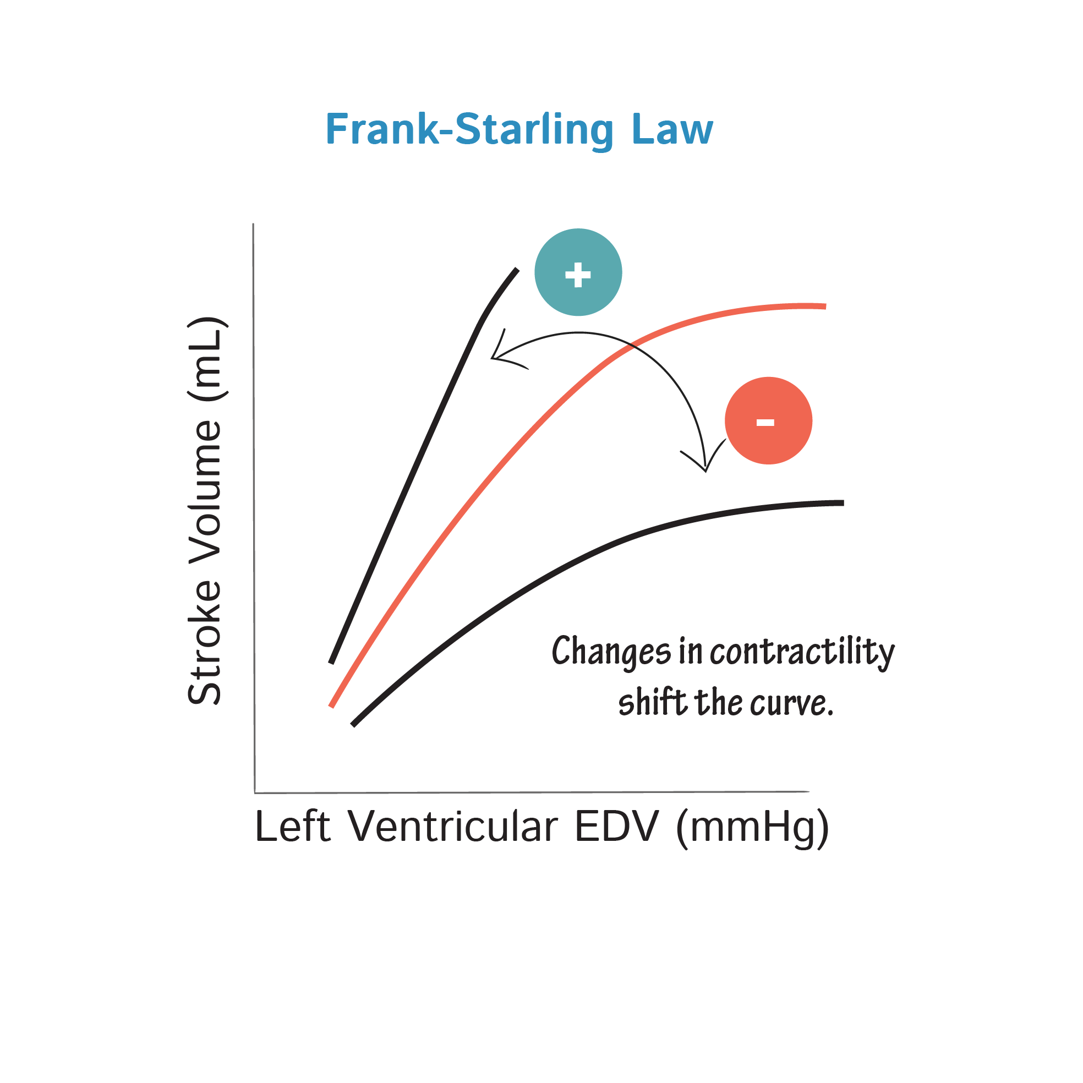

Slide 45
Clinical Significance of Frank Starling Law in Heart
Keeping the outputs of two ventricles equal
Keeping constant stroke volume when SVR increases
Life saving device in patient of heart failure and transplant

Slide 46
Bainbridge Reflex
Bainbridge reflex is an increase in heart rate due to increase in central venous pressure (if the initial HR was low).
Atrial receptors – Type B receptors (Stretch receptors)
Afferent via Vagus nerve
Efferent via sympathetic and parasympathetic
Role of ANP and ADH

Slide 47
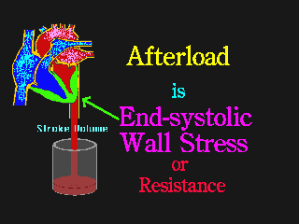
AFTERLOAD

Slide 48
Cardiac Output
Factors Maintaining Cardiac Output
  Heart Rate
  CO α HR (Directly proportional)
  Marked increase in HR , CO increased
  Marked decrease in HR , CO decreased

Slide 49
Effects of Heart Rate on Cardiac Output
Cardiac Output
Heart Rate
(Increased by Pacing)

Slide 50
Cardiac Output
Factors Maintaining Cardiac Output
  Peripheral Resistance : refers to the resistance offered to the flow of blood at the peripheral blood vessels.
  Peripheral resistance is the resistance or load against which the heart has to pump.
  CO α 1 / PR (inversely proportional to PR)
  Maximum resistance offered by Meta-arterioles (Resistance vessels)

Slide 52
Cardiac Output
Regulation of Cardiac Output
  Intrinsic Mechanism (Frank Starling Mechanism)
    Heterometric regulation
    2 to 2.5 times , 13 L /min
    important in keeping output in both pump equal transplanted heart , cardiac failure
  Extrinsic Mechanism (Autonomic Nervous Mechanism)
    Homometric regulation
    Sympathetic Activity
    Parasympathetic Activity

Slide 53
Intrinsic Regulation
Frank starling Mechanism
Depends on preload
End diastolic volume forms preload
EDV - Initial Length – FOC – CO

Slide 54
Extrinsic Regulation
Sympathetic activity
  Positive inotropic effect
Parasympathetic activity
    Negative inotropic effect

Slide 56
Integration of Intrinsic and extrinsic regulation
Shift to left
Shift to right

Slide 57
Cardiac Output
Measurement of Cardiac Output
  Direct method
    By using cardiometer
    By using flowmeter
      Mechanical flowmeter
      Electrical flowmeter
      Ultrasonic doppler flowmeter
  Indirect method
    By Fick’s Principle
    Indicator dye dilution method
    Thermodilution method
    Esophageal doppler transducer method
    Echocardiography
    ballistocardiography

Slide 58
Cardiac Output
Measurement of Cardiac Output
Fick’s principle states that amount of a substance taken up by an organ or by whole body per unit of time is equal to arterial level substance (A) minus venous level (V) times the blood flow
Q = (A-V) X F
So, F =Q / (A-V)

Slide 59
Cardiac Output
Measurement of Cardiac Output
Hamilton dye dilution method – Evan Blue
Thermo-dilution method - Cold saline
Physical Methods
  Echocardiography

Slide 60
Cardiac Catheterization
Definition
Indication
Procedure
  Left Heart
  Right Heart
Uses
  Diagnostic
  Therapeutic

Slide 61

Summary

Slide 62
Heart-Lung Preparation
Introduction : heart lung preparation is experimental setup devised by Starling.
To demonstrate the effect of various factors on heart rate & Cardiac output.
Also used to record cardiac function curves

Slide 63
Heart-Lung Preparation
Procedure
  Dog
  Anesthesia
  Dissection
  Heart – Lung isolated preparation
  Connected to various devises
  Recording

Slide 64
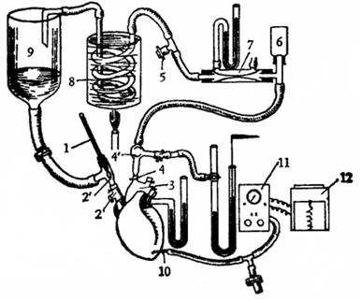
Starling’s Heart Lung Preparation

Slide 65
Heart-Lung Preparation
Uses of Heart –Lung Preparation
  Heart works as isolated organ
  So the effects of various factors can be demonstrated on the activities of heart, like HR, VR, CO
  Preload
  When VR ↓ → ↓ SV
  When VR ↑ → SV ↑
  Afterload
  When PR ↑ → CO ↓
  When PR ↓ → CO ↑

Slide 66
Cardiac Function Curves
Introduction
  Cardiac function curves are Frank Starlings curves.
  Which demonstrate the capacity of heart to maintain CO & blood circulation.
  Obtained from animal by Heart-Lung Preparation.
  Types
    Cardiac output curves
    Venous return curves

Slide 67
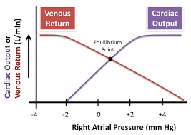

Slide 68
Cardiac Function Curves
Analysis of Cardiac Function Curves
  Cardiac output represents cardiac function curves and venous return curves represents vascular function.
  Shift to Left
  Shift to Right

Slide 69
Summary
Cardiac output
  Stroke volume
  Minute volume
  Cardiac index
  Cardiac reserve
  Ejection fraction
Variation
Measurement
Determinants
Regulation

Slide 70
Reference
Textbooks of….
Indu Khurana
Guyton
Vijaya Joshi
D.Venkatesh
K.Sembulingam
WWW…

Slide 71


Slide 72
Lecture 5 Cardiac Output @ CVS
CCES

Slide 73
Continuous Cumulative Evaluation System
Q. 1 : Amount of Blood Ejected by Each Ventricle per beat is known as …..
Stroke Volume
Cardiac Output
Cardiac Index
Cardiac Reserve

Slide 74
Continuous Cumulative Evaluation System
Q. 2 : Amount of Blood Ejected by Each Ventricle per minute is known as …..
Stroke Volume
Cardiac Output
Cardiac Index
Cardiac Reserve

Slide 75
Continuous Cumulative Evaluation System
Q.3 All the following factors are directly proportion to cardiac output (provided other factors constant) EXCEPT
Venous Return (Pre load)
Force of Contraction
Heart Rate
Peripheral Resistance (After load)

Slide 76
Continuous Cumulative Evaluation System
Q.4 : Which law states that “ With in physiological limit, Force of contraction is directly proportional to Initial length of muscle fibers”
Marey’s Law
All or None Law
Frank Starling’s Law
Bell Magendie’s Law

Slide 77
Continuous Cumulative Evaluation System
Q.5 All the following factors increase Cardiac Output EXCEPT
Fever
Exercise
Thyrotoxicosis
Sleep

