Slide 1
POSTURAL STRAIN AND OCCUPATIONAL HAZARDS
Dr. Jay Soni
M.P.T.-Musculoskeletal

Slide 2
Objectives of lecture
By the end of lecture students will be able to :
Describe in brief about good body mechanic like:
Identifying Proper lifting techniques
Identifying proper positioning at various work places like: at school, Industries, at Home.

Slide 3

INTRODUCTION
POSTURAL STRAIN- Postural strain often arises from prolonged or repeated activities or poor postures, such as that associated with sitting at a computer all day.
OCCUPATIONAL HAZARDS- An occupational hazard is something unpleasant that you may suffer or experience as a result of doing your job or hobby.

Slide 4
  AWKWARD POSTURES:
  Awkward postures are body positions that stress the muscles and joints.
  If you work in these positions too frequently or for too long at a time, the stress can result in injury.

Slide 5
Correct body posture/ Body Dynamics
We use our body to produce motion that is safe, energy conserving, and anatomically and physiologically efficient.
The body’s muscles, ligaments and joints are involved in adopting a posture, carrying out a movement and applying a force.

Slide 6
Benefits of Proper Body Mechanics
It Conserves Body energy
Reduce stress and strain to muscles, joints, ligaments, and soft tissue
Promote effective, efficient respiratory and cardiopulmonary function
Promote and maintain proper body control and balance
Promote effective, efficient, and SAFE movements

Slide 7
Mechanics: Poor Posture
Poor posture and movement can lead to stress on the muscles, ligaments and joints, resulting in complaints of the neck, back, shoulder, wrist and other parts of the musculoskeletal system.

Slide 8
Important Principles to maintain a good posture and movement
1. Joints must be in a neutral position
2. Keep the work close to the body
3. Avoid bending forward
4. Avoid repeated twisting of trunk
5. Avoid sudden movements and forces
6. Avoid sustained postures and movements

Slide 9
7. Limit the duration of any continuous muscular effort
8. Prevent muscular exhaustion / fatigue
9. More frequent or short breaks are better than a single long one.

Slide 10
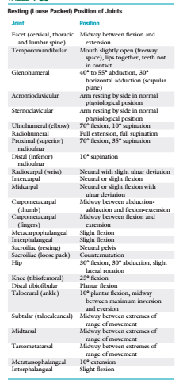
Joints must be in a neutral position

Slide 12
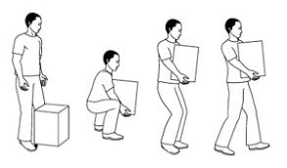
Keep the work/Load close to the body & Avoid bending forward

Slide 13
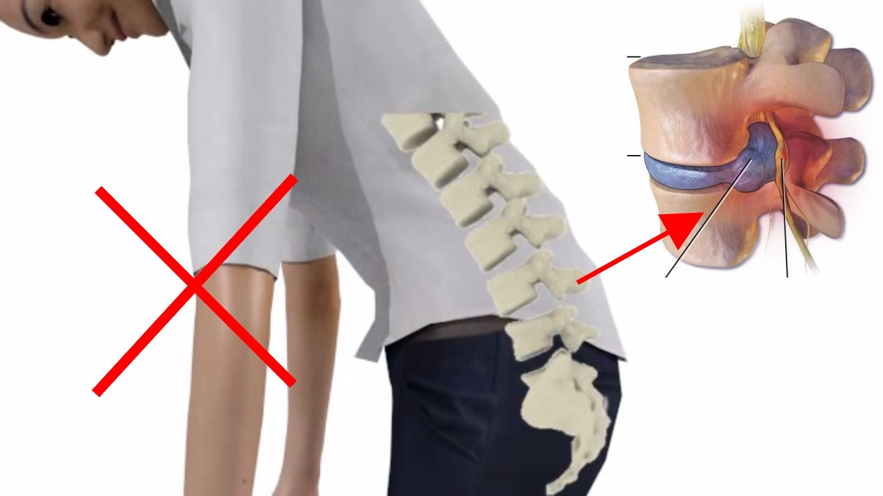
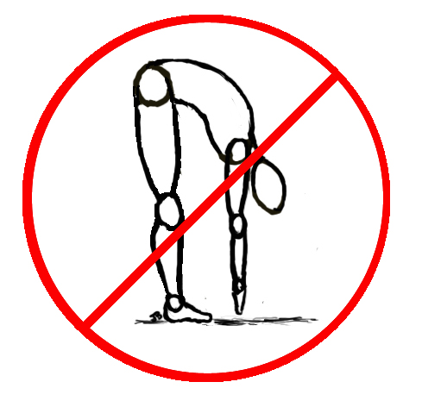
Stress forces at spine

Slide 14
Common places where of Correct Body Mechanics is essentially required
At School(For Teachers and Students)
At Home
At Work place
For patients & Physiotherapists
Risk factors and Awkward Posture to be Understood for the same

Slide 15
Body Mechanics at School

Slide 16
COMMON WORK TASKS OF
A SCHOOL TEACHER
Blackboard teaching
Prolonged Standing
Correcting assignments
Computer work
Frequent reading
Managing a class
Participating in different school committees

Slide 17
Awkward Posture for Teachers
Prolonged overhead writing and head-up position on the upper part of a blackboard
Back bent more than 30º
Head down postures while correcting assignments
  Forward head posture while working on computers

Slide 18
Incorrect working posture during marking homework at a pupil’s desk
Repetitive twisting postures during lectures
Prolonged sitting or standing while teaching
Poor posture and improper techniques of lifting or carrying eg., books OR other objects

Slide 19

Awkward Posture for teacher

Slide 20
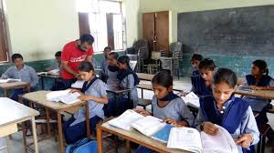
Teacher bending forward to monitor copies

Slide 21
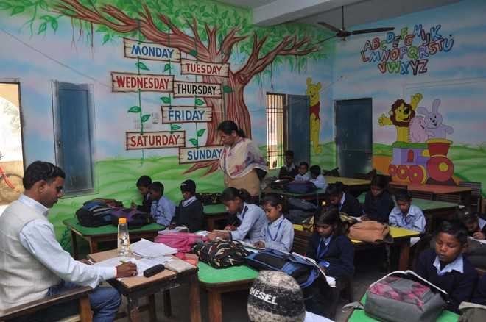
Teacher monitoring class

Slide 22
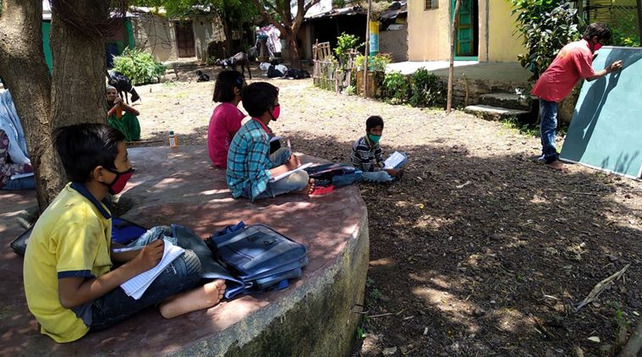
Teacher writing on board

Slide 23
FOR SCHOOL CHILDREN
Activities of school going children involve
Heavy back-pack lifting
Sitting at desks for long period of time
Writing without desk
Copying from black board

Slide 24
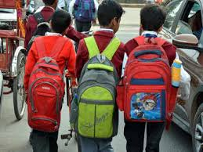

Students carrying Back pack

Slide 25

Writing on desk

Slide 26

Writing without desk

Slide 27
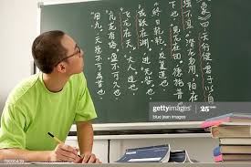
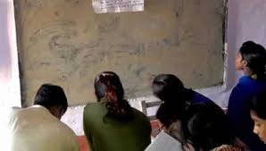
Writing from black board

Slide 28
Body Mechanics at Home
Body mechanics at home is a term used to describe the ways we move as we go about our daily lives.
It includes how we keep our body when we sit, stand, lift, carry, bend, and sleep.
Poor body mechanics are often the cause of body problems.
The following are some suggestions for activities that you may use with daily activities:

Slide 29
Basics of Body Mechanics
Quantify the load before you lift and assure that you can lift it
Think before you lift
Keep your back in its natural curve
Maintain a wide base of support
Hold objects as close to you as possible
Do not twist when carrying
Tighten stomach muscles when lifting
Lift with the legs or use the large muscles
Maintain good communication if two or more people are involved

Slide 30
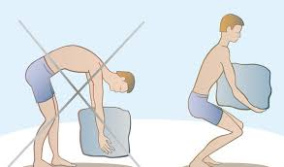
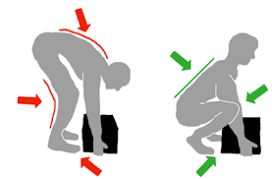
Lifting weight

Slide 31
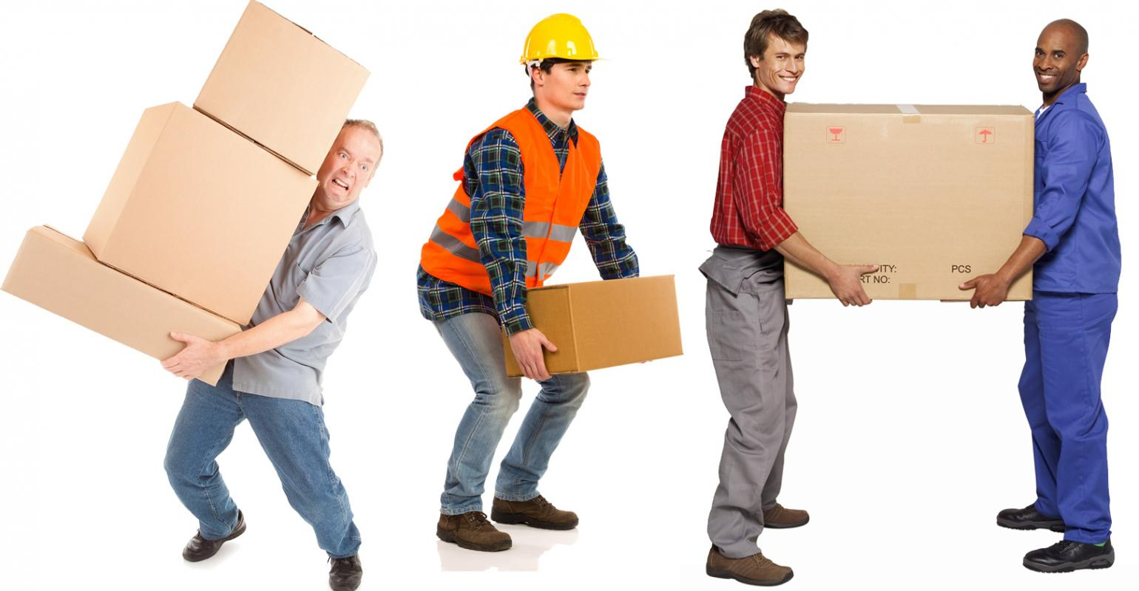
Lifting excessive weight

Slide 32
With the help of person

Slide 33
Move obstacles out of the way
Push rather than pull
Eliminate repetitive lifting duties if possible

Slide 34
Body Mechanics at Home

Slide 35
