Slide 1
Postural Strain and Occupational Hazards
Dr.Jay Soni
Assistant Professor

Slide 2
Objectives of lecture
By the end of lecture students will be able to :
Body mechanics
at workplace
While handling Patients
For Physiotherapist

Slide 3
Body Mechanics at Workplace
IS YOUR WORK ENVIRONMENT SAFE?
Employees in certain work environments may be at greater risk for injury, but office workers are specially at risk.
Many office injuries are caused by the repetitive tasks that put strain on our muscles and joints.

Slide 4
Overuse of the muscles through repeated movements can put stress on your body, causing a Repetitive Strain Injury (RSI).
Other names for RSI include Cumulative Trauma Disorder and Repetitive Motion Injury.

Slide 5

Awkward Postures
Reaching
Twisting
Bending
Kneeling
Squatting
Working overhead
Holding fixed positions

Slide 6

Contact Stress
Pressing your body
  against a hard or
  sharp edge
Puts pressure on nerves,
tendons, and blood
vessels
Allowing your wrists to
rest on the keyboard
when typing
Holding tools with
hard handles

Slide 7
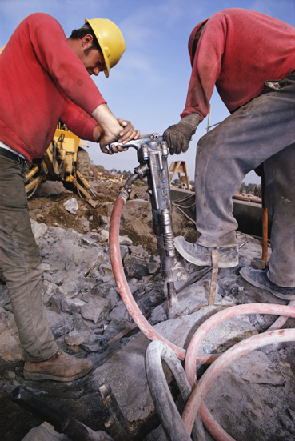
Vibration
Sanders
Grinders
Chippers
Routers
Drills
Saws

Slide 8

Video display terminal(VDT) USER`S-ERGONOMIC GUIDELINES
WORKING POSTURE
Wrist and forearm-held in straight line to reduce tendon & nerve stress
Upper & lower arm-at 90 degree angle
Elbows to be kept close to the sides
Head-Screen distance=25-48 inches from the VDT users eye
Optimal viewing angle is 20 degrees below the horizontal line from the eyes

Slide 9
VDT USER`S-ERGONOMIC GUIDELINES
VISION & LIGHTING
*NO GLAIR
*VDT to be placed 90 degrees to the light source, adjust screen angle
*Use screen filters to reduce glare
*Screen intensity needs to be adjusted
*Frequent breaks from the screen to reduce stress on eyes
*Screen Reflection / illusion

Slide 10
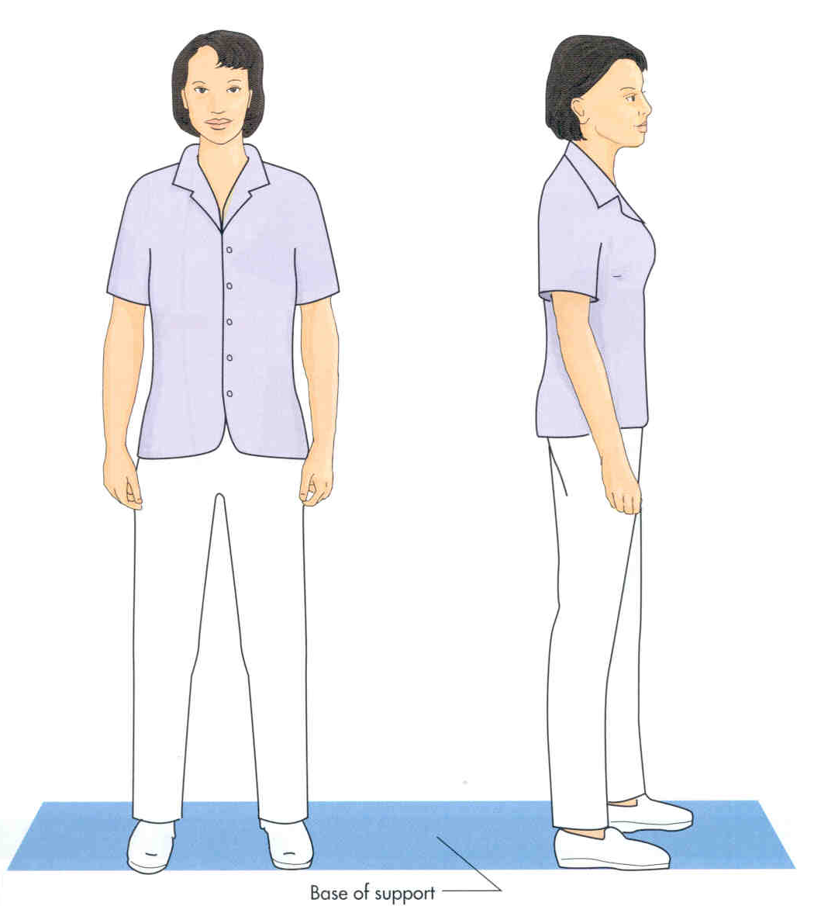
BASE OF SUPPORT
THE AREA ON WHICH AN OBJECT RESTS
A GOOD BASE OF SUPPORT IS NEEDED FOR BALANCE WHEN LIFTING
YOUR FEET ARE YOUR BASE OF SUPPORT
STAND WITH YOUR FEET APART FOR A WIDER BASE OF SUPPORT AND MORE BALANCE

Slide 11
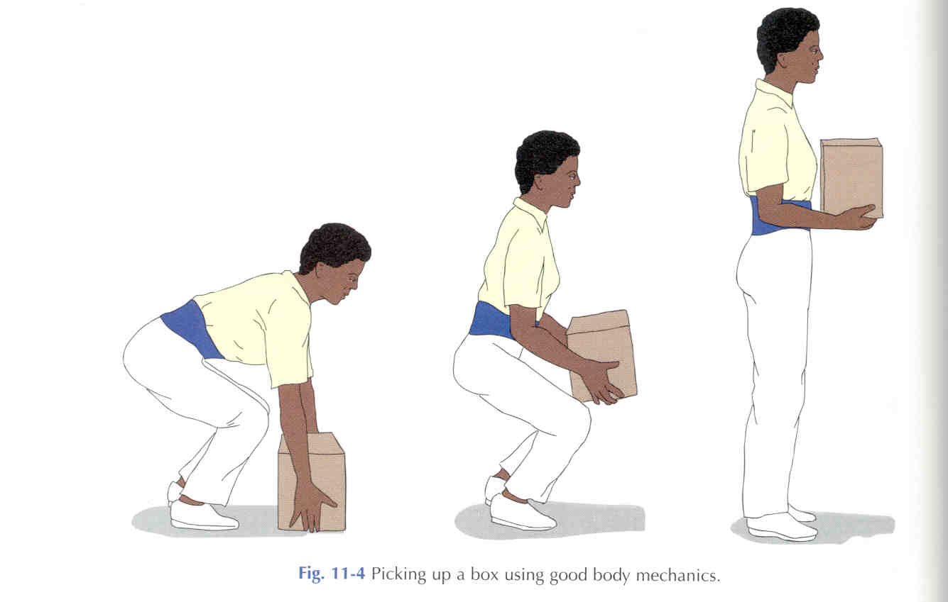
BEND YOUR KNEES AND SQUAT TO LIFT A HEAVY OBJECT
DO NOT BEND FROM YOUR WAIST

Slide 12
Standing
Bring your work close to you.
Put one foot up, shift your weight and position frequently.
Keep your work at a comfortable height.
Wear comfortable shoes and stand on an anti-fatigue mat, if possible.

Slide 13
Standing
DO NOT:
Stand in one place too long.
Stand bent forward at your waist or neck.
Lock your knees into a straight or over-extended position.

Slide 14

Pushing
Push whenever possible.
Keep head up, knees bent, and back straight.
Keep the load in front and use both hands.
Remain close to the item being pushed.

Slide 15
Pulling or Twisting
DO NOT:
Pull when you can push
Twist your body
Lean forward

Slide 16
Carrying Objects or
Lifting items
When carrying objects:
Test the load first
Use a cart/transfer device whenever possible
Pivot with your feet - don't twist at waist
Take multiple trips
Use both hands
Keep objects near your body and directly in front of you
Ask for assistance with heavy items.

Slide 17
Lifting
When lifting objects, DO NOT:
Lift in a bent-over, stooped position
Twist at waist
Lift with one hand
Lift with outstretched arms
Keep feet together
Lift above shoulders or below knees when feasible

Slide 18
Reaching
When reaching for an object, remember to:
Keep back straight
Reach with two hands
Face the object
Stand on a stable step-stool to reach high items
Bend knees slightly.

Slide 19
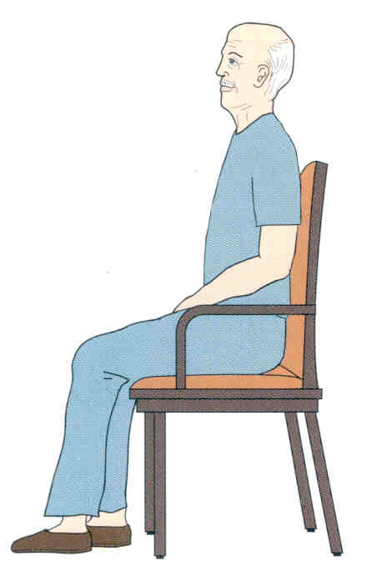
PROPER POSITIONING IN A CHAIR
THE PERSON IN A CHAIR SHOULD SIT UP STRAIGHT
THE BACKS OF HIS KNEES
SHOULD BE SLIGHTLY AWAY
FROM THE SEAT OF
THE CHAIR
HIS LOWER BACK SHOULD REST AGAINST THE BACK OF THE CHAIR
HIS FEET SHOULD EITHER REST ON THE FLOOR OR ON A STOOL

Slide 20
Sitting and Computer station work
Sit close to your work
Hips, knees and ankles are open to 90 degrees
Elbows are open to 90-120 degrees
Wrists are in relaxed and neutral position (not bent)
Both feet are flat on the floor or use a foot rest
Shoulders are low and relaxed
Head and neck are aligned with spine

Slide 21
Sitting and Computer station work
Do not slump or lean forward or downward to reach for work.
Do not sit for more than 60 minutes without getting up or changing position.
Raise the height of the computer screen so screen is at or slightly below eye level.

Slide 22
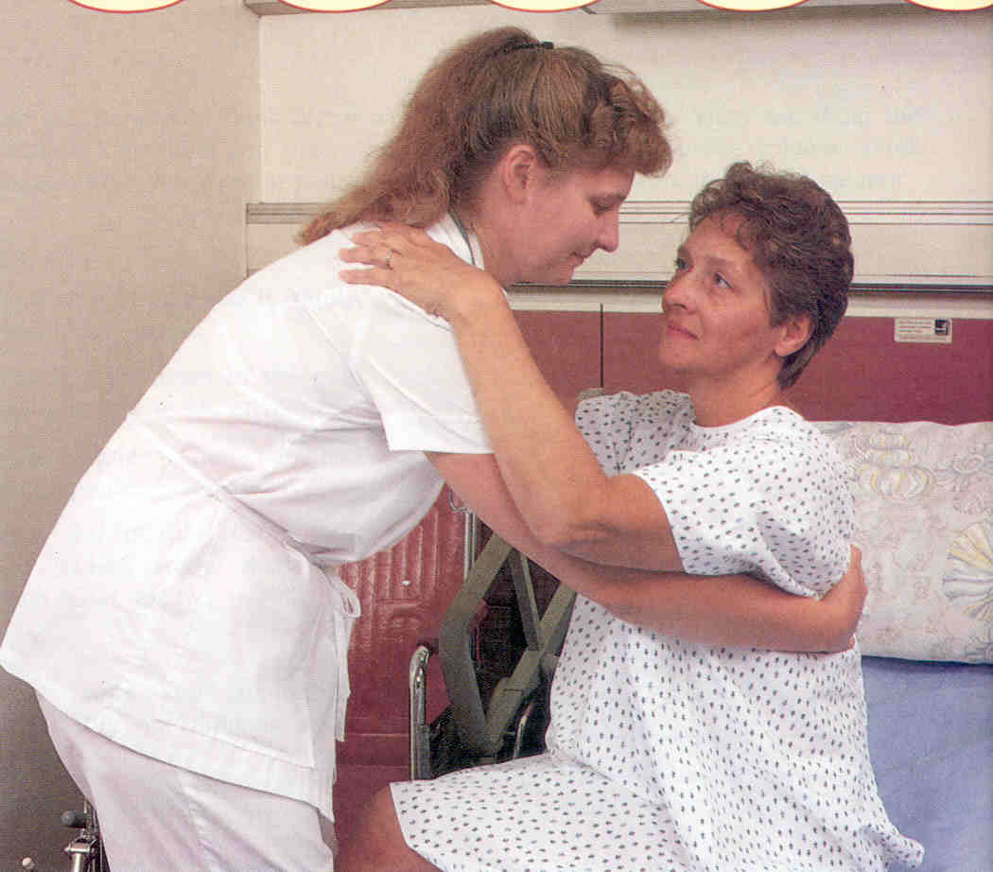
Proper Body Mechanics for Handling Patients

Slide 23
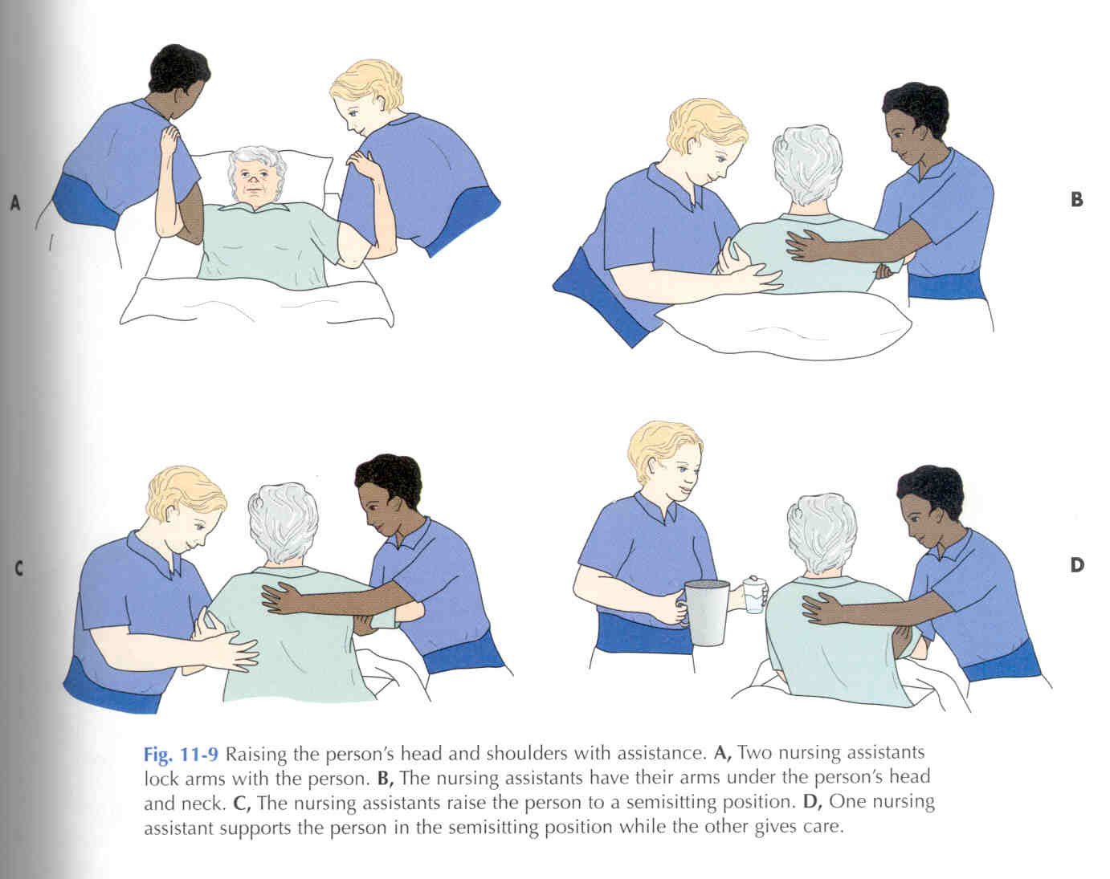
RAISING THE SHOULDERS
WITH TWO HELPERS

Slide 24
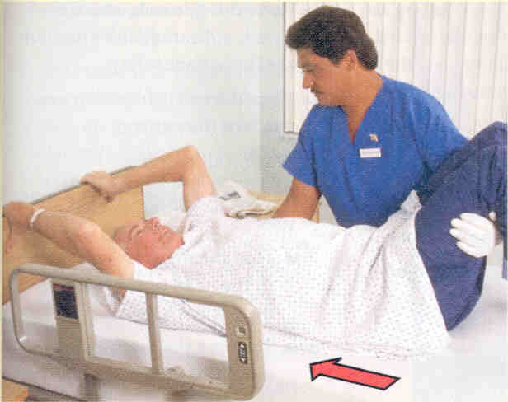
ASSISTING A PATIENT TO MOVE
UP IN BED
IF THE PATIENT CAN ASSIST:
HAVE THE PATIENT GRASP THE HEADBOARD AND BEND HIS KNEES
PLACE YOUR FOREARMS UNDER HIS SHOULDERS AND KNEES
LIFT AT THE COUNT OF THREE

Slide 25
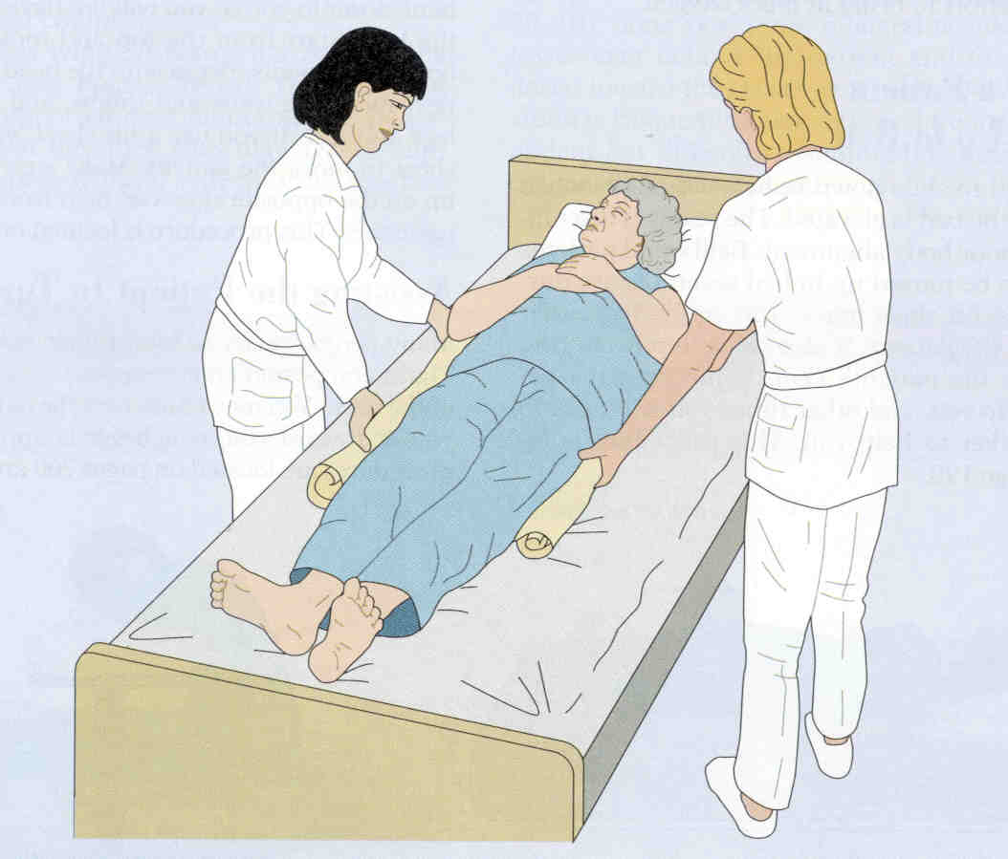
USING A LIFT SHEET
A LIFT SHEET MAKES LIFTING EASIER
HELPS PREVENT FRICTION AGAINST THE PATIENT’S SKIN
TAKES TWO WORKERS TO LIFT
IF PATIENT CAN HELP HAVE HIM BEND HIS KNEES
USE FOR PERSONS WHO CAN NOT HELP WITH THE MOVE

Slide 26
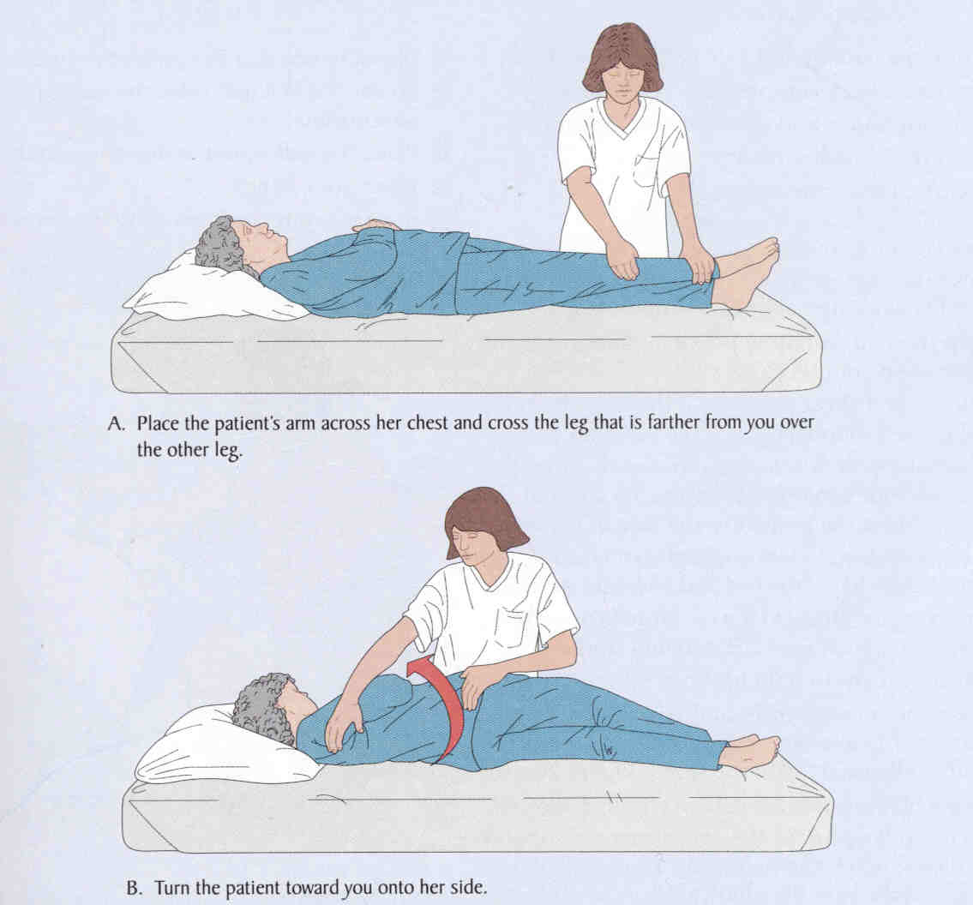
TURNING A PATIENT

Slide 27
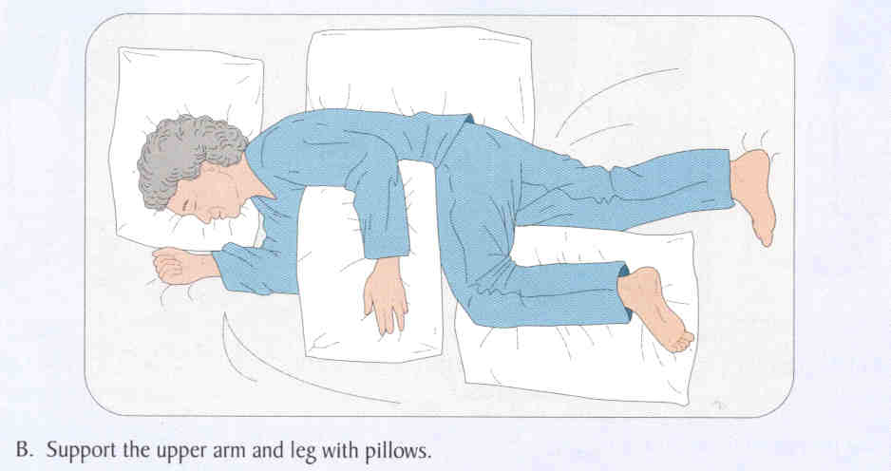
PROPER POSITIONING FOR LATERAL POSITION

Slide 28
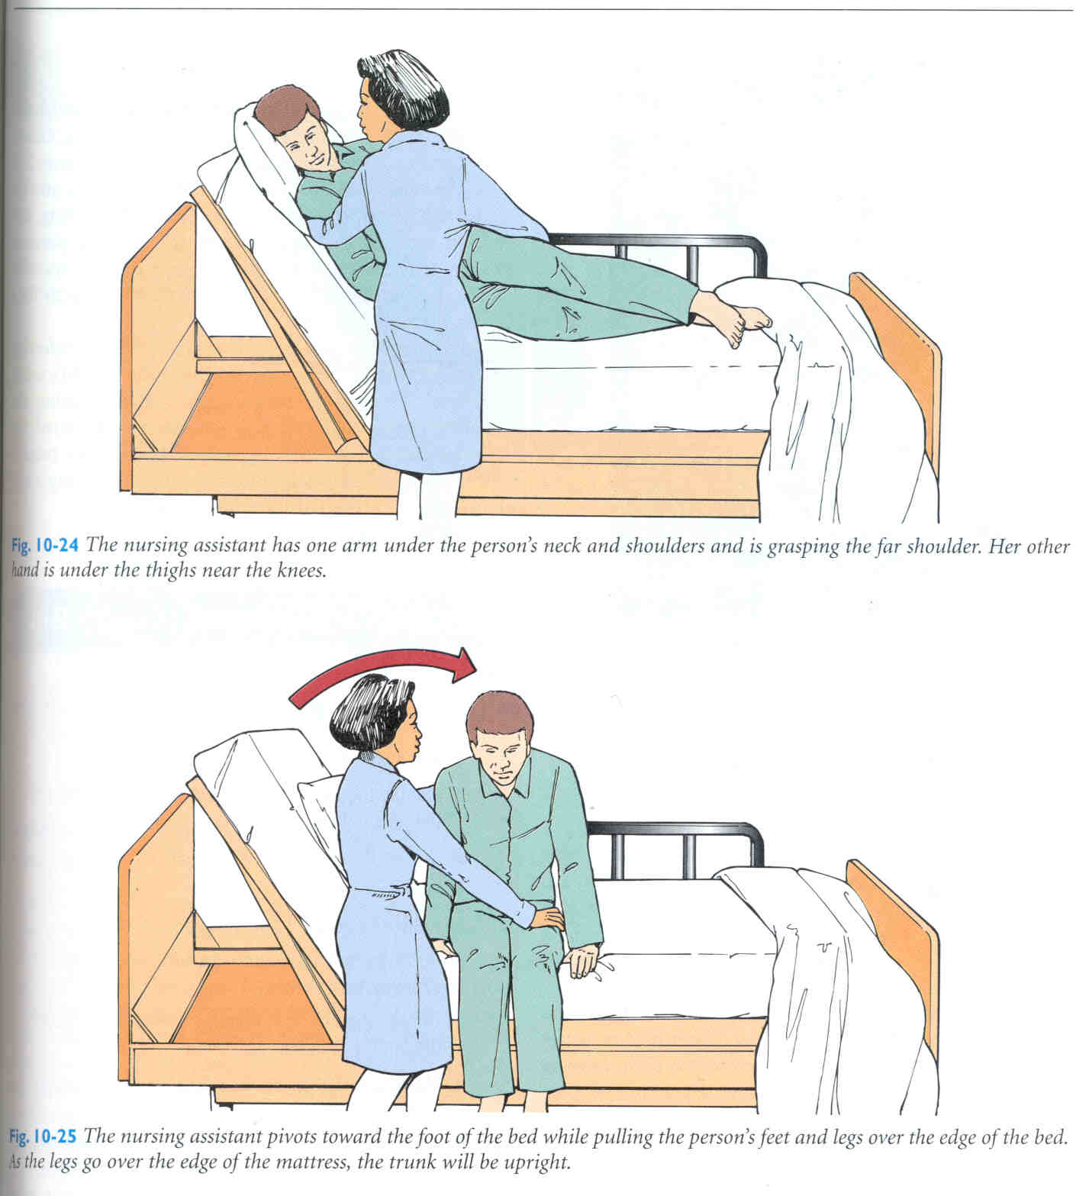
ASSISTING TO DANGLE
DANGLING REFERS TO SITTING ON THE SIDE OF THE BED WITH THE FEET HANGING DOWN

Slide 29
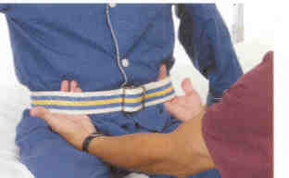
RULES FOR GAIT BELT / TRANSFER BELT
APPLY THE BELT AROUND THE PERSON’S WAIST, OVER THE CLOTHING.
TIGHTEN THE BELT SO IT IS SNUG. IT SHOULD NOT CAUSE DISCOMFORT OR IMPAIR BREATHING. YOU SHOULD BE ABLE TO SLIDE YOUR OPEN HAND UNDER THE BELT.
PLACE THE BUCKLE SLIGHTLY OFF CENTER IN THE FRONT.
DO NOT USE WITH PATIENTS WITH FRACTURED RIBS, ABDOMINAL SURGERY, OR HAVING BREATHING DIFFICULTIES

Slide 30
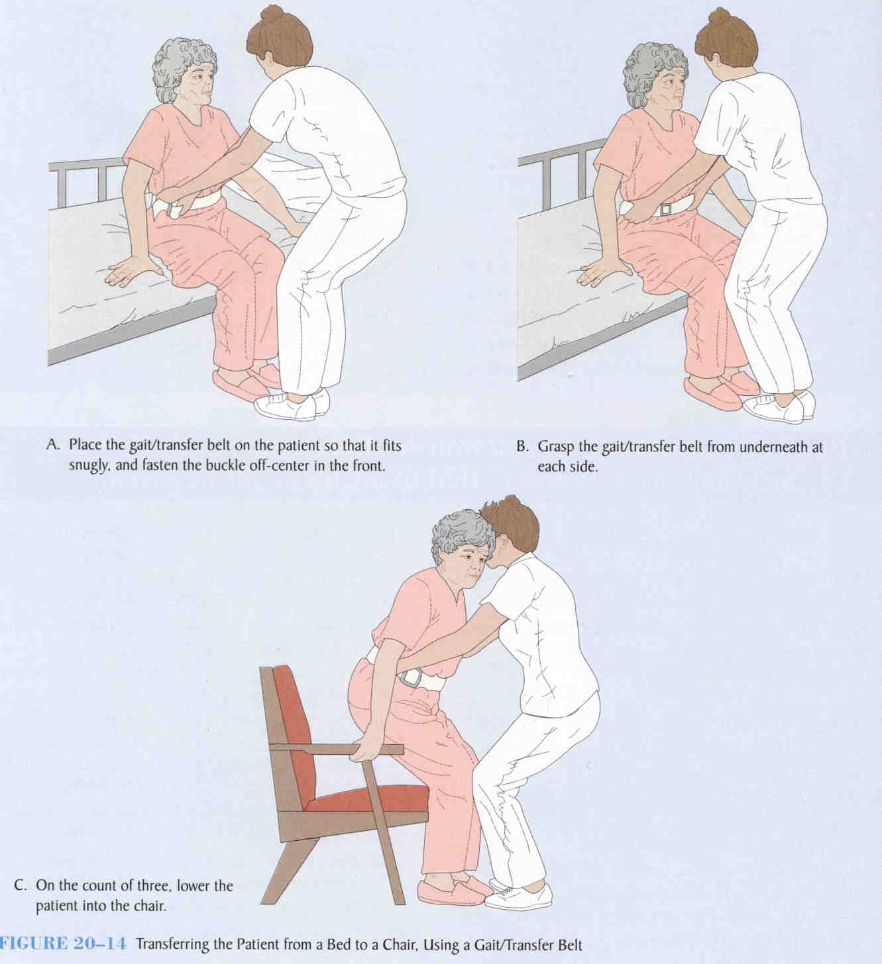

Slide 31
Patient movement or transfer
Update yourself on the patient's physical limitations or condition.
Let the patient know what you are going to do so they may assist.
Position the patient for transfer.

Slide 32
Prepare Yourself/Team
Keep feet apart, knees bent with back and head straight
Be close to patient
Use transfer device to assist in moving patient: transfer belt, slide board
Pivot feet, don't twist waist
Have adequate number of persons to transfer patient (based on patient's size and/or type of transfer required)

Slide 33
Prepare Equipment
Use mechanical lifts when possible.
Lock wheels of bed, wheelchair or stretcher.
Adjust position and height of bed, wheelchair or stretcher.
Do not attempt to move patients by yourself. This may cause injury to yourself or the patient.

