Slide 1
REVISION
Cardiac Cycle
Definition
Events
  Electrical
  Mechanical
Phases of Cardiac Cycle
  Atrial
  Ventricular

Slide 2
Continuous Cumulative Evaluation System
Question 1
At the heart rate of 75/Min, Normal Duration of Cardiac Cycle = ______ sec
0.08
0.6
0.8
8

Slide 3
Continuous Cumulative Evaluation System
Question 2
First heart sound is heard during which phase ?
Isovolumetric Relaxation phase
Last Rapid filling Phase
First Rapid filling Phase
Isovolumetric Contraction Phase

Slide 4
Continuous Cumulative Evaluation System
Question 3
Heart sound recoded as graph known as;
Electrocardiogram
Phonocardiogram
Sphygmogram
Electroencephalogram

Slide 5
Continuous Cumulative Evaluation System
Question 4
Following is not an event in the ventricular systole
Diastasis
Isovolumetric contraction phase
Rapid Ejection phase
Reduced Ejection Phase

Slide 6
Continuous Cumulative Evaluation System
Question 5
In cardiac cycle, during which phase AV valves and semilunar valves remain closed ?
Atrial systole
Isovolumetric relaxation phase
Rapid ejection phase
First rapid filling phase

Slide 7

HEART SOUND
Dr. Mahavirsingh H. Rajput
Professor
Department of Physiology
Smt. B.K. Shah M.I. & R.C.

Slide 8

Heart Sound ????
No…No..
You Idiot its
Lub… Dub…
Dhak… Dhak…

Slide 9
Learning Objectives
After this lecture you will be able to understand ;
  What is heart sound ?
  Why heart sounds are generated ?
  Which instruments is required ?
  Where to listen ?
  How to auscultate or record heart sounds ?
  What is murmur ? Why & when it produces ?
  When murmur appearing ?

Slide 10
Overview
Definition & Introduction
Types of Heart Sound
Normal Heart Sounds
Valves Locations & Auscultatory Areas
Phonocardiography
Difference between different heart sounds (S₁ Vs S₂)
Applied Physiology : Abnormal Heart Sounds (Murmur)
Stenosis Vs Regurgitation

Slide 11
Heart Sound : Introduction
Definition : is sound or noise produced by vibration due to certain mechanical activities of heart during each cardiac cycle transmitted to surrounding tissue then to chest wall, heard or recorded from precordium.
Heart sounds are generally produced by movements of;
  Valves of heart
  Blood through chamber of heart
Heard by placing the ear over chest wall or by using stethoscope or microphone. These sound can be recorded graphically by PHONOCARDIOGRAM

Slide 12

Importance of Heart Sound
The study of heart sounds has important diagnostic as well as prognostic value in clinical practices
because the alteration in the heart sounds may indicate the underlying serious cardiac ailment involving heart valves & heart.
From START of Life to END of Life…

Slide 13
Classification of Heart Sounds
Heart Sounds
Normal Heart Sounds
Abnormal Heart Sounds
(MURMUR)
Systolic M.
Diastolic M.
Continuous M.
First HS
Second HS
Third HS
Fourth HS

Slide 14
Normal Heart Sounds
Four Heart Sounds can be recorded via phonocardiography, but normally only Two Heart Sounds, the First and the Second heart sounds, are audible through a stethoscope.

Slide 15
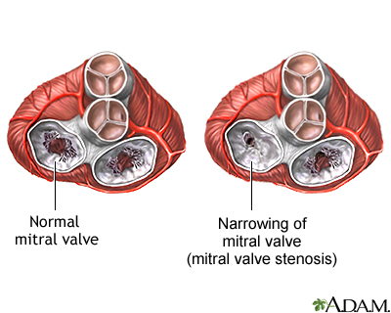
Anatomo-physiology Of Heart Sound
FOUR HEART VALVES
  Two AtrioVentricular (AV) Valves
    Tricuspid Valve (Rt side)
    Mitral Valve (Lt side)
  Two Semilunar (SL) Valves
    Pulmonary Valve (Rt side)
    Aortic Valve (Lt side)

Slide 16
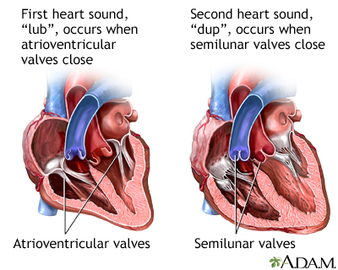

Slide 17
Types of Normal Heart Sound
First Heart Sound (S1) : at Onset of isovolumetric contraction phase due to Closure of AV valves
Second Heart Sound (S2): at Onset of isovolumetric relaxation phase due to Closure of SL valves
Third Heart Sound (S3): during First Rapid filling Phase due to turbulence of blood flow (After opening of AV valves)
Forth Heart Sound (S4): during Second or Last Rapid filling phase due to turbulence of Blood flow (Atrial Contraction)

Slide 18
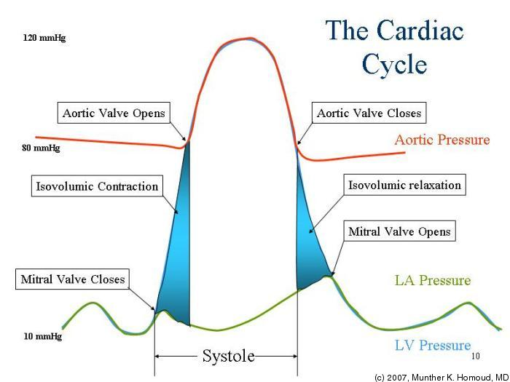
Dub
Lub

Slide 19
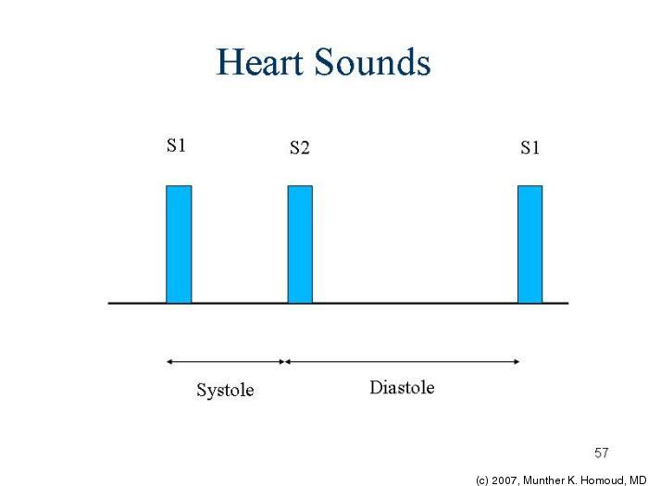
Lub
Dub
Lub

Slide 20
Anatomy of Heart Sounds
LUB---DUB-------------LUB---DUB
S1 S2 S3 S4 S1 S2
The time between lub to dub → Clinical SYSTOLE
The time between dub to next lub→ DIASTOLE

Slide 21
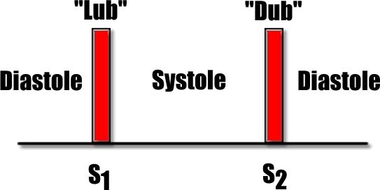

Slide 22
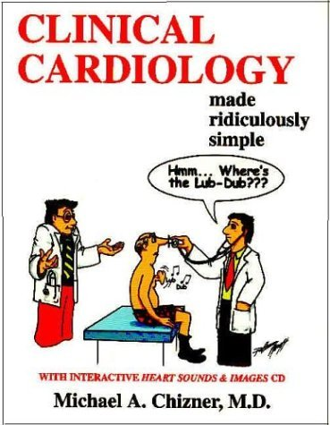

Slide 23
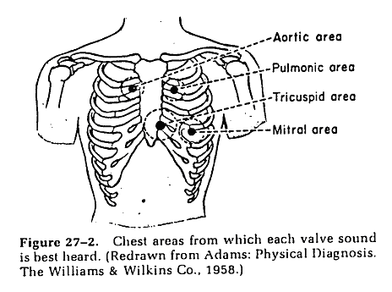
Where to Auscultate ?

Slide 24
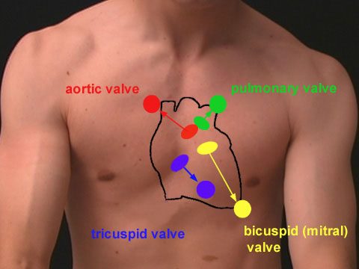
LOCATION OF VALVES & AREAS

Slide 25
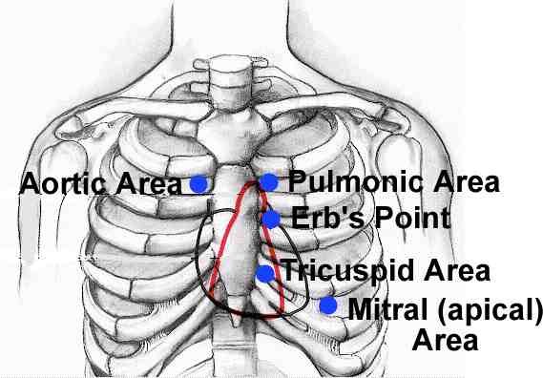
Auscultatory Area Over the Chest

Slide 26
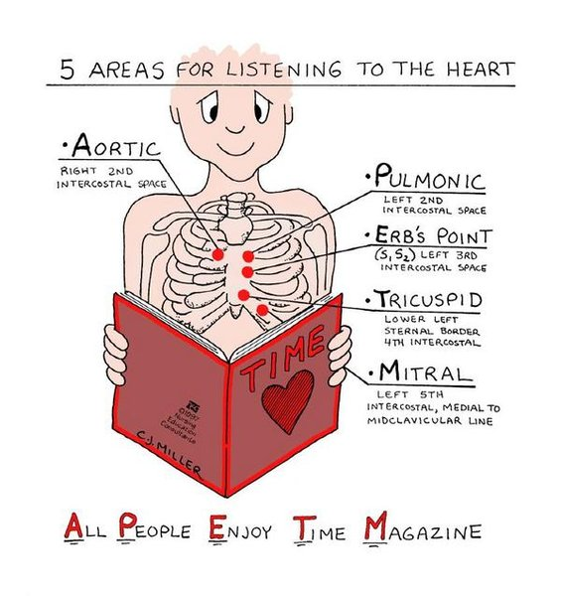

Slide 27
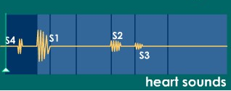
Description of Heart Sounds
First Heart Sound (S1) : Lubb or Lub
Second Heart Sound (S2): Dubb or Dup
Third Heart Sound (S3) : Ventricular gallop or Diastolic gallop
Fourth Heart Sound (S4) : Atrial Gallop or Presystolic Gallop

Slide 28
FIRST HEART SOUND:
occurs when the Atrioventricular (AV) valves close at the beginning of ventricular contraction.
is louder, longer, more resonant than the second heart sound.

Slide 29
First Heart Sound Characteristics
Cause : Sudden & synchronous (Simultaneous) Closure of AV valves
Duration : 0.10 to 0.17 sec (Long)
Frequency : 25 -45 cycles/ second (Low pitch)
In ECG : coincides with “R” Wave
Phonocardiogram : 9-13 vibrations, Crescendo & diminuendo.

Slide 30
Importance of First Heart Sound
Sensitive Indicator of myocardial contractibility.
Sensitive indicator of function of AV valves.

Slide 31
Applied Physiology
Reduplication of First heart Sound : Splitting of S1 : Stenosis or Septal Defects
Soft First heart sound : Pericardial effusion
Loud first heart sound : Rheumatic Heart Disease
Cannon Sound : VT

Slide 32
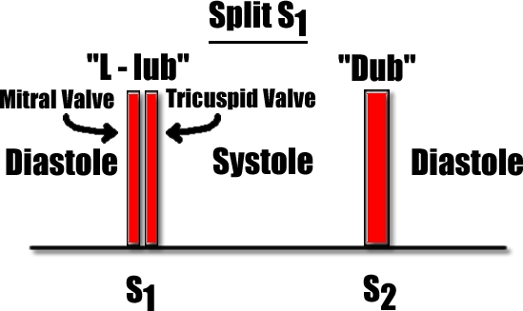

Slide 33
SECOND HEART SOUND
occurs when aortic and pulmonary semilunar valves close at the beginning of ventricular diastole
- Aortic valve closes slightly before pulmonary valve.

Slide 34
Second Heart Sound Characteristics
Cause : Sudden & almost simultaneous closure of SL valves
Duration : 0.10 to 0.14 sec (Short)
Frequency : 50 cycles/ second (High pitch)
In ECG : coincides with “T” Wave
Phonocardiogram : 4-6 vibration, Same amplitude

Slide 35
Applied Physiology
Reduplication of Second heart Sound : Splitting
  Physiological Splitting
  Pathologial Splitting
  Reverse Splitting
Loud S2 : Systemic or Pulmonary Hypertension
Soft S2 : Heart Failure

Slide 36
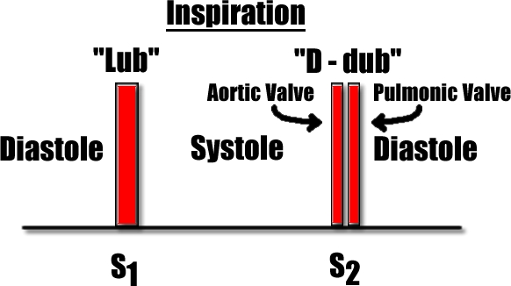

Slide 37
Differences between First and Second Heart Sounds
S1 Vs S2
First heart sound S1
Second heart sound S2
Closure of AV valves
0.10 to 0.17 sec
Syllable ‘lubb’
Long, loud, low pitch
Mitral , tricuspid area
Coincides with R-wave
Onset of Contraction
Pre- Carotid Pulse
A-L-L-L-L
Closure of Semilunar valves
0.10 to 0.14 sec
Syllable ‘ dubb’
Short , sharp, high pitch
Pulmonary & Aortic area
(Splitting present)
Coincides with T wave
Onset of Relaxation
Post- Carotid Pulse
S-S-S-S-H

Slide 38
Third heart Sound
Low pitched sound
Rapid filling of ventricles
Ventricular gallop or diastolic gallop

Slide 39
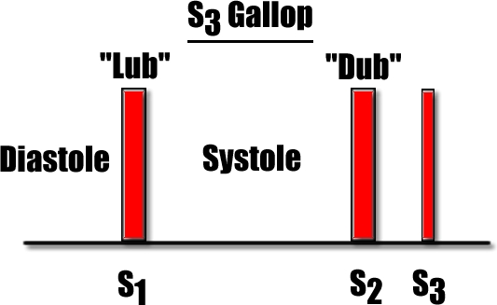

Slide 40
Third Heart Sound : Characteristics
Cause : Rapid filling of ventricle
Duration : 0.07 to 0.10 sec
Frequency : 1-6 cycles/ second
In ECG : coincides between “T” & “P” Waves
Phonocardiogram : 1-4 vibration

Slide 41
Condition of Third Heart Sound becomes audible by Stethoscope
Physiological S3
  Children
  Athletes
  Pregnancy
Pathological S3
  After age of 40 Years
  CHF, AR, Dilated ventricles

Slide 42
Fourth Heart Sounds
An inaudible sound
Pathologic conditions : audible
Produced due to atrial systole
Atrial gallop or presystolic gallop

Slide 43
Fourth Heart Sound : Characteristics
Cause : Rapid Filling of ventricle due to atrial systole
Duration : 0.02 to 0.04 sec
Frequency : 1-4 cycles/ second
In ECG : appears between “P” & “Q” Waves
Phonocardiogram : 1-2 vibration

Slide 44
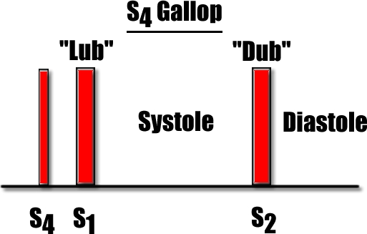

Slide 45
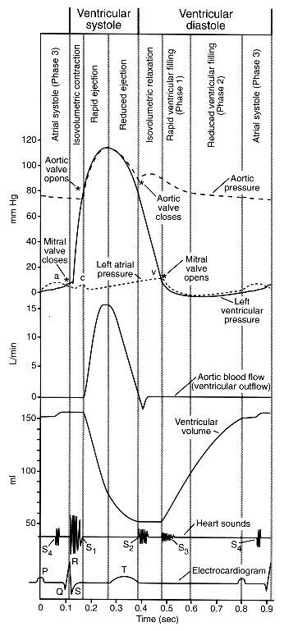

Slide 46

Method to Study Heart Sound
Auscultation with Stethoscope : 1st & 2nd
By using Microphone : 1st , 2nd & 3rd .
Phonocardiogram : All Four Sounds

Slide 47
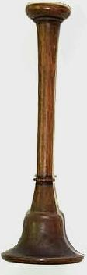
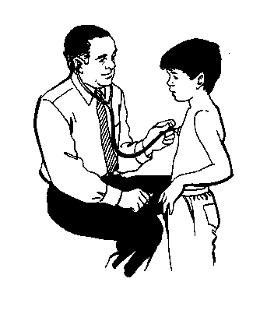
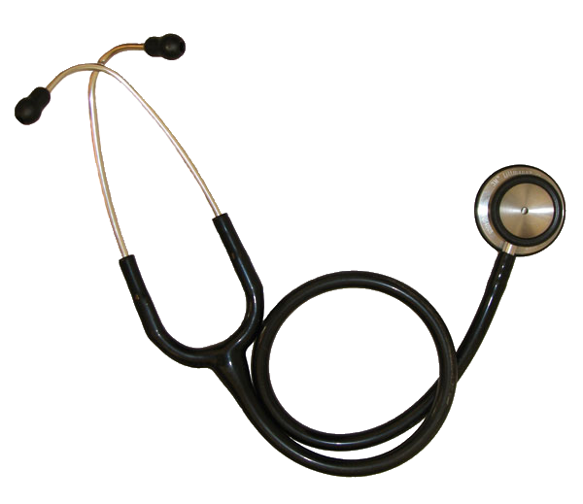
By using Stethoscope
The first and second heart sounds are heard on the auscultatory areas by using the stethoscope.
4 Auscultatory Area

Slide 48
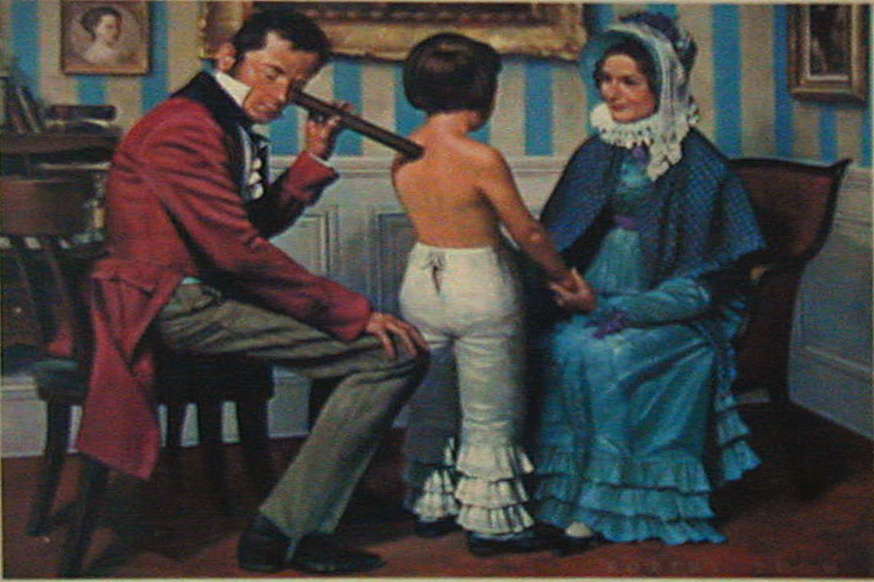
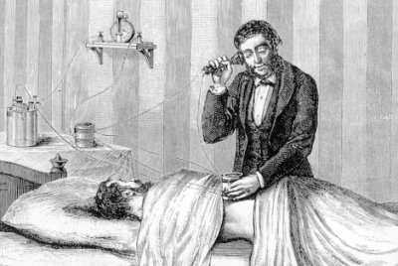
Historical Aspect of Stethoscope
LAENNEC

Slide 49
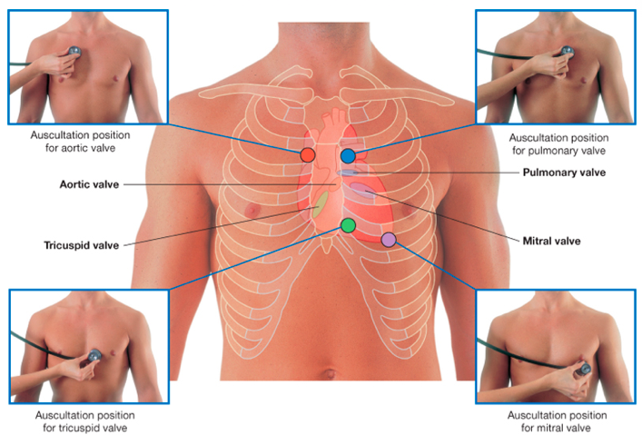

Slide 50

Hello, Students
I Wanna Play
A Game - Quiz

Slide 51
Quiz Game
Identify the area ?
Anatomical Location ?
Which heart sound better heard over here ? Why ?
Clinical Significance ?

Slide 56

By Using Microphone
A highly sensitive microphone is placed over the chest. The heart sounds are amplified by means of amplifier and heard by using loud speaker.
S1, S2, S3 are heard

Slide 57
By Phonocardiogram
Phonocardiography is the technique used to record the heart sounds.
Phonocardiogram is the graphical record of the heart sounds.
It is done by placing an electronic sound transducer over the chest
This transducer is connected to a recording device like Polygraph.
All the four heart sounds can be recoded in Phonocardiogram.

Slide 58
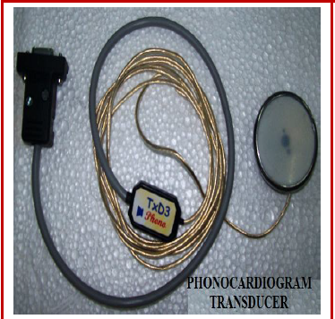

Slide 59
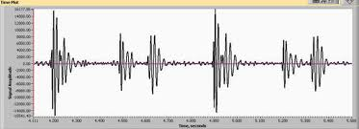
Phonocardiogram

Slide 60
Appearance of Heart Sound in Phonocardiogram
Sounds | Appearance
First Heart Sound or S1 | Crescendo 9-13 waves Single group wave
Second Heart Sound or S2 | Same amplitude 4-6 waves Single Group wave
Third Heart Sound or S3 | 1-4 waves Very low amplitude
Fourth Heart Sound or S4 | 1-2 waves Mostly merges with S1 Lowest amplitude

Slide 61

Heart Sounds
S1 – closure of AV Valves
S2 – closure of the semilunar valves
S3 – ventricular gallop
S4 – atrial gallop
Murmurs
Notes:
The two major audible heart sounds in a normal cardiac cycle are the first and second heart sound, S1 and S2
S1 occurs at the onset of the ventricular contraction during the closure of the AV-valves. It contains a series of low-frequency vibrations, and is usually the longest and loudest heart sound. The audible sub-components of S1 are those associated with the closure of each of the two AV-valves
S2 is heard at the end of the ventricular systole, during the closure of the semilunar valves. Typically, its frequency is higher than S1, and its duration is shorter. It has aortic and pulmonary sub-components
a third low-frequency sound (S3, ventricular gallop) may be heard at the beginning of the diastole, during the rapid filling of the ventricles. A fourth heart sound (S4, atrial gallop) may be heard in late diastole during atrial contraction
Opening snaps of the mitral valve or ejection sound of the blood in the aorta may be heard in case of valve disease (stenosis, regurgitation)
Murmurs are high-frequency, noise-like sounds that are heard between the two major heart sounds during systole or diastole. They can be innocent, but can also indicate certain cardiovascular defects

Slide 62
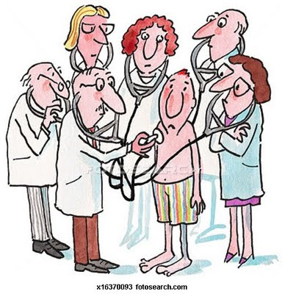
Applied Physiology : Murmur

Slide 63
Heart Murmur
Abnormal or unusual heart sound heard by stethoscope along with normal heart sound.
Also called Cardiac murmur or cardiac bruit.
Is produced because of the change in pattern of the blood flow.
occur in valvular diseases, vascular defects and septal defects
Thrills ??

Slide 64
Valvular Disease
Are of Two Types ;
  StenOsis : Valves unable to Open properly
    Narrowing of heart valves orifice
    The blood flow rapidly with turbulence through narrow orifice → Murmur
  InCompetence : Valves unable to Close Properly
    Weakening of Valve
    Back flow of blood resulting in turbulence→ Regurgitation → Murmur

Slide 65
Mitral Stenosis : Partially open

Slide 66
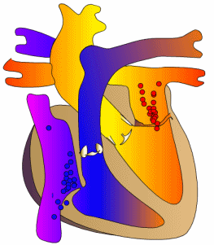
Mitral Stenosis

Slide 67
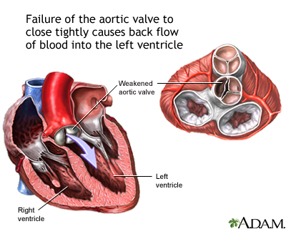
Aortic Incompetence : Partially Closed

Slide 68
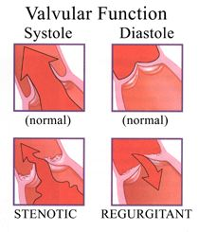
Stenosis Vs Regurgitation

Slide 69
Classification of Murmur
Cardiac Murmur is classified on the basis of timing of appearance during cardiac cycle in to;
  Systolic Murmur
  Diastolic Murmur
  Continuous Murmur

Slide 70
Hello,Students
I Wanna Play
A Game - Quiz

Slide 71
Quiz Game
Identify the Heart Sound & Murmur ?
Site of Murmur ?

Slide 73
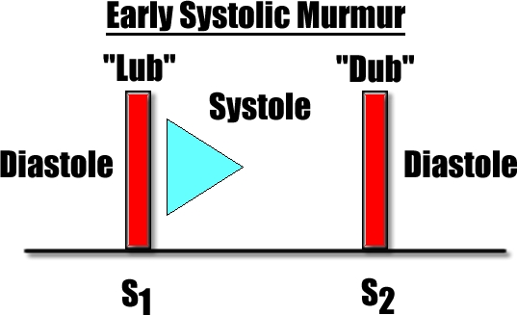

Slide 74
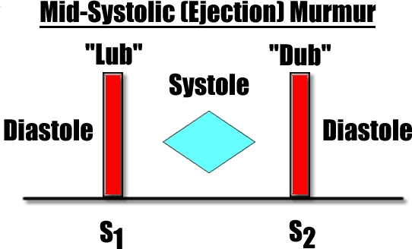

Slide 75
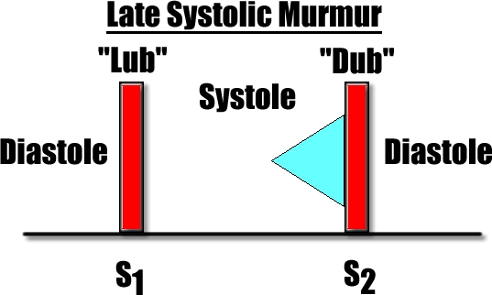

Slide 76
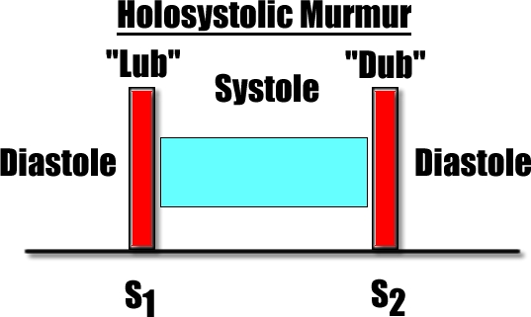

Slide 77
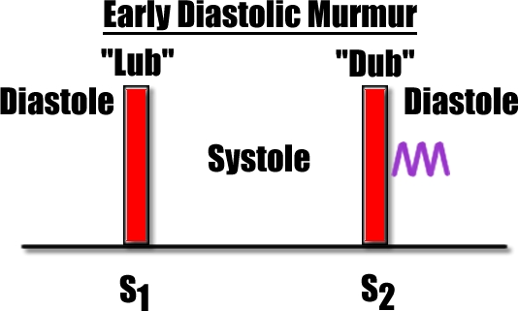

Slide 78
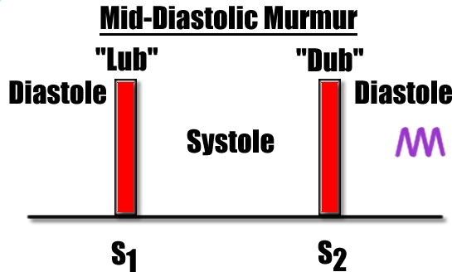

Slide 79
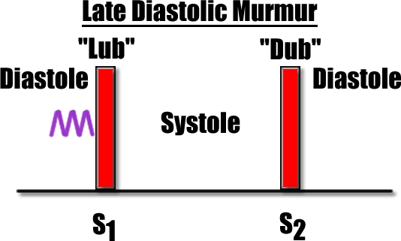

Slide 80
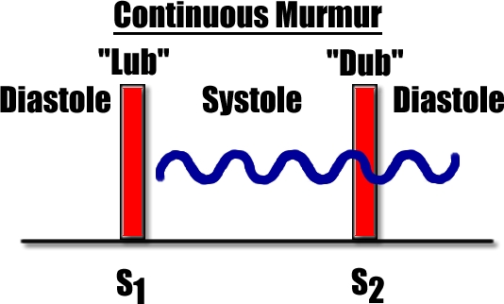

Slide 81
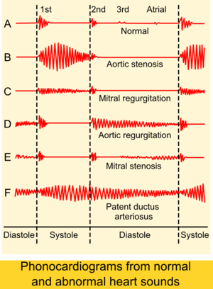

Slide 82
Easy to Remember
PASS
PAID
P : Pulmonary
A : Aortic
S : Stenosis
S : Systole
P : Pulmonary
A : Aortic
I : Incompetence
D : Diastole
Atrioventricular Valve : Opposite
AVIS

Slide 83
Causes of Cardiac Murmurs
Type of Murmur | Causes
Systolic Murmur | Stenosis of Semilunar Valves Incompetence of AV valves Anaemia Septal defects Coarctation of Aorta
Diastolic Murmur | Stenosis of AV valves Incompetence of Semilunar Valves
Continuous Murmur | Patent ductus arteriosus

Slide 84
You Can Refer to
Textbooks of….
Indu Khurana
Guyton
Vijaya Joshi
D.Venkatesh
K.Sembulingam
WWW…

Slide 85

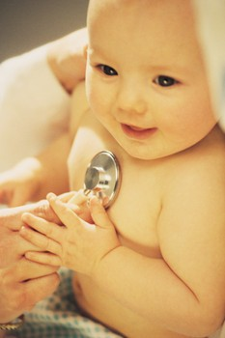
THANKS
CCES
13/04/2017
Lecture
HEART SOUND (CVS)

Slide 86
Continuous Cumulative Evaluation System
Qus 1 : First heart sound (Lubb) is generated due to…
Closure of Atrio-ventricular Valves
Opening of Atrio-ventricular Valves
Closure of Semilunar Valves
Opening of Semilunar Valves

Slide 87
Continuous Cumulative Evaluation System
Qus 2: Location of Tricuspid Area
2nd Right Intercostal Space, Just near to Sternum
2nd Left Intercostal Space, Just near to Sternum
4th Left Intercostals Space, Just near to Sternum
5th Left Intercostals Space, Just near to mid clavicular line

Slide 88
Continuous Cumulative Evaluation System
Qus 3 : Second Heart Sound (Dubb) is best heard at………
Mitral Area
Tricuspid Area
Erb Area
Aortic Area

Slide 89
Continuous Cumulative Evaluation System
Qus 4 : Abnormal heart sounds are known as…..
Murmur
Korotkoff’s sound
Crepitation
Rhonchi

Slide 90
Continuous Cumulative Evaluation System
Qus 5 : Cause of Systolic Murmur…
Mitral Stenosis
Pulmonary Stenosis
Tricuspid Stenosis
None

Slide 91
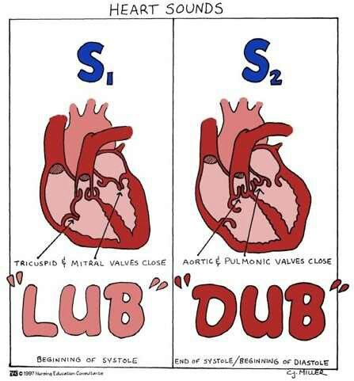
Thanks

