Slide 1
Proprioceptive Neuromusclar Facilitation
Dr Megha Mehta

Slide 2
Objectives
At the end of topic the learner should be able to write;
What is PNF
Diagonal patterns
Procedure of PNF
Special techniques in PNF

Slide 3
Before starting lets revise few things….
Proprioception: It is sense of position and movement of the body and limbs.
Proprioceptors: Receptors that detects change in position and movement of the body and limbs. There are three types of proprioceptors. 1) muscle spindle, 2) Golgi tendon organ (GTO) and 3) Joint receptors

Slide 4
Muscle spindle: The muscle spindle is the major sensory organ of muscle.
Function: To receive and convey information about changes in the length of a muscle and the velocity (speed) of the length changes (occurs during muscle contraction or when muscle is lengthen i.e. stretching).
Golgi tendon Organ (GTO): The Golgi tendon organ (GTO) is a sensory organ located near the musculotendinous junctions.
Function: To monitor changes in tension
of muscle-tendon units.

Slide 5
Joint receptors: present on the articulating surfaces.
Function: detects change in joint movement and position.

Slide 6
Introduction to
Proprioceptive neuromuscular facilitation (PNF)
Lecture 1

Slide 7
PNF is a method of promoting or speeding the response of the neuromuscular mechanism through stimulation of the sensory receptors particularly proprioceptors
Type of responses:
  contraction for strengthening
  relaxation for lengthening
  improved balance and equilibrium

Slide 8
The technique was developed by Dr. Herman Kabat – 1940s
He observed,
All human beings including those with disabilities have untapped potential. Human beings respond to demand and their existing potentials may be developed by placing higher demands.
Human movement is a fusion of many joint movement- mass action, with specific spiral (rotational) and diagonal movements (movement goes in a sloping direction).
Particular combination of movements are more stronger than single movement.

Slide 9
Margaret Knott and Dorothy Voss (physiotherapists) further worked on the Mass movement patterns which are spiral and diagonal in nature and resemble movement seen in functional activities.
In normal motor activity the brain registers total movement and not individual muscle action. So they used mass movement patterns to work with individuals with disabilities and named them as “Diagonal Patterns”

Slide 10
DIAGONAL PATTERNS
These are mass movement patterns observed in most functional activities.
Two diagonal motions are for each major part of the body.
Each diagonal pattern has a flexion and extension component together with rotation and movement away from (Abduction) and towards the midline (Adduction).

Slide 11
Upper and lower extremity patterns are described according to the three movement components at the proximal joint i.e. shoulder joint for UE and hip joint for LE
Flexion/extension
Abduction/adduction
External/internal rotation

Slide 12
Voss introduced shorter descriptions for the extremity patterns– diagonal pattern
Diagonal 1 (D1) flexion or extension
Diagonal 2 (D2) flexion or extension

Slide 13
UPPER EXTREMITY
Flex-ABD-ER (D2)
Flex-ADD-ER (D1)
Ext-ABD-IR (D1)
Ext-ADD-IR (D2)

Slide 14
Combinations (Synergy) in UE
Shoulder flexion combines with external rotation, supination and wrist radial deviations.
Shoulder extension combines with internal rotation , pronation and wrist ulnar deviation.
Shoulder adduction combines with wrist flexion and finger flexion.
Shoulder abduction combines with wrist extension and finger extension.

Slide 15
Functional uses:
UE D1 flexion: hand-to-mouth motion in feeding, combing hair on right side with left hand
UE D1 extension: pushing a car door to open from inside
UE D2 flexion: combing hair on right side with right hand
UE D2 extension: pitching a baseball

Slide 16
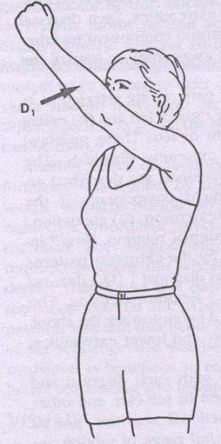
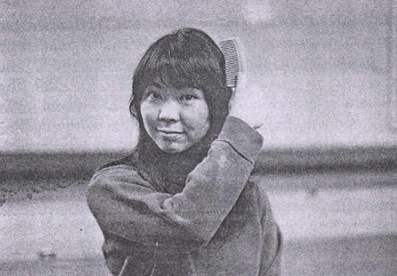

Slide 17
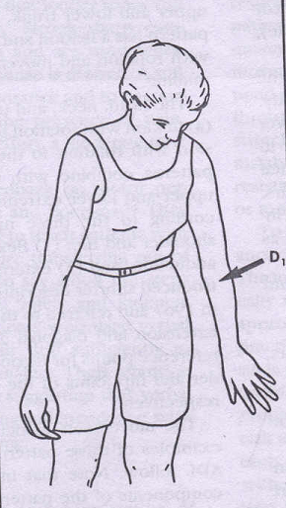
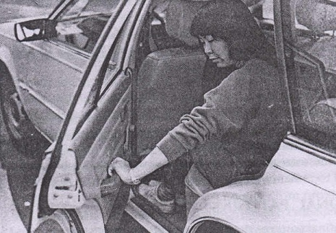

Slide 18
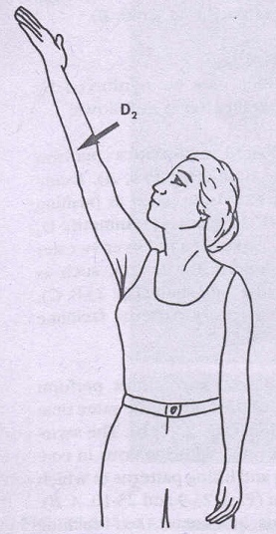
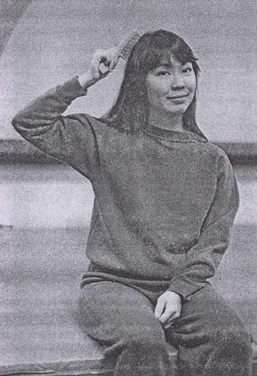

Slide 19
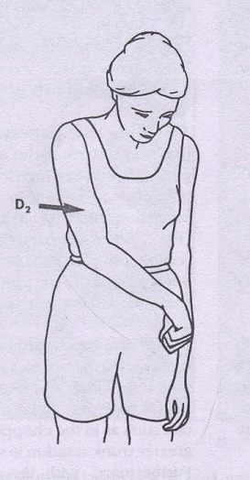
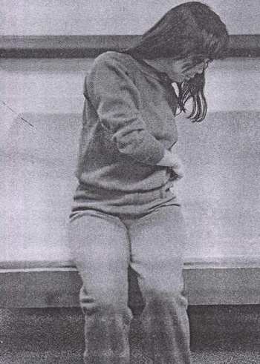

Slide 20
LOWER EXTREMITY
FLEX-ABD-IR (D2)
FLEX-ADD-ER (D1)
EXT-ABD-IR (D1)
EXT-ADD-ER (D2)

Slide 21
Combinations (Synergy) in LE
Flexion of the hip combines with dorsiflexion of ankle and extension of toes.
Extension of hip combines with plantar flexion and flexion of toes.
With adduction of the hip, occurs external rotation of the hip and foot inversions.
Abduction of the hip combines with internal rotation of the hip and foot aversions..

Slide 22
Functional uses:
LE D1 flexion: putting on a shoe with leg crossed
LE D1 extension: putting leg into pants
LE D2 flexion: climbing a bike
LE D2 extension: long sitting with legs crossed

Slide 23
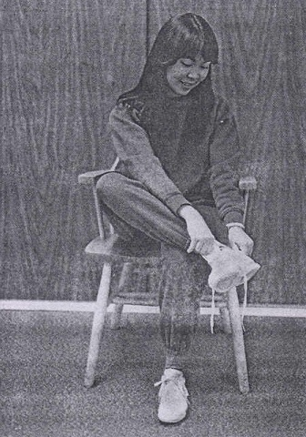
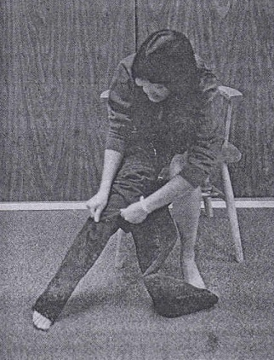

Slide 24
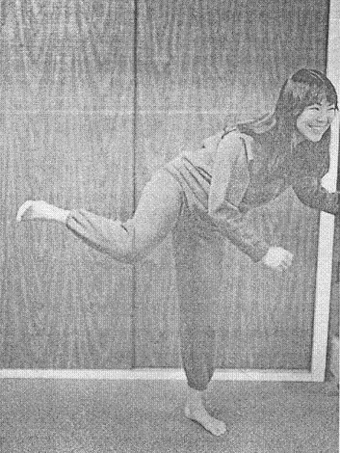
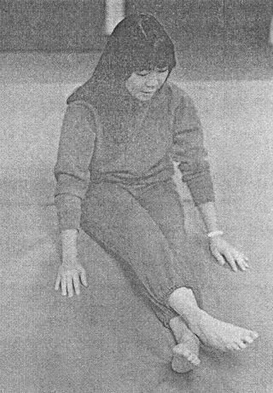

Slide 25
Head, neck and trunk patterns
Flexion with rotation to right or left
Extension with rotation to right or left

Slide 26
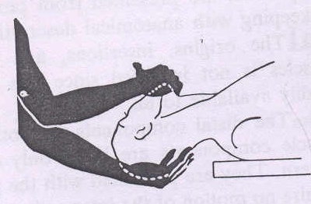
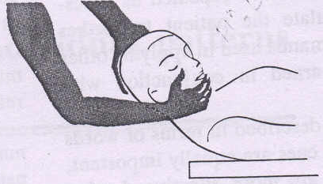
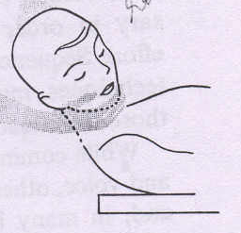
Head and neck:

Slide 27
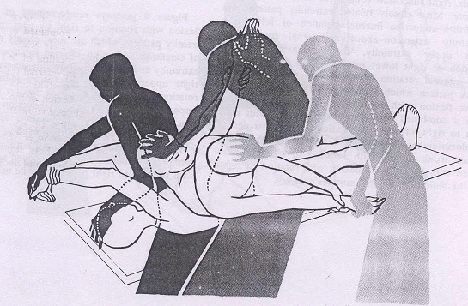
Upper trunk:

Slide 28
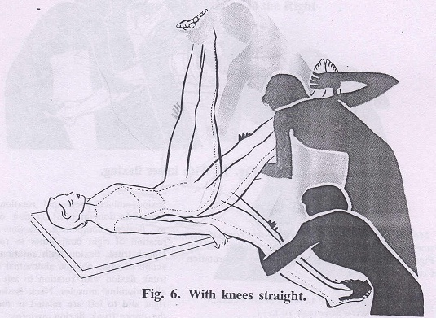
Lower trunk:

Slide 29
Uses of PNF
To initiate movement
To learn a movement
To change rate (speed) of movement
To increase strength
To increase stability
To increase coordination and control
To increase endurance
To increase range of motion
To promote relaxation
To decrease pain

Slide 30
Next Lecture
Techniques / Procedures used in PNF
Revise- Proprioceptors, efferent & afferent pathways, alpha motor neurons, posterior nerve root ganglion, cross section of spinal cord & Stretch reflex

Slide 31
Thank you…..

