Slide 1
Fournier's Gangrene after a trivial foot injury
- Dr. Tushar Vaishnav

Slide 2
Clinical History
A 54-year-old Chinese male patient was referred to us with 3 days history of penetrating foot injury
by a nail. He presented with swelling of scrotum and groin area, fever, mild respiratory distress and
developed urinary retention within 3 days of injury. The patient was treated successfully with early
surgical debridement and antibiotic cover

Slide 3
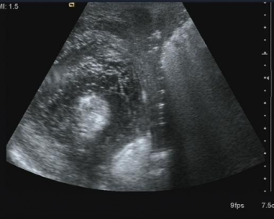
Imaging Findings
Thickening of soft tissues with multiple echogenic foci

Slide 4
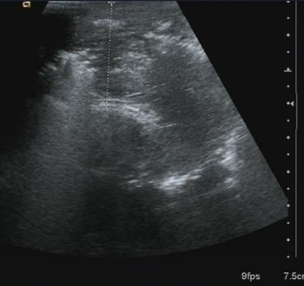
Groin

Slide 6
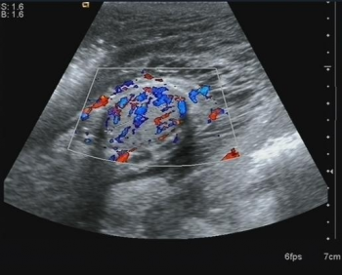
Right testis

Slide 7
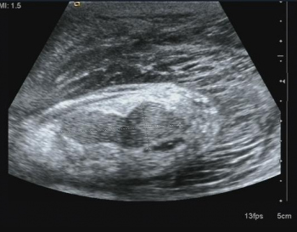
Right epididymus

Slide 8
Discussion
Fournier's gangrene is a mixed microbial infection which results in rapidly progressive necrotising
fasciitis of the urogenital area. It is more prevalent in middle aged men with a male to female ratio
of 5:1 [1]; however, no age is exempt as more than 50 cases have been reported in children [2]. It
can be idiopathic or associated with diabetes mellitus, alcoholism, HIV infection, long-term use of
steroids, chemotherapy, radio-therapy, various malignancies, and trauma. In 40-60% patients with
Fournier's gangrene, diabetes mellitus has been found to be an independent risk factor [3].
Patients may present with scrotal swelling, redness, pain, crepitus and perceptible stench. Fournier's
gangrene can become a vascular emergency after infection and leads to necrosis of skin and
subcutaneous fatty tissue resulting in sloughing of the skin of scrotum. Testes become exposed to
the surface, but remain healthy in most of the cases

Slide 9
. Local infection and necrosis spreads upward
into adjacent tissues and retroperitoneum. Severe sepsis can ensue, progressing rapidly into multiple
organ failure and imminent death in a previously immunocompromised patient. Inflammatory
markers are found to be raised, especially C reactive protein [4]. Blood cultures typically show
more than three organisms in single cases. Gram positive bacteria such as E. coli, Staph aureus,
Proteus species and gram negative organisms like Bacteroides, anaerobic streptococci and clostridia
are the main culprits involved in the pathogenesis of Fournier's gangrene [5].

Slide 10
Differential Diagnosis List
Gas containing scrotal abscess,
Scrotal hernia with bowel contents, Epididymo-orchitis

