Slide 1
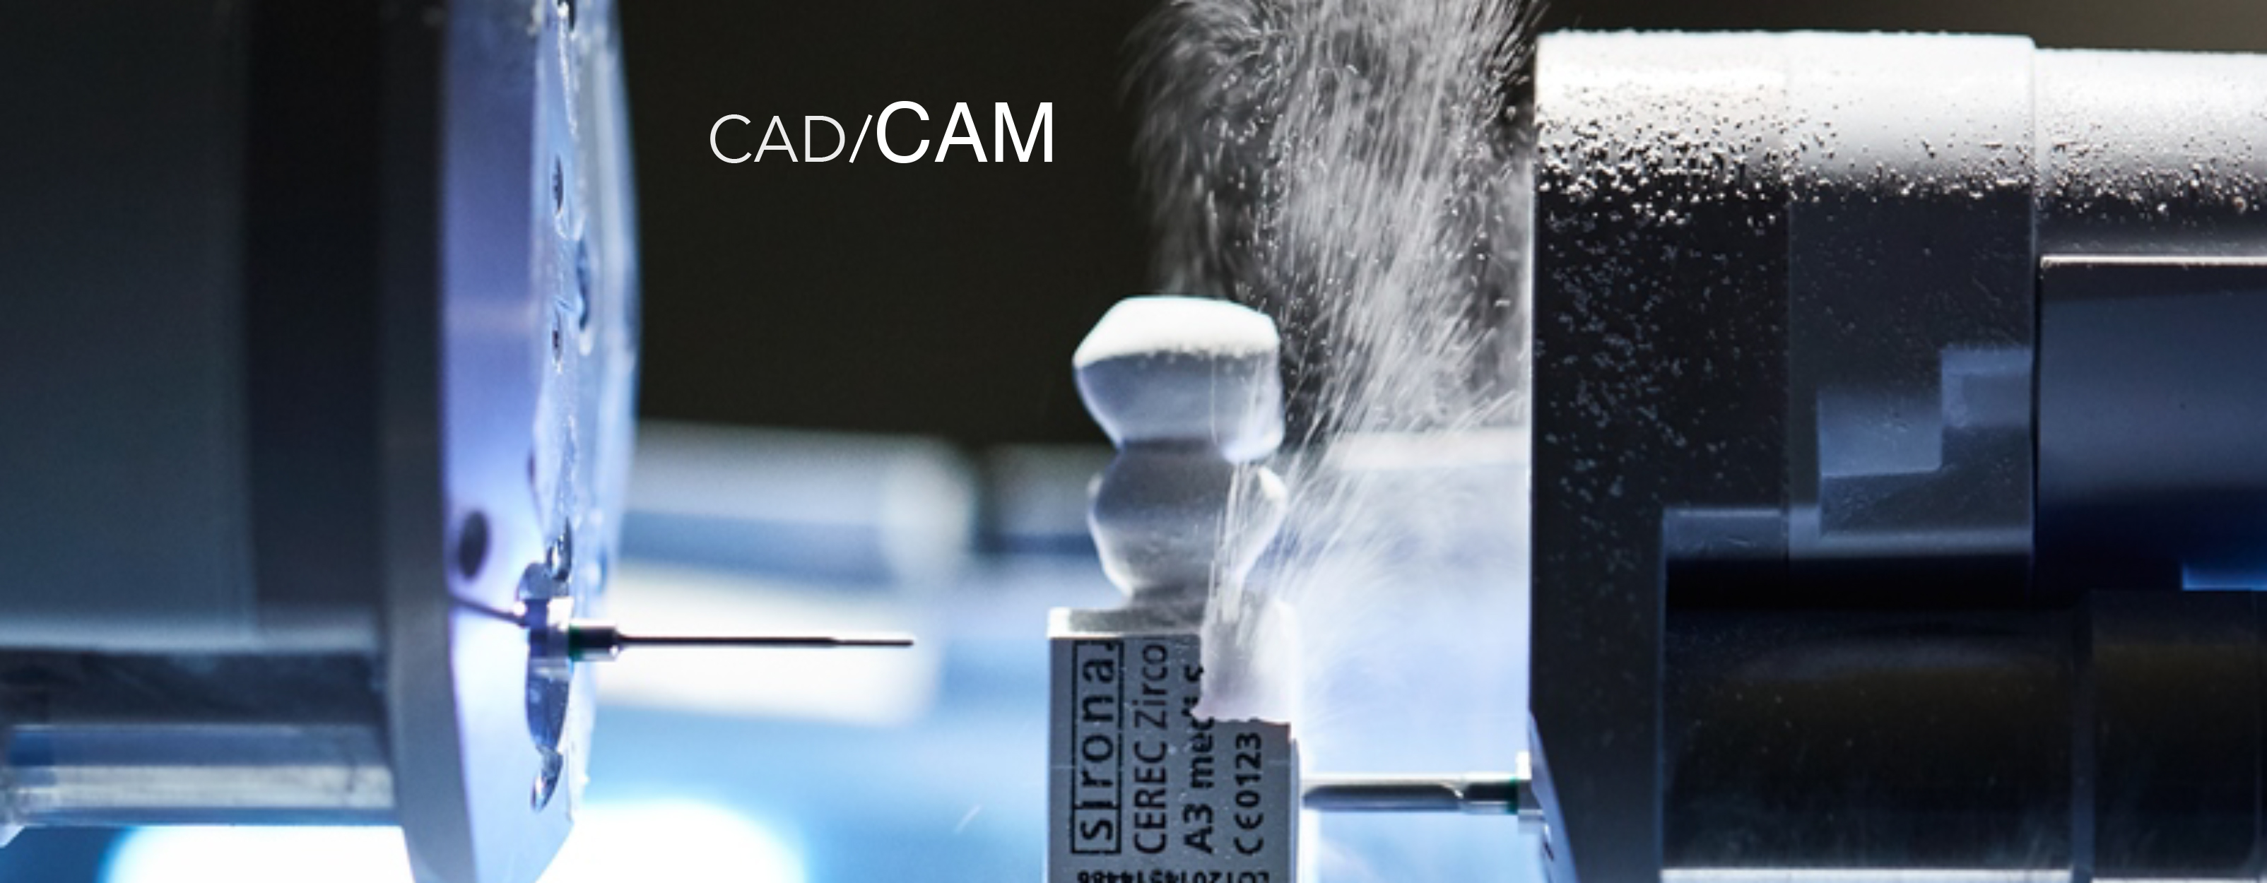

CAD CAM
DR. NAMRATA SHAH-NAIDU

Slide 2


What will you learn from this lecture:
What is CAD/CAM
History of CAD/CAM
Overview of CAD/CAM
  Laboratory based
  Office based
Advantages and Disadvantages
Future scope

Slide 3
FIRST DEVELOPED IN 1950s BY DEFENSE ARM OF THE UNITED STATES.
THE FIRST RESTORATION WAS MILLED IN 1983.
WERNER MORMANN DEVELOPED – THE FIRST COMMERCIAL CAD/CAM – CEREC (DENTSPLY SIRONA) – CERAMIC RECONSTRUCTION OR CHAIR-SIDE ECONOMICAL RESTORATION OF ESTHETIC CERAMICS.

Slide 4
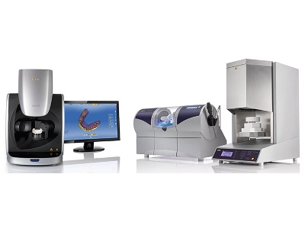
LABORATORY- BASED CAD/CAM SYSTEMS :
AN OPTICAL OR MECHANICAL SCAN OF MASTER CAST
A DIGITAL RESTORATION DESIGN
A MILLING CENTER

Slide 5
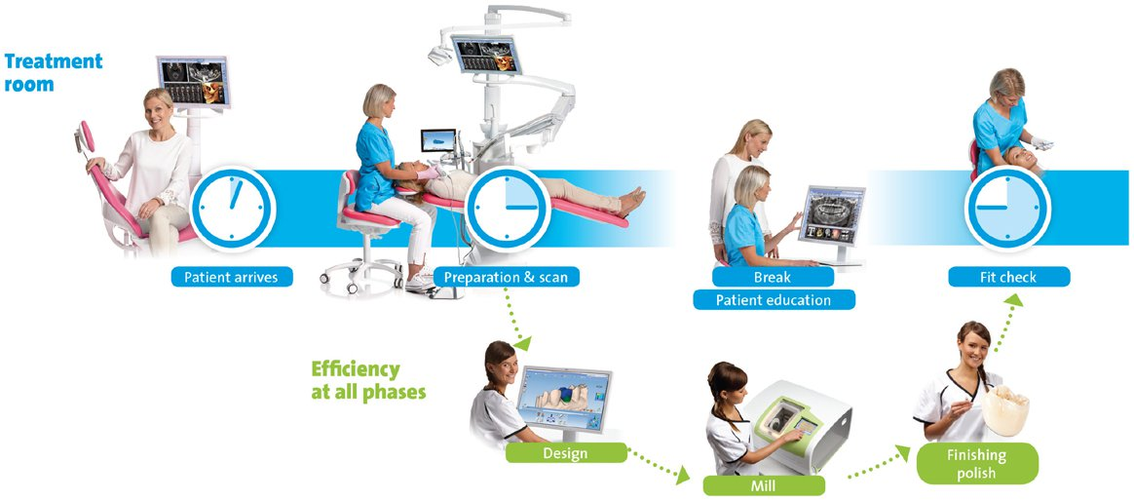
CHAIR SIDE- BASED CAD/CAM SYSTEMS :
AN OPTICAL SCAN OF ORAL CAVITY
A DIGITAL RESTORATION DESIGN
A MILLING CENTER

Slide 6
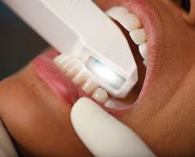
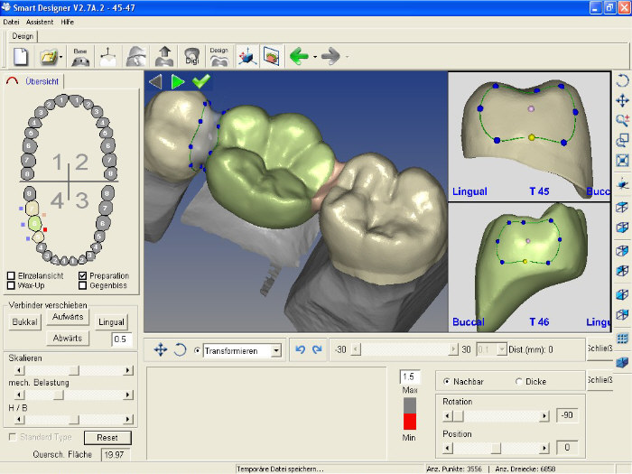

Slide 7
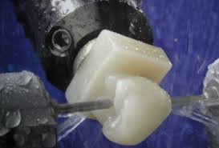
TYPES OF MILLING UNITS
3-AXIS
4-AXIS
5-AXIS

Slide 8
VARIOUS RESTORATIONS THAT CAN BE FABRICATED :
SINGLE CROWNS
INLAYS
ONLAYS
VENEERS
IMPLANT ABUTMENTS
IMPLANT FRAMEWORKS
REMOVABLE PROSTHESIS
COMPLETE DENTURES
IN COMBINATION WITH 3D PRINTERS, CHAIRSIDE CAD/CAM SYSTEMS CAN PROVIDE AN EVEN
GREATER RANGE OF CLINICAL APPLICATIONS AND APPLIANCES, INCLUDING NIGHT GUARDS,
OCCLUSAL SPLINTS, ORTHODONTIC APPLIANCES, SURGICAL GUIDES, PROVISIONAL RESTORATIONS,
AND STUDY MODELS.

Slide 9
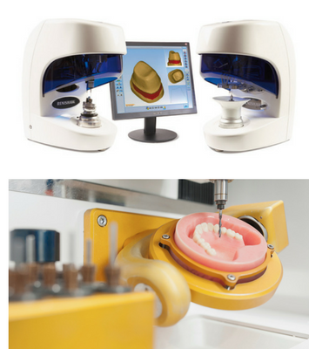

Slide 10


Slide 12

FUTURE ….

Slide 13


