Slide 1
Jugular Foramen Schwannoma
- Dr. ParthivBrahmbhatt

Slide 2
Clinincal Presentation
43 year old female patient came with chief complaints of
right sided facial pain and
increasing dysphagia since 3 months.
Pateint was advised MRI brain

Slide 3
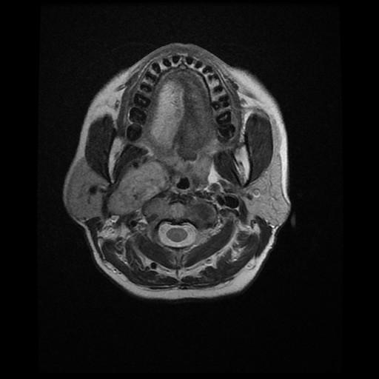
Axial T1WI
Lobulated hyperintense mass lesion abutting parapharyngeal muscles and occupying the right carotid space

Slide 4
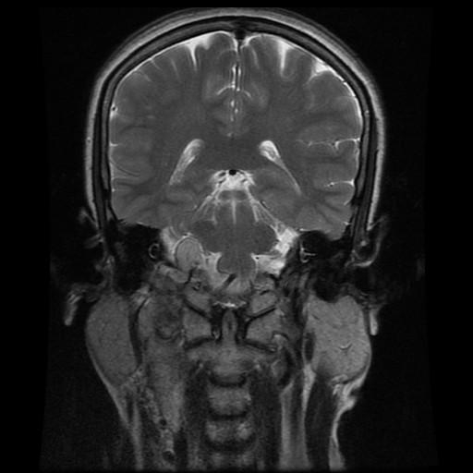
CORONAL IMAGES OF CVJ
Lobulated T2 iso-hyperintense lesion extending through the jugular foramen on the right side.

Slide 5
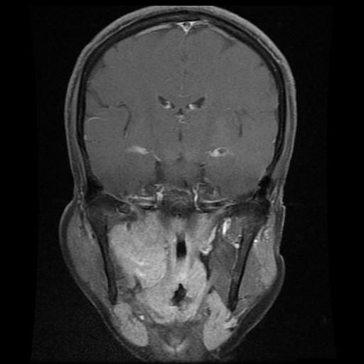
POST CONTRAST IMAGES
Lobulated intensely enhancing mass lesion in the right parapharyngral space occupying the carotid space on the right side.

Slide 6
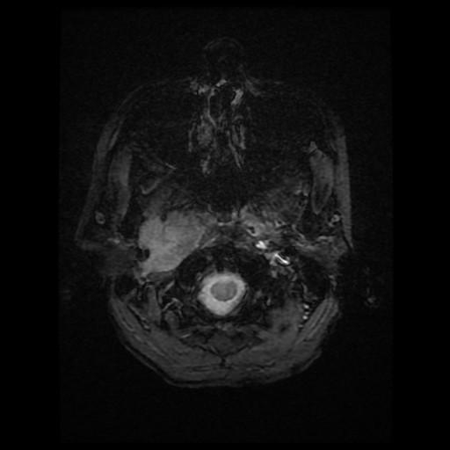
GRE
No blooming on GRE suggestive of a nonhemorrhagic lesion

Slide 7
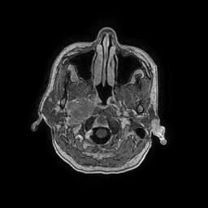
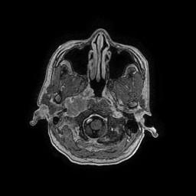
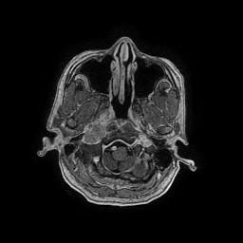
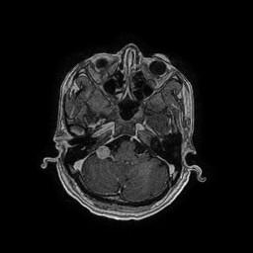
THIN AXIAL SECTIONS FSPGR FROM SKULL BASE TO CP ANGLES

Slide 8
Differential Diagnosis
Paraganglioma
Meningioma
Cerebellopontine angle tumours
Neurofibromatosis type 2

Slide 9
Conclusion
Imaging helps to delineate anatomical planes which will help the surgeon perform a morbidity free surgery more often. The diagnosis of cranial origin of schwannoma is usually made once the tumor attachment to the IX, X, or XI nerve is seen at surgery.
On plain CT scan the tumour is hypodense or isodense with brain, while it shows moderate enhancement on contrast administration and internal auditory canal is normal. Angiography generally demonstrates an avascular or only slightly vascular mass whereas glomus jugulare tumour is usually highly vascular. MRI signal characteristics unique to schwannomas are hypointensity on T1, hyperintensity on T2 and intense homogeneous enhancement on post contrast images.

Slide 10
THANK YOU

