Slide 1
PRINCIPLES OF STABILITY
By – Dr Noel

Slide 2
Objectives
Able to Understand Two types of Balance
Discuss the factors that affect the stability

Slide 3
INTRODUCTION
Ability to maintain once balance under unfavorable circumstances is recognized as one of the basic motor skill
There are two types of balance: Static & Dynamic
Static balance is the ability to maintain one particular stance or posture
Examples include standing on tip toes or on foot without losing once balance

Slide 4
Dynamic balance is an aspect in many activities
Examples: walking on a balance beam or tight rope. Even in sports, dynamic balance is an important aspect
Examples: activities like throwing, catching a ball, kicking a ball, making quick changes in different direction requires such skills
There are many factors which affect the balance of an individual. Such aspects are important to know as many day to day activities require both static and dynamic balance

Slide 5
PRINCIPLES OF STABILITY
Height of COG
Size of BOS
Relation of LOG to BOS
Mass of the body
Momentum & impact of an external force
Friction
Segmentation
Visual & psychological factors
Physiological factors

Slide 6
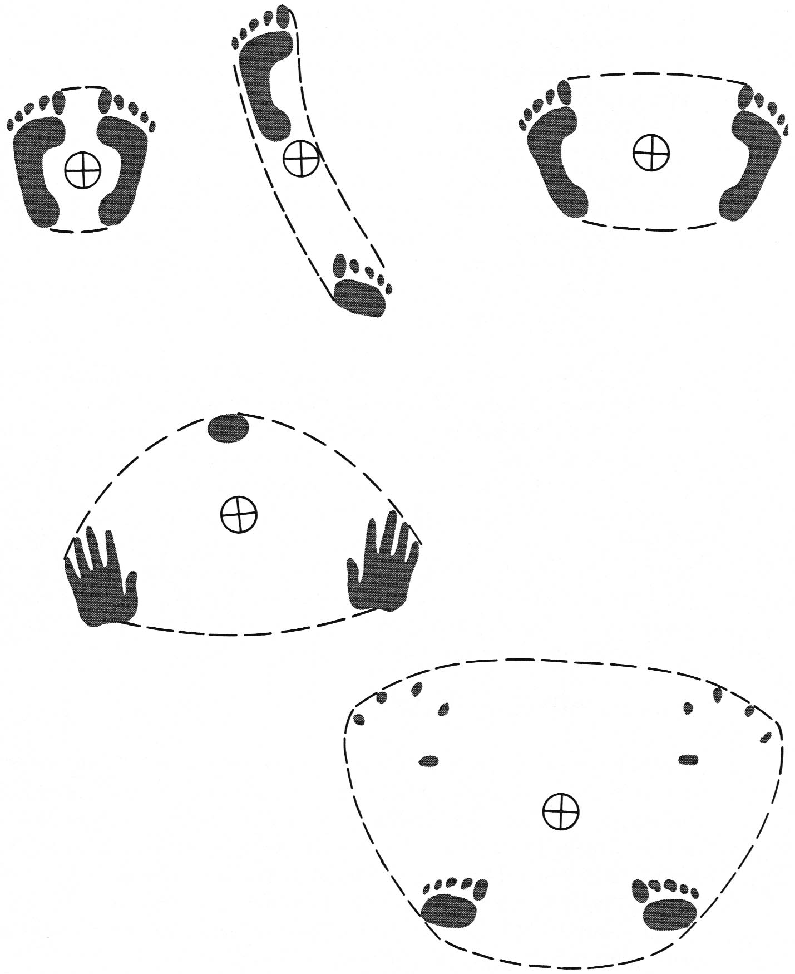
Size of the Base of Support
C of G must remain within the base of support in order to maintain equilibrium.
Easier with larger base of support.
Standing
Walking
Headstand
Fig 14.6

Slide 7
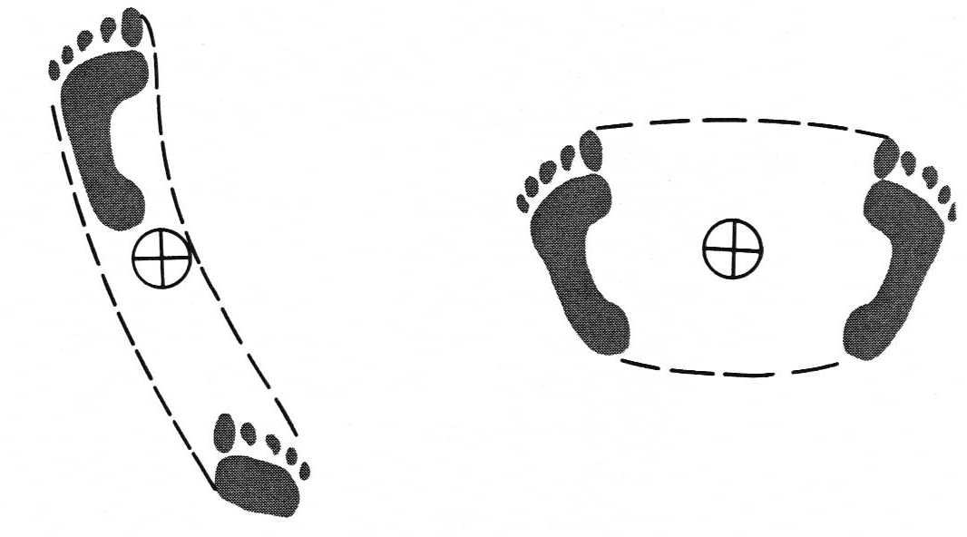
Shape of the Base of Support
Fig 14.6c
Fig 14.6b
Resistance to
AP forces
Resistance to
lateral forces

Slide 8
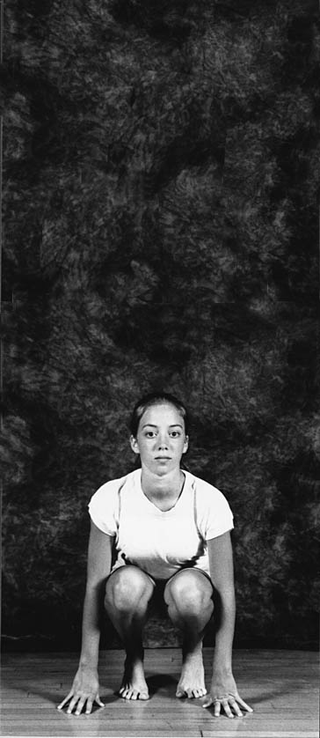

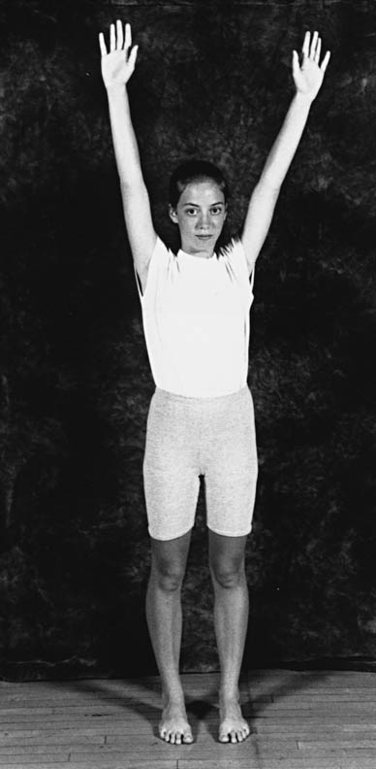
Height of the Center of Gravity
Height of C of G changes with body position.
As C of G moves closer to base of support more angular displacement can occur before it goes beyond the base of support.
a > b > c with respect to stability
x
x
x
Fig 14.8
a
b
c

Slide 9
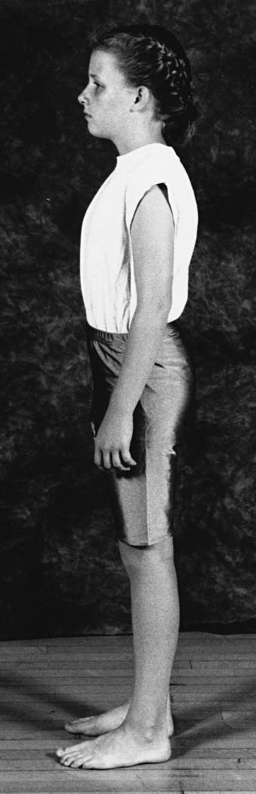
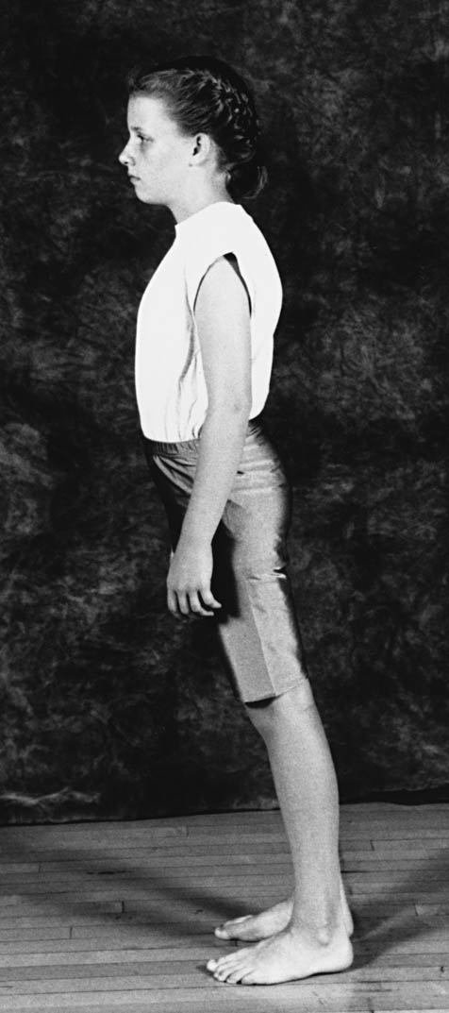
Relationship of the Line of Gravity to the Base of Support
To maintain equilibrium, line of gravity must remain within the base of support
Notice the hyper-extended the trunk to maintain the line of gravity within the base of support in Fig 14.10
Fig 14.9
Fig 14.10
Notes:
Just rearranged to cut down the number of words.

Slide 10
Mass of the Body
Only a factor when motion or an external force is involved.
Amount of force needed to effect a change in motion is proportional to the mass being moved.
The greater the mass, the greater the stability.

Slide 11
Momentum & impact of an external force

Slide 12
Friction
Friction is related to the size of the base of support.
It has greater influence when body is in motion or being acted on by an external force.
Inadequate friction makes it more difficult to maintain equilibrium.

Slide 13
Segmental Alignment
The human body consists of a series of segments placed one above the other. The problem of retaining equilibrium is a multiple one.
When segments are aligned in a single vertical line, there is less strain to joints and muscles.
When one segment gets out of line, another segment must compensate for it.

Slide 14
Visual and Psychological Factors
External visual cues may affect stability:
  Even if the supporting surface is adequate,
  The sense of balance may be disturbed by extraordinary stimuli.
  Compensation: fix eyes on a stationary spot above or beyond the “danger area”.
    Seems to facilitate neuromuscular control by reducing the disturbing stimuli.

Slide 15
Physiological Factors
Semicircular canals can affect equilibrium:
  Colds, viruses, and other problems that can affect the inner ear may also interfere with balance.
Any disturbance of the general physical condition is likely to affect the sense of balance.

Slide 16
Principles of Stability:
Other things being equal, the lower the C of G, the greater will be the body’s stability.
Greater stability is obtained if the base of support is widened in the direction of the line of force.
For maximum stability the line of gravity should intersect the base of support at a point that will allow the greatest range of movement within the area of the base in the direction of the forces causing motion.
Other things being equal, the greater the mass of a body, the greater will be its stability.

Slide 17
Principles of Stability:
Other things being equal, the most stable position of a vertical segmented body is one in which the C of G of each weight-bearing segments lies in a vertical line centered over the base of support.
Other things being equal, the greater the friction between the supporting surface and the parts of the body in contact with it, the more stable the body will be.
Other things being equal, a person has better balance in locomotion under difficult circumstances when the vision is focused on stationary objects rather than on disturbing stimuli.

Slide 18
Principles of Stability:
There is a positive relationship between one’s physical and emotional state and the ability to maintain balance under difficult circumstances.
Regaining equilibrium is based on the same principles as maintaining it.

Slide 19
Evaluating the Center of Gravity of Dislocations in Soccer Players With and Without Reconstruction of the Anterior Cruciate Ligament Using a Balance Platform
Angelica Castilho Alonso,^{I} Júlia Maria D’Andréa Greve,^{I} and Gilberto Luis Camanho^{II}
Clinics. 2009 Mar; 64(3): 163–170.

