Slide 1
Wrist & Hand complex
DR PURVI PATEL

Slide 2
Introduction
STRUCTURE AND FUNCTION OF THE WRIST
The wrist (carpus) consists of two compound joints: the radiocarpal and the midcarpal joints, referred to collectively as the wrist complex.
The radiocarpal joint is formed by the radius and radioulnar disk as part of the triangular fibrocartilage complex (TFCC) proximally and by the scaphoid, lunate, and triquetrum distally

Slide 4
Midcarpal joint
Articulation between the scaphoid, lunate and triquetrum proximally and the distal carpal row composed of the trapezium, trapezoid, capitate and hamate.
It is a functional rather than an anatomical unit.

Slide 5
Ligaments
Extrinsic
Intrinsic
Volar carpal ligament
Radiocarpal: radioscaphocapitate, radiolunotriquetral, radioscapholunate
Ulnocarpal
Volar radiocarpal: main stabilizer of proximal row
Radial collateral

Slide 6
Ulnocarpal ligament complex: TFCC, ulnolunate, ulnar collateral ligament
Intrinsic
Scapholunate interosseous: key ligament for scaphoid stability
Lunotriquetral interosseous: stability between lunate and triquetrum

Slide 7
Dorsal carpal ligament
Dorsal radiocarpal ligament
Dorsal intercarpal ligament: from the triquetrum to the lunate, scaphoid and trapezium

Slide 10
Wrist Joint—Characteristics and Arthrokinematics
The wrist joint is multiarticular and is made up of two compound joints. It is biaxial, allowing flexion (volar flexion), extension (dorsiflexion) around coronal axis and radial deviation (abduction), and ulnar deviation (adduction) around anteroposterior axis.
The pisiform is not part of the wrist joint but functions as a sesamoid bone in the flexor carpi ulnaris tendon. The distal radioulnar (RU) joint is not part of the wrist joint.

Slide 11
Conwell explained the order of relative motion of the various segments.
Starts with full flexion: distal carpal row moves on relatively fixed proximal row. Distal row glides in the same direction as motion.
When it reaches neutral, ligament spanning capitate and scaphoid draw them into closed pack position.

Slide 12
Combined unit of distal row and scaphoid moves on relatively fixed lunate and triquetrum.
Approx. 45 extension, scapholunate interosseous ligament brings lunate and truquetrum into closed pack position.
Completion of movement, proximal articular surface of the carpals move on the radius and TFCC.
Wrist motion from full extension to full flexion occurs in reverse sequence.

Slide 13
Radial and ulnar deviation
In radial deviation, the carpals slide ulnar side on radius and vice versa.
Wrist in neutral: greatest RD/UD possible
Full extension: closed pack position so very little movement of RD/UD
Full flexion: carpals are splayed so no further movement can occur so little movement of RD/UD.

Slide 14
Muscles
Volar wrist musculature
Palmaris longus
Flexor carpi radialis
Flexor carpi ulnaris
Flexor digitorum superficialis
Flexor digitorum profundus
Flexor pollicis longus

Slide 15
Dorsal wrist musculature
Extensor carpi radialis longus
Extensor carpi radialis brevis
Extensor carpi ulnaris
Extensor digitorum communis
Extensor pollicis longus
Extensor pollicis brevis
Abductor pollicis longus
Extensor indicis
Extensor digiti minimi

Slide 16
The Hand complex
It consists of five digits
Total bones: 19
Total joints: 19

Slide 17
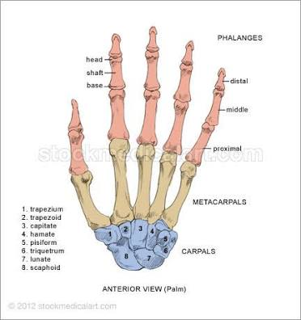

Slide 18
Carpometacarpal and Intermetacarpal Joints of fingers
Composed of the articulations between the distal carpal row and the bases of the second through fifth metacarpals.
2nd metacarpal- trapezoid, secondarily with trapezium and capitate
3rd metacarpal- capitate
4th metacarpal- capitate and hamate
Intermetacarpal articulations are the joints between the bases of the metacarpal bones of the four fingers.
Movement between these joints is of slight gliding.

Slide 19
The carpometacarpal joints of the four fingers have dorsal, volar and interrosseous ligaments.
Deep transverse metacarpal ligament spans the heads of the second through fourth metacarpals volarly.
Proximal transverse arch: bones, TCL, intercarpal ligament.

Slide 20
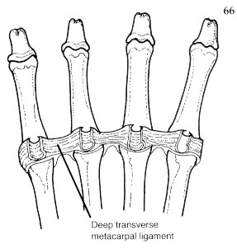

Slide 21
Range of motion
Observable at metacarpal heads.
Increasing from second to fifth CMC joints
Plane synovial joints with one degree of freedom: flexion/extension
Fifth is saddle joint with two degree of freedom.

Slide 22
Metacarpophalangeal Joints of Digits 2 through 5
The metacarpophalangeal (MCP) joints are biaxial condyloid joints between the convex head of the metacarpal and base of the phalanx.
The MP joint is surrounded by a capsule.
Each joint is supported by a volar and two collateral ligaments. The collaterals become taut in full flexion and prevent abduction and adduction in this position.
Volar plate: it is a unique structure that increases joint congruence. Also provides stability to the MP joint by limiting hyperextension.

Slide 23
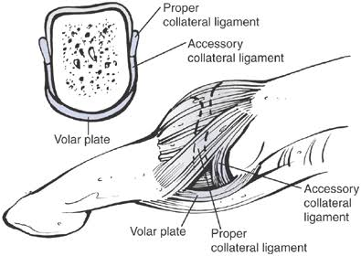

Slide 24
Movements are flexion, extension, abduction, adduction and circumduction.
Arthrokinematics. The distal end of each metacarpal is convex and the proximal phalanx concave.

Slide 25
Interphalangeal Joints and MCP Joint
Characteristics. Each of these joints is a uniaxial hinge joint. There is a proximal (PIP) and distal (DIP) interphalangeal joint for each digit, 2 through 5.
The capsule of each joint is reinforced with collateral ligaments, which are taut in extension. Going radial to ulnar in digits 2 through 5, there is increasing flexion/ extension range in the joints. This allows for greater opposition of the ulnar fingers to the thumb and also causes a potentially tighter grip on the ulnar side of the hand.
Arthrokinematics. The articulating surface at the distal end of each phalanx is convex; the articulating surface at the proximal end of each phalanx is concave.

Slide 26
Extrinsic finger flexors
Flexor digitorum superficialis
Flexor digitorum profundus

Slide 27
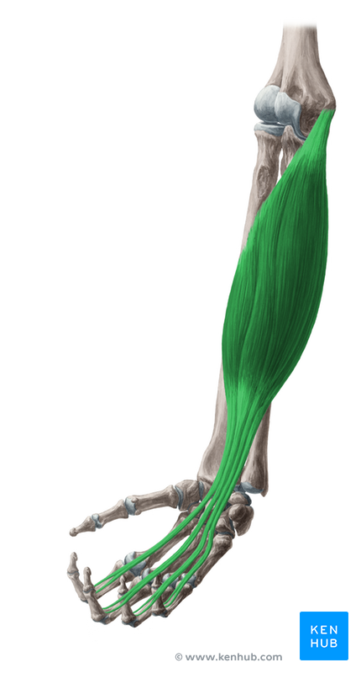

Slide 28
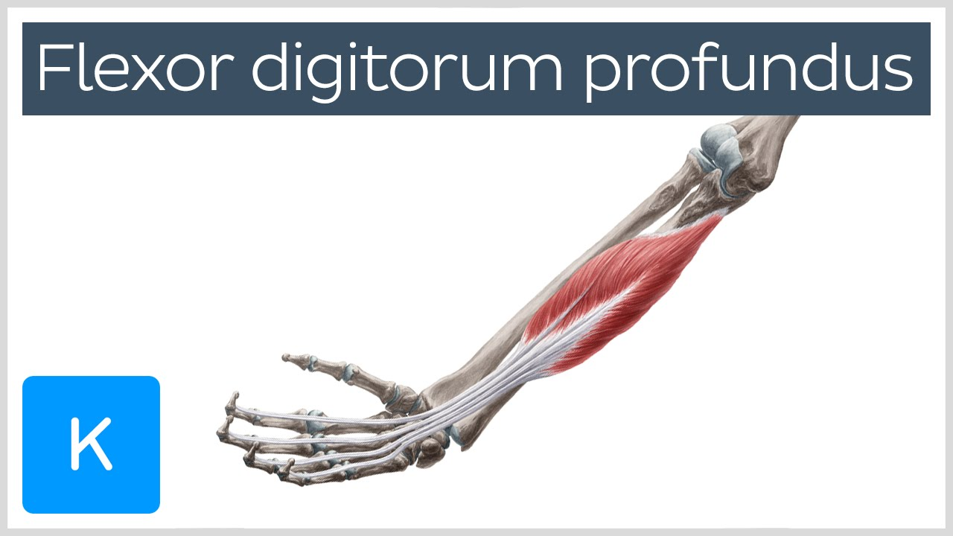

Slide 29
Extrinsic finger extensors
Extensor digitorum communis
Extensor indicis
Extensor digiti minimi

Slide 30
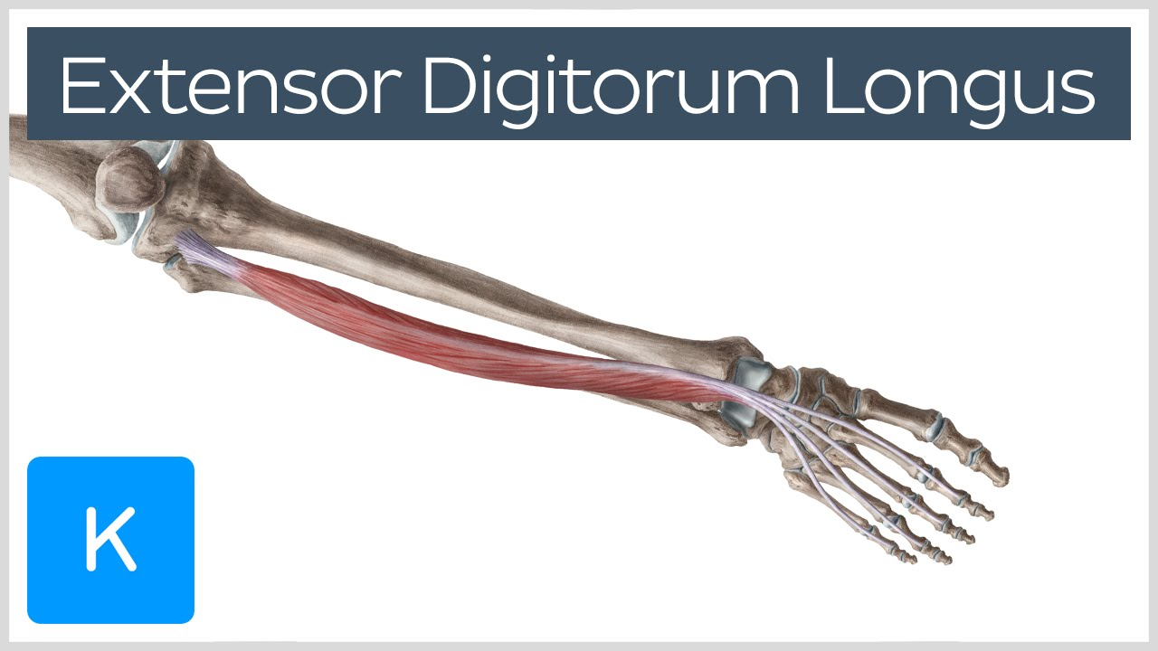

Slide 31


Slide 32
Intrinsic muscles
Dorsal and volar interossei
Lumbricals

Slide 33
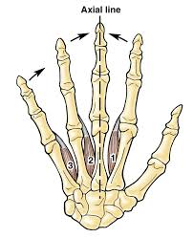
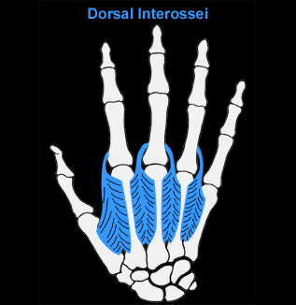

Slide 34
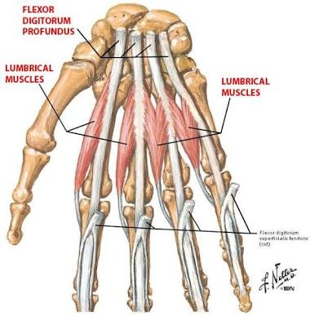

Slide 35
The thumb
CMC joint of thumb is the articulation between the trapezium and the base of the first metacarpal.
It is a saddle joint.
flexion/extension, abduction/adduction, opposition
Ligaments: intermetacarpal, dorsoradial, anterior oblique ligament

Slide 36
MCP joint of thumb: condyloid joint with two degree of motion
The thumb has only one interphalangeal joint, The MCP joint of the thumb differs in that it is reinforced by two sesamoid bones on the volar surface, which improve the leverage of the flexor pollicis brevis muscle.
Ligaments: collateral ligament, intersesamoid ligament

Slide 37
Extrinsic thumb muscles
Flexor pollicis longus
Extensor pollicis longus
Extensor pollicis brevis
Abductor pollicis longus

Slide 38
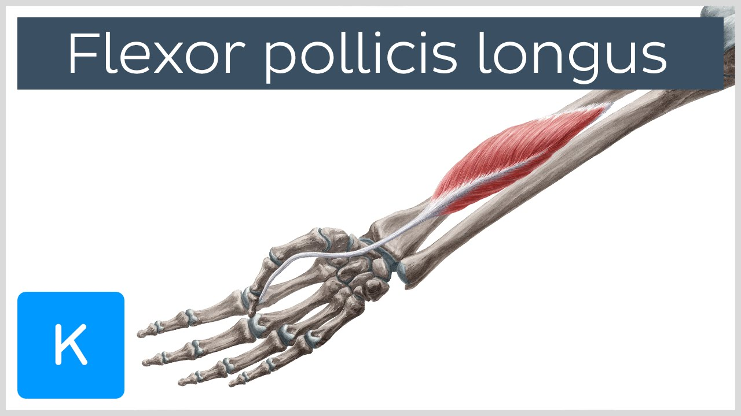

Slide 39
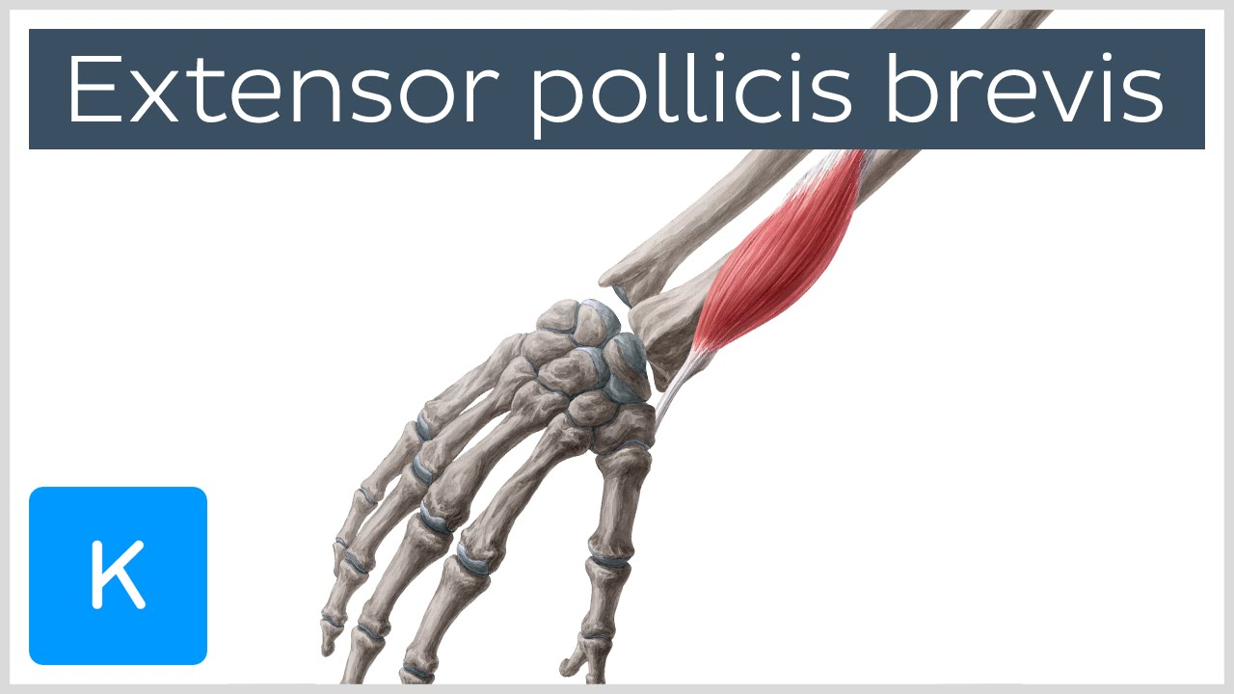

Slide 40
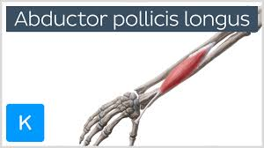

Slide 41
Intrinsic thumb muscles
Opponens pollicis
Abductor pollicis brevis
Flexor pollicis brevis
Adductor pollicis

Slide 42
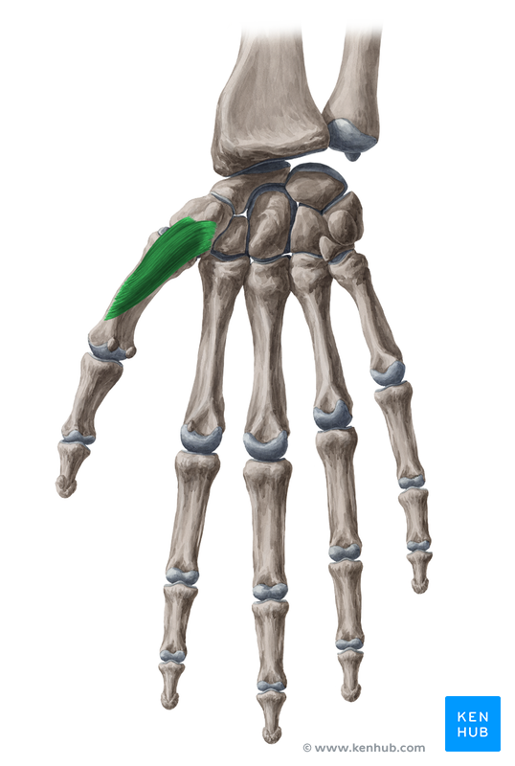

Slide 43
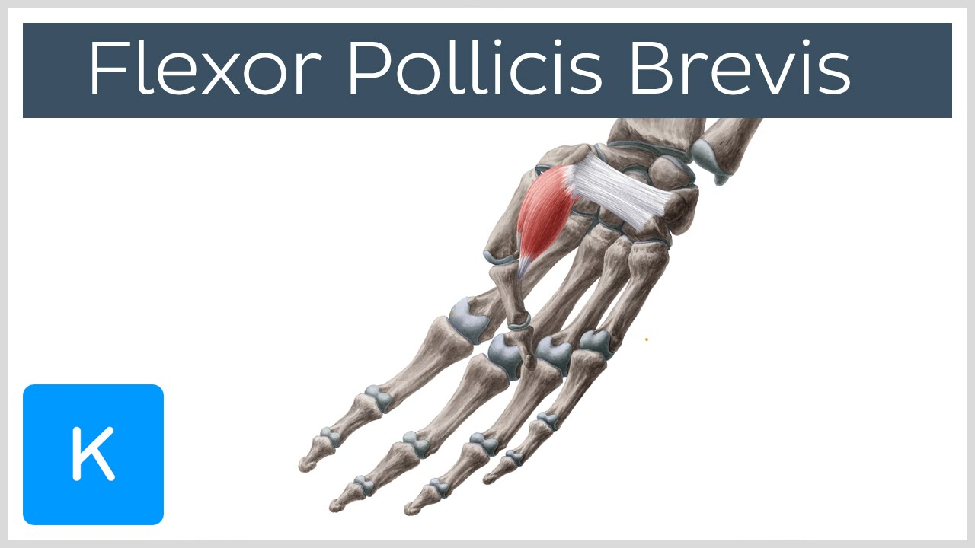

Slide 44
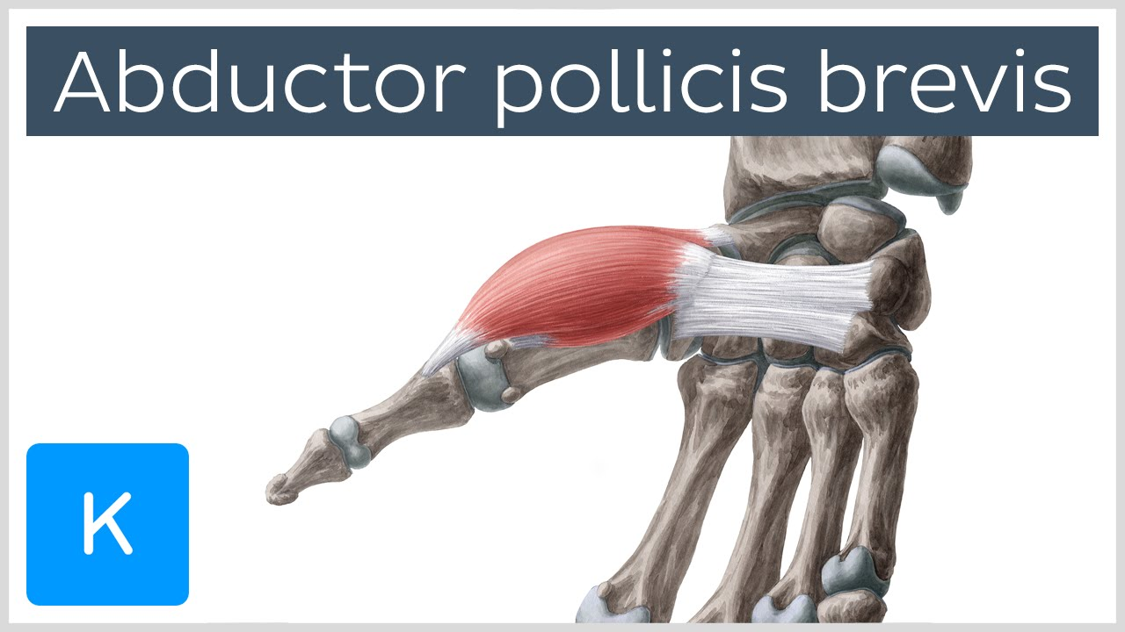

Slide 45
Grips and Prehension Patterns
Prehension can be categorized as either power grip (full hand prehension) or precision handling (finger-thumb prehension)
Power grip is generally a forceful act resulting in flexion at all finger joints. When the thumb is used, it acts as a stabilizer to the object held between the fingers and, most commonly, the palm. Precision handling, in contrast, is the skillful placement of an object between fingers or between finger and thumb. The palm is not involved.

Slide 46
Power grip is the result of a sequence of
(1) opening the hand,
(2) positioning the fingers,
(3) bringing the fingers to the object, and
(4) maintaining a static phase

Slide 47
Power Grips
Description. Power grips involve clamping an object with partially flexed fingers against the palm of the hand and with counter pressure from the adducted thumb. Power grips are primarily isometric functions.
Varieties include cylindrical grip, spherical grip, hook grip, and lateral prehension.

Slide 48
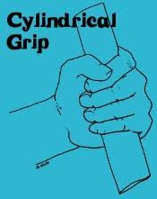
Cylindrical grip

Slide 49
Use of flexors to carry the fingers around and maintain grasp on an object.
Dynamic action, by FDP muscle
For static phase, FDS assists.
The intrinsics- primarily as MP joint flrxors, abductors/adductors
Thumb- FPL and all thenar muscles are active.
AdP in greater magnitude

Slide 50
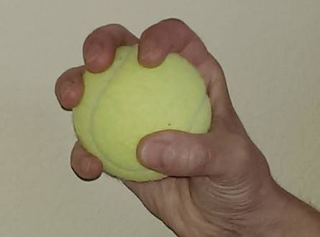
Spherical grip

Slide 51
The extrinsic finger and thumb flexors and the thenar muscles follow similar patterns.
Greater spread of fingers, interossei will work more.
Extensors provide smooth and controlled opening of the hand and release of the object.

Slide 52

Hook grip

Slide 53
Specialized form of prehension.
A function primarily of fingers.
It may include palm but never include thumb.
FDP and FDS.

Slide 54
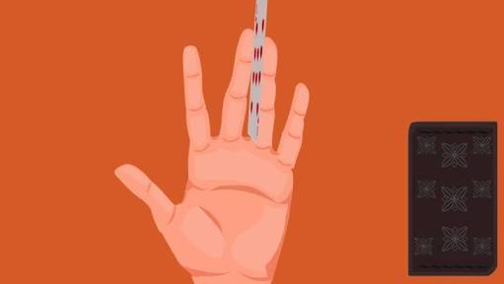
Lateral prehension

Slide 55
It’s a rather unique form of grasp.
Contact occur between two adjacent fingers.
The MP and IP joints are usually maintained in extension as the contiguous MP joints simultaneously abduct/adduct.
EDC and lumbricals.
interossei

Slide 56
Precision Patterns
Description. Prehension patterns involve manipulating an object that is not in contact with the palm of the hand between the opposing abducted thumb and fingers. The muscles primarily function isotonically. The sensory surfaces of the digits are used for maximum sensory input to influence delicate adjustments. With small objects, precise handling occurs primarily between the thumb and index finger (two jaw chuck).
Varieties include pad-to-pad, tip-to-tip, and pad-to side prehension.

Slide 57
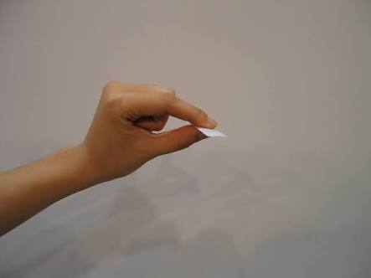
Pad-to Pad prehension

Slide 58
Opposition of pad or pulp of the thumb and finger.
The MP and PIP are partially flexed. DIP is extended.
Primarily action of FDS muscle
Interosseous activity sometimes to supplement flexor force.
Thumb CMC flexion, abduction and rotation.
MP and IP partially flexed.
OP,FPB, APB.
AdP increases with increasing pinch

Slide 59
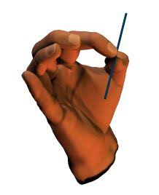
Tip-to-Tip prehension

Slide 60
Differ as DIP is also into flexion.
FDP, FPL and interossei muscles are needed.

Slide 61
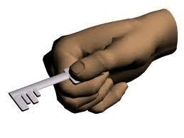
Pad-to-Side prehension

Slide 62
Key grip
Between pad of thumb and side of the index finger.
Thumb is more adducted and less rotated so activity of FPB is more and OP is less.
AdP also works
Interossei of fingers.

Slide 63
PATHOMECHANICS
1. Swan neck deformity
Hyperextension of PIP and flexion of DIP jts. Often seen in Rheumatoid arthritis

Slide 64
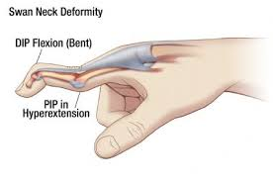

Slide 65
2. Boutonierre deformity
Flexion at PIP and extension at DIP

Slide 66
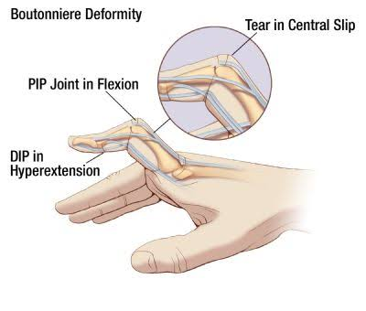

Slide 67
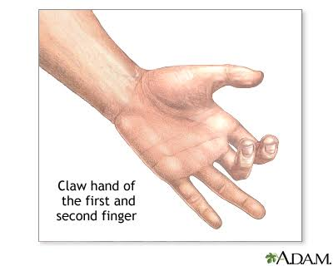
Claw hand

Slide 68
In RA there is radial deviation of wrist and ulnar drift of fingers at MCP joints

Slide 69
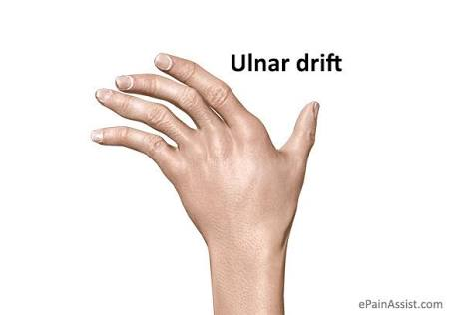

Slide 70
4. Carpal tunnel syndrome
It is compression of median nerve when it passes through the carpal tunnel (flexor retinaculum
above and carpal bones below)
There are sensory changes in the radial 2/3 of palm, palmar surface of first 3 and a half digits and dorsum of diastal phalanges, weakness of OP, APB, superficial head of FPB, lumbricals 1st and 2nd.

Slide 71
5. The 1st CMC joint is prone to degenerative changes and so Osteoarthritis of this joint is common.

Slide 72
MCQs

Slide 73
Grip in which there is flexion at all finger joints is
Power
Precision
2. Lateral prehension is a type of ____ grip
Precision
Power
3. In CTS ____ nerve is entrapped
Radial
Ulnar
Median
None

Slide 74
4. Key grip is a type of
Power
Precision
5. FCU gets inserted at
Pisiform
Triquetrum
Scaphoid
none

Slide 75
6. In which grip from below doesn’t involve thumb
Pad-to-pad
Spherical grip
Hook grip
Key grip
7. 1st and 2nd lumbricals are affected in ___ nerve compression
Median
Radial
Ulnar
None

Slide 76
8. In Boutonniere deformity there is
Flexion at PIP, Extension at DIP
Flexion at PIP, Flexion at DIP
Extension at PIP, Extension at DIP
Extension at PIP, Flexion at DIP
9. In Swan-neck deformity there is
Flexion at PIP, Extension at DIP
Flexion at PIP, Flexion at DIP
Extension at PIP, Extension at DIP
Extension at PIP, Flexion at DIP

Slide 77
10. Extensor Carpi Radialis Longus gets inserted at
Ist metacarpal
2nd metacarpal
3rd metacarpal
None

Slide 78
PICO
P: Hand OA patients
I: joint protection & home hand exercises
C: controls receiving information about OA
O: grip strength & global hand function

Slide 79
Title: Joint protection and home hand exercises improve hand function in patients with hand osteoarthritis: A randomized controlled trial
Type of study | RCT
Year of publication | 2002
Level of evidence | 1b
Authors | Stamm et al
Citation | arthritis & rheumatism 47: 44-49, 2002
Aim | To determine the effect of joint protection & home exercises on hand function of patients with hand OA
Method | Randomized, controlled, 3 month trial with a blinded assessor. Primary outcome was grip strength, secondary outcomes were health assessment questionnaire & VAS for pain & global hand function. 40 patients were assigned to 2 groups. One group received home exercises & controls received information session
Results | Grip strength & global hand function improved in experimental group
Conclusion | Joint protection & hand home exercises were found to increase grip strength & global hand function

