Slide 1
Staining in diagnostic microbiology
Ms. Sangita vasava

Slide 2
Why we should be Stain Bacteria
Bacteria have nearly the same refractive index as water, therefore, when they are observed under a microscope they are opaque or nearly invisible to the naked eye.
Different type of staining methods are used to make the cells and their internal structures more visible under the light microscope.

Slide 3
Staining help in observation of Bacteria
Microscopes are of little use unless the specimens for viewing are prepared properly.
Microorganisms must be fixed & stained to increase visibility, accentuate specific morphological features and preserve them for future use.

Slide 4
Stains and Staining
Bacteria are slightly negatively charged at ph 7.0
Basic dye stains bacteria
Acidic dye stains background
Simple stain
Aqueous or alcohol solution of single basic dye

Slide 5
What is a stain
Substance that adheres to a cell, giving the cell colour.
The presence of colour gives the cells significant contrast so are much more visible.
Different stains have different affinities for different organisms, or different parts of organisms.
Used to differentiate different types of organisms or to view specific parts of organisms

Slide 6
Staining Techniques
Staining is an auxiliary technique used in microscopy to enhance contrast in the microscopic image
Stains and dyes are frequently used in biology and medicine to highlight structures in biological tissues for viewing, often with the aid of different microscopes

Slide 7
Fixation
Consist of several steps-
aims to preserve the shape of the cells or
tissue involved as much as possible.
Sometimes heat fixation is used to kill
adhere and alter the specimen so it will accept
stains

Slide 8
Simple staining
Actual staining process may involve immersing the sample(before or after fixation and mounting) in dye solution, followed by rinsing and observation
The stain can be poured drop on the slide.
Methylene blue, Basic fuchsin
Provide the colour contrast but impart the same colour to all the organisms in a smear

Slide 9
Simple staining
Loffler”s methylene blue:
Sat. Solution of M. Blue in alcohol-
30mlkoh, 0.01%in water, filter-100ml
Dissolve the dye in water, filter.
Dilute Carbol fuchsin:-
by diluting Z-N stain with 10-15 times its
volume of water-Stain for 20-25 seconds,
wash with water.
Use: To demonstrate the morphology of Vibrio
cholera
Polychrome methylene blue
Use: M”Fadyean”s reaction- B. anthracis

Slide 10
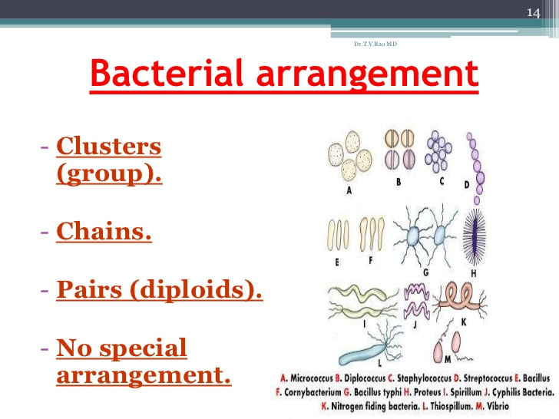

Slide 11
Differential Stains
Use two or more stains and allow the cells to be categorized into various groups or types.
Both techniques allow the observation of cell morphology, or shape but differential staining usually provides more information about the characteristics of the cell wall(Thickness).

Slide 12
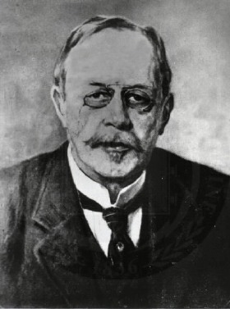
Gram staining
Named after Hans Chritian Gram,
Differentiates between Gram- positive purple and Gram-negative pink stains.

Slide 13
Gram staining – Principles
Used to determine gram status to classify bacteria broadly.
It is based on the composition of their cell wall.
Gram staining uses crystal violet to stain cell walls
Iodine as a mordant, and a fuchsin or safranin counterstain to mark all bacteria.
Gram-positive bacteria stain dark blue or violet. Their cell wall is typically rich with peptidoglycan and lacks the secondary membrane and lipopolysaccharide layer found in Gram-negative bacteria

Slide 14
Gram Staining Steps
Crystal violet acts as the primary stain . It dyes the cell wall of any bacteria.
Gram’s iodine acts as a mordant (helps to fix the primary dye to the cell wall).
Decolourizer is used next to remove the primary stain (crystal violet) from Gram Negative bacteria.
Decolourizer is composed of an organic solvent, such as acetone or ethanol or a combination of both.
Finally a counter stain ( Safranin ) is applied to stain those cells (Gram Negative) that have lost the primary stain as a result of decolourization.

Slide 15
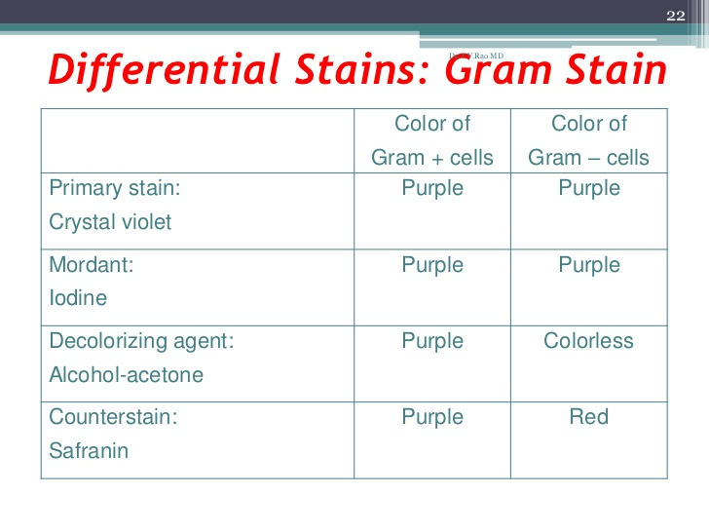

Slide 16
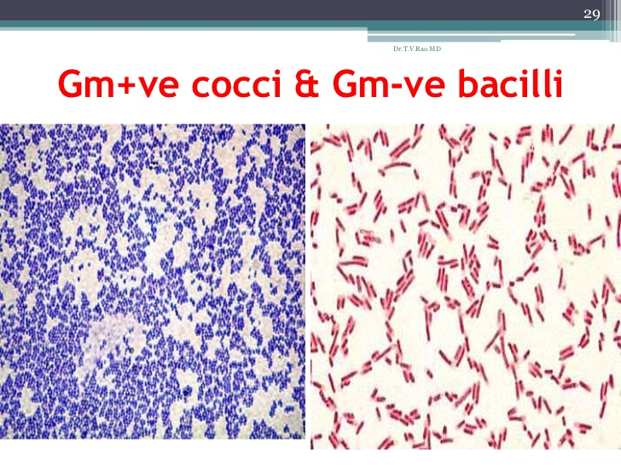

Slide 17
Gram-positive
Stained dark blue or violet by Gram staining.
This is in contrast to Gram-negative bacteria, which cannot retain the crystal violet stain ,instead taking up the counter stain (safranin or fuchsine) and appearing red or pink .
Gram-positive organisms are able to retain the crystal violet stain because of the high amount of peptidoglycan in the cell wall.
Gram-positive cell walls typically lacks the outer membrane found in Gram-negative bacteria

Slide 18
Gram Negative Bacteria
Do not retain crystal violet dye in the Gram staining protocol.
In a Gram stain test, a caunter stain (commonly safranin) is added after the crystal violet,coloring all Gram-negative bacteria with a red or pink color.

Slide 19
Acid-Fast Stain
Acid-fast cells contain a large amount of lipid and waxes in their cell walls primarily mycolic acid.
Acid fast bacteria are usually members of the genus Mycobacterium or Nocardia.

Slide 20
Ziehl-Neelsen stain
Used to stain species of mycobacterium tuberculosis that do not stain with standard laboratory procedure like Gram staining.
The stains used are the red colored Corbol fuchsin that stains the bacteria and a counter stain like Methylene blue or Malachite green

Slide 21
Ziehl-Neelsen Procedure
Tilt slide 45 degree over the sink and
add acid alcohol drop wise until the red colour stops streaming from the smear
Add Loeffler Blue stain on smear for one minute
Rinse slide.
Blot dry
Use oil immersion to view

Slide 22
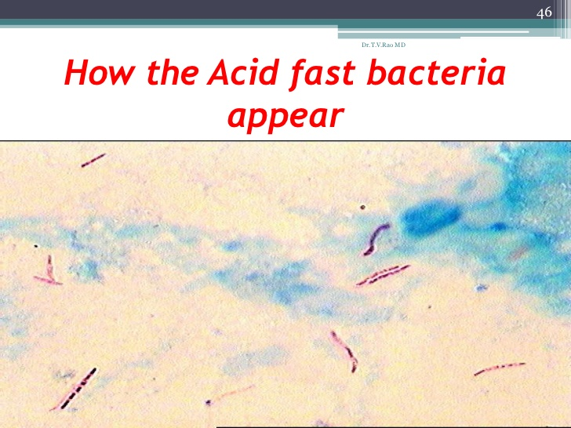

Slide 23
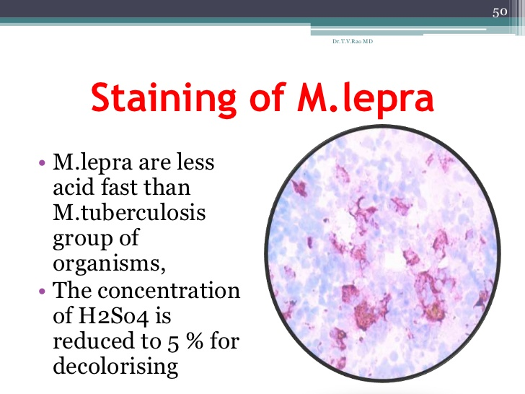
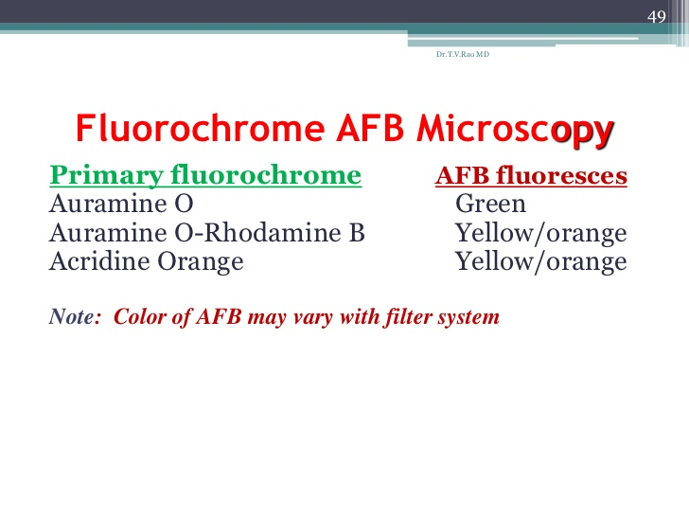

Slide 24
Albert’s staining for C. diphtheria
Albert stain I
Toluidine blue 0.15gm
Malachite green 0.20gm
Glcial acetic acid 1.0ml
Alcohol (95%) 2.0ml Distilled water 100ml
Albert stain II
Iodine 2.0gmtassium iodide 3.0gm
Distilled water 300ml

Slide 25
Albert staining Procedure
Cover the heat-fixed smear with Albert stain I.
stand for two minutes
Wash with water.
Cover the smear with Albert stain II.Let it
stand for two minutes.
Wash with water, blot dry and examine.

Slide 26

C. diphtheria
Metachromatic granules in C. Diphtheria appear bluish black whereas the body of bacilli appear green or bluish green.

Slide 27
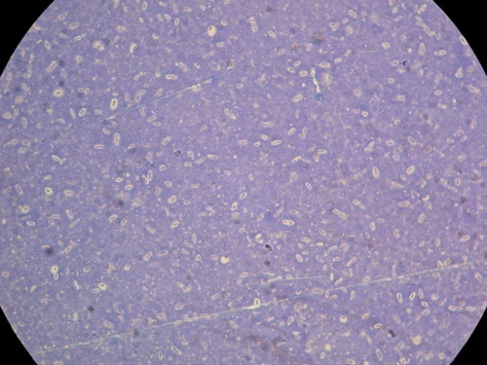
Capsule staining
Used to reveal negatively charged bacterial capsules. The encapsulated cells will have a halo appearance under the microscope.

Slide 28
Negative staining
India Ink, Negrosin
Organisms are not stained ,only the background is stained
To demonstrate the
capsule of Crypto-coccus neoformans
Streptococcus pneumoniae

Slide 29
Same day sputum smear microscopy approach with modified ZN staining for the diagnosis of pulmonary tuberculosis in a microscopy centre at Rajahmundry. IJMM Year : 2014 | Volume : 32 | Issue : 2 | Page : 153-156
Author | Level | Materials & Methods | Conclusions | Author’s remark
TJ Chandra¹, RS Raj², YV Sharma³ | :IV | two spot sputum samples (SS ₂ approach) are collected within a gap of one hour (same day sputum smear microscopy) in addition to the standard spot morning (SM) approach. The smears were stained with standard Ziehl Neelsen (ZN) and modified ZN staining techniques | Diagnosis of lung tuberculosis is possible with two spot sputum samples with modified ZN staining | Sputum smear microscopy is the main-stay in the diagnosis of pulmonary tuberculosis in many developing countries. To overcome the drop outs, same day diagnosis is ideal

Slide 30
THANK
YOU

