Slide 1

E classroom-ZOOM @MEU ROOM
Date 11-5-20 Time: 10-11am.
ENDOCRINOLOGY
COMPETENCY CODE: PY8.2 (contd…)
BY
DR J M HARSODA
PROFESSOR AND HEAD

Slide 2
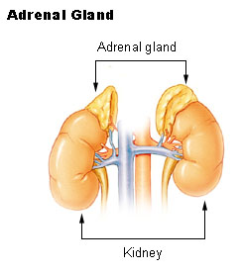
1`

Slide 3
FUNCTIONAL ANATOMY OF ADRENAL GLANDS
There are two adrenal (supra renal) glands, one at the top of each kidney; in adults, each adrenal weighs 4-5 gm and consists of two distinct parts: outer adrenal cortex and the adrenal medulla.
Adrenal cortex is essential to life.

Slide 4
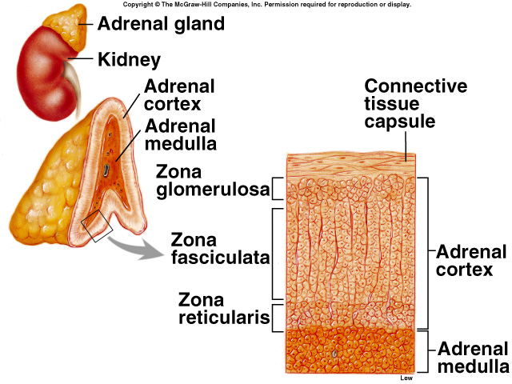
FUNCTIONAL HISTOLOGY OF ADRENAL CORTEX

Slide 5
ADRENAL CORTEX

Slide 6
HORMONES OF ADRENAL CORTEX
Hormones of adrenal cortex are also called adrenocorticoids.
Glucocorticoids:
Corisol or hydrocortisone
Corticosterone
Mineralocorticoids
Aldosterone
Deoxycorticosterone (DOC)
Sex steroids
Androgen
Dehydroepiandrosterone
Estrogen and progesterone

Slide 7
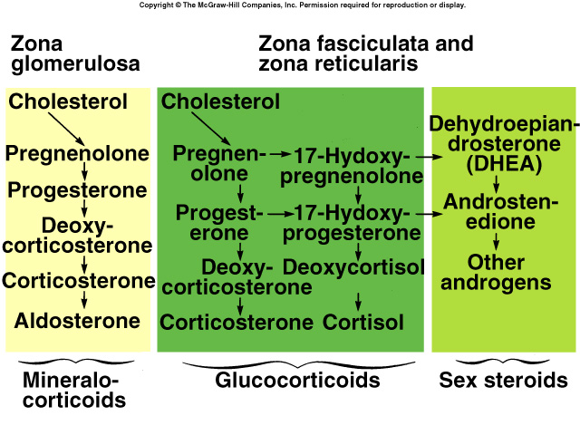
BIOSYNTHESIS OF STEROIDS

Slide 8
Mechanism of steroid hormone action
The multiple effects of glucocorticoids are triggered by binding to glucocorticoid receptors, and the steroid- receptor complexes act as transcription factors that promote the transcription of certain segments of DNA.
This, in turn, leads via the appropriate mRNAs to synthesis of enzymes that alter cell function.
In addition, it seems likely that there are nongenomic actions of glucocorticoids .

Slide 9
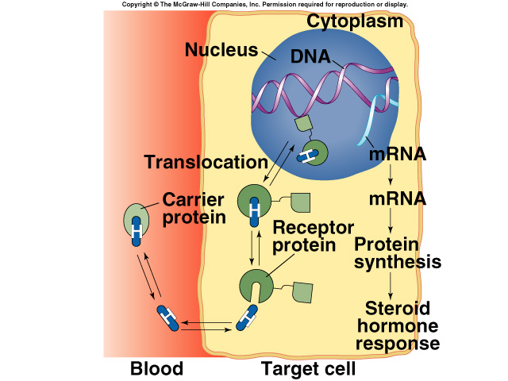

Mechanism of steroid hormone action Transcription and translation effects

Slide 10
PHYSIOLOGICAL EFFECTS OF GLUCOCORTICOIDS
On carbohydrate metabolism
On protein metabolism
On fat metabolism
On bone metabolism
Anti inflammatory and anti allergic effects
On blood and lymphatic system
On CVS
On GIT
On excretory system
On CNS
Resistance to stress

Slide 11
PHYSIOLOGICAL EFFECTS OF MINERALOCORTICOIDS: ALDOSTERONE
Retention of sodium and excretion of potassium.
Increases reabsorption of sodium from GIT, salivary and sweat glands.
PHYSIOLOGICAL EFFECTS OF SEX STEROIDS:
Growth and development of internal and external genitalia in both sexes during foetal life and just after birth.
Development of libido in female.

Slide 12
ENDOCRINOPATHIES OF ADRENAL CORTEX
HYPER SECRETION OF
ADRENAL CORTEX
HYPO SECRETION OF
ADRENAL CORTEX
CUSHING’ S SYNDROME
HYPER ALDOSTERONISM
(CONN’ S DISEASE)
ADRENOGENITAL SYNDROME
ADDISON’S DISEASE
ADDISONIAN CRISIS
WATER HOUSE FRIDERICHSEN SYNDROME

Slide 13
CUSHING’ S SYNDROME
Excess glucocorticoid secretion produces a moon-faced, plethoric appearance, with trunk obesity, purple abdominal striae, hypertension, osteoporosis, protein depletion, mental abnormalities, and, frequently, diabetes mellitus (Cushing's syndrome).

Slide 14



CLINICAL FEATURE OF CUSHING’ S SYNDROME

Slide 15

CLINICAL FEATURE OF CUSHING’ S SYNDROME

Slide 16
CUSHING’ S SYNDROME
Cushing's syndrome due to anterior pituitary tumors is often called Cushing's disease because these tumors were the cause of the cases described by Cushing.
However, it is confusing to speak of Cushing's disease as a subtype of Cushing's syndrome, and the distinction seems to be of little more than historical value.

Slide 17
HYPER ALDOSTERONISM (CONN’ S DISEASE)
Excess mineralocorticoid secretion leads to K⁺ depletion and Na⁺ retention, usually without edema but with weakness, hypertension, tetany, polyuria, and hypokalemic alkalosis (hyperaldosteronism).
This condition may be due to primary adrenal disease (primary hyperaldosteronism; Conn's syndrome) such as an adenoma of the zona glomerulosa, unilateral or bilateral adrenal hyperplasia, adrenal carcinoma.
In patients with primary hyperaldosteronism, renin secretion is depressed..

Slide 18
SECONDARY HYPER ALDOSTERONISM
Secondary hyperaldosteronism with high plasma renin activity is caused by cirrhosis, heart failure, and nephrosis.
Increased renin secretion is also found in individuals with the salt-losing form of the adrenogenital syndrome, because their ECF volume is low.
In patients with elevated renin secretion due to renal artery constriction, aldosterone secretion is increased; in those in whom renin secretion is not elevated, aldosterone secretion is normal.

Slide 19
ADRENOGENITAL SYNDROME
Excess androgen secretion causes masculinization (adrenogenital syndrome) and precocious pseudopuberty or female pseudohermaphroditism.
Virilization, because the increase in ACTH secretion causes steroids to pile up behind the blockades and to be shunted to the production of androgens.

Slide 20


CLINICAL FEATURE OF ADRENOGENITAL SYNDROME

Slide 21
ADDISON’S DISEASE
Primary adrenal insufficiency due to disease processes that destroy the adrenal cortex is called Addison's disease.
The condition used to be a relatively common complication of tuberculosis, and now it is usually due to autoimmune inflammation of the adrenal.
Patients lose weight, are tired, and become chronically hypotensive.
They have small hearts, probably because the hypotension decreases the work of the heart.
Eventually they develop severe hypotension and shock (addisonian crisis).

Slide 22
ADDISON’S DISEASE
This is due not only to mineralocorticoid deficiency but to glucocorticoid deficiency as well. Fasting causes fatal hypoglycemia, and any stress causes collapse.
Water is retained, and there is always the danger of water intoxication. Circulating ACTH levels are elevated.
The diffuse tanning of the skin and the spotty pigmentation characteristic of chronic glucocorticoid deficiency are due, at least in part, to the MSH activity of the ACTH in the blood.
Minor menstrual abnormalities occur in women, but the deficiency of adrenal sex hormones usually has little effect in the presence of normal testes or ovaries.

Slide 23


CLINICAL FEATURE OF ADDISON’S DISEASE

Slide 24


CLINICAL FEATURE OF ADDISON’S DISEASE

Slide 25
WATER HOUSE FRIDERICHSEN SYNDROME
Waterhouse–Friderichsen syndrome (WFS):
is defined as adrenal gland failure due to bleeding into the adrenal glands, commonly caused by severe bacterial infection.
Typically, it is caused by Neisseria meningitidis. The bacterial infection leads to massive bleeding into one or (usually) both adrenal glands.

Slide 26
MCQ TEST AFTER END OF LECTURE
1 One of the following hormone is release from adrenal cortex:
A Adreno cortico tropic hormone
B Dopa
C Aldosterone
D GTH
2 One of the following hormone is example of glucocorticoids:
A Deoxycorticosterone
B Dehydroepiandrosterone
C Androgen
D Corisol

Slide 27
MCQ TEST AFTER END OF LECTURE
3 Moon-faced, plethoric appearance, with trunk obesity is clinical feature of :
A Conn’ s disease
B Cushing's syndrome
C Addison's disease
D Adrenogenital syndrome
4 One of the following clinical feature of adrenogenital syndrome:
A Pseudohermaphroditism.
B Hypotension
C Fatal hypoglycemia,
D Purple abdominal striae

Slide 28
MCQ TEST AFTER END OF LECTURE
5 Retention of sodium and excretion of potassium by kidney is action of :
A Cortisol
B Androgen
C Aldosterone
D Hydrocortisone

Slide 29


