Slide 1
Cardio-Pulmonary
Assessment Scales and Exercise test Protocols

Slide 2
OBJECTIVES
Meaning of stress test
Classification of the test
Brief knowledge about field and laboratory test
Commonly performed tests in Physiotherapy

Slide 3
Borg’s scale
Introduction
During recent decades we have become more interested in how people feel, what aches and pains they have, has difficult they perceive their work to be.
Most scientists and practitioners in the health sciences agree that it is important to understand subjective findings and how they relate to objective symptoms.

Slide 4
Therefore , need of some methods which quantify these subjective symptoms.
These methods should be equally applicable to most people regardless of gender, age, circumstances, and national origin.

Slide 5
PE as an indicator of physical strain
Perception of exertion is a subjective symptoms.
The individual’s perception of exertion during physical work is important when studying man at work or leisure time activities, in diagnostic situations or exercise prescription.

Slide 6
Perceived exertion reflects the interaction between the mind and body.
The Swedish psychologist Gunnar Borg developed 15 category RPE scale.

Slide 7
Definition
Rate of perceived exertion (RPE) scale is a psychophysiological scale, meaning it calls on the mind and body to rate one’s perception of effort.
The RPE scale measures feelings of effort, strain, discomfort, and/or fatigue experienced during both aerobic and resistance training.

Slide 8
Guidelines for measure RPE
The Borg scale is simple to understand and very user-friendly. However, to use it effectively, it is necessary to adhere to the standard guidelines in measuring perceived exertion. These guidelines are:
1) It should be clear to either the client, patient, or athlete that perceived exertion is a method to determine the intensity of effort, strain, and/or discomfort that is felt during exercise;

Slide 9
2) The range of sensations must correspond to the scale. For example, number 6 should be made in reference to the feelings during rest, whereas number 20 should refer to the maximal level of exertion;
3) Either the RPE should be made specific to the overall body perception or the perception derived from a certain anatomical region of the body such as chest, arms and/or legs. Typically, individuals interested in monitoring the stress of a workout use RPE ratings.

Slide 10
4) It is important to know that when rating one’s perception of exertion there is no right or wrong
answer for the rating. However, the individual must clearly understand the meaning of the descriptors, so careful explanation of the scale is necessary before using.

Slide 11
15 category RPE scale
Developer : Dr. Gunnar Borg
He constructed a new category scale for rating of perceived exertion which is linearly increased with exercise intensity for work.
Because oxygen consumption and heart rate increase linearly with work load.

Slide 12
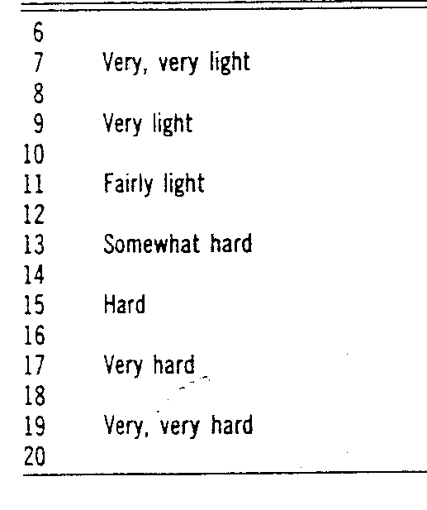
BORG’S SCALE

Slide 13
USES :
Exercise testing
Exercise prescription

Slide 14
A New category scale with ratio properties( 0-10)
They made the scale easy for the lay population and not to those familiar with mathematical or technical terminology, they used a simple number range,
e.g. 0-10.

Slide 15
Source: Borg G.A. Psychophysical bases of perceived exertion. Medicine and Science in Sports and Exercise. 1982; 14:377-381.
How you might describe your exertion | Borg rating of your exertion | Examples (for most adults <65 years old)
None | 6 | Reading a book, watching television
Very, very light | 7 to 8 | Tying shoes
Very light | 9 to 10 | Chores like folding clothes that seem to take little effort
Fairly light | 11 to 12 | Walking through the grocery store or other activities that require some effort but not enough to speed up your breathing
Somewhat hard | 13 to 14 | Brisk walking or other activities that require moderate effort and speed your heart rate and breathing but don’t make you out of breath
Hard | 15 to 16 | Bicycling, swimming, or other activities that take vigorous effort and get the heart pounding and make breathing very fast
Very hard | 17 to 18 | The highest level of activity you can sustain
Very, very hard | 19 to 20 | A finishing kick in a race or other burst of activity that you can’t maintain for long

Slide 16
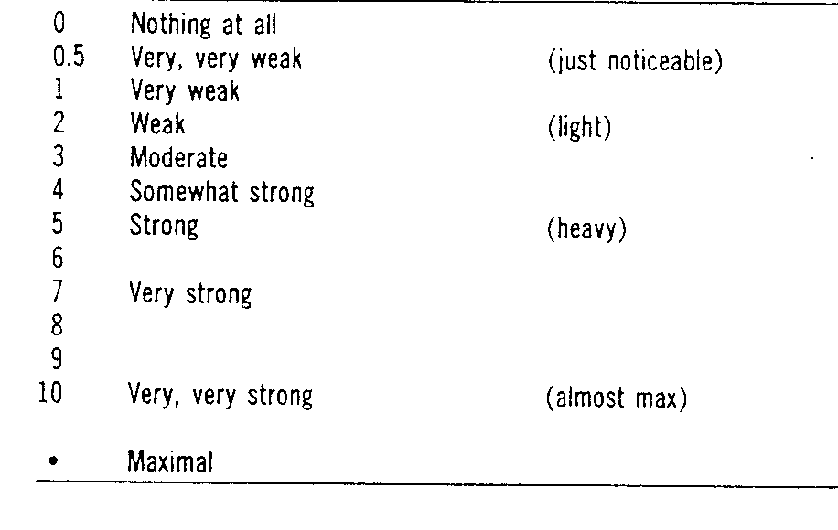
Modified Borg’s scale

Slide 17
Uses : to measure….
Exertion level of patient/individual
May also be used for pain, dyspnea sometimes

Slide 18
It is important to note that using the RPE can be especially important in two situations.
If heart-rate measurement is difficult for some reason, or
if the individual is on medication that alters normal heart rate response to physical stress, RPE can be an excellent tool to regulate and monitor intensity.

Slide 19
Modified Medical Research Council (MMRC)
The Modified Medical Research Council Dyspnea Scale, or MMRC, uses a simple grading system to assess a patient's level of dyspnea -- shortness of breath.
This scale doesn't define the sensation of breathlessness per se, but rather the degree of disability that such breathlessness poses on day-to-day activities

Slide 20
Assess the effects of interventions (treatments) such as medications and pulmonary rehabilitation
For research purposes and comparing treatments across different people

Slide 21
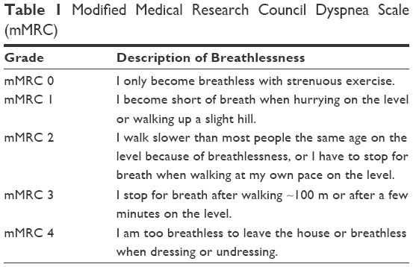

Slide 22
NYHA
The New York Heart Association (NYHA) Functional Classification[1] provides a simple way of classifying the extent of heart failure. It places patients in one of four categories based on how much they are limited during physical activity.

Slide 23
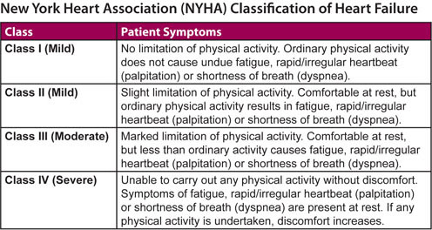

Slide 24
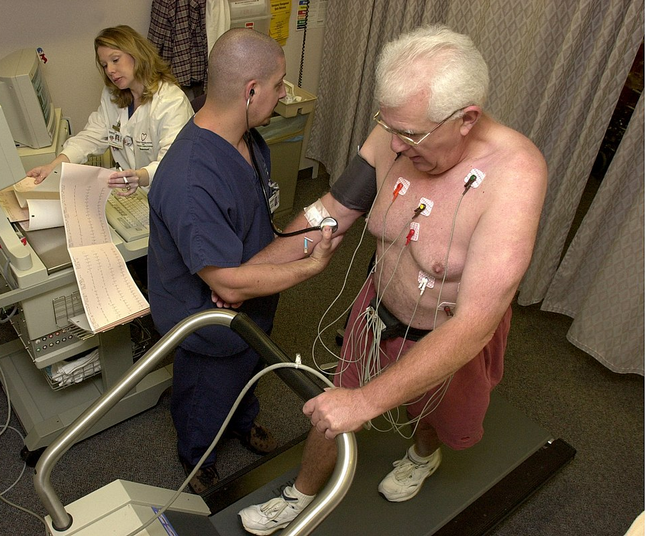

Slide 25
Some exercise test protocols
The Bruce treadmill test remains one of the most commonly used protocols; however, it employs relatively large increments (i.e., 2–3 METs per stage) every 3 minutes. Protocols with larger increments (e.g., Bruce, Ellestad) are better suited for screening younger and/or physically active individuals,
whereas protocols with smaller increments, such as Naughton or Balke-Ware (i.e., 1 MET per stage or lower), are preferable for older or deconditioned individuals and patients with chronic diseases

Slide 26
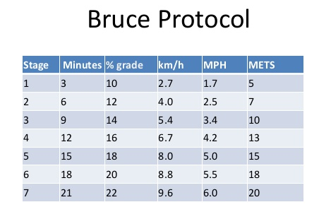

Slide 27
Cycle ergometer test
The Astrand-Rhyming cycle ergometer test is a single-stage test lasting 6 minutes

Slide 28
It is a single stage intensity examination which is chosen by gender and whether the subject is conditioned or not.
It is 6 minutes long if achieved steady state heart rate
HR is taken each minute
BP is taken at 1st , 2nd and 5th minutes
The test will determine the VO2 Max.
This test is special examination as it does not count age in VO2 equation therefore age correction is necessary

Slide 29
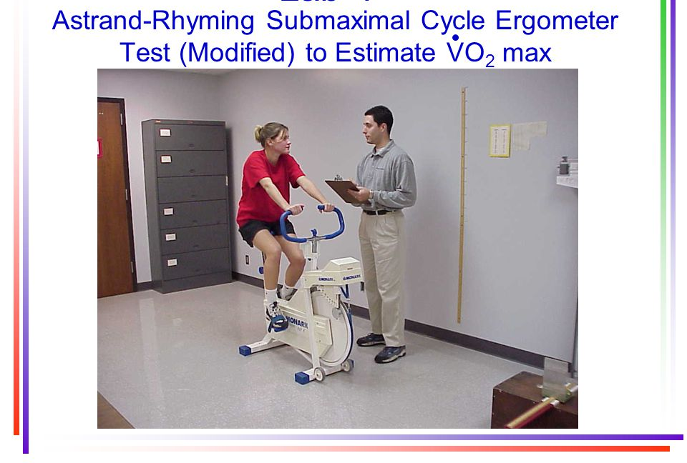

Slide 30
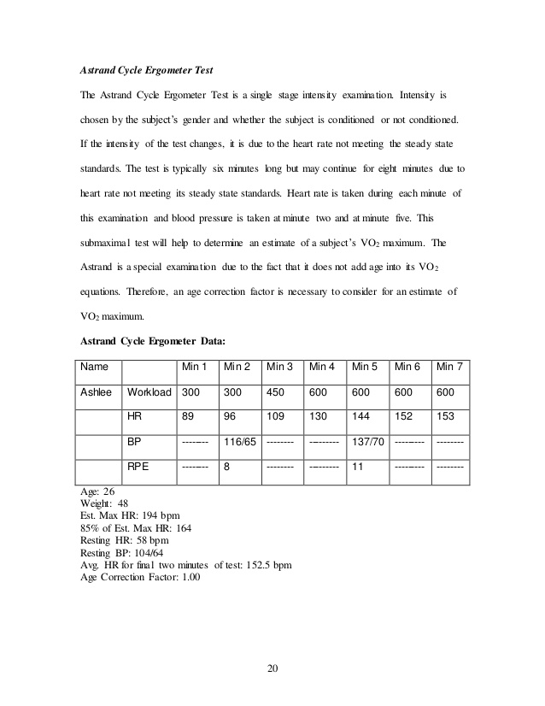

Slide 31
Step test:
Queen’s college step test
YMCA step test, 3 minute , 12 inch step stool, stepping rate 24/minute
  Heart rate values obtained and compared to normative values
To check the heart rate recovery

Slide 32
QCT was performed on a stool for a total duration of 3 min at the rate of 22-24 cycles /min which was set by metronome.
After completion of the exercise, the participant was asked to remain standing and pulse rate was measured from 5 to 20 seconds of the recovery period

Slide 33
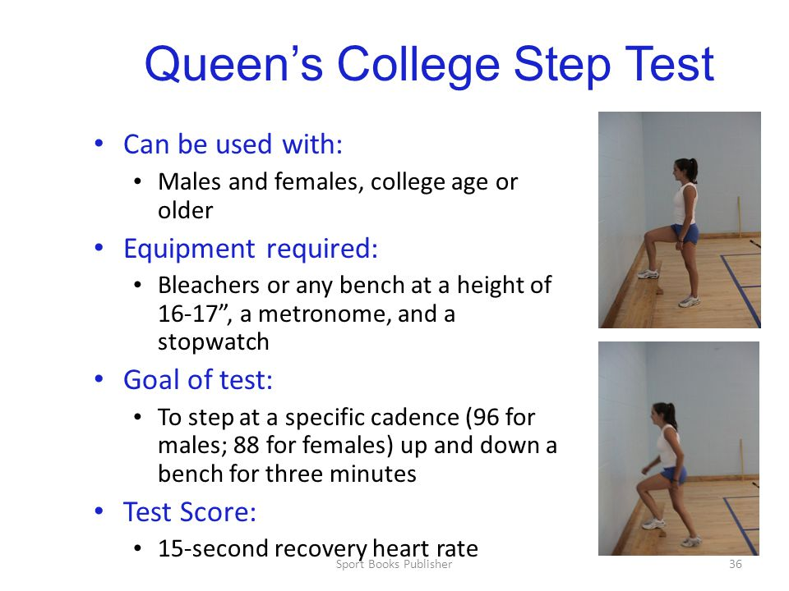

Slide 34
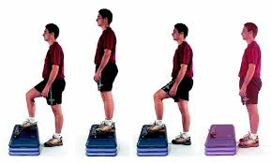

Slide 35
Thank u……

