Slide 1
Short wave diathermy
Dr. Kalpesh Satani

Slide 2
Introduction
SWD is a Deep heating modality
Short wave diathermy current has a frequency between – 10⁷ and 10⁸ Hz and wavelength between 3 m to 30 m.
For therapeutic use frequency of 27.12 MHz is used with wavelength of 11 m.

Slide 3
SWD circuit
SWD produces electric & magnetic fields which alternate at high frequency. These rapidly alternating electric & magnetic fields produce therapeutic effects.

Slide 4
Machine circuit
The machine circuit consists of a sine wave generator circuit which consists of alternating current at frequency 27.12 MHz.
The basic oscillator circuit consists of an inductance (L) and a capacitor (C).

Slide 5
To produce a high frequency, small capacitance and inductance are required, while for a current of low frequency, a large capacitor or inductances are required.

Slide 6
Resonant circuit
Resonant circuit is patient’s circuit and sine wave generator supplies energy to patient’s circuit.
Resonant circuit consists of an inductor of inductance L and capacitor of capacitance C, the frequency at which it oscillates is called as resonant frequency and depends on L & C.

Slide 7
Capacitance of the patient’s circuit varies, as the pair of electrodes with tissue in between acts as a capacitor and contributes to the total capacitance.
The variable capacitor C of the resonant circuit should be adjusted so that the resonant frequency is equal to the machine circuit or sine wave generator.

Slide 8
Tuning is done manually or by excursion meter.
After tuning, heating of the tissues is controlled by regulating the output of sine wave generator, done by adjusting the output control of the machine.

Slide 9
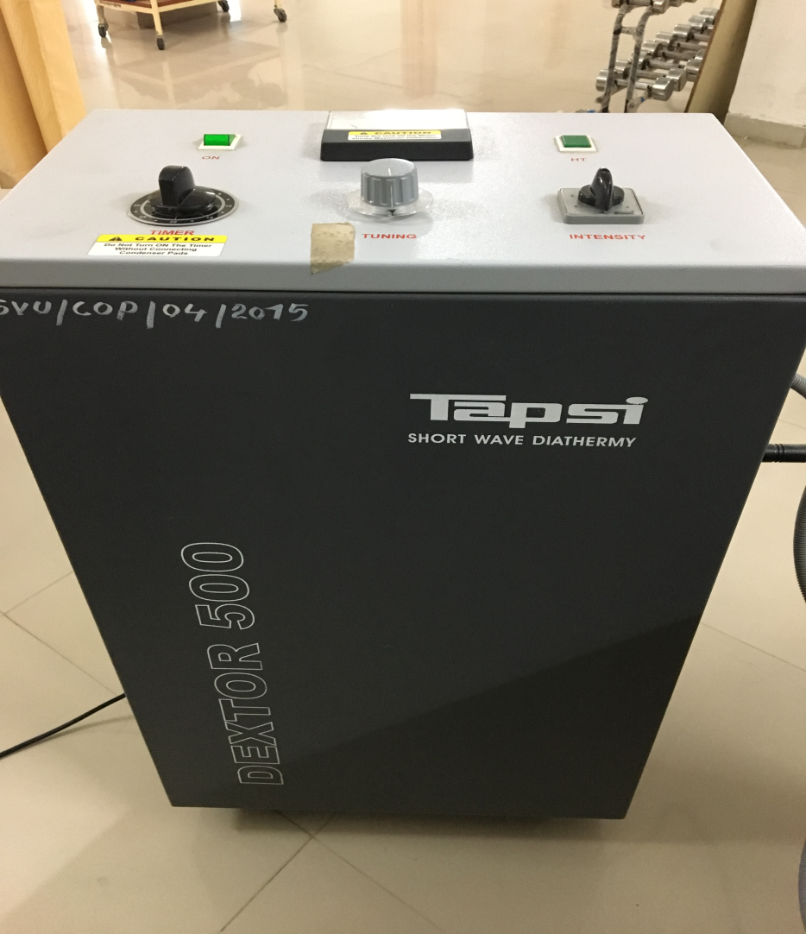
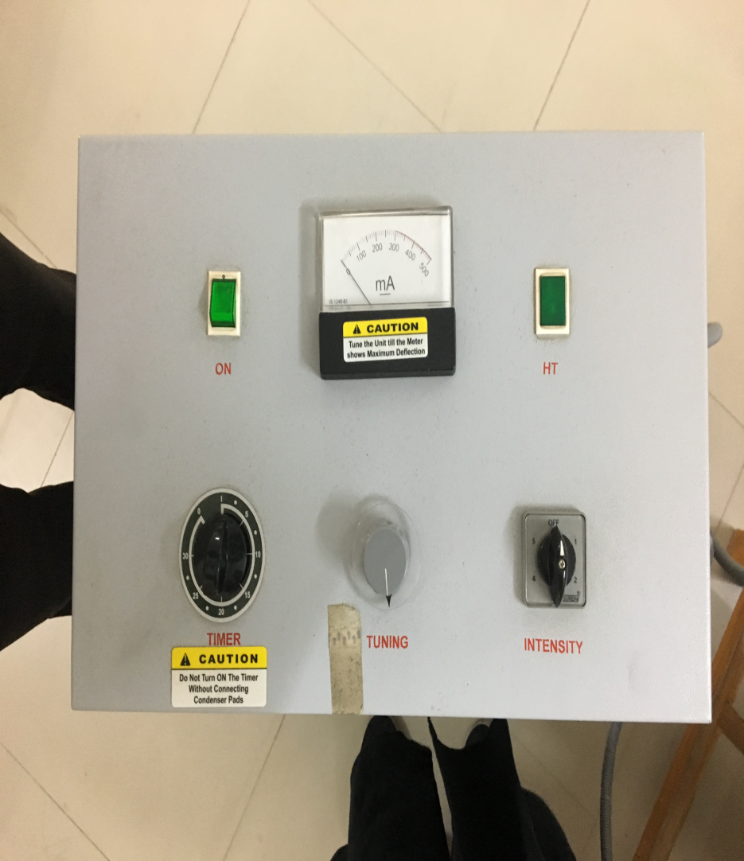

Slide 10
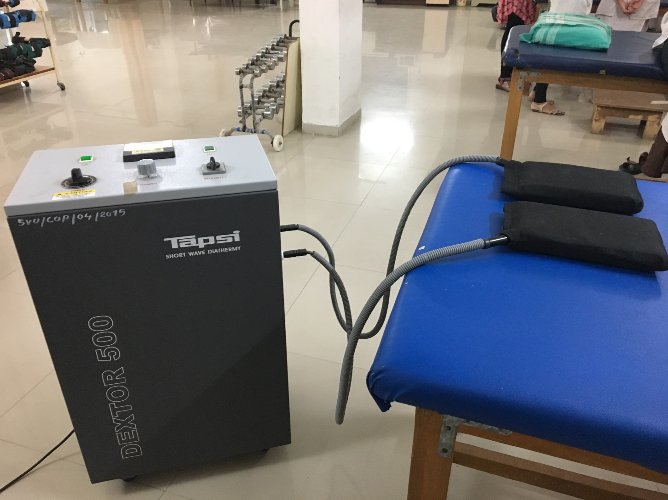

Slide 11
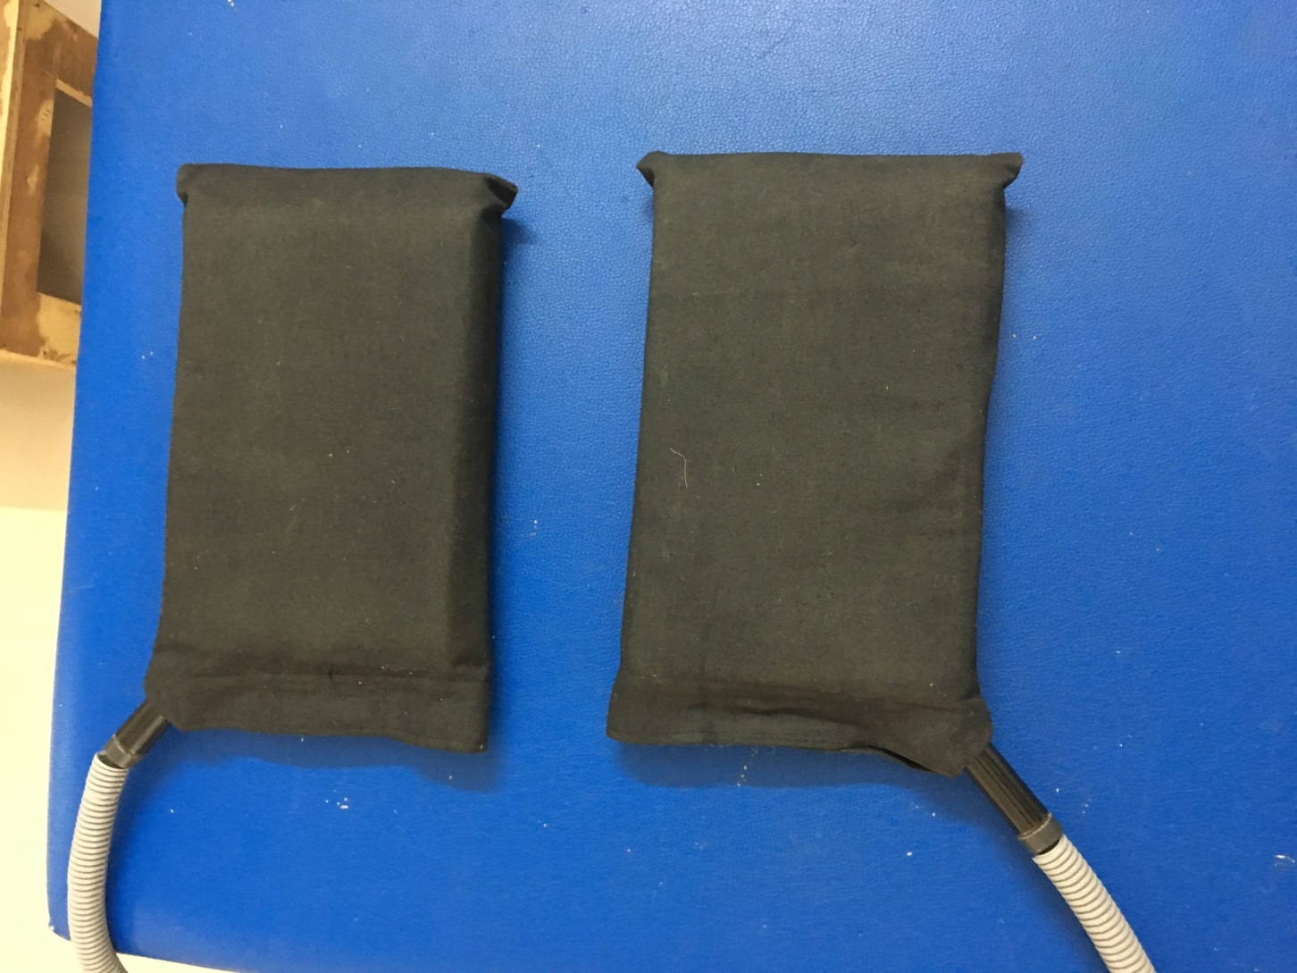

Slide 12
Physiological Effects of SWD

Slide 13
Methods of application
Two methods
Condenser/capacitor field method
Inductothermy (cable) method

Slide 14
Condenser/Capacitor field method
Electrodes are placed on each side of the part to be treated, separated from the skin by an insulating material. The electrodes act as the plates of capacitor, while the patient’s tissue together with the insulating material forms the dielectric.

Slide 15
Effects of electric field
Conductor - is a material in which electrons can be easily displaced from their atoms when such material lies within varying electric field there is rapid oscillation of electrons and a high frequency current is set up.

Slide 16
Electrolyte - is a substance which contains ions,
Electrolyte also contain dipoles having two oppositely charged ions.
Effect of SWD on electrolytes results in vibration of ions and rotation of dipoles

Slide 17
Insulator - in insulators, electrons are strongly held by their central nuclei, so in such a substance varying electric field causes molecular distortion.
In the body, the tissue fluids are electrolytes
Fat are insulators

Slide 18
When tissues containing appreciable amount of fluid lie in electric field, there happens vibration of ions and rotation of dipoles within them. Tissues which contain appreciable amount of fat act as insulators….

Slide 19
Heat production is primary effect of diathermy on tissues.
But it differs from other heat treatments in the distribution of heat produced. This depends primarily on the distribution of the electric field.

Slide 20
Differential heating of tissues
The electric field tends to spread between the electrodes and so its density is usually greatest close to the electrodes.
Superficial tissues lies close to the electrodes than deep ones so density of the field & so heating will be greater in superficial than deep.

Slide 21
Lines of force pass easily through materials of high dielectric than through materials of low dielectric constant. (mean dielectric constant of tissue is 80, pure water 81)
Blood and muscles (having higher dielectric constant) are heated the most.

Slide 22
Deeper tissues lie parallel to electric field, heating is greatest in those of low impedance and it is difficult to obtain direct heating of those structures with high impedance and situated deeper.

Slide 23
There is also rise in the temperature of tissues which are not directly heated by the tissues, heat is conducted through the tissues, so when muscles surrounding a joint are heated, the heat is also transmitted to the joint.

Slide 24
Heat loss
Blood passing through the part was heated serves to carry away heat to different parts. This especially happens in vascular areas, as the temperature rises, blood vessels dilate. For this reason heat should be applied gradually for vasodilatation to take place and steady rate of heat loss to be established.

Slide 25
If any factor impedes the flow of blood through the area, the heat loss is not carried away, overheating is liable to occur.
Heat is lost by conduction and also by small amount of radiation to the surrounding tissues.
Aim is to achieve even field as possible throughout the deep and superficial tissues.

Slide 26
Size of electrodes
General rule - Electrodes should be of a larger size than the structures being treated. The electric field spreads at edges particularly resulting in lower density of field and so less heating in deep tissues than superficial.

Slide 27
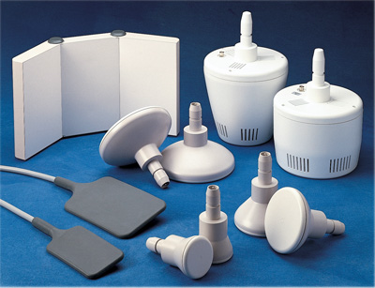
Different sized electrodes

Slide 28
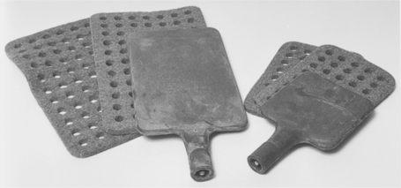

Slide 29
If the electrodes are large, the outer part of the field where the spread is greatest is not utilized, the structure to be heated lies in the more even central part of the field.
For trunk – electrodes should be as large as possible.
For limb – electrodes should be larger than the diameter of the limb.

Slide 30
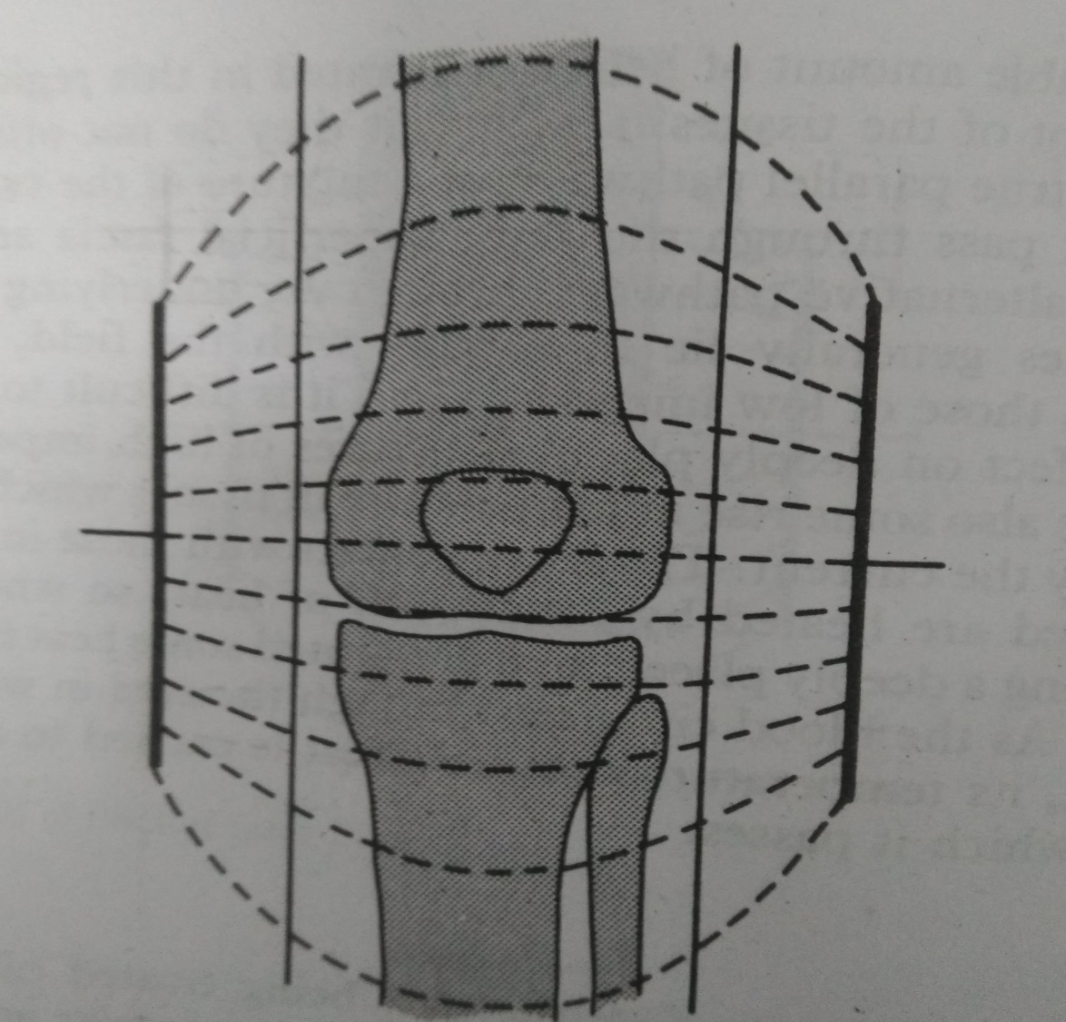

Slide 31
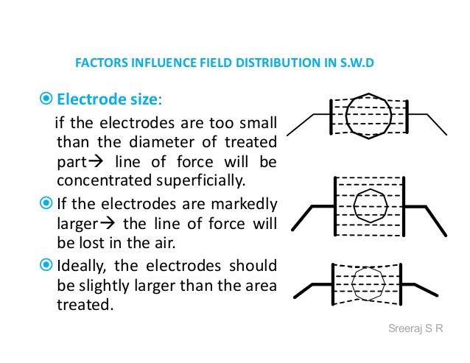

Slide 32
Further the size of both the electrodes should be equal, else they would form a capacitor with different sized plates, and hence different quantities of electricity would be required to charge them, apart from this charge may get concentrated on electrode with larger size.
No advantage of using uneven size.

Slide 33
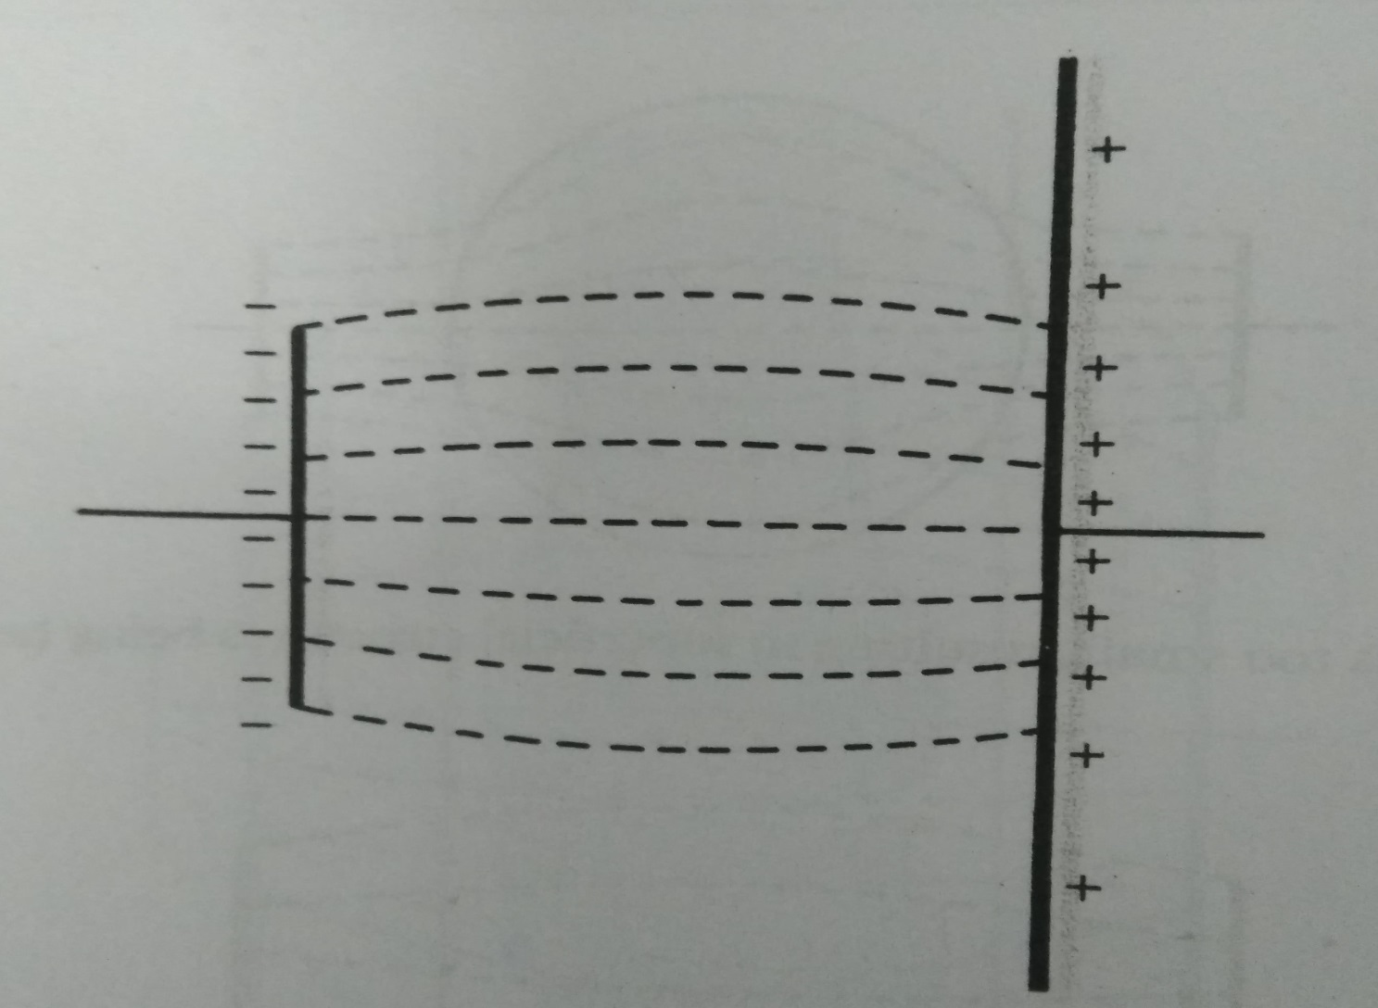

Slide 34
Electrode spacing
Spacing between the electrodes and the patient’s tissue should be wide as the output of the machine allows, and the material between the electrodes and skin should be of a low dielectric constant, air being the most satisfactory.

Slide 35
With narrow spacing, electric field tends to concentrate at the superficial tissues resulting in more heating of the superficial tissues.

Slide 36
When electrodes are widely spaced, there is no difference in the density of the field in superficial and deep tissues. Thus wider spacing helps to reduce the tendency for the superficial tissues to be heated greater than the deep tissues.
But it put considerable demand on the output of the machine.

Slide 37
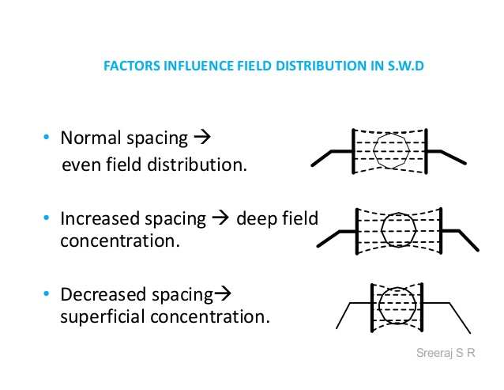

Slide 38
If one electrode is placed nearer to the skin then other, there is a greater heating effect under the closer electrode than the further one.

Slide 39
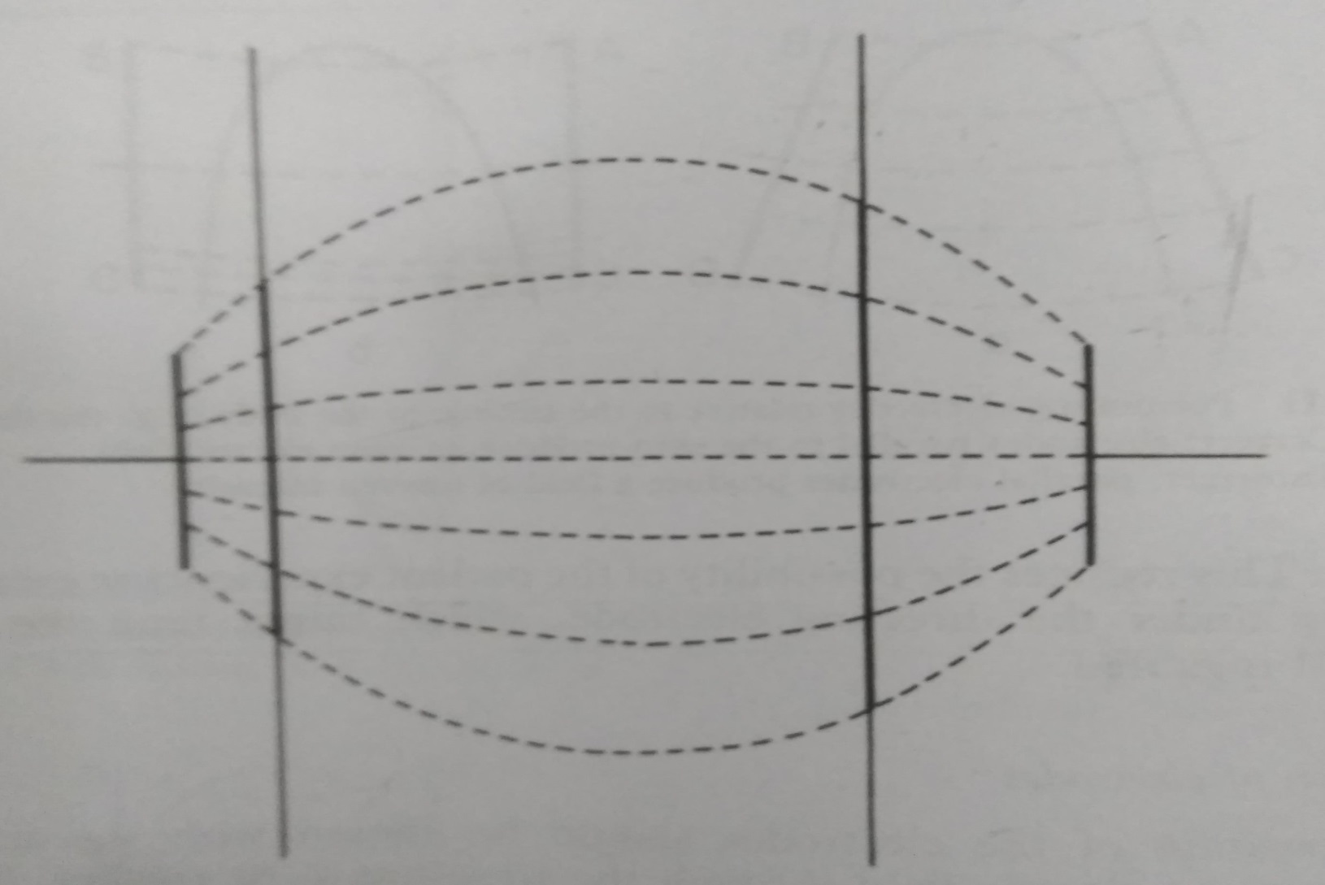

Slide 40
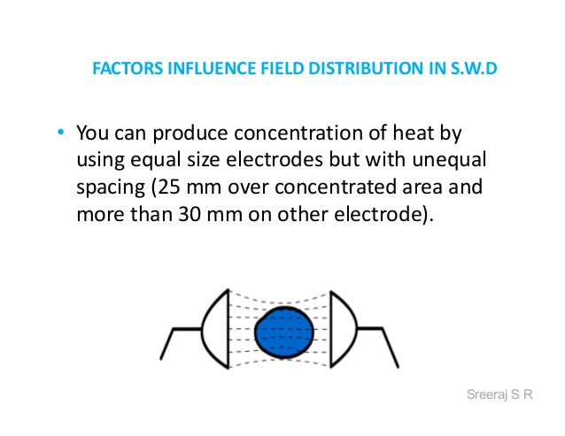

Slide 41
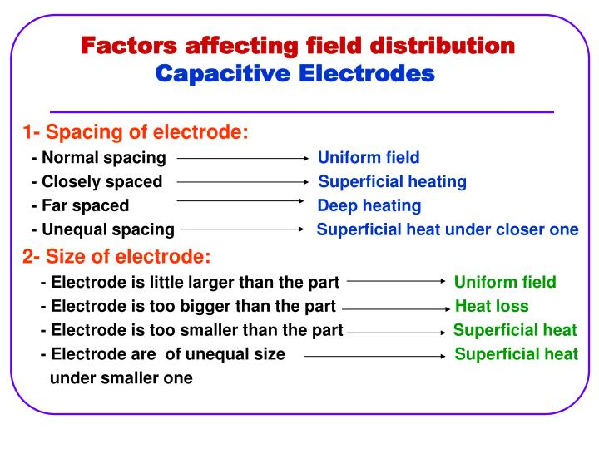

Slide 42
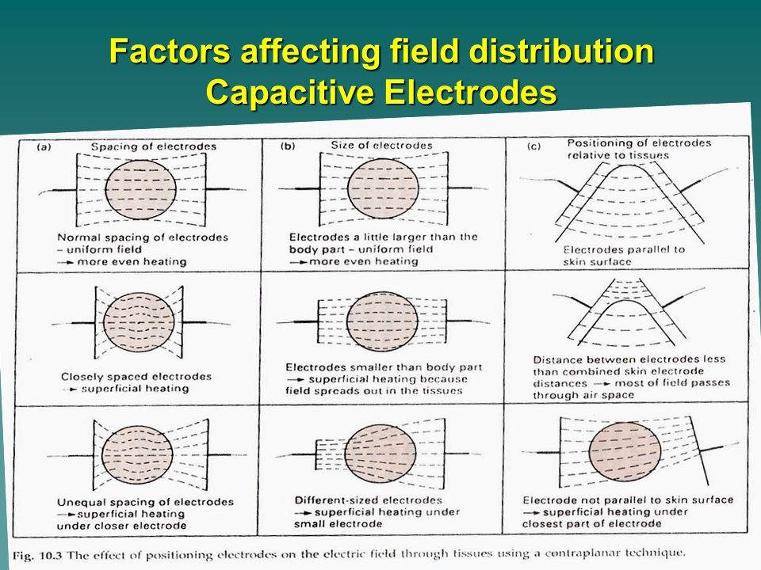

Slide 43
Position of electrodes
Position of electrodes should be chosen with the aim of directing the electric field through the structure to be treated.
If the structure to be treated is of high impedance, electrodes should be arranged in a way that the different tissues lie in series with each other and at right angles to the electric field.

Slide 44
To treat structure of low impedance, the tissues should be parallel to the field.

Slide 45
The electrodes should be placed parallel to the skin otherwise field concentrates in area of tissues closest to the electrode.
Insulating material should be of low dielectric constant, i.e. it should offer considerable impedance to the lines of force, majority of which will then take the shortest pathway through it.

Slide 46
The tissues have high dielectric constant, so lines of force can travel through them easily, and the longer pathway offers little more impedance.
For example considering lateral aspect of shoulder joint, which is narrower above than below. If electrodes lie parallel to the skin, they are at a slight angle to each other, but an even field is obtained.

Slide 47
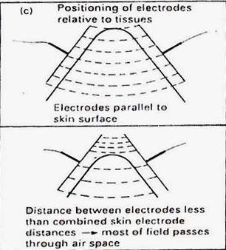

Slide 48
Electrodes should be placed over an even surface of the body. In case of irregular surface, concentration of field over the most prominent surface
It can be avoided/reduced by using wider spacing.

Slide 49
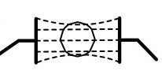

Slide 50
Types - Positions of electrodes
Contraplanar positioning
Co-planer positioning
Cross fire method
Monopolar technique

Slide 51
Contraplaner positioning
Most satisfactory method for treating deeply placed structures.
The electrodes are placed over opposite aspects of the trunk or limbs so that the electric field is directed through the deep tissues.
Electrodes should be parallel to the skin and not too close to each other.

Slide 52
Coplanar positioning
Electrodes are placed side by side on the same aspect of the part.
The distance between the electrodes is more than the total width of spacing; otherwise the electric field will not pass through the tissues at all.

Slide 53
The heating is more superficial than with contra planer method, but this may be satisfactory for certain superficial structures which are too extensive for a contra planer application, for e.g. spine can be treated with this arrangement.
Suitable for superficial heating when heating of deep structures is undesirable.

Slide 54
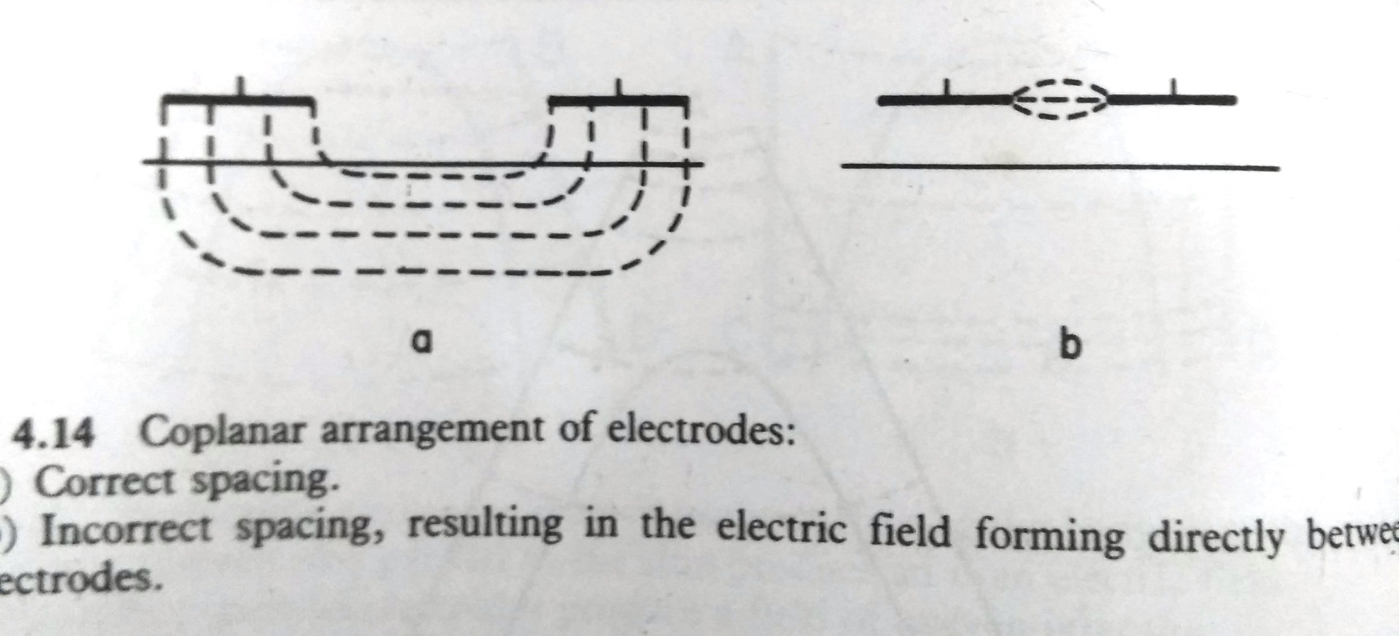

Slide 55
Cross fire method
Half the treatment is given with the electrodes in one position, and then the arrangement is changed so that the electric field lies at right angles to that obtained during the first part of the treatment.
For knee joint – half treatment with electrodes over the medial and lateral aspects, the other half with them over the anterior and posterior aspects.

Slide 56
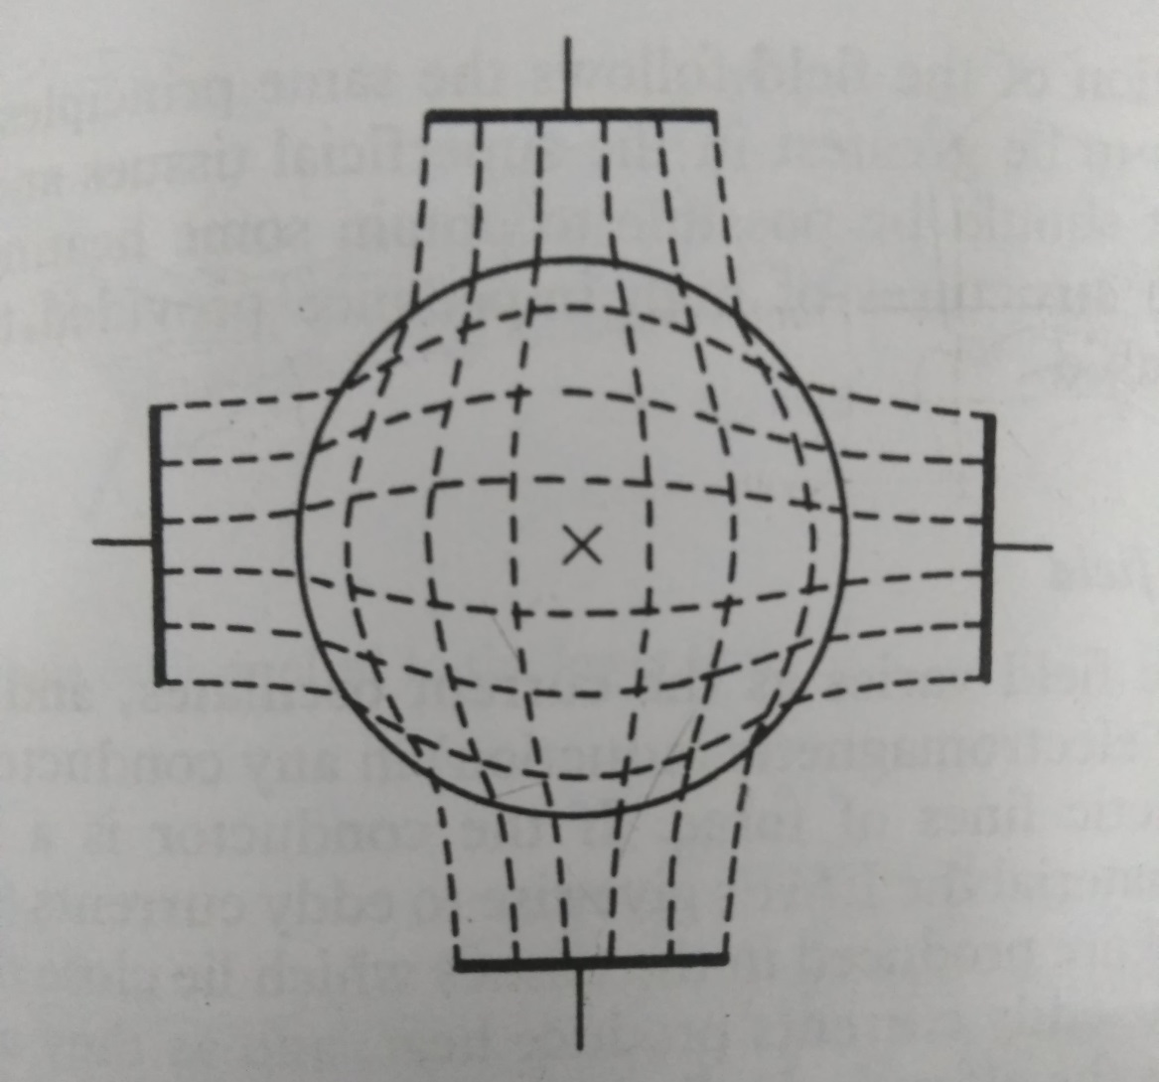

Slide 57
This is used for the treating the walls of cavities containing air, e.g. frontal, maxillary, ethmoid sinus.
Lines of force pass through the tissues between the electrodes but avoid the cavity, as the air within it has a low dielectric constant. Thus those walls of the cavity which face the electrodes are not treated.

Slide 58
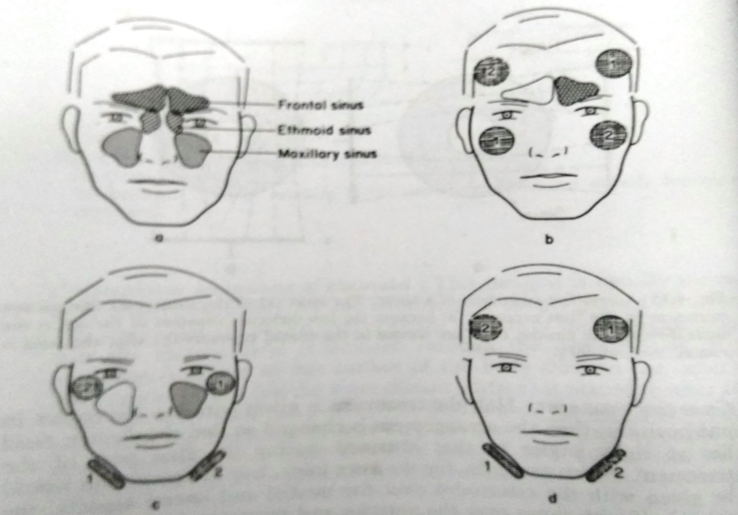
Rx for Frontal sinus
Rx for all sinuses including ethmoidal sinus
Rx for Maxillary
sinus

Slide 59
This method is used for deeply placed structures for e.g. pelvic organs.

Slide 60
Monopolar technique
Active electrode is placed over the site of lesion and indifferent electrode is applied to some distant part of the body or may not be used.
Separate electric field is set under each electrode and lines of force radiating from the electrode.
Thus density of the field becomes less as the distance from the electrode increases.

Slide 61
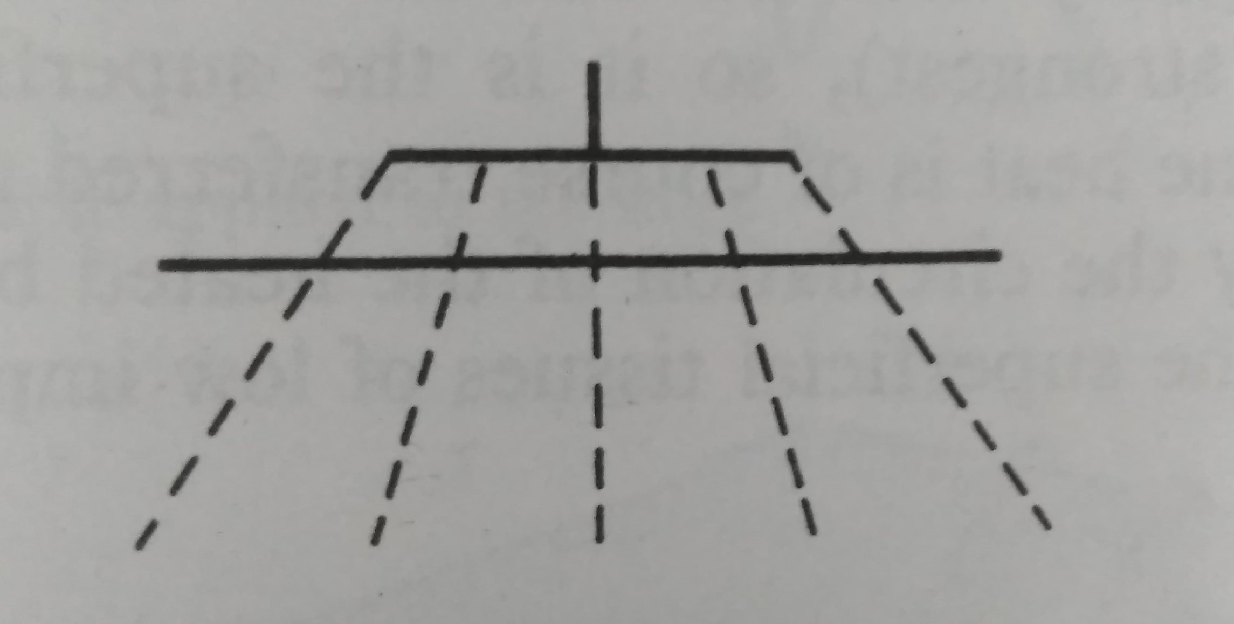

Slide 62
This method is useful for superficial heating.

Slide 63
Cable method
When SWD is applied by cable method, effect of electric field as well as magnetic field is used at the same time.
Magnetic field - Inductotherapy
The electrode consists of a thick, insulated cable which completes the patient’s circuit of the machine.

Slide 64
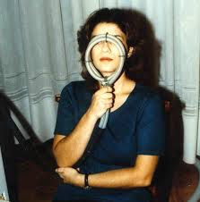
Cable electrode

Slide 65
The cable is arranged in relationship to patient’s tissues, but separated from them by a layer of an insulating material.
As high frequency current oscillates in the cable, a varying electrostatic field is set up between its ends and an varying magnetic field is set up at its central part.

Slide 66
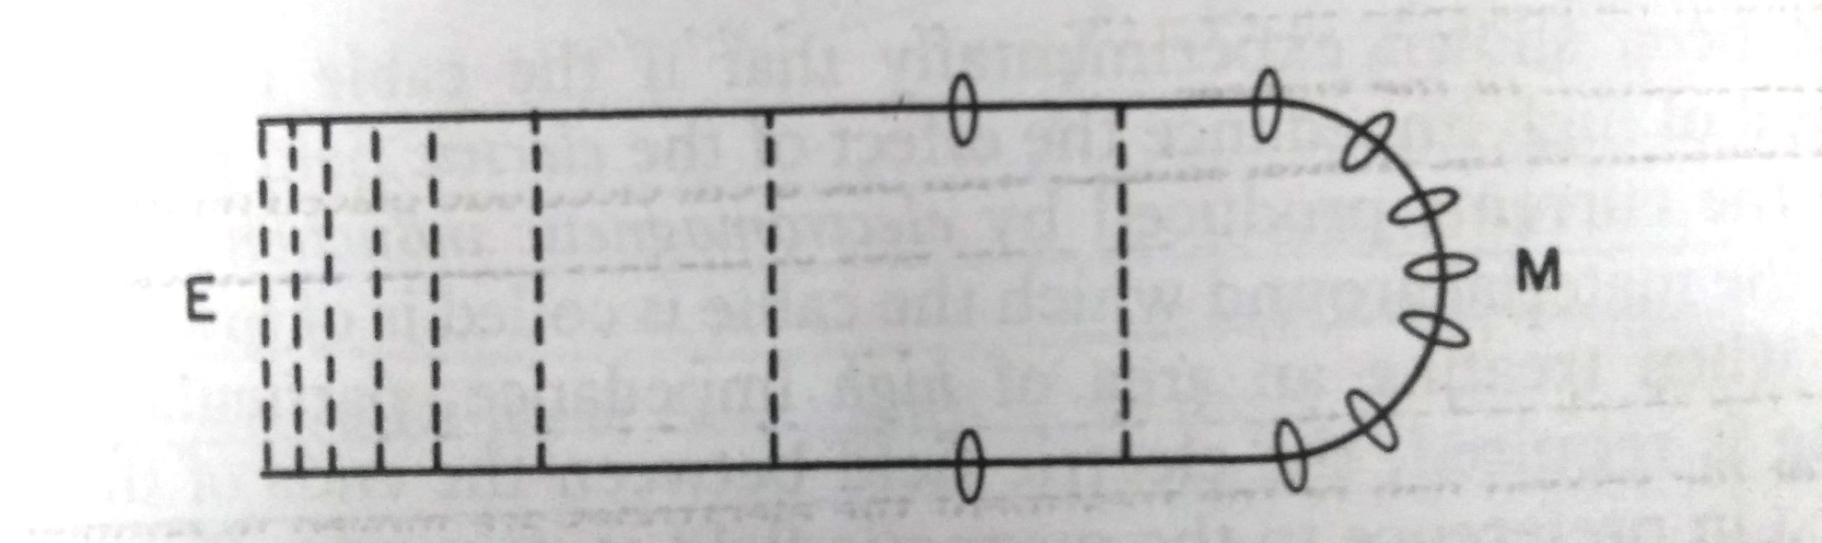

Slide 67
Electrostatic field
The tissues which lie between the ends of a cable are subjected to electrostatic field. (effects on the tissues will be similar to capacitor field method)
Heating tends to be greater in superficial tissues and those of low impedance, heating of deeper tissues can be obtained when the tissues lie parallel to the field (with suitable technique).

Slide 68
Magnetic field
A varying magnetic field is set up due to oscillating currents, and so EMFs is induced by electromagnetic induction in any conductor which is cut by the magnetic lines of force.
If the conductor is solid piece of conducting material, EMFs give rise to eddy currents

Slide 69
Eddy currents are produced in the tissues which lie close to the centre of the cable, which produce heat in the tissues.
This heat is confined to the tissues of low impedance so that heating of subcutaneous tissues (fat) is avoided.

Slide 70
However, these currents are set up near the surface of conductors where the magnetic field is strongest, so it is the superficial tissues which are heated the most.
Some heat will be transferred to adjacent tissues by conduction and by circulation of the heated blood, but effect will be primarily on superficial tissues.

Slide 71
Relative effects of both fields
If the cable is coiled around the material of high impedance the effect of electric field predominates while effect of magnetic field predominates when the cable is coiled around material of low impedance.
When treating a structure of high impedance, deep heating is required, electric field between the ends of cable is preferred, whereas when tissues of low impedance, like superficial heating is preferred, magnetic field at the center of the cable is preferred.

Slide 72
Alternatively both effects are used when the entire cable is wound around the whole limb.
For treatment of limbs, cable is wound around the part.
If area is extensive, whole cable is used.

Slide 73
When treating smaller area, is to be treated either ends of the cable or the center of the cable may be utilized depending upon whether the tissue to be treated is of high or low impedance and whether superficial or deep structures are to be treated.
For e.g. for knee joint, 2 turns may be made with each end of the cable, these lying above and below the joint.

Slide 74
To treat a flat surface cable can be arranged in a form of a flat helix. 2 helices can be made from its either ends or a grid arrangement is used.

Slide 75
Indications of SWD
1. Chronic OA & RA
2. Sprains
3. Strains
4. Hematoma
5. Muscle and tendon tear
6. Capsule lesions

Slide 76
7. Chronic inflammatory conditions
8. Boils or carbuncles
9. Sinusitis
10. Pelvic conditions
11. Infected surgical incisions

Slide 77
Contraindications of SWD
Haemorrhage
Venous thrombosis or phlebitis
Arterial disease
Pregnancy
Metal implant
Disturbed skin sensation

Slide 78
Tumours
Recent X-ray therapy
Patients at particular risk - small children and mentally defective people. Unconscious patients or epileptic patients

Slide 79
Therapeutic uses of SWD
Effects on inflammation
Supply of heat to the tissues results in vasodilatation and increased flow of blood to the part making supply of oxygen and nutrients and bringing more antibodies and WBCs to the injured tissues thus taking away the waste products.
SWD recommended in only sub-acute & chronic inflammation.

Slide 80
Effects in bacterial infection
Inflammation is the normal response of the tissues to bacterial invasion, and signs of inflammation being vasodilatation, exudation of fluid into the tissues, and increased concentration of WBCs and antibodies to the part, heating the tissues actually.
Helpful in boils, carbuncles and abscesses.

Slide 81
Traumatic condition
Application of SWD to the part results in increased blood flow to the part and thereby efficient removal of waste products and helps in healing processes.
Before treating stiff joints, SWD is recommended.

Slide 82
Reducing healing time

Slide 83
Relief of pain
Mild degree of heating helps to reduce pain due to sedative effect.
As heating increases blood flow, it causes the removal of pathological pain causing substance away from the site.
When pain is due to inflammation, suppression of inflammation causes suppression of pain.

Slide 84
Effects on muscle tissue
Heating the tissues induces muscle relaxation, thus SWD may be used for relief of muscle spasm associated with inflammation and trauma.
Increased efficiency of muscle action also aid the satisfactory performance of active exercises.

Slide 85
Dangers of SWD
Burns
Burns are liable to occur with SWD, in severe cases, there is coagulation and tissue destruction, which appears as a white patch surrounded by a reddened area of inflammation.
In milder cases, a red patch with a blistering is liable to occur.

Slide 86
Factors responsible for burns
Concentration of field
Excess current
Hypersensitive skin
Impaired blood flow
Leads touching the skin

Slide 87
Scalds
Scald is caused by moist heat,
If the area where the electrodes are placed are damp or moist (because of perspiration).
It may cause overheating & scalding the skin.

Slide 88
Over dose
This can cause aggravation of symptoms especially pain or if at all diathermy is used in case of acute inflammation.
Increase in pain after treatment indicates reduction of intensity in subsequent applications.

Slide 89
Precipitation of gangrene
Heat accelerates chemical changes including metabolic processes in the tissues, increasing the demand for oxygen, this is supplied by increased blood flow.
But if the blood flow is impeded to the tissues they will be deprived of oxygen and hence gangrene is liable to occur.

Slide 90
Electric shock.
Sparking.
Faintness.
Giddiness.
Damage to equipment.

Slide 91
Pulsed electromagnetic energy - PEME
Major limitation of continuous SWD is that its thermal effect is greatest in fatty tissue and this limits the amount of energy which can be applied to the patient before thermal damage occurs. Beneficial effects can be produced when sub-thermal dose is applied.

Slide 92
Number of machines exists which produce pulsed electromagnetic energy with the aim of stimulating tissue repair in a non-thermal way. They operate at a frequency of SWD is 27.12 MHz same as SWD.
This has lead to the popular term ‘pulsed shortwave’.

Slide 93
Frequency: 25- 600 Hz with varying no. of intermediate steps.
Pulse width: 20 microseconds is the shortest, 40 ms is the longest. Most popular units operates at fixed pulse width of 65 microseconds.

Slide 94
Power/ depth of penetration: Power control varies for each pulse from 293 watts (penetration is 1 inch) to 975 watts (penetration is 6 inch).

Slide 95
Rest period: Depends upon the selected pulse width and frequency, the treatment/rest ratio is 1:25. It would be possible using a long pulse width and a high frequency to produce a mild thermal effect.

Slide 96
Physiological effect
Principle/ effect of pulsed SWD: electrical potential across a normal cell membrane is -60 to 90 mV. In damaged cells this potential becomes -40 mV which would affect the normal metabolic reactions in the cell.

Slide 97
Pulsed SWD is postulated to give a push to start the system working back and thus allowing somehow this potential to reach back to -60 mv. This normal potential is an essential part for the cellular reactions to restart.

Slide 98
Indications
OA & RA
Sprains
Strains
Hematoma
Muscle and tendon tear
Capsule lesions

Slide 99
Contraindications
Same as SWD except acute inflammatory conditions which cannot be treated with continuous mode can be safely treated with pulsed SWD as there is no danger of thermal energy.

Slide 100
Technique of application
The single treatment head is placed in close contact with the area to be treated; the parameters are set as per condition.
Tuning is done by tuning the knob on treatment head itself and resonance is shown by the brightest illumination of a light on the head.

Slide 101
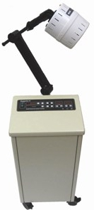

Slide 102
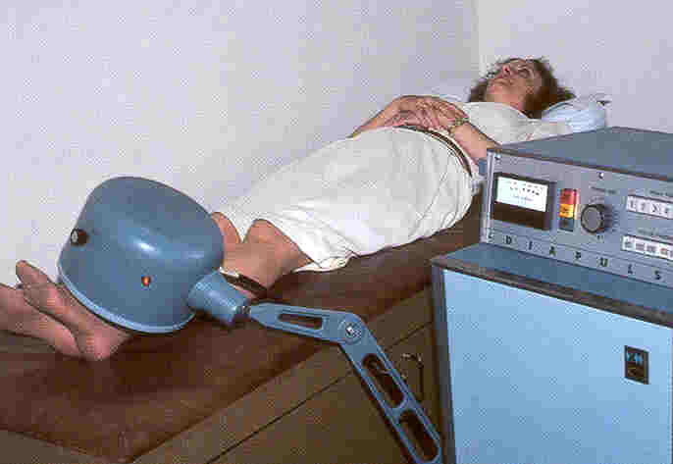

Slide 103
The patient feels nothing hence doesn’t need to be warned or no sensation test needs to be carried out.
Duration of the treatment is according to the stage of the condition being treated.

