Slide 1
NORMAL DEVELOPMENT OF CHILD
BY: Dr. Dhwani Chanpura

Slide 2
NORMAL DEVELOPMENT
Child development is a process where every child goes through. This process involves learning and mastering skills like sitting, walking, talking,etc,...These skills, called developmental milestones, appear at predictable time periods.

Slide 3
PRINCIPLES OF DEVELOPMENT
1) Development is a continuous process from conception to maturity. It must not be thought of mere milestones. Before any ‘milestone’ is reached a child has to go through many preceding stages of development and for developmental diagnosis one has to be conversant with all these stages.
2) Development depends on the maturation and myelination of the nervous system.

Slide 4
3) The sequence of development is the same for all children, but the RATE of development varies from child to child.
4) Certain primitive reflexes anticipate corresponding voluntary movement and have to be lost before the voluntary movement develops.

Slide 5
5) The direction of development is cephalocaudal. The first step in the development of locomotion is the acquisition of head control, involving the neck muscles. Later the spinal muscles develop coordination so that the child is able to sit up with a straight back instead of a round one.
6) Generalized mass activity gives way to specific individual responses.

Slide 6
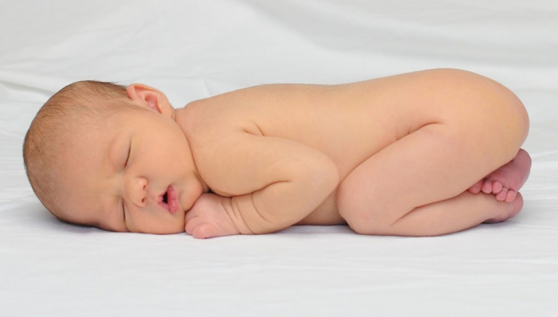
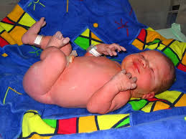
At 1 month:

Slide 7
At 1 month:
At birth, the new born neonate is in –physiological / global flexion.
Random movements
Rotate head in prone
Will take weight on legs in standing
Hands loosely fisted
Visual preferences - 8to 10inches
Enjoys prone position

Slide 8
Belly breather
Oral reflexes present, roots when hungry
Responds to noises with startle
The baby sleeps for the most part of the day, can suck swallow.
Immediately after birth baby turns to human voice, turn to smell of his mother’s breast.
Doll’s eye phenomenon(the movement of the eyes as a unit in the opposite direction when the head is moved)present at time of birth from birth to 10 days. Spontaneous smile present

Slide 9
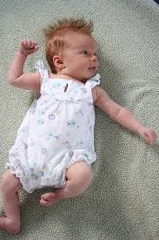
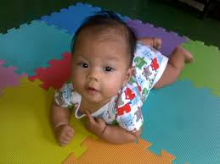

Slide 10
At 2 months:
Period of maximum asymmetry
Head rarely in midline(ATNR)
Physiological flexion reduces
Lifts head to 45degrees
Pushes through elbows in prone
May not take weight in standing

Slide 11
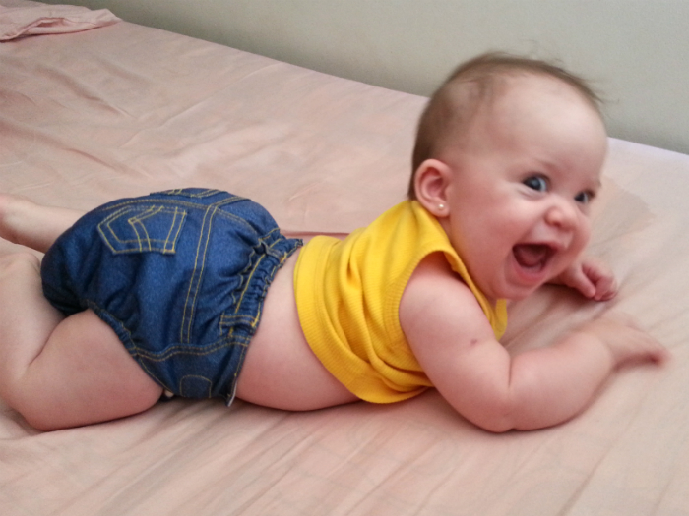
1) Gross Motor Milestone:
3 Months
Prone
Head compensates when held in ventral suspension.
Lifts head when resting on forearm.
On verge of rolling to supine.
Head rotates and extends.

Slide 12

Supine
Symmetrical head and arm posture.
Rolls part way to side.

Slide 13
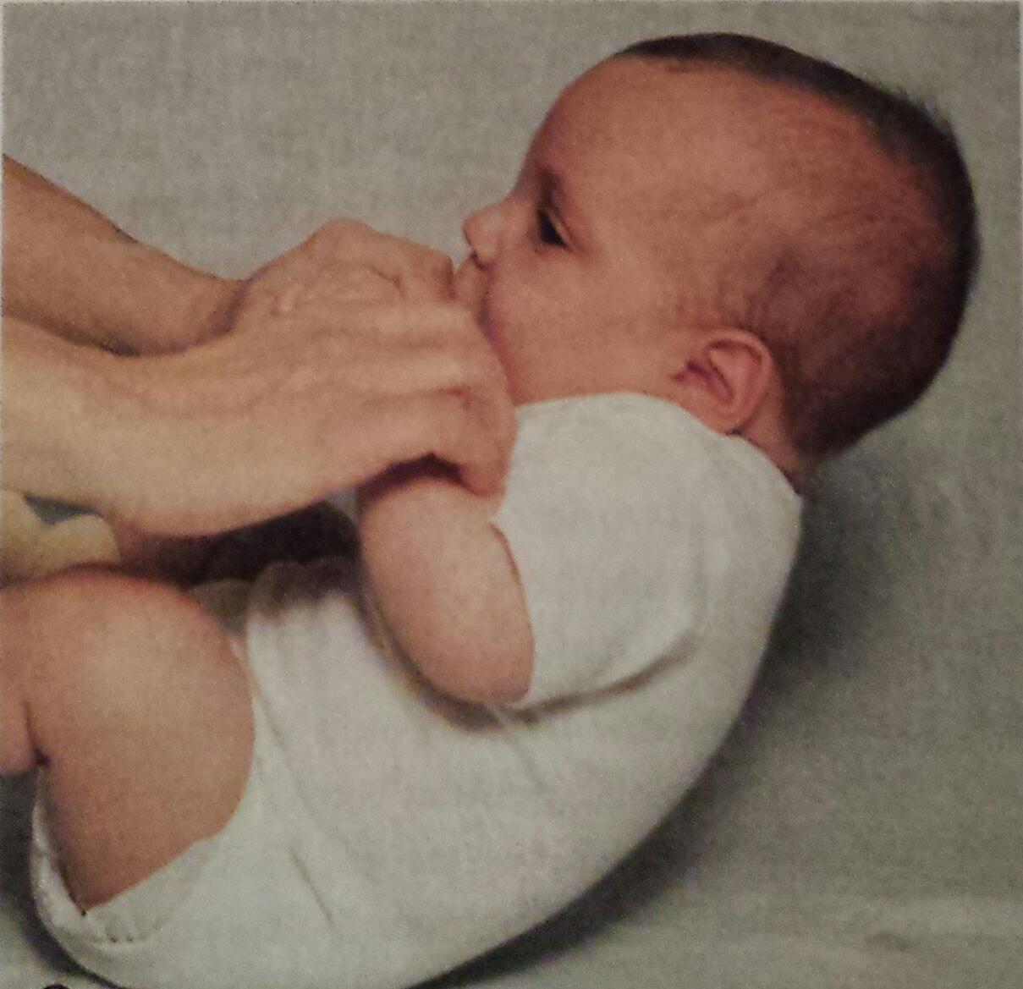
Supported Sitting
Slight head lag when pulled to sitting
Head steady lumbar curve

Slide 14
Supported Standing
Bears small fraction of weight on legs briefly

Slide 15
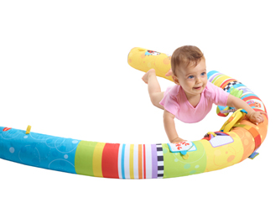

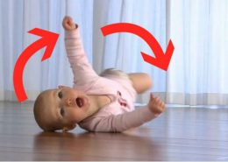

6 Months
Cghvjbkn .m,

Slide 16
6 Months
Prone:
Legs and arms extended, weight on Hands.
Lifts arm with stimultion
Rolls to supine
Circular pivoting

Slide 17


Supine
Lifts Head
Rolls to prone

Slide 18
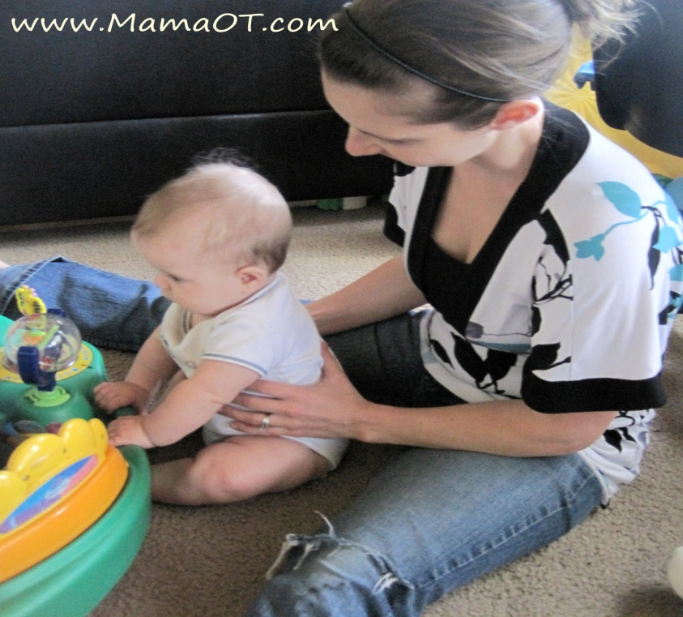
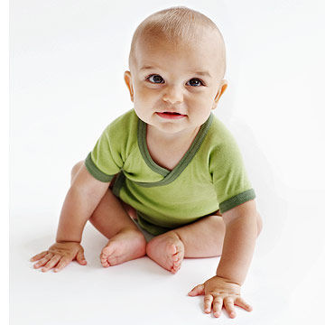
Supported Sitting
Lifts head and assists in pull to sitting
Holds head erect when leaning forward
Active in supported sitting
Sit momentarily, leaning on hands

Slide 19
Supported Standing
Bears large fraction of weight on legs and bounces.

Slide 20

9 Months
Prone
Assumes hand knee creeping position
Creeps on all fours, hitch on buttocks

Slide 21

Sitting
Sits independently, unsupported
Assumes sitting without assistance

Slide 22
Standing
Pulls to standing at rail or furniture
Lowers to floor at rail or furniture

Slide 23
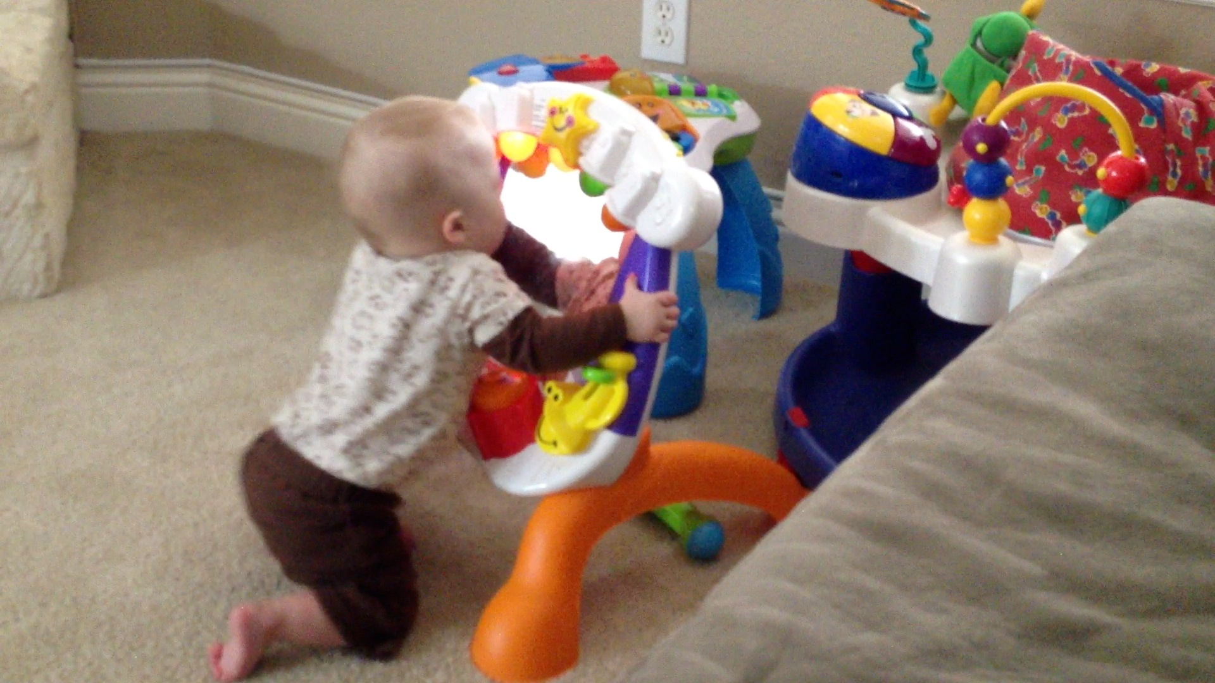

Slide 24
12 Months
Pivots in sitting
Cruises at rail
Walks with one hand held
Creeps or hitches upstairs

Slide 25

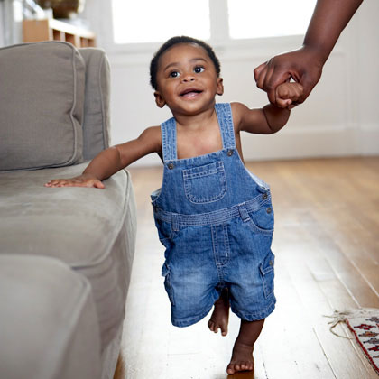
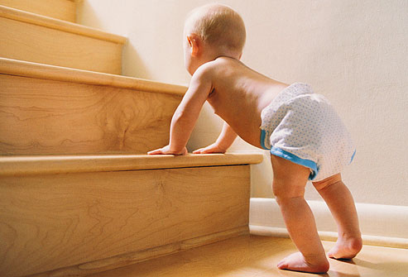

Slide 26
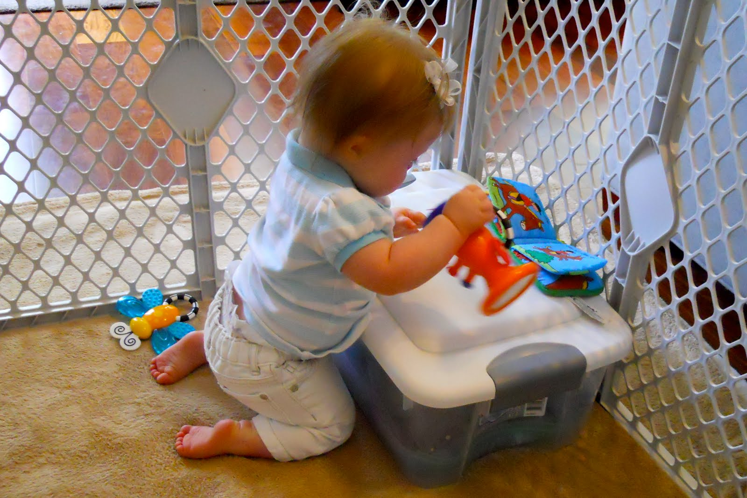
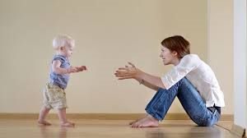
15 Months

Slide 27
15 Months
Walks alone several steps
Assumes and maintain kneeling balance
Falls by sitting
Rises to standing independently

Slide 28
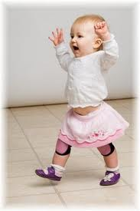
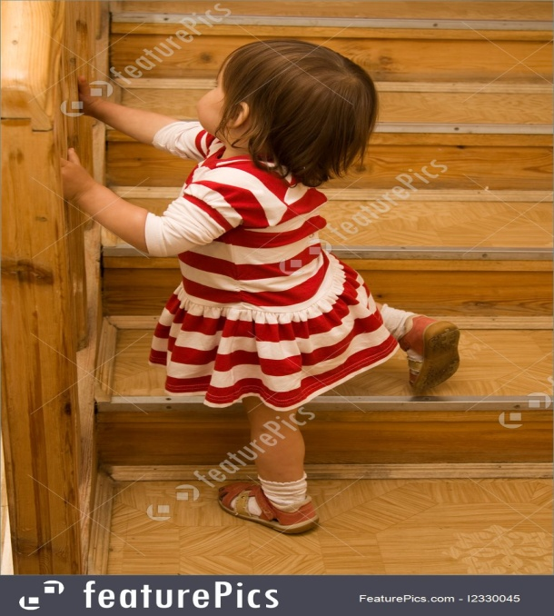

18 Months

Slide 29
18 Months
Walks alone, seldom falls
Upstairs with one hand
Seats self in small chair

Slide 30

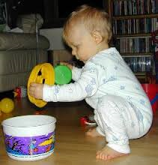
21 Months

Slide 31
21 Months
Upstairs holding one rail
Downstairs with one hand help
Squat in play

Slide 32
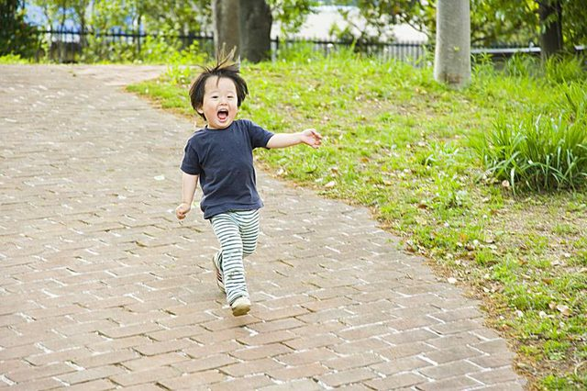

2 Years

Slide 33
2 Years
Runs fairly well
Upstairs and downstairs alone
Kicks in standing

Slide 34
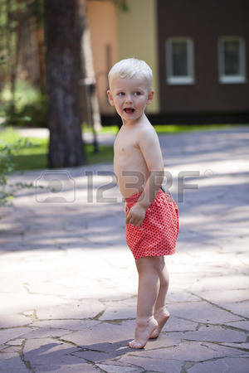
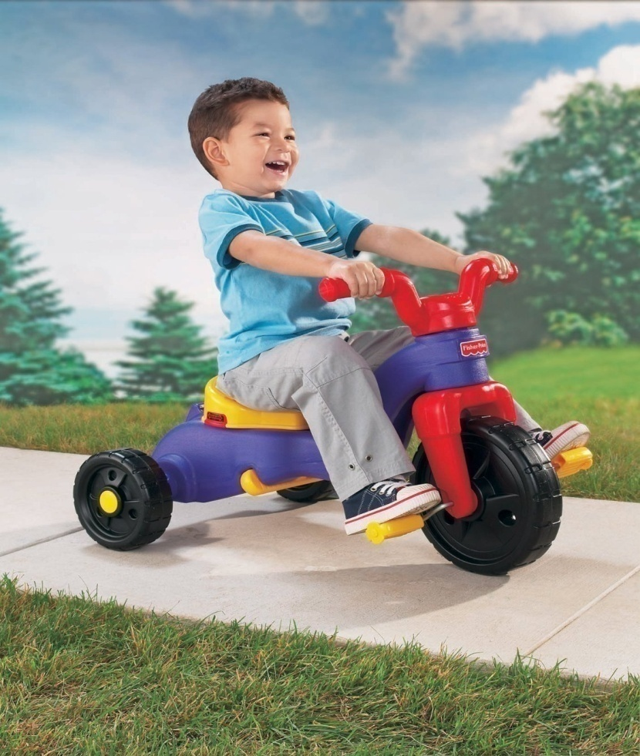
3 Years

Slide 35
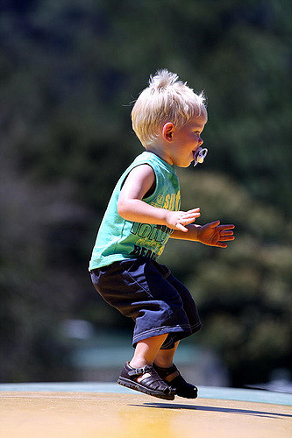


Slide 36
3 Years
Walks on tip toe
Runs on toes
Rides tricycles
Jumps on both feet
Upstairs alternate feet
Momentary one foot standing

Slide 37
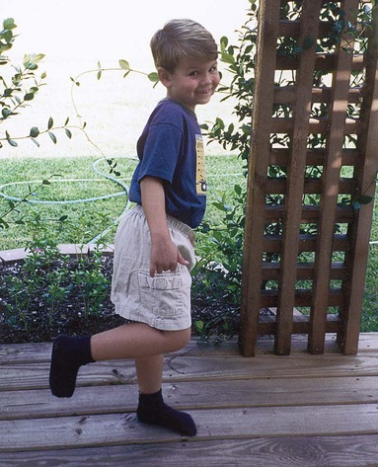
4 Years
Downstairs alternating feet
One foot standing balance 4-8 sec
Skips on one foot

Slide 38
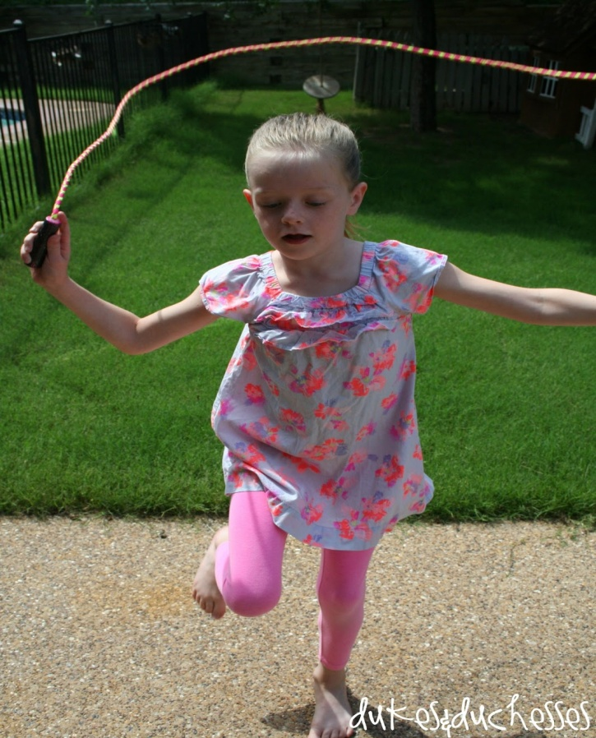
5 Years
Skips with alternating feet
One foot standing balance, 8 sec plus
Walking broad- full length

Slide 39
6 Years
Jump from height of 12’’landing on to toes
Stands on alternating feet , eyes close
Advanced throwing

Slide 40


Slide 41
Fine Motor Milestone

Slide 42
3 Months
Hand Use
Hold toy actively (1/2 inch peg)
Arms activate on sight of toy
Symmetrical head and arm posture(supine)

Slide 43
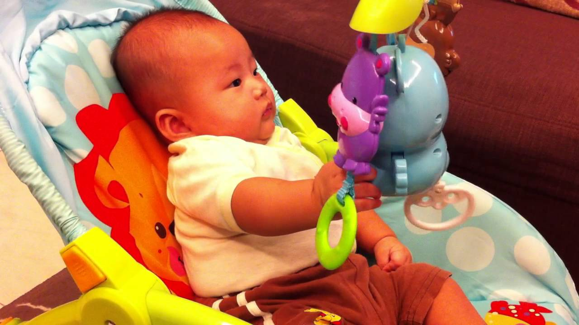
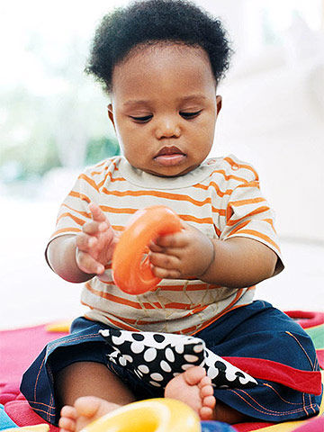

Slide 44
6 Months
Hand Use
Reaches purposefully
Transfer objects
Drops objects

Slide 45
9 Months
Hand Use
Extended reach and grasp
Opposed grasp
Feeding
Finger feeding

Slide 46
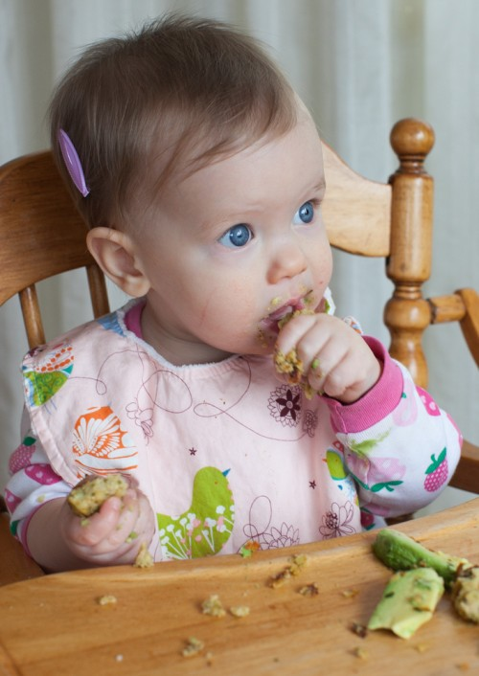

Slide 47

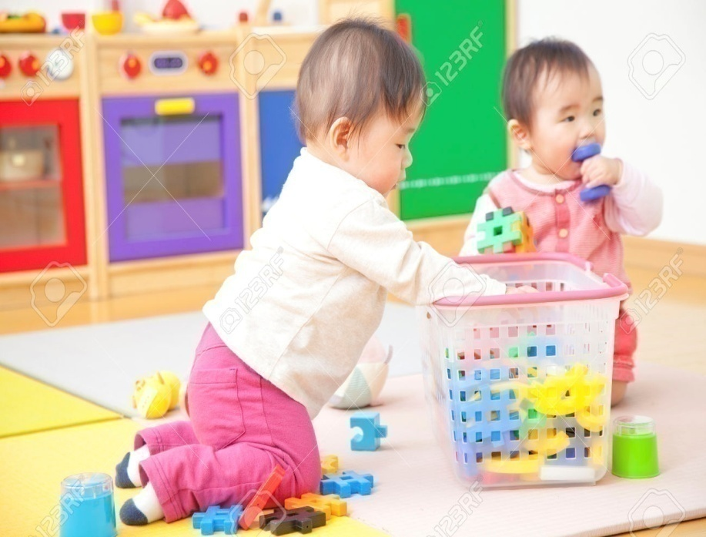
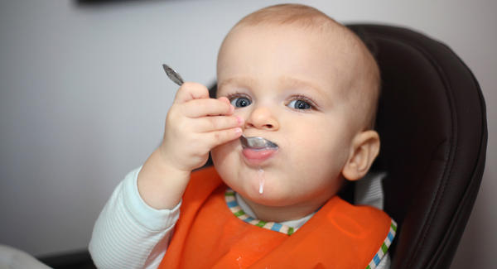

1 Year

Slide 48
1 Year
Hand Use
Voluntary release
Bring one block over another
Rolls ball imitatively
Puts cube in container

Slide 49
Feeding
Grasp spoon
Chews food
Dressing
Cooperates with dressing
Writing
Contacts paper with crayon

Slide 50
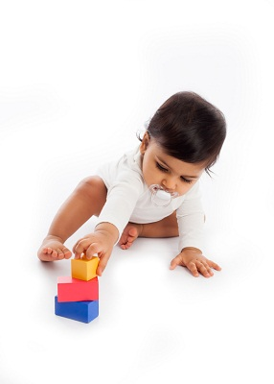
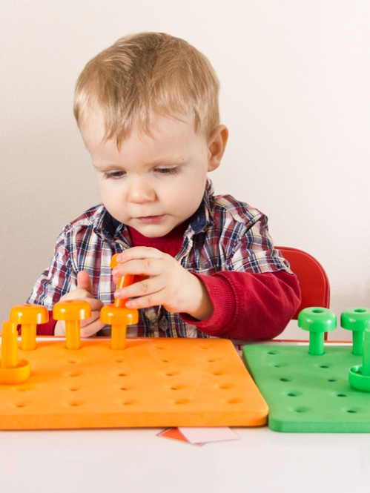
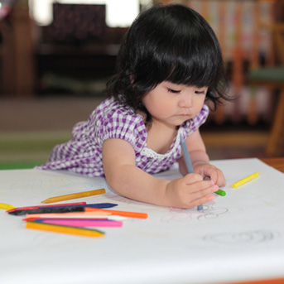
18 Months

Slide 51
18 Months
Hand Use
Builds 3 block tower (1 inch block)
Places peg in hole (1 inch peg)
Turn pages (2 or 3 at a time)

Slide 52
Feeding
Fills spoon with food
Dressing
Removes socks
Writing
Picks up crayon and scribbles

Slide 53

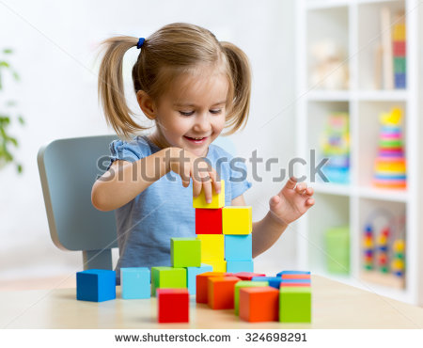
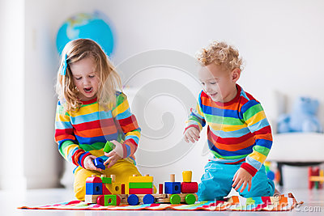
2 Years

Slide 54
2 Years
Hand Use
Build 6 block tower (1 inch block)
Build 3 block train (1 inch block)
Turn pages (1 at a time)
Throw ball inaccurately
Strings bed (1 inch beans)

Slide 55
Feeding
Drinks from cups
Drinks from glass( 2 inch diameter)
Dressing
Removes shoes( laces undone)
Removes pants(assistance over hips)

Slide 56
2^{1/2} Years
Writing
Imitates vertical stroke
Grooming
Washes and dries hands partially

Slide 57
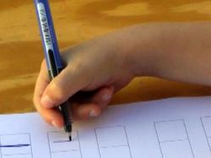
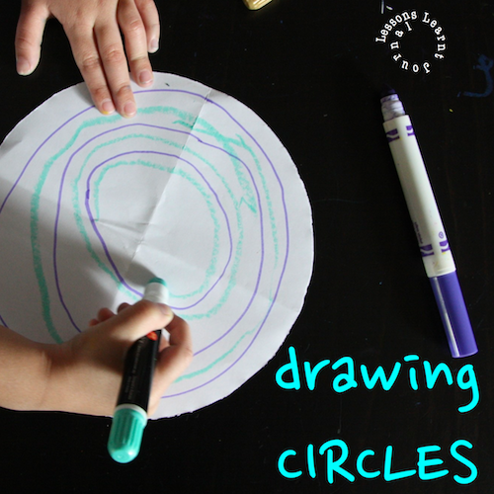

Slide 58
3 Years
Hand Use
Builds 9 block tower(1 inch block)
Builds 3 block bridge
Feeding
Feeds self independently

Slide 59
Dressing
Unbuttons medium shirt buttons
Unlaces shoes
Removes clothing completely( no back or small fastening)
Puts on underpants
Puts on socks
Puts on shoes

Slide 60
Writing
Imitates horizontal stroke
Copies circle
Grooming
Washes and dries hands

Slide 61
4 Years
Dressing
Buttons large buttons on shirts
Laces shoes
Writing
Copies cross vertical and horizontal lines

Slide 62
Grooming
Brushes teeth
Washes and dries face
Takes responsibility for toilet

Slide 63
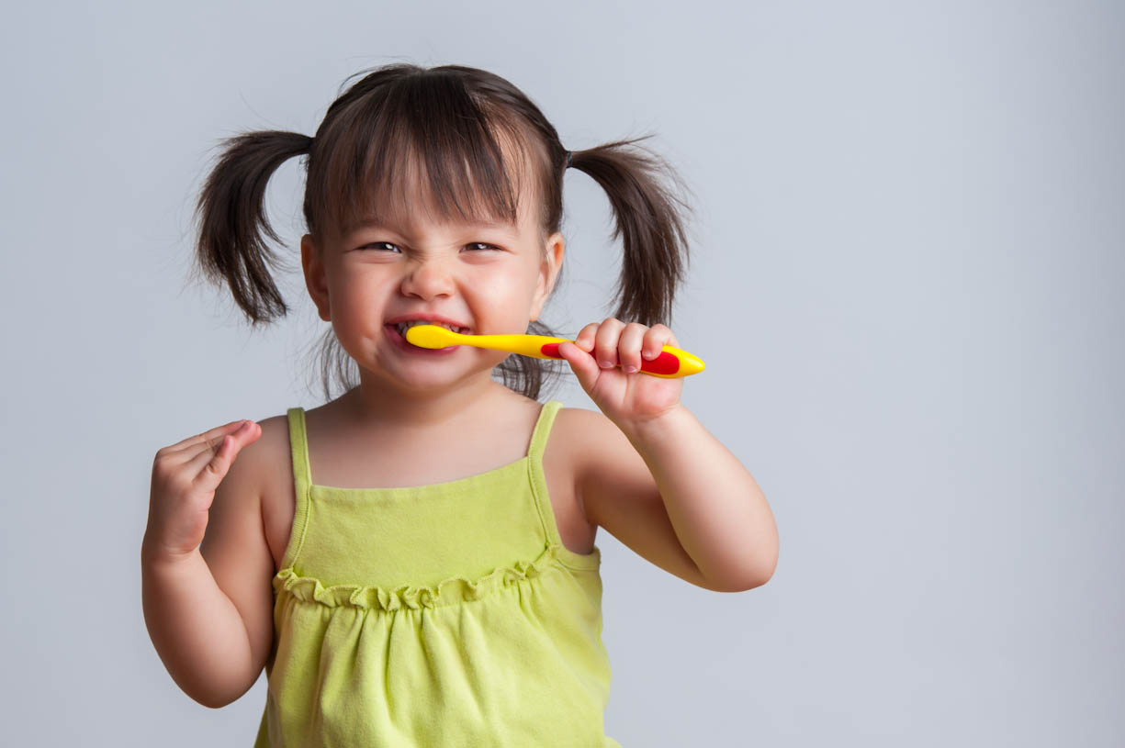


Slide 64
5 Years
Dressing
Buttons medium buttons on shirt
Dress self (except for bows and small buttons)
Writing
Imitates square
Draws recognizable man

Slide 65
6 Years
Feeding
Cuts bread (chapatti)
Ties bows on shoes
Buttons small buttons on shirt
Writing
Copies printing
Grooming
Combs and brushes hair
Blows and cleans nose

Slide 66

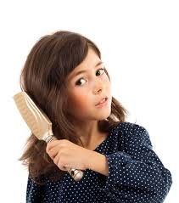

Slide 67
Language Milestone

Slide 68
AGE MILESTONE
1 months Turns head to sound.
3 months Cooing
6 months Monosyllables
9 months Bisyllables
12 months Two words with meaning
18 months Ten words with meaning
24 months Simple sentence
36 months Telling a story

Slide 69
Personal Social Milestone

Slide 70
6 weeks
Smiles responsively
Coos responsively

Slide 71
3 months
Recognizing mother

Slide 72
6 months
Enjoy bath

Slide 73
9 months
Show objects to mother
Mirror image

Slide 74
12 months
Comes when called
Finds hidden object
Waves bye bye
Gives toys on request

Slide 75
18 months
Cups: Lifts drink put down
Self spoon feeding
Pulls at dirty nappy
Does dusting, sweeping

Slide 76
2-2^{1/2} years
Plays alone.
Day by day puts on shoes. Socks and Pants
Turns door handles
Uses spoon and fork

Slide 77
3 to 3 ½ years
Goes toilet unassisted
Dresses/ undresses with minimum assistance
Knows some nursery rhymes
Handles knife and fork
Plays with peers

Slide 78
4 to 5 years
Wipes own bottom
Eats using knife and fork
Dresses- except for tie and laces
Imaginative play
Plays in group
Shares toy
Obeys rules

Slide 79

THANK YOU

