Slide 1
CEREBRAL PALSY
Dr.Dhwani Chanpura

Slide 2
Cerebral palsy is a term used to describe a broad spectrum of motor disability which is non-progressive and is caused by damage to the brain at or around birth.
Although the damage is non-progressive, the clinical picture changes as the nervous system develops and the child grows.

Slide 3
CAUSES
Prematurity
Asphyxia
Trauma
Severe jaundice
Hypoglycaemia
Intra-uterine virus infection
Neonatal meningitis
Genetic causes
Vascular causes

Slide 4
CLASSIFICATION OF DISTRIBUTION
Topographical classifications are an attempt to describe what is seen clinically according to the part or parts of the body involved.
I. One side of the body affected - hemiplegia.
2. All four limbs affected, upper more than lower - quadriplegia.
3. All four limbs affected, one side more than the other - bilateral hemiplegia.
4. The legs mainly affected, but arms less so - diplegia.
5. One limb only affected - monoplegia (very rare).

Slide 5
Based on Physiological Abnormality :
Spastic
Dyskinetic – Athetoid / Dystonia
Ataxic
Mixed
Hypotonic

Slide 6
COMMON ASSOCIATED PROBLEMS
Visual problems
Hearing problems
Speech
Mental handicap
Epilepsy
Emotional problems

Slide 7
TYPES
Spastic :
Spasticity is a disorder of tone characterised by an initial increased resistance to stretch which may then lessen abruptly.
It is caused by damage to the upper motor neurone in the cortex or along the pathways which terminate in the spinal cord, and is characterised by increased deep tndon reflexes and extensor plantar responses.
Spastic muscles are continuously contracting

Slide 8
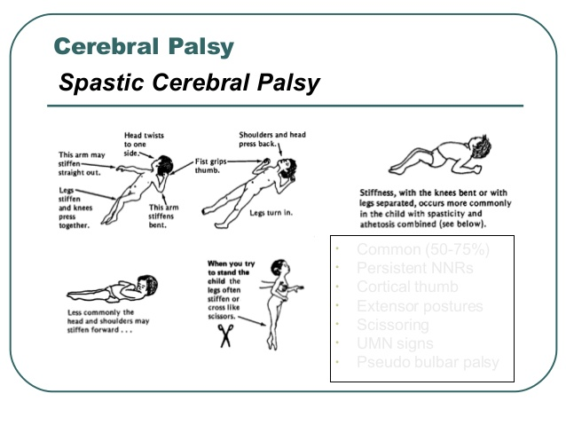
and there is apparent weakness of their antagonists leading to abnormal positions of the Joints on which they act.
Deformities of ioints develop which may become fixed contracturcs with time.

Slide 9
Dystonic choreoathetosis
Involuntary movements (choreo-athetosis) are so frequently combined with dystonic posturing that they are conveniently classified together.
The damage is centred on the basal ganglia.

Slide 10
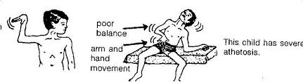
Athetosis is defined as irrepressible slow writhing movements, the result of imperfectly co-ordinated activity of agonist and antagonists, which are exacerbated by attempting voluntary movement.

Slide 11
Ataxia:
Ataxia is caused by damage to the cerebellum or its pathways.
The signs are of hypotonia, disturbance of balance, inco-ordination, intention tremor, dysarthria and sometimes nystagmus.
This is a relatively rare form of cerebral palsy and may be part of a dysmorphic syndrome or be associated with intra-uterine infection.

Slide 12
ASSESSMENT
It is logical and essential that an assessment of the child gives baseline that will point to appropriate treatment and management aims and techniques.
The fundamental problems to be considered are those of deficient ability and developing deformity.

Slide 13
ABILITY
The standard, normal child development charts are useful to alert the clinician regarding a child's developmental delay.
In assessing the child's ability it is helpful to look at the following factors relative to each of the positions of lying (prone, supine, side lying), sitting (floor, chair), and standing.

Slide 14
The ability of the child to be placed in each position. Does his body conform easily to the supporting surface, or do parts of his body rebel against it? Is he able to anchor his base of support, for example when he is pulled to sitting?
2. The distribution of weight when the child is placed in each position. Note if there is more weight on one side of the body than the other, or if the child's centre of gravity appears to be unusually high, resulting in 'floating legs' and poor ability to raise the head against gravity.

Slide 15
The ability of the child to maintain the position while he moves, which means that he must counterbalance the movements without changing his base of support.
The ability of the child to move out of a position,for example, to change his base of support as in rolling or getting from a chair to the floor.
The ablity of a child to attatin a position : for example to establish organised lying ,to get from lying to sitting,or to get from sitting to standing.

Slide 16
With reguard to these levels ,it is important to recognise that the ability to be placed in a position is a definite level of ability.
All children should be assessed in each of the positions of lying,sitting,and standing, as many of them,although they may be fairly able,still have deficiencies of posture and movement in lower positions.

Slide 17
DEFORMITY
Basic concept is that if the body spends prolonged periods of time in a position, it will gradually deform into that position.

Slide 18
The positional preferences typically seen in:
spastic cerebral palsies;
UPPERLIMB
shoulder- protraction or retraction, adduction and internal rotation,
elbow - flexion,
Forearm- pronation, and
wrist and finger -flexion.

Slide 19
LOWER LIMB
In the leg,hip - semi-flexion, internal rotation and adduction,
knee- semi flexion,
ankle - plantar flexion, and
foot -pronation or supination.

Slide 20
Athetoid or dystonic posturing –
usually incorporates extremes of movement such as total flexion or extension.
Natural history of deformity- postural deformity usually precedes structural deformity.
It is essential that a postural deformity be noted early as it is at this stage that measures must be taken in order to prevent its natural progression.

Slide 21
Once a deformity has become fixed or is structural, it must either be accommodated in handling and positioning, or dealt with surgically.
for this reason that treatment aimed at prevention/reduction of deformity must be directed also toward the deficient ability that is contributing to the deformity.

Slide 22
One of the most important complexes to note is the windswept deformity of the hips.
Most children with cerebral palsy are asymmetrical to some extent, bearing more weight on one side of the body than the other. The resulting deformities can be seen in lying, as well as in sitting and standing, and include the following:

Slide 23
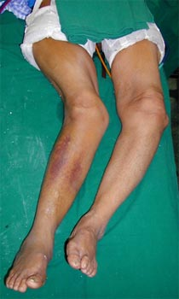
windswept deformity of the hip

Slide 24
windswept hips:
one flexed, abducted, and externally rotated, the other flexed, adducted, and internally rotated and in danger of posterior dislocation,
knee flexion
ankle and foot deformities, often mirror images of each other

Slide 25
pelvic obliquity
scoliosis
preferred head turning
preferred hand usage

Slide 26
weakness
As the child lacks the ability to use certain movement patterns,the muscles involved can eventually become weak due to disuse.
As a result of her assessment, the therapist should be able to define the child’s present level of postural ability,and existing or potential deformity.
The abilities to be promoted in treatment and handling.

Slide 27
2) The positions and handling required to prevent or ameliorate deformity.
3) The support required in various positions which will allow the child to function optimally.

Slide 28
MANAGEMENT
AIMS:
To promote the child's assets and abilities, and, if possible, to stimulate normal patterns of movement.
2. To prevent or reduce deformity.
3. To discourage positions, movements and behaviours that make handling difficult, such as extending and thrusting backwards.

Slide 29
LIFTING AND CARRYING

Slide 30
LIFTING AND CARRYING
A. For flexed children.
B. For extended or thrusting children. The adult's hands may be under or in front of the child's knees in either method of carrying.
C. For children with tight hip adductors, hemiplegia and more able children.
Note the position of the hemiplegic right arm, held by the adult in the extended position. For a lefthemiplegia carry on the left hip

Slide 31
POSITIONING
LYING:
SUPINE:children are completely unable to function,and in this position they may be most asymmetrical.
If the supine position must be used, a pillow placed under the head and shoulders often promotes symmetry and the ability to
get the hands togther.

Slide 32
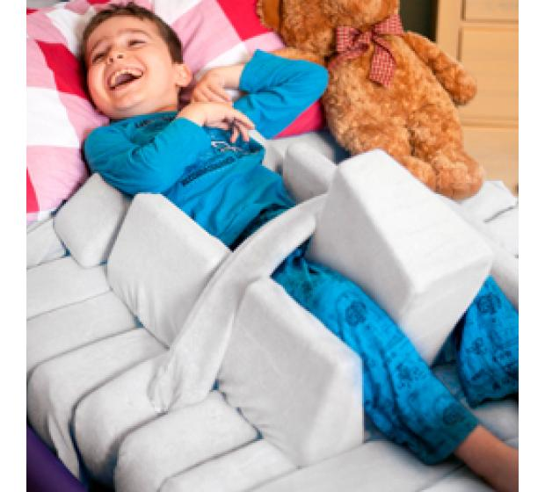

Slide 33
PRONE:
The children are often more
symmetrical,but they usually need to be raised off the floor, such as on wedge,in order to use their hands and heads.
A sandbag or strap placed across the child’s bottom may be needed to help the child maintain the position.

Slide 34
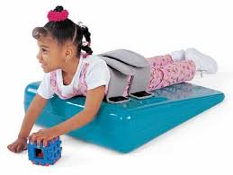

Slide 35
SIDE LYING:
position in which,the child can be quite symmetrical; both hands are within his vision and are more likely to be used together.
However, care must be taken that he does/not fall partially into prone or supine lying, and therefore into a'windswept deformity.
Leg gaiters, if tolerated, can help in maintaining a relatively symmetrical position.

Slide 36
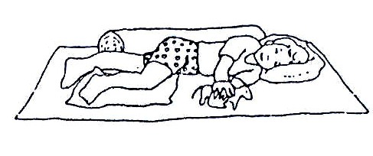

Slide 37
SITTING
The postural education that take place in long sitting is obviously important. This is also a position in which the hamstrings and hip adductors can be stretched.
Some children choose to side-sit. If they do this more easily to one side then the other, there is probably a related problem of windswept hips, and the child should be encouraged to sit symmetrically, or on the other side for part of time.

Slide 38
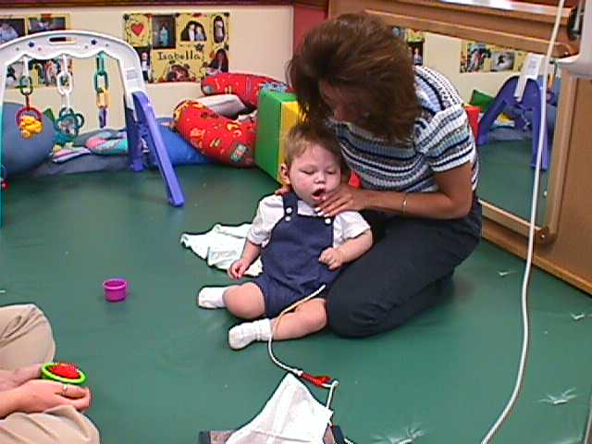

Slide 39
Crossed legged sitting for some a comfoable, acceptable alternative to long sitting.
The only contra-idication might be a child whose legs 'frog' (hips externally rotate d abdu) excessively, when the hips might be in danger of anterior dislocation.

Slide 40
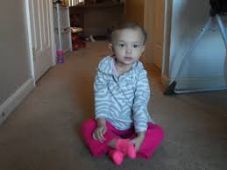

Slide 41
W-sitting (between heels) has long been frowned upon by therapists.
This is due to its possible reforcement of the flexed, adduced d internally rotated position of the hips.
It may contribute also to tibial torsion and foot deformity.
However, for many cerebral palsied children it is easily assumed and stable position for play, and such children must already have the necessary range of motion at the hip joints.

Slide 42
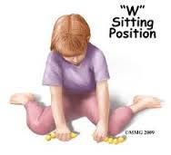

Slide 43
For children able to sit on a chair freely without falling, consideration must be given to;
(a) the stability of the chair;
(b) its height - the child's feet should reach the floor, or a foot platform and
(c)the height of e work surface.

Slide 44
STANDING
BENEFITS OF STANDING;
Prevention of flexion deformity at the trunk,hipd and knees ane equinus deformity at the ankles.
Devlopment of weight bearing surfaces of the feet.
A child is often more able to use his head,arms and hands in standing than in other positions.

Slide 45
4) sensory feedback in standing is important both proprioceptively and perceptually.
5) the child benefits socially from being at the same height as his standing peers.
6) the cardiovascular,digestive,respiratory and excretory functions are stimulated.

Slide 46
In general cerebral palsy child who is not standing well by the age of 12-18 months should be stood regularly.
Care mustbe taken to prevent the child from standing in a windswept positions,the use of asymmetrical straps to pull the pelvis and possibly the thorax to the middle is often effective.

Slide 47
In upright standing in either flex their trunks and pull down strongly with their arm, and therefore inch their way up the prone board, removing any weight from their feet; or totally hyperextend.
(a) the child is very flexed and the main aim is to straighten him out, or
(b) he has developed severe deformities and the effect of gravity in uptight standing only serves to pull him down into his deformities.

Slide 48
If a child hyperextends when stood in upright standing, a position in which the hips are slightly flexed (5° to 10°) is often effective in overcoming this tendency.

Slide 49
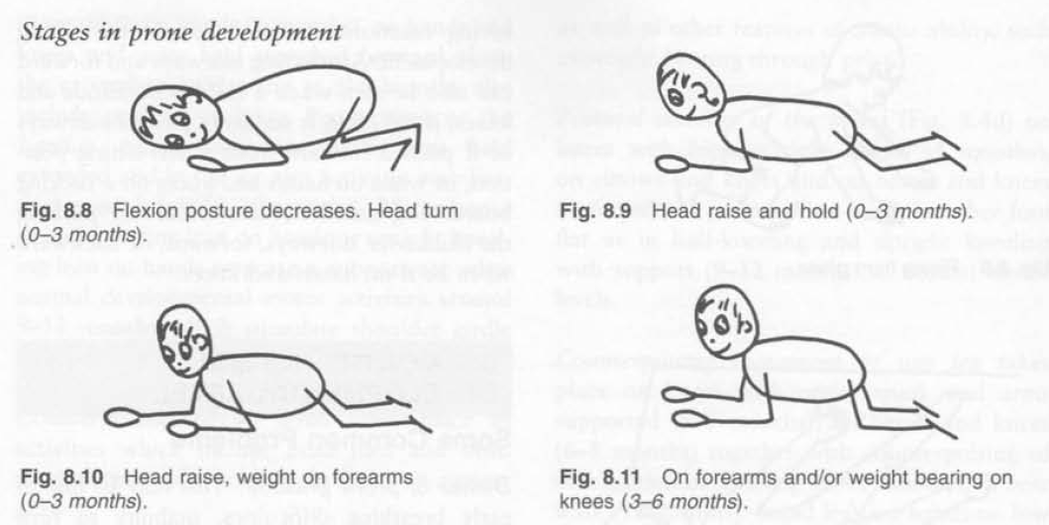
DEVLOPMENT IN PRONE

Slide 50
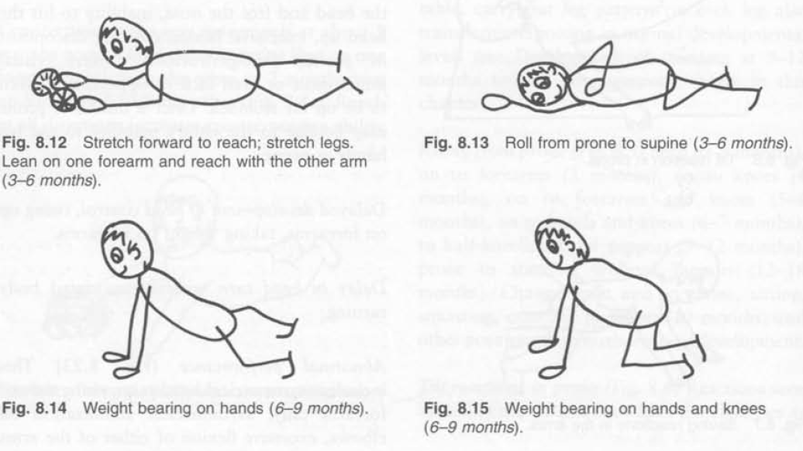

Slide 51
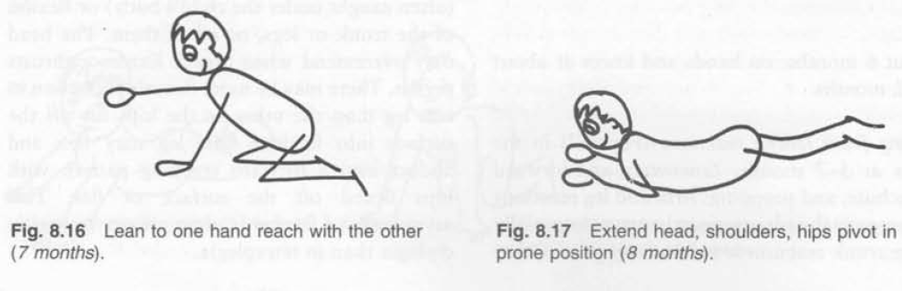

Slide 52
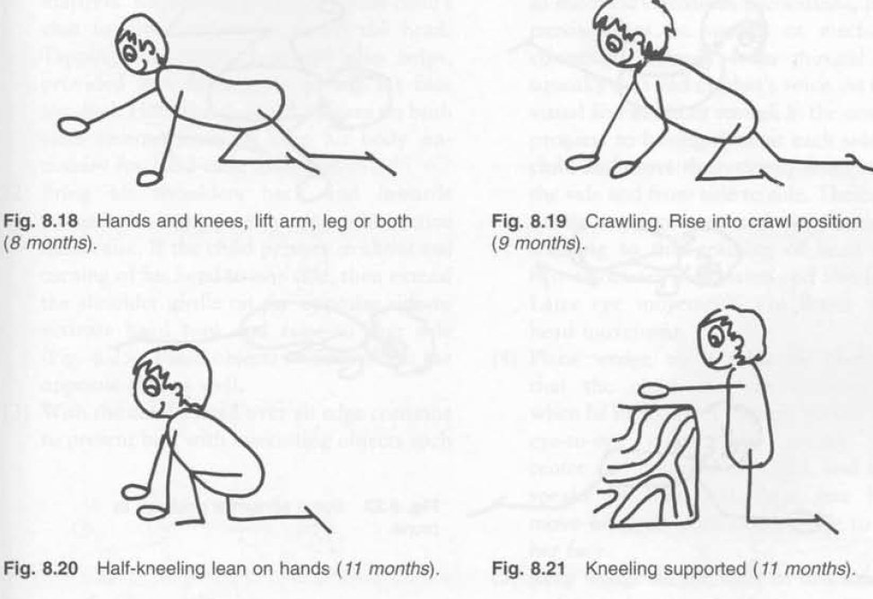

Slide 53
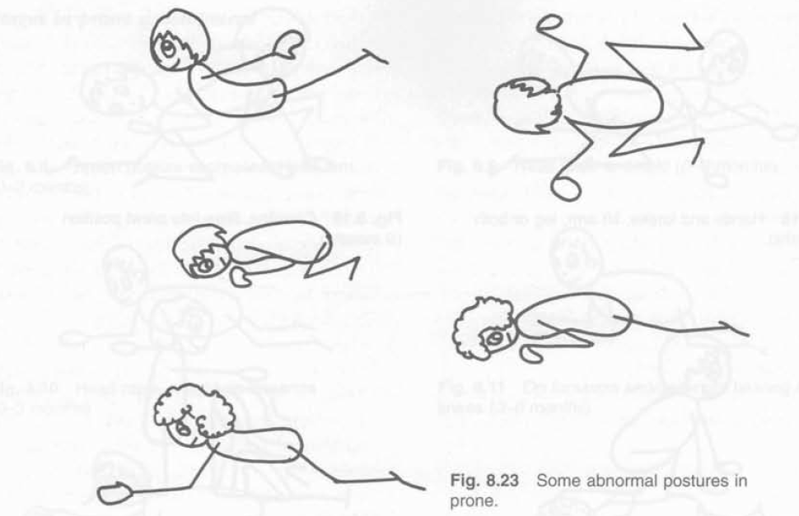
ABNORMAL POSTURE IN PRONE

Slide 54
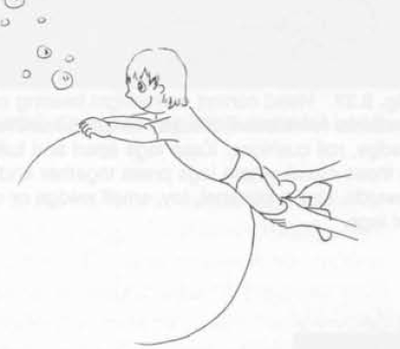
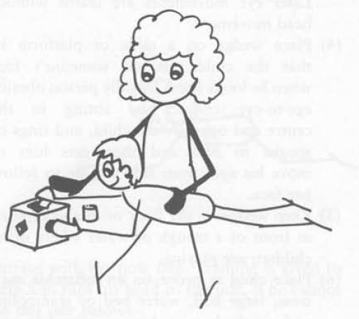
TREATMENT

Slide 55
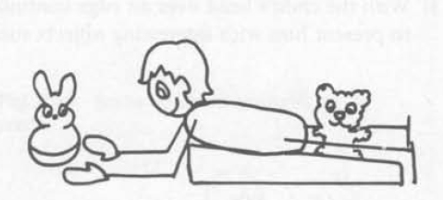
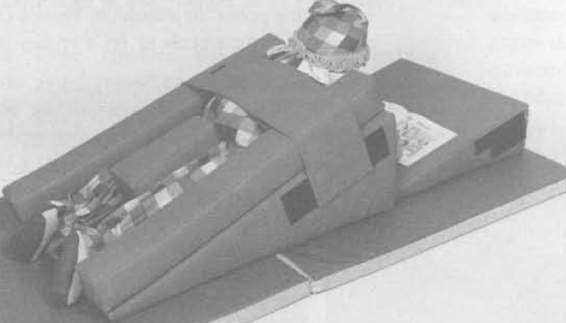

Slide 56
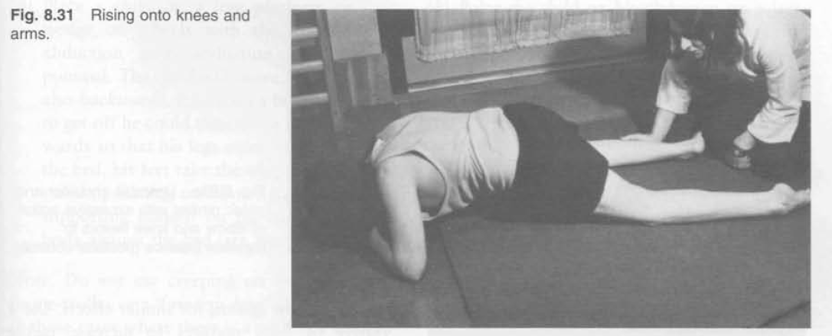
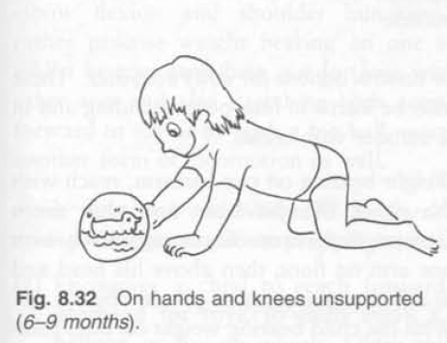

Slide 57
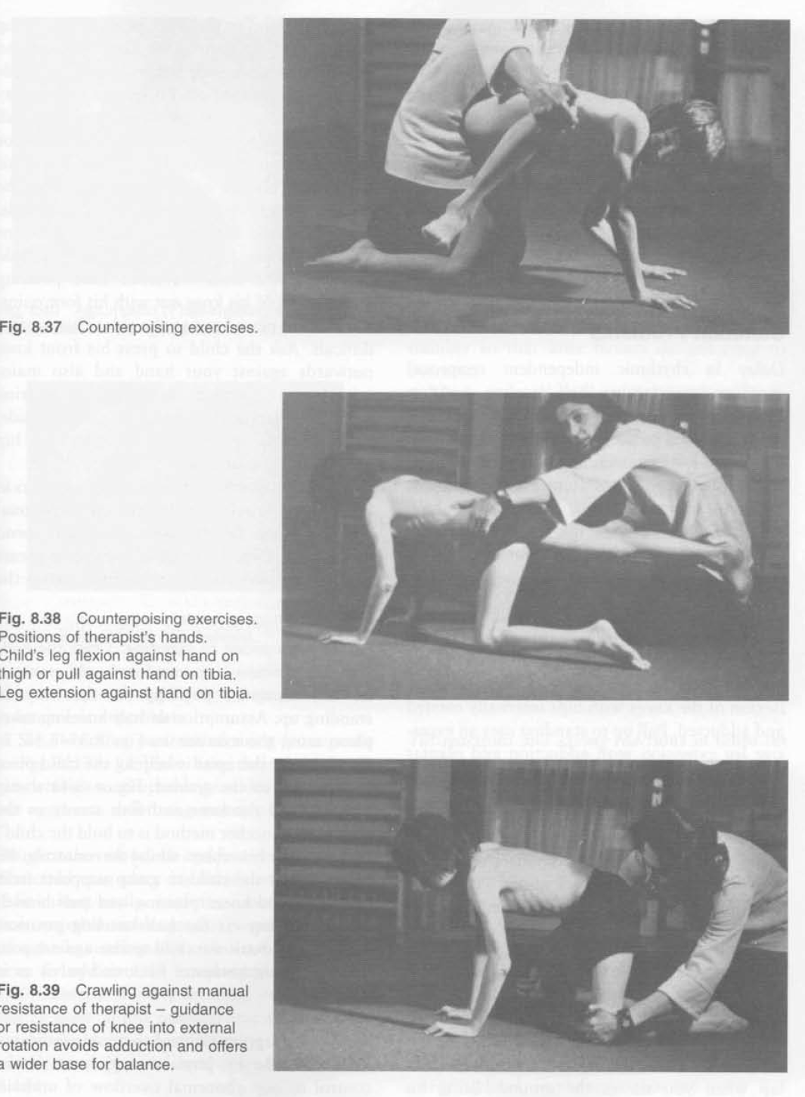

Slide 58
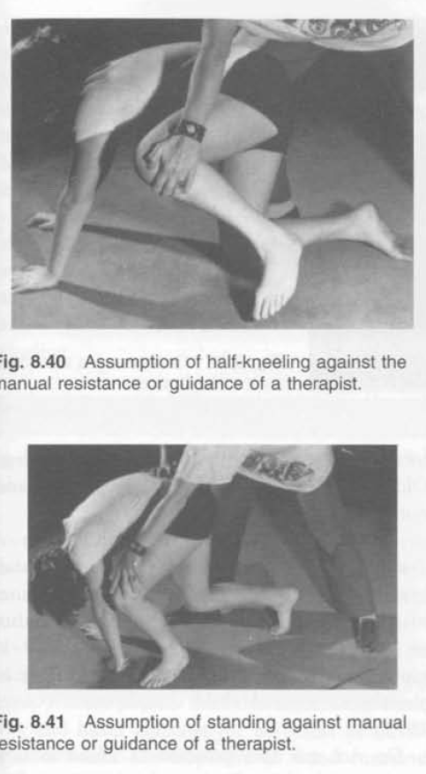

Slide 59
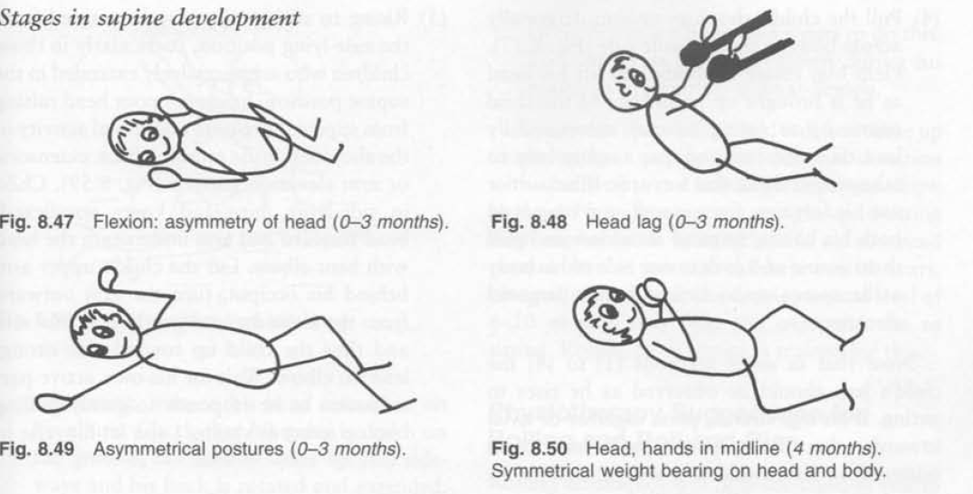
SUPINE DEVLOPMENT

Slide 60
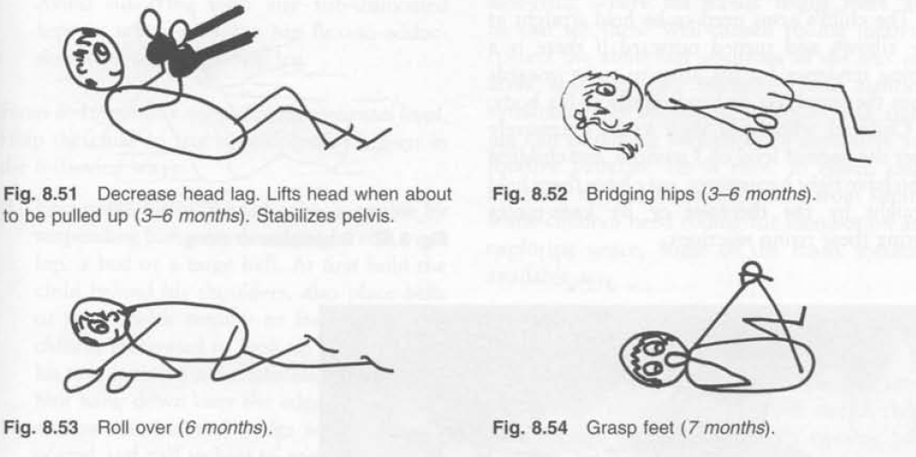

Slide 61
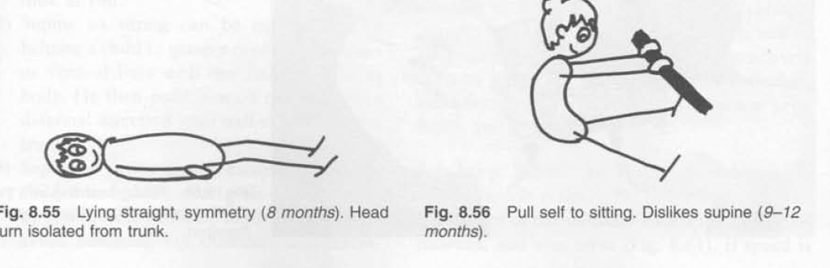

Slide 62
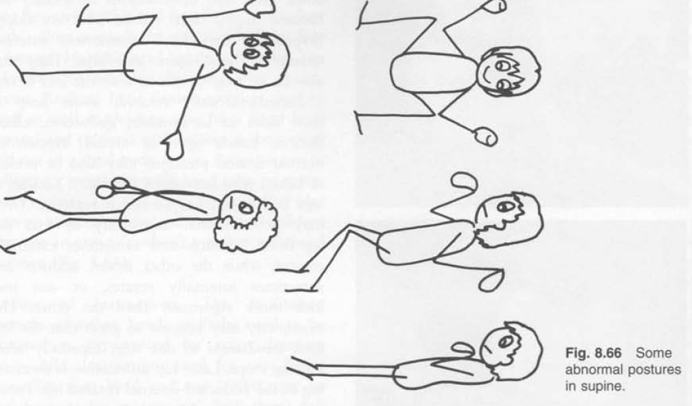
ABNORMAL POSTURE IN SUPINE

Slide 63
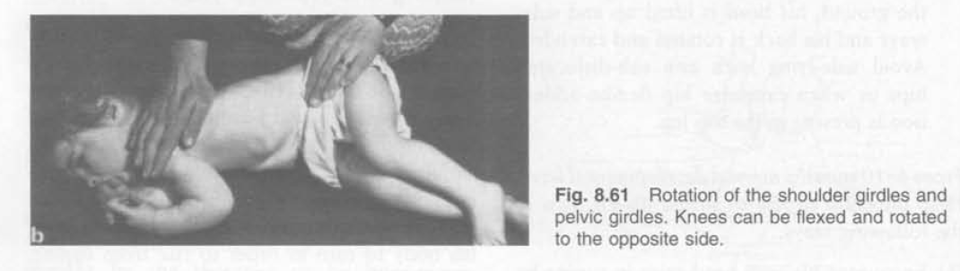
ROLLING

Slide 64
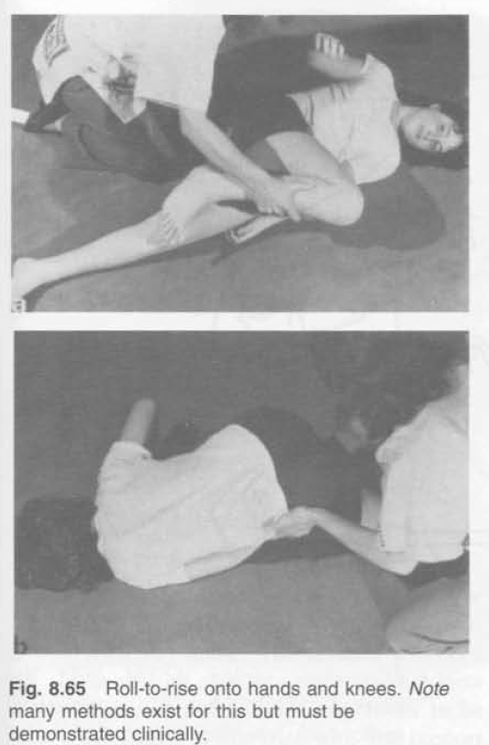

Slide 65
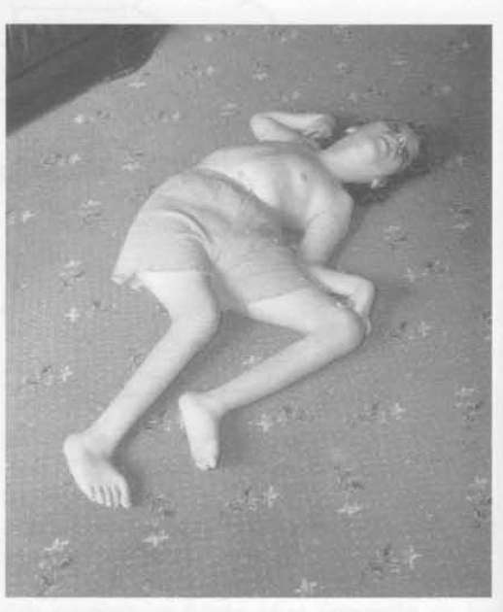
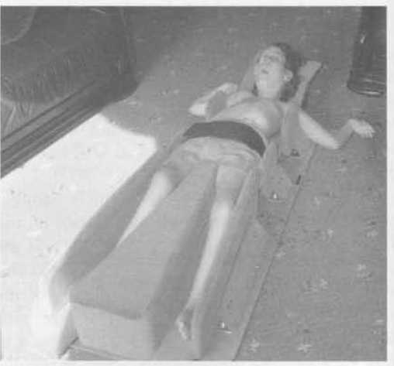

Slide 66
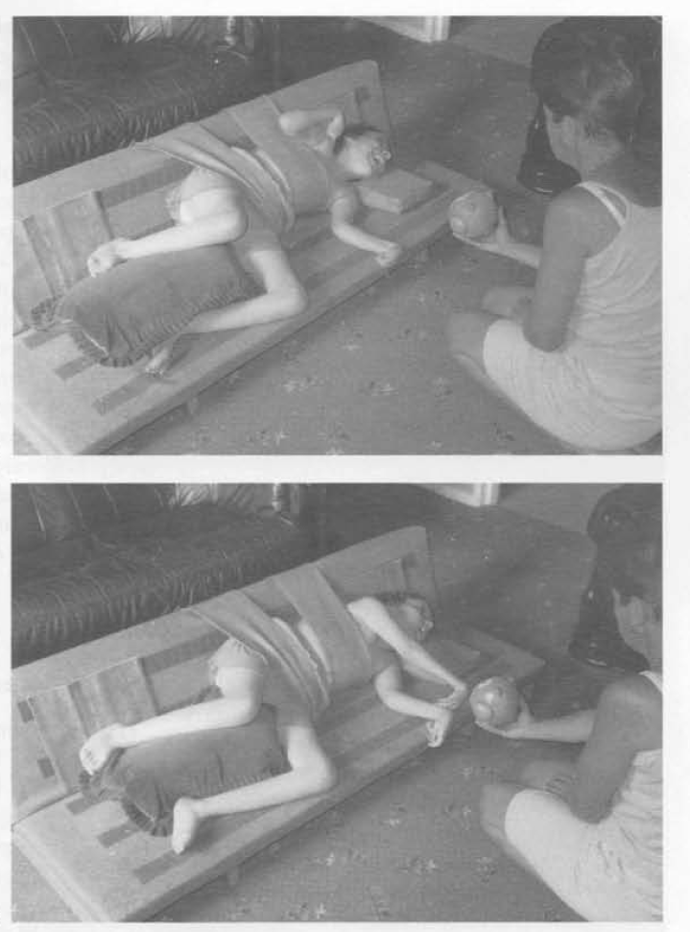

Slide 67
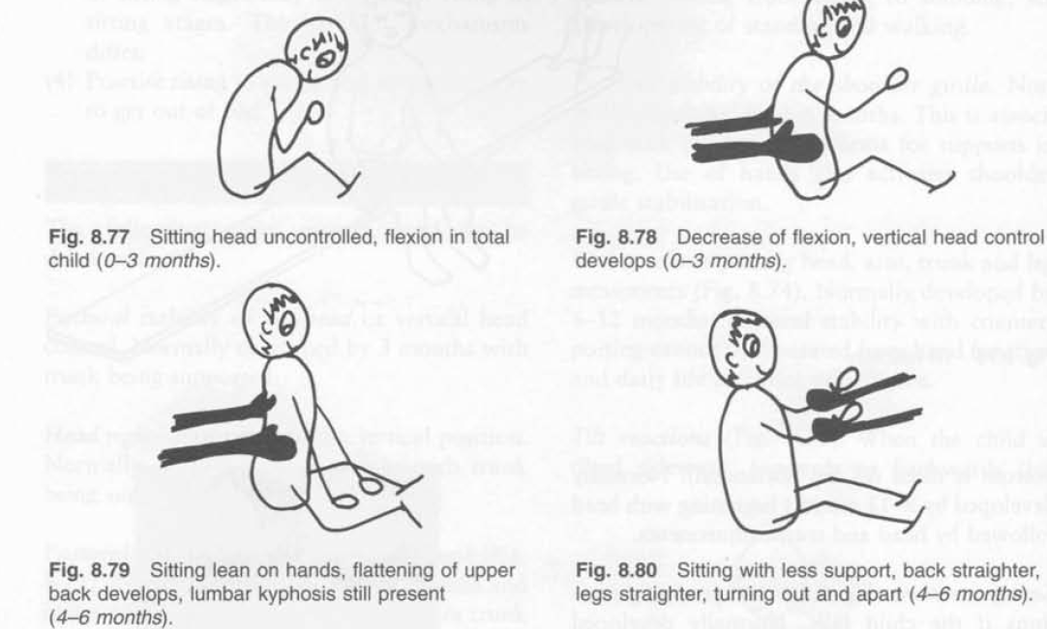
SITTING DEVLOPMENT

Slide 68
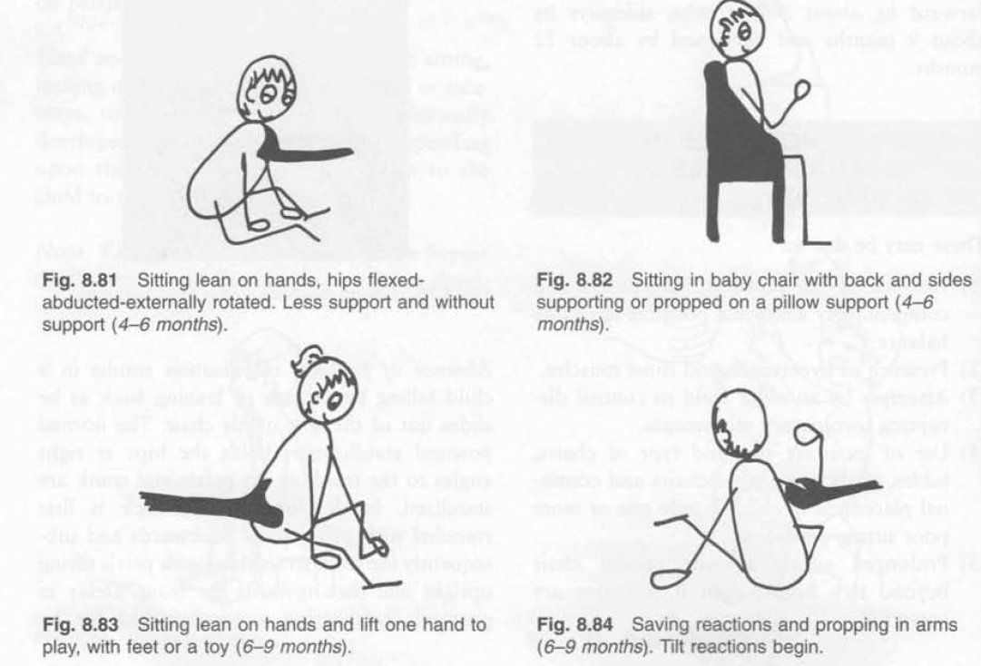

Slide 69
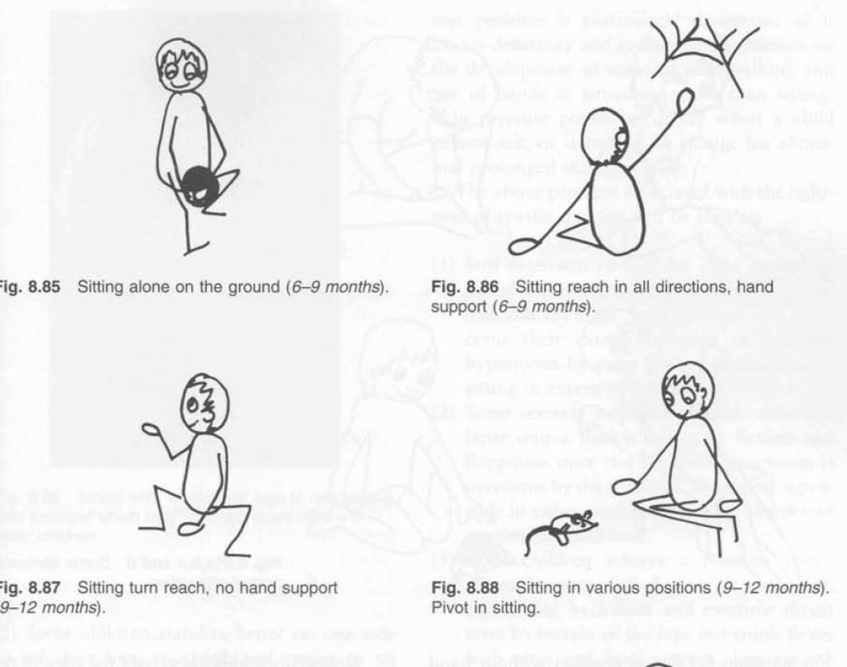

Slide 70
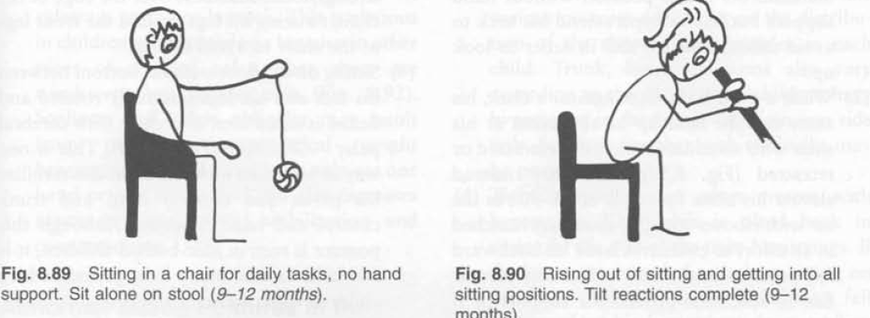

Slide 71
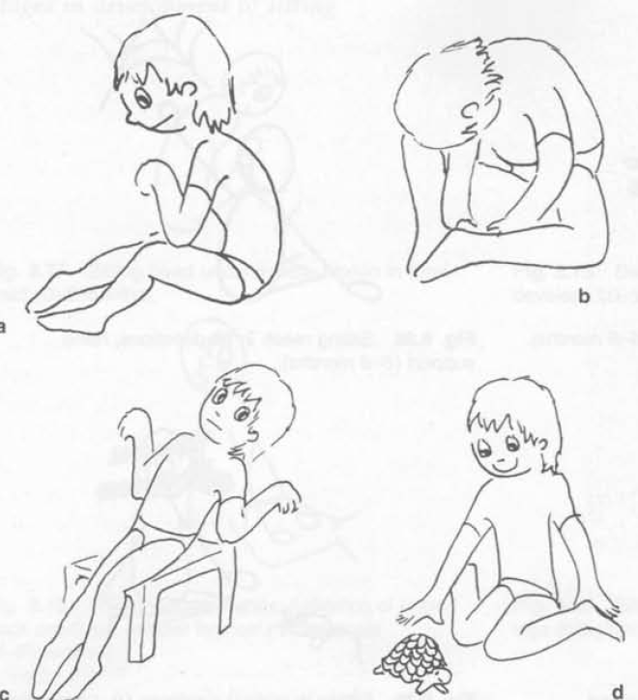
ABNORMAL POSTURE IN SITTING

Slide 72
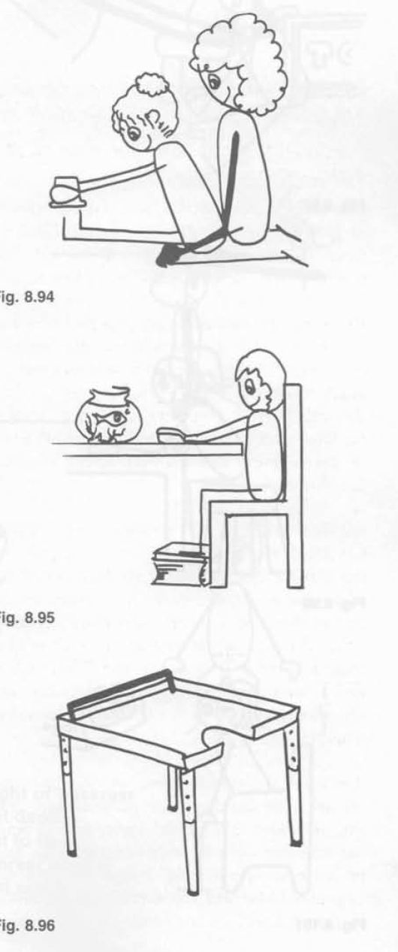

Slide 73
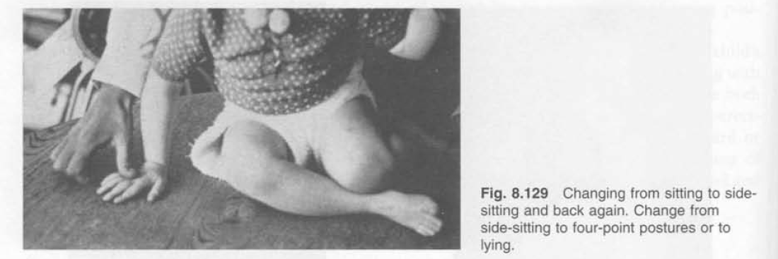
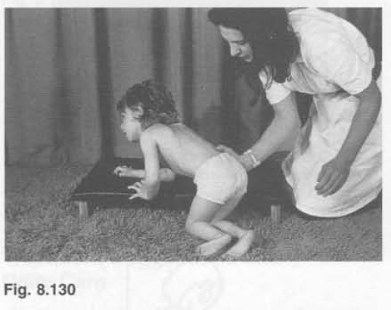

Slide 74
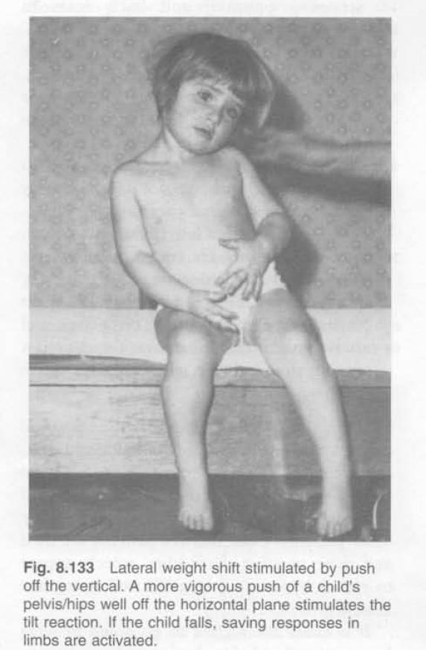

Slide 75
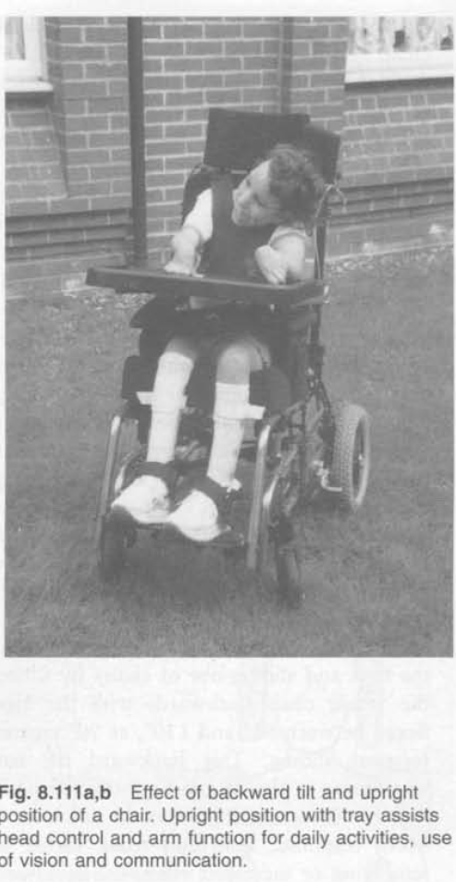

Slide 76
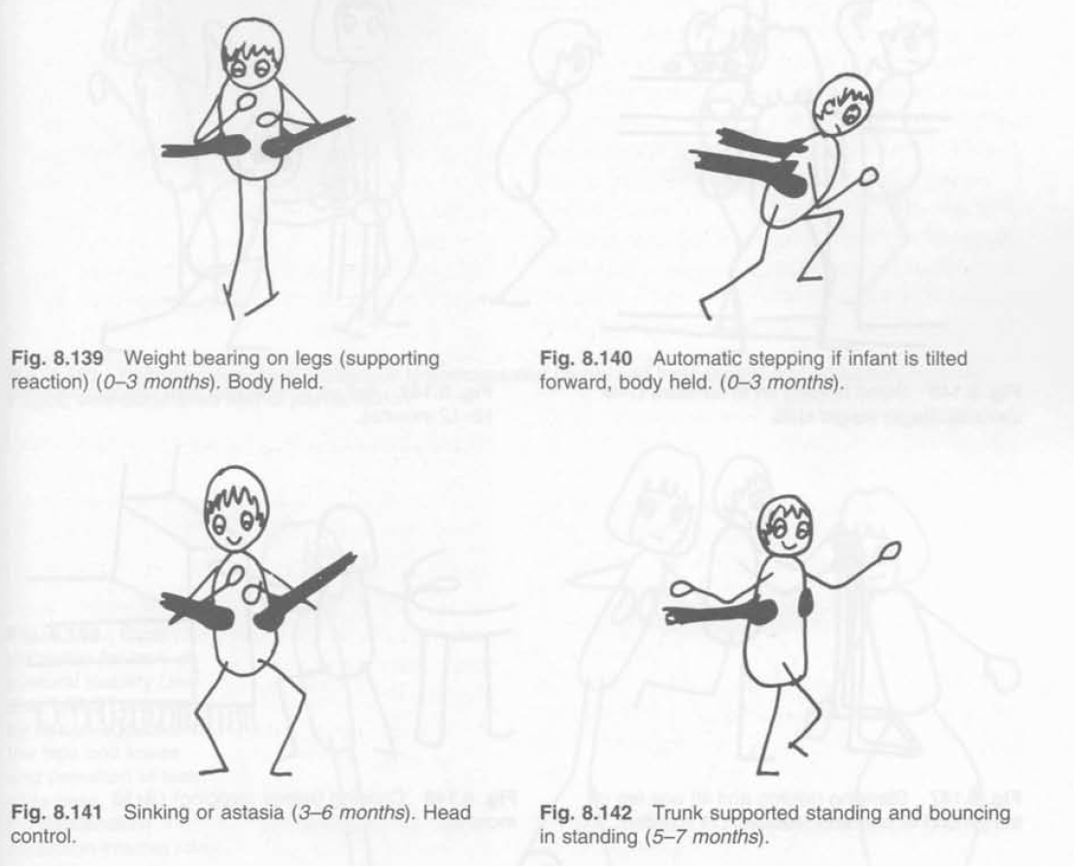
DEVLOPMENT IN STANDING &WALKING

Slide 77
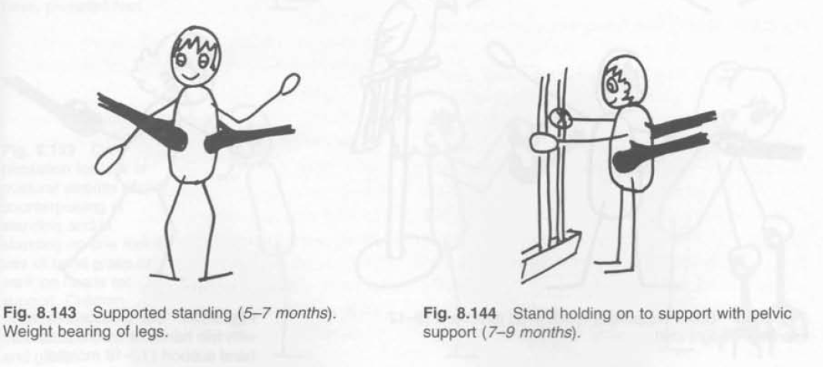

Slide 78
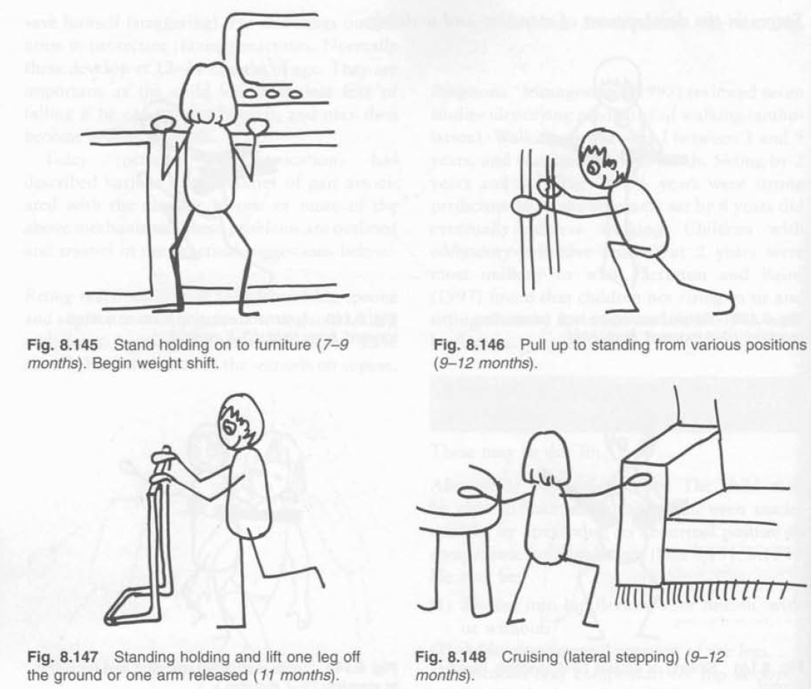

Slide 79
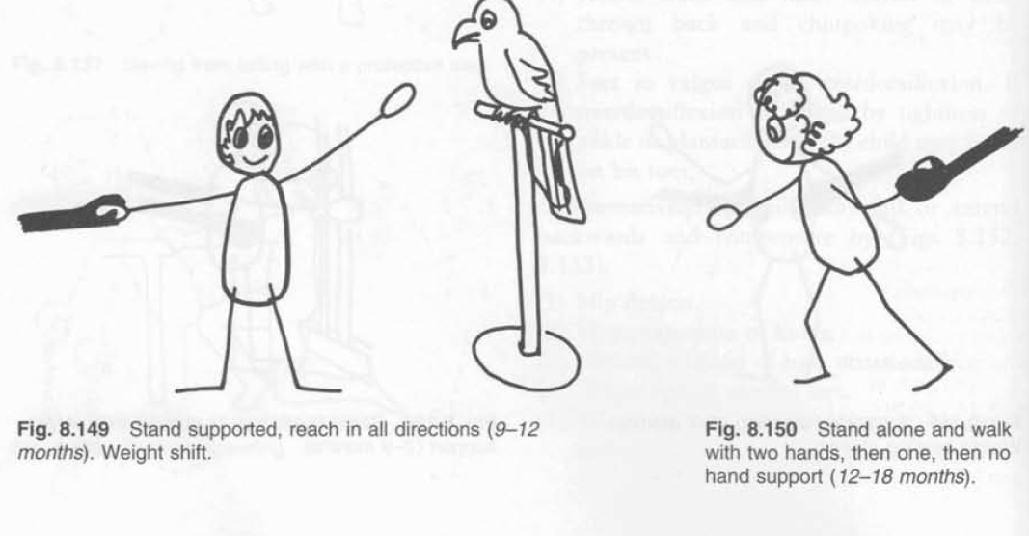

Slide 80
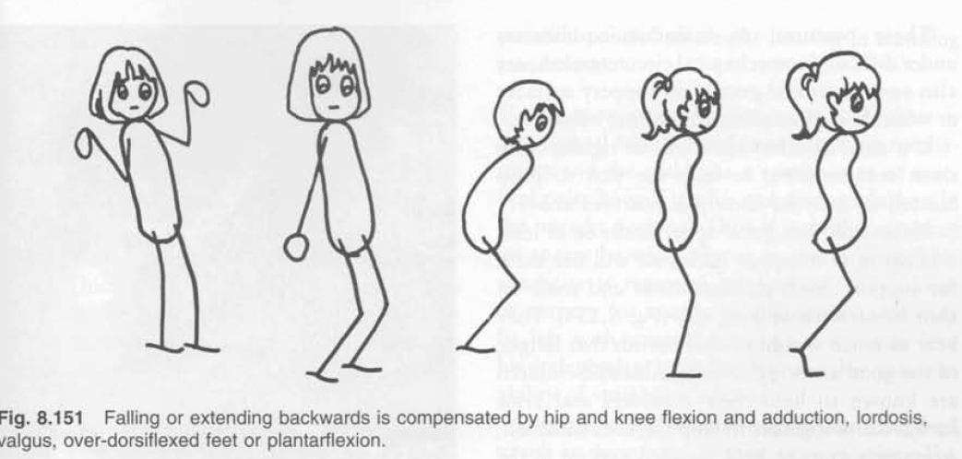

Slide 81
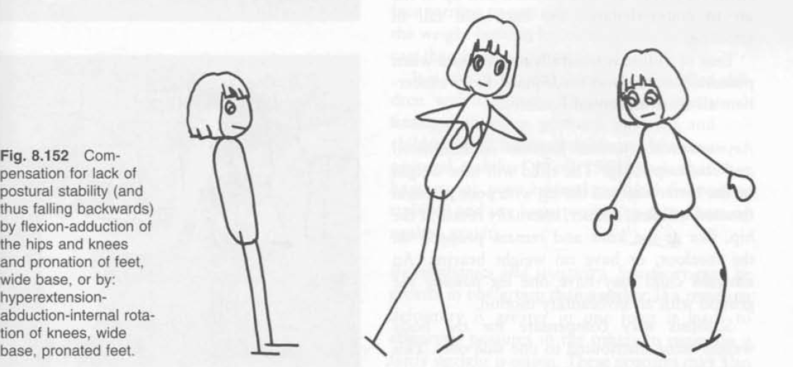

Slide 82
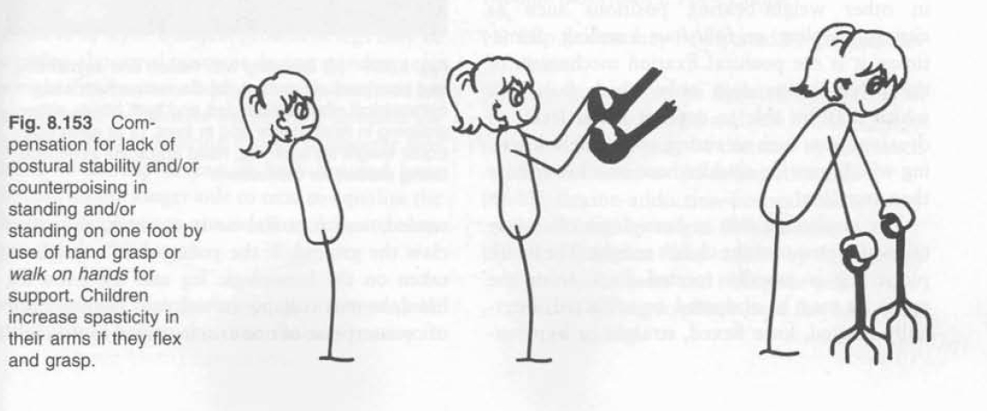

Slide 83
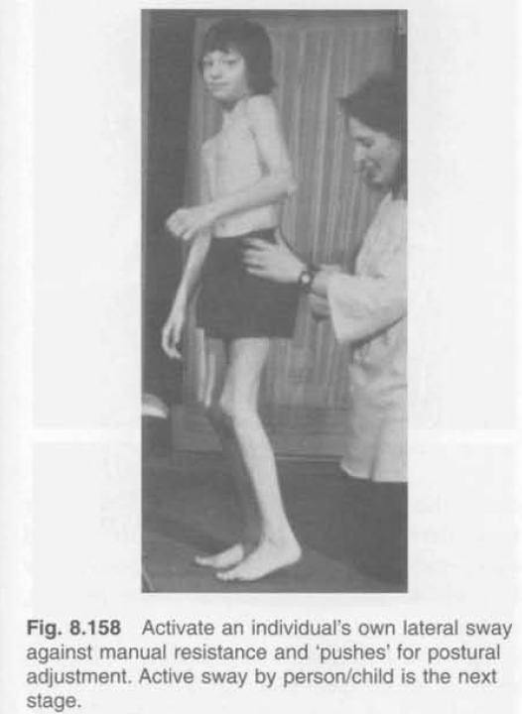
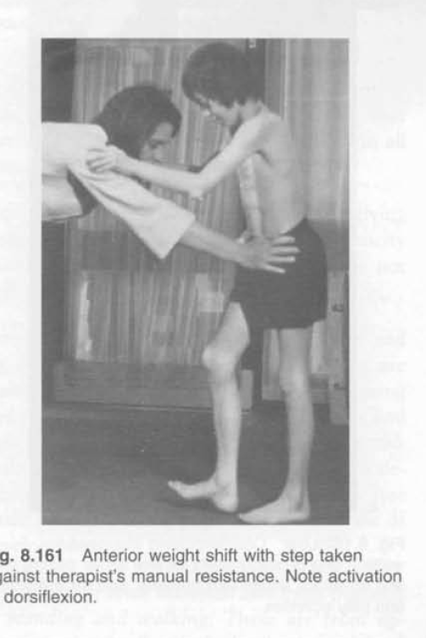

Slide 84


Slide 85


Slide 86



Slide 87


Slide 88


Slide 89


Slide 90


Slide 91


Slide 92


Slide 93


Slide 94


Slide 95


Slide 96


