Slide 1
Syringomyelia
Dr. Nalina Gupta

Slide 2
Syringomyelia is a condition in which an abnormal fluid-filled cavity, or syrinx, develops within the central canal of the spinal cord.
The syrinx is a result of disrupted CSF drainage from the central canal, commonly caused by a Chiari malformation or previous trauma to the cervical or thoracic spine.

Slide 3
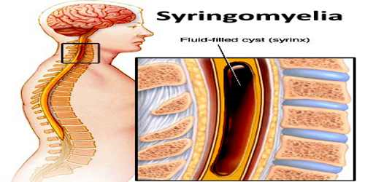
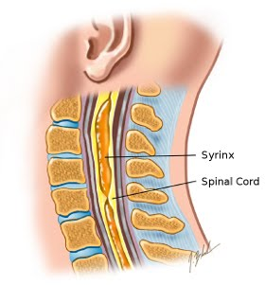

Slide 4
Epidemiology
3–4% of patients with traumatic spinal cord injury (SCI) develop symptomatic syringomyelia.
Sex: ♂ > ♀, especially in SCI-related syringomyelia
Age range: 30–40 years; however SCI-related syringomyelia may occur in all age groups

Slide 5
Etiology
Chiari malformation
Posttraumatic SCI (common)
Post-inflammatory: transverse myelitis; arachnoiditis
Post-infectious: meningitis
Intramedullary tumors: ependymoma, hemangioblastoma
Other congenital malformations: tethered spinal cord
Idiopathic

Slide 6
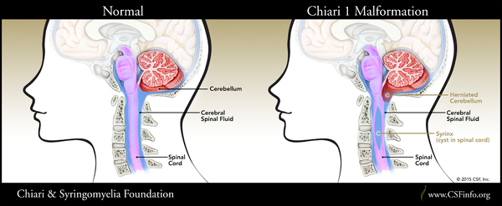

Slide 7
Pathophysiology
Obstructed central canal of spinal cord (usually cervical spine, may affect the thoracic spine) → impaired CSF drainage → formation of a dilated fluid-filled cavity in central spinal cord (syrinx) → compression and damage (with reactive gliosis) to crossing neural fibers of the lateral spinothalamic tract first (which affect pain and temperature) → bilateral dissociated sensory loss and dysesthetic pain
Expansion of the syrinx may damage: Lower motor neurons in the medial part of the corticospinal tract → initially bilateral weakness → eventual bilateral flaccid paralysis and muscle atrophy

Slide 8
Descending hypothalamic fibers in T1 to T4 cord segments → Horner syndrome
Posterior column (advanced disease) → loss of position sense and vibration sense in the feet
Medulla → syringobulbia
A hydromyelia is an abnormal widening of the central canal of the spinal cord in which CSF collects, despite there being a connection to the 4th ventricle of the brain.

Slide 9
Clinical Features
Often asymptomatic
Cape-like distribution (neck, shoulders, arms) of: Dissociated sensory loss
Dysthetic pain
Muscle atrophy, fasciculations, and areflexia (patients may present with a claw hand deformity)
Spastic paraparesis of the lower limbs may occur.
Autonomic disturbances: Horner syndrome, anhidrosis, disturbances in bladder and colon function, erectile dysfunction

Slide 10
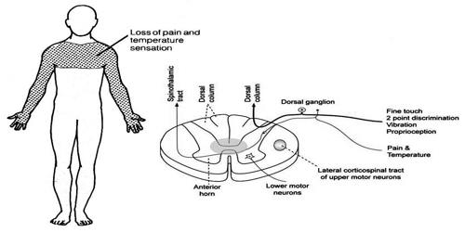

Slide 11
Respiratory insufficiency
Other: painless ulcers of the hands, Charcot joints, thoracic scoliosis
Syringobulbia Tongue atrophy
Loss of pain and temperature sensation in trigeminal nerve
Nystagmus
Dysphagia
Palatal and pharyngeal weakness

Slide 12
Diagnosis
X-ray or CT: to detect scoliosis and assess the bony spine
MRI (confirmatory test): detection of the syrinx (may be septated) and adjacent spinal cord lesions (e.g., tumors, adhesions in arachnoiditis)

Slide 13
Treatment
Conservative therapy is usually sufficient, but definitive surgical treatment is recommended for patients with progressive neurological symptoms.
Surgical treatment
Removal of the tumor (if present)
Decompression by drainage of CSF fluid from the cavity Cerebral shunt
Laminectomy and syringotomy

Slide 14
Supportive therapy
Physiotherapy and psychotherapy
Spasticity: baclofen, methocarbamol
Analgesia: amitriptyline, NSAIDs, gabapentin (not FDA-approved for use in syringomyelia, but may be considered due to its effectiveness in treating neuropathic pain)

Slide 15
The physical therapy for patients suffering from Syringomyelia differs depending on the location and impact of the disease, unless presented with an MRI, a neurological examination should clear out at which level the syrinx occurs.
The goals of the treatment are to stop the spinal cord damage from getting worse using the techniques explained in the following paragraph and to maximize functioning. They may require active physical therapy, passive mobilizations, occupational therapy or even speech therapy.

Slide 16
1.Increasing their muscle strength (Usually upper extremity and paravertebral muscles, using training schemes individualized to the patients’ tolerance)
2.Training neck stability (best guided by physiotherapist at first)
3.Sitting and standing balance can be physical and occupational therapy (referring to daily activities as in getting dressed and grooming)
4.Educating the patients about their disease and it’s process over time. It is important to maintain an active lifestyle but there are several risks in high impact activities which should not be overlooked. They should also learn about adequate pain management and coping techniques

Slide 17
5.Improving and/or maintaining communication using speech therapy (when the syrinx is present in the lower brain stem, although that should be referred to as ‘syringobulbia’)
6.Maximizing functional capabilities by testing and asking the patient about daily activities and then acting upon the answers. This includes activities such as getting in and out of bed, walking, using a cane of crutches and such. Physical therapists may also refer a patient to the use of leg braces if they are deemed appropriate.

Slide 18
Hospital Course: pain relief will be the most significant factor. Therefore it is important the patient receives a lot of bed rest and moves carefully.
During the first month after surgery: when the operation is successful, the pain and neurological symptoms should improve rapidly. The patient should try to maintain a modestly active lifestyle. It is important that these patients try to avoid tasks involving heavy lifting! Walking and performing daily activities at ease is highly recommended.
On the long term: an adequate follow-up is very important for these patients. If they do not deteriorate, they should try to maintain a relatively active lifestyle.

Slide 19
Avoid: Activities that cause excessive strain on the nervous system and spinal cord.
Any activity in which high impact can be expected (e.g. football, rugby…)
Avoid straining due to heavy bowel movement
Avoid extensive coughing
Most important: avoid heavy lifting and straining

