Slide 1
Poison Information Center
Dr. SUNIL DOSHI

Slide 2
What Is a poisons centre?
The poison information centre is a specialized unit providing information on poisoning, in principle to the whole community.
Its main functions
  provision of toxicological information and advice, management of poisoning cases,
  provision of laboratory analytical services
  toxicovigilance activities - development, implementation, and evaluation of measures for the prevention of poisoning.
  research, education and training in the prevention and treatment of poisoning.
  developing contingency plans for responding to chemical disasters,
  in monitoring the adverse effects of drugs, and in handling problems of substance abuse.

Slide 3
How does WHO assist Member States to establish poisons centers?
guidance and training materials
training workshops
fosters links between new and well-established poisons centers.
collection of internationally harmonized data on poisoning
a multilingual software system for compiling enquiry and agent databases (the INTOX Data Management System)
may support the cost of initial subscriptions
periodically organizes INTOX User Group meetings to provide additional training and to foster the development of multi-centre projects using this system

Slide 4
Location:
centre is centrally situated within the geographical and demographic area it serves.
at a leading hospital with emergency and intensive care services, as well as a medical library and a laboratory.
should be linked directly with a hospital department where poisoned patients are treated. Treatment and laboratory facilities at a hospital may be further developed to fulfill it.
aim of the facility to operate 24 hours a day all year round
if more than 5000 emergencies are registered each year, a fulltime staff will be required to provide a 24hoursaday service; If fewer than 5000 calls are received annually, outside support(from emrgency, ICU etc) may be required to maintain a 24hour service

Slide 5
Staff
a multidisciplinary team of poison information specialists
physicians, nurses, analysts, pharmacists, veterinarians, and other scientists representing a wide variety of disciplines including biology, chemistry, medicine, pharmacology, and psychiatry.
A poison information specialist should work under the supervision of a medical toxicologist.
Medical personnel from emergency, intensive care, and treatment units may work part time in the information unit, thus adding to their experience.
  Medical Director –1
  Medical Toxicologist -2 (emergency medicine, paediatrics, public health, internal medicine, intensive care, and forensic medicine)
  Poison Information Specialists -8
  Analytical toxicologist -2
  Technical staff -3
  Administrative staff -2
  Supporting staff - 5
  Veterinary expertise, Advisers in special areas(Medical, non medical) - SOS

Slide 6
Infrastructure
suitable rooms or working areas, equipped with basic furniture (desks, tables, chairs)
One room should be allocated to the "answering" service with telephone lines, computer & internet, essential books & literature
An area should be set aside as a library where scientific work can be undertaken
Another area is required for working groups and staff or other meetings (large enough to allow all staff)
Facilities for personal hygiene, food, drink & rest
an office or suitable private area for the medical director for specific work, interviews, and consultations
A separate area for administrative and secretarial work

Slide 7
Equipments
Office furniture
Storage cupboards for confidential data
Toll free Telephone lines – 2
Computers with printers, scanner & xerox
Library – online, hard copy books, journals, charts, cards
Other means of communications – Fax, telex, shortwave radio are highly desirable
a refrigerator for stock antidotes and other substances used in the treatment of poisonings
slide, overhead, and video projection equipment for training & workshops

Slide 8
Legal status of authorization
should be officially recognized by government authorities.
The legal status of a centre should enable it to maintain the confidentiality of the data it handles.
Information should be provided free of charge to enquirers, particularly in emergencies, although charges may be levied in certain circumstances.

Slide 9
Library
A poison information centre should have its own library, which could be associated with a university or medical library but must be accessible at all times.
Certain books and publications should be accessible at all times at the centre itself.
The IPCS has developed a computerized information package, known as IPCS INTOX, to help centres in developing their own poison information systems.
List of books, for library & laboratory – sec 8

Slide 10
Laboratory
Within or close to clinical services where poisoned patients are treated
Equipments - balances, centrifuges, vortex mixer, waterbath, refrigerator, freezer, and fume cupboard
Colorimetry, spectrophotometry, and thin layer chromatography
experienced analytical toxicologist
Adv facility - immunoassay, gas chromatography, mass spectrometry, high performance liquid chromatography, and atomic absorption spectrophotometry
List of equipments & procedures – sec 4

Slide 11
Clinical Toxicological Unit
Emergency, ICU, Wards

Slide 12
Before a centre becomes operational
obtain certain essential literature (see section 9)
provide basic training for the staff
print forms (in the local language) for collecting information on local commercial products and for recording enquiries to the centre, with provision for follow up of calls and cases (see Section 8)
begin compiling files on the chemicals used in local commercial products, including pharmaceuticals, on local natural toxins, and on relevant medical and analytical services available in the country (see below and Section 8).

Slide 13
Target population, publicity & Access
Telephone hotlines
Email/web site
Direct in person – face to face
Written letter
Social media

Slide 14
Poison Info Centres in India
CEARCH (Center for Education, Awareness and Research on Chemicals and Health) Supath II Vadaj Ashram Road Ahmedabad +91 79 275 53 595 +91 982 404 7400 cearchtoxicology@yahoo.com www.cearch.in 24hrs.
Poison Information Centre National Institute of Occupational Health Mental Corner Meghani Nagar Ahmedabad +91 79 226 84 756/+91 79 226 86 351 +91 79 226 86 110 +91 79 226 86 330 pic_india_abad@yahoo.com 9.30-18.00, Monday-Friday and 10:30-14:30 Saturday.
Poison Control, Training and Research Centre Tower Block II First Floor Government General Hospital Chennai +44 25 30 59 69 +91 44 253 05 115 +91 44 253 05 757 pctrc2010@gmail.com 24hrs
Poison Control Centre Amrita Institute of Medical Sciences & Research Cochin +91 484 400 8056/+91 484 285 6034/+91 484 400 1234 +91 484 280 20 20 +91 98 952 82 388 toxicology@aims.amrita.edu; poisonunit@aims.amrita.edu; toxlab@aims.amrita.edu www.aimshospital.org 24hrs
India National Poisons Information Centre All India Institute of Medical Sciences Ansari Nagar New Dehli +91 112 659 36 77 or +91 112 658 93 91 24hrs.
Poison Information Centre, JSS Hospital, Mysore. Karnataka. Telephone: +91-821- 2335577, Fax: +91-821-2548356. pic.jsscp@jssuni.edu.in www.picjsscpm.jssuni.edu.in

Slide 15
INTOX Data Management System - Component databases
compilation of databases for enquiries, substances and products
1. Enquiries database:-This is called the Communications Explorer in the INTOX system. The Communications Explorer employs a standard format (Communication Record), controlled, defined terminology (Authority Lists) and internationally harmonized classification schemes (Use/Function Classification, Poisoning Severity Score). These features make it possible to compare data collected by different centers, both within the same country and internationally.

Slide 16
2. Communication record Form
Your call to NPIC shall help in
Studying the pattern of poisoning in your area.
Developing a prevention programme.

Slide 17
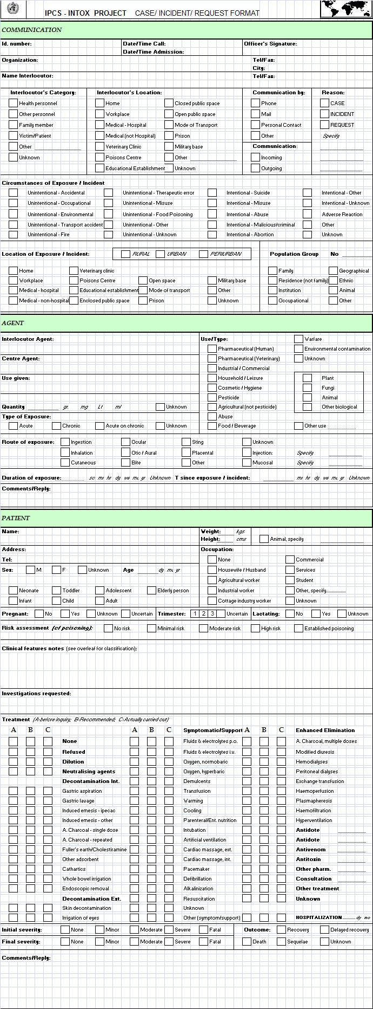

Slide 18
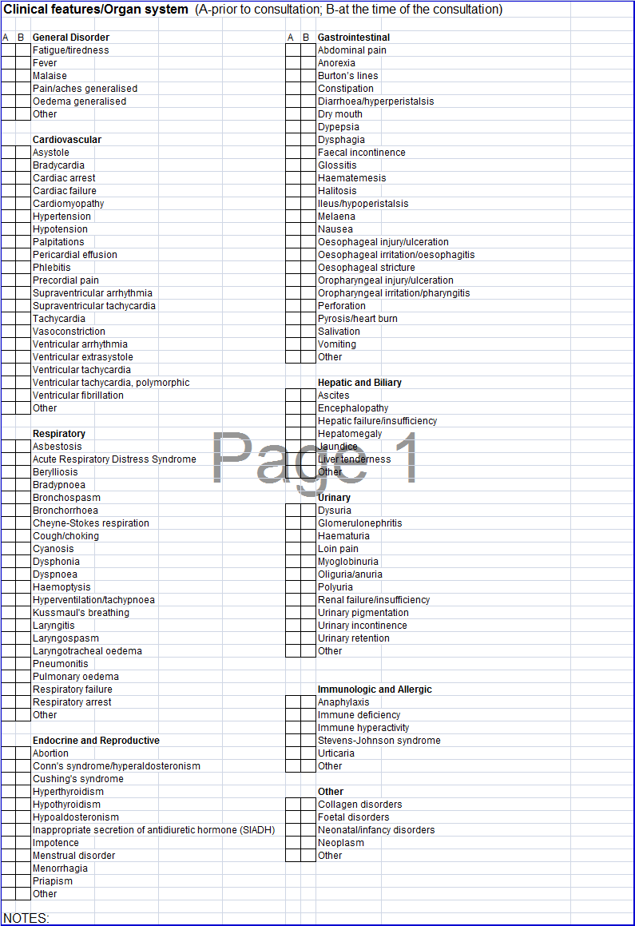

Slide 19
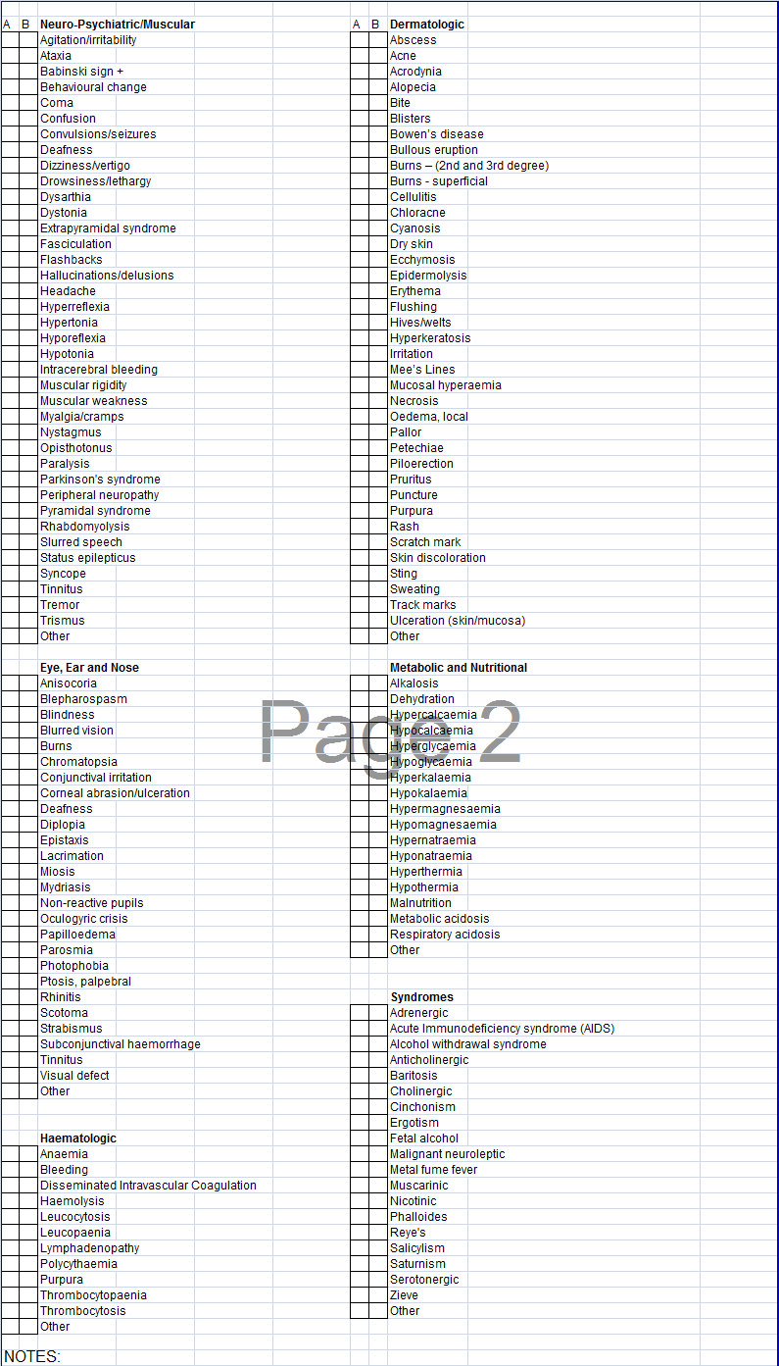

Slide 20
3.Data analysis:- Details of enquiries and cases that have been logged in the Communications Explorer can be analysed for clinical, scientific or administrative purposes. Reports can be produced for any time interval, using either pre-set reports provided with the system or user-defined reports. Thus, when a government ministry asks the poisons centre how many calls it has had about exposure to a substance and whether these exposures were accidental or intentional, the INTOX Data Management System can retrieve and present this information.

Slide 21
Substances database
The substances database is contained within the Agents Explorer component of the INTOX system. Separate, structured record formats are provided for chemicals, pharmaceuticals, plants, animals, fungi, bacteria and algae. Information can be written or pasted into the records and images can also be included. Part of the process of compiling the database involves establishing the preferred name and synonyms for each substance. This provides the means for ensuring consistency in data entry on cases of exposure

Slide 22
The INTOX Data Management System is developed and maintained by the Canadian Centre for Occupational Health and Safety (CCOHS) in partnership with WHO.

Slide 23
The INTOX Data Management System is flexible and can be adapted to a centre's specific needs, for example, to comply with national data collection requirements. An example of the use of this system for poisons centre reporting can be seen on the web site of the Centro de Información Toxicológica Universidad Católica de Chile (CITUC)
Currently 17 poisons centres in 12 countries are using the system
An INTOX users group meets periodically to discuss system developments and joint projects. There is also a technical support group that can provide training and advice on the use of the system.

Slide 24
You will be attended on telephone by a Poison Information Consultant who will ask all relevant details including your name, affiliation, telephone number, patient’s age and sex, product involved, signs and symptoms and treatment provided. Please donot be hesitant in divulging the information as it helps the consultant to assess a case. Proper management plays a vital role in poisoning cases.

Slide 25
Try to take an exact history and make sure you know all the relevant details especially the product consumed, its constituents, the amount ingested and the time elapsed. It will aid in diagnosis and proper management
You will get precise and concise information on the product involved, likely signs and symptoms, pre-hospital treatment, supportive and symptomatic care, antidotal therapy including dosage and availability.

Slide 26
NPIC has readymade information cards covering signs and symptoms, prehospital and hospital management protocols including therapeutic drugs and antidote dosing schedule.
Poison Management cards* are available on :
Organophosphat , Carbamates, Organochlorines
Aluminium phosphide Ethylene dibromide Pyrethroids
Corrosives Rodenticides
Benzodiazepines Tricyclic antidepressants Phenytoin
Copper sulfat
Opioid Scorpion sting Methanol
Carbon monoxide Paracetamol Datura
Yellow Oleander Cyanide

Slide 27
Establishment of WHO Sponsored National Antidote Bank at NPIC
Antidote / Essential Drugs | Poisoning - Indications
Atropine | Organophosphates/Carbamates
Acetylcysteine (oral & IV preparations) | Paracetamol
Adrenaline (epinephrine) | Anaphylactic and anaphylactoid reactions from many poisonings or during Anti Snake Venom administration
Benzathine Penicillinne | Mushrooms
Charcoal activated | In a number of poisonings as an adsorbant
Calcium gluconate | Acids
Cholestyramine | Organochlorines

Slide 28
Antidote / Essential Drugs | Poisoning - Indications
Diazepam | Convulsions
Dopamine | Hypotension/shock in many poisonings
Diphenhydramine HCl | Excessive histamine effects Pretreatment before administration of antivenoms
DMPS | Heavy metals
DMSA | Heavy metals
Esmolol HCl | Supraventricular and ventricular tachyarrhythmias and hypertension from sympathomimetics (stimulants, hyperthyroid state) Hypotension and tachycardia from theophylline or caffeine
Flumazenil | Benzodiazepines
Furosemide | Aluminium phosphide, Lithium, Cholecalciferol
Glucagon | Hypotension, bradycardia or conduction impairment caused by β-adrenergic blocker intoxication

Slide 29
Antidote / Essential Drugs | Poisoning - Indications
Haloperidol Deconoate | Cannabis
Magnesium sulphate | Aluminium phosphide As cathartic in various poisonings In BaCO₃ poisoning (for oral administration
Mannitol | Fluid retention
Methylene blue | Methemoglobinemia producing agents (Nitro benezene etc.)
Naloxone | Opium
Neostigmine Methyl Sulphate | Snake bite envenomation
Nifedipine | Hypotension from vasoconstrictive drugs (phenyl propanolamine, cocaine, amphetamines, phencyclidene or other stimulatns
Noradrenaline (norepinephrine) | Shock/hypovolemia
Penicillamine | Heavy metals

Slide 30
Antidote / Essential Drugs | Poisoning - Indications
Phenobarbitone | Recurrent convulsions/status epilepticus
Pyridoxine HCl | Isoniazid, Ethylene glycol
Prazosin HCl | Scorpion sting
Pralidoxime (2-PAM) | Organophosphates
Propranolol HCl | Hypertension in (theophylline, caffeine) Symapathomimetics (anphetamine, cocaine)
Protamine sulphate | Heparin
Potassium Chloride | Hypokalemia from various poisonings
Phenytoin | Convulsions
Ranitidine HCl | GI irritation

Slide 31
Antidote / Essential Drugs | Poisoning - Indications
Rabies vaccine | Rabies
Snake antivenom | Snake bite envenomation
Sodium Ca edetate | Heavy metals
Sodium bicarbonate | Metabolic acidosis in many of the poisonings
Sodium nitroprusside | Severe hypertension with stimulants/ MAO inhibitors intoxication
Sucralfate | NSAID's
Thiamine | Alcohol, Hypoglycemi a
Vitamin K₁ | Coumarin derivatives, Hypoprothrombinemia in salicylate intoxication
Xylocaine | Ventricular arrhythmias from cardioactive drugs (digoxin, cyclic antidepressents, stimulants, theophylline)

