Slide 1

ABO BLOOD GROUP SYSTEM
DR. KUNTAL PATEL

Slide 2
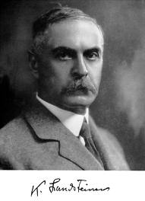
INTRODUCTION
KARL LANDSTEINER DISCOVERED THE ABO BLOOD GROUP
IN 1900-1901.

Slide 3
LANDSTEINER CONCLUDED FROM HIS OBSERVATION THAT:
INDIVIDUALS WHO LACK THE ANTIGENS OF ABO SYSTEM, HAVE CORRESPONDING ANTIBODY IN THEIR SERUM.
ANTIBODIES OF ABO SYSTEM ARE USUALLY ’’NATURALLY OCCURING’’ Ig M TYPE. THESE ARE CAPABLE OF CAUSING INTRAVASCULAR HEMOLYSIS IN PATIENTS,IF TRANSFUSED WITH INCOMPATIBLE BLOOD.
THUS AN ERROR IN ABO GROUPING OF DONOR OR RECIPIENT CAN BE FATAL.

Slide 4
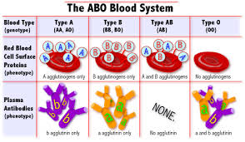
BLOOD TYPE | TYPE A: RBC with type A surface antigens and plasma with anti- B antibodies | TYPE B: RBC with type B surface antigens and plasma with anti- A antibodies | TYPE AB: RBC with type A and B surface antigens and plasma with neither anti-A and anti- B antibodies | TYPE O: RBC with neither type A nor B surface antigens and plasma with both anti-A and anti- B antibodies

Slide 5
BASIC GENETICS
FOLLOWS THE MEDELIAN LOWS OF INHERITENCE
THE LOCUS OF ABO GENE IS ON CHROMOSOME 9 WHICH IS OCCUPIED BY ONE OF THE 3 MAJOR ALLELIC GENES i.e. A,B OR O
PARENTS: AO BO
CHILD: AB AO BO OO
(FAMILY TREE OF ABO BLOOD GROUP SYSTEM)

Slide 6
BIOCHEMISTRY
THE BASIC PRECURSOR SUBSTANCE HAS SHORT CHAINS OF SUGAR(OLIGOSACCHARIDES)
TYPE 1 AND TYPE 2 CHAINS DIFFER IN THE MANNER IN WHICH THE TERMINAL GALACTOSE JOINS THE SUB-TERMINAL N-ACETYL GLUCOSAMINE.
IN THE TYPE 1 CHAIN THE CARBON 1 OF GALACTOSE IS LINKED TO CARBON 3 OF N – ACETYL GLUCOSAMINE(1-3) LINKAGE.
IN TYPE 2 CHAIN THE CARBON 1 OF GALACTOSE IS LINKED TO CARBON -4 OF N ACETYL GLUCOSAMINE(1-4) LINKAGE.

Slide 7
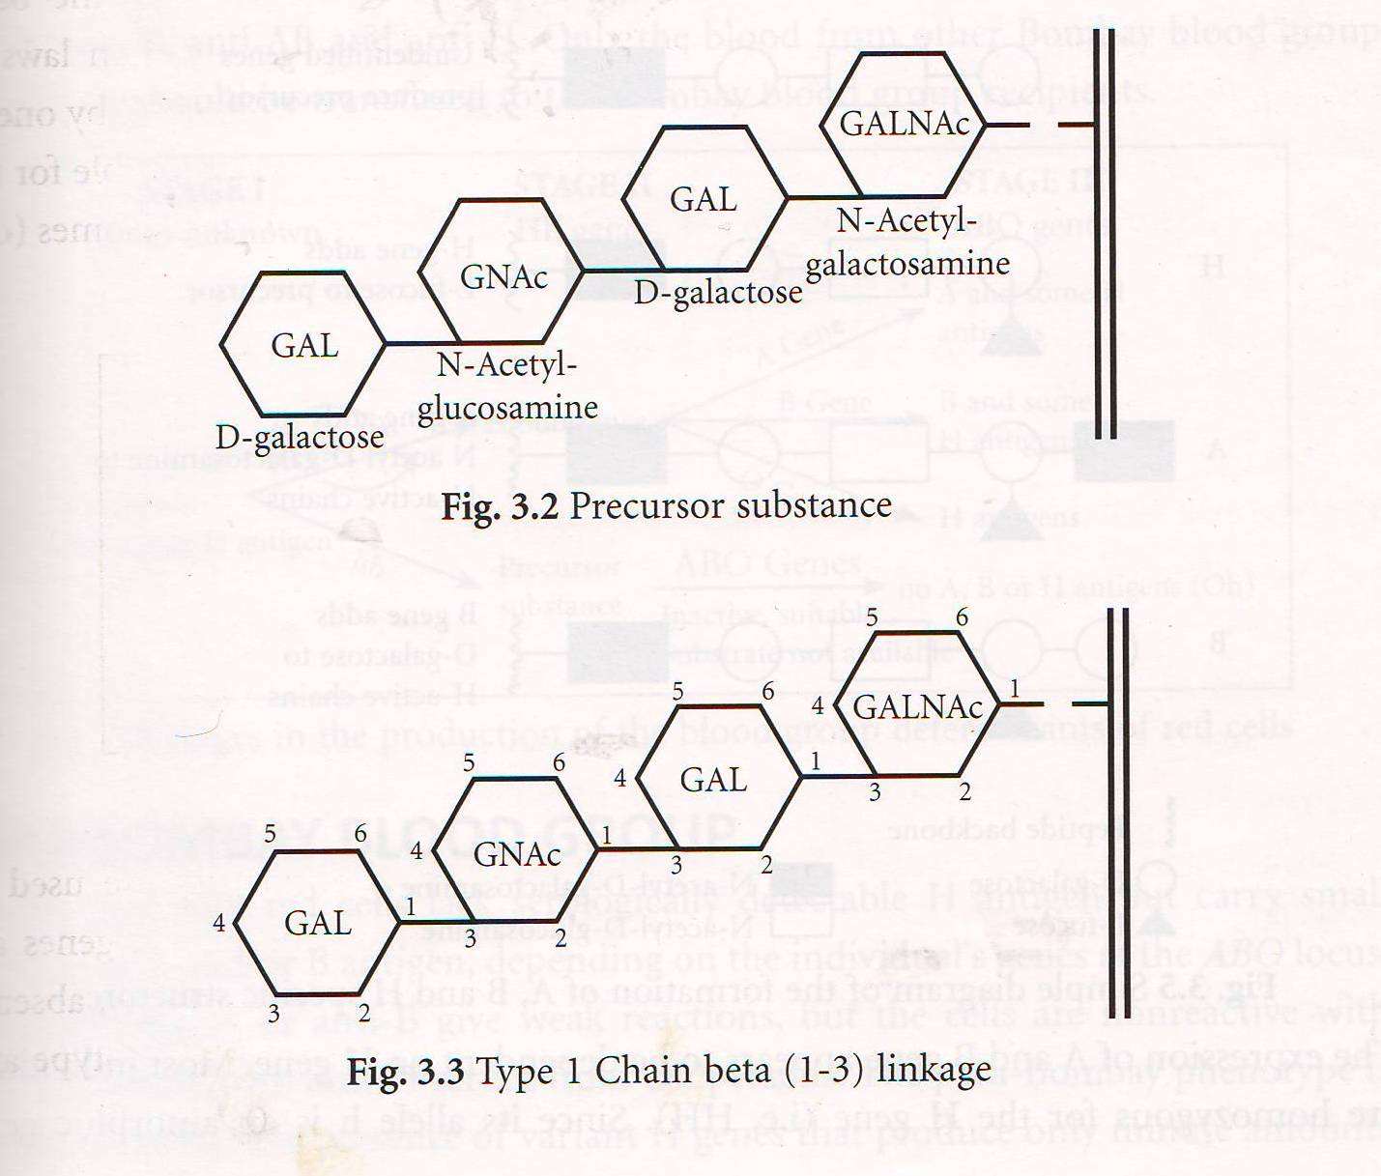

Slide 8
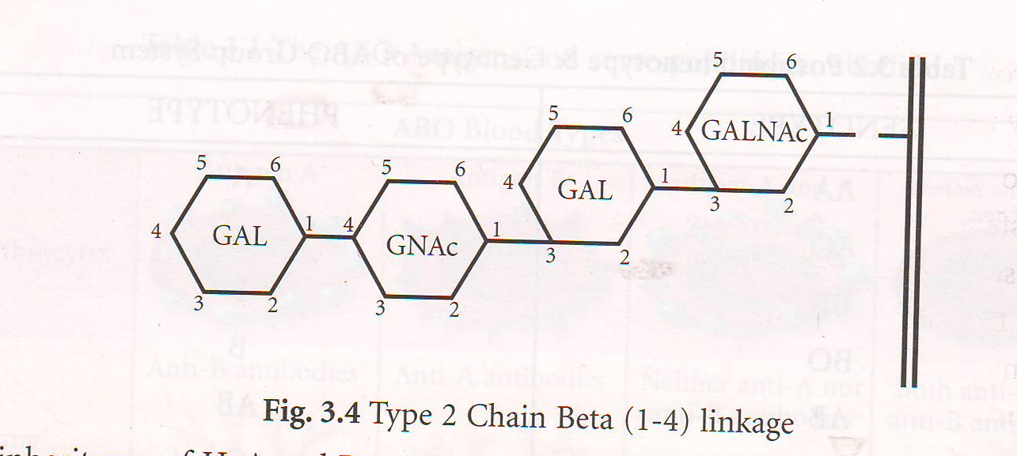

Slide 9
THE INHERITANCE OF H,A AND B GENES OCCURS AS EXPLAINED BELOW
The basic precursor substance (oligosaccharide) is converted by an enzyme L fucosyl transferase,(a product of H gene), to H substance by the addition of the sugar L fructose to the terminal D- galactose of the precursor substance.
The H substance is partly converted by the specific transferase namely N-acetyl galactosaminyl transferase and D –galactosaminyl tranferase,(the product of A and B gene) to A and B antigens by attachment of N-acetyl-galactosamine and D-galactose respectively to H substance.

Slide 10
The expression of A and B gene appears to be dependent on H gene. Most individuals are homozygous for the H gene(i.e. HH) . Since its allele h is an amorphic gene,the heterozygous Hh cannot be recognized. The phenotype hh(genotype hh)is extremely rare.
Genes do not synthesize antigen directly. The products of A,B and H genes are transferase enzymes. Precursor substance is acted upon by H gene specified transferase enzyme and is converted into H substance. Next the A and/or B gene specified transferase enzymes act on H substance to convert H substance to A and /or B antigens. The O gene is an amorph(no gene product) and group O cells contain only H substance. Some H substance remains unconverted. Thus all A and/or B cells normally contain some H substance,A and/or B antigens. The amount of H substance on red cells is , in order of diminishing quantity.
O>A2>A2B>B>A1>A1B

Slide 11
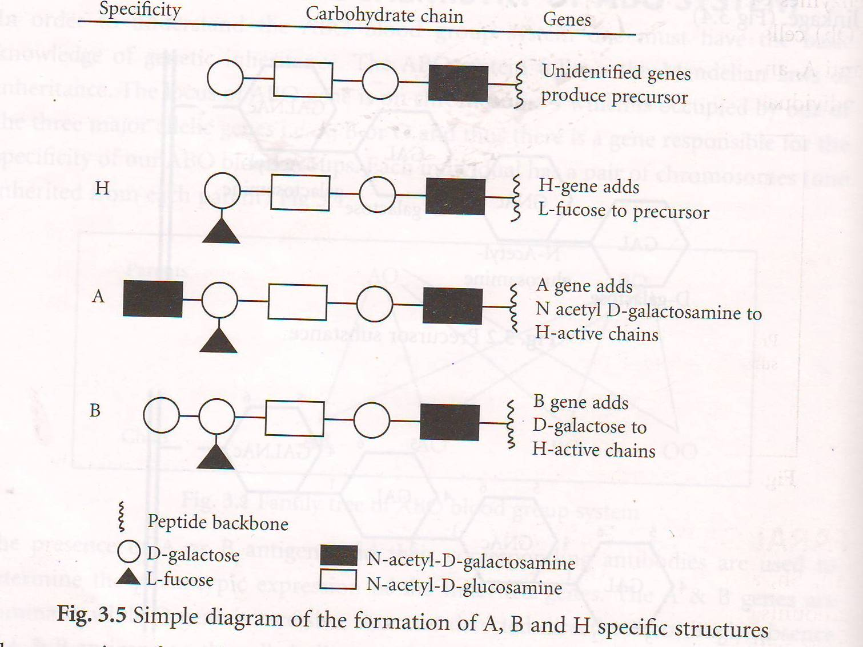
DIAGRAM OF FORMATION OF A,B,AND H SPECIFIC STRUCTURE

Slide 12
POSSIBLE PHENOTYPE AND GENOTYPE OF ABO GROUP SYSREM
GENOTYPE | PHENOTYPE
AA | A
AO | A
BB | B
BO | B
AB | AB
OO | O

Slide 13
BOMBAY (Oh) BLOOD GROUP
THE BOMBAY PHENOTYPE WAS REPORTED BY BHENDE et al IN 1952 IN BOMBAY,INDIA.
THE BLOOD GROUP RESULTING FROM HOMOZYGOUS hh CONDITION IS CALLED THE BOMBAY (Oh) BLOOD GROUP.
BOMBAY BLOOD CELLS HAVE NO A,B,O AND H ANTIGEN.
SERUM CONTAINS anti A, anti B, anti AB and anti H.

Slide 14
CHARACTERISTICS OF ABO ANTIGEN

Slide 15
A,B AND H ANTIGENS
ARE PRESENT IN ALL TISSUE AND BODY FLUIDS(EXCEPT CNS)
SECRETION OF A,B AND H SUBSTANCE IN SALIVA AND OTHER BODY FLUID IS CONTROLLED BY PAIR OF ALLELES Ss AND ss CALLED SECRETOR GENES.

Slide 16
SUB GROUP OF A, AB AND B
A and AB have been divided into subgroups A1,A2,A1B and A2B depending upon the reaction with anti A1
About 80% of group A and AB belong to subgroup A1 and A1B
20% belongs to subgroup A2 or A2B and they have antiA1 in their serum. But this antibody is usually weak and has no / less role in selection blood for transfusion.

Slide 17
DIFFERENCE BETWEEN A1 AND A2 SUBGROUP
THE DIFFERENCE IS BOTH QUANTITATIVE AND QUALITATIVE
A1 RBC→ HAVE ABOUT A MILLION A ANTIGENS/CELL
A2 RBC → HAVE ONLY 2,50,000 (1/4th the amount that A1 cells have) ANTIGENS/CELL
QUALITATIVE DIFF. – ONLY 1-8% OF THE A2 INDIVIDUALS PRODUCE ANTI A1 IN THEIR SERUM AND 25%OF THE A2B PRODUCE ANTI A1.

Slide 18
SUBGROUP OF B
RARE
EITHER Bm or Bx .
Recognized by variations in the strength of reaction using anti-B and anti-AB

Slide 19
ANTIBODY OF ABO
THE ANTIBODIES OF ABO BLOOD GROUP SYSTEM i.e. ANTI A AND ANTI B DEVELOP FEW MONTHS AFTER BIRTH(3-4 MONTHS) AND REACH AT THE PEAK BY 5-10 YEARS AND GRADUALLY BECOMES WEAKER.
THE ANTIBODIED ARE USUALLY IG M TYPE.
HOWEVER IG G CLASS FOUND IN GROUP O INDIVIDUAL.

Slide 20
O GROUP INDIVIDUAL…
HAVE HIGH TITRE OF ANTI AB AS THEY HAVE BOTH IgM AND IgG TYPE.
AND ARE OFTEN REFERED TO AS HIGH TITRE O GROUP INDIVIDUALS.
THESE HIGH TITRE ANTIBODIES ARE IMPORTANT IN TWO SITUATIONS:
USING O DONORS AS UNIVERSAL DONORS
IN PREGNANCY , IF MOTHER GROUP IS O AND THE BABY GROUP IS A OR B, THE CHANCES OF ABO HEMOLYTIC DISEASE OF NEWBORN ARE MORE AS IgG ANTIBODIES CAN CROSS PLACENTA.

Slide 21
ABO BLOOD GROUP PROCEDURE
FORWARD TYPING
REVERSE TYPING
THE UNNKNOWN TEST CELLS ARE ANTIGEN TYPED AGAINST POTENT AND SPECIFIC ANTI A AND ANTI B.
UNKNOWN SERUM IS TESTED AGAINST KNOWN GROUP A AND GROUP B CELLS

Slide 22
FORWARD TYPING AND REVERSE TYPING
FORWARD TYPING |  | GROUP INTERPRITATION | REVERSE TYPING
ANTI A | ANTI B |  | A1 CELLS | B CELLS
++++ | NEG | A | NEG | ++++
NEG | ++++ | B | ++++ | NEG
++++ | ++++ | AB | NEG | NEG
NEG | NEG | O | ++++ | ++++

Slide 23
ABO BLOOD GROUP REAGENT
ANTIBODY REAGENT
RED CELL REAGENT
SUPPLIMENTARY REAGENT

Slide 24
1.ABO ANTIBODY REAGENT
THE MONOCLONAL REAGENT FOR ABO GROUPING i.e. anti A, anti B and anti AB have significant advantages over earlier traditional polyclonal reagents in terms of
SPECIFICITY
POTENCY
BATCH TO BATCH CONSISTENCY
ABSENCE OF NON SPECIFIC ANTIBODIES
FREE FROM VIRUS

Slide 25
2.RED CELL REAGENT
POOLED A cells , B cells and O cells
Cells need to be washed in saline to remove serum, plasma and hemolysed cells small clots →may leads to false positive reactions
Super nantant of the last wash should be clear
2-4 % cell suspension for tube and microplate method
30-40% cell suspension for slide method

Slide 26
Use of group O cells in serum grouping
To detect antibodies other than anti A or anti B in some donors.
These are not naturally occurring
And called IRREGULAR ANTIBODIES.
They occur due to immunization either by
Transfusion
pregnancy

Slide 27
3.SUPPLIMENTARY REAGENT
For suspected blood group
The main supplementary used in ABO grouping are
Anti A1 lectin
Anti H
Anti A1 lectin produced from seeds of dolichus biflorus react strongly only with A1 individual.
Anti H reacts selectively with ABO group according to H substance.
(Group O individual which contain only H react strongly with anti H, while A1B contains very little H and thus react very weakly or negatively with anti H.)

Slide 28
ABO BLOOD GROUPING PROCEDURES

Slide 29
ABO BLOOD GROUPING PROCEDURES
SLIDE OR TILE METHOD
TUBE METHOD
MICROPLATE METHOD
I.D. MICROTYPING SYSTEM(Diamed/Bioview)
AUTOMATION OR SEMI – AUTOMATIC INSTRUMENTATION

Slide 30
NO MATTER, WHATEVER METHOD IS USED, THE BASIC PRINCIPLE REMAINS THE SAME
ABO GROUPING IS ALWAYS DONE AT ROOM TEMPERATURE
AGGLUTINATION IS OBSEVED AGAINST A WELL LIT BACKGROUND

Slide 31
1.SLIDE OR TILE METHOD
MATERIALS:
Glass slide / white tile
Test serum/ reagent antibody
Reagent/ test red cells
Applicator sticks
THUS ALL SLIDE TESTS SHOULD BE CONFIRMED EITHER BY TUBE / MICROPLATE METHOD
++ POINTS | - - POINTS
USED FOR EMERGENCY/ OUTDOOR CAMP TIME CONSUMING | INSENSITIVE THUS NOT RELIABLE FOR WEAK ANTIGENS IN FORWARD GROUP AND LOW TITRE ANTIBODIES IN REVERSE GROUPING DRYING EFFECT

Slide 32
METHOD(SLIDE / TILE)
LABEL THE SLIDE
ADD ONE DROP OF 30-40% RBC SUSPENSION TO ONE DROP OF TEST SERUM
MIX WITH CLEAN APPLICATOR STICK AND SPREAD THE MIXTURE OVER AN AREA OF 2 CM.
ROCK GENTALY FOR AGGLUTINATION
RECORD THE RESULTS WITHIN TWO MINUTS

Slide 33
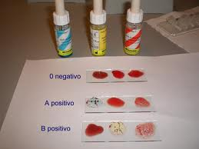

Slide 34
2.TUBE METHOD
ADVANTAGE
IT ALLOWS FOR LONGER INCUBATION WITHOUT ANY DRYING IT CAN BE CENTRIFUGED TO INHANCE ANTIGEN ANTIBODY REACTION
CAN BE DONE BY EITHER…
IMMEDIATE SPIN TECHNIQUE
SALINE ROOM TEMPERATURE TECHNNIQUE

Slide 35
1.IMMEDIATE SPIN TECHNIQUE
BETTER FOR RAPID ABO GROUPING THAN SLIDE
MATERIAL:
75X12 MM TUBE
TEST SERUM / REAGENT ANTISERA
TEST RED CELLS

Slide 36
METHOD(IMMEDIATE SPIN-TUBE)
SET UP THREE ROWS OF CLEAN TEST TUBES AND LABLE THEM
ADD 2 DROPS OF ANTISERA i.e. anti A, anti B & anti AB IN EACH
ADD ONE DROP OF 2-4 % CELL SUSPENSION IN EACH TUBE
CENTRIFUGE FOR 15-20 SECONDS
LOOK FOR HEMOLYSIS OR AGGLUTINATION AGAINST WELL LIGHTED BACK GROUND

Slide 37
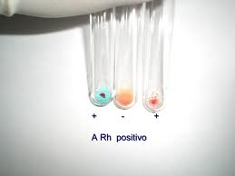

Slide 38
2.SALINE ROOM TEMPERATURE TECHNIQUE
FORWARD TYPING/CELL TYPING
METHOD:
SET UP 3 RAWS OF CLEAN TEST TUBES AND LABEL
MIX THE CONTENT OF EACH TUBE GENTLY
INCUBATE AT ROOM TEMPERATURE FOR 60 MIN, LOOK FOR HEMOLYSIS OR AGGLUTINATION
Add 1 DROP OF 2-4 % CELL SUSPENSION IN EACH TUBE
ADD 2 DROPS OF ANTISERA i.e anti A , anti B and anti AB in prelabbeled tubes
MATERIAL:
PRECIPITIN TUBES 50X7 mm / 75x12mm tubes
TEST RED CELLS

Slide 39
REVERSE GROUPING / SERUM GROUPING
SIMILAR TUBE TECHNIQUE TO TEST DONORS / PATIENTS SERUM WITH 3-4 % POOLED CELL SUSPENSION OF GROUP A cells. B cells and O cells

Slide 40
3.MOCROPLATE METHOD FOR ABO GROUPING
Ideal for testing large numbers of blood samples and this is rapidly replacing test tube method in many labs
Cost effective and saves time
Micro plates are polysterene plates having 96 small wells which can hold 200 – 300 micro litres of reagents
The wells are either V type, flat bottom or U type
U type well is used for blood serology , because the results can be read easily

Slide 41
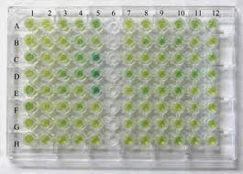
Standard 96 well microplate

Slide 42
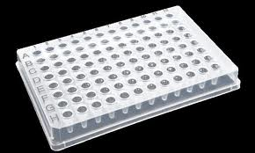

Slide 43
The microplates are intended to be disposable however they can be reused after cleaning them properly.
MATERIAL:
microplates
reagent or test serum
reagent or test red cells

Slide 44
METHOD(MICRPLATE)
ADD ONE DROP OF ANTISERA INTO THE APPROPRIATE WELLS OF PLATE
ADD ONE DROP OF 2-4 % SALINE SUSPENSION OF DONOR / PATIENNT RED CELL TO EACH OF THE WELLS WITH ANTISERA
MIX THE CONTENTS BY GENTLY SHAKING THE PLATE
INCUBATE AT ROOM TEMPERATURE FOR 20-30 MIN
LOOK FOR ANY HEMOLYSIS IF PRESENT AND RECORD (CONT..)

Slide 45
CONT..
GENTALY SHAKE THE PLATE EITHER BY TAPPING THE SIDE OF THE PLATE WITHPALM OF HAND OR WITH THE MAICROPLATE SHAKER
READ THE AGGLUTINATION REACTION S DIRECTLY OR WITH THE AID OF MICROPLATE READING MIRROR.
IN NEGATIVE REACTIONS THE RED CELLS TRAIL FROM THE CENTRE OF WELL……WHILE IN POSITIVE REACTION THE CELLS REMAINS IN THE CENTRE OR FALL AS A DISCRETE BUTTON

Slide 46
GRADING OF REACTION
IT IS IMPORTANAT TO KNOW THE STRENGTH OF REACTION.
i.e.
++++ : complete agglutination of all cells
+++ : majority of cells agglutinated with some free cells
++ : many fairly large clumps with many free cells
+ : fine granular appearance visually but definite small clumps per low power field
-ve : no agglutination

Slide 47
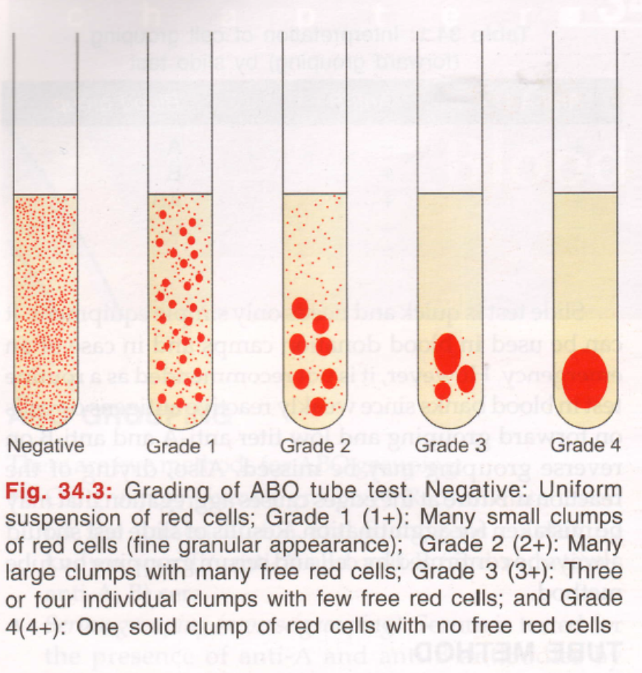
Grading of reaction

Slide 48
4.I.D. MICROTYPING SYSTEM(DIAMED/BIOVIEW) FOR GROUPING
PRINCIPLE:
MICROTUBES IN THE FORM OF CARDS, FILLED WITH BUFFERED DEXTRAN GEL ARE USED WHICH MAY BE NATURAL OR IMPREGNATED WITH ANTISERA.
WITH NEGATIVE REACTION THE RED CELLS PASS THROUGH THE GEL UPON CENTRIFUGATION
WHERE AS IN POSITIVE REACTION THE AGGLUTINATED RED CELLS ARE TRAPPED ON TOP OF THE GEL OR SUSPENDED WHITHIN IT.

Slide 49
ADVANTAGE
One of the main advantage is that microtubes are combined on the top of the test card→ facilitates and simplifies labeling
Errors are avoided and safety is increased→ in antigen typing there is no need to indicate the specificity of the test reagents enclosed in the gel as they are already pre labeled.
Clean work place(sample tubes and typing cards)
One of the outstanding feature is the versatility of the system. Reverse group is good example. It contains three tubes with neutral gel and three tubes with coombs gel.
the results can be easily documented by making photocopies
The reaction pattern are stable for hours or even for few days if the cards are closed with a tape and kept in refrigerator.
Clear cut results
Typing cards allow automation→ positive sample identification is easy
Cells never need to be washed→0.8% cell suspension is prepared and pipetted onto gel → centrifugation→ reading

Slide 50
WIDELY ACCEPTED BECAUSE….
EASY TO USE
SIMPLE METHOD
PROVIES EASY READABLE AGGLUTINATION REACTION
AVAILABLE TO PERFORM BLOOD GROUP SEROLOGY
VERY USEFULL FOR ANTIBODY SCREENING
AVILABLE FOR PRE TRANSFUSION CROSS MATCH
HAS THE POTENTIAL TO BE AUTOMATED

Slide 51
MOLECULAR BLOOD GROUP / GENOTYPING
The exact genotype of various blood group system is now known, owing to the HUMAN GENOME PROJECT
Suitable techniques for genotyping of ABO,Kell, Duffy,kidd, MN and Ss have been used.
ADVANTAGES:
highly sensitive technique which identifies signals that are weak and may even be missed during serology.
Highly specific , which identifies all clinically relevant signals that may not be separated by antibodies.
It is molecular blood grouping techniques aid in solving several controversial issues about blood group genetics
Cost effective
Allows creation of blood group databases
No adverse ethical / legal issues involved in this technique.

Slide 52
UNIVERSAL RBC

Slide 53
NEED
ABO antigen typing still remains the critical step in RBC transfusion , necessary because of the presence of preexisting antibodies to A and B antigens. Elimination of this need for typing, by the creation of a universal RBC for transfusion.→would ring about a revolution in blood banking
Transfusion induced fatalities can be eliminated
There is universal shortage of all parts of blood including India. Group O RBCs contain neither A nor B antigens , so can be transfused safely…. ☺

Slide 54
APPROACHES FOR MAKING UNIVERSAL BLOOD
First approach
Second-Sheath cells-
involves removal of A and /or B antigens
ECO-(enzymatically converted) group O cells-done by converting or degrading A and B antigens enzymatically or non enzymatically to O grp.
Application:-
-not economically viable
-biochemical complexity of A cells →difficult practically to convert A to O.
masking of RBC antigens using polyethylene glycol (PEG)
Adv: -significantly reduce the Ab-mediated agglutination of the PEG RBCs →only theoretically possible
Used for any patient-who needs chronically transfusion
Disadv.: in vitro serological problem
Redused in vivo survival
Immunogenic in animal/human

Slide 55
PROBLEMS IN ABO GROUPING
IMPROPER IDENTIFICATION OF SPECIMEN
IMPROPER TECHNIQUES:
Failure to add proper reagents/incorrect cell to serum ratio/failure to identify hemolysis/high ambient temperature in lab/incorrect reading or interpretation
FAILURE OF EQUIPMENT
Improper centrifuge calibration-over/under centrifugation
POORLY STANDARDIZED OR STORAGE REAGENTS
PATIENT PROBLEMS(cont…)

Slide 56
PATIENT RELATED PROBLEM
A. patient may fail to express abo antigen on red cells
Age(new born/old age)
Disease state: leukaemia , lymphoma
B. acquired B antigen occur in :
Infection(gram negative septisemia)
Carcinoma colon
C . blood group chimera(i.e. an individual with two population of cells.) it can be :
ARTIFICIAL: BM transplant/ transfusion of O blood to A or B individual
PERMANENT: exchange of blood in twin’s inutero due to vascular anastomosis.
D. Rouleaux formation:
Patients when albumin/globulin ratio is abnormal or can also occur in cord blood samples due to whartons jelly contamination.
E. acquired antibodies:
Anti A1 and A2 person
Anti H in Bombay phenotype
Cold auto antibodis
F. Absence or weakening antibodies:
immunodeficiency state
agammaglobunemia
G. Excessive A or B substance

Slide 57
RESOLVING DISCREPANCIES IN ABO GROUPING
Check all labels and records
Obtain fresh sample of patient
Check patient’s record for history of transfusions , drug, disease and diagnosis
Check equipments and reagents for quality control
Repeat testing with new samples

Slide 58


Slide 60
Martin L. Olsson, Nidal M. Irshaid, Bahram Hosseini-Maaf, Åsa Hellberg, Marilyn K. Moulds, Hannele Sareneva, and M. Alan Cheste. 2001 by The American Society of Hematology
Name of author | TITLE OF STUDY & DESIGN | AIM | OBJECTIVE | conclusion
Martin L. Olsson, Nidal M. Irshaid, Bahram Hosseini-Maaf, Åsa Hellberg, Marilyn K. Moulds, Hannele Sareneva, and M. Alan Cheste | Genomic analysis of clinical samples with serologic ABO blood grouping discrepancies: identification of 15 novel A and B subgroup alleles LEVEL 4 | Since the cloning in 1990 of complementary DNA corresponding to messenger RNA transcribed at the blood group ABO locus, polymorphisms and phenotype-genotype correlations have been reported by several investigators. Exons 6 and 7, constituting 77% of the gene, have been analyzed previously in samples with variant phenotypes but for many subgroups the molecular basis remains unknown. This study analyzed 324 blood samples involved in ABO grouping discrepancies and determined their ABO genotype. | Samples from individuals found to have known subgroup alleles (n = 53), acquired ABO phenotypes associated with different medical conditions (n = 65), probable chimerism (n = 3), and common red blood cell phenotypes (n = 109) were evaluated by ABOgenotype screening only. Other samples (n = 94) from apparently healthy donors with weak expression of A or B antigens were considered potential subgroup samples without known molecular background. The full coding region (exons 1-7) and 2 proposed regulatory regions of the ABO gene were sequenced in selected A (n = 22) or B (n = 12) subgroup samples. | The full coding region (exons 1-7) and 2 proposed regulatory regions of the ABO gene were sequenced in selected A (n = 22) or B (n = 12) subgroup samples. Fifteen novelABO subgroup alleles were identified, 2 of which are the first examples of mutations outside exon 7 associated with weak subgroups. Each allele was characterized by a missense or nonsense mutation for which screening by allele-specific primer polymerase chain reaction was performed. The novel mutations were encountered in 28 of the remaining 60 A and B subgroup samples but not among normal donors. .

Slide 61
EXERCISE:
1. THE ABO BLOOD GROUP SYSTEM HAS ___________ MAJOR ALLELE GENES.

Slide 62
EXERCISE:
1. THE ABO BLOOD GROUP SYSTEM HAS _THREE_ MAJOR ALLELE GENES

Slide 63
EXERCISE:
2. THE ABO LOCUS IS ON CHROMOSOME NUMBER _________

Slide 64
EXERCISE:
2. THE ABO LOCUS IS ON CHROMOSOME NUMBER _9_

Slide 65
EXERCISE:
3.NO H CHAINS ARE SYNTHESIZED WHEN PERSON IS___________

Slide 66
EXERCISE:
3.NO H CHAINS ARE SYNTHESIZED WHEN PERSON IS_h/h_

Slide 67
EXERCISE:
4.PHENOTYPIC NAME FOR h/h INDIVIDUAL IS ______

Slide 68
EXERCISE:
4.PHENOTYPIC NAME FOR h/h INDIVIDUAL IS _BOMBAY OR Oh OR ABH null_

Slide 69
EXERCISE:
5.WHICH OF THE FOLLOWING FOUR OPTIONS RESULTS IN THE MOST COMPATIBLE CROSS MATCH….
A | DONOR BLOOD GROUP A | PATIENT GROUP AB
B | DONOR BLOOD GROUP AB | PATIENT GROUP A
C | DONOR BLOOD GROUP A | PATIENT GROUP B
D | DONOR BLOOD GROUP O | PATIENT GROUP AB

Slide 70
EXERCISE:
5.WHICH OF THE FOLLOWING RESULTS IN THE MOST COMPATIBLE CROSS MATCH….
A | DONOR BLOOD GROUP A | PATIENT GROUP AB
B | DONOR BLOOD GROUP AB | PATIENT GROUP A
C | DONOR BLOOD GROUP A | PATIENT GROUP B
D | DONOR BLOOD GROUP O | PATIENT GROUP AB

Slide 71
EXERCISE:
6. GROUP O CELLS ARE USED IN SERUM GROUPING TO DETECT __________

Slide 72
EXERCISE:
6. GROUP O CELLS ARE USED IN SERUM GROUPING TO DETECT _IRREGULAR ANTIBODIES_

Slide 73
EXERCISE:
7. ENNUMERATE FIVE SUB GROUPS OF A ANTIGEN. WHICH OF THEM IS FOUND MOST FREQUENTLY?

Slide 74
EXERCISE:
7. ENNUMERATE FIVE SUB GROUPS OF A ANTIGEN. WHICH OF THEM IS FOUND MOST FREQUENTLY?
A1
A2
A3
Ax
Aint

Slide 75
EXERCISE:
8.WHEN THERE IS DISCREPANCY BETWEEN CELL GROUPING AND SERUM GROUPING
PATIENT RED CELL GROUP RATHER THAN SERUM GROUP IS USED TO MATCH WITH THE DONOR
ADDITIONAL TESTS MUST BE PERFORMED TO RESOLVE IT.

Slide 76
EXERCISE:
8.WHEN THERE IS DISCREPANCY BETWEEN CELL GROUPING AND SERUM GROUPING
PATIENT RED CELL GROUP RATHER THAN SERUM GROUP IS USED TO MATCH WITH THE DONOR
ADDITIONAL TESTS MUST BE PERFORMED TO RESOLVE IT.

Slide 77
EXERCISE
9. THE Se /se GENES CONTROL THE SECRETION OF A, B, AND H______ IN THE BODY FLUIDS SUCH AS SALIVA.

Slide 78
EXERCISE
9. THE Se /se GENES CONTROL THE SECRETION OF A, B, AND H_SUBSTANCE_ IN THE BODY FLUIDS SUCH AS SALIVA.

Slide 79
EXERCISE
10.BACTERIAL ENZYMES MAY CAUSE GROUP A PEOPLE TO ACQUIRE
1 .NEW B ANTIGEN
2 .ALTERED ANTIGEN, VERY SIMILAR TO B ANTIGEN

Slide 80
EXERCISE
10.BACTERIAL ENZYMES MAY CAUSE GROUP A PEOPLE TO ACQUIRE
1 .NEW B ANTIGEN
2 .ALTERED ANTIGEN, VERY SIMILAR TO B ANTIGEN

Slide 81
EXERCISE
11. WHAT ARE SHEATH RBCS?

Slide 82
EXERCISE
11. WHAT ARE SHEATH RBCS?
THESE ARE RBCs MADE UNIVERSAL BY MASKING RBC ANTIGENS USING PEG(POLYETHYLENE GLYCOL)

Slide 83
EXERCISE
12. LIST TWO APPLICATION OF UNIVARSAL RBCs

Slide 84
EXERCISE
12. LIST TWO APPLICATION OF UNIVARSAL RBCs
1.OUTDATED BLOOD UNITS COULD BE ENZYMATICALLY CONVERTED TO GROUP O RBCs
2. PEG RBCs WOULD BE A GREAT BENEFIT IN PATIENTS WITH ANTIBODIES TI HIGH INCODENCE ANTIGENS.

Slide 85
EXERCISE
13. WHAT IS THE APPERENT PHENOTYPE OF AN INDIVIDUAL WITH A GENOTYPE hh ?
CANT BE DETERMINED
B
AB
O

Slide 86
EXERCISE
13. WHAT IS THE APPERENT PHENOTYPE OF AN INDIVIDUAL WITH A GENOTYPE hh ?
CANT BE DETERMINED
B
AB
O

Slide 87
EXERCISE
14. WHEN THE PATIENT’S SERUM REACTS WITH A AND B CELLS BUT FORWARD GROUPING DOES NOT SHOW GROUP O, THE REACTION IS MOST LIKELY TO BE DUE TO….
1.PRESENCE OF ANTI A AND ANTI B ANTIBODIES
2.UNEXPECTED ANTIBODIES.

Slide 88
EXERCISE
14. WHEN THE PATIENT’S SERUM REACTS WITH A AND B CELLS BUT FORWARD GROUPING DOES NOT SHOW GROUP O, THE REACTION IS MOST LIKELY TO BE DUE TO….
1.PRESENCE OF ANTI A AND ANTI B ANTIBODIES
2.UNEXPECTED ANTIBODIES.

Slide 89
PROBLEM IN ABO BLOOD GROUPING
15. THE PROBLEM CAN BE RESOLVED AS…..
CELL GROUP | SERUM GROUP
FORWARD TYPE | REVERSE TYPE
ANTI A ANTI B | A CELLS B CELLS
++++ NEG | + ++++
CELL GROUP= A | SERUM GROUP = O

Slide 90
SOLUTION:
FURTHER TESTS:
USING SUPPLIMENTARY REAGENT TO RESOLVE
+ REACTION WITH A1
REACTION WITH SUPPLEMENTARY REAGENTS
ANTI A1 LECTIN | ANTI H
NEG | +++

Slide 91
SOLUTION(CONT…)
NEGATIVE REACTION WITH ANTI-A1 LECTIN INDICATES, IT IS NOT GROUP A1. HOWEVER, +++ REACTION WITH ANTI-H, SUGGESTS A SUBGROUP BUT NOT A1 AND A INTERMEDIATE.
TESTING AT THE STAGE INDICATES THAT IT IS GROUP A AND NOT GROUP O. WE MAY CONCLUDE THAT + REACTION WITH A1 CELLS INDICATE ATYPICAL ANTIBODY
TO CONFIRM THIS, TEST SERUM (REVERSE GROUPING) WITH ANTI A2 CELLS , O CELLS AND DO AUTOCONTROL(PATIENTS OWN CELLS AND SERUM).

Slide 92
SOLUTION
TEST FOR ATYPICAL | ANTIBODY
A2 CELLS | O CELLS | AUTOCONTROL
NEG | NEG | NEG
CONCLUSION:
THE PATIENT /DONOR IS A SUBGROUP MOST LIKELY A2 WITH A1 ANTIBODY.
PATIENT CAN BE SAFELY TRANSFUSED A2 OR
O CELLS.

