Slide 1
Sex determination from the bones
Dr SUNIL DOSHI

Slide 2
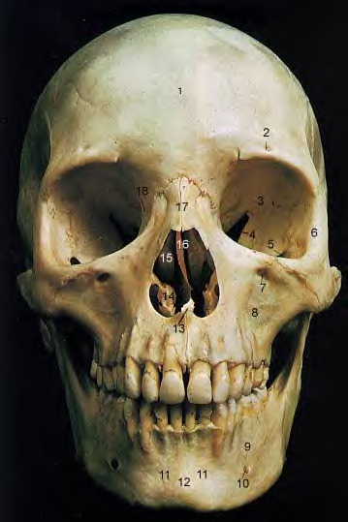
Do bones speak?

Slide 3
There are 206 types of bones in our body.
But forensic point of view as regard to the sex determination from bones following bones are of major important.
  Pelvis---------------95%
  Skull----------------90%
  Both----------------98%
  Long bones--------80%

Slide 4
Pelvis

Slide 5
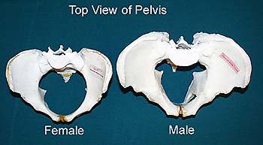
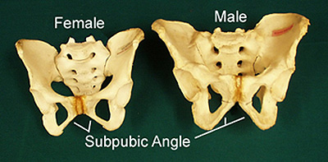

Slide 6
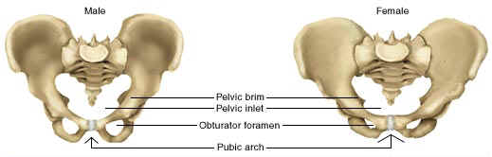

Slide 7
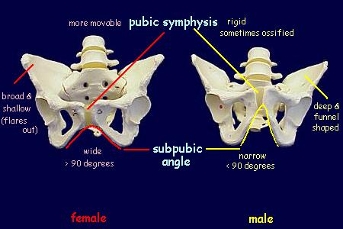

Slide 8
Pelvis
Feature | Male | Female
General | Funnel shaped | Flat bowl
Greater sciatic notch | Smaller, narrower and deep | Larger, wider, Shallower.
Obturator foramen | Oval ,large and base is upwards | Smaller, Triangular and apex forwards
Sub pubic angle | “V” shaped and sharp angle, it is 70-75º | “U” shaped rounded broader angle
Ischial tuberosity | Inverted | Everted
Pelvic brim | Heart shaped | Circular , more spacious
Pelvic cavity | Conical and funnel shaped | Broad and round
Pubic symphysis | Higher ,bigger and narrow in width. Margins of pubic arch everted. | Lower ,wider and rounded Margins of pubic arch are not everted

Slide 9
Sacrum
Feature | Male | Female
General feature | Larger, heavier, rough and narrow | Smaller, lighter, smooth and broader
Breadth of the body of first sacral vertebra | More than breadth of one side ala | Less than breadth of one side of ala
Sacroiliac articulation | Extend up to third segment | Extends up to 2nd and 3rd segment
Coccyx | Less movable | More movable

Slide 10
Skull

Slide 11
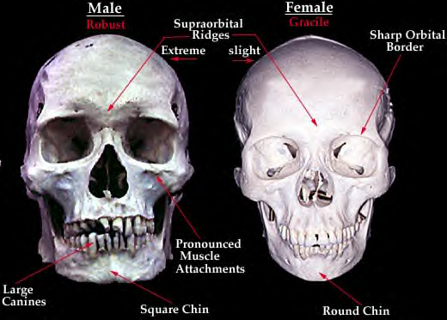

Slide 12
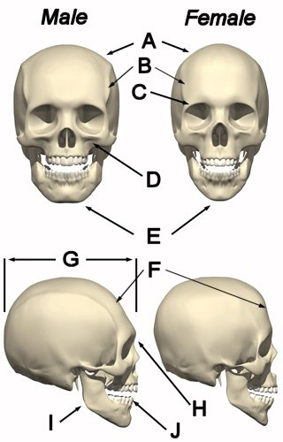
Skull

Slide 13
Feature | Male | Female
General appearance | Larger, heavier, rugged, more marked muscular ridges | Smaller, lighter, smoother, and less marked muscular impression
Capacity | 1500-1550 cc | 1350-1400 cc
Frontal surface | Irregular and rough | smoother
Glabella | Prominent | Less prominent
Supraorbital ridges | Prominent | Less Prominent
Fronto -nasal junction | Distinct angulation | Smoothly curved
Orbit | Square with roundish margins, set lower on face | Roundish with sharp margins, sets higher on the face

Slide 14
Feature | Male | Female
Frontal eminence | Less prominent | More prominent
Parietal eminence | Less prominent | More prominent
Occipital area | Muscular impression and protuberance are prominent | Muscular impression and protuberance are not prominent
Mastoid process | Medium to large, round, blunt | Small to Medium , smooth, relatively prominent
Base | Sites of muscular insertion are marked | Sites of muscular insertion are less marked
Digastric groove | Deep | Shallow
Condylar facet | Long and narrow | Short and broad

Slide 15
Mandible
Feature | Male | Female
General appearance | Larger, thicker | Smaller, thinner
Symphysis menti | Square or U-shaped | Rounded
Anatomical angle of body with the ramus (Gonion) | Less obtuse and everted | More obtuse and inverted
Angle of mandible condyle | Everted larger | Not so small

Slide 16
Femur

Slide 17
Femur
Feature | Male | Female
Head | Articular surface is more than 2/3rd of sphere | Articular surface is less than 2/3rd of sphere
Neck- shaft angle | Obtuse of about 125º | Almost right angle
Bicondylar width | 74-89mm | 67-76mm
Vertical diameter of head | Usually more than 18mm | Usually less than 41mm
Popliteal length | 135-145mm | 106-114mm

Slide 18
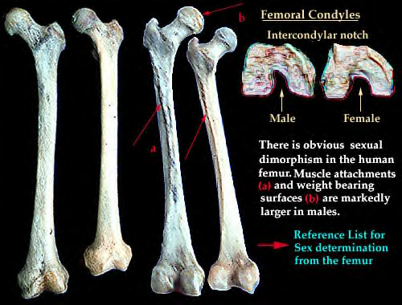

Slide 19
Thank you

