Slide 1
PHSYIOTHERAPY ASSESSMENT & MANAGEMENT OF
ROTATOR CUFF TENDINITIS
NIKETA PATEL
02/01/19

Slide 2
Objectives
After completing this lecture, you will be able to:
Recall shoulder anatomy
Explain biomechanics of Rotator cuff muscles
Discuss Physiotherapy assessment and management for Rotator cuff tendinitis
Apply Evidence based Physiotherapy

Slide 3
ANATOMY OF SHOULDER JOINT
The osseous segments of the shoulder complex are the clavicle, scapula, and humerus.
These three segments are joined by three interdependent linkages:
SC joint
Acromioclavicular (AC) joint
GH joint.

Slide 4
The articulation between the scapula and the thorax is often described as the scapulothoracic (ST) “joint,” although it does not have the characteristics of a fibrous, cartilaginous, or synovial union.
An additional functional articulation is the subacromial (or suprahumeral) “joint”.

Slide 5
This functional joint is formed by movement of the head of the humerus below the coracoacromial arch.
Elevation of the upper extremity refers to the combination of scapular, clavicular, and humeral motion that occurs when the arm is raised either forward or to the side

Slide 6
Motion of the scapula on the thorax normally contributes about one third of the total motion necessary for elevation of the arm whereas the GH joint contributes about two thirds of the total motion.

Slide 7
Static Stabilization of the Glenohumeral Joint in the Dependent Arm
As there is incongruence of the GH articular surfaces, the bony surfaces alone cannot maintain joint contact in the dependent position (arm hanging at the side).
As the humeral head rests on the fossa, gravity acts on the humerus parallel to the shaft in a downward direction.

Slide 8
This appears to require a vertical upward pull to maintain equilibrium.
Such a vertical force could be supplied by muscles such as the deltoid, supraspinatus, or the long heads of the biceps brachii and triceps brachii.

Slide 9
The line of gravity (LoG) acting on the upper extremity and extended through the humerus creates a downward force on the humerus.
The magnitude of passive tension in the structures of the rotator interval capsule (superior capsule, superior GH ligament, and coracohumeral ligament) that are taut when the arm is at the side the resultant pull of both the LoG and the rotator interval capsule creates a line of force that compresses the humeral head into the lower portion of the glenoid fossa.

Slide 10
Two other mechanisms help provide static stability of the dependent arm.
In a healthy GH joint, the capsule has an airtight seal, which produces negative intra-articular pressure which creates a relative vacuum that resists inferior humeral translation caused by the force of gravity.

Slide 11
Loss of intra-articular pressure due to tears in the glenoid labrum, results in large increases in inferior humeral translations.
When the available passive forces are inadequate for static stabilization, as may occur in the heavily loaded arm, activity of the supraspinatus is recruited.

Slide 12
Although the supraspinatus may not be active when the arm is hanging at the side, paralysis or dysfunction in the supraspinatus may lead to gradual inferior subluxation of the GH joint.
Without the reinforcing passive tension of the intact supraspinatus muscle, the sustained load on the structures of the rotator interval capsule apparently causes these structures to gradually stretch (become plastic), which results in a loss of joint stability.

Slide 13
Subscapularis through its connections to the rotator interval, provide some support to those structures.
Inferior GH subluxation is commonly encountered in patients with diminished rotator cuff function caused by stroke or other brain injury.

Slide 14
Dynamic Stabilization of the Glenohumeral Joint

Slide 15
The Deltoid and Glenohumeral Stabilization
Deltoid muscle is a prime mover along with the supraspinatus for GH abduction.
The anterior deltoid is also considered the prime mover in GH flexion.

Slide 16
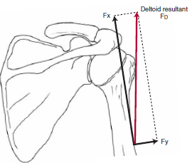

Slide 17
The action lines of the three segments of the deltoid acting together coincide with the fibers of the middle deltoid.
When the muscle action line (FD) is resolved into its parallel (Fx) and perpendicular (Fy) components in relation to the long axis of the humerus, the parallel component directly cephalad (superiorly) is by far the larger of the two components.

Slide 18
That is, the majority of the force of contraction of the deltoid causes the humerus and humeral head to translate superiorly; only a small proportion of force is applied perpendicular to the humerus and directly contributes to rotation (abduction) of the humerus.

Slide 19
At many other joints, a force component parallel to the long bone has a stabilizing effect because the parallel component contributes to joint compression.
Consequently, the force (Fx) applied parallel to the long axis of the bone creates a shear force (approximately parallel to the contacting articular surfaces) rather than a stabilizing (compressive) effect.

Slide 20
The large superiorly directed force of the deltoid, if unopposed, would cause the humeral head to impact the coracoacromial arch before much abduction had occurred.
But pain from impinged structures in the subacromial space will prevent much motion.

Slide 21
The inferior pull of gravity cannot offset the Fx component of the deltoid, because the resultant force of the deltoid must exceed that of gravity before any rotation can occur.
That is, the deltoid cannot independently abduct (elevate) the arm. Another force or set of forces must be introduced to work synergistically with the deltoid for the deltoid to work effectively. This is the role of the muscles of the rotator.

Slide 22
The Rotator Cuff and Glenohumeral Stabilization
The supraspinatus, infraspinatus, teres minor, and subscapularis muscles compose the rotator cuff.
These muscles are considered to be part of a “cuff” because the inserting tendons of each muscle of the cuff blend with and reinforce the GH capsule.

Slide 23
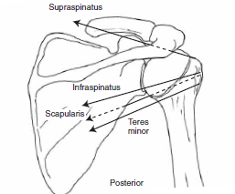
All have action lines that significantly contribute to the dynamic stabilization of the GH joint.

Slide 24
If any one or all three of the vector pulls of the infraspinatus, teres minor, or subscapularis muscles is resolved into its components, it can be seen that the rotatory force component (Fy) not only tends to cause at least some rotation of the humerus, given its orientation to the long axis of the bone, but Fy also compresses the head into the glenoid fossa. This is an example of a rotatory component (rather than a translatory component) creating joint stabilization.

Slide 25
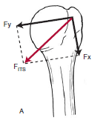

Slide 26
Although the infraspinatus, teres minor, and subscapularis muscles of the rotator cuff are important GH joint compressors, equally critical is the inferior (caudal) translatory pull of the muscles.
The sum of the three negative (inferior) translatory components of these three muscles nearly offsets the superior translatory force of the deltoid muscle.

Slide 27
The teres minor and infraspinatus muscles, in addition to their stabilizing role, contribute to abduction by providing the external rotation of the humerus to help clear the greater tubercle from beneath the acromion.

Slide 28
The Supraspinatus and Glenohumeral Stabilization
The action line of the supraspinatus muscle unlike the action lines of the other three rotator cuff muscles, has a superior (cephalad) translatory component.
Given its line of pull, the supraspinatus is not able to offset the upward dislocating action of the deltoid.

Slide 29
The supraspinatus has a large enough moment arm (MA) that it is capable of independently producing a full or nearly full range of GH joint abduction while simultaneously stabilizing the joint.
With a concentric contraction of the supraspinatus, the proportionally small superiorly directly translatory force is offset by the inferiorly directed force of gravity, which results in linear equilibrium but effective rotation.

Slide 30
So the resultant of the gravitational and supraspinatus forces contributes to an inferior gliding of the humeral head surface during abduction of the arm, allowing full articulation of the joint surfaces andpreventing abnormal superior displacement.

Slide 31
The rhomboid major and minor muscles (downward rotators) are active in elevation of the arm, especially in abduction.
These muscles serve a critical function as stabilizing synergists to the muscles that upwardly rotate the scapula.

Slide 32
The middle trapezius muscle is also active during elevation (especially abduction) and may contribute to upward rotation of th scapula early in the ROM.
The serratus anterior and trapezius muscles are prime movers for upward rotation of the scapula. These two muscles are also synergists for the deltoid during abduction at the GH joint.

Slide 33
Even though symptoms may be “chronic” in terms of long standing or recurring, if there is inflammation the initial treatment priority is to get the inflammation under control.

Slide 34
Management: Protection Phase
1. Control Inflammation and Promote Healing:
Modalities and low-intensity cross-fiber massage are applied to the site of the lesion. While applying the modalities, position the extremity to maximally expose the involved region.
Support the arm in a sling for rest.

Slide 35
2. Patient Education: The environment and habits that provoke the symptoms must be modified or avoided completely during this stage.
The patient should be informed about the mechanics of the irritation and given guidelines for anticipated recovery with compliance.

Slide 36
3. Maintain Integrity and Mobility of the Soft Tissues:
Passive, active-assistive, or self-assisted ROM is initiated in pain-free ranges.
Multiple-angle muscle setting and protected stabilization exercises are initiated. Of particular importance in the shoulder is to stimulate the stabilizing function of the rotator cuff, biceps brachii, and scapular muscles at an intensity tolerated by the patient.

Slide 37
Precautions
It is important to use caution with exercises during this stage to avoid the impingement positions.
Often the mid-range of abduction, scaption with internal rotation, or an end-range position when the involved muscle is on a stretch (such as putting the hand behind the back) provokes a painful response.

Slide 38
4. Control Pain and Maintain Joint Integrity:
Pendulum exercises without weights can be used to cause pain-inhibiting grade II joint distraction and oscillation motions.

Slide 39
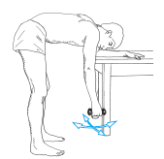

Slide 40
5. Ultrasound: The presence or absence of a calcific deposit, as demonstrated by radiographs, should not affect the treatment plan.
Resolution of inflammatory exudates.
Increased blood flow to assist the healing process.
May provide some pain relief, although persistent pain is usually not a problem

Slide 41
6. Instruction in appropriate use of the arm:
Strict avoidance of activities that may cause impingement or tension stress at the site of involvement

Slide 42
Management: Controlled Motion Phase
The main emphasis becomes use of the involved region with progressive, non-destructive movement and proper mechanics while the tissues heal.
If there is a functional laxity in the joint, the intervention is directed toward developing strength in the stabilizing muscles of both the scapula and glenohumeral joint.

Slide 43
1. Patient Education:
Patient adherence with the program and avoidance of irritating the healing tissues are necessary.
2. Develop a Strong, Mobile Scar:
cross-fiber or friction massage are used.
The technique is applied to the tolerance of the patient.

Slide 44
3. Develop Balance in Length and Strength of Shoulder Girdle Muscles:
Typical interventions in the shoulder girdle include but are not limited to:
Stretch shortened muscles. Shortened muscles typically include the pectoralis major, pectoralis minor, latissimus dorsi and teres major, subscapularis, and levator scapulae.

Slide 45
Strengthen and train the scapular stabilizers:
Scapular stabilizers typically include the serratus anterior and lower trapezius for posterior tipping and upward rotation and the middle trapezius and rhomboids for scapular retraction.
Strengthen and train the rotator cuff muscles, especially the shoulder lateral rotators.

Slide 46
4. Develop Muscular Stabilization and Endurance:
a. Alternating isometric resistance is applied to the scapular muscles in open-chain positions (side-lying, sitting, supine), including protraction/retraction, elevation/ depression, and upward/downward rotation.
So the patient learns to stabilize the scapula against the outside forces.

Slide 47
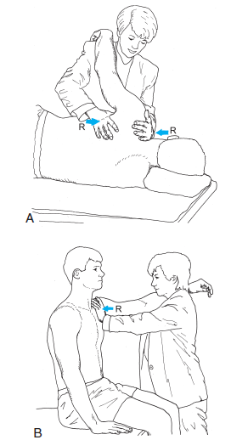

Slide 48
b. Scapular and glenohumeral patterns are combined using flexion, abduction, and rotation.
Alternating isometric resistance is applied to the humerus while the patient holds against the changing directions of the resistance force.

Slide 49
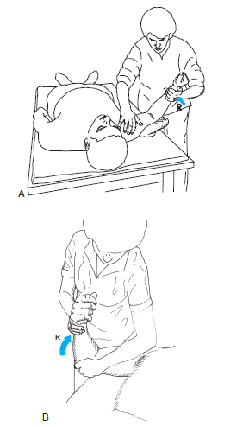

Slide 50
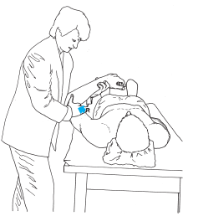

Slide 51
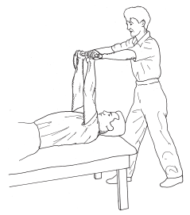

Slide 52
c. Closed-chain stabilization is performed with the patient’s hands fixated against a wall, a table, or the floor (quadruped position) while the therapist provides a graded, alternating isometric resistance or rhythmic stabilization.
Observe for abnormal scapular winging.
If it occurs, the scapular stabilizers are not strong enough for the demand; so the position should be changed to reduce the amount of body weight.

Slide 53
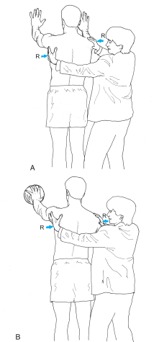

Slide 54
Muscular endurance is progressed by increasing the amount of time the individual holds the pattern against the alternating resistance.
The limit is reached when any one of the muscles in the pattern can no longer maintain the desired hold.
The goal at this phase should be stabilization for approximately 3 minutes.

Slide 55
6. Progress Shoulder Function: As the patient develops strength in the weakened muscles, it becomes important to develop a balance in strength of all shoulder and scapular muscles.
To increase coordination between scapular and arm motions, dynamically load the upper extremity within tolerance of the synergy with submaximal resistance.
To improve muscular endurance, have the patient increase control from 1 minute to 3 minutes.

Slide 56
Management: Return to Function Phase
Specificity of training toward the desired functional outcome begins as soon as the patient has developed control of posture and the basic components of the desired activities without exacerbating the symptoms.

Slide 57
Increase Muscular Endurance: To increase muscular endurance, repetitive loading of the defined patterns is increased from 3 minutes to 5 minutes.
Develop Quick Motor Responses to Imposed Stresses:
The stabilization exercises are applied with increased speed.
Plyometric training in both open-chain and closed-chain patterns is initiated if power is a desired outcome.

Slide 58
3. Progress Functional Training:
Specificity of training progresses to an emphasis on timing and sequencing of events.
Eccentric training is progressed to maximum load.
Desired functional activities are simulated—first under controlled conditions, then under progressively challenged situations using acceleration/deceleration drills.

Slide 59
The patient is involved in assessing performance in terms of safety, symptom provocation, postural control, and ease of execution and then practices adaptations to correct any problems.

Slide 60
Evidence based practice
Progressive resistance training in patients with shoulder impingement syndrome: A randomized controlled trial

Slide 61
P | Shoulder impingement syndrome patients
I | Progressive resistance training
C | No treatment
O | VAS Disabilities of the Arm, Shoulder, and Hand (DASH) questionnaire Brazilian version of the Short Form 36 (SF-36) Cybex 6000 isokinetic dynamometer

Slide 62
JOURNAL AUTHORS | STUDY DESIGN LEVEL OF EVIDENCE | AIMS | METHODOLOGY | CONCLUSION
Arthritis Care & Research 2008 | RCT LEVEL: 1b | To assess pain, function, quality of life, and muscle strength in patients with shoulder impingement syndrome who participated in muscle strengthening exercises. | A total of 60 patients diagnosed with shoulder impingement syndrome were selected randomly into experimental and control groups. Patients then participated in the progressive resistance training program for the musculature of the shoulder, which was held twice a week for 2 months, while the control group remained on a waiting list. | The progressive resistance training program for the musculature of the shoulder in patients with shoulder impingement syndrome was effective in reducing pain and improving function and quality of life.

Slide 63
Evidence Based Practice
Electromyographic analysis of the deltoid and rotator cuff muscles in persons with subacromial impingement.

Slide 64
JOURNAL AUTHORS | STUDY DESIGN LEVEL OF EVIDENCE | AIMS | METHODOLOGY | CONCLUSION
Journal Of Shoulder And Elbow Surgery Reddy AS et. Al., | Comparative Study | The purpose of this study was to compare subjects with subacromial impingement and subjects with normal shoulders with respect to muscle activity. | Fifteen subjects in each group were studied by means of fine-wire electromyography. The middle deltoid and rotator cuff muscles were evaluated during isotonic scaption from 30 to 120 degrees. | This study demonstrates that muscle activity in subjects with impingement is most notably decreased in the first arc of motion. Also the inferior force vector (from the infraspinatus and subscapularis) is less functional in subjects with impingement than is the superior compressive vector (from the supraspinatus).

Slide 65
MCQs
1. Which of the following therapeutic measures should be taken to develop a Strong, Mobile Scar
AROM exercises
Cross-fiber or friction massage
PROM exercises
d. Stretching

Slide 66
2. The teres minor and infraspinatus muscles, in addition to their stabilizing role, contribute to abduction by providing ___________ of the humerus.
Internal rotation
External rotation

Slide 67
3. Ultrasound is used for which effect?
Resolution of inflammatory exudates.
Increased blood flow to assist the healing process.
May provide some pain relief, although persistent pain is usually not a problem
All of the above

Slide 68
4. ___________GH subluxation is commonly encountered in patients with diminished rotator cuff function caused by stroke or other brain injury.
Superior
Inferior

Slide 69
5.

Slide 70
Mobilization exercises
Pendulum exercises
Stretching exercises
Progressive resisted exercises

