Slide 1
SNAKES
- Dr Sunil Doshi

Slide 2
World :3500/250
India :330/70
Snake bite :2,00,000
Death :10,000 – 15,000

Slide 3
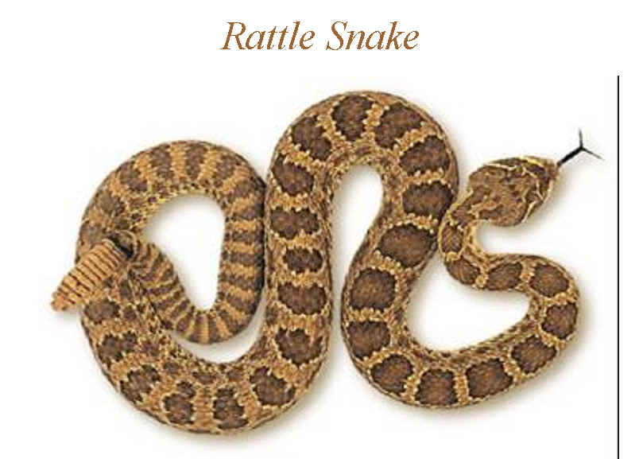
Classification:
Crotalidae : e.g., Rattle snakes.

Slide 4
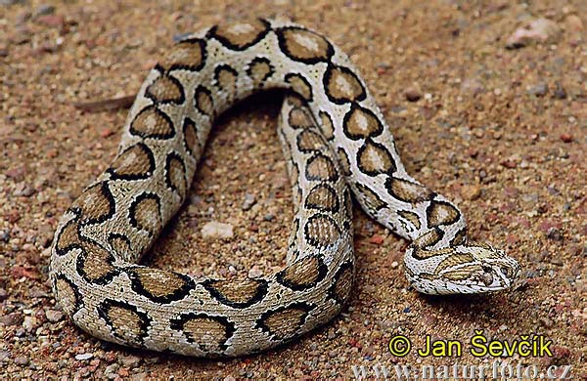
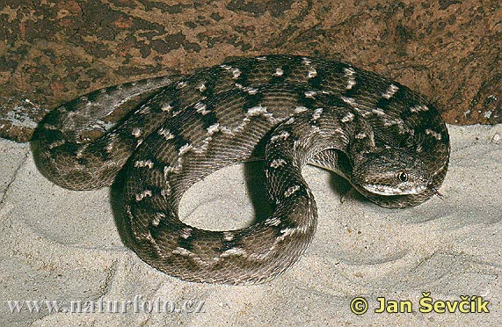
2. Viperidae : e.g., Russell’s viper, saw scale viper.

Slide 5
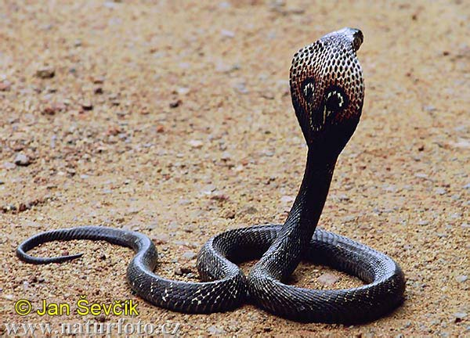
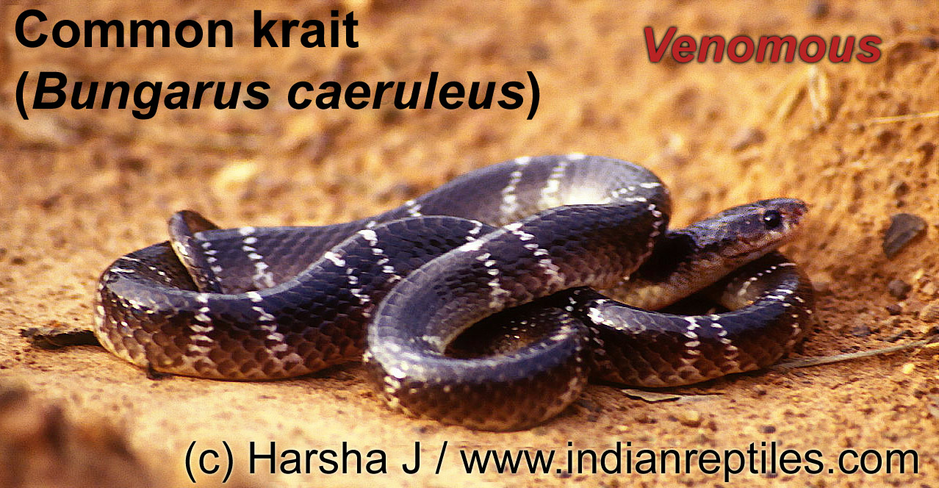
3. Elapidae : e.g., Cobra, krait.

Slide 6
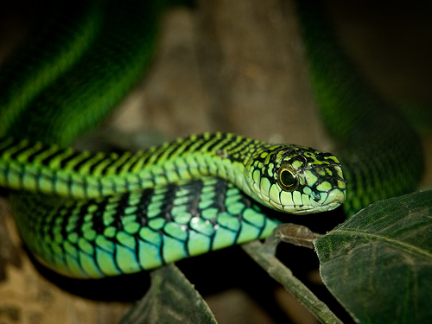
4. Colubridae: e.g., boom slang.

Slide 7
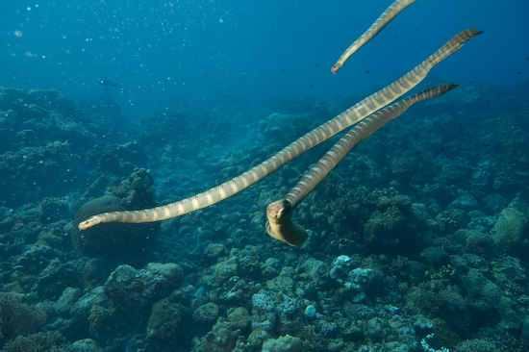
5. Hydrophidae: Sea snakes.

Slide 8
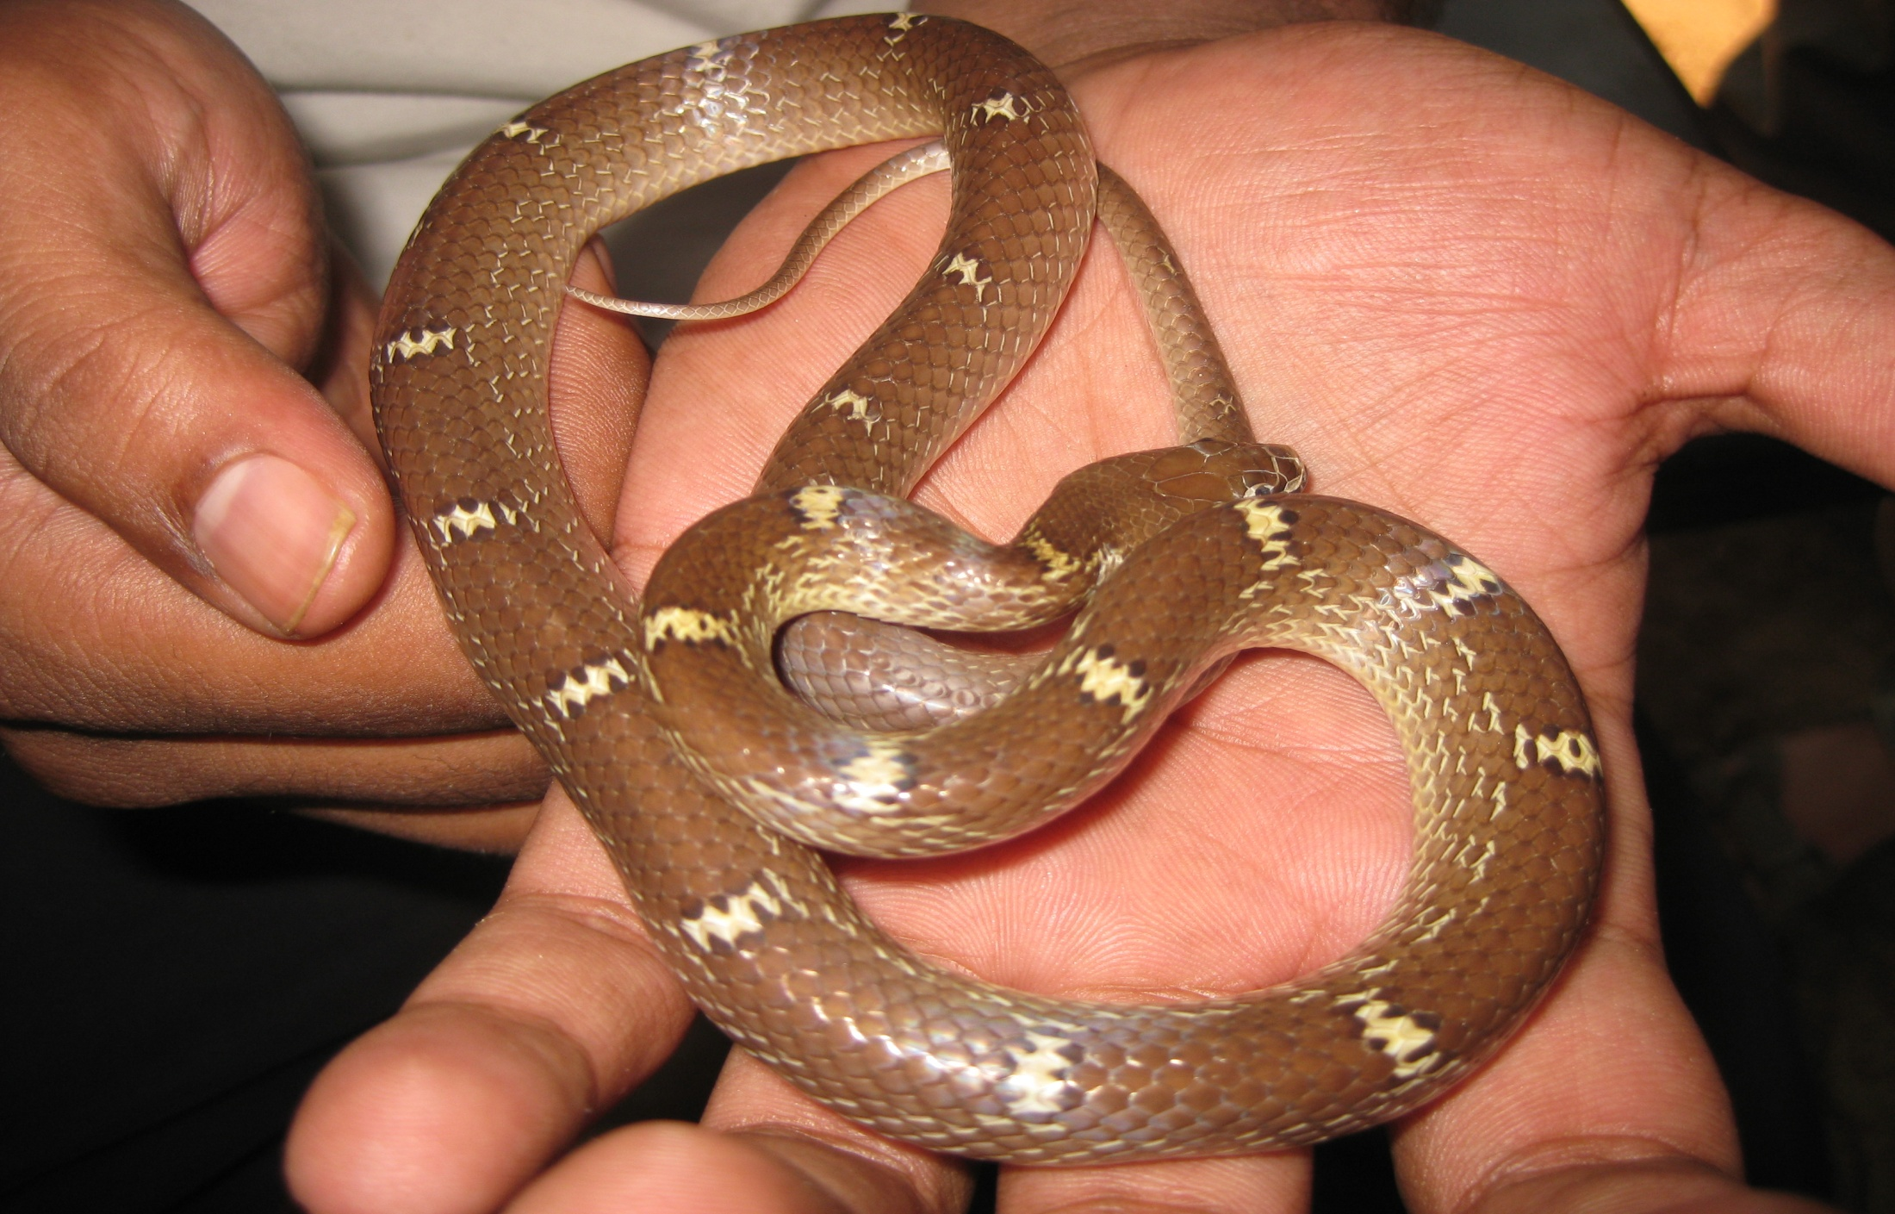
Non poisonous snakes:

Slide 9
Difference b/w poisonous & non poisonous snakes:

Slide 10
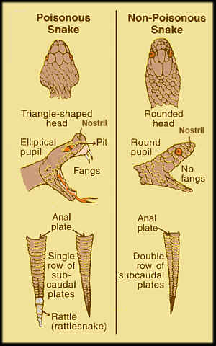

Slide 11
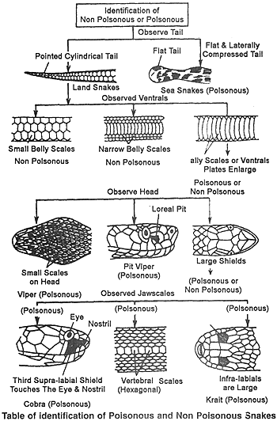

Slide 12
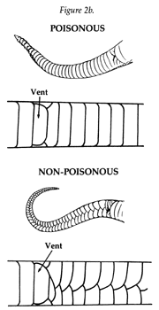

Slide 13
Which snake poisons are dangerous to mankind?
Common poisonous snake in India?

Slide 14
COBRA:
Scientific name: Naja naja.
Habitat.
Life span: 5 – 25 years.
Venom: Neurotoxic.

Slide 16
KRAIT:
Scientific name: Bungarus caeruleus.
Habitat.
Life span: 5 – 10 years.
Venom: neurotoxic.

Slide 18
RUSSELL’S & SAW-SCALED VIPER:
Scientific name:
Vipera russelli (russell’s) & Echis carinatus (saw-scaled).
Habitat.
Life span: 2 – 5 years.
Venom: Haemotoxic.

Slide 21
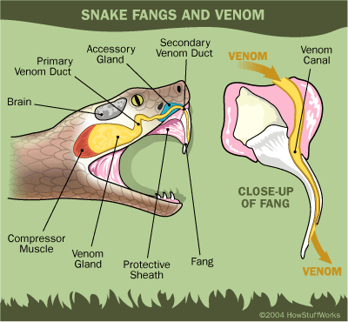

Slide 22
Snake venom:
Enzymatic: Phospholipidase A, proteases, hyaluronidase. (Local & systemic).
Non-enzymatic: Peptides and polypeptides (lethal).
Haemorrhagins
Cardiotoxin
Neurotoxin

Slide 23
SIGNS AND SYMPTOMS:
Ophitoxaemia.
Bites:
Non-venomous (mostly).
20-50% of venomous snake bite is nontoxic.

Slide 24
Common symptom:
Fright.

Slide 25
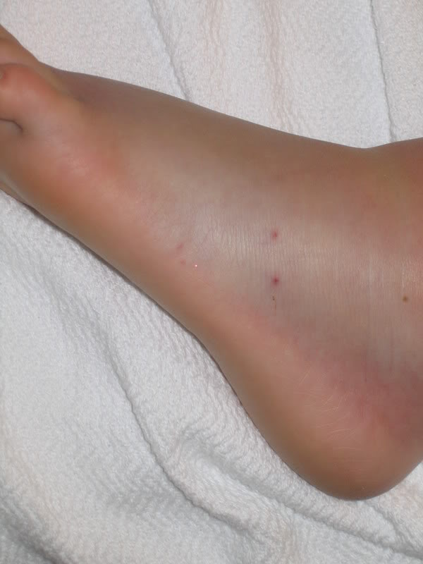
COBRA:
Local: 6 to 8 mins.

Slide 26
Systemic: 15 – 30 mins.
Nausea & vomiting (early).
Weakness & paralysis of limbs.
Ptosis.
Dysathria and dysphagia.
Respiratory arrest.
Convulsions.
Coma and death.

Slide 27
KRAIT:

Slide 28
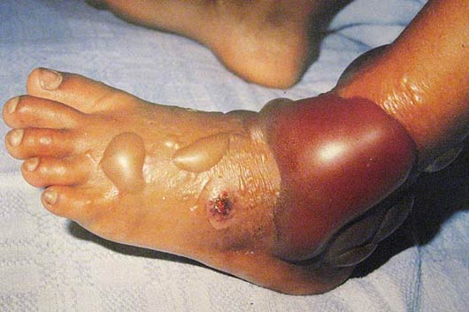
VIPER:
Local: 8 mins.

Slide 29
Systemic:
Persistent bleeding from bite site.
Decrease in RBC & Platelets.
Urine: blood, sugar and protein.
Prolonged bleeding and clotting time.
Intravascular haemolysis: haemoglobinuria & renal failure.
Death: shock & haemorrhage.

Slide 30
FATAL DOSE:
Cobra: 12 mg.
Russell’s viper: 15 mg.
Saw-scaled viper: 8 mg.
Krait: 6 mg.

Slide 31
FATAL PERIOD:
Cobra: ½ to 6 hours.
Viper: 1 to 3 days.
Krait: 24 hours.

Slide 32
DIAGNOSIS:
1. Fang marks.
2. Identification of snake.
Laboratory Investigations:
Hematological.
ECG.
Metabolic.
Urine analysis.
Chest x-ray.
Immunodiagnosis: ELISA.

Slide 33
FIRST AID:
Verbal assurance.
Immobilization.
Broad firm bandage:
Sutherland wrap.
Tourniquet.
Clean the wound.
Incision and suction.

Slide 34
g) Cryotheraphy.
h) Drugs: e.g., paracetamol.

Slide 35
POLYVALENT ANTISNAKE VENOM:
Prepared in India:
Haffkine Institute, Mumbai.
King Institute, Chennai.
Serum Institute, Pune.
Central Research Institute, Kasauli.

Slide 36
PREPARATION:
Hyperimmunisation of horse with snake venom.
Serum lyophilised by drying.

Slide 37
TREATMENT:
Reid’s criteria:
Prolonged hypotension.
Persistent shock.
Pronounced leucocytosis.
ECG changes.
Protracted GI symptoms.

Slide 38
Acidosis.
Raised CPK.
Cellulitis.
Haemolysis.
Pregnant women.
Small children.

Slide 39
1. PSV Administration:
0.2-0.3 ml of 1:10 intradermally.
Dose:
I. Minimal: Local swelling but no systemic manifestation.
Dose: 5 vials.
II. Moderate: Swelling progressive with systemic reaction.
Dose: 10 vials.

Slide 40
III. Severe: Marked local reaction with severe symptoms
Dose: 15 vials.

Slide 41
2. Clean bite site
3. Leave blisters alone.
4. Antibiotics: penicillin or erythromycin.
5. Intra compartmental syndrome.
6. Coagulation abnormalities: FFP, Cryoprecipitate, platelets, whole blood.

Slide 42
7. Hypotensive shock: Dopamine.
8. Renal failure: dialysis.
9. Neurotoxicity: Neostigmine.
10. Respiratory support.

Slide 43
PREVENTION OF SNAKE BITE:

Slide 44
POST-MORTEM APPEARANCES:
Bite marks.
Hemorrhagic spots in bowel, pericardium, lungs.
Internal organs are congested.

Slide 45
MLI:
Accidental.
Homicide.
Cattle poison.
Suicide.

Slide 46
J Occup Med Toxicol. 2010 Mar 25;8(1):7. doi: 10.1186/1745-6673-8-7
Rao CP, Shivappa P, Mothi VR Cohort Level 3 | Fatal snake bites - sociodemography, latency pattern of injuries | 60 fatal snakebite cases were studied retrospectively for 5 years with an objective to know the socio-demography, latency and pattern of injuries in rural Southern India | Most of the victims were males, in the age group of 31-50 years and were at risk of snake bites while farming. Large sample of subjects approached traditional therapists and were deprived of essential care in the critical first few hours after snake bite. Fang marks (90%), local ecchymoses (50%) and internal hemorrhage (28.3%), were the frequent demonstrable signs appreciated at autopsy

Slide 47
THANK YOU

