Slide 1
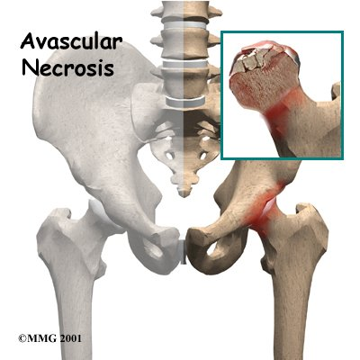
PERTHE’S DISEASE
By: Purvi Patel

Slide 2
Legg-calve-perthes
It is a transient ischemic necrosis of the capital femoral epiphysis.
Occurs in children between age of 2 to 12 yrs, mainly between 4 to 8 yrs
Boys > Girls, 4 times
Etiology unknown

Slide 3
PATHOLOGY
Recurrent episodes of ischemia
Disease progresses in 3-ill stages:
1.Stage of synovitis
2.Stage of trabecular necrosis
3. Stage of healing

Slide 4
Avascular necrosis
Temporary cessation of growth
Of epiphysis
Revascularization from periphery
Resumption of ossification
Potential Perthes

Slide 5
Pathological fracture
Resorption of underlying bone
Replacement by biologically Plastic bone
Subluxation
Deformity
True Perthes

Slide 6
CLINICAL PRESENTATION
Limp may or may not be associated with pain in the groin and inner thigh.
Pain may be referred to the distal thigh and knee
Muscle spasm
Shorten or deformed limb

Slide 7
TREATMENT
Self limiting condition
Prognosis depends on :
1.Age of onset
2.The amount of femoral head involved
To minimize the deformity during active stage of disease
Plaster, splint, containment osteotomy
Rest with or without traction

Slide 8
SURGICAL TREATMENT
Proximal femoral varus derotation osteotomy
Salter pelvic osteotomy

Slide 9
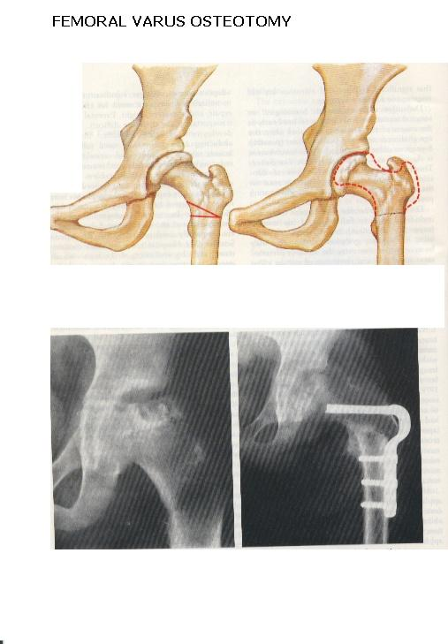

Slide 10
Physiotherapy management
Measures to control pain, inflammation and muscle spasm
Cryotherapy
Thermotherapy
Measures to strengthen the muscles
Isometrics to gluteal, quadriceps, hamstring
Active, active assisted, resistive exercise to all L.L. muscles

Slide 11
Measures to improve movements
Passive ROM exercises to hip joint
Active assisted and active ROM exercise to all joints
Measures to prevent contractures
Repeated prone lying position
Repeated slow passive stretching
Measures for ambulation
Non-weight bearing standing and walking initially in parallel bar. Later with walker and axillary crutches

Slide 12
Walking by bearing weight
Initially with designed brace and splints.
Scottish -Rite brace
Petric cast
Maintains position of flexion, abduction and internal rotation
After removal of brace/splint, gait training

Slide 13
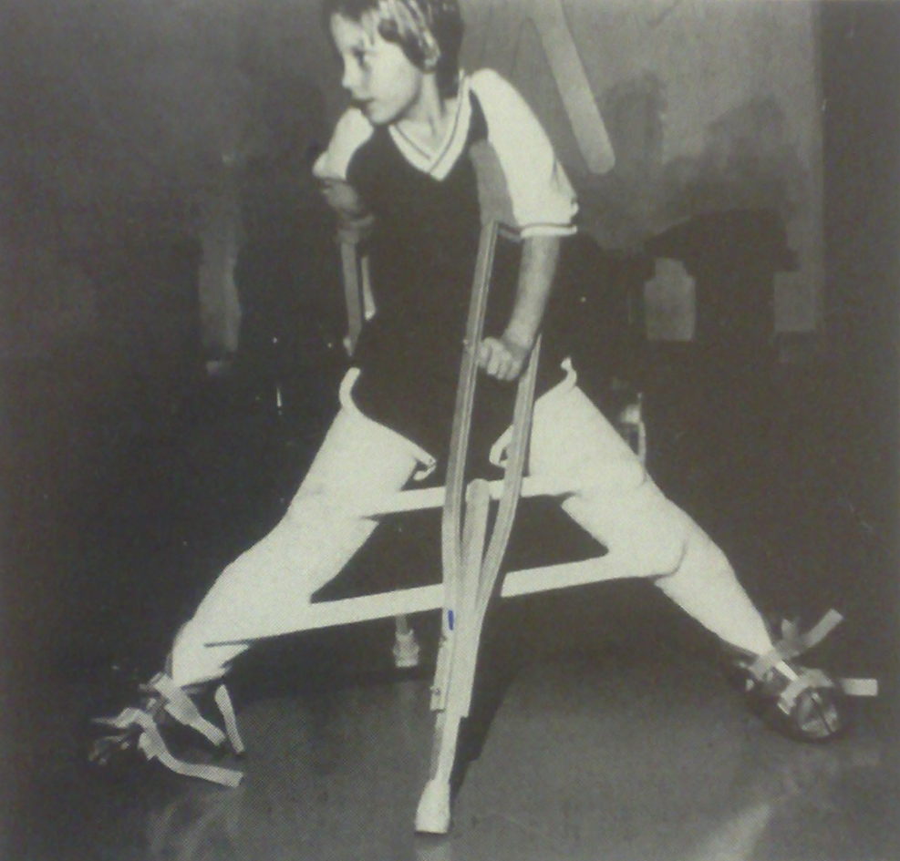
Petrie cast

Slide 14
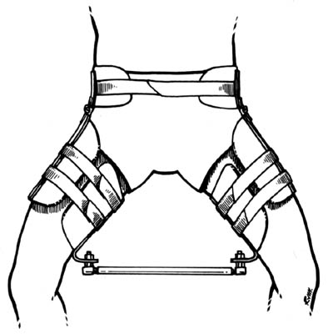
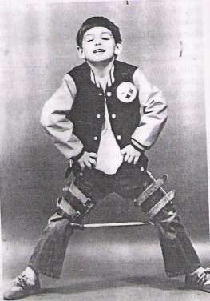
Treatment (Orthosis)
Atlanta Scotish Rite Brace

Slide 15
POST OPERATIVE TREATMENT
Post operative routine care
Weight bearing delayed atleast 6 weeks
Maintain the pre -operative range of movement and muscle strength
Once the plaster is removed vigorous physiotherapy is required to regain hip and knee joint range prior to weight bearing
CPM after removal of cast
Gait training

