Slide 1
Cardiac Rehabilitation
By, Kalpesh Satani

Slide 2
Objectives
What is CR?
Phases of CR
Exercise protocols
Difference in protocol in each phase

Slide 3
Cardiac rehabilitation is a medically-supervised program consisting of exercise training, education on heart-healthy living, counseling to reduce stress, and helping patients return to an active lifestyle and recover sooner. (AHA)

Slide 4
Phase -1 - ICU - max. protection phase
Phase -2 - In pt. program
Phase -3 - Home program
Phase -4 - Community program

Slide 5
Phase I begins on first day of admission and ends with discharge for patients undergoing invasive procedures or suffering from acute events.
Phase I programs should form a foundation for subsequent cardiac rehabilitation programs.

Slide 6
Objectives or goals
To assist the pt. in becoming ambulatory.
To prepare the pt. family & others for a healthy life-style.
To reduce psychological and emotional disorders.
To facilitate adjustment to hospital environment & to the acute event.
To begin to identify and modify CAD risk factors.
To create a positive attitude that will motivate the pts to make a long term commitment to healthier life-style.

Slide 7
Personnel
Physician
Cardiac therapist
Cardiac rehab nurse
Psychologist / psychiatrist
Nutritionist
Counselor

Slide 8
C A N D I D A T E S F O R I M M E D I A T E O U T P A T I E N T P R O G R A M S
Patients with coronary artery disease
Post-myocardial infarction
Post-coronary arterial bypass graft surgery
Post-coronary angioplasty/stents
Symptomatic ischemia (angina)
Silent ischemia (ST-segment depression on graded exercise test without angina)

Slide 9
Patients with other heart conditions
Compensated heart failure
Controlled dysrhythmias
Automatic implanted cardioverter-defibrillator or pacemaker
Post–valve replacement
Cardiomyopathy
Myocardial aneurysm resection
Heart transplant (pre- and post-)
Congenital heart defects

Slide 10
Patients with risk factors for cardiovascular disease
Hypertension
Dyslipidemia
Smoking
Diabetes
Obesity
Sedentary lifestyle
Strong positive family history for cardiovascular disease
Post-menopausal women without hormone replacement therapy

Slide 11
Conduct of the program
When to start
Start according to physicians
Usually (24-48hours) after the acute event
Ex program
Low level exercise program
exercise testing

Slide 12
Low level exercise testing
Possible end points
20-30 beats/min above resting HR
A max HR of 120-140
70-75% of age estimated MHR
For pts on b-blockers, RPE of hard may be suggested as end-points
Testing from 3-days to 3-weeks after an event
Pts who respond well to early ex testing & in whom CI of exercise do not appear are good candidates for continuation of physical therapy at home or supervised phase-2 program

Slide 13
Pts who respond poorly to early ex testing will need to be assessed thoroughly & progress cautiously
Prior to ex, pt. is evaluated for
Pulse
BP
ECG
Muscular and joint limitation
Dizziness
General appearance
Any associated symptoms

Slide 14
Exercise program

Slide 15
Absolute CI to exercise training
A recent significant change in the resting ECG suggesting infarction or other acute cardiac event
Recent complicated myocardial infarction (unless participant is stable and pain-free)
Unstable angina
Heart failure- acute and decompensated
Uncontrolled ventricular arrhythmia
Uncontrolled atrial arrhythmia that compromises cardiac function
Third-degree AV heart block without pacemaker

Slide 16
Acute congestive heart failure
Severe aortic stenosis
Suspected or known dissecting aneurysm
Active or suspected myocarditis or pericarditis
Thrombophlebitis or intracardiac thrombi
Recent systemic or pulmonary embolus
Acute infections
Significant emotional distress (psychosis)

Slide 17
Relative CI to exercise training
Resting DBP>115 mm Hg or resting SBP>200 mm Hg
Moderate valvular heart disease
Known electrolyte abnormalities (e.g., hypokalemia, hypomagnesaemia)
Pacer-dependent, fixed-rate pacemaker
Exercise-induced ventricular tachycardia
Ventricular aneurysm
Uncontrolled metabolic disease (e.g., diabetes, thyrotoxicosis, myxedema)

Slide 18
Chronic infectious disease (e.g., mononucleosis, hepatitis, AIDS)
Neuromuscular, musculoskeletal or rheumatoid disorders that are exacerbated by exercise
Advanced or complicated pregnancy
Cognitive impairment relative to safety issues
Congenital heart disease with fixed cardiac output (or cyanotic)
Resting ST-segment depression (>3 mm)

Slide 19
Benefits of phase-1
The extend of knowledge
Effect of behavioral modification
Reliability and validity of self-administered questionnaire
Readiness of the pt. for intervention & benefits of phase-1

Slide 20
Facilities
Most of the program at bed-side and adjacent corridors & stairs
Special facility in some hospitals
Separate room for individual and group counseling
Sufficient space that accommodate 5-10 persons
Teaching and counseling room should be well lighted, pleasantly decorated & easily accommodate

Slide 21
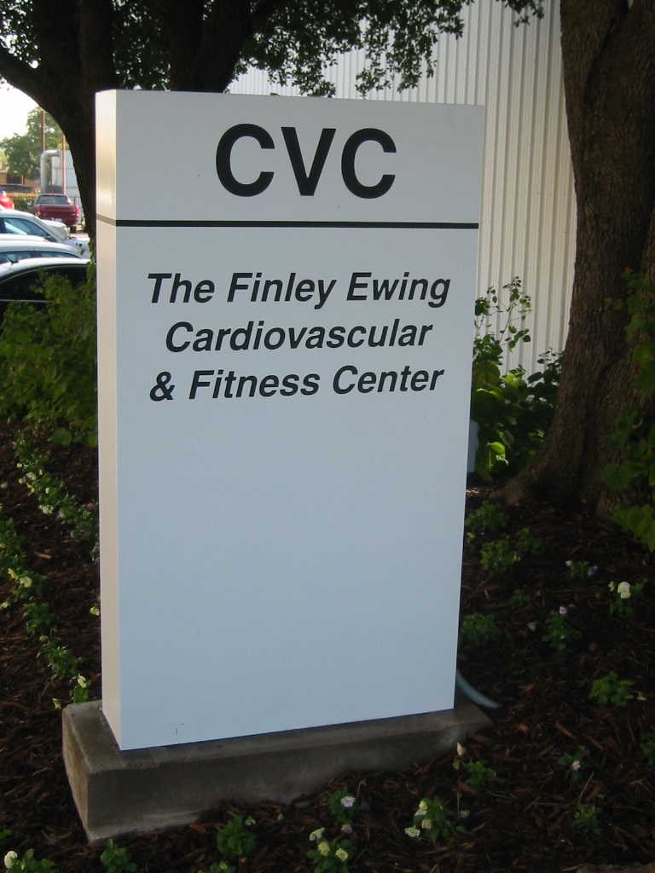
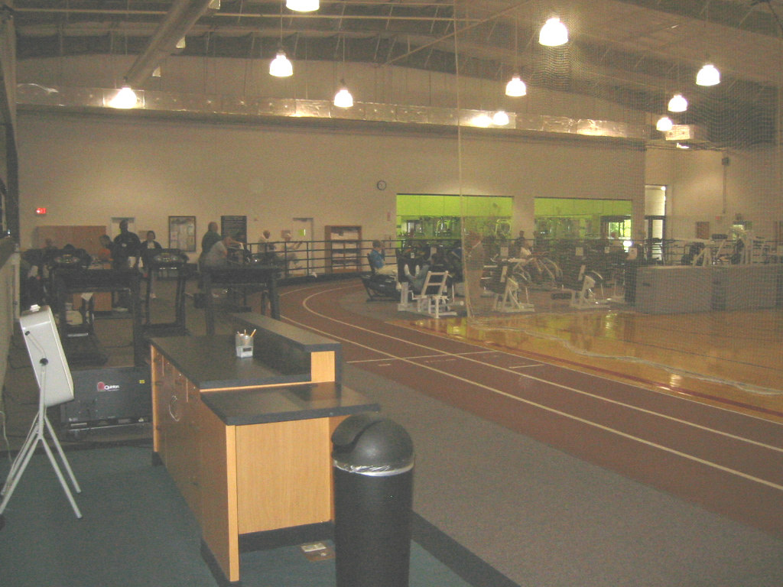
Facility

Slide 22
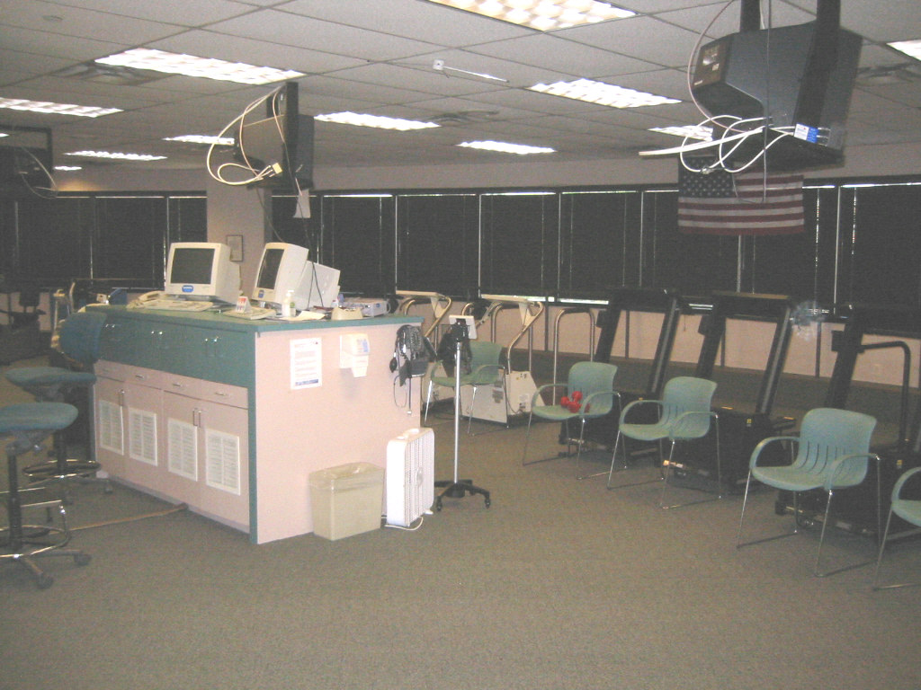
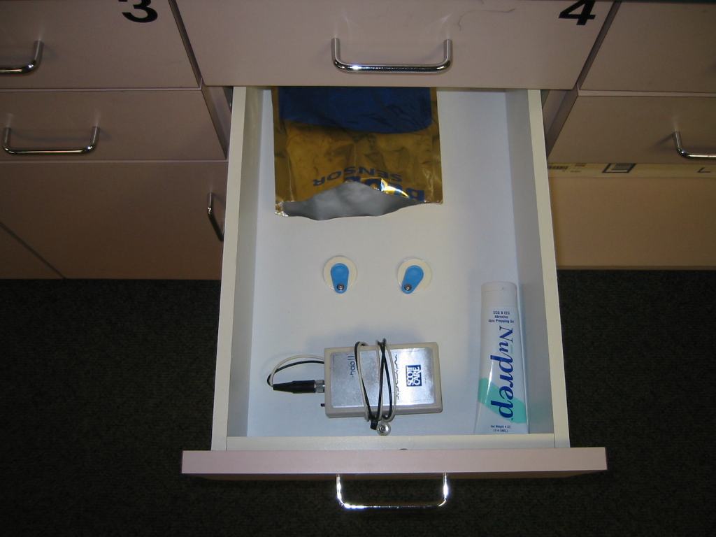
Rehab

Slide 23
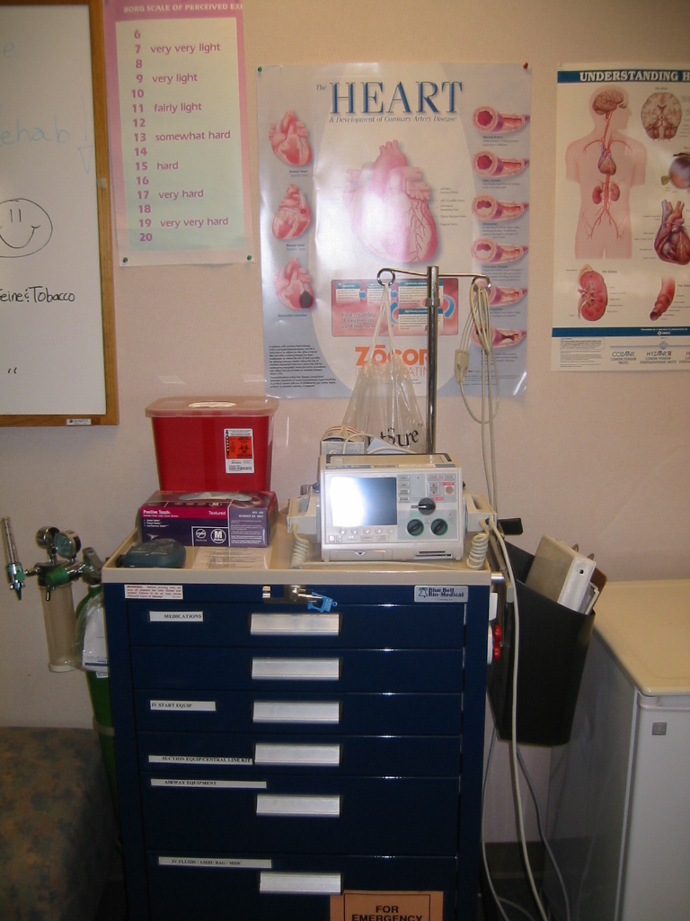
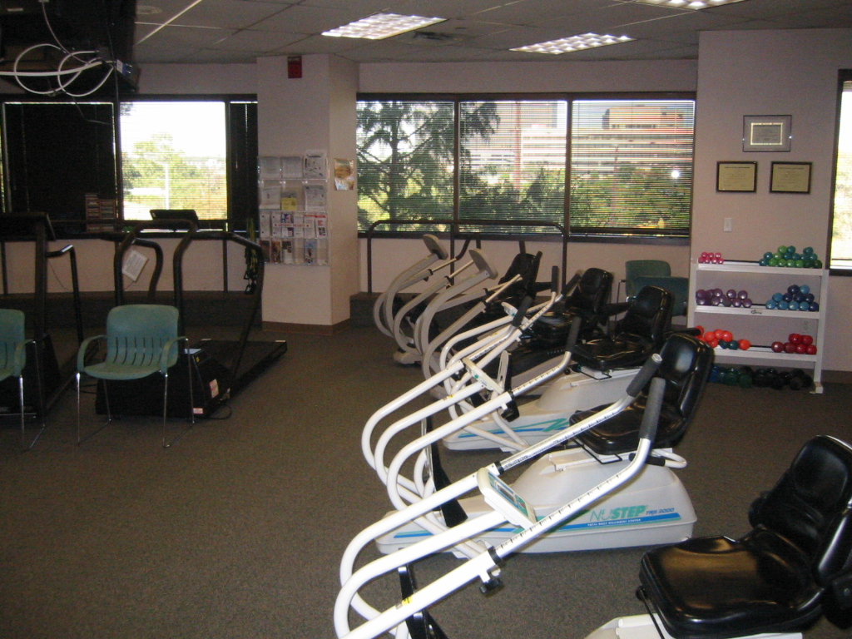

Slide 24
Equipments
Relatively lesser equipments
Light weights (1-2 pounds)
BP apparatus
Stop watch
Small game balls
Audio-visual equipments for education and life-style modification that includes-
    Camera
    Audio-visual tapes and recorder
    Slides
    Flip charts
    Manuals
    Books
    Film slips
    Variety of hand out materials

Slide 25
American Association of Cardiovascular and Pulmonary Rehabilitation (AACVPR) Parameters for Inpatient Cardiac Rehabilitation Daily Ambulation
No new or recurrent chest pain in previous 8 hours
Stable or falling creatine kinase and troponin values
No indication of decompensated heart failure (e.g., resting dyspnea and bibasilar rales)
Normal cardiac rhythm and stable electrocardiogram for previous 8 hours

Slide 26
STEPS | CARDIAC REHABILITATION/ PHYSICAL THERAPY | WARD ACTIVITY | PATIENT EDUCATION
Step 1: 1-1.5 METs | Deep breathing ex, Sitting with feet supported, active assistive to active ROM exercise of major muscle groups, active scapular elevation/depression, protraction/retraction 3-5 reps, deep breathing ex. | Begin sitting in chair(when stable) several times a day for 10-30 min. May ambulate 100-200 ft with assistance, 1-2 times daily. | Orient to Cardiac ICU, reinforce purpose of physical therapy and deep breathing exercise. Orient to exercise component of rehabilitation program. Answer patient and family questions regarding progress.

Slide 27
STEP | CARDIAC REHABILITATION/ PHYSICAL THERAPY | WARD ACTIVITY | PATIENT EDUCATION
Step 2: 1.5 METs | Sitting: repeat exercises from step 1 and increase repetitions to 5-10, deep breathing twice daily, monitored ambulation of 200ft with assistance as tolerated (stress on correct posture) twice daily. | Continue activities from step 1 | As step 1

Slide 28
STEP | CARDIAC REHABILITATION/ PHYSICAL THERAPY | WARD ACTIVITY | PATIENT EDUCATION
Step 3: 1.5-2 METs | Standing: begin active UE and trunk exercise without resistance (shoulder flexion, abduction, internal/external rotation, circumduction backward, hyperextension, elbow flexion, trunk flexion, lateral flexion and rotation, knee extension (if appropriate), ankle exercise; 5-10 reps, twice daily. | Increase ambulation to 300ft or approximately 3 corridor lengths at slow pace with assistance twice daily | Begin pulse –taking instruction when appropriate and explain RPE scale, answer questions of patient and family .

Slide 29
STEP | CARDIAC REHABILITATION/PHYSICAL THERAPY | WARD ACTIVITY | PATIENT EDUCATION
Step 4: 1.5-2 METs | Standing- active exercise as step 3; 10-15 reps, twice daily. Monitored ambulation. | Increase ambulation to 1 lap at slow pace with assistance twice daily

Slide 30
STEP | CARDIAC REHABILITATION/ PHYSICAL THERAPY | WARD ACTIVITY | PATIENT EDUCATION
Step 5 : 1.2-2.5 METs | Active exercise from step 3, 15 repetitions, once daily. monitored ambulation for 5-10 mins. (424-848 ft) as tolerated. Monitored ROM / strengthening exercise from step 3, 15 reps, leg stretching (hamstring and gastrocnemius); treadmill or bicycle 5-10 min. | Increase ambulation up to 3 laps (1,320 ft) daily as tolerated. Begin participating in daily ADL and personal care as tolerated. Encourage chair sitting with legs crossed. | Continue instruction in pulse taking and use of RPE scale. Explain value of exercise.

Slide 31
STEP | CARDIAC REHABILITATION/ PHYSICAL THERAPY | WARD ACTIVITY | PATIENT EDUCATION
Step 6: 1.5-2.5 METs | Standing- active exercise from step 3 with 1-lb weight each UE, 15 repetitions, once daily, leg stretching, treadmill/bicycle 15-20 mins and stair climbing (6-12 stairs) with assistance. | Increase ambulation upto 5 laps (1,980ft) daily. Encourage independence in ADL, encourage chair sitting with legs elevated. | Discuss about discharge instructions to patient and family.

Slide 32
STEP | CARDIAC REHABILITATION/ PHYSICAL THERAPY | WARD ACTIVITY | PATIENT EDUCATION
Step 7: 2-3 METs | Standing: active exercises from step 3 with 0.5 kg weight each UE, 15 repetitions, once daily, leg stretching, treadmill/bicycle 20-30 mins and stair climbing (upto 14 stairs) with assistance. | Continue activities from step 6. Increase ambulation upto 8 laps (3,300ft ) daily | Discuss and initiate referral to phase 2 program if appropriate. Give instruction in home exercise program. Explain pre discharge GXT (Graded exercise test) and upper limit HR

Slide 33
STEP | CARDIAC REHABILITATION/PHYSICAL THERAPY | WARD ACTIVITY | PATIENT EDUCATION
Step 8: 2-3 METs | Standing- Exercise from step 3 with 1 kg weight each UE, 15 reps, once daily. leg stretching, 10 reps , treadmill/bicycle 20-30 mins and stair climbing (up to 16 steps) | Continue activities from step 7 , increase ambulation upto 9 laps (upto 3,746 ft) daily | Reinforce prior teaching

Slide 34
STEP | CARDIAC REHABILITATION/ PHYSICAL THERAPY | WARD ACTIVITY | PATIENT EDUCATION
Step 9: 2-3 METs | Standing- Exercise from step 3 with 1 kg weight each UE,15 reps, once daily, leg stretching, treadmill/bicycle 20-30 mins , stair climbing (upto 18 stairs) | Continue activities from step 8.increase ambulation upto 5060 ft | Finalize discharge instructions. complete referral to phase 2

Slide 35
STEP | CARDIAC REHABILITATION/ PHYSICAL THERAPY | WARD ACTIVITY | PATIENT EDUCATION
Step 10: 2-3 METs | Standing- Exercise with 1.5 kg weight each UE, 15 reps, once daily.leg stretching , treadmill or bicycling 20-30 mins, stair climbing (upto 24 hours). A symptom limited GXT (graded exercise test) is recommended at this time. | Continue activities from step 9.increase ambulation up to 5936 ft daily.

Slide 36
ACSM guidelines to terminate Phase 1 exercise session
Fatigue
Failure of monitoring equipment
Light-headedness , confusion , ataxia , cyanosis , dyspnea , nausea or any peripheral circulatory insufficiency
Onset of angina with exercise
Symptomatic supraventricular tachycardia
ST displacement (3mm) horizontal or downward slopping from rest
Ventricular tachycardia
Exercise induced LBBB

Slide 37
Onset of 2nd or 3rd degree AV block
R on T PVC
Frequent multifocal PVCs(30% of complexes)
Excessive hypotension (>20mm Hg drop in SBP during exercise)
Excessive BP rise (SBP>220 mmHg or DBP >110mmHg)
Inappropriate bradycardia (drop in HR more than 10bpm)with an increase or no change in workload

Slide 38
Conclusion
Phase-1 consists of combination of low-level physical activity & pt. education
The program has been shown to be beneficial although benefits are less documented
Most imp objective is to prepare the pt. for the beginning of a life-time commitment to a healthier life-style

Slide 39
R I S K S T R A T I F I C A T I O N
Risk stratification by a physician is mandatory upon program entry to adequately match the participant with the level and type of exercise program (including level of cardiac monitoring available). Participants should be stratified into low, intermediate, or high risk as early as possible following hospitalization or upon intake assessment. Risk status is related to the type and pathophysiological severity of cardiovascular disease, especially the degree of left ventricular dysfunction, exercise-induced myocardial ischemia manifested as ST-segment depression, angina pectoris, and a history of malignant cardiac dysrhythmias. Phase II programs should accept low- to high-risk patients upon discretion of the medical director.

Slide 40
Phase-2
I M M E D I A T E
O U T P A T I E N T
P R O G R A M S
Pt. education
+
life-style modification

Slide 41
Supervised out-pt. program of individually prescribed ex with continuous or intermittent ECG monitoring
May be operated at hospital or free standing
Ex program is based on individual prescription of intensity, duration, frequency & mode of training.

Slide 42
Pt. education and life-style modification are the integral parts of phase-2

Slide 43
Objectives
To enhance CVS function.
To enhance physical work capacity, strength, endurance & flexibility.
To detect arrhythmia's & other ECG changes during exercises.
To educate the pt. about proper technique of ex.
To prepare the pt. for a return to work & familial & social role.
To provide pts with guidelines for long term exercises.

Slide 44
Eligibility
Documented MI
CABG or angioplasty
Heart transplantation surgeries.
Valvular & congenital heart disease surgeries
Stable angina pectoris

Slide 45
I N T A K E A S S E S S M E N T
Physician assessment
Referral prior to participation in an immediate outpatient program.
This includes a health history with presenting and past medical history (including pertinent medical records),
Physical examination
Medication review
The intake assessment should use a multidisciplinary team approach with appropriate case management throughout

Slide 46
Laboratory test results
The following laboratory test results should be included with the records:
Symptom-limited graded exercise stress test
Lipid profile (taken pre-cardiac event or taken two to three months post-event), which includes total cholesterol, HDL, LDL, and triglycerides
Glycosylated hemoglobin (Hb a1c)

Slide 47
Positive risk factors
A risk-factor review should note positive risk factors
Men >45 years of age
Women >55 years of age or who exhibit premature menopause without hormone replacement therapy
Personal and/or family history of cardiovascular disease
Cigarette smoking
Blood pressure >140/90 mm Hg, confirmed by measurements on at least two separate occasions, or participant on antihypertensive medication
Dyslipidemia
Diabetes mellitus
Sedentary lifestyle
Obesity

Slide 48
Nutritional assessment
Weight history
Assessment of eating habits, food preparation methods, food choices, and nutritional knowledge
Twenty-four hour recall or three-day food record
Recommendations for dietary modification

Slide 49
Medication review
List of medications, including dosages and schedule
Participant’s compliance to medication
Participant’s knowledge base about the medications being taken
Side effects of medications

Slide 50
Psychosocial and educational needs
Understanding of illness and implications for lifestyle change
Verbalization of learning needs in relation to risk modification and treatment
Assessment of the impact of heart disease and associated lifestyle changes on the family
Assessment of coping responses, both positive and adverse, using selected indices as appropriate

Slide 51
Participant’s goals and objectives
By the end of the intake assessment, participants should identify their specific goals and acknowledge their commitment to them as the start of an ongoing process for their recovery.
Both short- and long-term goals may be identified, along with benchmarks, or objectives, that can be used to assess the participant’s progress.

Slide 52
Low-risk patients
No significant left ventricular dysfunction (ejection fraction >50%)
No resting or exercise-induced myocardial ischemia manifested as angina and/or
ST-segment depression
No resting or exercise-induced complex arrhythmia’s
Uncomplicated myocardial infarction, coronary artery bypass surgery, angioplasty, or atherectomy
Functional capacity > 6 metabolic equivalents (METs) on graded exercise test three or more weeks after clinical event

Slide 53
Intermediate-risk patients
Mild to moderately depressed left ventricular function (ejection fraction
31% – 49%)
• Functional capacity <5–6 METs on graded exercise test three or more weeks after clinical event
• Failure to comply with exercise-intensity prescription
• Exercise-induced myocardial ischemia (1–2 mm ST-segment depression) or reversible ischemic defects (echocardiographic or nuclear radiography)

Slide 54
High-risk patients
Severely depressed left ventricular function (EF < 30%)
Complex ventricular arrhythmia’s at rest or appearing or increasing with exercise
Decrease in SBP of >15 mm Hg during exercise or failure to rise with increasing exercise workloads
Survivor of sudden cardiac death
Myocardial infarction complicated by congestive heart failure, cardiogenic shock, and/or complex ventricular arrhythmia’s
Severe coronary artery disease and marked exercise-induced myocardial ischemia (>2 mm ST-segment depression)

Slide 55
E X E R C I S E
P R E S C R I P T I O N

Slide 56
Instructions before exercise
Do not eat heavy meal at least b4 2 hours
Alcohol should not be consumed
Do not drink beverages at least b4 2 hours
Do not smoke at least b4 1 hours
Wear comfortable clothing
If any unaccustomed symptoms of pain, discomfort or soreness let the nurse know
Try to arrive 10-15 min. prior to schedule time
Inform the nurse about any change in medication

Slide 57
The focus of phase-2 Cardiac Rehabilitation is a regular aerobic exercise that is designed primarily to improve muscular endurance and CV fitness.

Slide 58
Principles for setting the exercise prescription
The exercise prescription should be based on medical history and the findings of physical examination, risk factors, and recent stress test results.
It should be reviewed after myocardial infarction, coronary artery bypass graft (CABG) surgery, stenting, or angioplasty, after medication adjustment for malignant dysrhythmias, or after new onset of symptoms.
It should be adjusted for additional medical reasons such as orthopedic, neurological, metabolic, or pulmonary conditions.

Slide 59
It should be adjusted following medication changes, if appropriate.
It should be adjusted, as needed, based on ongoing evaluation by staff and self- evaluation by participant.
It should be adjusted, as needed, following an annual stress test or after any stress test that may be required to assess new cardiac problems

Slide 60
Warm-up
To prepare the CVS
To prepare the skeletal muscle for the activity
The higher the temperature increases, the performance increases
Increase temp. in the muscle causes reduction in viscosity of the muscle secondary to increase in nerve conduction impulse
To prevent muscle soreness

Slide 61
Conditioning phase
Exercise prescription: FITT principal
F Frequency
I Intensity
T Time
T Type of exercise

Slide 62
Intensity of ex
Vigorous activities can produce adverse events
Low-to-moderate intensity ex training is beneficial
Can produce beneficial changes in
    Functional capacity
    Cardiac function
    Coronary risk factors
    Possibly improve survival
Pts. with low functional capacity-frequent and short duration ex stimulus throughout the day

Slide 63
Intensity is prescribed and monitored by several methods
HR
MHR
HRR
RPE
MET

Slide 64
Frequency

Slide 65
Time

Slide 66
Type of exercise

Slide 67
Cool-down
Level of effort is gradually decreased to maintain systemic flow at a level that does not limit myocardial O2 demand
Ventricular filling increases & stroke volume augmented
Vigorous ex. if stopped suddenly, it is associated with pooling of venous blood.
Enhance removal of metabolic by-products & reduces the possibilities of muscle soreness (AOMS & DOMS)

Slide 68
Emergency procedures
All staff involved with exercise supervision should be trained in BLS and one staff member must be trained in ALS with cardiac arrest management skills
The exercise must be conducted within the immediate vicinity of a telephone
Telephone numbers for emergency assistance should be clearly posted on all telephones
Emergency plans should be established and posted.
Regular rehearsal of emergency plans and scenarios should be conducted and documented

Slide 69
Regular drills should be conducted at least quarterly for all staff
The exercise component of the class should not be carried out without all mandatory staff present
All equipment should be checked monthly and documented
An incident form must be filled out for every medical event or emergency

Slide 70
E X I T C R I T E R I A
Improvement in functional capacity
Appropriate hemodynamic and ECG response to exercise and recovery
Appropriate ECG response at peak exercise with normal or unchanged conduction, stable or absent arrhythmia’s, and stable and acceptable ischemic response
Stable or absent cardiac symptoms
Controlled baseline HR and BP

Slide 71
Implementation of risk-factor management strategies
Demonstrated knowledge of the disease process, signs and symptoms, appropriate intensity monitoring, and medication use and side effects
Progress toward the participant’s health goals as outlined during the intake assessment

Slide 72
Phase-3
I N T E R M E D I A T E
O U T P A T I E N T
P R O G R A M S
HOME PROGRAM

Slide 73
Objectives
To improve & maintain physical fitness.
To monitor BP, signs & symptoms and CI for ex.
To provide professional supervision for ex.
To prevent recurrence & complications of CAD.
To introduce new ex activity.
To teach skills for self monitoring & self awareness.
To provide the foundation for safe and effective home based program.

Slide 74
Eligibility criteria
Pts with CAD
Pts with CAD risk factors
Healthy individuals who r interested in enhancing physical fitness
Post-MI pts
Post-surgical pts
Age limit upto 65

Slide 75
Equipments
Aerobic ex devices like ergometry, treadmill, rovers, stairs, steps, etc.
Resistance ex devices like free wts.
Variable resistance machines
Equipments for recreation & sports activities
Monitoring ECG equipments
Portable ECG monitor & defibrillator
1st aid & emergency equipments
Audio-visual equipments & educational materials

Slide 76
Ex prescription
It is advised from the result of individual evaluation, personal interview & graded ex testing.
Result of graded ex testing helps to determine the intensity of the ex.
70% of MHR is recommended for pts who did not participated in phase-2 CR.
THR of 80-85% of MHR for pts who comleted the phase-2 & is gradually progressed until 80-90% of MHR when training adaptation is normal.

Slide 77
Exercise program
Aerobics- Continuous training
Interval training
Circuit training
Circuit-interval training
Aquatic training
Resistance training
Education

Slide 78
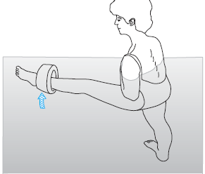

Slide 79
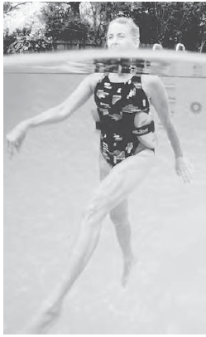

Slide 80
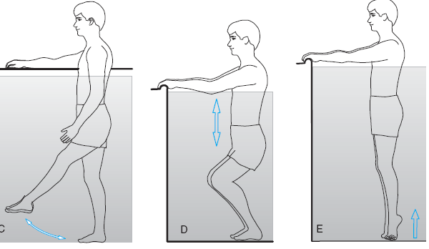

Slide 81
Special consideration
O2 uptake at a given external workload is significantly higher in UL ex than LL ex.
Myocardial efficiency is lower with LL ex than with UL ex.
Myocardial o2 consumption is higher with UL ex than with LL ex.
Notes- pts with CAD completes 35% less work with UL work than with LL ex before symptoms occur.

Slide 82
Adaptive changes
Adaptive changes following training of individuals with cardiac disease include:
Increased myocardial aerobic work capacity.
Increased maximum aerobic or functional capacity by predominantly widening the arterio-venous oxygen (a VO2) difference.
Increased stroke volume following high-intensity training 6 to 12 months into the training program.
Decreased myocardial demand for oxygen.
Increased myocardial supply by the decreased heart rate and prolongation of diastole.

Slide 83
Increased tolerance to a given physical workload before angina occurs.
Significantly lower heart rate at each submaximum workload and therefore a greater heart rate reserve.
When muscles are used that are not directly involved in the activity, the reduction in heart rate is not as great.
Improved psychological orientation and, over time, an impact on depression scores, scores for hysteria, hypochondriasis, and psychoasthenia on the Minnesota Multiphasic Personality Inventory.

Slide 84
Notes
Cardiovascular complications are prevented and/or reduced, if the program includes
appropriate selection of patients,
continuous evaluation of each patient,
Medical supervision of the exercise throughout the training period,
regular communication with the physician,
specific instructions to patients about adverse symptoms,
class size limitations to 30 or fewer patients,
maintenance of accurate records related to compliance to the program.

Slide 85
Phase-4
M A I N T E N A N C E
O U T P A T I E N T
P R O G R A M S
COMMUNITY PROGRAM

Slide 86
P – Patients with CABG
I – Chest PT in the form of Blow bottel
exercises
C –Chest PT in the form of Breathing Exercises
O – Improvement in lung volume

Slide 87
CHEST PHYSIOTHERAPY AFTER CORONARY ARTERY BYPASS GRAFT SURGERY—A COMPARISON OF THREE DIFFERENT DEEP BREATHING TECHNIQUES
Randomized trial | The effectiveness of three deep breathing techniques was evaluated in 98 male patients after coronary artery bypass graft surgery in a randomized trial. The techniques examined were deep breathing with a blow bottle-device, an inspiratory resistance-positive expiratory pressure mask (IR-PEP) and performed with no mechanical device | Chest PT in the form of Breathing Exercises vs blow bottle techniques. | The Blow bottle group had signi cantly less reduction in total lung capacity (p = 0.01) compared to the Deep breathing group, while the IR-PEP group did not signi cantly differ from the other two groups.

