Slide 1
WAR GASES
Dr. P K PATEL

Slide 2
Chemical Warfare :
Offensive use of nonliving toxic products produced by living (toxins such as botulinum, saxitoxin, ricin)
Biological Warfare :
Offensive use of Living organism (anthrax, virus, bacteria)

Slide 3
The war gases includes any chemical (liquid,gases,solid) which is used to produce destruction or damage mostly in time of war.
Vesicant / Blistering gases
Asphyxiants / Lung Irritant
Lachrymators / Tear gases
Nasal Irritants / Sternutators
Paralysants
Nerve Gases

Slide 4
1. Vesicants / Blistering gases
Sulphur, phosgene, oxime, mustard, arsenic(lewisite).
Volatile liquid
Used in artillery shells to saturate the area of attack.
Mustard gase= yellow cross :-
heavy, dark colored, oily, garlic odour,
vapourise at normal temp
S/S :-irritate eyes, nose, throat, respi passage, N/V/abd-pain.
passes through cloth:- itching redness vesication,ulceration (moist area)
severe dose :- edema of eyelid, suppuration and destruction of conjunctivae, cornea and eyeball.

Slide 5
Treatmnt:-
  Skin:- mustard gas removed by cotton mixed with alcohol, spirit, kerosene, petrol-→ bleach cream
  Eye :-water, 2% NaHCo3, Normal saline
  Nose:- 5% NaHCo3
Prevention By:-
  Respirator mask (which contain celluloid filter)

Slide 6
Lewisite= Lipid soluble Arsenic
Heavy dark liquid
Odour= geraneous
Dissolve in oil, benzene, organic solvent
Vesicant + Asphyxiants
Treatment:-
  B.A.L. give intramuscular 2 ml of 5% in arachis oil and benzyl benzoate.
  B.A.L. is antidot which prevent local and systemic effect.

Slide 7
Blister of Lewisite | Blister of Mustard
Clearly defined Cover whole erythematous area | Surrounded by red erythema
Filled by cloudy fluid | Clear serum
Leucocyte and arsenic | Only leucocyte, no mustard

Slide 8
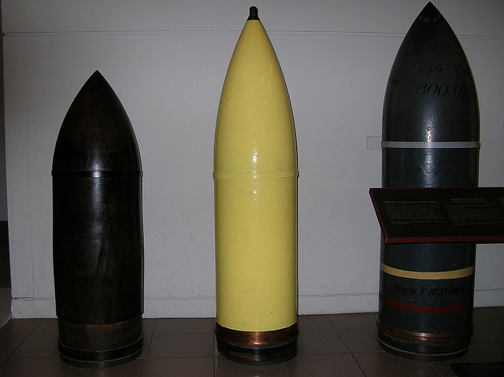
German Artillery shell

Slide 9
2. Asphyxiants /Lung Irritant
Chlorine and phosgene gases (released from tank or gas shell)
Chloropicrine and diphosgene (liquis used in gas shell)
Phosgene 10 time toxic than chlorine
Chloropicrine 4 time toxic than cholrine

Slide 10
Action:- mainly on pulmonary alveoli.
Phosgene = carbonyl chloride = COCl2
  Gas at N temp
  Smell- musty hay
  Decomposed by water in to HCL and HCo3
  Poor solubility so action may appear few hr after
Diphosgene:
  Oily liquid
  Smell and toxicity as phosgene
  Phosgene and Diphosgene called “Green Cross”

Slide 11
Chloropicrine:
  Yellow oily liquid
  Smell as chlorine
Sign & Symp:- watering eyes, coughing dyspnoea, tightness of chest, stertorous breathing, cyanosis, vomiting, headache, collaps,
Death in 24 to 48 hours d/t pulmonary oedema → blood stained sputum

Slide 12
Treatment:-
  Continuous O2 preferably through 95% alcohol to lower surface tension.
  Codeine for irritant cough
P.M. appearance:-
  Lung heavy and edematous, petechial heamorrhage.
  Serous effusion in plueral cavity.

Slide 13
3. Lachrymators / Tear gases
C.A.P. = Chloracetophenon (colourless crystalline solid, slightly soluble in water)
B.B.C.= Bromobenzylcyanide(dark brown oily liquid & penetrating bittersweet smell)
K.S.K.= Ethyliodoacetate (brown oily liquid &smell pear drop)

Slide 14
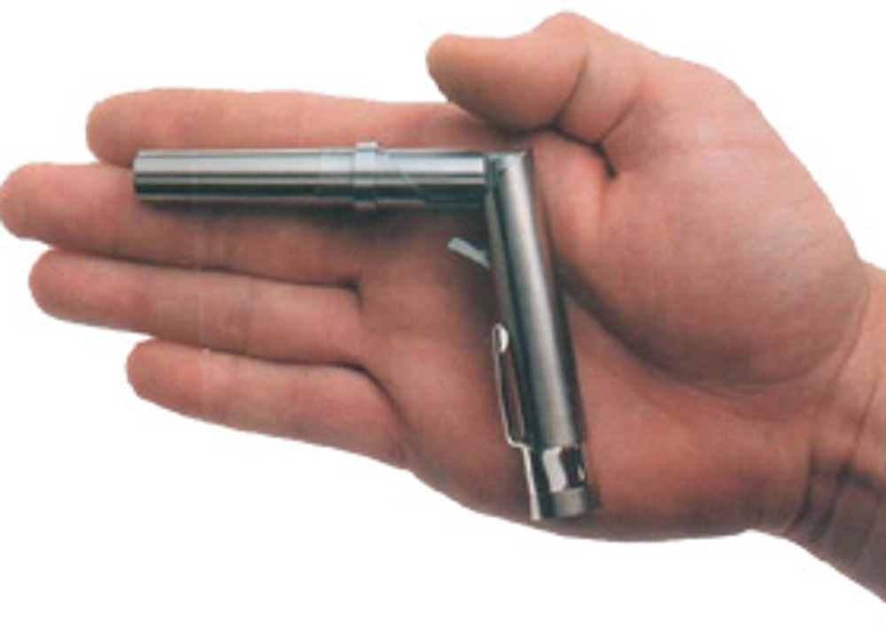
Pen gun

Slide 15
S/S:- irritation of eyes, copius flow of tears, spasm of eyelids, temporary blindness.
  irritation of air passage
  long exposure: N/ V/ blister of skin
Treatment :-
  removed to fresh air
  eye wash(NS/ Boric acid)
  Skin wash (NaHCo3)
  IV aminophylline / inhalational salbutamol

Slide 16
4. Sternutators / Nasal Irritant
D.A.= Diphenyl chlorarcine
D.M.= Diphenylamine chlorarcine
C.D.= Diphenyl cyanarcine
Solid organic compound of arsenic fired in artillery shell.

Slide 17
Diethylamine Chlorarcine(sickening gase) is 6 times as heavy as air.
specific action on:- vomiting center of brain
* intense pain and irritation of nose, sneezing
headache, salivation, N/V, tightness in chest
and prostration

Slide 18
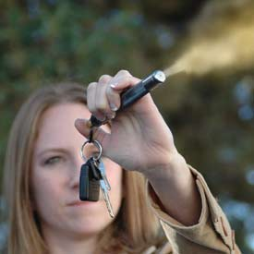
Gases used by Law Enforcement Agency and Military
  Ortho chloro benzylidene mononitrate(white crystalline solid– 10 time irritant than CAP but less toxic)
Personal Defense Spray:-
  Ortho chloro benzylidene mononitrate
  2-chloroaccetophenone
  Olioresin capsicum

Slide 19
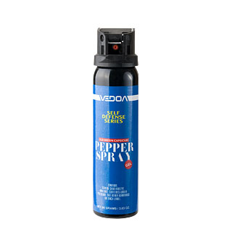
Capsacain is neurotoxic component of cyanne pepper
Dispersed in aerosol of liquid or powder
Effects begin in seconds
Ends in 10-15 mins.
  Cause:- hypothermia
  Neurogenic inflammation
  Desensitization

Slide 20
5. Paralysants
HCN
Carbon monoxide
Sulphurated hydrogen

Slide 21
6. Nerve Gases
Term nerve gases incorrect
Nerve agents are ester of phosphoric acid(Liquid)
  Tabun
  Sarin
  soman
Colourless, odourless, volatile liquid.
The vapour heavier than air
  So easily sink in to valley, trenches, basement

Slide 22
Absorbed from
  Lungs
  Skin
  GIT
  conjunctivae
Inhibit acetylcholine esterase
On exposure to large amount;
  Loss consciousness within seconds
  Convulsion after several minutes
  Muscle flaccid and breathing stop.
Treatment :- same as OP poison

Slide 23
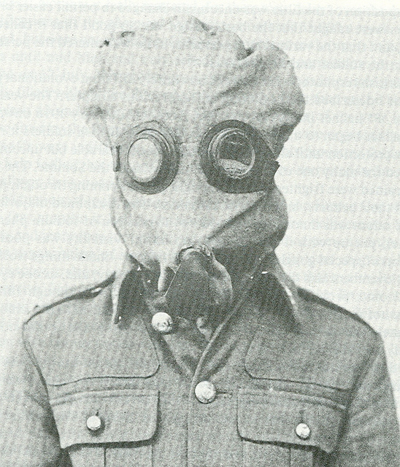
The P (or Phenate) Helmet
officially called the Tube Helmet,
It had flannel layers of cloth-dipped in sodium phenolate and glycerin and protected against chlorine and phosgene, but not against tear gas..

Slide 24
PH Helmet
The PH Helmet (Phenate Hexamine)
added hexamethylene tetramine, which greatly improved protection against phosgene and added protection against hydrocyanic acid.

Slide 25
PHG Helmet
The PHG Helmet appeared
similar to the PH Helmet but had a facepiece made of rubber sponge to add protection against tear gas.

Slide 26
Generic name during world war-I
Green cross is mixture of:-
  Phosgene and diphosgene
  Phosgene and chloropicrine
Blue cross is mixture of:-
  Diethylchloroarsine
  Diphenylcyanarcine
  Ethyl dichlorarcine
  Methyl dichlorarsine

Slide 27
Yellow cross is mixture of:-
  Mustard
  tetrachloromethane
White cross is mixture of:-
  BBC
  CAP
  ethyliodoacetate

Slide 28
Local made mask in war gas
Activated charcoal is used as local filter
  Burn Bread or coconut shell then ash is mix with ZnCl2 keep one day then make powder=activated charcoal which absorbs most organic matters
Glycerol soaked cloth
  Glycerine as cosmetic
  Glycerine soap

