Slide 1

Diseases of Bone
& Joints III

Slide 2
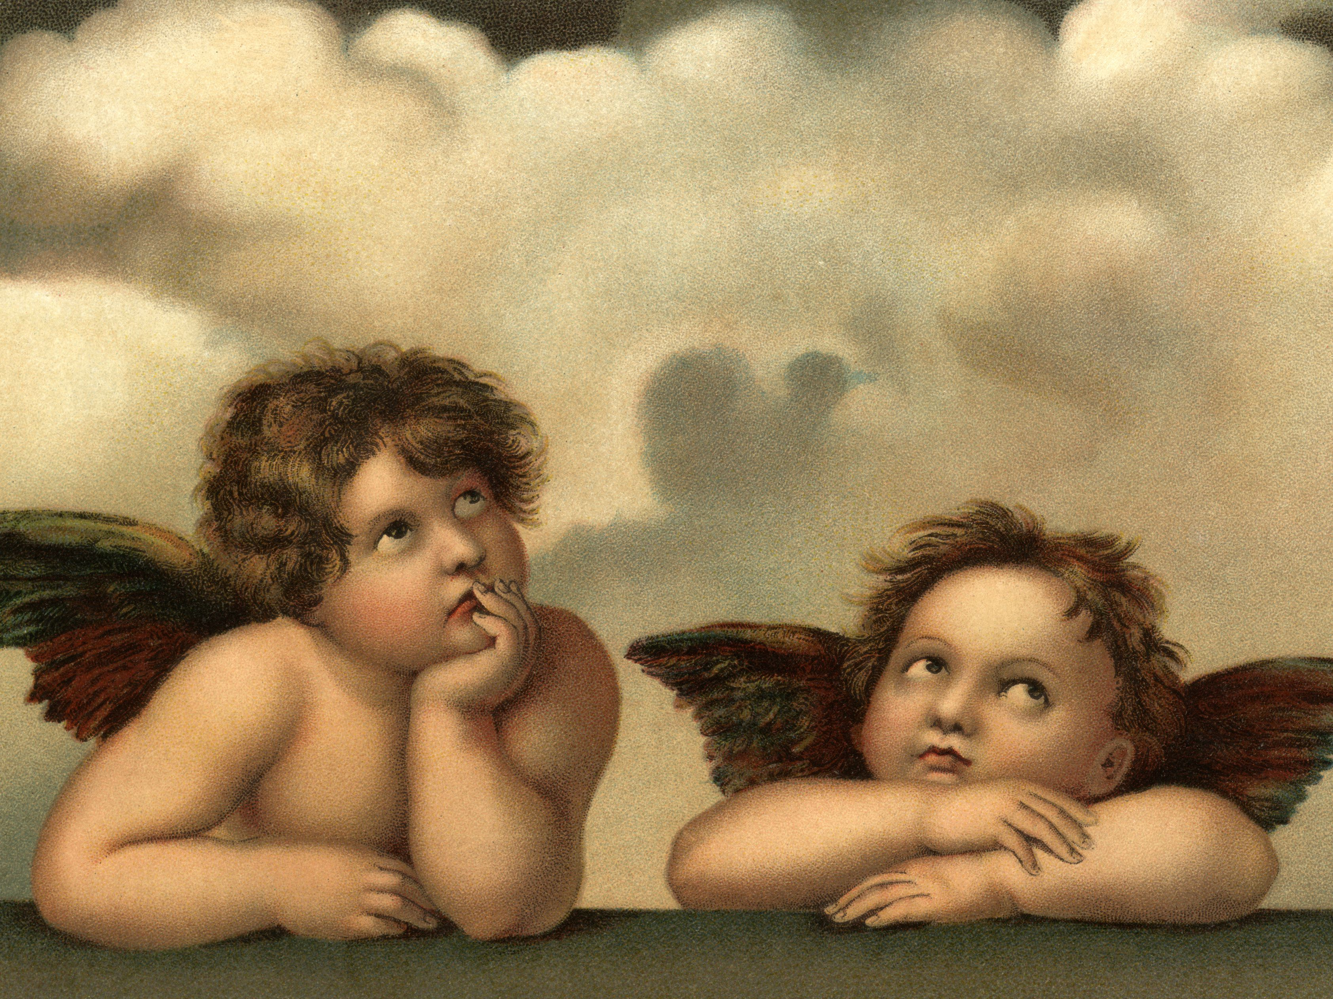
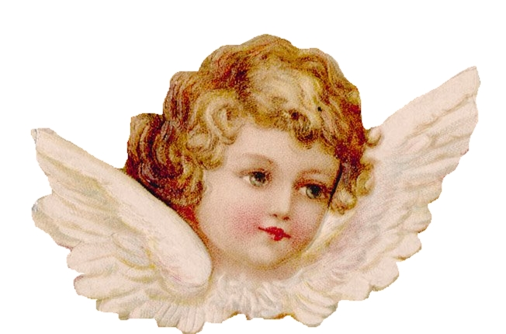

Slide 3
Cherubism
Familial Fibrous Dysplasia of jaws
Disseminated juvenile fibrous dysplasia
Cherubism first described by Jones.
PATHOGENESIS:
Rare developmental condition of the jaws.
Autosomal Dominant (4p16.3) with
high penetrance but variable expressivity in
fibroblast growth factor receptor-3 (FGFR-3)
reduction in bone resorption
deficiency of sex steroids, at puberty

Slide 4
Cherubism
M>F,
Onset usually 1-5yrs;
progresses until puberty, stops by age of 12-15yrs becomes stable, then slowly regresses.
Bilateral, symmetrical swelling of Mandibular body or maxillary tuberosities.
Firm, painless jaw expansion & jaw deformity
widened alveolar processes
Inverted V-shaped palatal arches
Premature exfoliation of primary teeth

Slide 5
Delayed permanent tooth eruption
Teeth displacement or resorption
Cervical lymphadenopathy
Condyles are spared in most cases
Hypertelorism
Eyes-to-heaven appearance
impaired mastication & speech difficulties.

Slide 6
Lesions in humerus
Gingival fibromatosis
Orbital involvement
Obstruction sleep apnea.
Grading system by Arnott (1978):
Grade I – involvement of both mandibular rami
Grade II- mandibular rami + maxillary tuberosity
Grade III- Albright syndrome involvement of maxilla & mandible except coronoid process & condyles

Slide 7
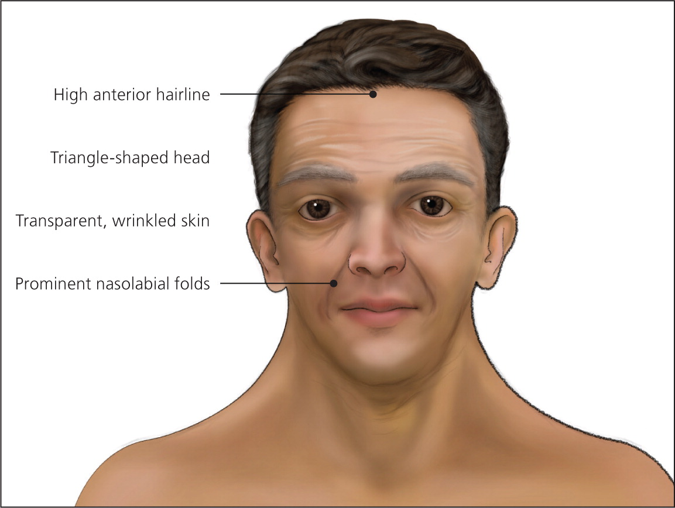
Noonan’s Syndrome

Slide 8
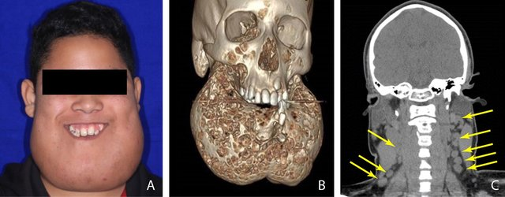
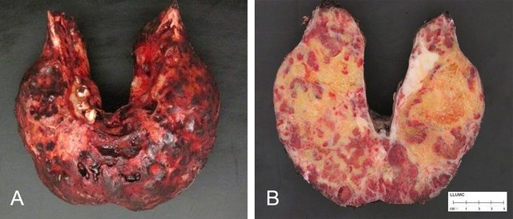

Slide 9
Radiographic Features:
Bilateral multilocular cystic expansion of jaws.
Displacement of inferior alveolar canal.
Presence of numerous unerupted teeth producing a radiographic appearance of floating tooth syndrome.
In adulthood, the cystic areas become reossified with irregular patchy sclerosis

Slide 10
Grading system by Kalantar Motanedi
Grade I: Lesions of mandible without signs of root resorption
Grade II: mandibular & Maxillary lesions without root resorption
Grade III: Aggressive lesions of mandible with root resorption.
Grade IV: Both the jaws are involved & root resorption is present.
Grade V: Rare, massively growing, aggressive & deforming juvenile cases involving the maxilla & mandible which may include the coronoid process & condyles.

Slide 11
Clavicle, ribs and humerus reported as rare extragnathic sites.
Microscopically similar to CGCG; eosinophilic cuff-like deposits around small vessels a helpful finding.
Long-standing lesions become more fibrous with fewer giant cells.
Prognosis variable; return to normalcy for many; some with significant deformity; dental management sometimes difficult.

Slide 12
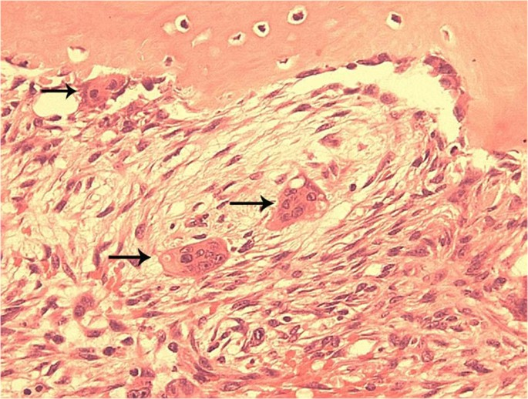

Slide 13
Prognosis & Predictive factors:
No treatment is suggested
Patients seek medical attention for aesthetic & functional concerns
Orthodontic treatment for malocclusion

Slide 14
Marfans Syndrome
Synonym: Arachnodactyly
It is an inherited defect of connective tissue with autosomal mode of transmission
Marfan syndrome is named after Antoine Marfan, the French paediatrician, in 1896
Pathogenesis
Defect in FBN1 gene located on 15q15-23, which encodes for a glycoprotein called fiber, a component of extracellular matrix

Slide 15
Clinical features
No sex predilection
Aortic aneurysms
Kyphosis and scoliosis
Hyperextensibility of joints
Mitral valve propolapse
Pigeon chest deformity
Myopia, retinal detachment and superior dislocation of joints

Slide 16
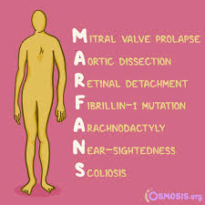

Slide 17
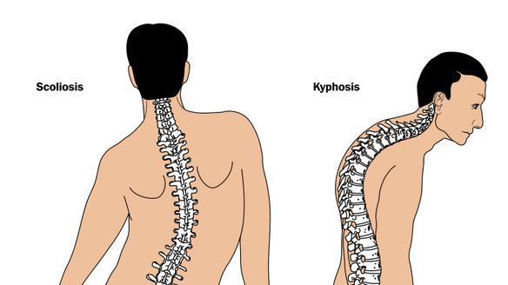
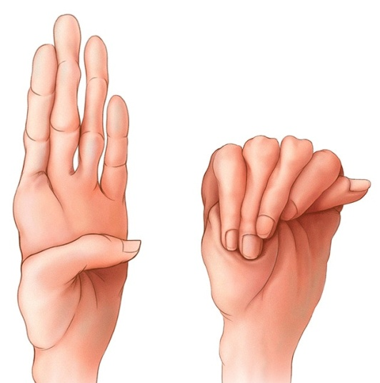
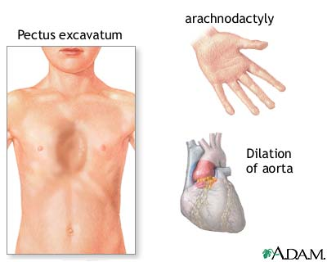

Slide 18
Oral manifestations
Long and narrow face
High arched palate
Cleft palate
Bifid uvula
Prognosis and predictive factor
There is no cure
Orthodonitc treatment for malocclusion and corrective surgery for cleft palate

Slide 19
Achondrogenesis
Achondrogenesis is a heterogenous group of lethal disorders that is characterized by a severe form of congenital chondrodysplasia in humans
It causes death in intrauterine life or in early neonatal life
Types:
Type- 1: Subtypes
Type1A: Houston-Harris achondrogenesis
Type 1B: Fraccaro achondrogenesis
Type - 2: Langer-Saldino achondrogenesis

Slide 20
Pathogenesis
Type 1A: An unknown chromosomal locus.
Type-1B: Mutations in DDST gene, which is located at 5q32-q33.
Type – 2 Collagenopathy resulting from mutations in COL2A1(collagen2α1 chain)gene.
Notes:
Achondroplasia is a common nonlethal chondrodysplasia transmitted as an autosomal dominant trait with complete penetrance, resulting in decreased endochondral ossification, decreased cellular hypertrophy, and decreased cartilage matrix production

Slide 21
Clinical features
No sex predilection
Achodrogenesis is detected prenatally or at birth because of typical clinical, radiographic, histopathological and molecular findings
Type-1 Achondrogenesis results in stillbirth and it occurs more frequently than type-2

Slide 22
Type-1 Achondrogenesis:
Craniofacial features include
Soft skull, sloping forehead,
Convex facial plane,
Deep horizontal groove,
Small nose, anteverted nostrils,
Increased distance between lower lip and lower edge of chin and
Double chin appearance

Slide 23
Type-2 Achondrogenesis:
Disproportionately large head
Large and prominent forehead,
Flat facial plane,
Flat nasal bridge,
Small nose with severe anteverted nostrils,
Normal philtrum and micrognathia

Slide 24
Histopathology
Type-1A
Normal cartilage matrix
No collagen rings are present around chondrocytes
Intrachondrocytic inclusion bodies
Enlarged lacunae
Woven bone

Slide 25
Type 1B:
Cartilage matrix shows coarse collagen fibers that are particularly dense around chondrocytes forming collagen ring
Type2
Slightly larger than normal and grossly destorted(lobulated and mushroomed) epiphyseal cartilage
Cartilaginous matrix is markedly deficient.
Prognosis and predictive factors
There is no cure
Genetic counselling and antenatal diagnosis help in prevention

Slide 26
Thank you

