Slide 1
ATELECTASIS
By, Dr. Kalpesh Satani

Slide 2
Atelectasis
It is an abnormal collapse of alveoli (distal lung parenchyma).

Slide 3
CAUSES AND TYPES OF ATELECTASIS
Although atelectasis can occur from large variety of problems, here mentioning two primary types associated with postoperative or bedridden patients
Types:-
  Resorption atelectasis
  Passive atelectasis

Slide 4
RESORPTION ATELECTASIS:
  It occurs when mucus plugs are present in the airways and block ventilation of the affected region.
  Gas distal to obstruction is absorbed by passing blood in the pulmonary capillaries, which causes the non-ventilated alveoli to partially collapse.

Slide 5
PASSIVE ATELECTASIS
  It is primarily caused by persistent use of small tidal volumes by the patients. This is common when general anaesthesia is given, with use of sedatives and bed rest, and when deep breathing is painful as when broken ribs are present or surgery has been performed especially in upper abdominal region.
  Weakening or impairment of diaphragm also can contribute to passive atelectasis.

Slide 6
FACTORS ASSOCIATED WITH CAUSING ATELECTASIS
  Any patient who cannot take deep breaths periodically.
  Upper and lower abdominal surgery
  Thoracic surgery
  Significant obesity
  Neuromuscular disorders
  Bedridden patients

Slide 7
CLINICAL SIGNS OF ATELECTASIS
Physical signs of atelectasis may be absent or very subtle if patient has minimal atelectasis.
When atelectasis involves more significant portion of lungs, patients respiratory rate will increase proportionally, late inspiratory crackles may be heard over affected lung field.
If lung consolidated due to atelectasis, abnormal bronchial breath sound present. Tachycardia may be present if atelectasis leads to significant hypoxemia.

Slide 8
DIAGNOSIS
  X-RAYS
  Atelectatic region of the lung will demonstrate
    Increased opacity
    Narrowing of the space between ribs
    Shift of trachea and / or mediastinum same side and
    Sometimes compensatory hyper-expansion of surrounding lung.

Slide 9
TREATMENT
  Lung expansion therapy is an effective strategy in the treatment of atelectasis.
  For patient with minimal risk of postoperative atelectasis,
    Deep breathing exercise
    Frequent re-positioning and
    Early ambulation
    is usually effective treatment

Slide 10
LUNG EXPANSION THERAPY
The most common modalities include,
  Breathing exercises
  Incentive spirometer
  Intermittent positive pressure breathing (IPPB)
  Continuous positive airway pressure and (CPAP)
  Positive expiratory pressure

Slide 11
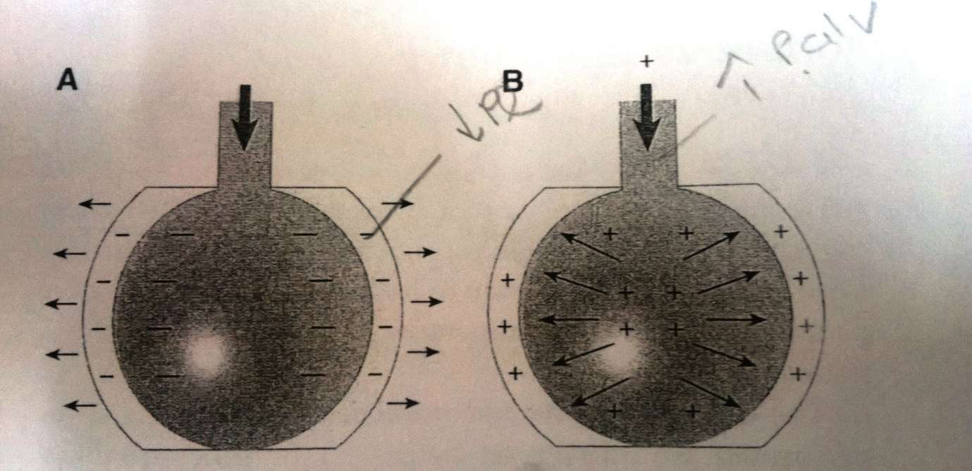
Lung expansion therapy increase lung volume by increasing the trans-pulmonary pressure gradient. Trans-pulmonary pressure gradient is difference between alveolar pressure and pleural pressure.
Trans-pulmonary pressure gradient can be increased by either
  Decreasing surrounding pleural pressure (figure A)
  Increasing alveolar pressure (figure B)

Slide 12
INCENTIVE SPIROMETER
Incentive spirometer enhances lung expansion via spontaneous and sustained decrease in pleural pressure.
The basic principle of incentive Spirometry is sustained maximal inspiration.
Sustained maximal inspiration is a slow, deep inhalation from FRC upto TLC followed by 5 to 10 second of breath hold (breath hold to improve collateral circulation).

Slide 13
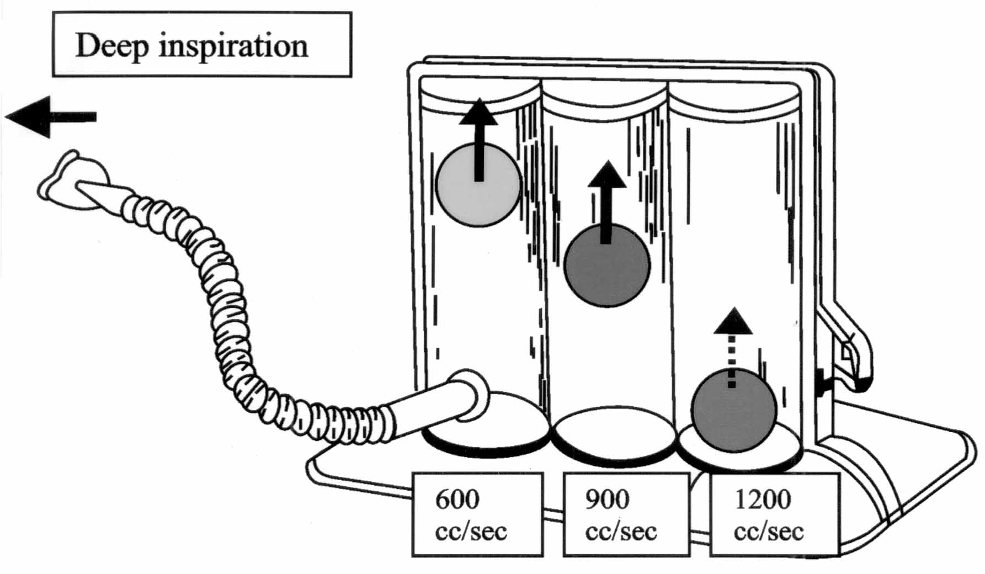

Slide 14
INTERMITTENT POSITIVE PRESSURE BREATHING
IPPB refers to an application of positive pressure to spontaneous breathing patient as an intermittent or short term therapeutic modality.
IPPB usually lasts for 15 to 20 minutes.
IPPB increases trans-pulmonary pressure gradient by increasing alveolar pressure.
IPPB may be useful for patients who are at high risk of atelectasis and not able to co-operate with more simple technique such as incentive spirometer.

Slide 15
POSITIVE AIRWAY PRESSURE THERAPY
Positive expiratory therapy (PEP)
Continuous positive airway pressure (CPAP)
Expiratory positive airway pressure (EPAP)
PEP and EPAP create expiratory positive pressure only while CPAP maintains positive pressure throughout both inspiration and expiration.

Slide 16
An evidence for a lung expansion therapy to prevent post-operative pulmonary complications

Slide 17
Incentive Spirometry with expiratory positive airway pressure reduces pulmonary complications, improves pulmonary function and 6-minute walk distance in patients undergoing coronary artery bypass graft surgery
Haeffener et al
American Heart Journal 2008
P | Undergoing CABG patients
I | Incentive spirometer, EPAP
C | coughing technique, early mobilization, and deep breathing exercises
O | Pulmonary Function test, 6 minute walk test, Pimax, Chest X-Ray

Slide 18
High level evidence (Systemic review) | Aim of the study was to determine the effect of incentive spirometer and EPAP in patients undergoing coronary artery bypass graft surgery to reduce or prevent pulmonary complications. | 34 patients undergoing CABG were randomly assigned to a control group or Incentive Spirometer + EPAP group. Maximal respiratory pressures, pulmonary function test, 6-minute walk test and chest x-ray were performed at baseline as well as 1 week and 1 month after CABG. | In patients undergoing CABG, Incentive Spirometer + EPAP results in improved pulmonary function and 6-minute walk distance as well as a reduction in Post operative Pulmonary Complications.

