Slide 1


Community Physiotherapy and Rehabilitation
Final Year BPT, College of Physiotherapy

Slide 2
Objectives
At the end of the lecture the students will be able to:
Discuss in short about different types of upper limb orthosis
Discuss in short about different types of orthosis used in different nerve palsies.

Slide 3

BIONIC REHABS Opp.Baroda High School Alkapuri. Ph.0265 232 1234
DR. VEERENDRA SHANDILYA(CPO -USA)
Consultant Orthotist - Prosthetist

Slide 4
UPPER EXTRMITY ORTHOSIS

Slide 5
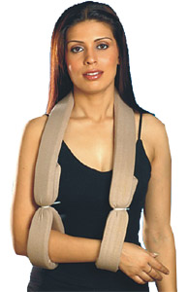
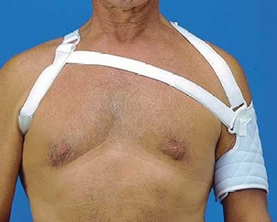
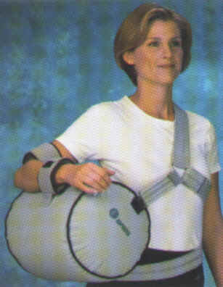
SHOULDER SUPPORT
The collar and cuff
Cuff support
The abduction roll or wedge or pillow

Slide 6
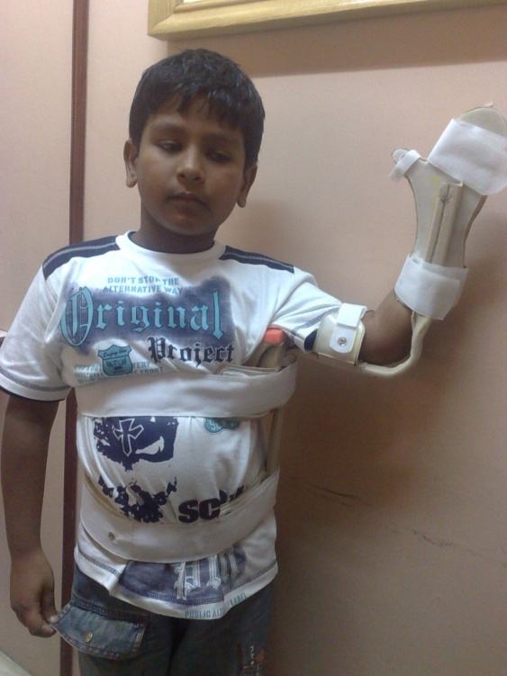
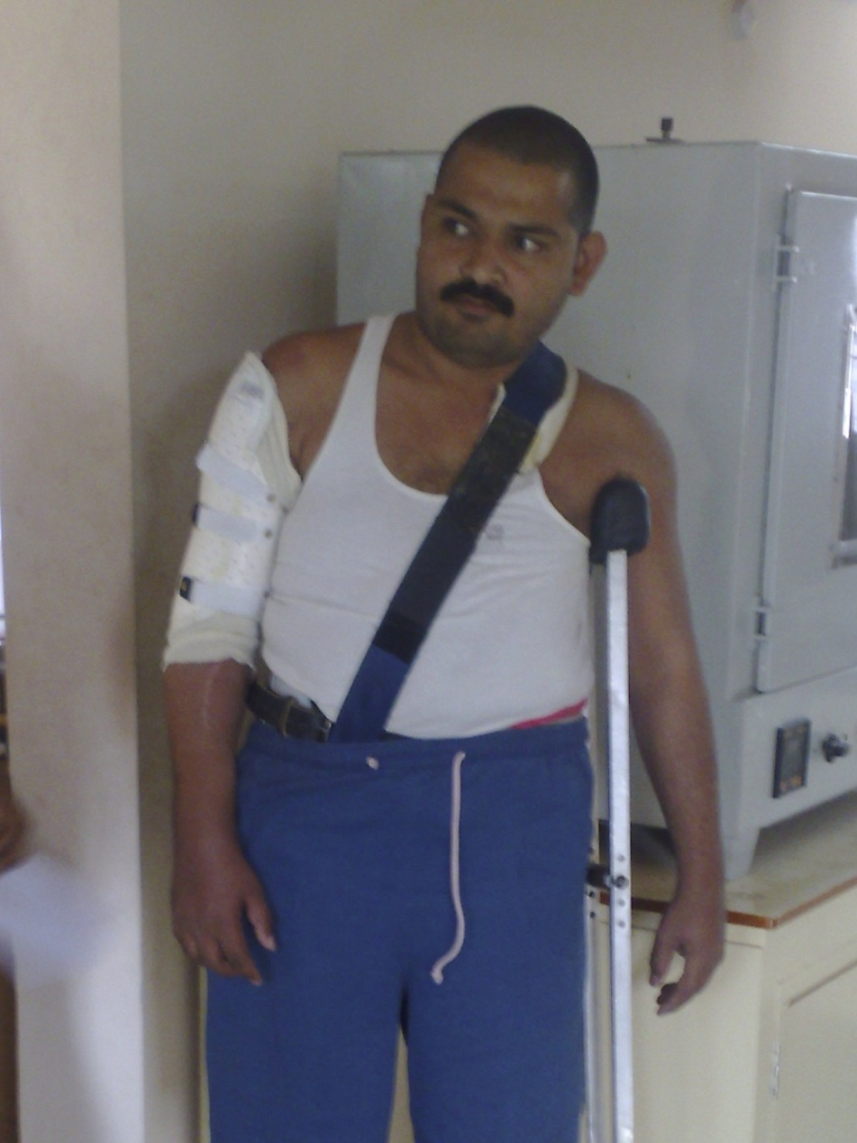
Shoulder abduction splint
Humerus brace

Slide 7
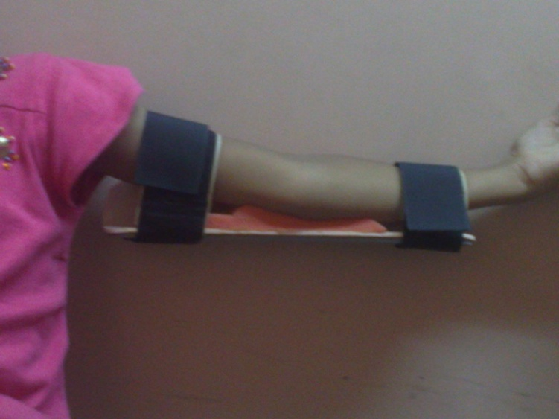
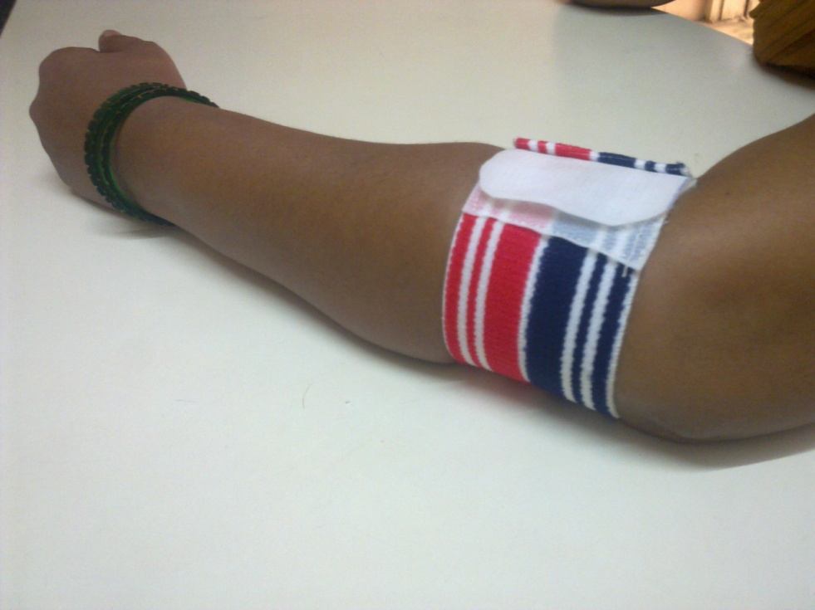
ELBOW ORTHOSIS
Pull-over orthosis
Tennis elbow brace

Slide 8
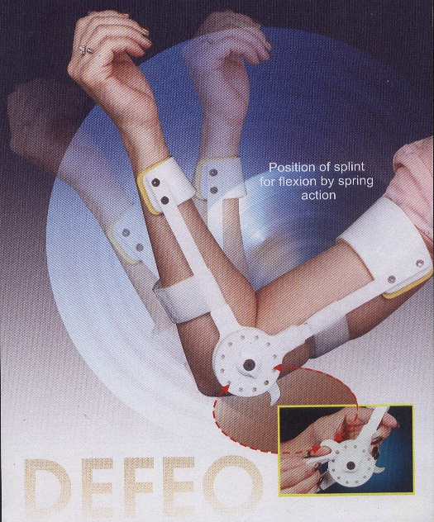
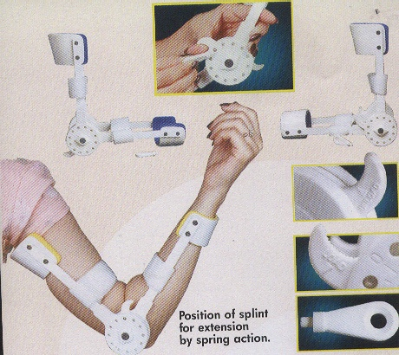
Elbow Orthosis

Slide 9
FOREARM, WRIST & HAND ORTHOSIS
TYPES
STATIC
DYNAMIC
SPLINTING FOR THE SPASTIC WRIST AND HAND
SPLINTING FOR HYPOTONIC WRIST AND HAND
ORTHOSES FOR BURNS
ORTHOSES USED IN RA
ORTHOSES USED IN SPINAL CORD INJURY
ORTHOSES USED IN SPORTS AND PERFORMING ARTS
ORTHOSES USED FOR INFLAMMATION OF JOINTS AND TENDONS
ORHOSES FOR OCCUPATIONAL DISEASES
ORTHOSES POST INJURY AND POST SURGERY

Slide 10
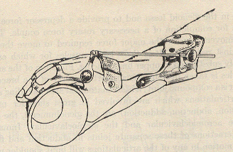
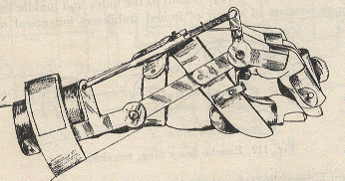
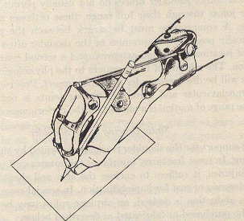
TRAINING

Slide 11
PLASTIC GUTTER SPLINT

Slide 12
FINGER STRIPS

Slide 13
MALLET FINGER SPLINT

Slide 14
GUTTER SPLINT

Slide 15
DYNAMIC SPLINT

Slide 16
FLAPPER SPLINT

Slide 17
SILICON GEL finger cap

Slide 18

Volkman’s Turn Buckle Splint

Slide 19
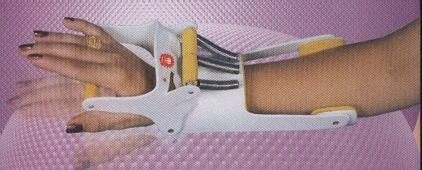
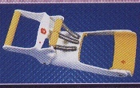
Dynamic Radial Palsy Splint

Slide 20
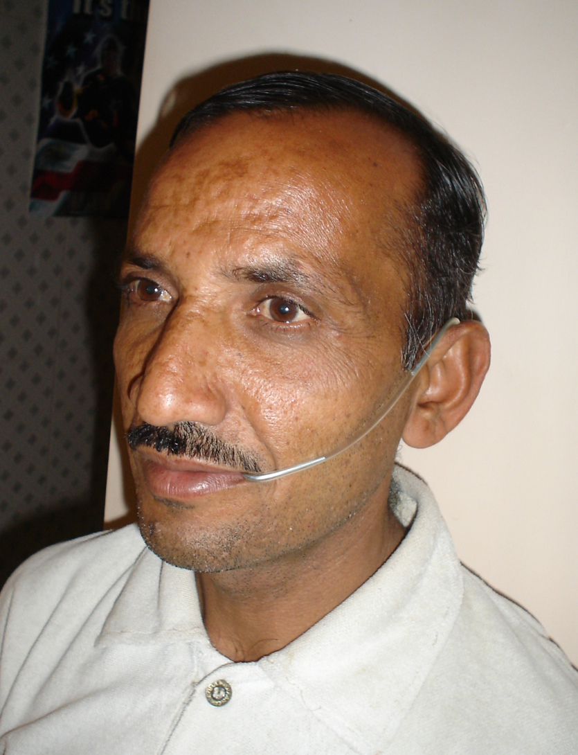
Facial Palsy Splint

Slide 21

It’s always Team work

Slide 22
Thank you

