Slide 1
Preterm babies

Slide 2
Objectives
At the end of the lecture the students will be able to:
Discuss problems faced by the preterm babies
Discuss in short about the evaluation of the pre term babies
Explain in short the role of physiotherapy while handling pre term babies

Slide 3
Preterm infants are those born before 37 weeks of gestation.
A preterm baby is small in size (usually less than 47cm long).
The head is relatively large , sutures are widely separated and fontanel is large and face appears small.

Slide 4
General activity is poor and neonatal reflexes such as moro, sucking and swallowing are sluggish .
There is hypotonia with a poor recoli of flexed forearm when it is extended.

Slide 5
CAUSES
Maternal factor | Medical disease of the mother during pregnancy
 | Complications of pregnancy e.g: placenta previa and antepartum of hemorrhage.
 | Incompetence of cervix
 | Maternal infections
 | Previous premature delivery
Fetal factors | Mutiple pregnancy
 | Congnital malformation
Medical factors | Uncontrolled diabetes mellitus in the mother
 | Severe cardiac illness.
 | Hypertension,toxemia.
 | Fetal hypoxia and fetal distress.
 | Severe intrauterine growth retardation.
Iatrogenic | Improper diagnosis of maturity in elective deliveries.

Slide 6
Clinical Hazards of prematurity
1) Immaturity of the nervous system
The preterm infants are lethargic and inactive.
They have poor neonatl reflexes and uncoordinated sucking and swallowing to feed difficulties.

Slide 7
2) Respiratory problems:
Respiration tends to be irregular in depth and rate with periods of apnea lasting for a few seconds.
Poor cough reflex increases the rate of infections.
Areas of atelectasis are frequent because of poor devlopment of lungs and weak respiratory muscles.

Slide 8
The surfactant , a pulmonary lipoprotein ,is often deficient.
Therefore, the surface tension in the lungs cannot be reduced ,resulting in secondary atelectasis resulting in respiratory distress due to hyaline membrane disease.

Slide 9
Gastrointestinal system:
There is a tendency to regurgitate due to an incompetent cardio-esophageal sphincter and small capacity of the stomach.
The functional immaturity of the liver leads to hyperbilirubinemia.

Slide 10
Temperature regulation:
The preterm infants loses more heat due to its larger surface area.
The subcutaneous fat is less.
Thermic responses are also inadequate because of poor food intake,muscular inactivity and less oxygen consumption.
Therefore ,preterm babies are more prone to develop hypothermia.

Slide 11
Immuature renal function:
The glomerular filtration rate and the concentrating ability of the kidney tubules are reduced.
These infants are more prone to devlop acidosis.

Slide 12
Circulatory system:
The closure of ductus arterious may be delayed in premature infants.
The peripheral circulation is inadiquate , intracranial hemorrage may occur due to poor autoregulation of cerebral blood flow.

Slide 13
Liability to nutritional deficiency:
The nutritional requirments of premature infants are higher because of the need for the postnatal catch up of the growth.
Therefore they are more prone to develop nutritional deficiencies .

Slide 14
Increased susceptibility to infection.
Preterm infants are three to ten times more vulnerable to infections as compared to normal neonates.

Slide 15
EVALUATION OF INFANT
Neurobehavioral state - Physiologic, Motor, State, Interaction/attention
Musculoskeletal status - anomalies and or contractures
Neurological status - Level of motor ability, tone & Reflexes
Oral motor abilities

Slide 16
Neurological Assessment
Active mobility
Posture
Muscle tone
Responses to stimulus of Noise, Touch etc
Reflexes

Slide 17
Musculoskeletal Examination
Range of Motion
Congenital Anomalies

Slide 18
Physical examination
General appearance
Global flexion or abnormal posture
State of consciousness
Obvious skeletal abnormalities
Skin color and response with touch

Slide 19
Oral Motor Examination
Oral structure examination (lips, tongue, jaw, hard & soft palate, breathing & oral movement)
Positioning
Mode of feeding
Pace of feeding

Slide 20
GOALS
Modify Sensory stimulation to promote behavioral organization and physiological stability
Reduce active reinforcements of abnormal movement patterns and positions
Facilitate normal patterns of movement
promote appropriate feeding behaviors

Slide 21
GOALS
Minimize contractures and deformities
Foster attachment to primary caregivers/parents
Support parental engagement and competency during critical course
Promote developmental progression
Follow up services

Slide 22
INTERVENTION
Body positioning
Graded sensorymotor intervention/ neurobehavioral activities
Oral motor activities/feeding, facilitation of sucking (pacifier)
Range of motion exercises with caution
Extremity splints

Slide 23
INTERVENTION
Containment
Kangaroo care & alignment
Education of parents/ caregivers

Slide 24
POSITIONING
Potential components of this high risk postural profile follows:
Hyperextended neck
Elevated shoulders with adducted scapula
Depressed midline arm movement (hand to mouth)
Excessively extended trunk
Immobile pelvis (anterior tilt)
Infrequent antigravity movement of legs

Slide 25
ET tube placement contributes to the neck hyperextension posture who require mechanical ventilator
In some high risk infants, excessive postural stabilizing into neck hyperextension may contribute to sequential blocking of mobility in shoulder, pelvis and hip region

Slide 26
POSITIONING
SUPINE, PRONE & SIDE LYING
Swaddling, nesting- boundaries
Stress reduction, state organization
Enhances flexor patterns, increase midline orientation, promote state organization
Proper weight shifts
Increase hand to mouth awareness
Inhibit jittery or disorganized movement
Prevention of skin degradation

Slide 27
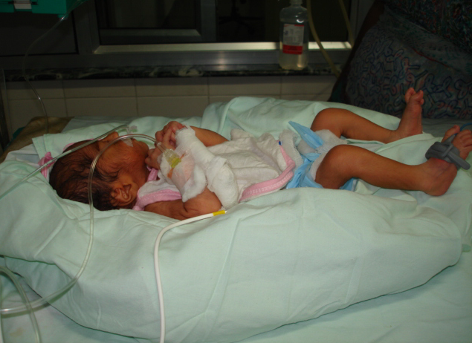
SUPINE POSITIONING

Slide 28
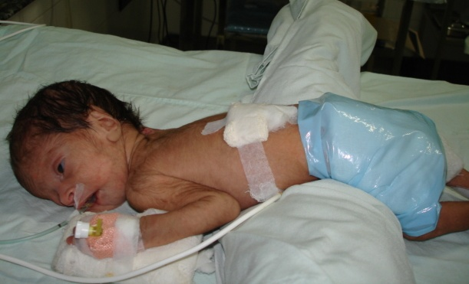
PRONE POSITIONING

Slide 29
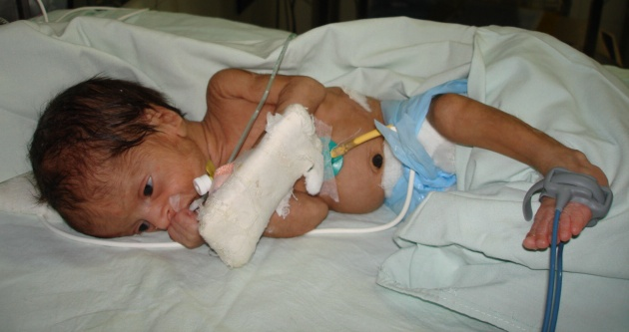
SIDE LYING POSITION

Slide 30
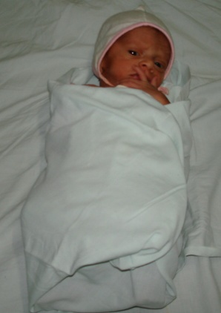
SWADDLING POSTURE

Slide 31
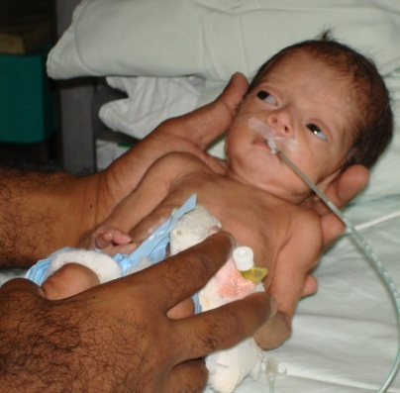
CONTAINMENT
It provides comfort and sense
of security.
Sustained even touch is readily accepted by fragile infants
Helps during handling, medical procedures & nursing care.

Slide 32
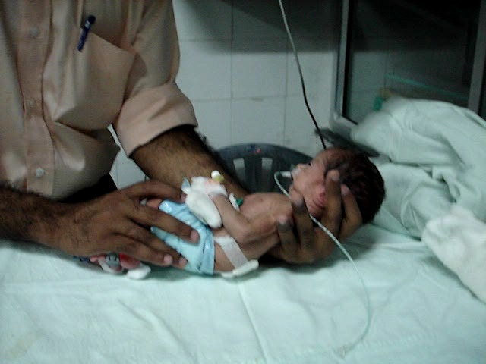
CONTAINMENT

Slide 33
HAMMOCK HANDLING
Activate trunk muscles
Facilitate head righting
Facilitate alertness
Facilitate vestibular system
Provide the perception of various positions

Slide 34
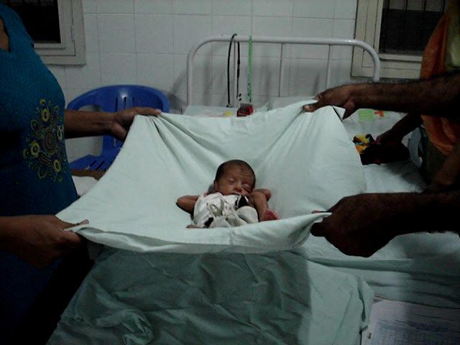
HAMMOCK HANDLING

Slide 35
Feeding difficulty
Feeding difficulties are common among LBW due to:
Neurological immaturity
depressed oral reflexes
prolonged use of an ET tube for mechanical ventilation or
insufficient postural tone

Slide 36
Other variables influencing feeding may include:
Decreased tongue mobility
Tongue thrusting
Depressed lip seal on nipple
Nasal regurgitation
Tactile hypersensitivity in the mouth
Inefficient and uncoordinated respiratory pattren
Hypertonic posturing of the neck and trunk in extension

