Slide 1
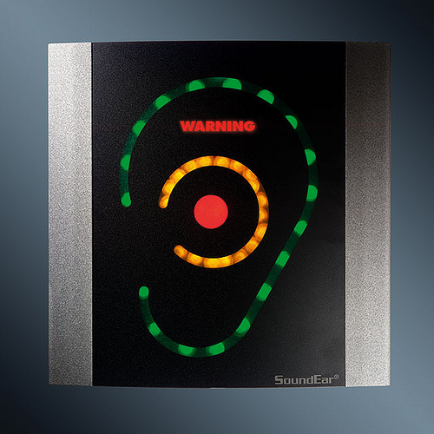
NOISE LEVEL AND HEARING IMPAIRMENT
Dr.Manish Kathad
Department of Community medicine

Slide 2
Noise is “wrong sound, in the wrong place, at the wrong time”
The 20th century has been described as the “Century of Noise”
Noise has become a very important “stress factor” in the environment of man

Slide 3
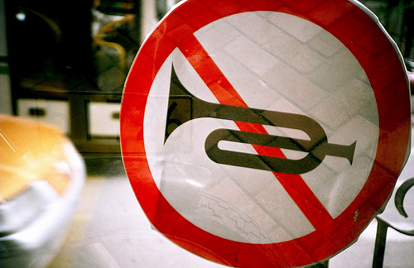
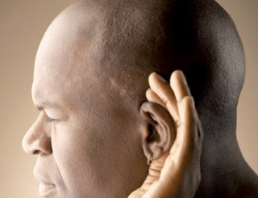
The term “NOISE POLLUTION” has been recently coined to signify the vast cacophony of sounds that are being produced in modern life, leading to health hazards.

Slide 4
SOURCES OF NOISE POLLUTION
The sources of noise pollution are many and varied. Emanates from automobiles, factories , air-crafts amongst others.
Noise pollution is particularly acute near railway stations, airport, bus terminals and traffic round-abouts.
Use of pressure horns, recreational noise of loudspeakers particularly at night are other sources of noise pollution.

Slide 5

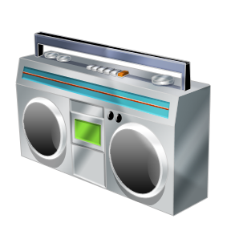
Domestic noise from T.Vs and radio transistors all add to the quantum of noise in daily life

Slide 6
Noise has two components :
Loudness: which depends upon amplitude of vibrations which initiated the noise. It is measured in decibels (dB) .
Frequency: it is denoted as Hertz (Hz). One Hz is equal to one wave of per second.

Slide 7
Community noise level
 | -160 (In decibels, dB)
 | -150
 | -140
 | -130
 | -120
 | -110
 | -100
 | -90 Recommended maximum (85 dB)
 | -80 Printing press
 | -70 Heavy street traffic
 | -60 Normal conversation
 | -50
 | -40 Quiet library
 | -30
 | -20 Whispering
 | -10

Slide 8
Sound levels of some noises
SOURCES OF NOISE | SOUND LEVELS
Whisper | 10
Speech, 2-3 people | 73
Speech on radio | 80
Music on radio | 85
Children shouting | 79
Children crying | 80
Vacuum cleaner | 76
Piano | 86
Jet take-off | 150

Slide 9
Acceptable noise levels (dB)
Residential | Bedroom | 25
 | Living room | 40
Commercial | Office | 35-45
 | Conference | 40-45
 | Restaurants | 40-60
Industrial | Workshop | 40-60
 | Laboratory | 40-50
Educational | Class room | 30-40
 | Library | 35-40
Hospitals | Wards | 20-35

Slide 10
HEARING LOSS
AUDITORY EFFECTS of noise pollution
Auditory fatigue: it appears in the 90db region and is greatest at 4000 Hz. Associated with side effects such as whistling and buzzing in ears.
Deafness: the most serious pathological effect. The victim is generally unaware of it in early stages. Hearing loss may be temporary or permanent.

Slide 11
Temporary hearing loss results from a specific exposure to noise and disappears after 24 hours
Most temporary hearing losses occurs in frequency range between 4000-6000 Hz
Repeated or continuous exposure to noise around 100db leads to Permanent hearing loss

Slide 12
Many studies with different methodologies have been conducted to assess the link between noise levels and hearing impairment

Slide 13
S. SADHRA, C. A. JACKSON, T. RYDER and M. J. BROWN, 2002 | A Cross Sectional study (Medium level of evidence) | This study focused on students working part-time (up to 16 h/week) in music bars and discotheques in a university entertainment venue. Pre- and post-exposure audiometry was used to determine hearing threshold at both high and low frequencies. Personal dosemeters and static measurements were made to assess noise levels and frequency characteristics. A questionnaire was used to determine patterns of noise exposure and attitudes to noise levels and hearing loss. | The mean personal exposure levels for security staff were higher than those of bar staff, with both groups exceeding 90 dB(A). The maximum peak pressure reading for security staff was 124 dB. Although TTS values were moderate, they were found to be highly significant at both low and high frequencies and for both ears. Twenty-nine per cent of subjects showed permanent hearing loss of more than 30 dB at either low or high frequencies. The correlation between TTS and personal exposure was higher at 4 kHz than the low and high frequencies.

Slide 14
H. O. Ahmed, J. H. Dennis, O. Badran, M. Ismail, S. G. Ballal, A. Ashoor and D. Jerwood, 2001 | A Cross-Sectional study (Medium level of evidence) | A cross-sectional study involving 269 exposed and 99 non-exposed subjects (nonindustrial noise exposed subjects) randomly selected. Current noise exposure was estimated using both sound level meter and noise-dosimeter. Past noise exposure was estimated by interview questionnaire. Otoscopic examination and conventional frequency (0.25–8 kHz) audiometry were used to assess the hearing loss in each subject. | 75% (202 subjects) from the exposed group were exposed to a daily Leq above the permissible level of 85 dB(A) and most (61%) of these did not and had never used any form of hearing protection. Hearing loss was found to be bilateral and symmetrical in both groups. Bivariate analysis showed a significant hearing loss in the exposed vs non-exposed subjects with a characteristic dip at 4 kHz. Thirty eight percent of exposed subjects had hearing impairment, which was an 8-fold higher rate than that found for non-exposed subjects. Multivariate analysis indicated exposure to noise was the primary, and age the secondary predictor of hearing loss. Hearing loss was also greater amongst those who used headphones to listen to recorded cassettes.

Slide 15
Lakhwinder Pal Singh, Arvind Bhardwaj, Kishore Kumar Deepak 2012 | A Cross Sectional study (Medium level of evidence) | The level of hearing protection was assessed through questionnaire survey of 572 workers. Out of these workers, 165 and another control group of 57 participants were assessed by formal audiometry. Audiometric tests were conducted at frequencies of 1.0 KHz to 8.0 KHz. The occurrence of hearing loss was determined on the basis of a hearing threshold level with a low fence of 25 dB. Student’s test and ANOVA were used to compare the various groups; a p value <.05 was considered statistically significant. | More than 90% of the workers sampled showed significant hearing loss at medium and high frequencies. The analyses revealed a higher prevalence of significant hearing loss among the forging workers compared with the workers associated with the other activities.

Slide 16
Sunil Suresh Saler, Parul Sunil Saler, Wilson Desai 2012 | A cross sectional and clinical study (High level of evidence) | One hundred and fifty dental students were selected to form a group for present study. They were given multiple choice questionnaires which the students were supposed to fill it and were related to use of personal music players, music on mobile phones, Ipods, residence near airport, railways or on roadside. They were interviewed afterward to clarify doubts either of the investigator or the students. All the subjects underwent routine ENT check-up followed by audiometric test. Audiograms of 10.7% of the subjects (16 students) were found to have hearing loss ranging from 26 to 42 with maximum loss at frequency of 4,000 Hz. | People generally lack knowledge of the ill effects which noise pollution creates. To avoid NIHL, attention must be given toward the noise around us. Wear adequate hearing protection like foam ear muffs, ear plugs. There will be a definite hearing impairment due to noise pollution which can be either permanent or temporarily, if early precautions are not taken

Slide 17
Barbosa A.S.M Cardoso M.R.A 2005 | Cross-sectional study (medium level of evidence) | Six hundred and twenty-four workers concerned with co-ordination of vehicle traffic were submitted to audiometry and answered a clinical questionnaire in the city of São Paulo, Brazil. | The prevalence of suspected NIHL was 28.5%, with a 95% confidence interval of 25.05–32.27%. In the multivariate analysis (logistic regression model), suspected NIHL was correlated with gender, age, city sector assignment, and prior occupational exposure to noise. The finding that prevalence was higher among those working in the noisier areas than among those working in areas with lower noise levels (38.8% versus 24.2%) suggests that occupational exposure to urban noise plays an important role

Slide 18
Conclusion
NIHL is a very common occurrence nowadays
Constant exposure to high noise levels or a sudden burst of high noise will imperatively lead to permanent hearing loss
Essential to limit exposure, use protective gear and educate youngsters
Proper laws enacted to keep in check noise limits

Slide 19
References
Sadhra S. et al. Noise Exposure and Hearing Loss among Student Employees Working in University Entertainment Venues. Ann Occup Hyg 2002;46(5): 455-463.
Ahmed H.O. et al. Occupational Noise Exposure and Hearing Loss of Workers in Two Plants in Eastern Saudi Arabia. Ann Occup Hyg 2001;45(5):371-380.
Singh L.P., Bhardwaj A., Deepak K.K. Occupational Noise-Induced Hearing Loss in Indian Steel Industry Workers An Exploratory Study. The Journal of the Human Factors and Ergonomics Society April 2013;55(2): 411-424.
Saler S.S., Saler P.S., Desai W. Non-occupational Hearing Loss: A Gift of Urbanization. Int J Head and Neck Surg 2012;3(3):125-126.
Barbosa A.S.M, Cardoso M.R.A. Hearing loss among workers exposed to road traffic noise in the city of São Paulo in Brazil. Auris Nasus Larynx 2005; 32(1): 17-21.

Slide 20
Questions
Q 1: The acceptable noise level is
  95 db
  100 db
  90 db
  85 db

Slide 21
Questions
Q 2: Auditory fatigue occurs at _____Hz
  2000
  3000
  4000
  8000

Slide 22
Questions
Q 3: Prolonged exposure to noise levels greater than the following can impair hearing permanently
  40 decibels
  85 decibels
  100 decibels
  140 decibels

Slide 23
Questions
Q 4: Name few sources of noise pollution

Slide 24
Questions
Q 5 : Exposure to noise above causes permanent hearing loss
  90 db
  100 db
  125 db
  160 db

