Slide 1


COLLEGE OF PHYSIOTHERAPY
SUMANDEEP VIDYAPEETH
An Institution deemed to be university
HYDROTHERAPY
1ST YEAR BPT
Prepared by,
Dr. Parthkumar Devmurari, PT

Slide 2
Objectives
At the end of the lecture students will be able to,
  Define hydrotherapy
  Explain different properties of water
  List indications and contraindications for hydrotherapy/aquatic exercises
  Describe bad ragaz technique for hydrotherapy

Slide 3



Slide 4
Definition
Hydrotherapy/Aquatic exercise refers to the use of multi-depth immersion pools or tanks that facilitate the application of various established therapeutic interventions like stretching, strengthening, mobilization, balance and gait training.
Notes:
So first what is hydrotherapy or we can say what is aquatic exercises?

Slide 5
Temperature regulation
Between 26-28 Celsius- ideal for exercises performed to improve/ maintain cardiovascular and respiratory system fitness.
Temperature between 26-33 Celsius – ideal for flexibility (stretching), strengthening, gait training (walking) and relaxation.

Slide 6
Temperature regulation
At 33 Celsius - ideal in exercises for acute painful injuries by improving relaxation and elevating pain tolerance and decrease muscle spasm.
Ideal immersion period is 20 minutes/session
Water temperature should not be less than 25 degree as patient may unable to maintain adequate core temperature during immersed exercises

Slide 7
Maintenance/ Treatment of water
The hydrotherapy pool water must be disinfected by chlorine or by an ultraviolet light plus hydrogen peroxide system
The hydrotherapy pool must have a filtration system that provides a continuous circulation of the pool water through the filter to maintain clean water.
Pool surface should be cleaned regularly as to avoid slippery surface if open pool with direct sunlight.

Slide 8
GOALS FOR AQUATIC EXERCISE
To Facilitate range of motion (ROM) exercise
To Facilitate cardiovascular & respiratory exercise
To Facilitate weight-bearing activities
To Initiate resistance training
To Initiate functional activity replication
To Enhance delivery of manual techniques
To Enhance patient relaxation
To Provide three-dimensional access to the patient
To Minimize risk of injury or re-injury during rehabilitation
To Decrease pain

Slide 9
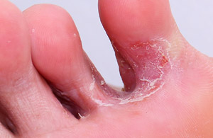
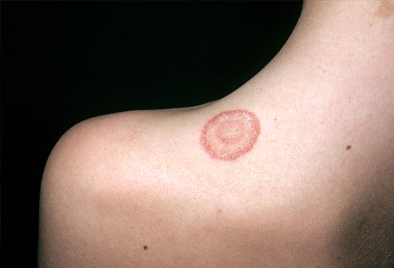
Contraindications
Patients with ischemia affecting the heart or brain.
Patients with poor respiratory function.
Danger of bleeding or hemorrhage.
Severe kidney disease:
Open wounds and skin infections such as tinea pedis and ringworm.

Slide 10
Uncontrolled bowel or bladder (incontinence)
Water and airborne infections or diseases: Examples include influenza, gastrointestinal infections, typhoid, cholera, and poliomyelitis.
Uncontrolled seizures/ epilepsy: Those prone to sudden attacks of unconsciousness.

Slide 11
Physiological effects of hydrotherapy
Increase in blood supply to muscle
Increase the muscle metabolism
Increase in respiratory rate
Resistance placed on the diaphragm due to hydrostatic pressure which allows lung to take in more oxygen
Increase in blood circulation around the body and decrease risk of Congestive heart disease.
Relieves muscle tension allows muscle relaxation thus reducing pain

Slide 12
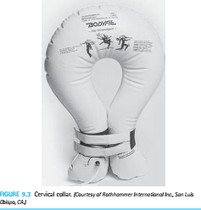
Special equipments for aquatic exercises
Cervical collar to assist with patient positioning by providing buoyancy assistance to maintain head out of water. This collar can be inflatable.
Such large rings can also be used for waist to maintain position at trunk

Slide 13
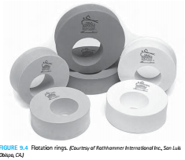
Special equipments for aquatic exercises
Floatation rings- comes in various sizes- used for wrist, ankles, knee to assist positioning and relaxation.

Slide 14
Various treatments using aquatic (water) environment
Stretching exercises
Strengthening exercises
Aerobic conditioning (aerobic exercises/ exercises for cardio vascular and respiratory systems)
Note: we shall begin to understand each above mentioned exercises with one examples each

Slide 15
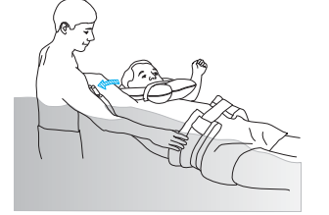
Let us begin with stretching exercises
Example: if patient’s shoulder abduction range is to improve
Therapist will stand in a pool on the side to be stretched (just like our practice of passive movement)

Slide 16
Patients position in supine with appropriate flotation devices to maintain supine lying.
Therapist’s one had at the waist ring to stabilize the trunk and another hand at elbow joint the at the desired degree of abduction apply stretch to improve abduction ranges.

Slide 17
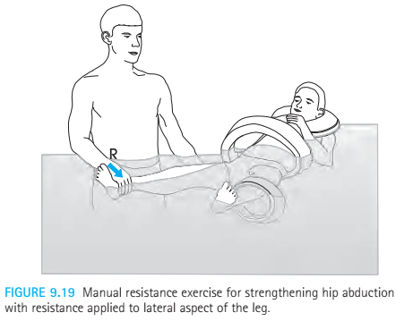
Strengthening in water
As we can see in the figure therapist is applying the resistance grasping patient’s leg distally and laterally. Patient is in supine position, with another hand he is also stabilizing the body of patient by grasping the waist ring.

Slide 18
Aerobic conditioning
This is another type of aquatic exercise where overall fitness can be improved/maintained by making an individual simply walk into the waist depth water or walk.
Other various exercises can also be given to improve cardio-respiratory fitness in the patient

Slide 19
One of the famous method in hydrotherapy is Bad Ragaz Techniques
REFER THE WORD DOCUMENT ATTACHED WITH MATERIAL PROVIDED

