Slide 1

CLEFT PALATE & ITS MANAGEMENT
DR. RISHABH NAVIN SHAH
BDS, MDS, FCCS
Cleft & Cranio-Maxillofacial Surgeon
Department Of Oral And Maxillofacial Surgery
K M Shah Dental College And Hospital
Sumandeep Vidyapeeth

Slide 2
INTRODUCTION
3rd most frequently occurring congenital deformity.
Unilateral cleft lip and palate – 46%
Isolated cleft palate – 33%
Cleft palates affect 1:2,000 live births worldwide
Isolated cleft palate occurs most commonly in females than in males

Slide 3
ETIOLOGY
Unknown
Genetics
Familial inheritance
Gestational exposures
Alcohol, cigarette smoking
Steroids, anticonvulsants
Retinoids
Rubella
Hypoxia
Syndromes associated with cleft palate
Velo-Cardiofacial Syndrome
Pierre-Robin Syndrome

Slide 4
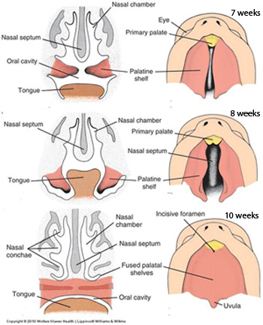
DEVELOPMENT OF PALATE
6th week
Primary palate is formed by merging of two median palatine process.
7th – 8th week
Formation of secondary palate .
Fusion of right and left maxillary process and medial nasal process.
Lateral palatine process grows downward and straightens to horizontal position, grows medially and fuses at midline and to nasal septum.

Slide 5
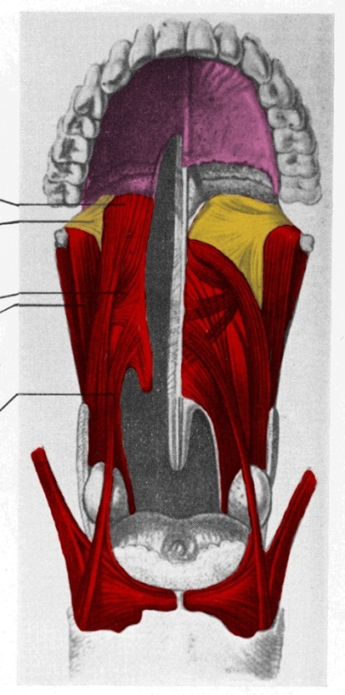
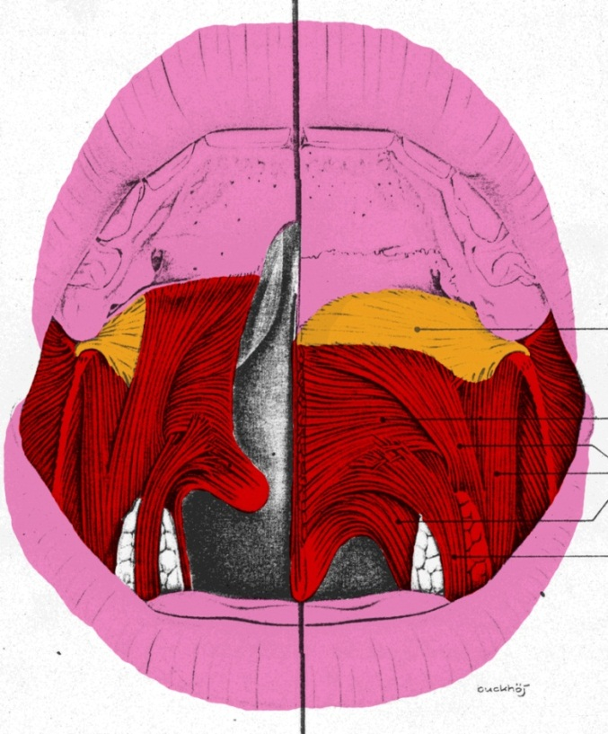
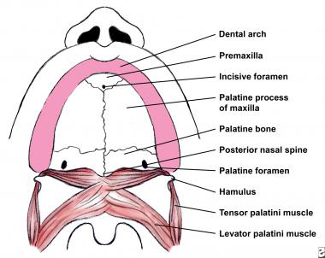
Anatomy of Cleft Palate & Normal Palate
Veau 1934
Skoog 1969
Normal Anatomy
The tensor palati and superficial portion of the palatopharyngeus muscles are fixed to the posterior border of the palate so that their orientation is longitudinal rather than transverse which is the normal. anatomy.

Slide 6
CLASSIFICATION

Slide 7
Davis & Ritchie
Pre-alveolar cleft (cleft lip only)
Unilateral
Median
Bilateral
Post-alveolar clefts (cleft palate only)
Soft palate
Hard palate
Alveolar clefts (cleft lip, alveolus & palate)
Unilateral
Median
Bilateral

Slide 8
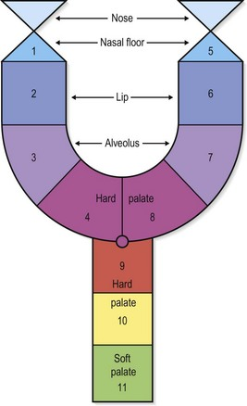
Kernhan’s Or Striped Y
Elsahy – Modified by adding triangular peak
Millard – Modified by inverted triangle.

Slide 9
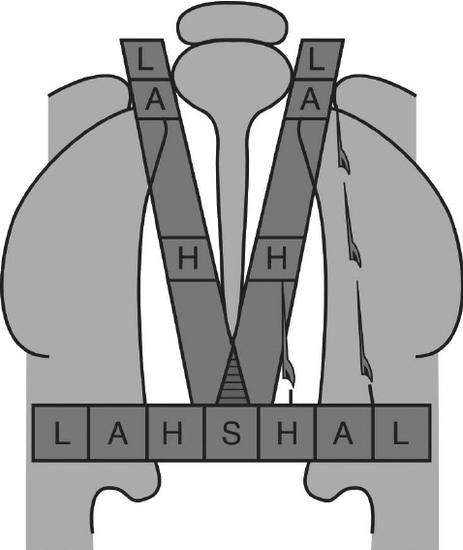
LAHSHAL or Kriens
R - Right Complete cleft of lip
L -Left Complete cleft of lip
Capital letters – Complete cleft
Lowercase – Partial clefts
Asterisks - Microform

Slide 10
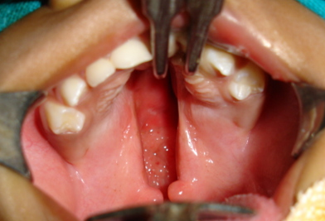
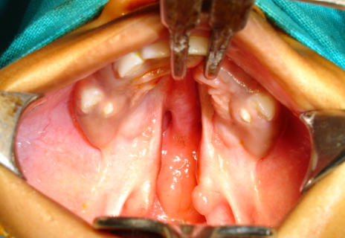
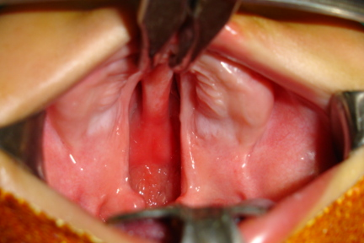
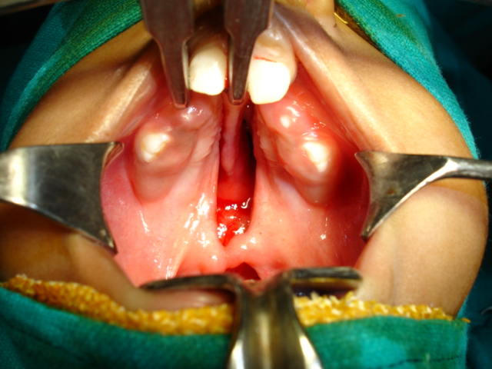
Cleft palate variations
Cleft of hard and soft palate associated with cleft lip
Unilateral complete cleft palate associated with cleft lip with palatal shelves at the same level anteriorly
Unilateral complete cleft palate associated with cleft lip with palatal shelves at the different levels anteriorly
Bilateral complete cleft palate associated with cleft lip with palatal shelves at the same level of the premaxilla anteriorly
Bilateral complete cleft palate associated with cleft lip with palatal shelves at the different levels of the premaxilla anteriorly

Slide 11
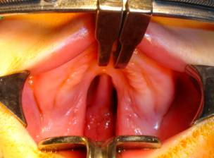
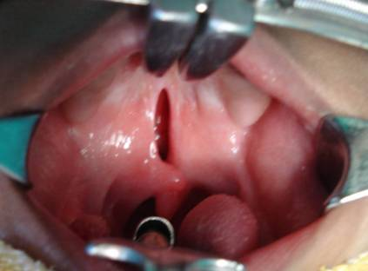
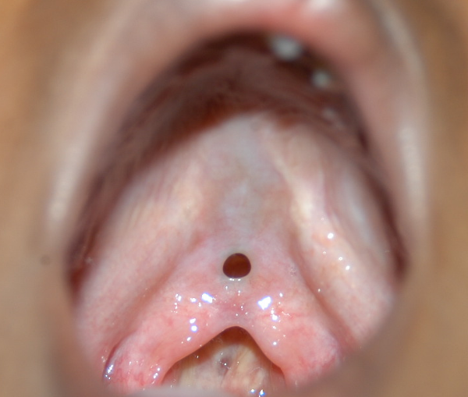
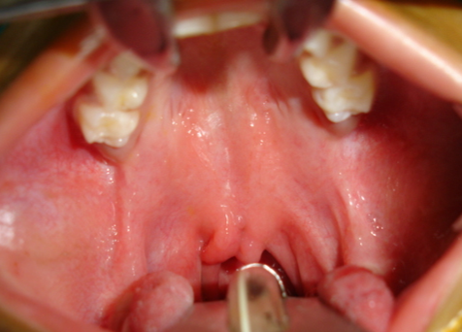
Cleft palate variations
Isolated Cleft Palate
Cleft of hard and soft palate
Cleft of soft palate
Submucous cleft palate
Bifid uvula

Slide 12
RATIONALE
Growth
Feeding & Swallowing
Speech
Eustachian tube

Slide 13
Primary Cleft Palate Repair
Age of Surgery [6-14 months]
Stages:- a. Lip & Soft palate
b. Lip & Vomerine flap
b. Lip only
c. Palate only
Technique :- a. Bardach two flap technique
b. Von Langenbeck
c. Furlow
d. Delaires
e. Sommerlads
f. Morphofunctional

Slide 14
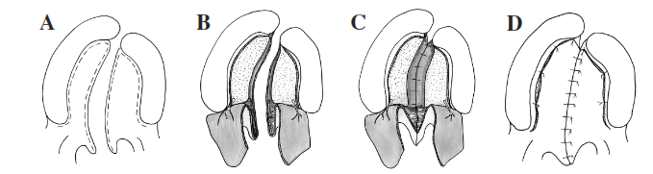
Cleft Palate Repair: Bardach
The design of this flap is entirely
dependent on the greater palatine
neurovascular pedicle and it provides
greater versatility to cover the cleft.
Advantages:-
Complete closure of the entire palate in
one stage.
Creation of more physiologic soft palate
muscle sling and a layered closure
technique.
Disadvantages:-
Does not provide additional length to
the repaired palate to allow normal
speech production.
Bardach J. Two flap palatoplasty Bardach Technique. Operative Techniques in Plastic and Reconstructive Surgery. 2(4):211-214.1995

Slide 15
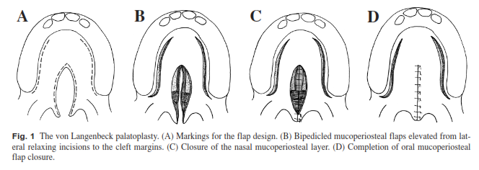
Cleft Palate Repair: Von Langenbeck
The Von Langenbeck technique is similar to
Bardach palatoplasty but preserves an
anterior pedicle for increased blood supply
to the flaps.
Used in isolated cleft palates.
Advantage:-
Easy to perform.
Requires less dissection.
Results in decreased raw area of palate.
Disadvantages:-
Cannot be used in wider and complete clefts.
Failure to provide additional palatal length.
Palatoplasty : Evolution and controversies Chang Gung medical journal 31(4):335-45·Nov 2007.

Slide 16
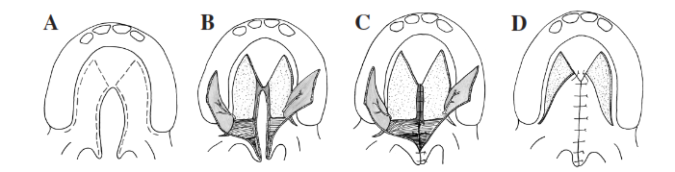
Cleft Palate Repair: Veau-Wardill-Kilner Technique – Pushback Palatoplasty
Used for incomplete clefts of the hard and soft
palate.
Advantages:-
Lengthening the palate and repositioning
the levator muscle in a more favorable
position.
Disadvantages:-
Adversely affects midfacial growth in cleft
palate patients because of scar tissue anteriorly.
Higher rate of fistula in complete cleft palate
than other techniques because it provides
only a single nasal mucosa layer anteriorly
Agrawal K. Cleft palate repair and variations. Indian Journal of Plastic Surgery : Official Publication of the Association of Plastic Surgeons of India. 2009;42(Suppl):S102-S109.

Slide 17
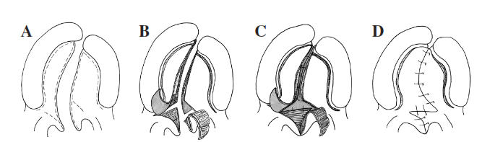
Cleft Palate Repair: Furlow
Alternating the reversing Z-plasties of the nasal and
oral flaps and repositioning the levator veli palatini
muscle within the posteriorly mobilized flaps.
Effective for primary closure of a submucous
cleft palate and secondary correction of marginal
velopharyngeal insufficiency.
Advantages:-
No need to raise large mucoperiosteal flaps from the
hard palate.
The soft palate can be lengthened.[Good speech outcome]
Disadvantages:-
Non anatomical palatal closure
Ignores musculus uvulae
Difficult to close wider clefts
Large raw area - needs to be covered with buccal flap.
Palatoplasty : Evolution and controversies Chang Gung medical journal 31(4):335-45·
Nov 2007.

Slide 18
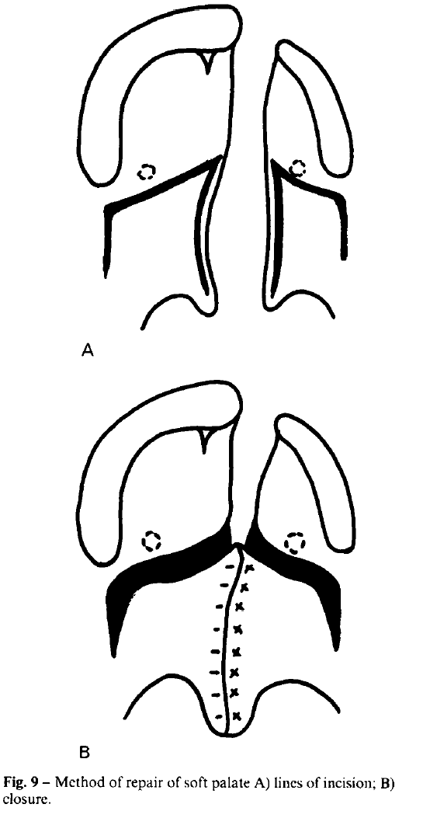
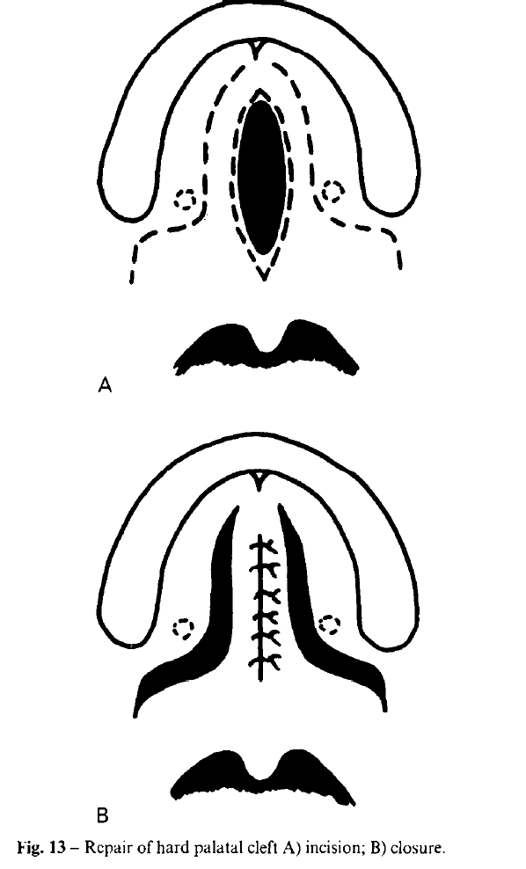
Cleft Palate Repair: Delaire
Two stage Palatoplasty – Lip + Soft Palate
[6 months]
Horizontal incision posterior to greater palatine
vessels.
Advantages
Encourages normal function of the soft palate and
the tongue.
Facilitates closure of the hard palate.
Prevents arch collapse.
Good palatal lengthening, fewer hearing problems.
Disadvantages
Two stage procedure.
Stage I Stage II
Markus AF, Smith WP, Delaire J. Primary Closure of cleft palate: a functional approach. British Journal of Oral and Maxillofacial Surgery. 31:71-774.1993

Slide 19
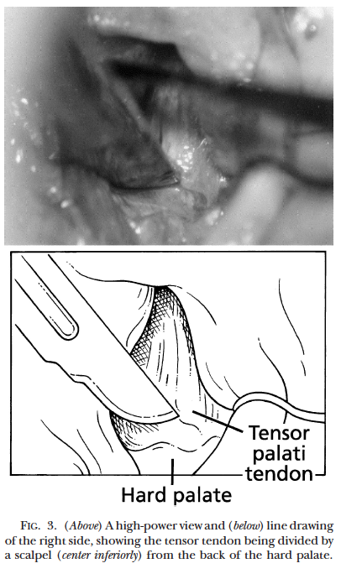
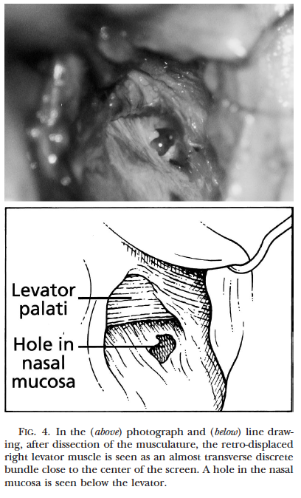
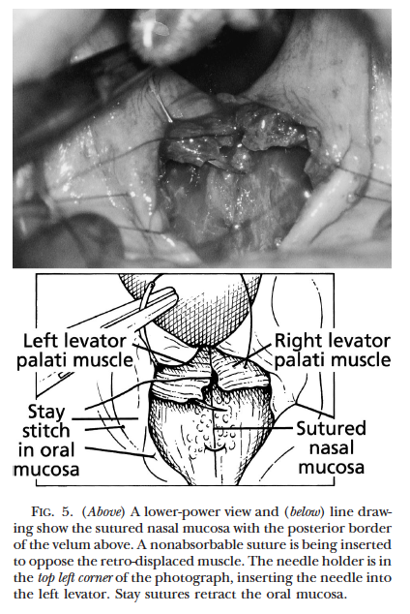
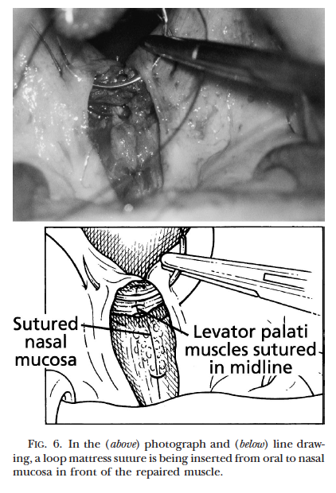
Cleft Palate Repair: Sommerlad
Radical retropositioning of the velar musculature
and tensor tenotomy using an operating
microscope to allow accurate levator muscle
reconstruction.
Advantages:-
Non tension closure even in wider palates.
Good speech outcomes.
Disadvantages:-
Recurrent ear infections due to tensor tenotomy.
High fistula rates due to radical muscle releiving
from the nasal area.
Loss of tautness of soft palate.
Sommerlad BC. A technique for cleft palate repair. Plastic and Reconstructive Surgery. 112(6):1542-1548.2003

Slide 20
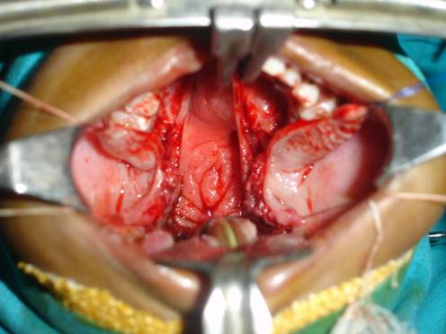
Morphofunctional Cleft Palate Repair
Two flap technique with optimal muscle dissection
Medial and Lateral incisions to expose the soft palate musculature and mobilize the hard palate flaps.
Gosla Reddy, S. (2017). Morphofunctional palatoplasty: evidence based recommendations. International Journal of Oral and Maxillofacial Surgery. 46. 21. 10.1016/j.ijom.2017.02.077.

Slide 21
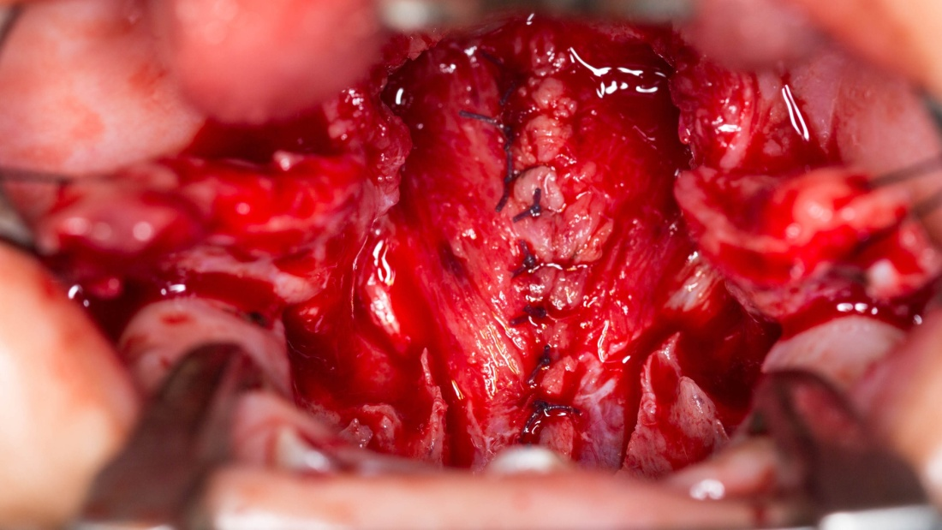
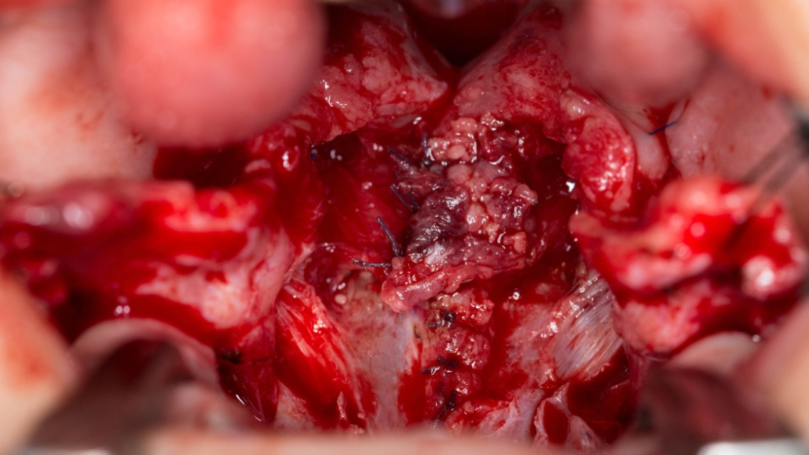
Two flap technique with optimal muscle dissection
SOFT PALATE MUSCLE DISSECTION
Tensor veli Palatini
Tensor veli Palatini
Optimal muscle dissection
Dissection only of Levator muscle bundle (Levator Myoplasty)
Tensor tendon is not dissected
Gosla Reddy, S. (2017). Morphofunctional palatoplasty: evidence based recommendations. International Journal of Oral and Maxillofacial Surgery. 46. 21. 10.1016/j.ijom.2017.02.077.

Slide 22
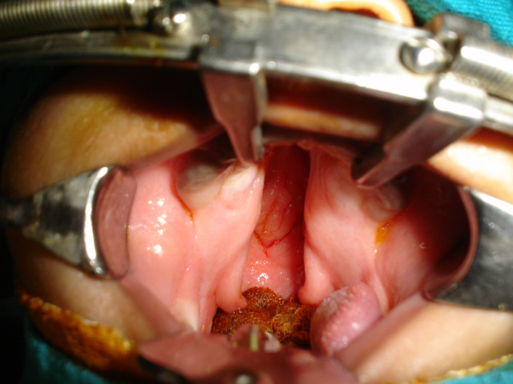
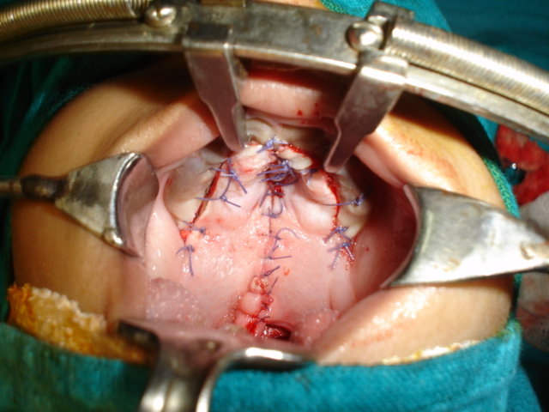
Two flap technique with optimal muscle dissection
Gosla Reddy, S. (2017). Morphofunctional palatoplasty: evidence based recommendations. International Journal of Oral and Maxillofacial Surgery. 46. 21. 10.1016/j.ijom.2017.02.077.

Slide 23
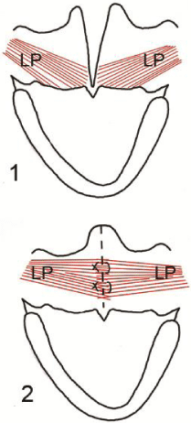
Intervelar Veloplasty
Dissection of the Levator Palati from the posterior border of the
hard palate, nasal and oral mucosa and posterior repositioning.
Suturing of the muscle with that of the opposite side for
the reconstruction of the Levator sling.
Sommerlad dissects the levator palatini belly separately and
sutures independently as the Levator is the dominant muscle for
elevation of the soft palate during speech. Also tensor tenotomy is
performed.
Court Cutting transects the Tensor Palati and to keep its function
intact, the cut end is transfixed with the hook of the hamulus.

Slide 24
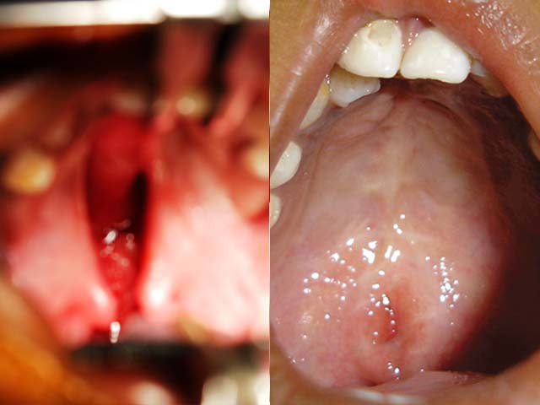
One Stage Palatoplasty
Complete Palate Repair at age 12-13 months
6 years post-op

Slide 25
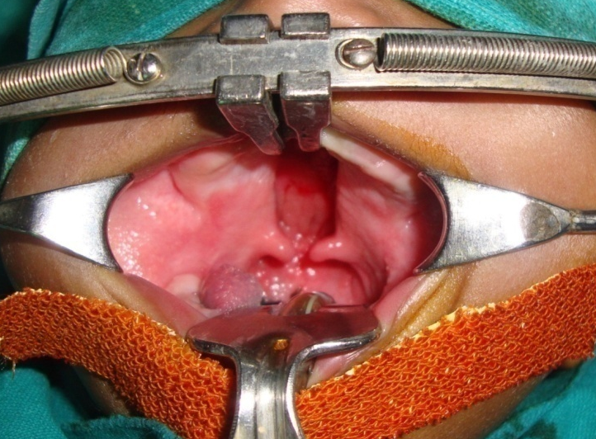
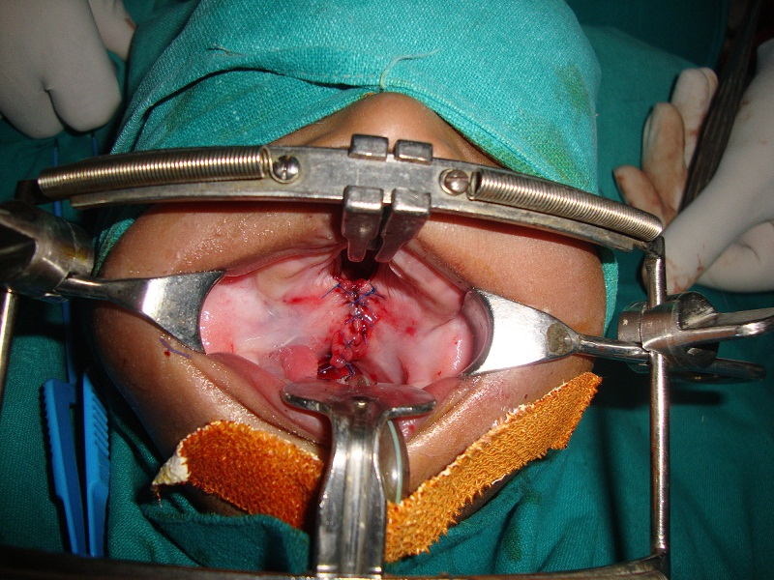
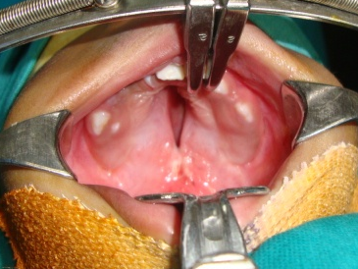
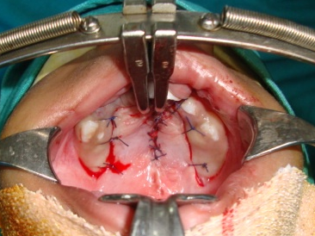
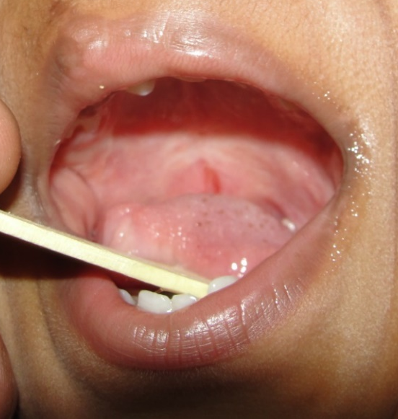
Two Stage Palatoplasty
SOFT PALATE CLOSURE (At age 12-13 months)
HARD PALATE CLOSURE (At age 24-25 months)
6 years post-op

Slide 26
VPI
Inability to achieve complete closure of the velopharyngeal apparatus during speech.
Velopharyngeal apparatus (Regulation of airflow from the lungs and larynx)
Soft Palate + Pharyngeal Structures.
Velopharyngeal insufficiency: inability to achieve complete closure of the
velopharyngeal apparatus during speech. [Structural Defect]
Velopharyngeal incompetence: Imperfect closure of velopharyngeal apparatus that
is caused by neuromuscular dysfunction. i;e impaired motor programming of
velopharynx. [Neurogenic Defect]
Velopharyngeal inadequacy: Imperfect closure of the velopharyngeal apparatus
caused by the tissue defect. [Tissue insufficiency]

Slide 27
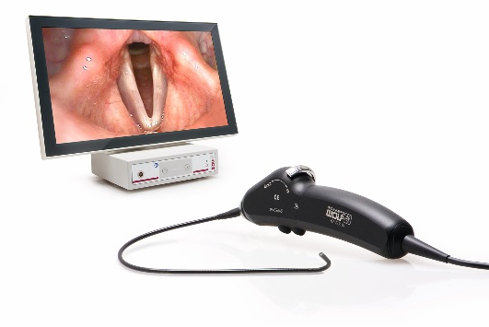
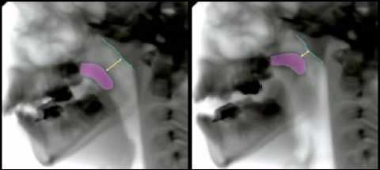
Assessment of the Velopharyngeal Function
Perceptual Speech Evaluation by a well trained speech pathologist.
Pressure Flow measurements.
Nasopharyngeal endoscopy.
Videofluoroscopy

Slide 28
VPI correction
Secondary Palatoplasty aims at correcting the velopharyngeal inadequacy (VPI)
VPI is defined as inadequate closure of the soft palate during speech to the posterior pharynx during speech, resulting in air leak up into the nasopharynx
(Lindsey and Davis, 1996).
5% to 36% of patients who have undergone primary palatoplasty have persisiting VPI
(Dorf and Curtin, 1982; Bardach and Morris, 1990; Peat et al., 1994; Hudson et al., 1995)

Slide 29
VPI correction
Surgeries for
VPI
Palatal lengthening
Velopharyngeal narrowing procedure
V-Y pushback procedure
Intravelar veloplasty
Double opposing Z- plasty
Sphincter pharyngoplasty
Pharyngeal flap
Superiorly based
Inferiorly based

Slide 30
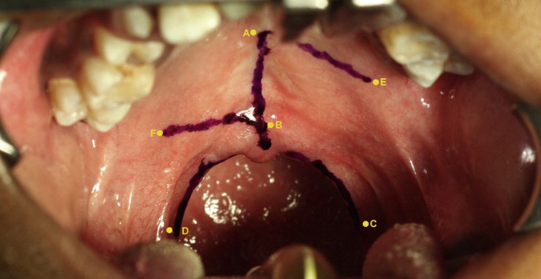
Modified Furlows ‘Z’ Plasty with Levator Myoplasty
Incision marking

Slide 31
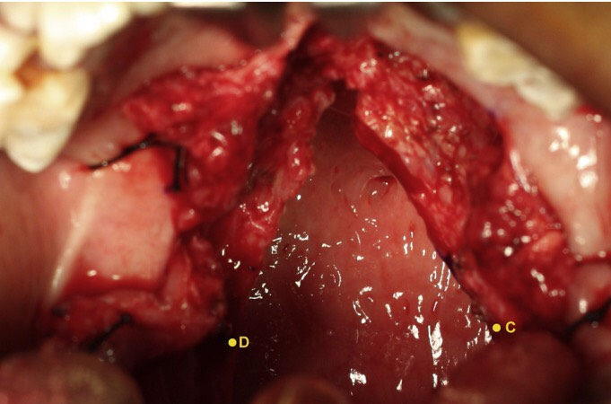
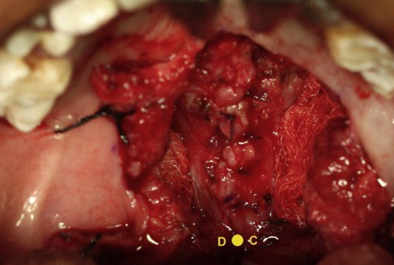
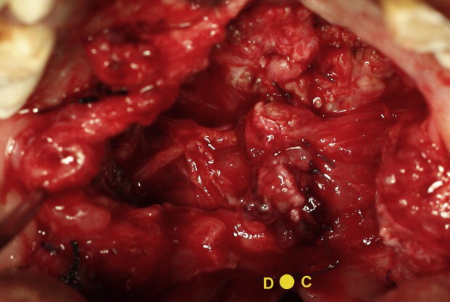
Modified Furlows ‘Z’ Plasty with Levator Myoplasty
Levator Myoplasty

Slide 32
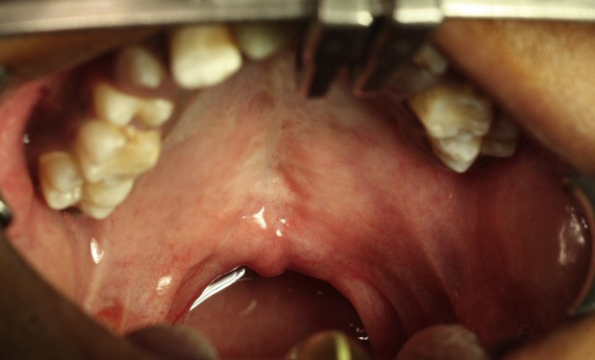
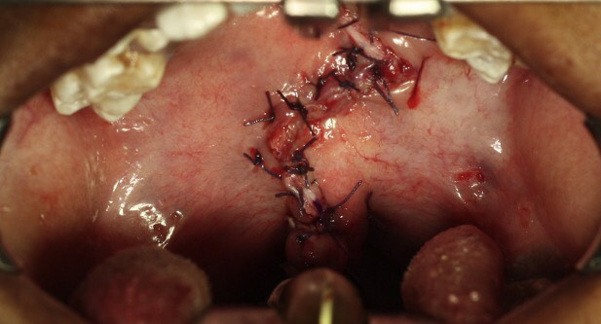
Modified Furlows ‘Z’ Plasty with Levator Myoplasty
Closure

Slide 33
Complications
Preoperative
Otitis media
Aspiration pneumonia
Nutritional Deficiency
Intraoperative
Blood Loss
Damage to the Pedicle
Immediate Post Operative
Bleeding
Airway obstruction
Wound Dehiscence/ Infection
Hanging Palate
Erosion of corner of mouth
Late Post Operative
Fistula formation
Velopharyngeal incompetence
Maxillary Hypoplasia
Recurrent ear infections

Slide 34
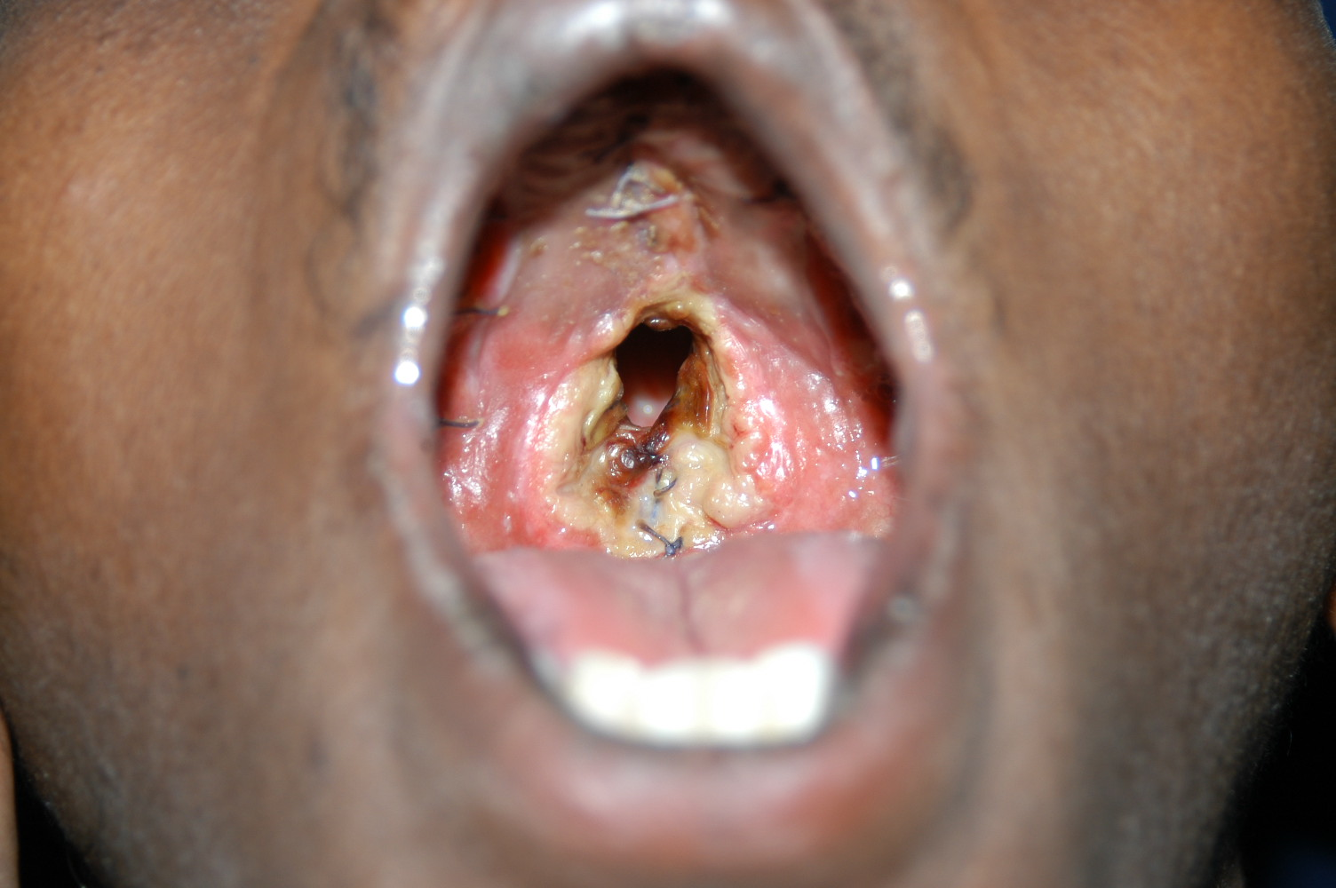
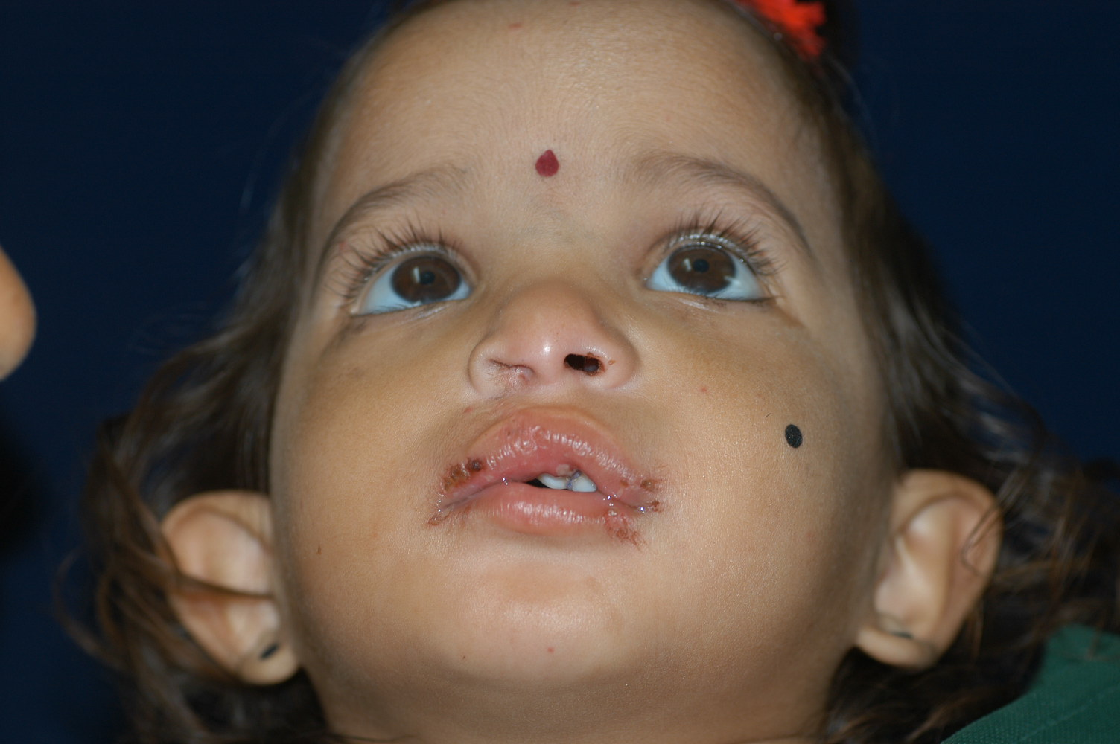
Wound Dehiscence
Erosion of corner of mouth

Slide 35
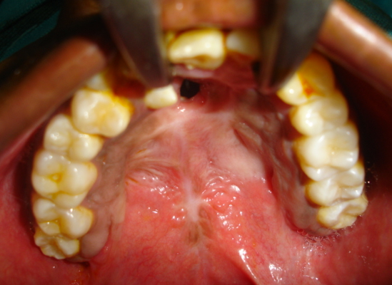
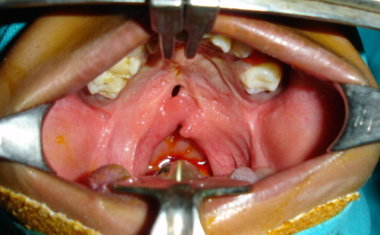
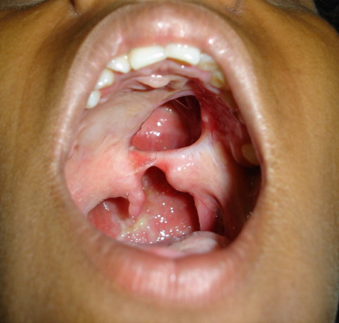
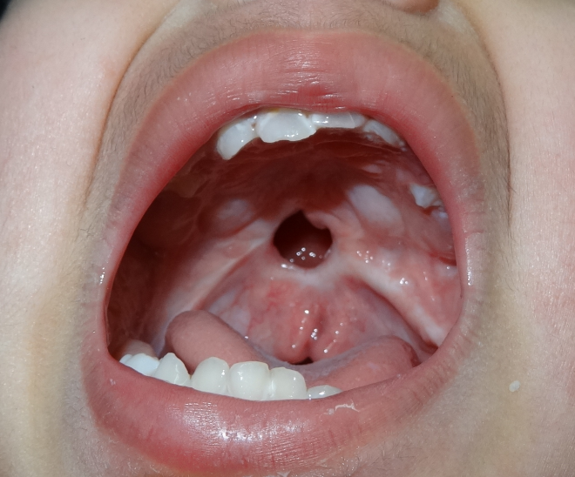
FISTULA FORMATION

Slide 36

Algorithm for the management of palatal fistula
Murthy J. Descriptive study of management of palatal fistula in one hundred and ninety-four cleft
individuals. Indian J Plast Surg. 2011 Jan;44(1):41-6. doi: 10.4103/0970-0358.81447.

Slide 37

Tongue Flap
Guerrero-Santos and Altamirano,
were the first to report on the use of
tongue flaps for palatal defect closure.
The tongue flap is easy and
reproducible with excellent esthetical
and functional results.
Advantages: The advantages are the
use of adjacent tissue, the excellent
blood supply and the low morbidity in
donor site.
Disadvantage: Inability in swallowing
and speech until depedicling of the flap
and in some cases the attachment of
the flap can be lost due to traction.

Slide 38


Buccal Myomucosal Flap
BMMF is a vascular and dependable flap. Vascular
supply of the flap is consistent and profuse.
The buccinator myomucosal flap is effective in
reducing/eliminating hypernasality in patients with
cleft palate and velopharyngeal insufficiency.
Advantages:
Flap congestion is occasional and necrosis is rare.
It tolerates stretching, folding, and twisting.
Disadvantages:
Fibrosis. Secondary healing.
Parotid duct orifice injury.

Slide 39


Hypolpastic maxilla
Orthognathic Surgery
Distraction Osteogenesis

Slide 40

Postoperative Management
Postoperative antibiotic dressing.
Postoperative feeding: Clean, clear and filtered fluids for 1 month.
Plenty of oral fluids.
Parent counselling.

Slide 41
Questionnaire
Essay
Comphrensive management of Cleft Lip & Palate.
Short Answer Questions
Embryology of Palate with neat labelled diagrams.
Anatomy of Palate Vs Cleft Palate
Von Langenbeck Technique
Bardach Technique
Management of Palatal Fistula
Furlows Technique
Long Answer Questions
Comlplications of Cleft Lip & Palate Surgeries
VPI and its management
C

Slide 42
Viva Voce
Muscles of palate.
Various gags used in Cleft Palate repair.
Various procedures of Cleft Palate repair.
Various palatal lengthening procedures.
Difference between Velopharyngeal Incompetence and Velopharyngeal Insufficiency.
Sommerlads technique.
Hanging palate.
Hole in one technique.
Raw area free palatoplasty.
Post operative instructions after palate repair.

Slide 43



Bring the Smile Back
Thank You

