Slide 1
SUSPENSION THERAPY
PRESENTED BY: DR. PINAL MODI

Slide 2
OBJECTIVES:
At the end of the lecture, student will be able to:
Describe suspension therapy
Briefly know about principles and advantages.
Identify and describe about tools and material used in suspension therapy
Describe types of suspension and their uses.

Slide 3
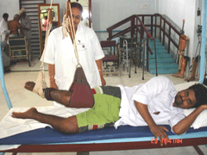
DEFINITION:
SUSPENSION IS DEFINED AS SUSPENDING A PART OF THE BODY OR WHOLE BODY WITH THE SUPPORTED SLINGS AND PULLEYS.
SUSPENSION FREES THE BODY FROM THE FRICTION OF THE MATERIAL UPON WHICH BODY COMPONENTS MAY BE RESTING AND IT PERMITS FREE MOVEMENT WITHOUT RESISTENCE WHEN THE FIXATION IS SUITABLY ARRANGED RELATIVE TO THE SUPPORTED PART.

Slide 4
PRINCIPLES:
FRICTION
PENDULUM
ELIMINATING GRAVITY MOVEMENT

Slide 5
FRICTION
It occurs during a particular surface moves on another.
It is the force, which restricts the movement of an object.
If the surfaces are more smooth and slippery will have less friction, in that surface movement Will be more and smooth.
If the surfaces are hard or rough results in more friction and the movements are opposed by the friction force.
The same principle is used in the suspension which has less friction causes the smooth and easy movement.

Slide 6
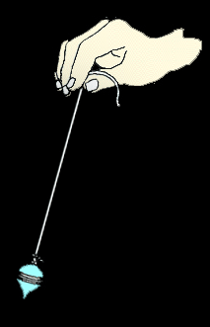
PENDULUM
Pendulum is heavy material suspended by the weightless thread.
If the force is applied on the pendulum, it results in to and fro movement.
One complete swing is called as oscillation.
During the oscillation, the arc of the movement of the pendulum forms a segment of base of the cone.
The oscillation will be continued until the force comes down.
In the human body, the pendular motion occurs mainly in the shoulder and hip joints

Slide 7
Forward leg movement and arm swing movement While walking is the simplest example.
The simple muscular contraction is necessary to initiate the oscillation.
The same mechanism is used in suspension therapy to maintain the muscle property, increase the range of the motion and strengthening the muscles.

Slide 8
ELIMINATING GRAVITY MOVEMENT
If the person has the muscle power 2(gravity eliminated), can go for the suspension exercises.
If the muscle power is less than 2, it is difficult to perform the suspension therapy ex. By the pt. himself.
So the pt. should have minimal muscle power of 2 to undergo for suspension therapy.
If the muscle power is above 3, the pt. can go for against the gravity exercises instead of suspension therapy exercise.

Slide 9

ADVANTAGES
It reduces the burden for therapist.
Easy to lift the limbs.
Active movements Can be performed easily with minimum friction.

Slide 10
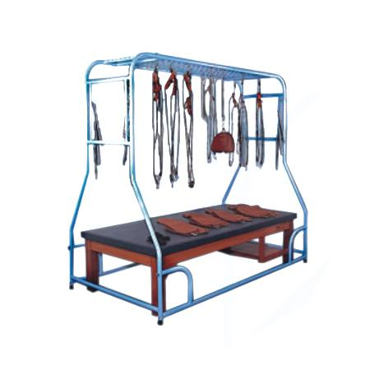
SUSPENSION INSTRUMENTS
SUSPENSION FRAME
SUPPORTING ROPES
PULLEYS
SLINGS
S-HOOK AND DOG CLIPS
WOODEN CLEAT

Slide 11
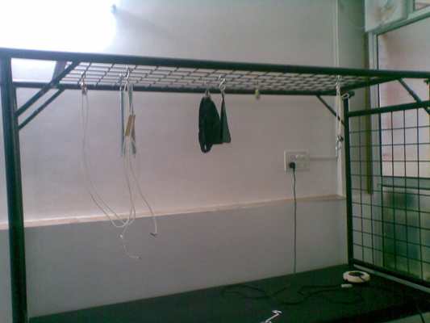
Suspension Frame

Slide 12
SUSPENSION FRAME:
It is made up of the stainless steel or plastic coated steels.
In the top and head end side presents the 5 cm metal mesh, and the remaining sides are kept open.
The measurements of the frame is 1 m or 2 m width, 2 m length, 2 m height.
In the middle of the frame 2 m length, 1 m width and 1 m height couch is placed for the patient’s accomodation.

Slide 13
SUPPORTING ROPE
It is 1.5 meters length.
One end of the rope consist of the fixed ring and another end of the rope passes through the wooden cleat and is knotted in half hitched manner.
There are 3 varieties which is used:
Primary supporting rope
Secondary supporting rope
Vertical supporting rope
(cont….)

Slide 14
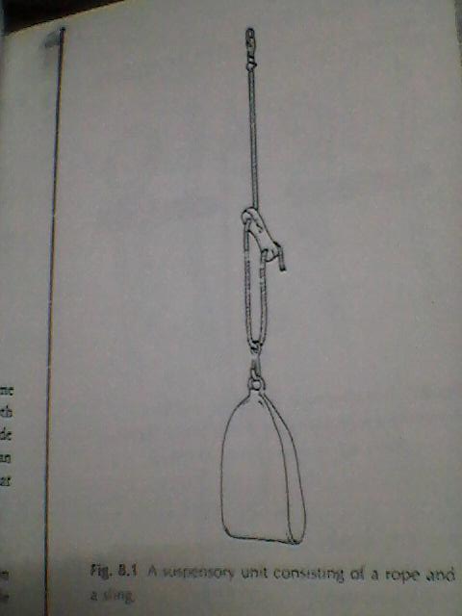
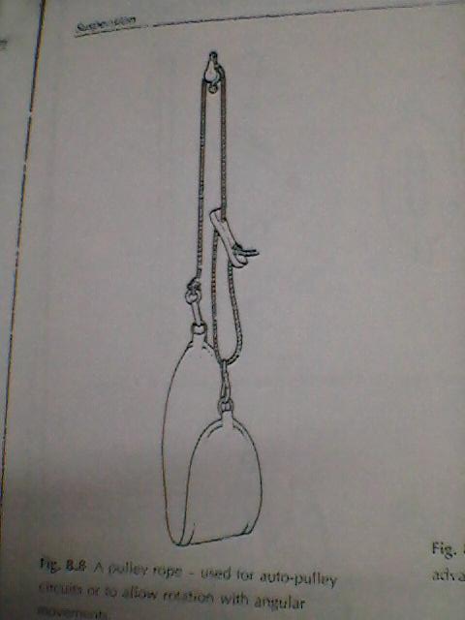
Unit consisting of rope and a sling
Unit consisting of sling with pulley

Slide 15
The primary rope which is used to take the axis as the point of suspension and it supports the distal joints.
The secondary rope is added with the primary rope to support the proximal joint.
Vertical ropes are used for vertical suspension and are supporting the mid portion of the body segment.

Slide 16
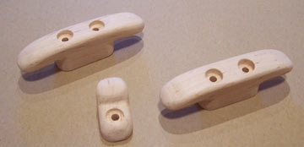
WOODEN CLEAT

Slide 17
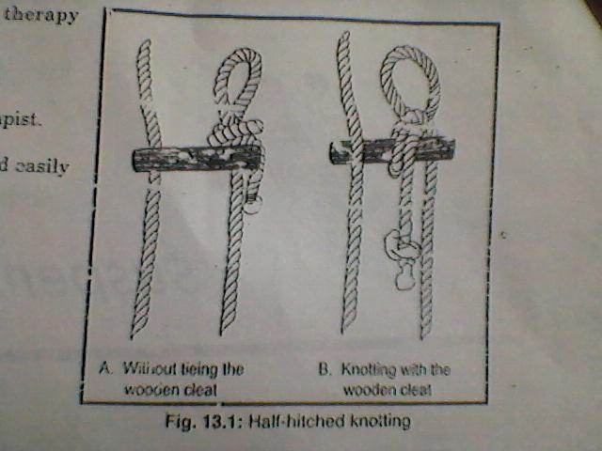
WOODEN CLEAT:
It is made of wood and is used for altering the length of the rope.
It has 2 or 3 holes for the rope passage, the rope itself holds cleat by friction resistance.
wooden cleat is placed horizontally for adjusting the length of the rope and the oblique alignment for support.

Slide 18
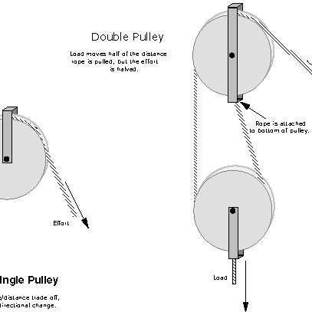
PULLEYS:
It gives the mechanical advantage. Pulleys are used to reduce the burden of lifting whole body or body parts.
Here sometimes single or double pulleys are used depends on the situation.
If the body part is big for e.g. trunk, thorax and thigh. Double pulleys are used.

Slide 19
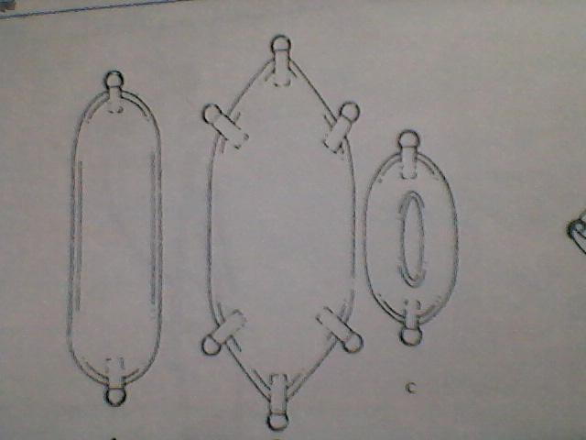
SLINGS:
The slings are made up of canvas. There are 4 varieties of slings are available.
Single sling
Double sling
Three ring sling
Head sling
Single sling
Double sling
Head sling

Slide 20
SINGLE SLING
It is 68 cm length and 17 cm width, both the ends are having the D-rings for the attachment with the dog clip or S-hook.
These types of slings are used for the elbow and knee region.
It is sometime folded in figure of 8 manner to support the wrist and ankle.

Slide 21
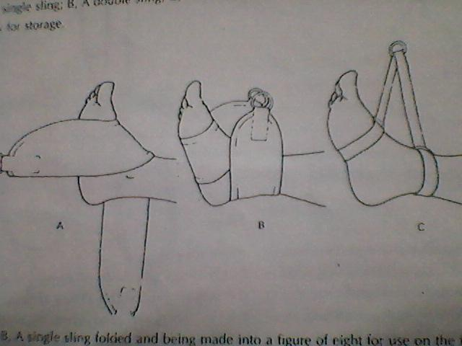
A AND B SUGGESTS SINGLE SLING.(IN TO FIGURE OF 8 AT ANKLE)
C SUGGESTS THREE RING SLING ON THE FOOT AND ANKLE.

Slide 22
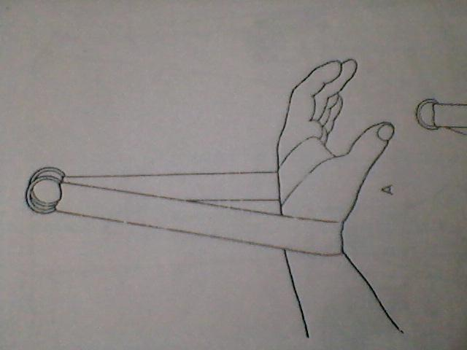
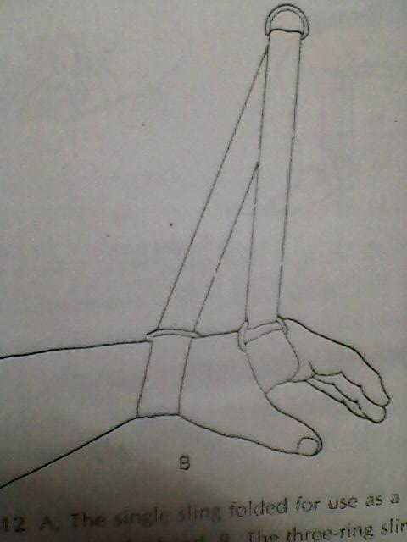
SINGLE SLING AT HAND
THREE RING SLING AT HAND

Slide 23
DOUBLE SLING
It is bigger than the single sling, it will have more than 2 sides with D-rings.
It is more useful for supporting the bigger part like thorax, trunk, and thigh.
It has 68 cm length and 28 cm width.
THREE RING SLING
It is 75 cm length and 3-4 cm width, it consists of 3 D-rings.
Two at the both end of sling and one in the middle kept moving.

Slide 24
It is mainly used for wrist and ankle regions.
HEAD SLINGS:
It is used for the head support in the middle of the slings presents a slit for accomodation of occipital region.
S-HOOK AND DOG CLIPS:
Used for:
To attach the sling with the supporting ropes
To attach the supporting rope with mesh.

Slide 25
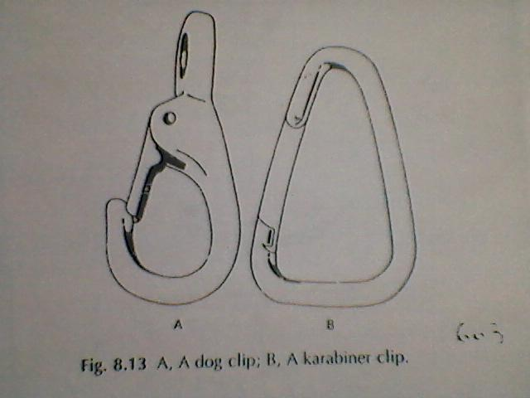
DOG CLIPS

Slide 26
TYPES OF SUSPENSION:
Axial suspension
Vertical suspension
Pendular suspension

Slide 27
AXIAL SUSPENSION
This occurs when all the ropes supporting a part are attached to one ‘S’ hook which is fixed to a point immediately above the center of the joint which is to be moved.
E.g. if the lower limb is to be moved at the hip joint, two ropes, one to the foot and one to the area of the knee, will be used and fixed at a point immediately over the axis of the hip joint.

Slide 28
When such fixation is set up the movement of the limb will be on a flat plane level with the floor.
If some resistance to the muscle work is required, the whole fixed point is moved away from the muscles which require resistance.
If the abduction is to be resisted then the fixed point is moved towards the adductors.

Slide 29
Uses:
Relaxation
Maintain muscle property
Increase the blood circulation
Increase the venous drainage
Increase the lymphatic drainage

Slide 30
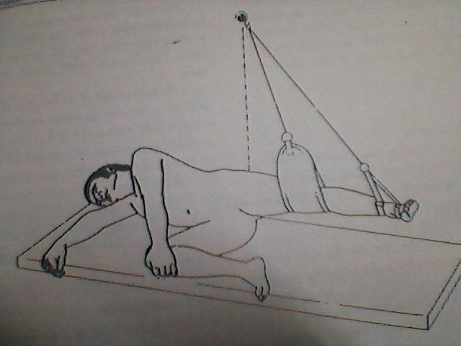
FLEXION AND EXTENSION AT HIP JT WITH AXIAL SUSPENSION

Slide 31
VERTICAL SUSPENSION:
In using vertical fixation, the rope is fixed so that it hangs vertically above the center of the gravity of the part to be suspended.
The center of the gravity of each part of the body is at the junction of the upper and middle third.
Uses:
To support the body part.
To reduce the pressure sore.

Slide 32
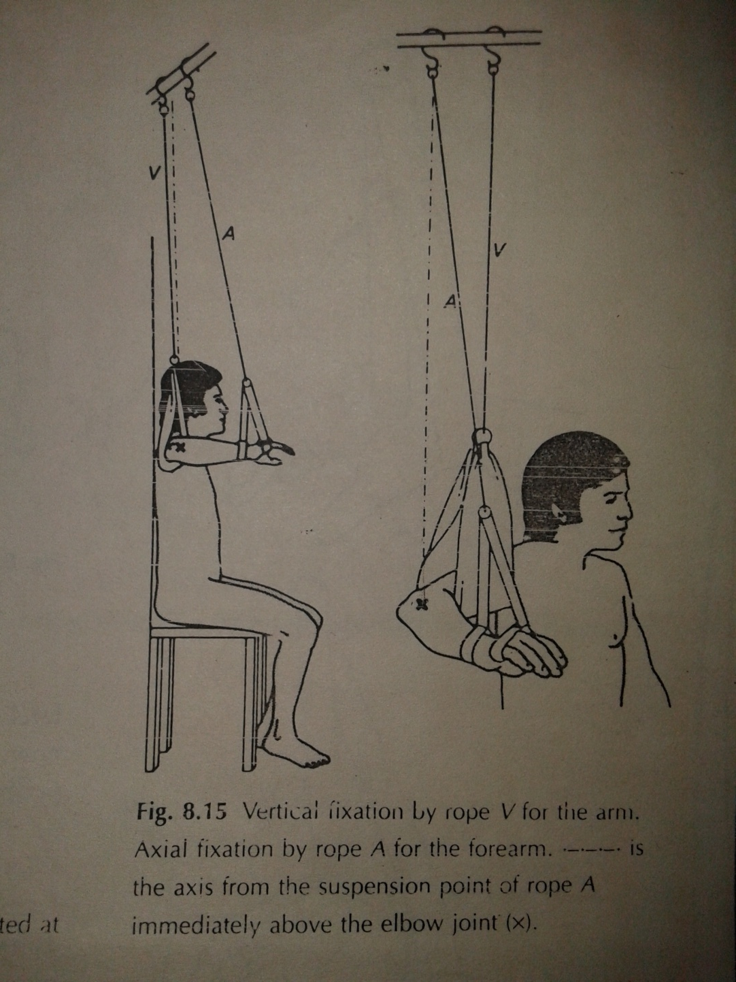

Slide 33
PENDULAR SUSPENSION
The axis of the joint is taken as the point of suspension.
Then depends on the strengthening of the muscle group, the axis is changing towards medially or laterally, anteriorly or posteriorly.
The muscles will be getting resistance while movt. If the axis is shifted opposite to that movt.
For e.g. if the axis is shifted towards the abductor side the adductor muscle will be getting resistance during movt.

Slide 34
USES:
TO STRENGTHEN THE MUSCLE
TO INCREASE THE MUSCLE POWER
TO INCREASE THE ENDURANCE

