Slide 1
STARTING POSITION
Dr. Megha Mehta

Slide 2
Objectives..
At the end of students will be able to
To know basic fundamental starting position
To know derived positions of each starting position
Effect and uses of each positions and
Muscle works of each positions

Slide 3
INTRODUCTION
Posture follows movement like a shadow:
Every movement begins in posture and ends in posture

Slide 4
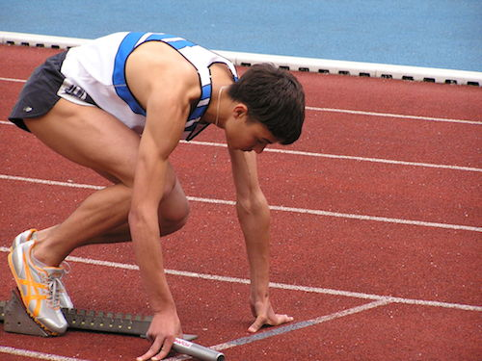
DEFINITION
The postures from which movement is initiated are known as starting positions.
It may be active or passive in character

Slide 5

FUNDAMENTAL STARTING POSITIONS
5
Standing
Kneeling
Lying
Hanging
Sitting

Slide 6
EQUILIBRIUM and STABILITY is maintained in these positions by a balance of forces acting upon body, and when the force of muscular contraction is used for this purpose the contraction is ISOMETRIC.

Slide 7
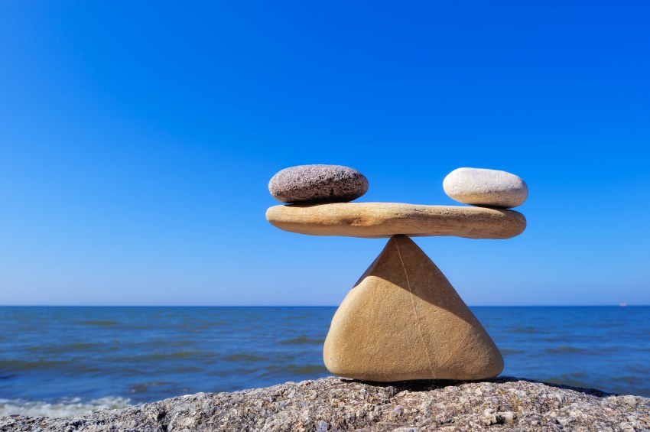
EQUILIBRIUM and STABILITY
When the forces acting upon a body are perfectly balanced and the body remains at rest.

Slide 8
Muscle Work
Concentric: Muscle shortening
Eccentric: Muscle lengthening
Agonists: Prime mover
Antagonists: Oppose agonist
Synergists: Act with agonist to facilitate movement

Slide 9
STANDING
Most difficult of the fundamental positions to maintain, as whole body must balanced and stabilised in correct alignment on a small base by the co-ordinated muscle work of many muscle groups.

Slide 10
Standing position may be described as
Heels are together and on same line
Toes slightly apart, (angle between feet not exceed 45*)
Knees are together and straight
Hips are extended and laterally rotated slightly
Pelvis is balanced on femoral heads
Spine stretched to maximum length (erect)
Vertex is thrust upwards, ears same level and eyes look straight forward
Shoulder are down and back, palms facing inwards towards body.

Slide 11
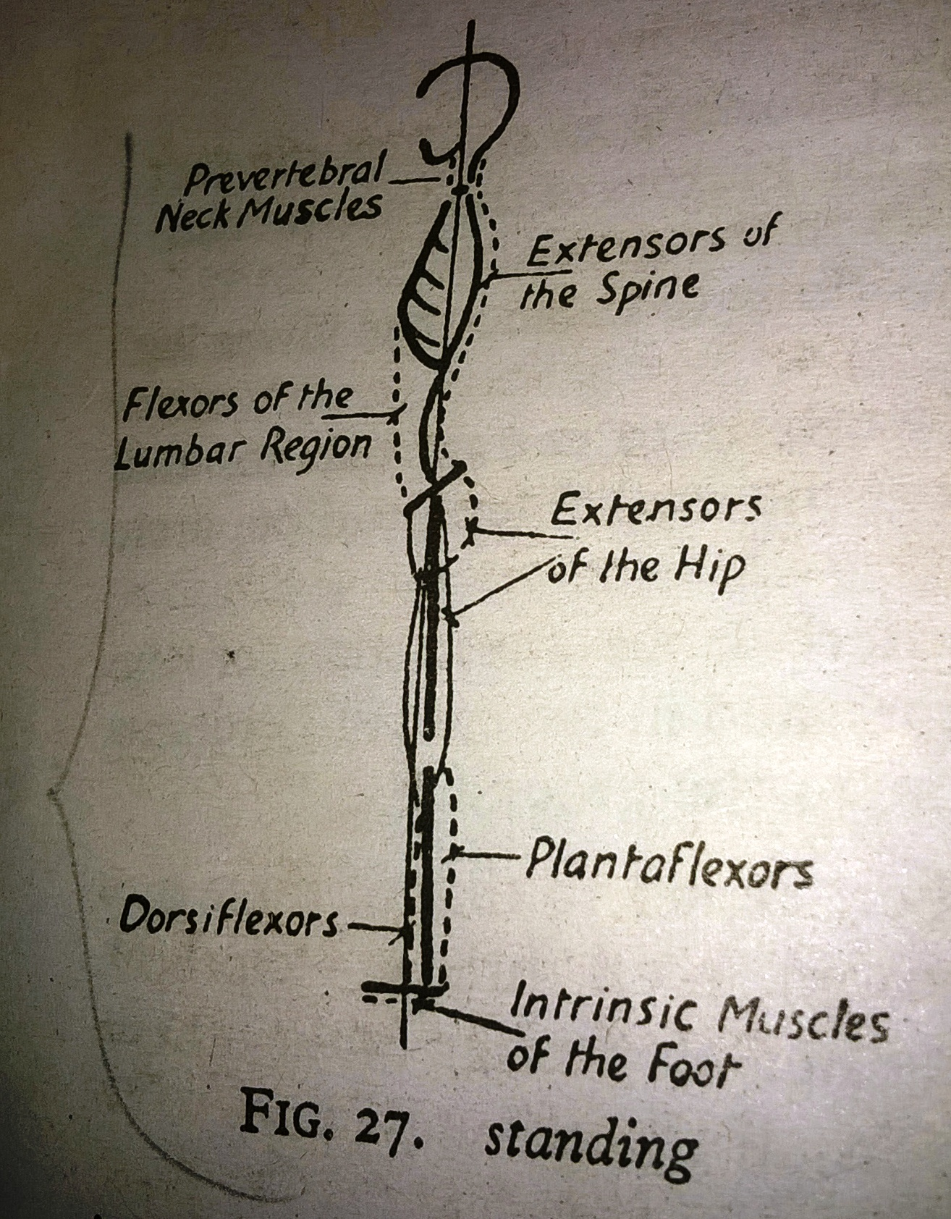

Slide 12
EFFECT AND USES
As base is small, centre of gravity is high, state of equilibrium of body is less stable than other fundamental starting position; therefore standing position is only for those who can maintain correctly.
The erect position of whole body is position of alertness, in which thorax is free and abdominal viscera are well supported.

Slide 13
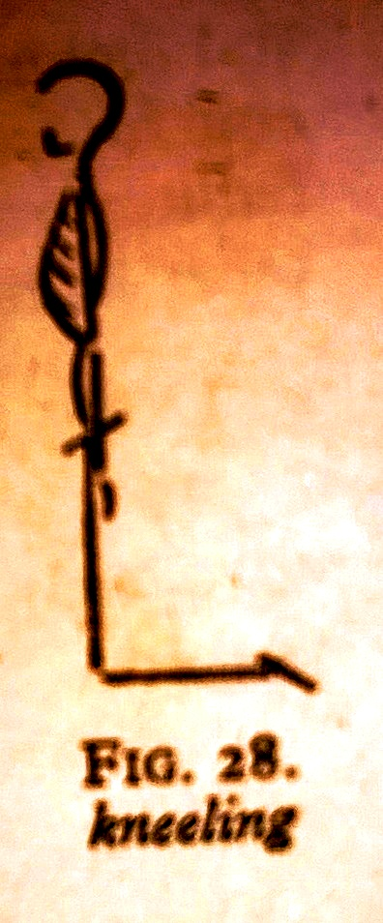
Kneeling
Body supported on knees which may be together or slightly apart.
Lower leg rests on the floor with feet plantar flexed or if plinth is used, the feet may be in the mid position over the edge.
Rest of the body is held as in standing.

Slide 14
MUSCLE WORK
Lower leg is relaxed; body must be stabilised on knees
Interplay between flexor and extensor of the knee to balance the femur vertically on the knees.
Hip extensor and lumbar flexor work strongly to maintain correct angle of pelvic tilt.
Rest all same as in standing

Slide 15
Effect and uses
COG relatively lower than standing and slightly stable than hanging but uncomfortable for most people.
Used as starting position for backward movement in sagittal plane and to train control of hip joints and lower trunk in preparation for standing position

Slide 16
SITTING
Position is taken on a chair or stool; the height and width of which allow the thighs to be fully supported and the hips and knees to be flexed to a right angle.
Knees are apart sufficiently to allow the feet rest on the floor with heels vertically below the knees.

Slide 17
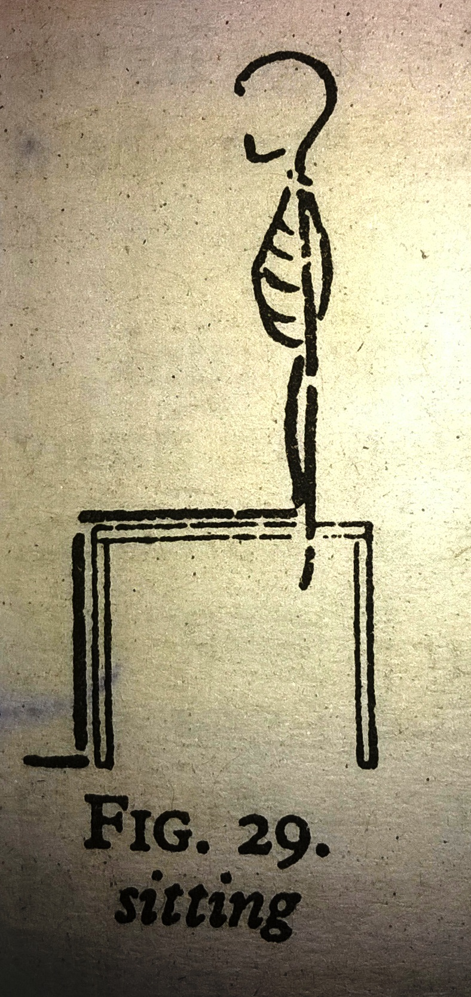

Slide 18
Muscle Work
There need be no muscle work to hold position of legs, as they are fully supported.
Hip flexors work to maintain a right angle at these joints and to prevent the tendency to slump.
Rest all same as standing

Slide 19
Effects and uses
Comfortable, natural and very stable position which is much used
Suitable for those who lack necessary strength and control to maintain more difficult position.
For lateral and rotatory movement can be localised to the spine
Non weight bearing knee and ankle exercise
Training of correct alignment of upper part of body

Slide 20
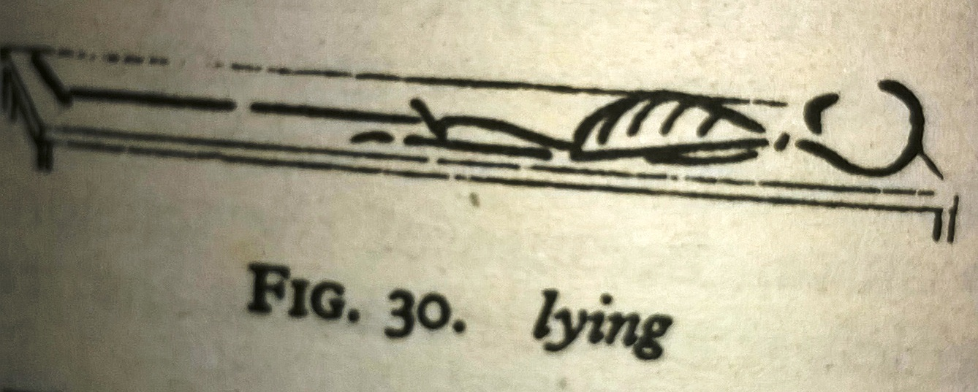
LYING
Easiest fundamental position
Completely supported in supine
Most stable

Slide 21
Muscle work
When lying position is used as starting position for exercise it is usually taken on a firm surface and following muscle groups work slightly;
Head rotators of both sides work reciprocally to stabilise the position of the head
Extensor of the hips and flexors of the lumbar spine to work to combat the tendency to hollow the back

Slide 22
Medial rotators of hips work to keep legs in the neutral position, so that knees and inner borders of the feet are held together

Slide 23
Effect and uses
Static posture training exercise
As Spine is relived of burden of transmitting weight of head and shoulders; therefore tends elongate and straighten, thus advantage in treatment of spinal deformity.
Breathing is slightly impeded by pressure of the abdominal viscera on diaphragm, often making unsuitable position for those suffering from respiratory or heart conditions.
Position also hinder return of blood from head and unsuitable for elderly or who suffers from high blood pressure

Slide 24
HANGING
Body is suspended by grasping over a horizontal bar,
Forearm pronated, arm straight and shoulder apart
Head is held high, scapula are drawn down and together, so that neck appears as long as possible.
Trunk and leg hang straight, with heels together and ankle plantar flexed

Slide 25
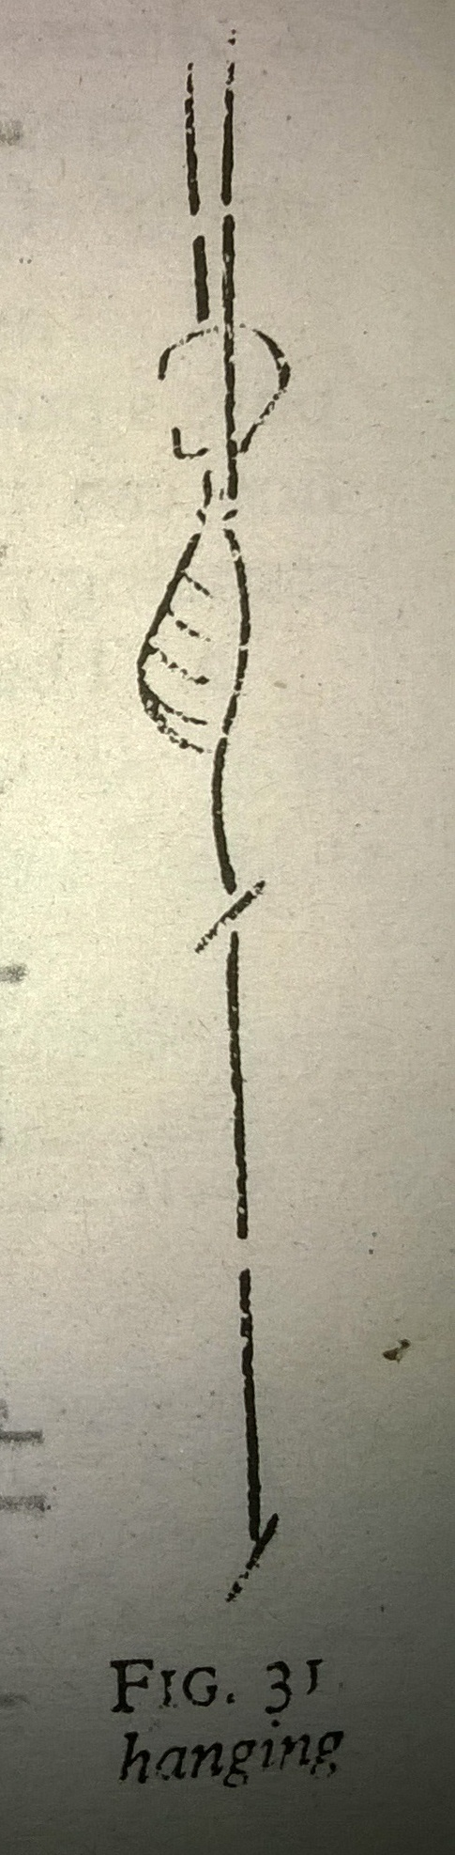

Slide 26
Muscle work
Finger flexor work strongly to grasp bar
All muscle around wrist work strongly to reduce strain on joints and to act as synergists and fixator for flexors of finger
Elbow flexors work to reduce strain on the joints
Adductors of shoulder joint work strongly to lift the body on the arms (specially latissimus dorsi posteriorly and pectoralis major anteriorly)
Depressor, retractor and medial rotator of scapula work strongly to fix scapula and brace upper limb

Slide 27
Pre vertebral and posterior neck muscle work reciprocally to maintain position of the head and neck.
Flexor of lumbar spine and extensors of hip work to correct tendency to arch back as result of latissimus dorsi working on sacrum
Adductor of hips work to keep leg together
Extensor of knees may work to maintain full extension
Plantar flexor work to point toes to the floor

Slide 28
Effect and uses
Its suitable for those whose muscular strength and body weight are well balanced
Unsuitable for cardio respiratory disease patients as breathing is difficult

Slide 29

MCQs

Slide 30
MCQ 1
The postures from which movement is initiated are known as
Active position
Passive position
Starting position
None

Slide 31
MCQ 2
Following which is Not fundamental starting position?
Standing
Sitting
One leg standing
kneeling

Slide 32
MCQ 3
Identify position shown in figure
Standing
Sitting
Kneeling
Lying

Slide 33
MCQ 4
Most comfortable starting position is
Standing
Sitting
Lying
Kneeling

Slide 34
MCQ 5
Following which position is unsuitable for elderly or who suffers from high blood pressure
Lying
Sitting
Standing
Sitting

Slide 35
DERIVED POSITION

Slide 36
The position of the arms, legs or trunk may be altered in each fundamental positions to modify the effect of the positions, or of the exercises which are performed from them subsequently.

Slide 37
Purpose of derived position
To increase or decrease the size and stability of the base
To raise or lower the centre of gravity
To ensure maximum local or general relaxation
To alter position of the body in relation to gravity
To increase or decrease leverage
To increase or decrease the muscle work required to maintain position
To provide control or fixation for a particular part of the body so that movement may be localised to specific area
To provide convenient position from which a particular exercise is to be performed.

Slide 38
Positions derived from standing
By alteration of arms
By alteration of legs
By alteration of trunk
By alteration of leg and trunk

Slide 39
By alteration of arm
Wing standing
Bend standing
Reach standing
Stretch standing
Yard standing
Low wing standing

Slide 40
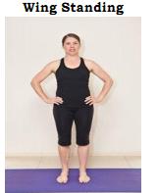
WING STANDING
Hands rest on iliac crests,
Fingers extended and adducted, being anterior
Thumbs posterior,
Wrists are extended,
Forearms pronated,
Elbow flexed and points straight sideways
Shoulders abducted
Rest all same as standing position

Slide 41
Muscle work:
Shoulder adductors and elbow extensor work slightly to press hands to the trunk.
Rest all same as standing position
Effect and uses:
Allows the physiotherapists to grasp the patient around the shoulders during some trunk exercise.
2. Fixed position of arms prevents their swinging during trunk exercise.

Slide 42
LOW WING STANDING
Similar to wing position, fingers being placed across the front of hip joints.
Effect and uses:
This is position of control as the patient is able to feel with the hands, the movement of flexion at the hip joint, tilting and lateral swing or any rotation of the pelvis.

Slide 43
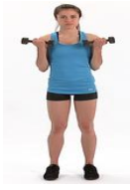
BEND STANDING
Shoulder laterally rotated and adducted,
Elbow flexed,
Forearms supinated,
Wrist and fingers flexed,
This all changes to rest upper limb above
lateral border of the acromion process.

Slide 44
Muscle work:
Lateral rotators and adductor of shoulder work strongly,
Retractors and depressors of scapula work as fixators,
Elbow flexors and forearm supinator work to maintain position of forearm,
Wrist flexors and finger flexors work slightly.
Effect and uses:
  Corrective position for upper back, and thorax expanded,
  During some trunk exercise,
  Prior to arm stretching exercise
  Suitable to perform abduction when shoulder abductor is weak because of short lever arm

Slide 45
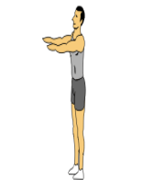
REACH STANDING
Shoulder flexed,
Elbow extended so arm held parallel,
Shoulder width apart and at right angles
to the body

Slide 46
Muscle work
Shoulder flexor maintain position against gravity
Transverse back muscle control forward movement of scapula
Extensor of elbows, radial flexors of wrist and extensor of the fingers work slightly to keep arm straight.
Effect and uses
In upright position forward raising of arms brings COG of body forwards and natural tendency to over compensate for this by lumbar extension.
Control of the position of the scapula by retractors and depressors is essential to avoid restriction of inspiratory movement

Slide 47
Prior to some arm and trunk exercises in sagittal plane, and to assist balance during balance walking sideways.
With hand supported and steady body used for leg and head exercise.

Slide 48
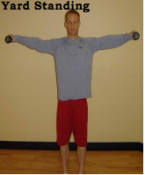
YARD STANDING
Arms are straight and elevated sideways
to horizontal position.
Muscle work:
Abductors, extensors, and lateral rotators
of shoulder work rotators of scapula to stabilise arms
Extensors of elbows, wrists and fingers work to hold the limb in straight line
Tendency to elevate shoulder girdle is controlled by scapula depressors

Slide 49
Effect and uses:
This position is corrective for the posture of upper back,
To facilitate body balance and is convenient for arm swinging exercise.

Slide 50
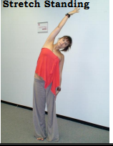
STRETCH STANDING
Arm is fully elevated so that they are in line with body,
parallel to each other and with palm facing.
Muscle work
Abductors, extensor and lateral rotators of
shoulder work strongly in conjunction with,
Lateral rotator of scapula
Elbow extensor
Wrist and fingers are kept in alignment by interplay between the muscles working over the wrist and by the extensor of the fingers
Rest all same as fundamental standing position

Slide 51
Effects and uses:
Muscle work is strong, often due to the tension of shortened opposing muscle, particularly pectoralis major and minor and latissimus dorsi.
Unsuitable for weak patients or who suffers respiratory conditions.
Strongly corrective position of the upper back
Give additional leverage to trunk exercise because of arm elevation which moves COG upward.
also useful in treatment of scoliosis

Slide 52
By alteration of leg
Close standing
Stride standing
Walk standing
Half standing
Toe standing

Slide 53
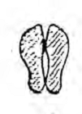
CLOSE STANDING
Legs are inward rotated at hips so that medial borders of feet are adjacent.
Muscle work
Leg muscles work more strongly than in fundamental position. (dorsi-plantar flexors, intrinsic, )
Effects and uses
Base is reduced and balance is more difficult, it is therefore progression on standing position
Relaxation of lateral rotators of hip

Slide 54

TOE STANDING
Heels are pressed together and raised from the floor.
Muscle work
Plantar flexors of ankle joint work strongly against gravity to keep heels elevated.
All the leg muscles work more strongly than
in the fundamental position to keep balance.
Effects and uses
Balance is reduced and COG raised, so used
as a balance position.
In treatment of postural flat feet and posture training

Slide 55

STRIDE STANDING
Legs are abducted so that heels are two foot lengths apart.
Feet remains same angle as in fundamental position and the weight is equally distributed between them.
Muscle work:
Hip adductors work to prevent the legs from sliding further apart if position is taken on slippery floor. On a matt surface, friction is sufficient to maintain stability.
Effect and uses
Stable position from which to perform
exercise, especially those in frontal plane

Slide 56
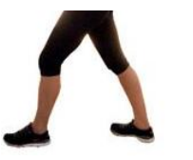
WALK STANDING
One leg is placed directly forwards so that the heels are two foot lengths apart and are on the same line.
Body weight is equally distributed between them.
Muscle work
Extensors of hip and knee works strongly to maintain position
Effect and uses
Base is enlarged antero-posterior direction
stabilise the body for exercise in sagittal plane.
Position used to localise rotation to the spine.
To prevent forward tilting of pelvis
in trunk flexion exercise

Slide 57
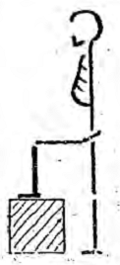
HALF STANDING
Whole weight of the body is supported on one leg, the other may be free or supported in a variety of positions.
Muscle work
Abductors of hip of standing leg to maintain COG over base
Lumbar side flexors of opposite side work to bring in trunk alignment
Muscles of standing leg is work more strongly than in standing to preserve balance

Slide 58
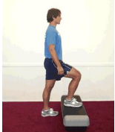
Effect and uses
Base is reduced, so balance is difficult, the leg which is freed from body weight may rest in variety positions,
Eg. On a stool with hip and knee bent – Step standing

Slide 59
By alteration of trunk
Lax stoop standing
Stoop standing

Slide 60
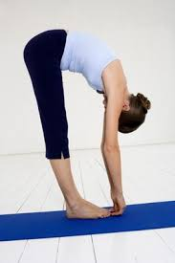
LAX STOOP STANDING
Hips are flexed,
Trunk, head and arms are relaxed so that they hang forward and downward. Balance is maintained by slight plantar flexion.
Muscle work
Very little muscle work is required except
in the region of ankle joint, where dorsiflexors
stabilise the position of joint. Intrinsic muscle
of foot grip the floor.

Slide 61
Effect and uses
Amount of forward flexion is dictated by the tension which develops in hamstrings and lumbar muscle.
To train local relaxation of upper body and to assist expiration.
It is used prior to extension exercise of hips and spine.
Unsuitable position for elderly patients

Slide 62
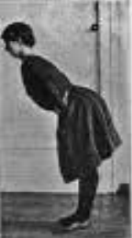
STOOP STANDING
Hip joints are flexed while the trunk, head and arms remain in alignment and are inclined forward.
backward inclination of legs is greater than in the previous position.
Angle to which trunk is inclined is usually about a right angle but depends on tension of hamstring.

Slide 63
Muscle work
Where dorsiflexiors stabilise the position of joint. Intrinsic muscle of foot grip the floor.
Extensor of knee may work to counteract the tension of hamstrings
Longitudinal and transverse back muscles and extensor of the shoulder and elbows maintain the position against gravity
Posterior neck muscle, controlled by pre vertebral muscles support head.
Effect and uses
Strong work for neck and back muscle with stretching spine, which occurs in horizontal position, trains good posture of the upper back.

Slide 64
By alteration of legs and trunk
Fallout standing
Lunge standing

Slide 65
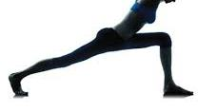
FALLOUT STANDING
One leg is placed directly forwards to distance of three foot length and this knee is bent; back leg is inclined forwards in line with it.
Muscle work:
extensor and foot muscle of the forward leg work strongly to support most of the weight, while extensor of back leg keep the trunk and leg straight.
Dorsiflexors of the this foot work
to keep the heel on the ground.

Slide 66
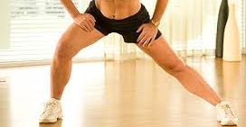
Effect and uses
Muscle work and co-ordination required to hold the position is considerable, and it may be used in treatment of spinal curvature.
LUNGE POSITION
It is similar with regards to placing of the legs, but the body always remains in vertical position.

Slide 67
MCQ

Slide 68
MCQ 1
The position of the arms, legs or trunk may be altered in each fundamental positions to modify the effect of the positions which is known as________?
Fundamental position
Starting position
Derived position
None

Slide 69
MCQ 2
Identify position
Wing standing
Yard standing
Bend standing
Reach standing

Slide 70
MCQ 3
Identify position
Wing standing
Yard standing
Bend standing
Reach standing

Slide 71
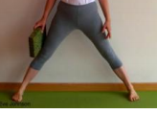
MCQ 4
Identify position
Close standing
Stride standing
Walk standing
Toe standing

Slide 72
MCQ 5
Identify position
Stoop standing
Stride standing
Fall out standing
Lunge standing

Slide 73
MCQs
STANDING

Slide 74
MCQ 1
The postures from which movement is initiated are known as
Active position
Passive position
Starting position
None

Slide 75
MCQ 2
Following which is not fundamental starting position?
Standing
Sitting
Sleeping
kneeling

Slide 76
MCQ 3
When the forces acting upon a body are perfectly balanced and the body remains at rest known as
Equilibrium
Non equilibrium
Resting position
None

Slide 77
MCQ 4
Muscle shortening is which type of muscle contraction?
Antagonist
Agonist
Isometric
None

Slide 78
MCQ 5
Prime mover muscle of specific action is also known as
Synergist
Agonist
Antagonist
None

Slide 79
THANK YOU

Slide 80
MCQs
KNEELING

Slide 81
MCQ 1
Identify position shown in figure
Standing
Sitting
Kneeling
Lying

Slide 82
MCQ 2
Most comfortable starting position is
Standing
Sitting
Lying
Kneeling

Slide 83
MCQ 3
Training of correct alignment of upper part of body is mainly done in which position
Standing
Sitting
Hanging
None

Slide 84
MCQ 4
Following which position is unsuitable for elderly or who suffers from high blood pressure
Lying
Sitting
Standing
Sitting

Slide 85
MCQ 5
In which position body is suspended by grasping over a horizontal bar
Standing
Sitting
Lying
Hanging

Slide 86
POSITIONS DERIVED FROM KNEELING
The positions of the arms are the same as in standing and may be added to the kneeling position as required.

Slide 87
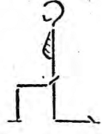
Half kneeling
One knee supports most of the body weight and the other leg is bent to a right angle at hip, knee and ankle so that is supported on the ground in a forward direction.

Slide 88
Half kneeling
Effect and uses:
  Useful for trunk side bending and rotation exercises as the pelvis is fixed well.

Slide 89

Kneeling sitting
The knees and hips are flexed and patients sits on his heels. Sometimes used for small children.
Very uncomfortable for most people

Slide 90

Prone kneeling
Trunk: horizontal and supported under the shoulders by the arms and by thighs at the pelvis. Must be held vertical. Head is held with the trunk.

Slide 91
Prone kneeling
Muscle work:
  Muscle round the shoulder and hip joints work to stabilize supporting limbs at the right angles to the trunk.
  Lumbar spine flexors prevent hollowing the back.
  Extensors of head and neck, controlled by the pre-vertebral muscles, keep the head in alignment.

Slide 92
Prone kneeling
Effect of uses:
  Stable position suitable for various trunk and head exercises.
  Spine is relieved from the weight of head and shoulders and tends to straighten and elongate.
  Pelvis is free for antero-posterior and lateral movement, but fixed for rotation.
  Can also achieve inclined prone kneeling from this position which relieves the weight of the abdominal viscera on weakened pelvic floor muscles.

Slide 93
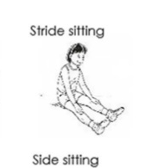
POSITIONS DERIVED FROM SITTING
STRIDE SITTING:
  Similar to fundamental position, except that the legs are abducted. Increases the stability and feet are pressed to the floor. Approx. 2 feet long

Slide 94
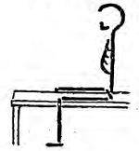
Ride sitting
Patient sits on a suitable apparatus, such as gymnastic ball which may be gripped between the knees by adductor muscles.

Slide 95
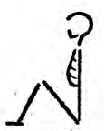
Crook sitting
Knees are bent when sitting on the floor when feet are together or apart.

Slide 96
Crook sitting
Muscle work:
  Hip flexor works strongly to prevent lumbar flexion and to support thighs.
  Additional fixation of legs by knee flexors and plantar flexors
Effect and uses: used for the exercise of upper trunk in treatment of kypho-lordosis.
Strong work of extensors of thoracic spine.

Slide 97
Long sitting
Similar to crook sitting but knees extended.
Knee extensors work to counteract the tension of hamstring muscles.
Unsuitable and difficult for most adults

Slide 98
Cross sitting
This is also similar to crook sitting, but the ankles crossed and the hips strongly abducted and laterally rotated, lateral aspect of the knees pressed on the floor.
Uncomfortable for most adults

Slide 99
Side sitting
Left side: left leg remains as in cross sitting and hip supports main weight of the trunk, while right leg is abducted and medially rotated so lower leg is bent and to side.
Lateral pelvic tilt to left side
Right lumbar side flexors work to keep spine upright

Slide 100
High sitting
Fundamental sitting position is taken on a high plinth or table but the feet remain unsupported. This is convenient for some foot and knee exercises.

Slide 101
POSITIONS DERIVED FROM LYING
Positions of the arms:
  Can be used similar to as used in standing position. However muscle work is reduced in lying.
  All positions derived from lying (except leg prone lying) can be used with upper trunk supported on forearms.
  Maintenance of the head and neck in position done by its muscles.

Slide 102

Crook lying

Slide 103
Crook lying
From lying, hips and knees are bent and feet rest on the floor/plinth.
Muscle work: very little for hip adductor and medial rotators preventing knees from falling apart
Effects and uses: relief of tension anterior to hip so, posterior roll of pelvis occurs and lumbar spine can be supported on the surface. Also used to train relaxation.

Slide 104
Crook lying with pelvis lifted
Effects and uses: useful during re-education of pelvic floor muscles. (e.g. After child birth)

Slide 105
Half lying

Slide 106
THANK YOU

