Slide 1
Kinetics of shoulder joint
Dr Neha Mukkamala

Slide 2
Kinetics refers to the study of the forces which are responsible for motion.

Slide 3
Passive stabilization of GH joint
Motions at SC and AC joints are limited by strong ligamentous structures and less by bony structures.
GH and ST joints have little ligamentous or bony stability.
GH joint has a loose joint capsule which is reinforced by ligaments.

Slide 4
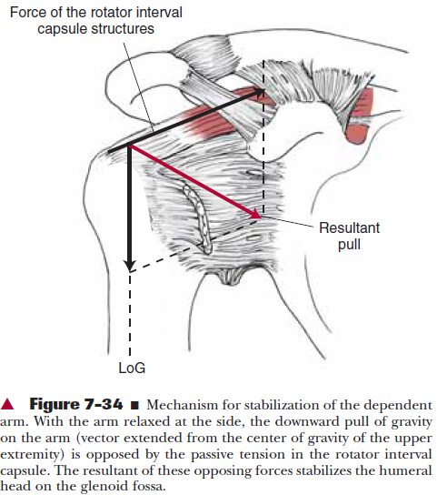

Slide 5
Passive stabilization of GH joint
1) With the arm hanging at the side, gravity acts on the humerus parallel to the shaft in a downward direction. The line of gravity (LoG) acting on the upper extremity creates a downward force on the humerus. But the passive tension in the structures of the rotator interval capsule and ligaments, results in compressing the humeral head into the lower portion of the glenoid fossa.
2) the capsule has an airtight seal, which produces negative intra-articular pressure. This pressure creates a vacuum that resists inferior humeral translation because of gravity.
3) the degree of glenoid inclination influences the stability of the GH joint. If there is a slight upward tilt of the glenoid fossa either anatomically in the structure of the scapula or through scapular upward rotation, the tilt of the fossa will produce a partial bony block against humeral inferior translation.

Slide 6
Dynamic stabilization of GH joint
Rotator cuff
Biceps brachii
Deltoid and Rotator cuff

Slide 7
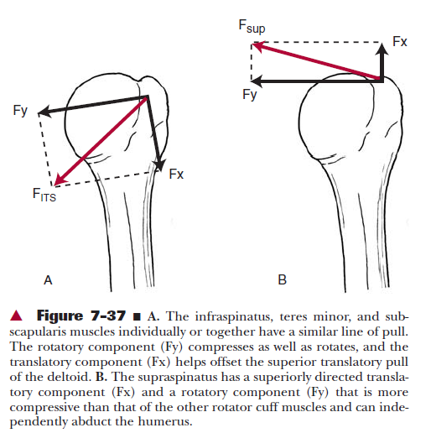
The rotator cuff and glenohumeral stabilization

Slide 8
The rotator cuff and glenohumeral stabilization

Slide 9
During heavy load lifting in the hand, Supraspinatus, infraspinatus and teres minor have been found to be active.
They hold the humeral head tightly against the glenoid to prevent subluxation.
Their most important and primary function is to provide stability to the joint by compressing the humeral head into the glenoid fossa.
During elevation, rotator cuff not only pulls the humerus to the glenoid, but also moves the humeral head into the lower portion of glenoid fossa thereby allowing sufficient space under the coracoacromial arch.

Slide 10
Biceps brachii
It aids in preventing the subluxation of GH joint when the elbow flexes with a weight in the hand.

Slide 11
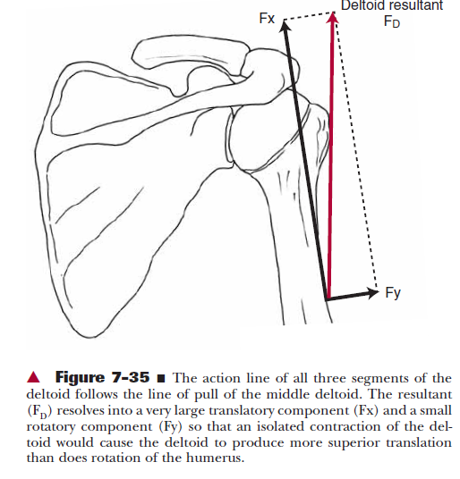
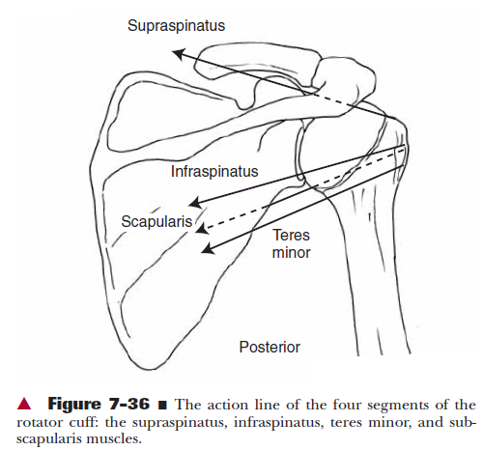
The Deltoid and Rotator Cuff

Slide 12
During early elevation, deltoid has a vertically directed force causing the humeral head to move upward to hit the coracoacromial arch. This is prevented by the horizontal and downward pull of rotator cuff muscles.
By pulling the humeral head inferiorly during elevation, rotator cuff provides more stability and decreases the risk of impingement.
As elevation progresses, lever arms for abduction increase but most of the force is directed towards the stabilizing component.
When the arm is fully elevated, deltoid and rotator cuff muscles provide stability.

Slide 13
Synergistic Muscle Actions
Sometimes the muscles work synergistically to produce a desired motion, at other times, they are antagonistic to each other.
Eg: Elevation of the scapula occurs with activity from upper trapezius and levator scapulae, with depression resulting from lower trapezius and pectoralis minor contraction.
Upward rotation is due to serratus anterior, upper trapezius and lower trapezius whereas pectoralis minor, levator scapulae and rhomboids produce downward rotation.

Slide 14
When synergistic muscles produce rotation, they are referred to as a force couple. A force couple is defined in mechanical terms as two forces whose points of application occur on opposite sides of an axis and in opposite directions to produce rotation of the body.
As they are on opposite sides of an axis, when they work by themselves, they produce a motion that is opposite to the synergist.
When they work together, they produce rotation.

Slide 15
During elevation of the arm, there are 2 force couples acting. One at the GH joint and the other at ST joint.
ST force couple includes upper and lower trapezius and serratus anterior to produce upward rotation of the scapula.
The GH force couple consists of deltoid and rotator cuff- deltoid and supraspinatus contract together to produce elevation at GH joint and infraspinatus, teres minor and subscapularis produce rotation of joint.

Slide 16
Another force couple at the ST joint includes rhomboids, levator scapulae and pectoralis minor producing downward rotation of scapula.

Slide 17
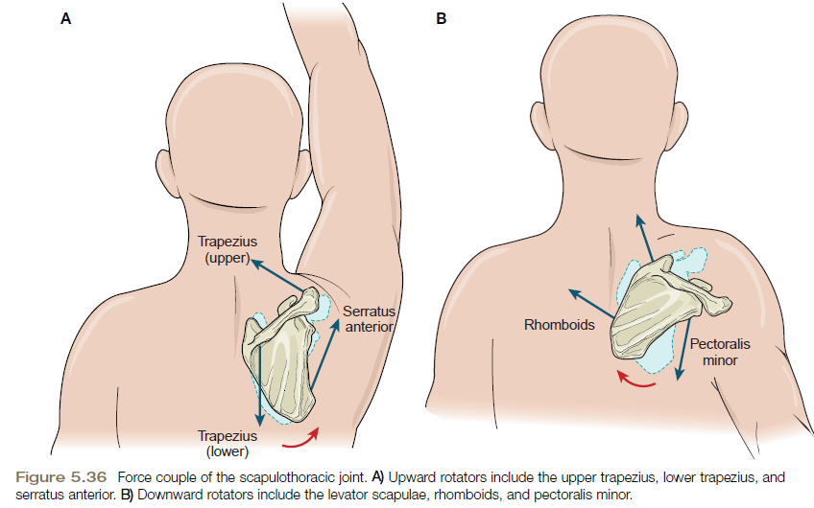

Slide 18
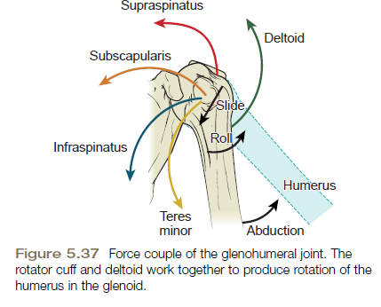

Slide 19
Muscle forces and moment (lever) arm lengths
The greatest strength occurs when the muscles contract in the elongated position and the torque decreases when the muscles shorten.
In the first 30-60 degrees of abduction, leverage for supraspinatus is greater than deltoid’s,which indicates supraspinatus provides a major force in the initiation of abduction.
Moment arm lengths for the deltoid increase with motion of abduction.

Slide 20
Once the supraspinatus elevates the arm to a sufficient height, the deltoid’s moment arm is positioned to provide additional rotation

Slide 21
Muscle Activity during Functional Motions
Reaching overhead in a standing or sitting position (a flexion-abduction-upward rotation movement) requires concentric contraction of the anterior deltoid, pectoralis major (clavicular head), coracobrachialis, biceps brachii, and the rotator cuff muscles at the glenohumeral joint as well as the trapezius and serratus anterior muscles at the scapulothoracic joint.

Slide 22
When the arm is returned to the side in the same sitting or standing position, the motion is antagonistic (extension-adduction-downward rotation), but the muscles providing the movement are not the antagonistic muscles.
If we provide manual resistance against the return motion from an overhead position, this time the antagonistic muscles—push against the force to return the arm to the side.
During supine position???

Slide 23
Placing the Hand behind the Head
Muscles producing these actions: the trapezius and serratus anterior acting as a force couple at the scapula; the deltoid and supraspinatus providing the force couple at the glenohumeral joint; and the infraspinatus and teres minor providing lateral rotation.

Slide 24
Pulling
When pulling an object, the shoulder’s motion is adduction-extension. Joint motions include: elbow flexion; sternoclavicular depression and posterior rotation; scapular retraction, downward rotation, and depression; and glenohumeral adduction, extension, and rotation.
Muscles work concentrically to overcome the resistance.

Slide 25
Pathomechanics
At the glenohumeral joint, 3-5 muscles that can perform each motion.
Scapular muscles often perform very specific actions.
If one is deficient, the motion usually does not occur as it should. This principle called “scapular dyskinesis” refers to an abnormal position and pattern of motion of the scapula.

Slide 26
When the arm is raised overhead, the scapula rotates upward and simultaneously protracts on the rib cage, with the medial border assuming an oblique position, and inferior angle lying in line with the axilla.
The serratus anterior, upper trapezius, and lower trapezius work together to produce this movement.
With serratus anterior dysfunction, the scapula is not held against the rib cage and the medial border is winged and patient is unable to push on doors or drawers. Scapulohumeral rhythm is abnormal and the person is unable to fully elevate the arm normally.

Slide 27
Resting posture of the scapula in the presence of paralysis of the trapezius is that of downward rotation, protraction, and depression.
Due to paralysis of both the trapezius and the serratus the arm cannot be elevated greater than 120°

Slide 28
Pathomechanics
Adhesive capsulitis: inflammation of shoulder joint capsule
Impingement syndrome: impingement of supraspinatus tendon against coracoacromial arch
Bursitis: inflammation of subacromial /subdeltoid bursae
Tendinitis: inflammation of tendon

Slide 30
Clinical Query
Will the shoulder muscle activity change according to the different exercises in normal adults?
P- Normal adults
I- different exercises
C-none
O- change in muscle activity

Slide 31
Shoulder Muscle Activity and Function in Common Shoulder Rehabilitation Exercises
Review article Low level of evidence (review) | Sports Med 2009; 39 (8): 663-685 Rafael F. Escamilla, Kyle Yamashiro, Lonnie Paulos James R. Andrews | Supraspinatus force during maximum effort isometric scapular plane abduction (scaption) at the 90⁰ position was 117 N. Its activity increases as resistance increases during scaption movements, peaking at 30 ⁰–60 ⁰ for any given resistance. At lower scaption angles, its activity increases to provide additional humeral head compression. While performing scaption with IR (‘empty can’) and scaption with IR (‘full can’),with both exercises supraspinatus produces similar amounts of activity. although the ‘full can’ results in less risk of subacromial impingement. Infraspinatus and subscapularis activity have been reported to be higher in the ‘full can’ compared with the ‘empty can’, while posterior deltoid activity has been reported to be higher in the ‘empty can’ than the ‘full can’. High to very high supraspinatus activity has been quantified in several common rotator cuff exercises, such as prone horizontal abduction at 100 abduction with ER, prone ER at 90 abduction, standing ER at 90 abduction, flexion above 120 with ER. | During abduction, middle deltoid force is estimated to be 434 N, 323N from anterior deltoid, 283N from subscapularis, 205N from the infraspinatus, and 117N from the supraspinatus. These forces are generated not only to abduct the shoulder but also to stabilize the joint.

Slide 32
MCQ’s
Kinematics involves the study of forces causing motion
True
False
2. During glenohumeral flexion, with the humerus moving,rolling takes place
Anteriorly
Posteriorly
Inferiorly
None
3. During glenohumeral flexion, with the humerus moving,sliding takes place
Anteriorly
Posteriorly
Inferiorly
None

Slide 33
4. Factors responsible for static stabilization are:
Capsule
Bone
Ligaments
All
5. Abduction of glenohumeral joint takes place around_____ axis
Frontal
Sagittal
Vertical
none

Slide 34
Shoulder rotation is done by
Supraspinatus
Infraspinatus
Teres minor
All
2. Middle deltoid is a primary
Flexor and abductor
Extensor and abductor
Abductor
None
3. The angle between head & neck and shaft iscalled
Angle of torsion
Angle of inclination
A+b
None

Slide 35
4. The motions possible at Scapulothoracic joint are
Elevation and depression
Anterior and posterior tipping
Upward and downward rotation
All
5. Angle of inclination is normally _______ degrees
30-50
130-150
140-160
none

Slide 36
The superior translatory force of deltoid is offset by
Infraspinatus
Teres minor
Subscapularis
All
2. The ITS muscles cause ____ translation of humerus
Superior
Inferior
3. scapulohumeral rhythm is
2:1
3:1
1:1
None

Slide 37
4. Inflammation of shoulder joint capsule is
Bursitis
Impingement
Adhesive capsulitis
None
5. The superior translatory force of supraspinatus is offset by
Infraspinatus
Teres minor
gravity
All

Slide 38
MCQ’s
Which are the movements occurring at the Sternoclavicular joint?
Elevation and depression
Protraction and retraction
Anterior and posterior rotation
All
2. Motions of scapula are
Upward and downward rotation
Protraction and retraction
Internal and external rotation
All

Slide 39
3. Upward rotation is important for
Depression
Elevation
None
4. Sternoclavicularjoint is ____ joint
Plane synovial
Ball and socket
Saddle
None
5. Movements at Acromioclavicular joint are
Internal and external rotation
Anterior and posterior tipping
Upward and downward rotation
All

