Slide 1
Muscles of shoulder complex
Dr Neha Mukkamala

Slide 2
Scapular Stabilizers of Shoulder complex
Primarily responsible for movement and stabilization of the scapula during GH joint motion.
They each originate on the thorax and end on the scapula.
Serratus anterior
Trapezius
Rhomboid major and minor
Pectoralis minor
Levator scapulae

Slide 3
Muscles of Shoulder complex
Muscles are divided into three groups:
Scapular stabilizers
Glenohumeral stabilizers
Large movers

Slide 4
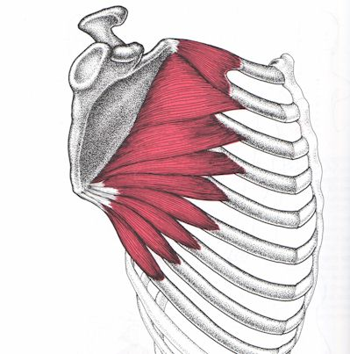
Serratus Anterior

Slide 5
Serratus Anterior
One of the most important muscles of the shoulder girdle.
As it’s the primary scapula protractor, without it arm cannot be raised overhead.
Called as the ‘SAW’ muscle.
When it is weak or paralysed and forward reaching is attempted, a typical ‘winging’ of the medial border of the scapula is seen as scapula fails to protract

Slide 6
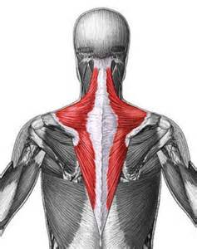
Trapezius

Slide 7
Trapezius
Superficial muscle
Named as “shawl” muscle due to its shape
Upper fibres: elevation and upward rotation of the scapula, and extension, lateral flexion, and contralateral neck rotation.
Middle fibres: upward rotation and adduction of the scapula
Lower fibres: upward rotation, adduction and depression of the scapula

Slide 8
In full abduction with scapular adduction, all fibres are recruited. Adduction/retraction of the shoulder girdle is done by the entire muscle, upper and lower fibres upwardly rotate the scapula.
Apart from upward rotation, upper fibres do scapular elevation and lower fibres do scapular depression.
Dysfunction leads to inability to perform full scapular upward rotation. So elevation is limited to 120⁰.

Slide 9
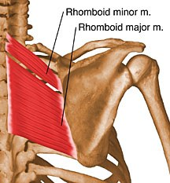
Rhomboids major and minor

Slide 10
Rhomboids major and minor
Lie under the Trapezius
Elevate and retract the scapula. Rhomboid major also downwardly rotates the scapula
Weakness causes scapula to assume a protracted position on the thorax.
Scapula positioned further laterally from spinous processes.

Slide 11
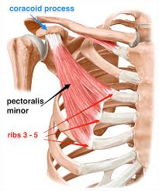
Pectoralis minor

Slide 12
Pectoralis minor
Lies deep to Pectoralis Major.
Causes depression and anterior tilt of the scapula as well as elevation of ribs 3-5.
Weakness results in reduced strength during scapular depression and downward rotation of scapula against resistance

Slide 13
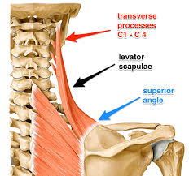
Levator Scapulae

Slide 14
Levator Scapulae
Causes elevation and downward rotation of scapula, and lateral flexion and ipsilateral rotation of cervical spine.
Eg. Shrugging the shoulder when the hand is behind the body.

Slide 15
Glenohumeral stabilizing muscles
Include the rotator cuff muscles which are also called SITS muscles.
They provide stability as well as mobility
Weakness of these muscles will result in reduced motion and stability

Slide 16
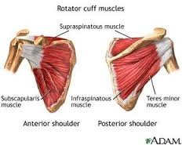
Supraspinatus

Slide 17
Supraspinatus
Its covered by the trapezius and deltoid
Its capable of performing full abduction without the assistance of Deltoid.
Its able to abduct the humerus against resistance and contributes approx. 50% of normal torque.

Slide 18
Infraspinatus and Teres Minor
Supplied by two different nerves but have same action.
Lateral rotation at GH joint

Slide 19
Subscapularis
Its primarily a medial rotator but depending on arm position, it can flex, extend, adduct or abduct the GH joint.
When the arm is overhead, it assists with extension.
It may work to adduct when the shoulder is medially rotated and abduct when the shoulder is laterally rotated.

Slide 20
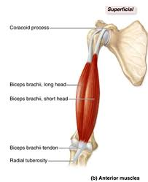
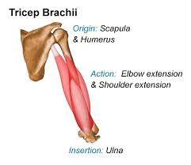
Biceps & Triceps

Slide 21
Biceps & Triceps
As it crosses shoulder joint, it acts on it.
It serves as a GH joint flexor and an abductor, and triceps is an extensor and adductor of GH joint.
When Deltoid and Supraspinatus are paralysed, long head of biceps is capable of substituting as an arm elevator, when the GH joint is in lateral rotation, slightly anterior to the frontal plane and without resistance in the hand.
This is useful for placing the hand over the head, but not strong enough to lift weights or perform work in this position.

Slide 22
The long head of triceps lends stability to GH joint during elevation activities.
As the humerus moves into abduction, triceps helps to steady the humeral head in glenoid.
It also stabilizes during weight-bearing activities.

Slide 23
Large muscle movers of Shoulder
They have their proximal attachments on the trunk and distal attachments on the humerus with little to no attachment on the scapula.
They perform multiple actions at the shoulder joint.
They are movers instead of stabilizers as their insertion is distant to the joint’s axis of motion.

Slide 24
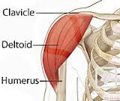
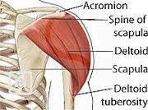
Deltoid

Slide 25
Deltoid
It’s a large superficial muscle just under the skin.
Comprises 40% of the mass of scapular muscles.
Roundness of the normal shoulder is due to Deltoid.
All 3 heads work to produce abduction as a common motion, anterior deltoid produces horizontal flexion (horizontal adduction) and medial rotation, posterior deltoid produces horizontal extension (horizontal abduction) and lateral rotation.

Slide 26
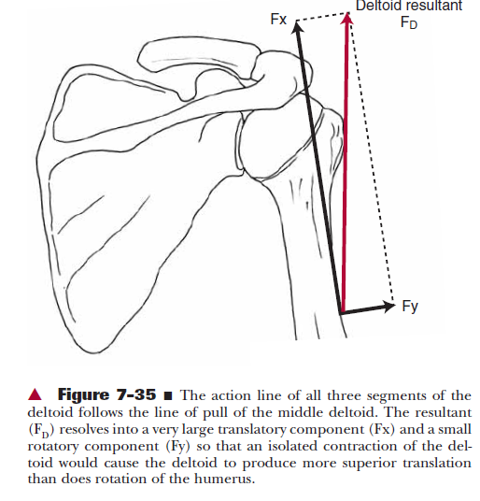

Slide 27
In normal abduction, Supraspinatus initiates motion. In persons with Supraspinatus injury or palsy, Deltoid is able to abduct humerus through full range if other rotator cuff muscles are able to counteract Deltoid’s translatory force. But it is produced with less normal strength (approx. 50%).
In the resting position with the arm at the side, the Deltoid’s angle of pull primarily elevates the humeral head with no lever arm for rotation.

Slide 28
At higher degrees of abduction, middle deltoid’s translatory moment arm (MA) decreases and rotatory MA increases starting at about 50 degrees and becomes larger than that of Supraspinatus above 50 degrees.
It works synergistically with the rotator cuff to be a prime mover in shoulder elevation after the initial ranges.

Slide 29
Deltoid does not rotate the GH joint into abduction until higher levels of abduction motion unless supraspinatus is unable to perform; in these cases the deltoid may be able to initiate abduction provided the rotator cuff muscles are intact.

Slide 30
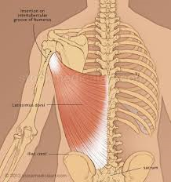
Latissimus Dorsi

Slide 31
Latissimus Dorsi
It is the broadest muscle of the low back.
It a medial rotator, extensor and adductor of the GH joint, Scapular depressor and elevator of pelvis.
If the arms are stabilized, as in pushing down on crutch handles or in seated press down, the distal attachment aids to lift the pelvis.
In crutch walking it allows the foot to clear ground, and in seated press down to lift the hips off the surface.
It serves a vital function for gymnasts who have to support their body weight with their upper extremities.

Slide 32
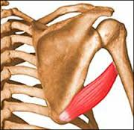
Teres Major

Slide 33
Teres Major
It acts in most pulling activities when the shoulder is extended or adducted against resistance.
Its function is closely associated with Latissimus Dorsi.

Slide 34
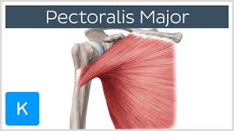
Pectoralis Major

Slide 35
Pectoralis Major
It has 2 parts: sternal and clavicular
It does flexion, adduction and medial rotation

Slide 36
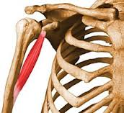
Coracobrachialis

Slide 37
Coracobrachialis
It’s a mover of the glenohumeral joint rather than a stabilizer since its line of pull is distant from the joint’s axis of motion.

Slide 38
Functions of muscles
Passive stabilization of GH joint
Capsule
Ligaments
Dynamic stabilization of GH joint
Muscles
SC and AC joints rely on passive structures for restraints whereas GH and ST joints rely on muscles for stability.

Slide 39
Passive stabilization of GH joint
Motions at SC and AC joints are limited by strong ligamentous structures and less by bony structures.
GH and ST joints have little ligamentous or bony stability.
GH joint has a loose joint capsule which is reinforced by ligaments.

Slide 40
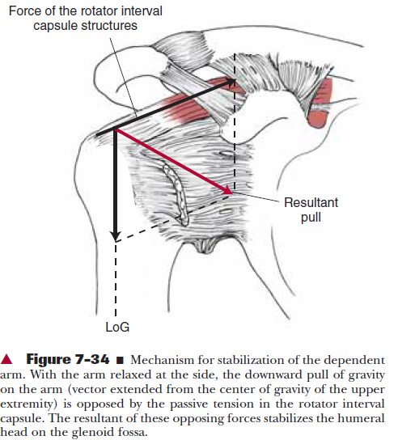

Slide 41
Passive stabilization of GH joint
1) With the arm hanging at the side, gravity acts on the humerus parallel to the shaft in a downward direction. The line of gravity (LoG) acting on the upper extremity creates a downward force on the humerus. But the passive tension in the structures of the rotator interval capsule and ligaments, results in compressing the humeral head into the lower portion of the glenoid fossa.
2) the capsule has an airtight seal, which produces negative intra-articular pressure. This pressure creates a vacuum that resists inferior humeral translation because of gravity.
3) the degree of glenoid inclination influences the stability of the GH joint. If there is a slight upward tilt of the glenoid fossa either anatomically in the structure of the scapula or through scapular upward rotation, the tilt of the fossa will produce a partial bony block against humeral inferior translation.

Slide 42
Dynamic stabilization of GH joint
Rotator cuff
Biceps brachii
Deltoid and Rotator cuff

Slide 43
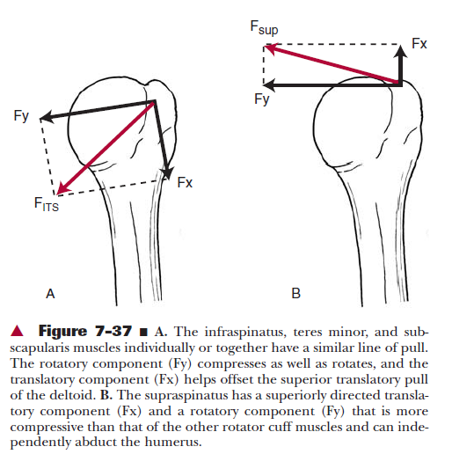
The rotator cuff and glenohumeral stabilization

Slide 44
The rotator cuff and glenohumeral stabilization

Slide 45
During heavy load lifting in the hand, Supraspinatus, infraspinatus and teres minor have been found to be active.
They hold the humeral head tightly against the glenoid to prevent subluxation.
Their most important and primary function is to provide stability to the joint by compressing the humeral head into the glenoid fossa.
During elevation, rotator cuff not only pulls the humerus to the glenoid, but also moves the humeral head into the lower portion of glenoid fossa thereby allowing sufficient space under the coracoacromial arch.

Slide 46
Biceps brachii
It aids in preventing the subluxation of GH joint when the elbow flexes with a weight in the hand.

Slide 47
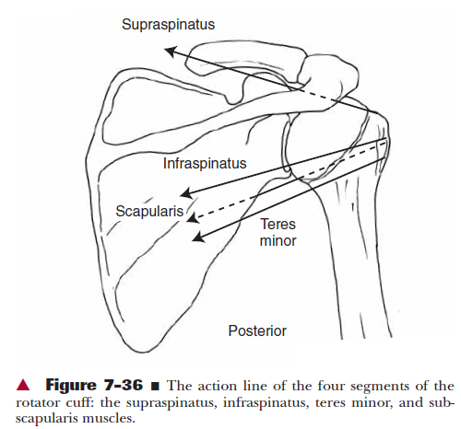
The Deltoid and Rotator Cuff

Slide 48
During early elevation, deltoid has a vertically directed force causing the humeral head to move upward to hit the coracoacromial arch. This is prevented by the horizontal and downward pull of rotator cuff muscles.
By pulling the humeral head inferiorly during elevation, rotator cuff provides more stability and decreases the risk of impingement.
As elevation progresses, lever arms for abduction increase but most of the force is directed towards the stabilizing component.
When the arm is fully elevated, deltoid and rotator cuff muscles provide stability.

Slide 49
Synergistic Muscle Actions
Sometimes the muscles work synergistically to produce a desired motion, at other times, they are antagonistic to each other.
Eg: Elevation of the scapula occurs with activity from upper trapezius and levator scapulae, with depression resulting from lower trapezius and pectoralis minor contraction.
Upward rotation is due to serratus anterior, upper trapezius and lower trapezius whereas pectoralis minor, levator scapulae and rhomboids produce downward rotation.

Slide 50
When synergistic muscles produce rotation, they are referred to as a force couple. A force couple is defined in mechanical terms as two forces whose points of application occur on opposite sides of an axis and in opposite directions to produce rotation of the body.
As they are on opposite sides of an axis, when they work by themselves, they produce a motion that is opposite to the synergist.
When they work together, they produce rotation.

Slide 51
During elevation of the arm, there are 2 force couples acting. One at the GH joint and the other at ST joint.
ST force couple includes upper and lower trapezius and serratus anterior to produce upward rotation of the scapula.
The GH force couple consists of deltoid and rotator cuff- deltoid and supraspinatus contract together to produce elevation at GH joint and infraspinatus, teres minor and subscapularis produce rotation of joint.

Slide 52
Another force couple at the ST joint includes rhomboids, levator scapulae and pectoralis minor producing downward rotation of scapula.

Slide 53
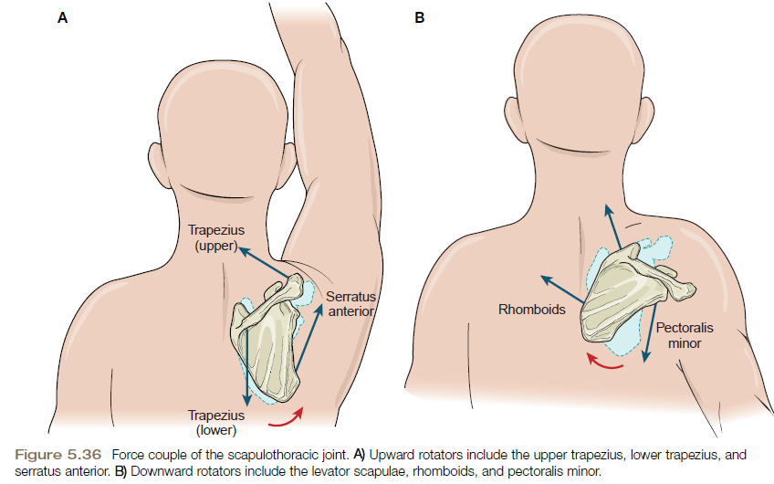

Slide 54
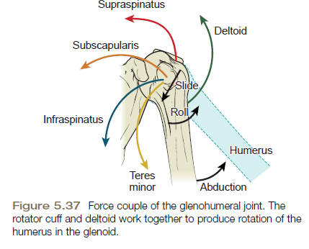

Slide 55
Muscle forces and moment (lever) arm lengths
The greatest strength occurs when the muscles contract in the elongated position and the torque decreases when the muscles shorten.
In the first 30-60 degrees of abduction, leverage for supraspinatus is greater than deltoid’s,which indicates supraspinatus provides a major force in the initiation of abduction.
Moment arm lengths for the deltoid increase with motion of abduction.

Slide 56
Once the supraspinatus elevates the arm to a sufficient height, the deltoid’s moment arm is positioned to provide additional rotation

Slide 57
Muscle Activity during Functional Motions
Reaching overhead in a standing or sitting position (a flexion-abduction-upward rotation movement) requires concentric contraction of the anterior deltoid, pectoralis major (clavicular head), coracobrachialis, biceps brachii, and the rotator cuff muscles at the glenohumeral joint as well as the trapezius and serratus anterior muscles at the scapulothoracic joint.

Slide 58
When the arm is returned to the side in the same sitting or standing position, the motion is antagonistic (extension-adduction-downward rotation), but the muscles providing the movement are not the antagonistic muscles.
If we provide manual resistance against the return motion from an overhead position, this time the antagonistic muscles—push against the force to return the arm to the side.
During supine position???

Slide 59
Placing the Hand behind the Head
Muscles producing these actions: the trapezius and serratus anterior acting as a force couple at the scapula; the deltoid and supraspinatus providing the force couple at the glenohumeral joint; and the infraspinatus and teres minor providing lateral rotation.

Slide 60
Pulling
When pulling an object, the shoulder’s motion is adduction-extension. Joint motions include: elbow flexion; sternoclavicular depression and posterior rotation; scapular retraction, downward rotation, and depression; and glenohumeral adduction, extension, and rotation.
Muscles work concentrically to overcome the resistance.

Slide 61
Pathomechanics
At the glenohumeral joint, 3-5 muscles that can perform each motion.
Scapular muscles often perform very specific actions.
If one is deficient, the motion usually does not occur as it should. This principle called “scapular dyskinesis” refers to an abnormal position and pattern of motion of the scapula.

Slide 62
When the arm is raised overhead, the scapula rotates upward and simultaneously protracts on the rib cage, with the medial border assuming an oblique position, and inferior angle lying in line with the axilla.
The serratus anterior, upper trapezius, and lower trapezius work together to produce this movement.
With serratus anterior dysfunction, the scapula is not held against the rib cage and the medial border is winged and patient is unable to push on doors or drawers. Scapulohumeral rhythm is abnormal and the person is unable to fully elevate the arm normally.

Slide 63
Resting posture of the scapula in the presence of paralysis of the trapezius is that of downward rotation, protraction, and depression.
Due to paralysis of both the trapezius and the serratus the arm cannot be elevated greater than 120°

Slide 64
Pathomechanics
Adhesive capsulitis: inflammation of shoulder joint capsule
Impingement syndrome: impingement of supraspinatus tendon against coracoacromial arch
Bursitis: inflammation of subacromial /subdeltoid bursae
Tendinitis: inflammation of tendon

Slide 66
Clinical Query
Will the shoulder muscle activity change according to the different exercises in normal adults?
P- Normal adults
I- different exercises
C-none
O- change in muscle activity

Slide 67
Shoulder Muscle Activity and Function in Common Shoulder Rehabilitation Exercises
Review article Low level of evidence (review) | Sports Med 2009; 39 (8): 663-685 Rafael F. Escamilla, Kyle Yamashiro, Lonnie Paulos James R. Andrews | Supraspinatus force during maximum effort isometric scapular plane abduction (scaption) at the 90⁰ position was 117 N. Its activity increases as resistance increases during scaption movements, peaking at 30 ⁰–60 ⁰ for any given resistance. At lower scaption angles, its activity increases to provide additional humeral head compression. While performing scaption with IR (‘empty can’) and scaption with IR (‘full can’),with both exercises supraspinatus produces similar amounts of activity. although the ‘full can’ results in less risk of subacromial impingement. Infraspinatus and subscapularis activity have been reported to be higher in the ‘full can’ compared with the ‘empty can’, while posterior deltoid activity has been reported to be higher in the ‘empty can’ than the ‘full can’. High to very high supraspinatus activity has been quantified in several common rotator cuff exercises, such as prone horizontal abduction at 100 abduction with ER, prone ER at 90 abduction, standing ER at 90 abduction, flexion above 120 with ER. | During abduction, middle deltoid force is estimated to be 434 N, 323N from anterior deltoid, 283N from subscapularis, 205N from the infraspinatus, and 117N from the supraspinatus. These forces are generated not only to abduct the shoulder but also to stabilize the joint.

Slide 68
MCQ’s
Kinematics involves the study of forces causing motion
True
False
2. During glenohumeral flexion, with the humerus moving,rolling takes place
Anteriorly
Posteriorly
Inferiorly
None
3. During glenohumeral flexion, with the humerus moving,sliding takes place
Anteriorly
Posteriorly
Inferiorly
None

Slide 69
4. Factors responsible for static stabilization are:
Capsule
Bone
Ligaments
All
5. Abduction of glenohumeral joint takes place around_____ axis
Frontal
Sagittal
Vertical
none

Slide 70
Shoulder rotation is done by
Supraspinatus
Infraspinatus
Teres minor
All
2. Middle deltoid is a primary
Flexor and abductor
Extensor and abductor
Abductor
None
3. The angle between head & neck and shaft iscalled
Angle of torsion
Angle of inclination
A+b
None

Slide 71
4. The motions possible at Scapulothoracic joint are
Elevation and depression
Anterior and posterior tipping
Upward and downward rotation
All
5. Angle of inclination is normally _______ degrees
30-50
130-150
140-160
none

Slide 72
The superior translatory force of deltoid is offset by
Infraspinatus
Teres minor
Subscapularis
All
2. The ITS muscles cause ____ translation of humerus
Superior
Inferior
3. scapulohumeral rhythm is
2:1
3:1
1:1
None

Slide 73
4. Inflammation of shoulder joint capsule is
Bursitis
Impingement
Adhesive capsulitis
None
5. The superior translatory force of supraspinatus is offset by
Infraspinatus
Teres minor
gravity
All

Slide 74
MCQ’s
Which are the movements occurring at the Sternoclavicular joint?
Elevation and depression
Protraction and retraction
Anterior and posterior rotation
All
2. Motions of scapula are
Upward and downward rotation
Protraction and retraction
Internal and external rotation
All

Slide 75
3. Upward rotation is important for
Depression
Elevation
None
4. Sternoclavicularjoint is ____ joint
Plane synovial
Ball and socket
Saddle
None
5. Movements at Acromioclavicular joint are
Internal and external rotation
Anterior and posterior tipping
Upward and downward rotation
All

