Slide 1
Glenohumeral joint biomechanics
Dr Neha Mukkamala

Slide 2
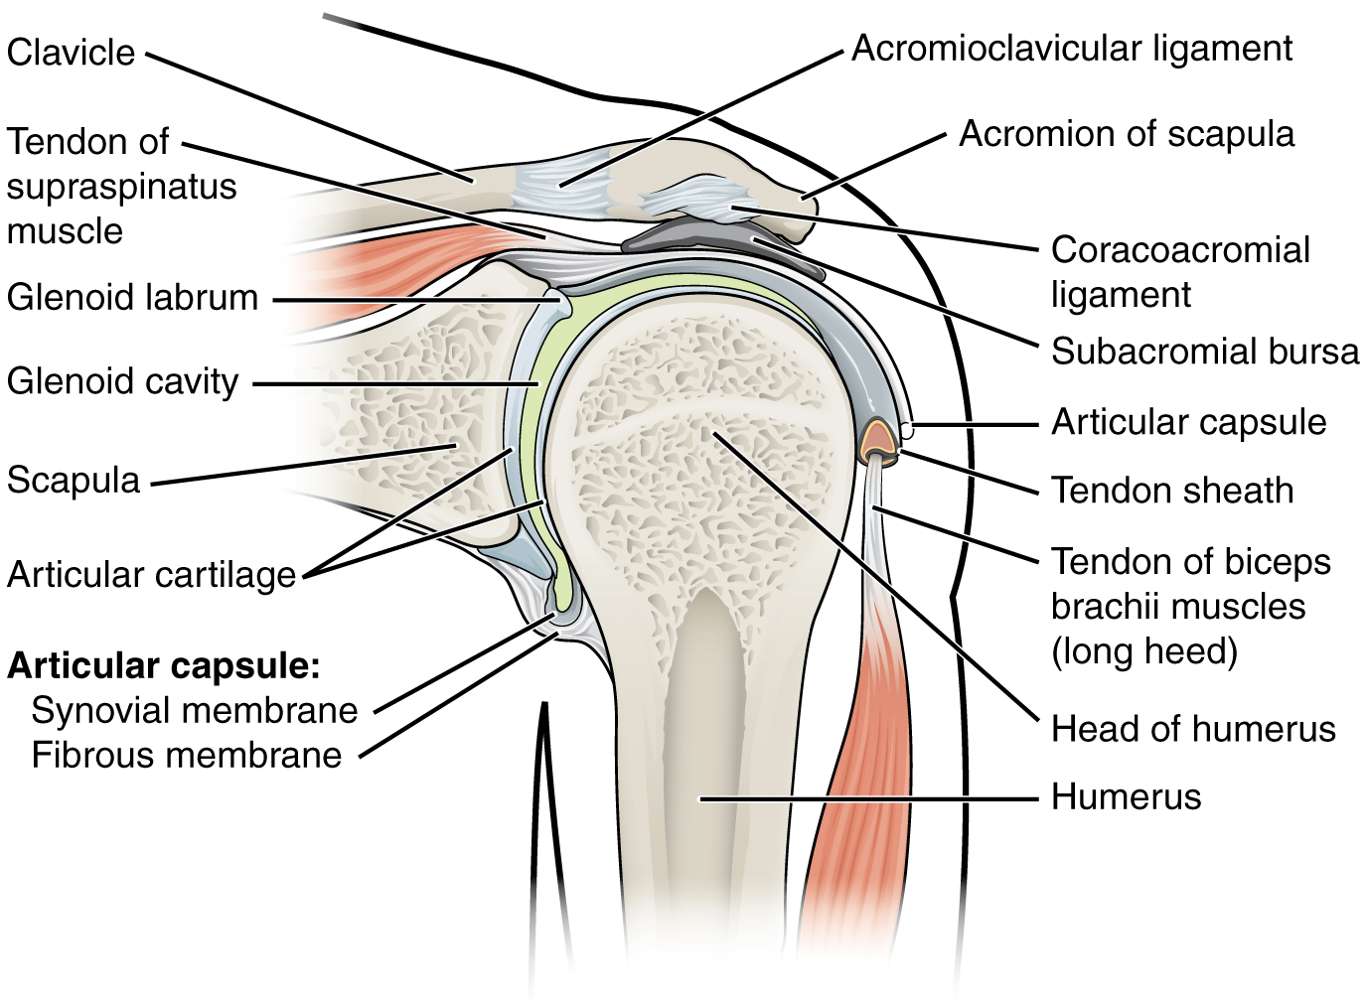
GLENOHUMERAL (GH) JOINT

Slide 3
GLENOHUMERAL (GH) JOINT
It’s a ball-and-socket joint with three degrees of freedom.
Humeral head is more than twice the size of glenoid fossa, so it has less bony stability.
Surrounding the rim of the glenoid is a cartilaginous labrum.
A loose and thin fibrous capsule covers the joint from the neck of the glenoid to the anatomic neck of the humerus and is lined by a synovial membrane.
The capsule permits injection of 10-15 ml of fluid.
There is an area in the inferior capsule called as axillary pouch which allows humeral head mobility during shoulder elevation.

Slide 4
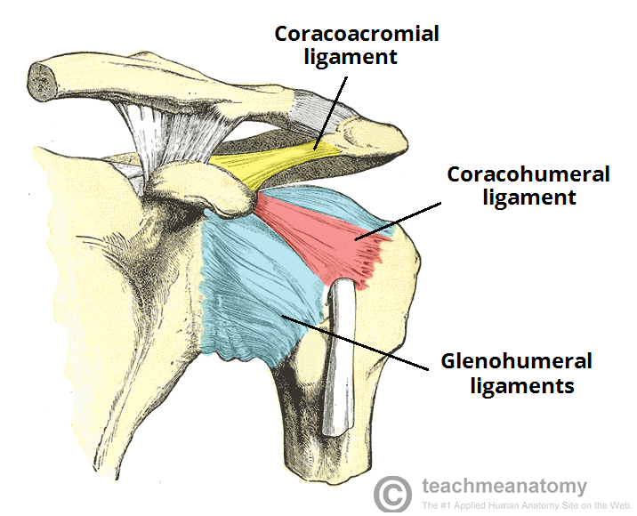
Ligaments and capsule

Slide 5
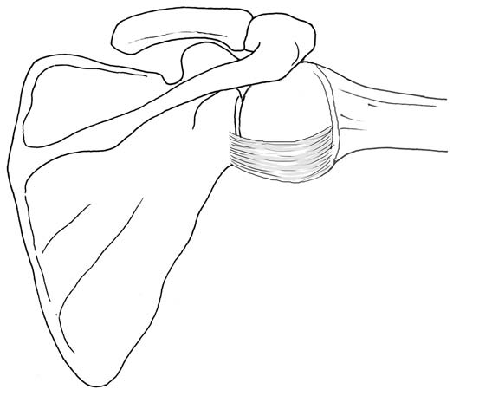
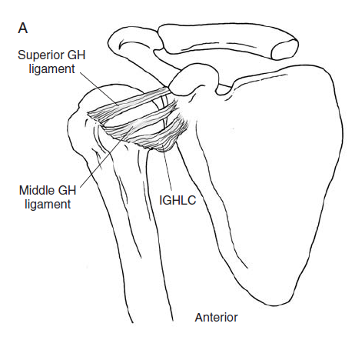
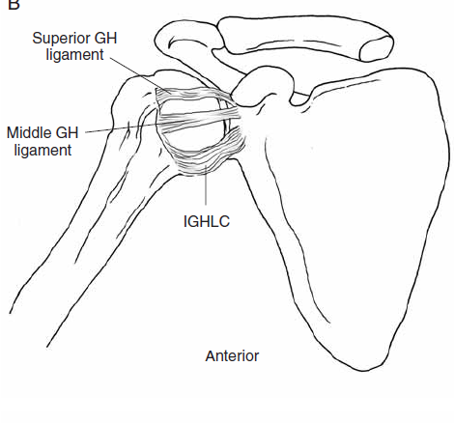

Slide 6
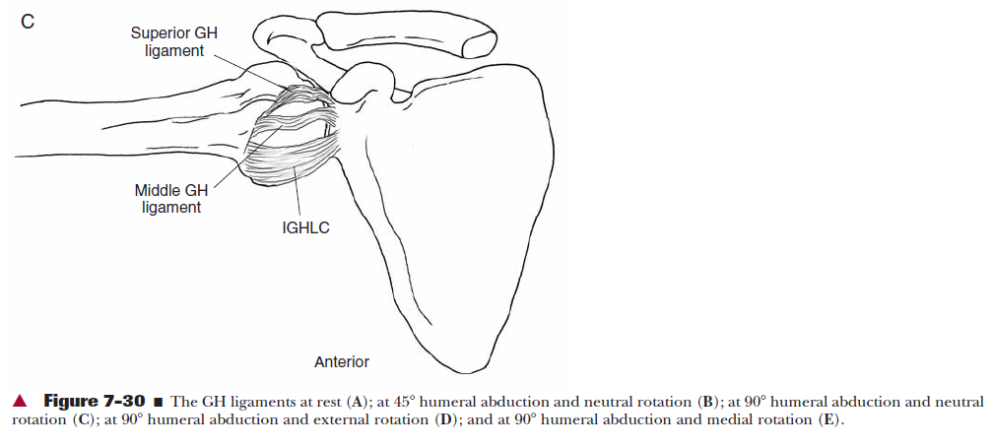

Slide 7
Ligaments and capsule
Ligaments and tendons blend with and reinforce the capsule for added stability.
Coracohumeral ligament crosses from the coracoid process of the scapula to the greater and lesser tubercles of the humerus, where it forms a tunnel for the tendon of the long head of biceps.
The superior, middle and inferior glenohumeral ligaments arise from the glenoid and its labrum and attach to humeral neck and lesser tubercle.
There is a weakness in the capsule between the superior and middle GH ligaments, called foramen of Weitbrecht, a frequent site of anterior dislocations of the joint.

Slide 8
The Coracohumeral, superior and middle glenohumeral ligaments support the dependent arm and limit lateral rotation in the lower ranges of abduction.
The inferior GH ligament (anterior, inferior and posterior bands) is the main stabilizer of the abducted arm and limits medial and lateral rotation in the abducted position.

Slide 9
The Coracohumeral ligament serves as the primary force against gravity’s downward pull on the joint in a resting position.
It prevents superior humeral head translation when the rotator cuff fails to do this
It limits lateral rotation with the arm resting at the side

Slide 10
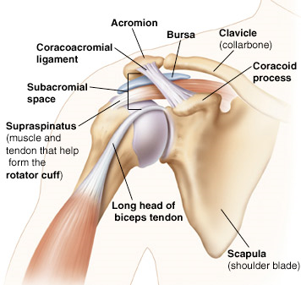
Coracoacromial Arch

Slide 11
Coracoacromial Arch
Coracoacromial ligament runs from anterior acromion to lateral coracoid process to form the coracoacromial arch.
The area between the arch and humeral head is called SUBACROMIAL SPACE.
Subacromial Space contains supraspinatus muscle and tendon, long head of the biceps tendon, subacromial bursa and superior capsule.
Subacromial Space is about 1 cm wide. This narrow space limits the room available for the soft tissue structures during shoulder motion and in pathological conditions.
The space narrows to half its normal width as the arm is elevated

Slide 12
Bursa
It reduces friction between two structures.
Several bursae within the shoulder joint area.
Two most important are the Subdeltoid and Subacromial bursa.
Subacromial bursa is between the supraspinatus tendon and coracoacromial arch and protects the supraspinatus tendon.
Subdeltoid bursa is continuous with the Subacromial bursa and is between deltoid muscle and supraspinatus tendon and humeral head, to reduce friction between them.

Slide 13
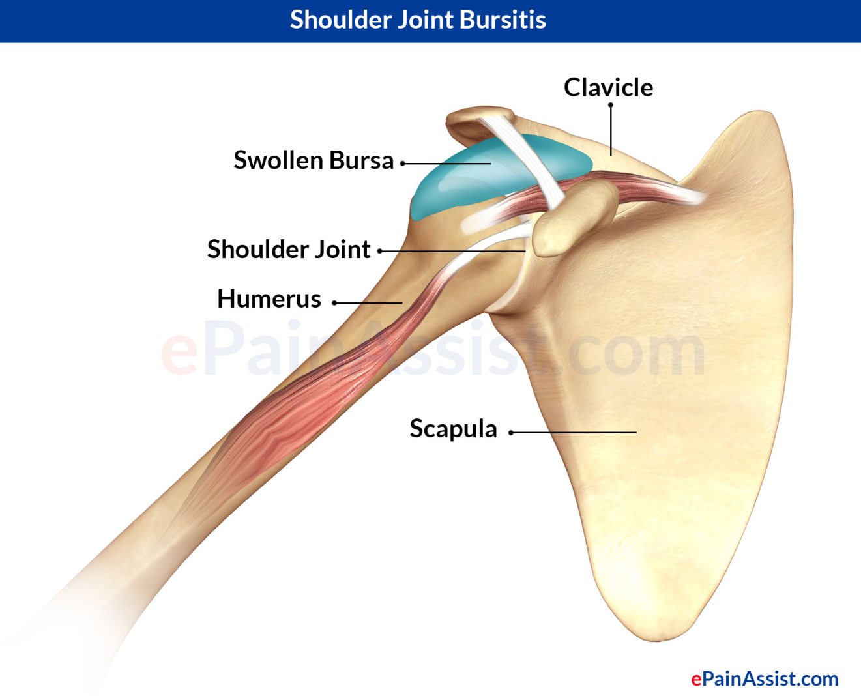
Bursae usually have very small amount of fluid. If they become inflamed and the amount of fluid increases. This can become problematic in the subacromial area.

Slide 14
Glenohumeral joint kinematics
3 degrees of motion:
flexion-extension
Abduction-adduction
Medial-lateral rotation
Abduction-adduction occur in a frontal plane around AP axis. As the humerus moves into abduction, humeral head glides inferiorly in the glenoid fossa. Dynamic stability is provided by deltoid and rotator cuff muscles.

Slide 15
Abduction
Amount of abduction depends on the rotation at GH joint
In full medial rotation, active abduction is limited to 60⁰ because greater tubercle strikes the acromion process and AC ligament.
With 90⁰ of lateral rotation, the greater tubercle rotates behind the acromion so abduction increases to 90⁰ where it is limited by active insufficiency of the deltoid.
Abduction can be continued passively to 120⁰ where it is limited by tension of the inferior glenohumeral ligament.

Slide 16
Rotations
Medial and lateral rotations take place about a vertical axis in the horizontal plane.
With GH joint in 90⁰ of abduction and 90⁰ elbow flexion, normal range for lateral rotation is 90⁰ and medial rotation is 70^{0.}
Rotation at GH joint is isolated from supination and pronation of the forearm by flexing the elbow to 90^{0.}
The amount of rotation changes with elevation of the arm. With abduction at 90⁰, 160⁰ of total rotation is possible. It is reduced to 90⁰ when the arm is fully elevated because of twisting of Coracohumeral and GH ligaments.

Slide 17
Elevation
It includes either flexion or abduction.
Flexion-extension occurs in the sagittal plane around medial-lateral axis.
Flexion at GH joint is 120⁰. Full flexion to 180⁰ is possible because of motion at ST joint. Flexion is limited by inferior GH capsule.
When the arm is at the side and then passes behind the body, terminal extension motion is called sometimes as hyperextension, which is 40⁰ to 60⁰. This motion is limited by Superior and Middle GH ligaments.

Slide 18
Normal range of shoulder flexion or abduction is conventionally 180⁰. This is combination of GH and ST motions. The scapular movements are accompanied by motions at the SC and AC joints.
90⁰ to 110⁰ occurs at GH joint and 60⁰ to 70⁰ occurs at AC and SC joints.
Achieving maximum GH elevation range requires lateral rotation at GH joint In abduction and for flexion, medial rotation and posterior tilting of scapula.
Full arm elevation in either flexion or abduction requires upward rotation of the scapula.

Slide 19
Horizontal abduction
Horizontal adduction

Slide 20
Glenohumeral arthrokinematic motions
According to the convex-concave theory of joint motion with motions of the humerus (physiological motions) the convex head rolls in the same direction and slides in the opposite direction in the glenoid fossa.
Eg: With flexion the humeral head slides posteriorly and with abduction the head slides inferiorly
Physiological motion Roll Slide
Flexion Anterior Posterior
Internal rotation Anterior Posterior
Extension Posterior Anterior
External rotation Posterior Anterior
Abduction Superior Inferior
The inferior slide during abduction limits humeral head from jamming against coracoacromial arch and avoids impingement

Slide 21
Scaption
Scapular plane GH abduction occurs 30⁰ to 40⁰ anterior to the frontal plane, called SCAPTION.
This position is recommended for examination of GH elevation as the capsule is in a loose packed position and there is less likelihood of impingement.

Slide 22
CLOSE-PACKED & LOOSE-PACKED POSITION
CLOSE-PACKED position
Surfaces of a joint’s segments usually match each other perfectly in only one position of the joint.
This point of congruency is called close-packed position.
When in this position:
Maximum area of surface contact occurs
Ligament attachments are farthest apart and under tension
Capsular structures are taut
Joint is mechanically compressed and difficult to distract

Slide 23
OPEN-PACKED or LOOSE-PACKED position:
In all other positions, the joint surfaces do not fit perfectly and are incongruent.
In this:
Ligament and capsular structures are slack
Joint surfaces can be distracted several mm.
They allow necessary motions of spin, roll and slide with an increase in accessory motions and decreased friction

Slide 24
RESTING POSITION
The position in which there is least congruency and at which capsule and ligaments are loosest or most slack
It is unique for each joint type but usually occurs when joint is positioned near its midrange.
It is the preferred joint position for Mobilizations to a joint.

Slide 25
Joint | Close-packed position | Resting position
Glenohumeral | Full abduction with full lateral rotation | The shoulder is abducted 55, horizontally adducted 30
SC | Arm is fully elevated | Arm resting by the side
AC | Arm is abducted to 90⁰ | undetermined

Slide 26
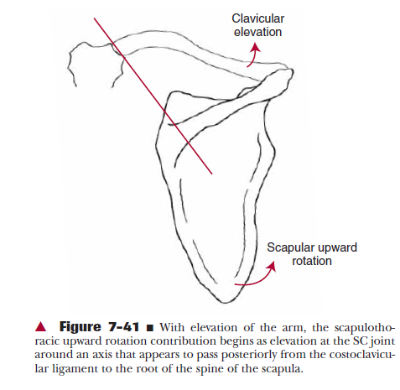
SCAPULOHUMERAL RHYTHM

Slide 27
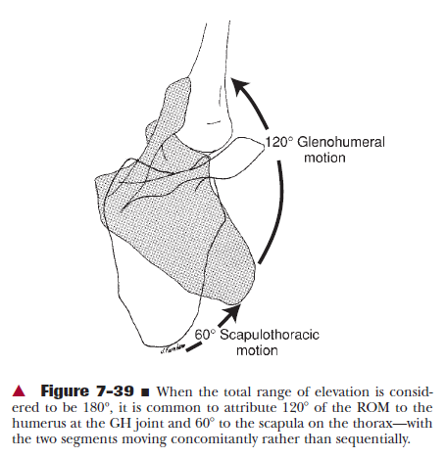
SCAPULOHUMERAL RHYTHM

Slide 28
SCAPULOHUMERAL RHYTHM
Joints of the shoulder complex move together to provide greater motion of the shoulder than any one of them could by itself.
As the glenohumeral joint moves into flexion or abduction, the scapula and humerus each move throughout elevation to provide maximal reach. This relationship between scapula and humerus movement is called scapulohumeral rhythm.
Both scapular and humeral segments participate throughout the motion.

Slide 29
SCAPULOHUMERAL RHYTHM
The early phase of abduction was termed as ‘SETTING PHASE’.
After about 30 degree of abduction a 2:1 ratio occurred.
For every 2⁰ of GH motion, 1⁰ occurred at the ST joint. There are variations in pattern to this.
The most common pattern showed greater GH motion at the beginning and end of the range and more scapular motion between 80-140 degree of abduction.

Slide 30
The case still remains that 60⁰ of elevation is contributed by the ST joint and 120⁰ by the GH joint.
As the scapula rotates during normal scapulohumeral motion, the axis of rotation of the scapula migrates from the medial root of the spine of the scapula to the region of the AC joint during elevation.

