Slide 1
Ankle and foot complex
By Dr Krina

Slide 2
Objectives
The structure and function of the ankle joint
The segments of the foot
Osteokinematics and arthrokinematics of the ankle joint
Osteokinematics and arthrokinematics of the subtalar joint
Ligaments of the ankle joint
Arches of foot
Pathomechanics of the ankle joint

Slide 3
Introduction
Ankle/foot complex has 26 bones that form 35 compound joints.
Distal tibiofibular joint
The talocrural or ankle joint
The talocalcaneal or sutalar joint
Transverse tarsal joint : talonavicular joint & calcaneocuboid joint
5 tarsometatarsal joints
5 metatarsophalangeal joints
9 interphalangeal joints

Slide 4
Functions of foot
It provide stability & mobility.
It also provides a stable base of support in variety of weight bearing posture.
It is acting as a rigid lever for effective push-off during gait .

Slide 5
The foot is divided into three segments: the hindfoot, midfoot, and forefoot.
Hindfoot. The talus and calcaneus make up the posterior segment.
Midfoot. The navicular, cuboid, and three cuneiforms make up the middle segment.
Forefoot. Five metatarsals and 14 phalanges make up the anterior segment. Each toe has three phalanges except for the large toe, which has two.

Slide 7
Distal tibiofibular joint
Tibiofibular Joints
Anatomically, the superior and inferior tibiofibular joints are separate from the ankle but provide accessory motions that allow greater movement at the ankle. Fusion or immobility in these joints impairs ankle function.
Inferior tibiofibular joint : The inferior tibiofibular joint is a syndesmosis with fibroadipose tissue between the two bony surfaces (Medial tibia and lateral fibula).
Superior & inferior sliding of the fibula. (with dosiflexion of ankle joint)
This strong articulation is supported by the tibiofibular interosseous ligament and the anterior and posterior tibiofibular ligaments.

Slide 8
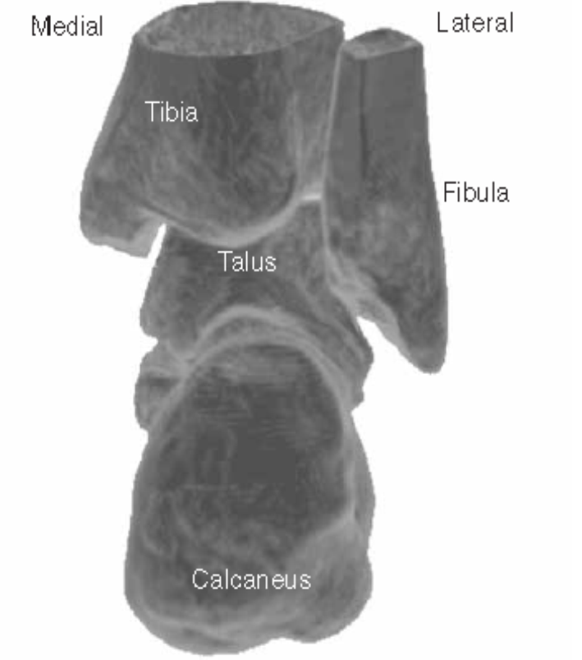
Ankle joint
Characteristics. The ankle (talocrural) joint is a synovial hinge joint formed by the mortise and the talus.
It is supported medially by the medial collateral (deltoid) ligament and laterally by the lateral collateral (anterior and posterior talofibular and calcaneofibular) ligaments.
Dorsiflexion is the close-packed, stable position of the talocrural joint. Plantarflexion is the loosepacked position.

Slide 9
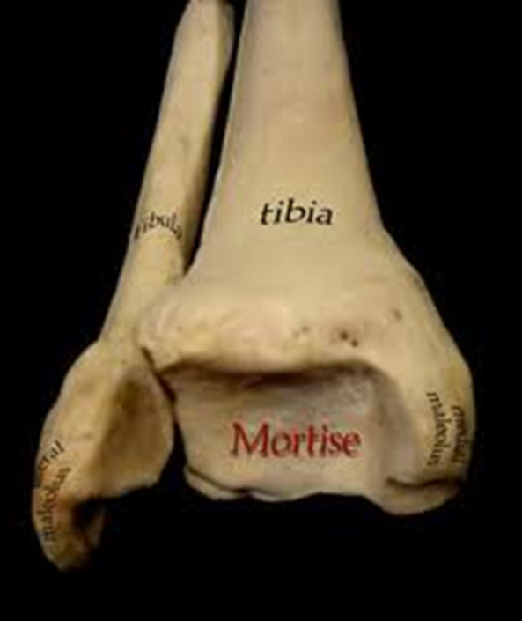
Ankle joint
Osteokinematics
Tibial component | Fibular component
Medial articulating surface | Lateral articulating surface
Distal aspect of tibia | Distal aspect of fibula
Medial styloid process – Medial malleolus | Lateral styloid process – Lateral malleolus
Arthrokinematics
Concave articulating surface of distal tibial condyle | Concave articulating surface of distal fibular condyle
Osteokinematics
Talus component
Proximal articulating surface
Superior aspect of talus bone
Arthrokinematics
Convex articulating surface of talus bone

Slide 10
Ligaments

Slide 11
Axis of ankle joint

Slide 12
Arthrokinematics. The concave articulating surface is the mortise; the convex articulating surface is the body of the talus. With physiological motions of the foot, the articulating surface of the talus slides in the opposite direction.
In non-weight bearing, During DF → TALUS ROLLS - ANTERIORLY AND GLIDES – POSTERIORLY & v/v IN PF.
Normal ROM
DF : 0⁰-10⁰ to 20⁰
PF : 0⁰-20⁰ to 50⁰

Slide 13
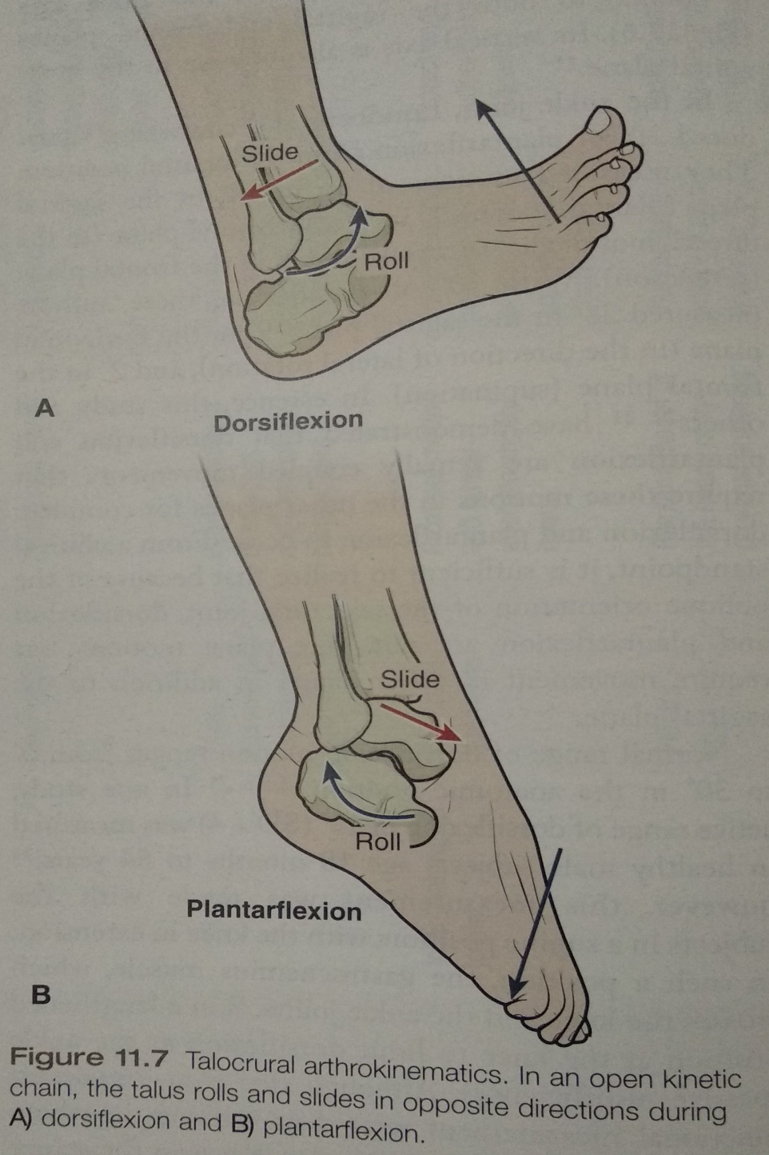

Slide 14
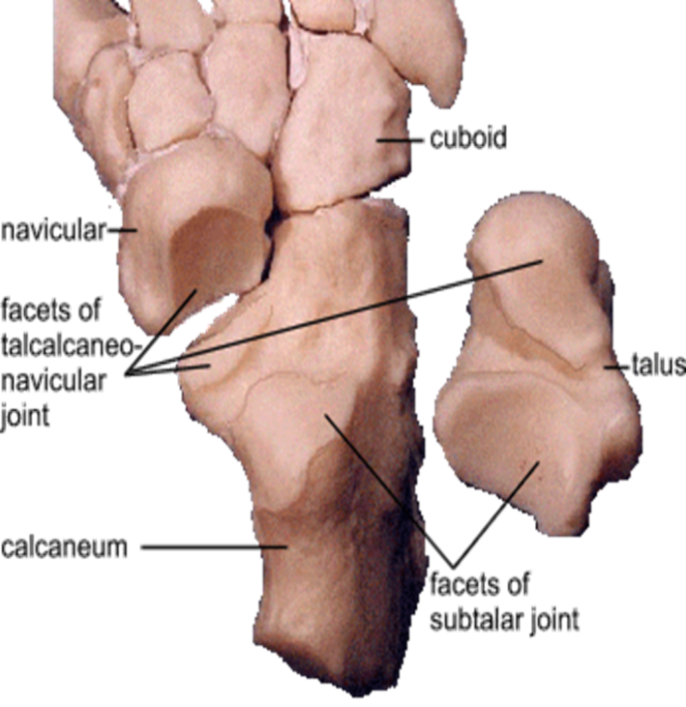
Subtalar joint
The subtalar (talocalcaneal) joint is a complex joint with three articulations between the talus and calcaneus. The subtalar joint is also supported by the medial and lateral collateral ligaments

Slide 15
Osteokinematics
Talus component | Calcaneal component
Proximal articulating surfaces (3 – Ant, Medial & Post) (inferior surface) | Distal articulating surface (superior surface)
Arthrokinematics
Posterior - concave surface (in non weight bearing) | Posterior - convex surface (in non weight bearing)
Concave moves over convex surface, Slides in same direction of movement
Anterior & medial – convex surface (in non weight bearing) | Anterior & medial – concave surface (in non weight bearing)
Convex moves over concave surface, Slides in opposite direction of movement
Twisting or screw like motion, and results in a triplanar supination/pronation.

Slide 16
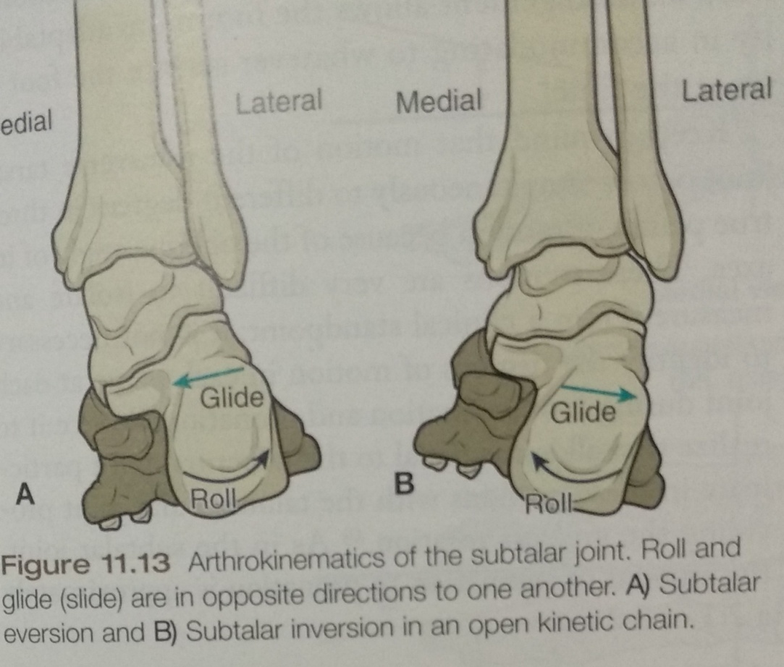

Slide 17
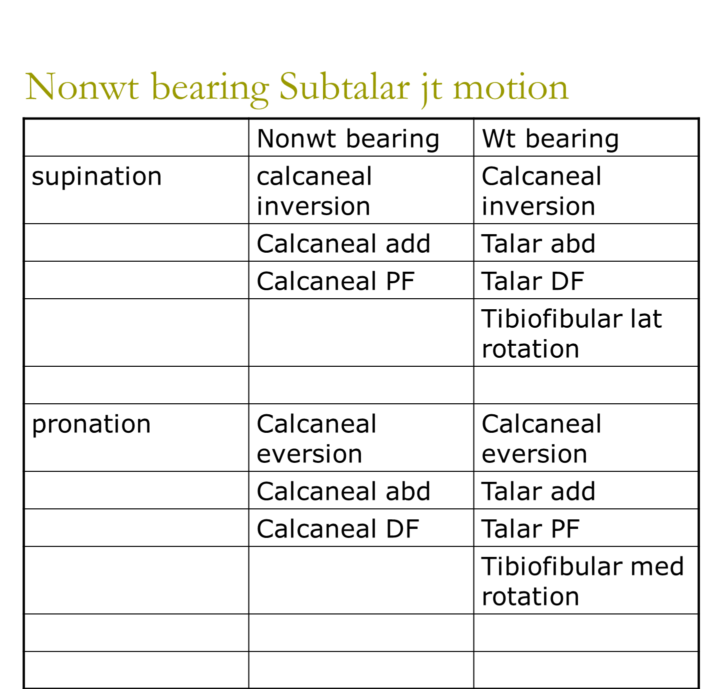

Slide 18
Talonavicular Joint
It is the articulation between the talus and navicular. It is supported by the spring, the deltoid, and the dorsal talonavicular ligaments. It is a modified ball and socket joint. The triplanar motions of the navicular on the talus function with the subtalar joint, resulting in pronation and supination.

Slide 19
ARTHROKINEMATICS OF THE ANKLE AND FOOT JOINTS
Physiologic motion Roll Slide
Talocrural joint: motion of talus
Dorsiflexion Anterior Posterior
Plantarflexion Posterior Anterior
Subtalar joint: motion of calcaneus (posterior articulating surface)
Supination with inversion Medial Lateral
Pronation with eversion Lateral Medial
Talonavicular joint: motion of navicular (open-chain)
Supination Plantar and Plantar and
medial medial
Pronation Dorsal and Dorsal and
lateral lateral
Metatarsophalangeal and interphalangeal joints: motion of the phalanges
Flexion Plantar Plantar
Extension Dorsal Dorsal

Slide 20
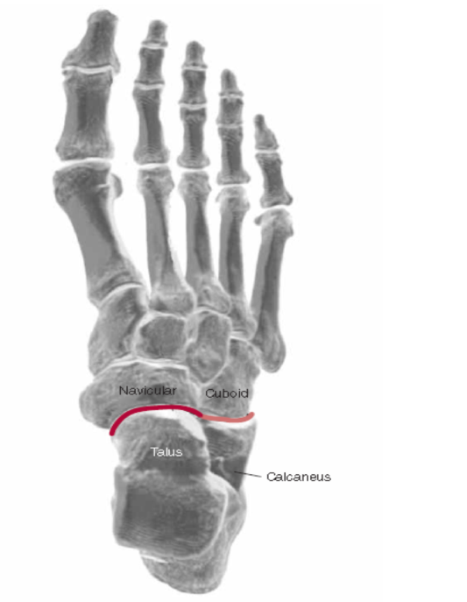
Transverse Tarsal Joint/
Midtarsal joint/ Chopart’s joints
It is the joint between the hind- and midfoot includes the talonavicular and calcaneocuboid joints.
The calcaneocuboid joint is saddle-shaped. It permits gliding motions. The transverse tarsal joint participates in the triplanar pronation/supination motions of the foot and makes compensatory movements to accommodate variations in the ground.

Slide 21
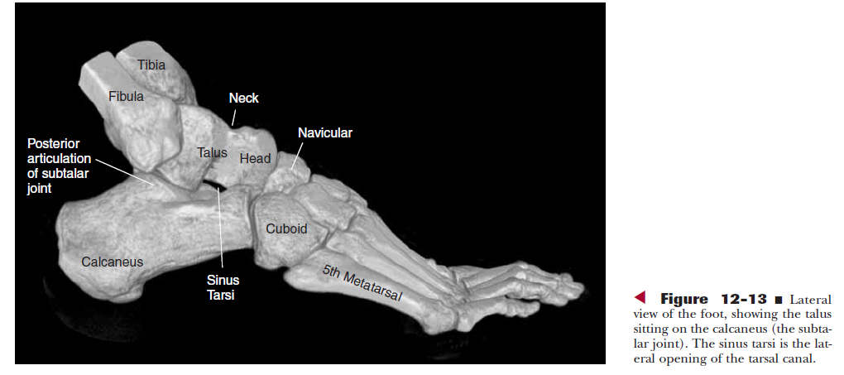

Slide 22
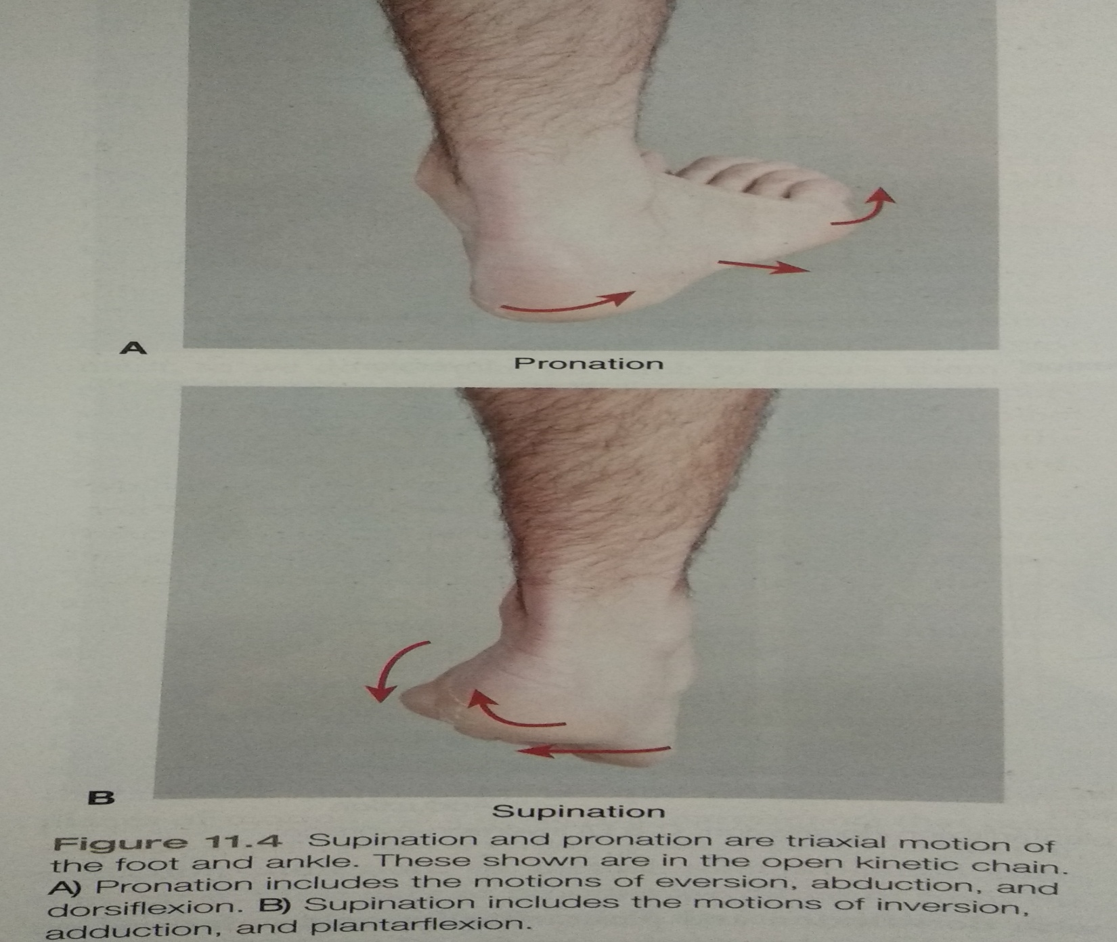

Slide 23
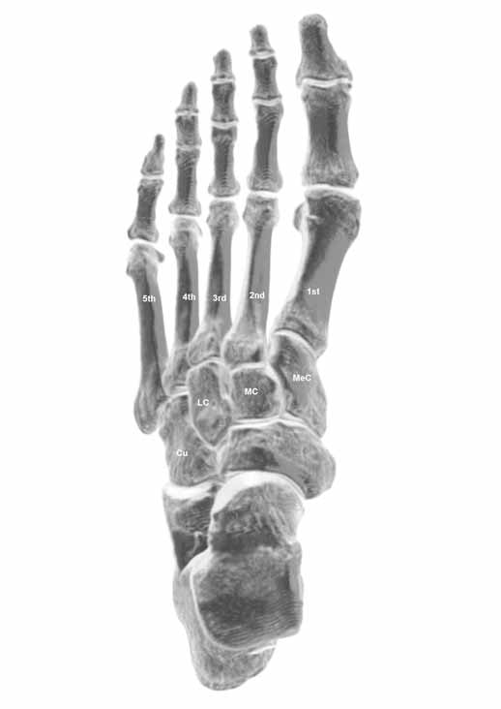
Intertarsal and Tarsometatarsal Joints
The remaining intertarsal and tarsometatarsal joints are plane joints that during weight bearing, help regulate the position of the forefoot on the ground and permit gliding motion.
Metatarsophalangeal (Lisfranc’s joint) and Interphalangeal Joints of the Toes
MTP joints are modified condyloid joints. IP joints are hinge joints

Slide 24
Arches of the foot
The foot typically is characterized as having three arches: medial and lateral longitudinal arches and a transverse arch, of which the medial longitudinal arch is the largest. The longitudinal arch extends from the heel to the heads of the five metatarsals. It is adapted to support the foot and to absorb shock.
The arches are not present at birth but evolve with the progression of weight-bearing.

Slide 25
Structure of the Arches
The longitudinal arches are anchored
  posteriorly at the calcaneus
  anteriorly at the metatarsal heads.
The longitudinal arch is continuous both medially and laterally through the foot, but because the arch is higher medially, the medial side usually is the side of reference.
The lateral arch is lower than the medial arch.
The talus rests at the top of the vault of the foot and is considered to be the “keystone” of the arch.
All weight transferred from the body to the heel or the forefoot must pass through the talus.

Slide 26
The transverse arch is a continuous structure. It is easiest to visualize in the midfoot at the level of the TMT joints.
At the anterior tarsals, the middle cuneiform bone forms the keystone of the arch. The transverse arch still can be visualized at the distal metatarsals but with less curvature.
The second metatarsal, recessed into its mortise, is at the apex of this part of the arch.
The transverse arch is completely reduced at the level of the metatarsal heads, with all metatarsal heads parallel to the weight-bearing surface.

Slide 27
The shape and arrangement of the bones are partially responsible for stability of the plantar arches.
The calcaneus and first metatarsal contribute to stability of the medial longitudinal arch, particularly in standing.
Although the structure of the tarsal bones provides a certain inherent stability to the arches, the arches would collapse without additional support from ligaments and muscles.

Slide 28
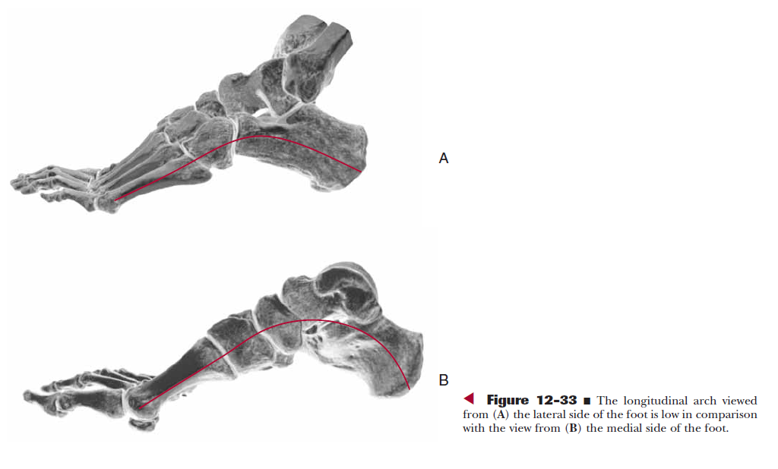

Slide 29
Because the three arches can be thought of as a segmented vault or one continuous set of interdependent linkages, support at one point in the system contributes to support throughout the system.
key for passive support are:
  The plantar calcaneonavicular (spring) ligament,
  the interosseous talocalcaneal ligament,
  the plantar aponeurosis

Slide 30
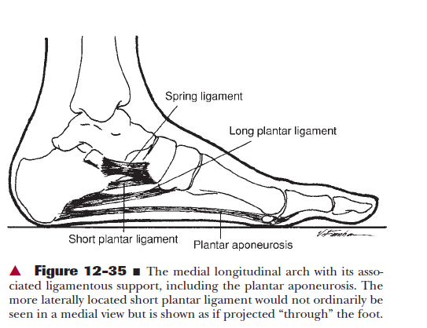

Slide 31
Function of Arches
The plantar arches are adapted uniquely to serve two contrasting mobility and stability weight-bearing functions. The foot must accept weight during early stance phase and adapt to various surface shapes. To accomplish this weight-bearing mobility function, the plantar arches must be flexible enough to allow the foot to
(1) dampen the impact of weight-bearing forces,
(2) dampen superimposed rotational motions, and
(3) adapt to changes in the supporting surface.
To accomplish weight-bearing stability functions, the arches must allow
(1) distribution of weight through the foot for proper weight-bearing and
(2) conversion of the flexible foot to a rigid lever.

Slide 32
PLANTAR FASCIA/ PLANTAR APONEUROSIS
The plantar aponeurosis is a dense fascia that runs nearly the entire length of the foot. It begins posteriorly on the medial tubercle of the calcaneus and continues anteriorly to attach by digitations to the plantar plates and then to the proximal phalanx of each toe.
Tension in the plantar aponeurosis caused by MTP joint extension can draw the hindfoot and forefoot together to raise the longitudinal arch.
Function: It supports the arches of the foot

Slide 33
Muscle Function in the Ankle and Foot
Plantarflexors
Tibialis posterior
Flexor hallucis longus and the flexor digitorum longus
Lateral Compartment Muscles
The peroneus longus and brevis
Anterior Compartment Muscles
The muscles of the anterior compartment of the leg are the tibialis anterior, the extensor hallucis longus, the extensor digitorum longus, and the peroneus tertius muscles.

Slide 34
PATHOMECHANICS
1. Pes Planus: The terms pes planus, pronated foot, and flat foot are often interchanged to mean a decreased medial longitudinal arch.
2. Pes cavus and supinated foot describe a high-arched foot.
3. Plantar Fascitis: Inflammation of plantar aponeurosis
4. Hallux Valgus: In the great toe the proximal phalanx shifts laterally towards the second toe.
5. Hallux Rigidus: Narrowing and eventual obliteration of 1st MTP space.
6. Claw Toe: MTP hyperextension and IP flexion
7.Hammer Toe: Due to imbalance between intrinsic and extrinsics MTP hyperextension, PIP flexion DIP hyperextension
8. Metatarsalgia: Excessive stresses contributing to pain under the metatarsal heads
9. Ankle sprain – sprain or injury to ligaments either on of side lateral or medial.
10. Calcaneal spur - Spike of the bone at the anterior edge of the calcaneal tuberosity.
11. Morton’s neuroma is the common lesion of the digital nerve that supplies 3rd and 4th toes. Mainly due to chronic hyperextension of the MTP joints. Resulting in the entrapement neuropathy

Slide 35
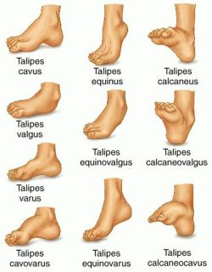
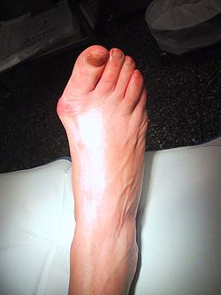
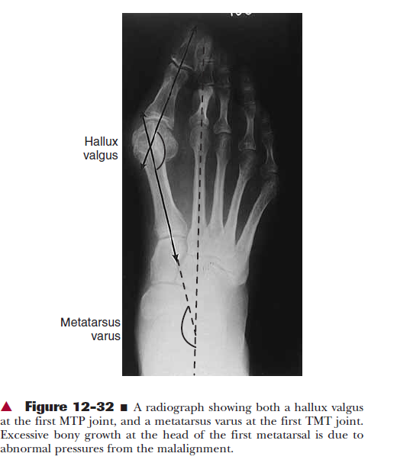

Slide 36
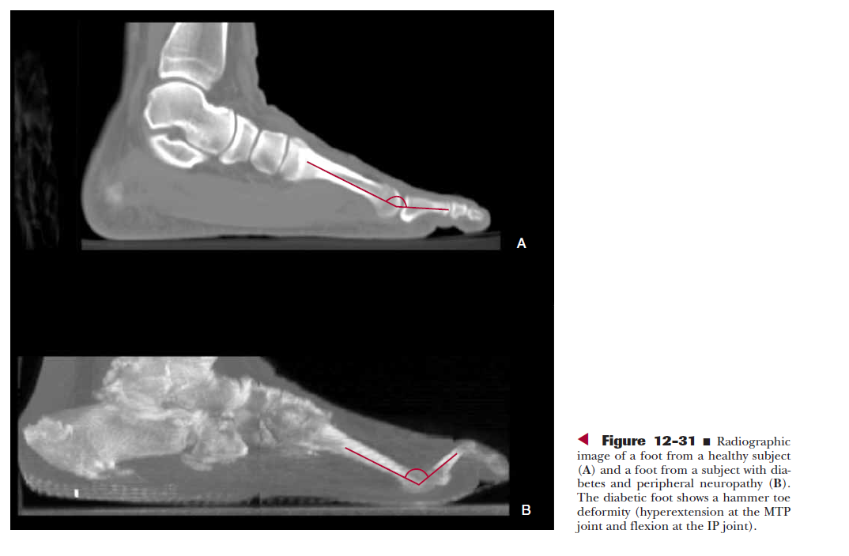

Slide 37
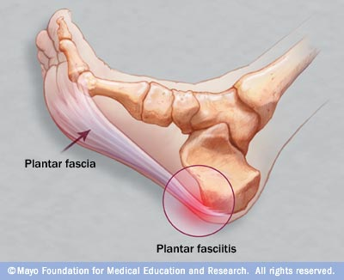
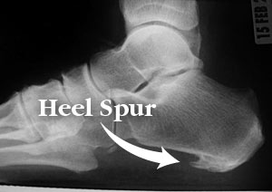

Slide 38
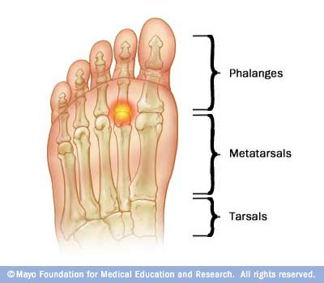
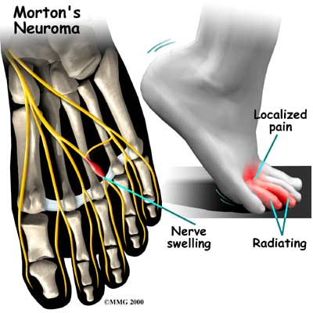

Slide 39
Thank you

Slide 40
Ankle joint is a ___ joint
Condyloid
Hinge
Irregular
None
Hindfoot is made up of
Talus and calcaneus
Talus and navicular
Calcaneus and navicular
none

Slide 41
The medial collateral ligament in the ankle is known as ___ ligament
Spring
Planter
Deltoid
None
4. Subtalar joint is made up of
Talus and calcaneus
Talus and navicular
Calcaneus and navicular
none

Slide 42
5. Planter fascia is attached to
Calcaneus and Metatarsals
Calcaneus and cuneiform
Calcaneus and Proximal phalanx
None
Key
1- b
2-a
3- c
4-a

Slide 43
Title: Changes in passive mechanical properties of the gastrocnemius muscle at the muscle at the muscle fascicle and joint levels in stroke survivors
Type of study | Comparative study
Year of publication | 2008
Level of evidence | 3b
Authors | Gao et al
Citation | Arch Phys Med Rehabil, 2008;90:819-26
Aim | To investigate ankle joint level and muscle fascicle level changes and their correlations in stroke survivors with spasticity, contracture & muscle weakness
Method | Fascicular changes of medial gastrocnemius using ultrasonography & biomechanical changes at ankle joint in 10 stroke patients
Results | These patients showed decreased fascicular length, smaller pennation angle, increased stiffness & reduced ROM at ankle
Conclusion | Results would help improve stroke rehabilitation

