Slide 1
DEMOGRAPHY-Terminology
Dr. Bhavesh Bariya
Assistant Professor
Dept. of PSM

Slide 2
It focuses its attention on three readily observable human phenomena:
Changes in population size (growth or decline)
The composition of the population size
The distribution of population in space.
It deals with five demographic processes’, namely
fertility,
mortality,
marriage,
migration and
social mobility.
These five processes are continuously at work within a population determining size, composition and distribution.

Slide 3
Religions of India (Census 2011)
Religion Population Percent (%)
All 1,210,854,977 100.00
Hindus 966,378,868 79.80
Muslims 172,245,158 14.23
Christians 27,819,588 2.30
Sikhs 20,833,116 1.72
Buddhists 8,442,972 0.70
Jains 4,451,753 0.37
Others 7,937,734 0.66
Not stated 2,867,303 0.24

Slide 4
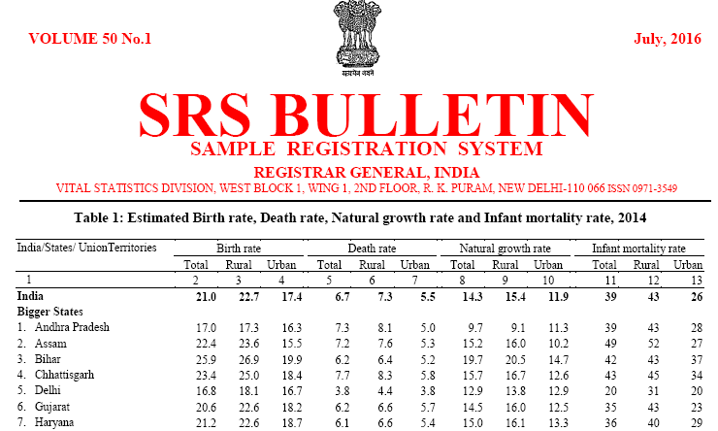

Slide 5
The common method to show the structure is by a population pyramid. This diagram is made up by putting two bar graphs (one for male, one for female) side by side. From this you can read off what percentage of a population is of a certain gender and age range.

Slide 6
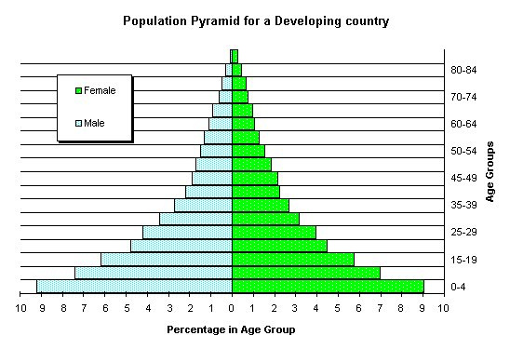

Slide 7
Population Structure - Developing Countries
This population pyramid is wide at the base, which means there are a large proportion of young people in the country. It tapers very quickly as you go up into the older age groups, and is narrow at the top. This shows that a very small proportion of people are elderly.
This shape of pyramid is typical of a developing country, such as Kenya or Vietnam.

Slide 8
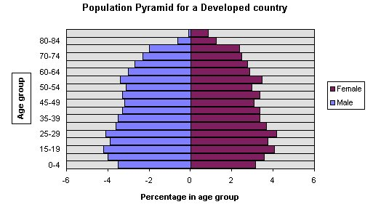

Slide 9
Population Structure - Developed Countries
This shape is typical of a developed country. It is narrow at the base, wider in the middle, and stays quite wide until the very top, as there is a sizable percentage of older people. Note that there are more old women than men. Italy and Japan have population structures that are of this shape.

Slide 10
STAGES OF DEMOGRAPHY CYCLE & COUNTRIES
High Stationary | High | High | India (1920)
Early Expanding | Unchanged | Decline | South Asia, Africa
Late Expanding | Fall | Further Decline | China, Singapore, India
Low Stationary | Low | Low | Austria (1980-1985)
Declining | Further lowers | Unchanged | Germany, Hungary
STAGE BIRTH RATE DEATH RATE COUNTRIES

Slide 11
.
 | 2001 | 2011
States/UTs | 35 | 35
Districts | 593 | 640
Tehsils | 5463 | 5767
Towns | 5161 | 7742
Villages | 593732 | 608786
Households | 194 Million | 240 Million
Population | 1.03 Billion | 1.20 Billion

Slide 12
Census 2011 and Demographic Trends in Indian
Population | 1,21,01,93,422 | Male : 62,37,24,248 Female :58,64,69,174
Decadal population growth | 18,14,55,986 | 17.64%
Density of population | 382 | Per sq .km
Sex ratio | 940 | Females per 1000 males
Population in the age group (0-6) | 15,87,89,287 | 13.12% (of total population
Literates | 77,84,54,120 | 74.04% Male :82.14% Females :65.46 %

Slide 13
1. In the demographic cycle, India is in the:
(a) High stationary stage
(b) Early expanding stage
(c) Late expanding stage
(d) Low stationary stage

Slide 14
2. Which states in India has the highest female/male sex ratio is:
(a) Kerala
(b) Haryana
(c) Tamil Nadu
(d) Himanchal Pradesh

Slide 15
3.Dependency ratio numerator is:
(a) Less than 15 years and more than 65 years
(b) Less than 85 years
(c) 30-35 years
(d) 15-65 years

Slide 16
4. Denominator in crude birth rate:
(a) Mid year population
(b) Total no. of live births in a year
(c) Mid year males between 15-44 years
(d) No. of children 0-4 years of age

Slide 17
5. Crude Death Rate of Gujarat is
A) 21
B) 20.6
C) 6.7
D) 6.2

Slide 18
Reference
http://censusindia.gov.in/

Slide 19
References
Study | Level of Evidence | Result | Suggestion
Row JR, Wilson PJ, Murray DL. J Anim Ecol. 2014 Jan 20. | Medium | results reveal that density dependence acting exclusively on survival as opposed to productivity is destabilizing, suggesting that a shift in the action of population regulation toward reproductive output may decrease cyclic propensity and cycle amplitude | Most important in all demographic process is survival by reproduction i.e. fertility.

