Slide 1
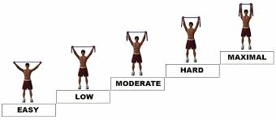
STRENGTHENING OF THE MUSCLE –
PROGRESSIVE RESISTED EXERCISE(PRE)
Dr. Krina Ved

Slide 2

Objectives
Principles of selection of equipment for PRE.
Strength training with the use of isometric, isotonic and isokinetic regime of muscles.

Slide 3
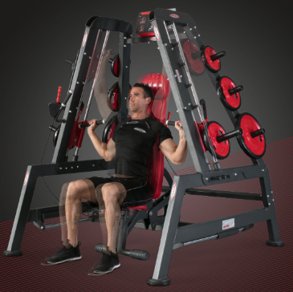
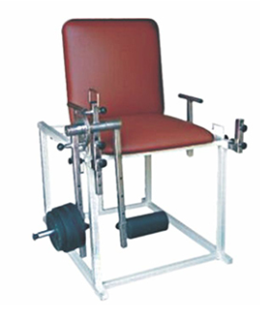
PRINCIPLES FOR THE SELECTION AND USE OF THE EQUIPMENT
Gym Exerciser
Quadriceps Table

Slide 4
Equipment can be used for
static or dynamic
concentric or eccentric
open-chain or closed-chain exercises
- to improve muscular strength, power, or endurance, neuromuscular stability or control, as well as cardiopulmonary fitness.

Slide 5
Use of equipments depends on
Availability
Cost of purchase
Maintenance and safety by a facility or a patient
Use-friendly and independently operated setup of equipment
Versatility of equipment
Space requirements of equipment
Individual needs
Abilities and goals of person using equipment

Slide 6
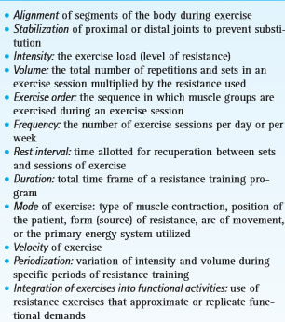
DETERMINANTS OF STRENGTH TRAINING

Slide 7
PHYSIOLOGICAL ADAPTATIONS TO STRENGTH TRAINING

Slide 8
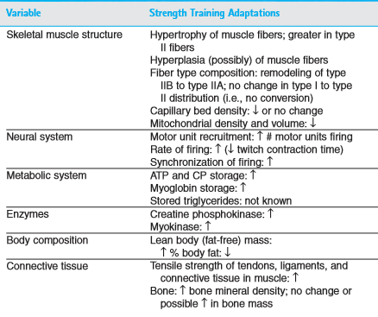

Slide 9
RE-EDUCATION OF MUSCLE
Muscle Grading | Techniques used to improve muscle strength
Grade 0 | Electrical stimulation – Interrupted Galvanic, Passive ROM exercise
Grade 1 | Electrical stimulation – Interrupted Galvanic, Assisted ROM exercise, Isometeric – stabilization, muscle setting exercises
Grade 2 | Electrical stimulation – Surged Faradic Active – assisted exercise, Suspension therapy, PNF
Grade 3 – 5 | Dynamic resistance exercises – PRE, DAPRE (Concentric, Eccentric and Isokinetic exercises)

Slide 10
TYPES OF STRENGTH/RESISTANCE TRAINING
Manual Resistance exercises
Mechanical Resistance exercises
Self resistance exercises
Therapist resistance exercises
Isometeric exercises
Multiple angle isometerics
Stabilisation exercises
Muscle setting exercises
Dynamic exercises – Concentric and Eccentric
Constant resistance : A) Body weight B) Free weight – Sand bags, Dumbbells, Medicine balls, Theraband/tubes, Springs C) Pulley system
Weight machine
Isokinetic device

Slide 11
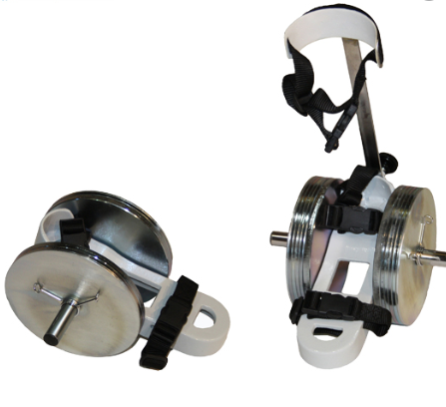
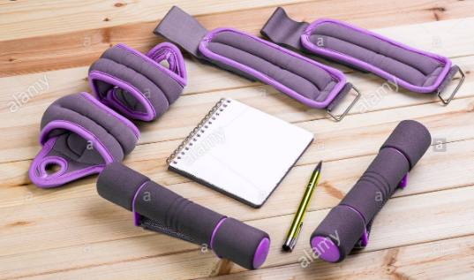
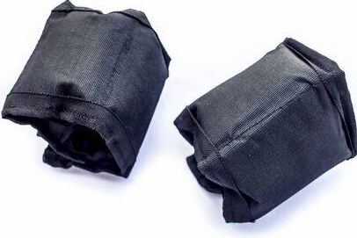
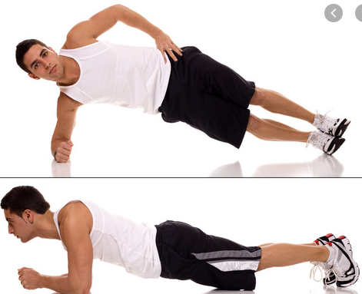
De’lorme Shoe
Sand Bags – wrist and ankle bands
Body weight training

Slide 12
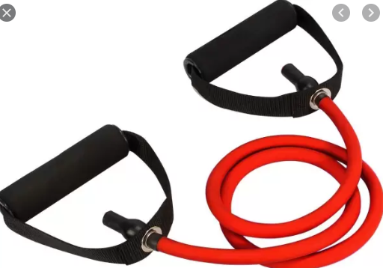
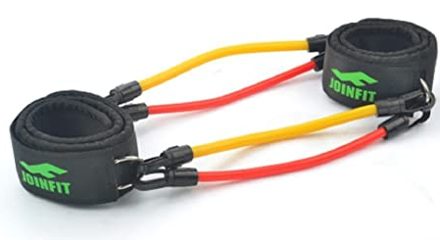
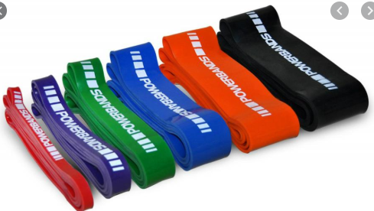
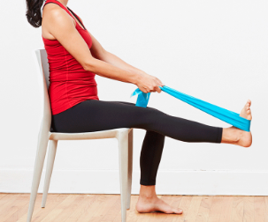
Resistance tube
Resistance bands

Slide 13
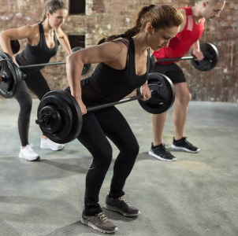
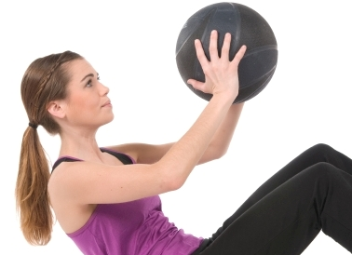
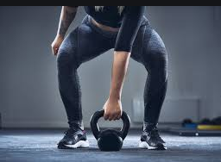
Dumbbells
Medicine Ball
Kettle ball

Slide 14
BENEFITS OF ISOMETERIC EXERCISE
To prevent or minimize muscle atrophy
To activate muscles (facilitate muscle firing) to begin to re-establish neuromuscular control
To develop postural or joint stability
To improve muscle strength when use of dynamic resistance exercise could compromise joint integrity or cause joint pain
To develop static muscle strength at particular points in the ROM consistent with specific task-related needs

Slide 15
BENEFITS OF ISOTONIC/DYNAMIC EXERCISE
To develop tension against muscle loading (Concentric)
To develop control against load (Eccentric)
Eccentric acts as source of shock absorption during high impact activities.
To improve muscle performance.
For subjects with high demand sports, sports related performance and work related activities.

Slide 16
BENEFITS OF ISOKINETIC EXERCISE
It is form of dynamic exercise in which constant rate of velocity of muscle shortening and lengthening of angular limb occurs by use of mechanical device.
Variable remain constant are: Velocity, Range, selection of muscle/s, joint/s involvement, fatigue level.
Athletic training

Slide 17
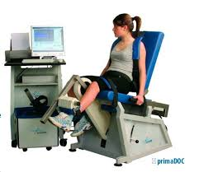
Isokinetic leg Exerciser

Slide 18
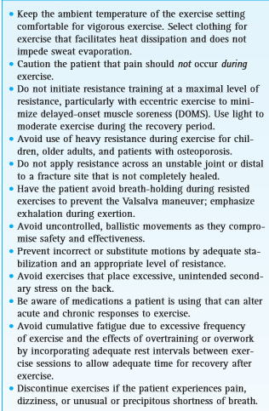
PRECAUTION DURING STRENGTH TRAINING

Slide 19
DOMS
Delayed onset muscle soreness is exercise induced muscle soreness developed after vigorous resisted exercises or overexertion seen in muscle belly or musculotendinous junction approximately after 12 to 24 hours and peaks at 48 to 72 hours.
Theories behind DOMS is metabolic waste (lactic acid) accumulation theory and muscle spasm theory (feedback cycle of pain caused by ischemia; reflex pain–spasm cycle)
Signs & Symptoms
Tenderness with palpation of muscle.
Local odema and warmth
↓ ROM

Slide 20
CONTRAINDICATION OF STRENGTH TRAINING
Pain
Acute Inflammation
Severe cardiopulmonary diseases

Slide 21
ADVANTAGES
Manual resistance
Mechanical resistance
Early stage rehabilitation
Graded resistance
Resistance can be adjusted throughout range
Controlled joint ROM
Direct manual stabilisation
Variable placement of resistance
Monitor patients performance.
Constant Exercise load
Constant velocity of exercise
Whole muscle group is involved.

Slide 22
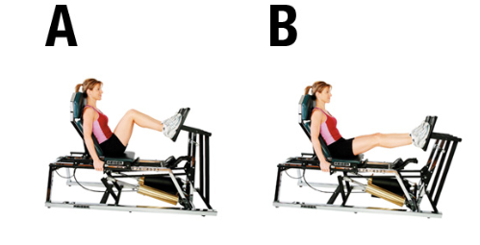
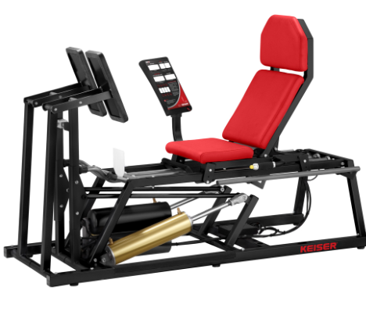
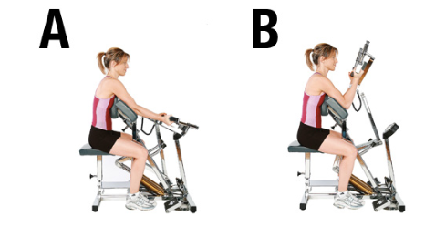
Evidences for new techniques of dynamic strength training
HYDRAULIC AND PNEUMATIC DEVICE

Slide 23
Thank you
Reference –
The principle of exercise therapy – 5th edition, Dena gardiner
Therapeutic exercise – 5th edition, Colby & Kisner

