Slide 1
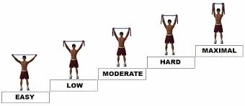
STRENGTHENING OF THE MUSCLE –
PROGRESSIVE RESISTED EXERCISE(PRE)
Dr. Krina Ved (PT)

Slide 2

Objectives
By the end of the lecture the students will be able to:
What is progressive resisted exercise ?
Which are the factors that influence the strength of the muscle ?
What is load assisted and load resisted exercise ?

Slide 3
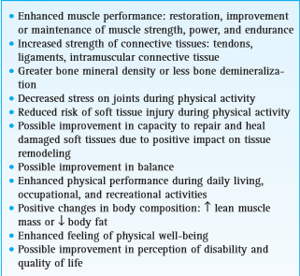
What is need for strengthening of muscles ?

Slide 4
DEFINITION
Muscle strength is a term that refers to the ability of contractile tissue to produce tension and a resultant force based on the demands placed on the muscle.
Muscle power is rate of performance of muscle work power unit time.
Muscle endurance is the ability of a muscle to contract repeatedly against a load (resistance), generate and sustain tension, and resist fatigue over an extended period of time

Slide 5
PRE
Progressive resisted exercise (PRE) is a system of dynamic resistance/strength training in which a constant external load is applied to the contacting muscle by some mechanical means (usually a free weight) and incrementally increased.
PRE is also known as Dynamic constant external resistance (DCER)

Slide 6
1 RM
The repetition maximum (RM) is used as the basis for determining and progressing the resistance.
1 RM is the greatest measurable force that can be exerted by a muscle or muscle group to overcome resistance during a single maximum effort

Slide 7
6RM &10 RM
6RM is the greatest measurable force that can be exerted by a muscle or muscle group to overcome resistance during a SIX maximum effort.
10 RM is the greatest measurable force that can be exerted by a muscle or muscle group to overcome resistance during a TEN maximum effort

Slide 8
Indications of PRE
PRE is beneficial for patients with a variety of pathological conditions including musculoskeletal injuries, osteoarthritis, rheumatoid arthritis, osteoporosis, hypertension, adult-onset (type II) diabetes, and chronic obstructive pulmonary disease.

Slide 9
DAPRE
Daily Adjustable Progressive Resistive Exercise (DAPRE) technique is system based on 6 RM of adjustable working weight.
DAPRE regime:
1 Set of 10 repetitions with 50% of 6 RM
2 Set of 6 repetitions with 75% of 6 RM
3 Set of max. possible repetition with 100% of 6 RM
4 Set of max. possible repetition with 100% of adjustable working weight.

Slide 10
FACTORS THAT INFLUENCE THE STRENGTH OF THE MUSCLE

Slide 11
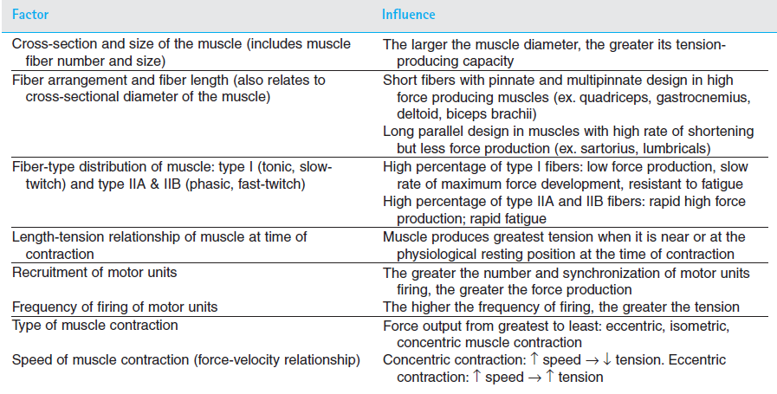
Habitual postural position
Habitual postural position

Slide 12
PRINCIPLES OF STRENGTH TRAINING

Slide 13
1. Overload Principle
It states that in order to improve in strength of muscle from exercise program, a load that exceeds the metabolic capacity of muscle must be applied.
As the demand of work increases
Level of muscle performance (supply)
has to increase.

Slide 14
2. SAID Principle
Specific Adaptation to Imposed Demands (SAID) states that body will adapt to the specific demands placed upon it.
Specificity of training is the adaptive effects of training, such as improvement of strength, power, and endurance, are highly specific to the training method.
Transfer of training/overflow/cross-training is training of nonexercised, contralateral limb in a resistance training program.

Slide 15
3. Detraining
Detraining is reflected by a reduction in muscle performance, begins within a week or two after the cessation of resistance exercises and continues until training effects are lost.

Slide 16
DELORME REGIMEN

Slide 17
Delorme and Oxford regimen
The concept of PRE was introduced almost 60 years ago by DeLorme, who originally used the term heavy resistance training and later load-resisting exercise to describe a new system of strength training.
DeLorme proposed and studied the use of three sets of a 10 RM with progressive loading during each set.
Other investigators developed a regimen, the Oxford technique, with regressive loading in each set.

Slide 18
The DeLorme technique builds a warm-up period into the protocol, whereas the Oxford technique diminishes the resistance as the muscle fatigues.
Both regimens incorporate a rest interval between sets; both incrementally increase the resistance over time; and both have been shown to result in training-induced strength gains over time.

Slide 19
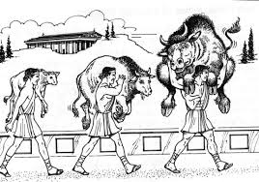

Slide 20
Delorme Regimen
Determination of 10 RM
10 repetitions with 50% of 10 RM
10 repetitions with 75% of 10 RM
10 repetitions with 100% of 10 RM

Slide 21
Oxford Regimen
Determination of 10 RM
10 repetitions with 100% of 10 RM
10 repetitions with 75% of 10 RM
10 repetitions with 50% of 10 RM

Slide 22
In reality, an ideal combination of these variables does not exist.
Extensive research has shown that many combinations of exercise load, repetitions and sets, frequency, and rest intervals significantly improve strength.
In general, training-induced strength gains occur with two to three sets of 6 to 12 repetitions of a 6 to 12 RM.
This gives a therapist wide latitude when designing an effective weight-training program.

Slide 23
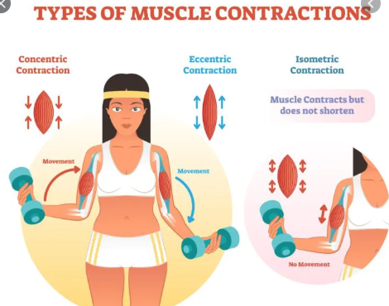
LOAD ASSISTED EXERCISE & LOAD RESISTED EXERCISE

Slide 24
load resisting exercises
augments the resistance of gravity-CONCENTRIC
load assisting exercises
eliminates or diminishes the resistance of gravity-ECCENTRIC

Slide 25
Thank you
Reference –
The principle of exercise therapy – 5th edition, Dena gardiner
Therapeutic exercise – 5th edition, Colby & Kisner

