Slide 1
DEMOGRAPHY
Introduction
By-
Dr. Bhavesh Bariya
Assistant Professor
Dept. of PSM

Slide 2
..
“Demo” means “the people” and “graphy” means “measurement”.
(Demos = population, Graphy = picture

Slide 3
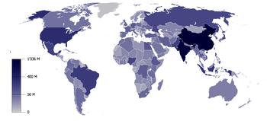
Demography
Demography is the ”scientific study of human population in which includes study of changes in population size ,composition and its distribution”

Slide 4
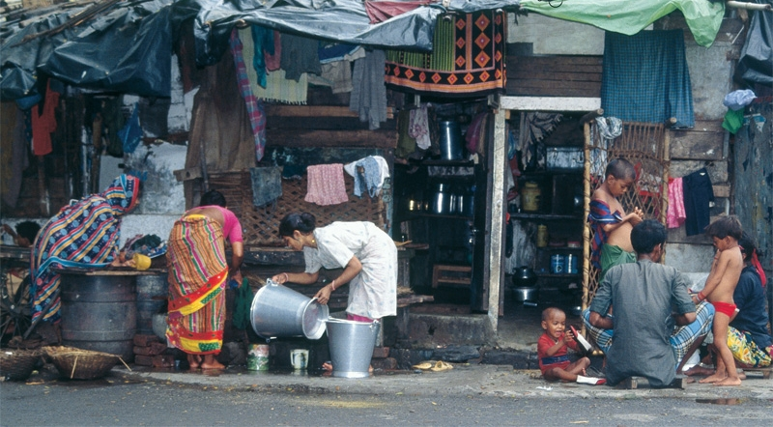
The elements of demography
  Size: increase or decrease
Composition: sex and age group
Distribution: territory

Slide 5
It focuses its attention on three readily observable human phenomena:
Changes in population size (growth or decline)
The composition of the population size
The distribution of population in space.
It deals with five demographic processes’, namely
fertility,
mortality,
marriage,
migration and
social mobility.
These five processes are continuously at work within a population determining size, composition and distribution.

Slide 6
Source of demography
POPULATION CENSUSES
NATIONAL SAMPLE
SURVEYS REGISTRATION
VITAL EVENTS

Slide 7
Census -Biggest source of data on
  Demography
  Economic Activity
  Literacy & Education
  Housing & Household
  Urbanization
  Fertility and Mortality
  Scheduled Castes and Scheduled Tribes
  Language, Religion & Migration

Slide 8
WORLD POPULATION TRENDS
YEAR | POPULATION( millions) | AVERAGE ANNUAL GROWTH RATE(%)
1800 | 978 | 0.4
1900 | 1650 | 0.6
1960 | 3037 | 1.79
1975 | 4066 | 1.89
1987 | 5000 | 1.63
1998 | 5884 | 1.6
2000 | 6054 | 1.4
2003 | 6313 | 1.1

Slide 9
In 1800 1 billion
In1930 2 billion(took 130 yrs for 1 million rise)
In 1960 3 billion (took 30 yrs)
In 1974 4 billion (took 14 yrs)
In 1987 5 billion(took 13 yrs)
In 1999 6 billion(took 12 yrs)
Expected to reach 8 billion by 2050.

Slide 10
Religious Data Composotion
Religious Composition | Population | (%)
Hindus | 827,578,868 | 80.5%
Muslims | 138,188,240 | 13.4%
Christians | 24,080,016 | 2.3%
Sikhs | 19,215,730 | 1.9%
Buddhists | 7,955,207 | 0.8%
Jains | 4,225,053 | 0.4%
Other Religions & Persuasions | 6,639,626 | 0.6%
Religion not stated | 727,588 | 0.1%
Total | 1,028,610,328 | 100.0%

Slide 11
Population growth of India per decade
Census Year Population Change (%)
1951 361,088,000
1961 439,235,000 21.6
1971 548,160,000 24.8
1981 683,329,000 24.7
1991 846,387,888 23.9
2001 1,028,737,436 21.5
2011 1,210,726,932 17.7

Slide 12
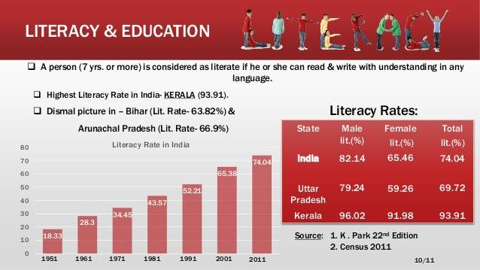

Slide 13
Religions of India (Census 2011)
Religion Population Percent (%)
All 1,210,854,977 100.00
Hindus 966,378,868 79.80
Muslims 172,245,158 14.23
Christians 27,819,588 2.30
Sikhs 20,833,116 1.72
Buddhists 8,442,972 0.70
Jains 4,451,753 0.37
Others 7,937,734 0.66
Not stated 2,867,303 0.24

Slide 14
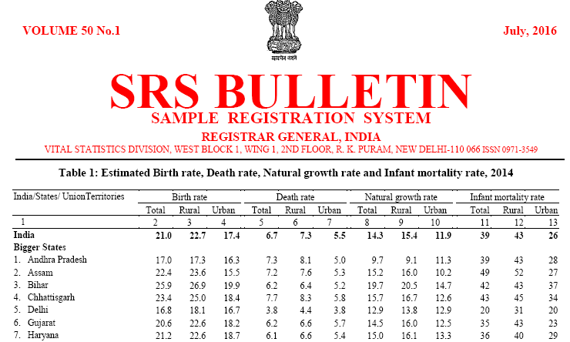

Slide 15
Importance of Demographic data
  Health status of a community depends upon the dynamic relationship between number of people, their composition& distribution
  Planning of health services can be guided by demographic variables, for example: How many health units do we need? How to distribute them in the community in order to be accessible to the target population? What type of manpower is needed?

Slide 16
DEMOGRAPHIC PROCESSE
It deals with the five demographic processes
FERTILITY
MORTALITY
MARRIAGE
MIGRATION
SOCIAL MORBILITY

Slide 17
The common method to show the structure is by a population pyramid. This diagram is made up by putting two bar graphs (one for male, one for female) side by side. From this you can read off what percentage of a population is of a certain gender and age range.

Slide 18
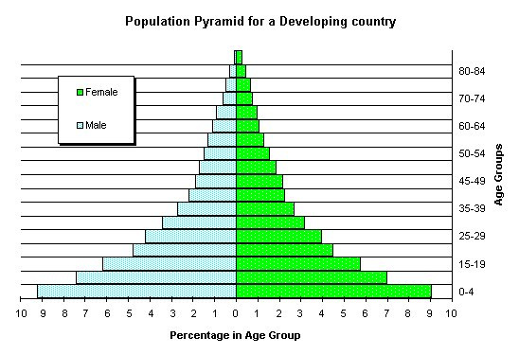

Slide 19
Population Structure - Developing Countries
This population pyramid is wide at the base, which means there are a large proportion of young people in the country. It tapers very quickly as you go up into the older age groups, and is narrow at the top. This shows that a very small proportion of people are elderly.
This shape of pyramid is typical of a developing country, such as Kenya or Vietnam.

Slide 20
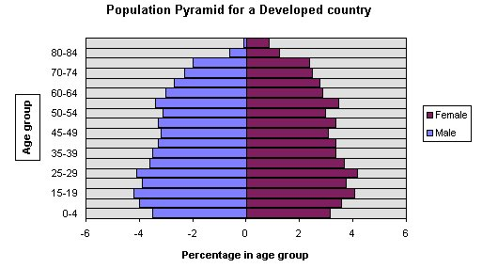

Slide 21
Population Structure - Developed Countries
This shape is typical of a developed country. It is narrow at the base, wider in the middle, and stays quite wide until the very top, as there is a sizable percentage of older people. Note that there are more old women than men. Italy and Japan have population structures that are of this shape.

Slide 22
DEMOGRAPHIC CYCLE(STAGE)
High stationary (first stage ): this stage is characterized by a high birth rate and high death rate ,no any change in size and population .Indian was in this stage till 1920.
Early expending (second stage ): the death rate begins to decline (starts decreasing )and birth rate no change . initial increase in population

Slide 23
.
Late expanding (third stage): the birth rate begins to decline while the death rate still decreases .
  continue increase in population
Low stationary (fourth stage ) :
This stage is characterized by a low birth rate & low death rate stability in population .
Declining (fifth stage ):in the declining stage birth rate is lower then the death rate .fall in population

Slide 24
DEMOGRAPHY CYCLE
High Birth Rate
High Death Rate
HIGH STATIONARY.
EARLY EXPANDING.
Unchanged Birth Rate
Decline Death Rate
LATE EXPANDING.
Fall in Birth Rate
Death Rate further
LOW STATIONARY.
Low Birth Rate
Low Death Rate
DECLINING.
Birth rate lower than
Death Rate

Slide 25
STAGES OF DEMOGRAPHY CYCLE & COUNTRIES
High Stationary | High | High | India (1920)
Early Expanding | Unchanged | Decline | South Asia, Africa
Late Expanding | Fall | Further Decline | China, Singapore, India
Low Stationary | Low | Low | Austria (1980-1985)
Declining | Further lowers | Unchanged | Germany, Hungary
STAGE BIRTH RATE DEATH RATE COUNTRIES

Slide 26
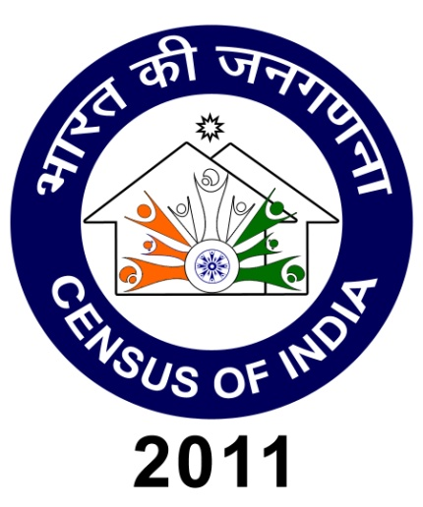
Census of India 2011
In 1872 the first Census was held in India.
The Census of India 2011 will be the 15th Census and the 7th after Independence.

Slide 27
.
 | 2001 | 2011
States/UTs | 35 | 35
Districts | 593 | 640
Tehsils | 5463 | 5767
Towns | 5161 | 7742
Villages | 593732 | 608786
Households | 194 Million | 240 Million
Population | 1.03 Billion | 1.20 Billion

Slide 28
Census 2011 and Demographic Trends in Indian
Population | 1,21,01,93,422 | Male : 62,37,24,248 Female :58,64,69,174
Decadal population growth | 18,14,55,986 | 17.64%
Density of population | 382 | Per sq .km
Sex ratio | 940 | Females per 1000 males
Population in the age group (0-6) | 15,87,89,287 | 13.12% (of total population
Literates | 77,84,54,120 | 74.04% Male :82.14% Females :65.46 %

Slide 29
1
The relationship between the economically active population and the non-working population is known as the:
A employment ratio
B economic ratio
C dependency ratio
D critical ratio

Slide 30
2
India is in which stage of demographic transition?
A stage 2
B stage 3
C stage 4
D stage 5

Slide 31
3
What is current Birth rate?
A 19
B 20
C 21
D 22

Slide 32
4
The fourth stage of the demographic cycle is:
(a) Declining
(b) Early expanding
(c) High stationary
(d) Low stationary

Slide 33
5
Literacy rate is maximum in
A Gujarat
B Punjab
C Kerala
D Delhi

Slide 34
References
Study | Level of Evidence | Result | Suggestion
Row JR, Wilson PJ, Murray DL. J Anim Ecol. 2014 Jan 20. | Medium | results reveal that density dependence acting exclusively on survival as opposed to productivity is destabilizing, suggesting that a shift in the action of population regulation toward reproductive output may decrease cyclic propensity and cycle amplitude | Most important in all demographic process is survival by reproduction i.e. fertility.

Slide 35
THANK YOU

