Slide 1


Management of Class III Malocclusion
Dr. Narayan kulkarni

Slide 2
Contents
Introduction
Definition
Features
Etiology
Treatment
Conclusion

Slide 3
Introduction
A class III malocclusion is rare as compared to other type of malocclusion, with an incidence of 4-5 percent.
It is easy to recognize and difficult to treat.
High chances of relapse tendency.
Attributed to unpredictable growth of mandible.

Slide 4
Classification
TRUE
DENTAL
PSEUDO
Class III
SKELETAL
TRUE

Slide 5
Features of true and pseudo class III
Pseudo class III
Straight / concave
a class I skeletal pattern,
Premature contacts present
Deviated path of closure
Normal gonial angle
Retrusion of mandible is possible
True class III
Concave profile
a class III skeletal pattern,
No premature contacts
Forward path of closure
Gonial angle increased or decreased.
Retrusion of mandible is not possible

Slide 6
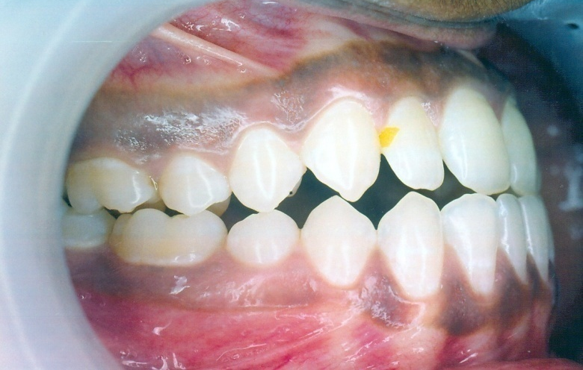
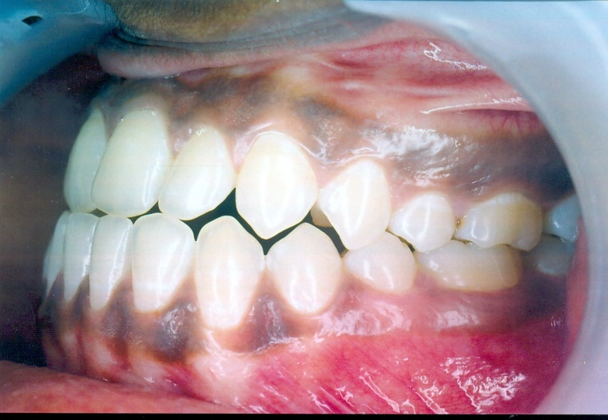
Class III subdivision
This is characterized by class I molar relation on one side and class III on the other side

Slide 7
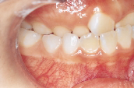
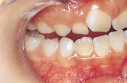
Habitual occlusion
Centric relation

Slide 8
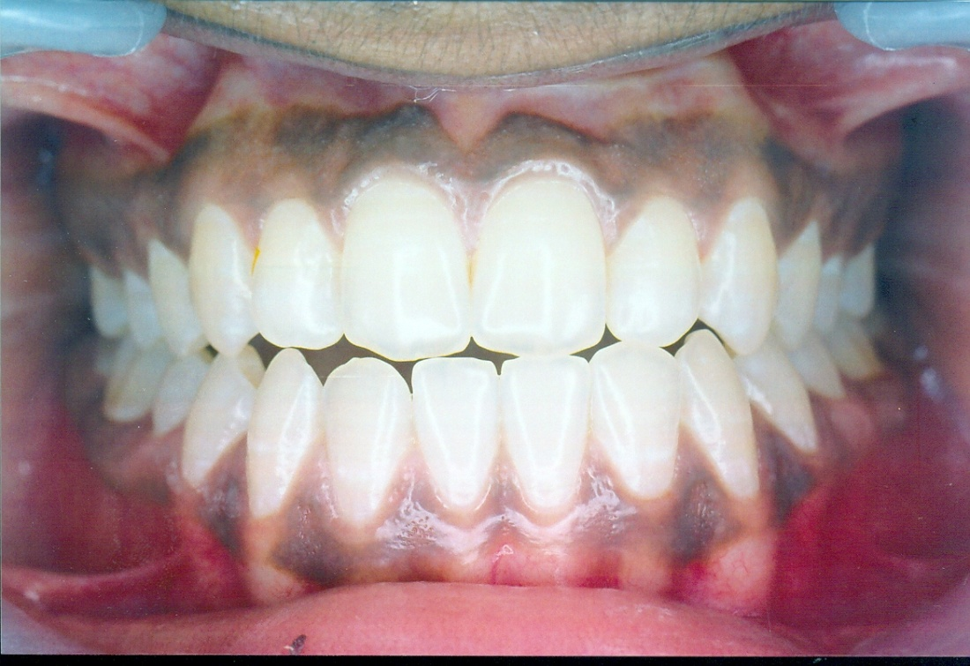

Slide 9
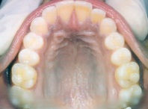
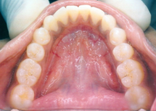

Slide 10
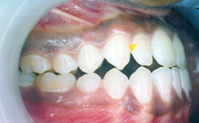
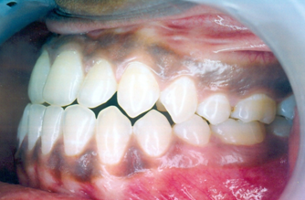

Slide 11
ETIOLOGICAL FACTORS
Heredity
Unilateral/bilateral hyperplasia of mandibular condyle
Occlusal prematurities
Enlarged adenoids
Habitual forward positioning of mandible predispose to pseudo Class III malocclusion
Premature loss of decidious molars

Slide 12
FEATURES OF CLASS III MALOCCLUSION
Extraoral:-
Concave profile with prominent chin.
Decreased lower facial height.
Prominent gonial angle.
Retrognathic maxilla and prognathic mandible or combination of both.
Intraoral:-
Class III molar relationship.
Anterior cross bite.
Narrow upper arch and broad lower arch.

Slide 13
Open bite or reverse open bite with deep bite may be present with type of growth pattern.
Crowding in upper arch and spacing in lower arch.

Slide 14
Treatment
Growth modification
Camouflage
Surgical correction
Facemask therapy
Functional appliance
Class III elastics
LeFort I osteotomy
BSSO
Extraction of teeth
Implants
Distraction osteogenesis

Slide 15
ETIOLOGY OF CLASS III
1 Genetical determination
2 Functional factors and soft tissue influence
3 Occlusal forces due to abnormal eruption pattern
4 Environmental factors
5 other factors

Slide 16
TREATMENT PLAN

Slide 17
SKELETAL – TREATMENT OPTIONS
GROWTH
PRESENT
GROWTH
COMPLETED
PRIMARY DENTITION
CAMOUFLAGE
MIXED DENTITION
SURGICAL
PERMANENT DENTITION

Slide 18
Treatment in the deciduous dentition
Class III relationship with the fault in the mandible
Class III relationship with the fault in the maxilla

Slide 19
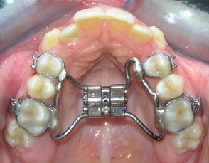
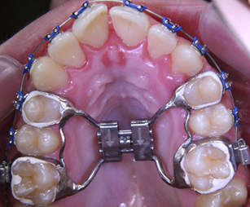
RAPID MAXILLARY EXPANSION

Slide 20
Indications for RME.
Unilateral or bilateral posterior crossbites involving several teeth
Anteroposterior discrepancies.
Cleft lip and palate patients with collapsed maxillae .
Procedure to gain arch length in patients who have moderate maxillary crowding.

Slide 21
Contraindications for RME
Uncooperative patient.
Single tooth cross bite
Patients who have anterior open bites, steep mandibular planes, and convex profiles
Adults with severe anteroposterior and vertical skeletal discrepancies

Slide 22
Class III relationship with the fault in the mandible
Treatment objective
Growth inhibition or redirection and posterior positioning of the mandible
A chincap or a reverse (Class III) activator can be used to exert a retrusive force on the mandible

Slide 23
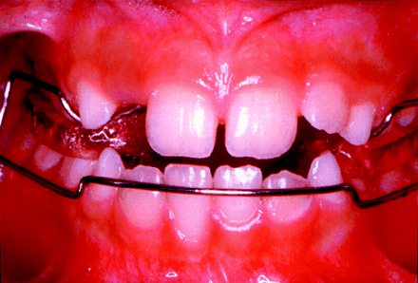
Class III / reverse bionator
to encourage development of maxilla.
construction bite- post most retruded position of mand.
allows a labial movement of maxillary incisors and restrictive influence on the mandible.

Slide 24
EBES - Pseudo-Class III malocclusion treatment with Balters’ Bionator
Authors | Journal | Study design/ Level of evidence | Aims and objectives | Results and conclusion
A. Giancotti, G. Mampieri et al | JCO 2003 | Case report/ Level 5 | The aim of this article is to show the use of the Balters’ Bionator in pseudo-Class III treatment. | The use of the Bionator III in this kind of malocclusion enabled the correction of a dental malocclusion in a few months and therapeutic stability of a mesially-positioned mandible encouraging favourable skeletal growth.

Slide 25
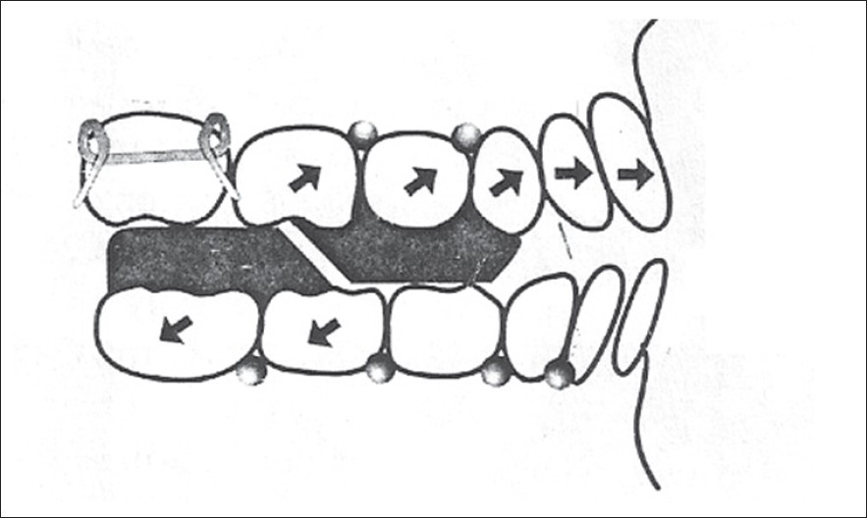
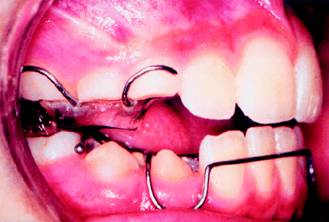
REVERSE TWIN-BLOCK

Slide 26
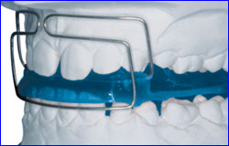
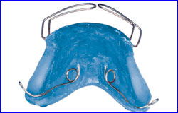
Karwetzky modification of activator

Slide 27
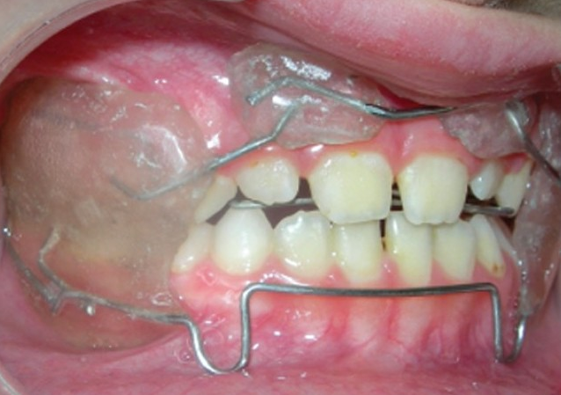
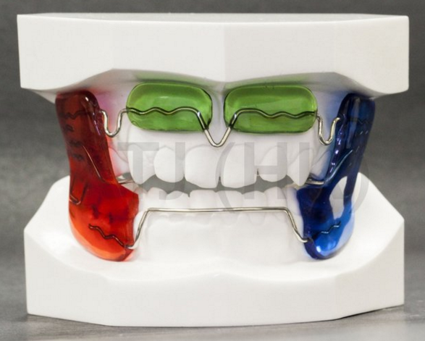
Functional regulator

Slide 28
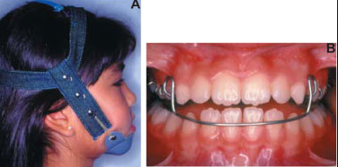
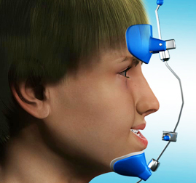
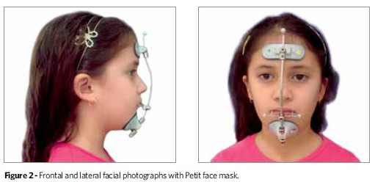

Slide 29
CHIN CAP – mandibular prognathism
Oldest of all the treatments.
Chin cups have been used for Class III correction.
Design of a chin cup for Class III patients directs the force posteriorly through the condyles.
To rotate the mandible upward, the line of force should be through the centroid of the roots of the lower arch.

Slide 30
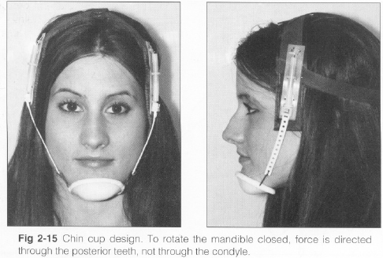
Types-
Occipital pull chin cap- in mand prognathism
Vertical pull chin cap – in steep mand plane angle and excess lower ant facial height.

Slide 31
Class III relationship with the fault in the maxilla
Retrognathic maxilla or midface
Orthognathic mandible
Treatment
In mild cases - with an activator or frankel appliance,
In severe problems- extraoral orthopedic protractive force using a delaire-type face mask is required.

Slide 32
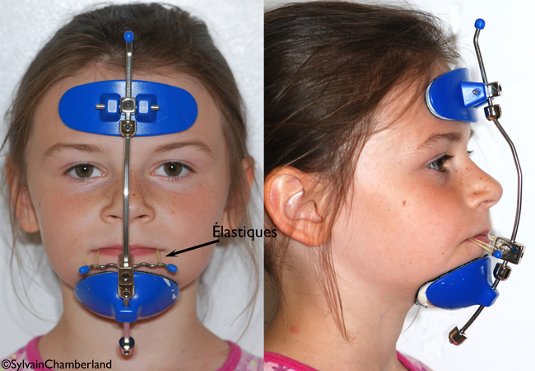
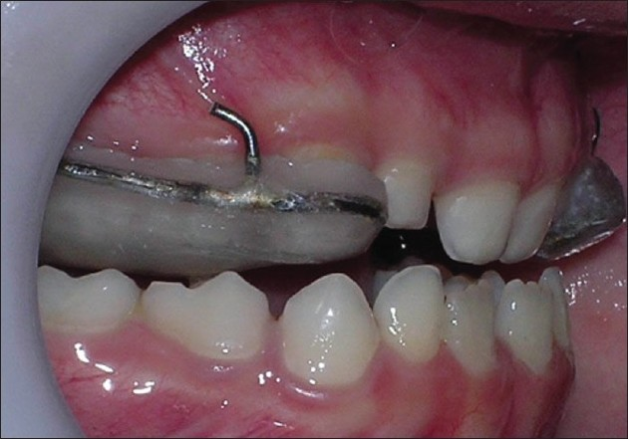

Slide 33
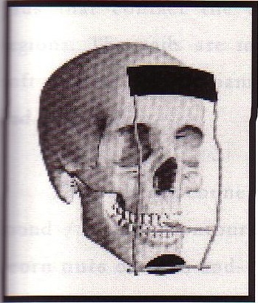
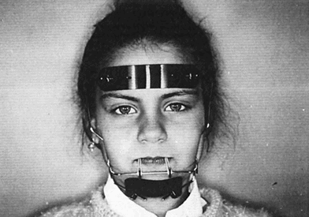
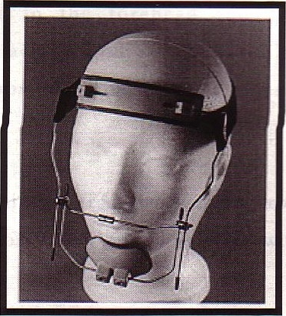
Delaire mask
.

Slide 34
Correction of class iii malocclusion in adults
TREATMENT OF THE PRE ADOLESCENT CHILD
TREATMENT DURING ADULTHOOD

Slide 35
Treatment of the pre adolescent child
RAPID MAXILLARY EXPANSION
FRANKEL III
CHIN CUP
FACEMASK
CLASS III BIONATOR
MONOBLOCK AND INTERMAXILLLARY ELASTICS

Slide 36
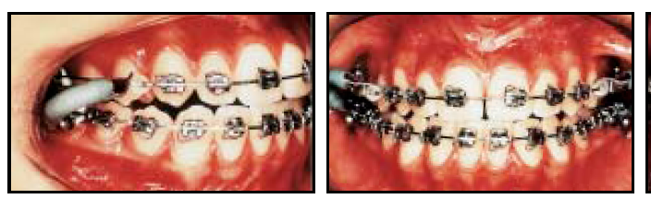
FIXED FUNCTIONAL APPLIANCES
JASPER-JUMPER

Slide 37
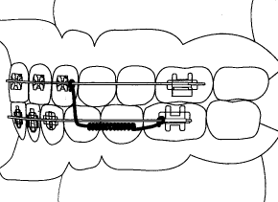
CHURRO-JUMPER

Slide 38
CAMOUFLAGE TREATMENT
Beyond the adolescent growth spurt to correct a skeletal problem teeth should be displaced relative to their supporting bone to compensate for the underlying jaw discrepancy.
This is termed camouflage treatment.

Slide 39
The characteristics of a patient who would be a good candidate for camouflage treatment are:
• Too old for successful growth modification
• Mild skeletal Class III
• Reasonably good alignment of teeth
• Good vertical facial proportions, neither extreme short face (skeletal deep bite) nor long face (skeletal open bite)

Slide 40
Camouflage treatment is avoided in:
Moderate or severe Class III
vertical skeletal discrepancies
Patients with severe crowding or protrusion of incisors
Patients with excellent remaining growth potential

Slide 41
EBES: Developing skeletal Class III malocclusion treated non-surgically with a combination of a protraction facemask and a multiloop edgewise archwire
Authors | Journal | Level of evidence/study design | Aims & objectives | Result & conclusion
Zhenhua yang et al | AJODO 2009 | Level 3 Clincial trial | To evaluated the effectiveness of non-surgical orthodontic treatment to treat a class III malocclusion . | All treatment objectives were achieved. The anterior crossbite was corrected, and satisfactory dental alignment, normal overjet and overbite, and ideal Class I molar and canine relationships on both sides were established. The overall facial balance was greatly improved. The post treatment extra-oral photographs showed a relaxed lip closure and an esthetically pleasing smile with a favorable smile arc. The patient was satisfied with her teeth and profile.

