Slide 1
PRINCIPLES OF MUSCULAR ACTION
Dr. Purvi Patel

Slide 2
CLASSIFICATION OF MUSCLES
STRUCTURAL CLASSIFICATION: Based on arrangement of muscle fibers
Longitudinal
Quadrilateral
Triangular or fan shaped
Fusiform or spindle shaped
Penniform or feather-like
Bipenniform

Slide 3
FUNCTIONAL CLASSIFICATION:
Based on Role of Muscle in Movement
Prime movers (agonists)
Antagonists
Synergists
Fixators

Slide 4
Based on primary function at different joints
Uniaxial
Hinge - Flexors & extensors
Pivot - Rotators
Bi-axial
Condyloid & Saddle - Flexors & extensors
Abductors & adductors
Tri-axial
Ball & socket – Flexors & extensors
Abductors & adductors
Rotators

Slide 5
Prime movers (agonists) – These are the group of muscles which contract to provide force required to produce movement
Antagonists – These are muscles whose action would oppose action of agonists
Synergists – These muscles work with agonists to provide a suitable background of activity and to facilitate movement
Fixators – These muscles work to stabilize bones of origin of agonists to increase their efficiency

Slide 6
LINE OF PULL
Force applied by a muscle to a bony segment is actually resultant of pull on a common point of attachment of all fibers that compose the muscle
Because each muscle fiber can be represented by a vector that has a common point of application
Fibers taken together form a concurrent force system with a resultant that represents total muscle force vector (Fms)

Slide 7
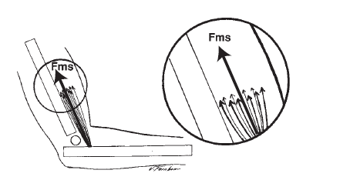
LINE OF PULL

Slide 8
Direction of pull for any muscle is always towards the center of the muscle

Slide 9
TYPES OF CONTRACTION
Muscle actions (or contractions) are described as
Isometric contraction (constant length)
Isotonic contraction
Concentric contraction (shortening of muscle)
Eccentric contraction (lengthening of muscle)

Slide 10
Isometric contraction
Iso - equal and Metric - measurement
Involves development of force by an increase in intramuscular tension without any change in length of muscle
During an isometric contraction, no work is being done because joint is not moving

Slide 11
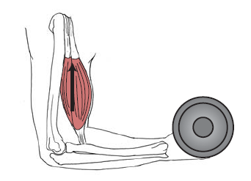
Isometric contraction

Slide 12
Isotonic contraction
Involves an increase in intramuscular tension along with change in length of muscle
Change in length may either shorten or lengthen the muscle

Slide 13
Concentric contraction
Muscles contract isotonically in shortening to produce movement
Attachments of muscle are drawn closer together (concentric – towards centre)
Movement is in direction of muscle pull

Slide 14
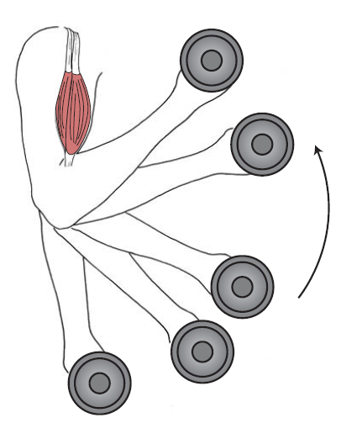
Concentric contraction

Slide 15
Eccentric contraction
Muscles contract isotonically in lengthening to produce movement
Muscle attachments are drawn apart (eccentric – from centre)
Muscle works to oppose action of a force which is greater than that of its own contraction
Movement is in direction of opposing force, i.e. in a direction opposite to that of muscle pull

Slide 16
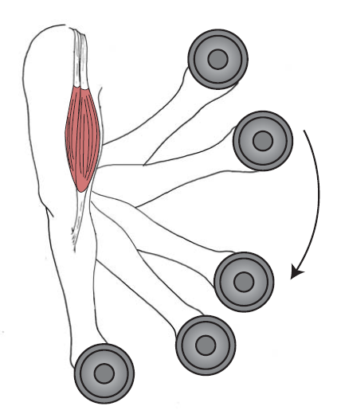
Eccentric contraction

Slide 17
Amount of tension that can be developed in a muscle varies according to type of contraction
Greater amount of tension can be developed in an isometric contraction than in a concentric contraction
In general, tension developed in an eccentric contraction is greater than what can be developed in an isometric

Slide 18
Isokinetic contraction
In Isokinetic muscle contraction, angular velocity of bony component is preset and kept constant by a mechanical device throughout a joint ROM
To maintain a constant velocity, resistance produced by isokinetic device is directly proportional to torque produced by a muscle at all points in the ROM

Slide 19
Isoinertial contraction
Isoinertial testing and exercising have been developed to quantify dynamic muscle work
Defined as a type of exercise in which muscles act against a constant load or resistance and measured torque is determined while constant load is accelerating or decelerating

Slide 20
MUSCLE FUNCTION
MUSCLE TENSION
Most important characteristic of a muscle is its ability to develop tension and to exert a force on bony lever
Tension can be either ACTIVE or PASSIVE, and total tension that a muscle can develop includes both active and passive components

Slide 21
PASSIVE TENSION
Refers to tension developed in parallel elastic component of muscle
Passive tension in parallel elastic component is created by lengthening muscle beyond the slack length of tissues

Slide 22
Total tension that develops during an active contraction of a muscle is a combination of passive (noncontractile) tension added to active (contractile) tension

Slide 23
ACTIVE TENSION
Refers to tension developed by contractile elements of muscle
Initiated by cross-bridge formation and movement of thick and thin filaments
Amount of active tension that a muscle can generate depends on neural factors and mechanical properties of muscle fibers

Slide 24
Neural factors that can modulate amount of active tension include frequency, number, and size of motor units that are firing
Mechanical properties of muscle that determine active tension are
Isometric length-tension relationship
Force-velocity relationship

Slide 25
Length-Tension Relationship
Primary evidence supporting the sliding filament theory of muscle contraction
There is an optimal sarcomere length at which a muscle fiber is capable of developing maximal isometric tension
Because thick and thin filaments are positioned so that maximum number of cross-bridges within sarcomere can be formed

Slide 26
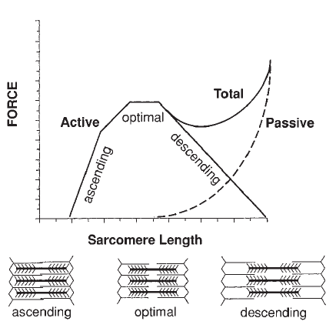
Length-Tension Relationship

Slide 27
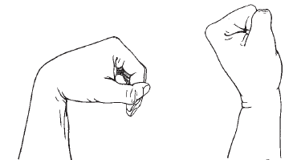
APPLICATION OF LENGTH-TENSION RELATIONSHIP
ACTIVE INSUFFICIENCY

Slide 28
Force-Velocity Relationship
Describes relationship between velocity of muscle contraction and force produced
Provides an explanation for what happens during concentric and eccentric muscle contractions
Speed of shortening is the rate at which myofilaments are able to slide past one another and form and re-form cross-bridges

Slide 29
Velocity of muscle contraction is a function of load being lifted
In a concentric muscle contraction, as shortening speed decreases, tension in muscle increases
In an isometric contraction, speed of shortening is zero, and tension is greater than in a concentric contraction
In an eccentric contraction, as speed of lengthening increases, tension in muscle increases

Slide 30
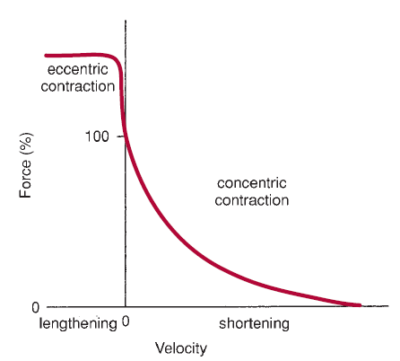
Force-Velocity Relationship

Slide 31
MCQs
1. Which group of muscles work with agonists to provide a suitable background of activity and to facilitate movement
Fixators
Agonists
Synergists
Antagonists
2. In Eccentric contraction of Biceps muscle, which movement of elbow occurs
a) Flexion
b) Supination
c) Pronation
d) Extension

Slide 32
3) What is an example of strap shaped muscle
Deltoid
Biceps brachii
Sartorius
Restus femoris
4)In concentric muscle contraction
shortening speed decreases, tension in muscle increases
shortening speed decreases, tension in muscle decreases

Slide 33
5. Direction of pull for any muscle is always towards the center of the muscle
True
False

